Slide 1
“HOW” IS IMPORTANT: The matrix as Functional Analytic Psychotherapy Rule 5 tool.
¹Michel André Reyes Ortega PsyD
²Angélica Nathalia Vargas Salinas PsyD
³Edgar Miranda Terres MA
^{1, 2} Association for Contextual Behavioral Science Mexico Chapter
^{1, 2, 3} Mexico’s Contextual Science and Therapy Institute
^{1, 2, 3} Mexico’s National Institute of Psychiatry Ramón de la Fuente

Slide 2
INTIMACY DEVELOPMENT
Motives, needs
Motives, needs
Vulnerable
self-disclosure
Responsiveness (understanding, validation, caring)
This slide credit goes to Jonathan W. Kanter

Slide 3
INTIMACY DEVELOPMENT
Motives, needs
Motives, needs
Social connection depends on how you respond to the other person when they express vulnerability.
Vulnerable
self-disclosure
Responsiveness (understanding, validation, caring)
This slide credit goes to Jonathan W. Kanter

Slide 4
INTIMACY DEVELOPMENT
Motives, needs
Motives, needs
Social connection depends on how you respond to the other person when they express vulnerability.
Vulnerable
self-disclosure
Responsiveness (understanding, validation, caring)
Appropriate responding increases connection and changes the behavior of disclosure over time
This slide credit goes to Jonathan W. Kanter

Slide 5
INTIMACY DEVELOPMENT
AWARENESS
AWARENESS
Social connection depends on how you respond to the other person when they express vulnerability.
COURAGE
LOVE
Appropriate responding increases connection and changes the behavior of disclosure over time
This slide credit goes to Jonathan W. Kanter

Slide 6
Functional Analytic Psychotherapy (FAP)
Contextual behavioral approach aimed to shape the client’s in-session behaviors by the therapist contingently responding to the client’s behavior within moment-to-moment client-therapist interactions (Kohlenberg & Tsai 1991, Tsai et al. 2009).
To achieve this, FAP therapist follow 5 rules…

Slide 7
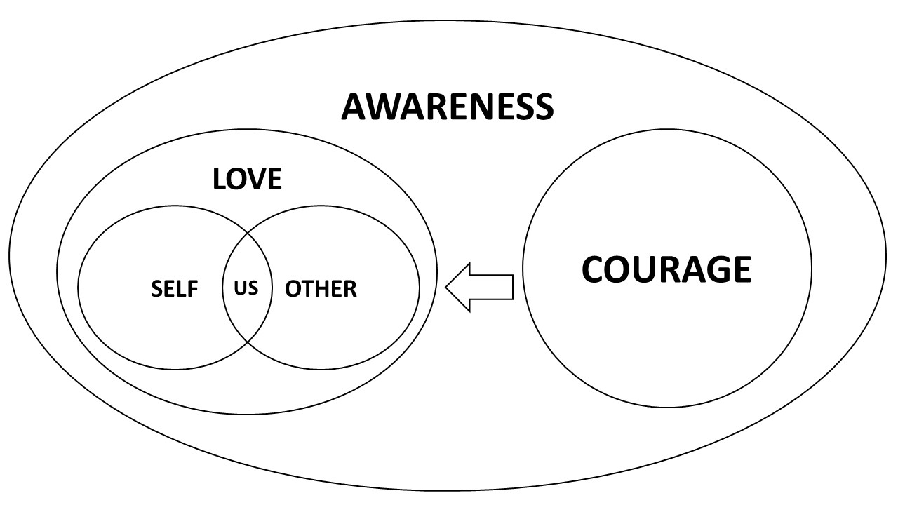
FAP 5 RULES
RULE 1 (Be aware)
Watch for CRBs (Be aware)
RULE 2 (Be courageous)
Evoke CRBs
RULE 3 (be loving)
Reinforce desirable behaviors (CRB2s) naturally
RULE 4 (Be aware of one’s impact)
Observe the potentially reinforcing effects
RULE 5 (Interpret and generalize)
Evoke functional analytic interpretations of behavior (CRB3-2)
Generalize desirable behavior outside therapy session (evoke O2s)
(Reyes, Kanter & Guirado, 2015)

Slide 8
FAP: AWARENESS, COURAGE AND LOVE (ACL) SKILLS TRAINING FOR BPD.
WHAT IS IT?
AIMS
Group therapy directed to non critical BPD clients who had finished a TAU trial (ACT MATRIX bassed, 9 sessions).
9 weekly sessions, applied weekly of two hours lenght.
16 – 20 participants per group.
2-3 group leaders 1 (1 certified FAP therapist, 1-2 cotherapist).
Enhancement of Awareness, Courage and Love Skills (CRB2s) evoked within the therapy session through natural interpersonal responding.
Development of a functional understanding of his own behavior antecedents and consequences (CRB3-2).
Use this understanding (CRB3-2) to generalize desirable behaviors (CRB2) in the natural environment (O2).

Slide 9
EVOCATIVE EXCERCISE
Evoke CRB2s (R2)
FEEDBACK
Reinforce CRB2s (R3)
REVIEW
ACL MATRIX (R5)
Be aware of CRB2s (R1)
Watch for the effect (R4)
Shift turns
THE FAP SEQUENCE INSIDE “ACL SKILLS TRAINING FOR BPD”.

Slide 10
5 SENSES EXPERIENCE
Telling the truth
Sharing my feelings
Hugging my kids
Arriving home at 22:00
Having dinner with my wfe, etc.
AWARENESS
COURAGE
LOVE
PRESENTING
THE ACL MATRIX
(1st SESSION)
AWAY MOVES ON GIVING LOVE /
OR RECEIVING LOVE
AWAY
HOW IS IMPORTANT TO CONNECT?
TOWARDS
WHAT I DON’T WANT TO THINK OR FEEL
WHEN GIVING LOVE / OR RECEIVING LOVE
WHO IS IMPORTANT?
My mother, My colleagues, My boyfriend, My family
My Friends, My mother, Mónica (my daughter), etc.
INNER EXPERIENCE

Slide 11
5 SENSES EXPERIENCE
Looking at the floor
Rubing my hands
Using a matter of fact tone
Denying my qualities
AWARENESS
COURAGE
LOVE
INTIMACY
THE ACL MATRIX AS
FAP RULE 5 TOOL -EVOKING O2s-
THE ACL MATRIX AS
FAP RULE 5 TOOL -EVOKING CRB3(2)-
AWAY MOVES ON GIVING LOVE /
ON RECEIVING LOVE
AWAY
HOW IS IMPORTANT TO CONNECT?
TOWARDS
WHAT I DON’T WANT TO THINK OR FEEL
ON GIVING LOVE / ON RECEIVING LOVE
WHO IS IMPORTANT?
Shame
I look weird
This is not me
I’m going to fail
She’ll feel akward
David (my boyfriend)
Mom and Dad
Claudia (my boss)
STUCK
INNER EXPERIENCE

Slide 13
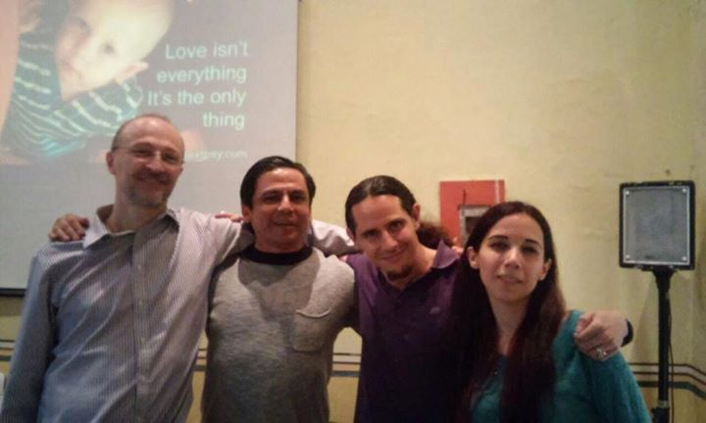
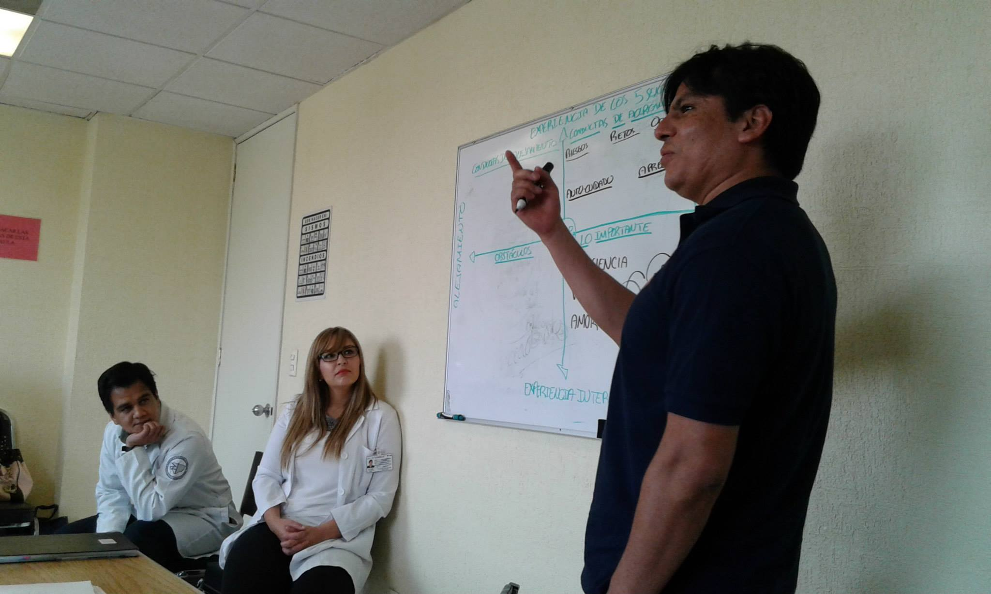
THANKS!!!

