Slide 1
Mindfulness and Acceptance for Gender & Sexual Minorities: Strategies to Foster Self-Compassion, Connection, and Equality
Matthew D. Skinta, PhD, ABPP, Palo Alto University
Aisling Curtin, MSc, ACT Now Ireland, WTF Psychology
18 July 2015

Slide 2
Aspiration for this Training
Deepening an understanding of our own histories of gender and sexuality training
Relating our own heartfelt experience to the transformative work we do
For the sake of deepening our ability to share, we invite everyone to treat what is shared with confidentiality

Slide 3
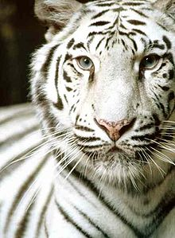
Mohini (Tara Brach)
Mohini was a regal white tiger who lived for many years at the Washington DC National Zoo. For most of those years her home was in the old lion house—a typical twelve-by-twelve-foot cage with iron bars and a cement floor. Mohini spent her days pacing restlessly back and forth in her cramped quarters. Eventually, biologists and staff worked together to create a natural habitat for her. Covering several acres, it had hills, trees, a pond and a variety of vegetation. With excitement and anticipation they released Mohini into her new and expansive environment. But it was too late. The tiger immediately sought refuge in a corner of the compound, where she lived for the remainder of her life. Mohini paced and paced in that corner until an area twelve-by-twelve feet was worn bare of grass.
Perhaps the biggest tragedy in our lives is that freedom is possible, yet we can pass our years trapped in the same old patterns. Entangled in the trance of unworthiness, we grow accustomed to caging ourselves in with self-judgment and anxiety, with restlessness and dissatisfaction. Like Mohini, we grow incapable of accessing the freedom and peace that are our birthright. We may want to love other people without holding back, to feel authentic, to breathe in the beauty around us, to dance and sing. Yet each day we listen to inner voices that keep our life small. Even if we were to win millions of dollars in the lottery or marry the perfect person, as long as we feel not good enough we won’t be able to enjoy the possibilities before us. Unlike Mohini, however, we can learn to recognize when we are keeping ourselves trapped by our own beliefs and fears. We can see how we are wasting our precious lives.

Slide 4
Mohini
When have you felt closeted (in a 12 X 12)?
Name one thing you have done to keep yourself in that 12 X 12/Closet
Write down your two answers anonymously & give to one of the volunteers if willing
Take 2-3 minutes to read what people have wrote in silence
What did you notice?

Slide 5
Minority Stress and Stigma
Minority stress theory suggests a broad range of mechanisms for the impact of societal stigma
Self-stigma (e.g., internalized homophobia; Yadavaia & Hayes, 2012)
Stigma/Expectation of Rejection
Outness/Concealment
Discrimination
Community connectedness
Related to a broad range of psychological symtpoms
May be due to reduced emotion regulation

Slide 6
Assumption of Healthy Normality
Psychological health is the natural homeostatic state in humans will naturally be happy and content
This state is disturbed by illness or distress
Abnormality is a disease or syndrome driven by unusual pathological processes
Notes:
Underlying assumptions of mainstream Western Psychology
Assumption of healthy normality: good physical health, good mental health
Assumption of abnormality as a disease
etiology, course, response to treatment
Identification of syndromes and symptoms

Slide 7
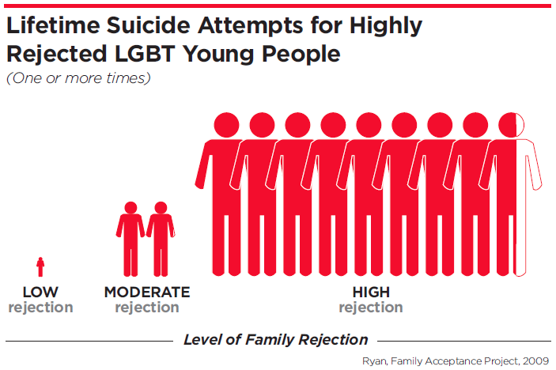
However…
most humans are hurting
Among gay men, the lifetime occurrence of depression is nearly 4 times that of heterosexual men; among lesbians, double that of heterosexual women (IOM, 2011)
50% of transgender individuals have experienced sexual assault. Transwomen have a 1 in 12 chance of being murdered, and 1 in 8 for transwomen of color. 41% have attempted suicide (TSER, 2015)
Despite a greater utilization of mental health services, most psychologists report little or no training in working with sexual minorities
Notes:
By dividing the world into normal and healthy versus abnormal and disturbed – we have failed to see that most humans are hurting.
Normal to abnormal.
Why? The answer must lie in the ordinary.

Slide 8
Acceptance and Mindfulness Processes
Notes:
Mostly about antecedent control- examine and attempt to manipulate what happens before avoidant and other problem behaviors in order to predict and influence it- will come back to this

Slide 9
Commitment and Behavior Change Processes
Notes:
Mostly about consequential control- after behavior- will come back to this but first have to talk about initial steps (the first few sessions)

Slide 10
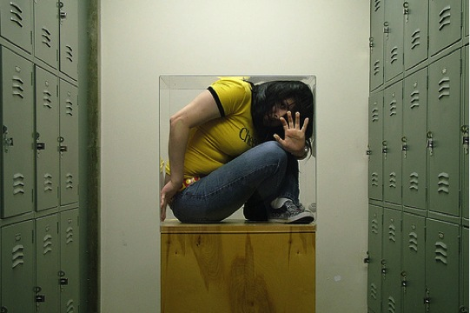
What does the GSM Hexaflex look like?
Discrimination - Preoccupied with past/future mistreatment
Expectation of Rejection - Unwillingness to experience fears of being seen as GSM
Concealment – Overachievement or avoidance of attention
Self-stigma - Fusion with thoughts about GSM stereotypes
Unclear or unexamined desires for authentic and full living
Rigid Perspective taking - small picture
(ACBS, 2015)

Slide 11
How GSM Individuals become Psychologically Flexible…
Connection to present moment
Emotions- Willingness to experience any fears & cultivating compassion
Clear on what is important, including relationships and community
Thoughts- Unhooked from Unwanted Thoughts about GSM Identity
Doing things that matter as a whole, present GSM person
Flexible Perspective Taking – Part of a Larger Community
(ACBS, 2015)

Slide 12
Sexuality & Gender Life History
Speak for 4 minutes about ways that you have been taught to express your gender or your sexuality professionally and personally – regardless of your identity
Consider your personal “12x12”, and what would be a forward move in disclosure
Listener – focus primarily on listening non-verbally
If you notice it, you might consider a gentle or minimal encouragement to share more deeply
Authentically and openly share the impact that hearing your partner’s story has had on you

Slide 13
GSM Hexaflex Processes in the Life History
Acceptance – of unwanted emotional experiences, including shame
Defusion – from fears that others might reject us for our stories
Present-Moment Awareness – attending to what it is like to connect with this content, here and now
SAC/Perspective-Taking – having the chance to experience our stories through the eyes of another, shifting the context
Values –the willingness to take this conversation as deeply as you are ready
Committed Action -

Slide 14
Let’s look at our lives in terms of workability
What are your away moves in your personal & professional life? Perhaps where it could be threatening to be identified as GSM or an ally?
What are your towards moves in your personal & professional life, where you are creating or encouraging GSM acceptance?
What are you trying to run away from in your personal & professional life regarding gender and sexuality?
What allows us to create GSM nurturing spaces?

Slide 15
Let’s look at our lives in terms of workability

Slide 16
Questions? Comments?

