Slide 1
FAP and Polish Culture
Joanna E. Dudek, M.A.
University of Social Sciences and Humanities Warsaw, Poland

Slide 2
?

Slide 3

Suwalszczyzna, Poland

Slide 4
Topics of Interest
Clinical perspective: Nuances of Polish culture
Scholar/researcher perspective:
Status quo of behavioral therapy and psychotherapy in Poland
Translation and dissemination of FAP

Slide 5
Nuances of Polish Culture
Notes:
I will start with nuances od Polish culture

Slide 6
History that we are carrying
Catholic
Be humble, work hard
Mother of God-Queen of Poland
Sacrifice yourself, be heroic
Fighting for independence for 123 years
Communism
Keep your secrets at home, be careful with whom you open up
But cherish close family and friends
43 insurrections (uprisings) from 1600 to 1945
Second World War

Slide 7
Philip Zimbardo on Poles
I noticed that you Poles, are often pessimistic. Recalling the terrible ghosts of the past - the communist regime, the Nazi occupation, and earlier times. Your “now” is contaminated with all the evil that ever happened to you. You say, “we are doomed, our country, our land is cursed” as if you were collectively suffering from PTSD. I call this a negative past, and from that comes your current fatalism.

Slide 8
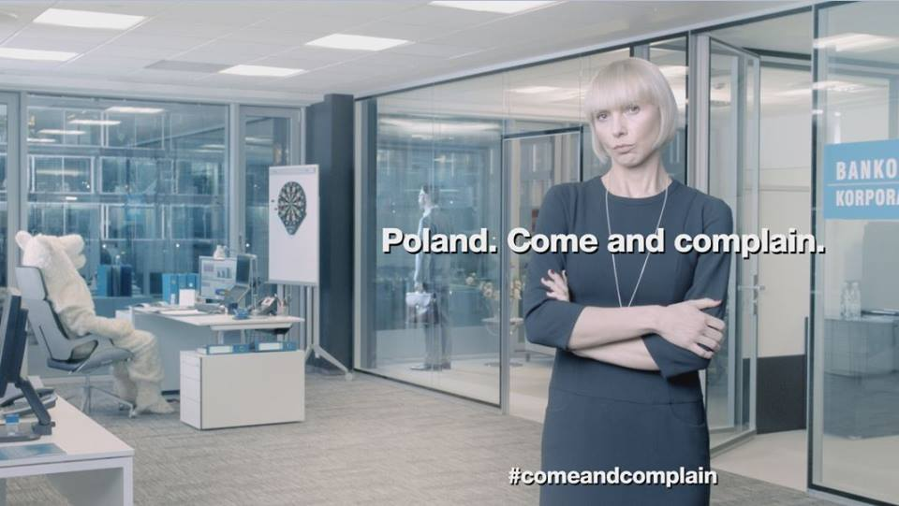
Complain to connect?

Slide 9
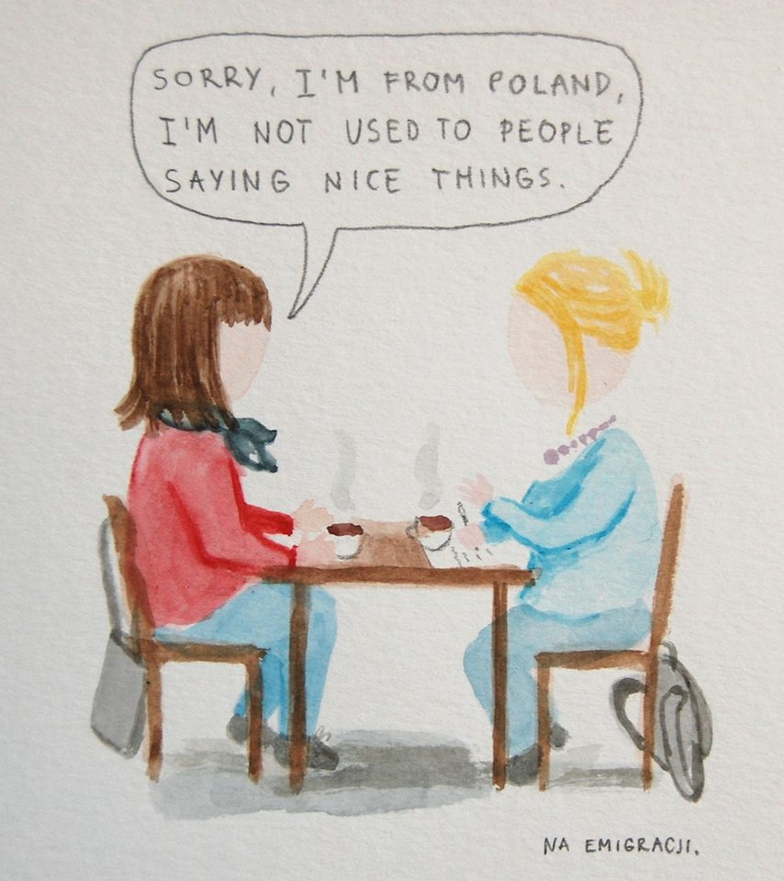

Slide 10


Slide 11
Implications for the FAP Therapist
Trust
Functional lenses
Complaining to connect
Available reinforcement
Complaining, prouds, speaking your truth
Idiographic approach

Slide 12
Status quo of behavioral therapy and psychotherapy in Poland

Slide 13
CBT in Poland
Polish Association for Behavioral and Cognitive Therapies
established in 1998
CBT refunded by government
since 2009
Certified CBT therapists- circa 400
approximately 1 for 100,000 citizens

Slide 14
Behaviorism in Poland
Polish Society for Behavioral Psychology, affiliated chapter of ABAI
established in 2002
Number of members
44
Certified behavioral therapists -150
approximately 1 for 270,000 citizens

Slide 15

Third Wave is coming!

Slide 16
“Clinical context of behavior analysis: Three waves of behavioral therapy”
The XI International Scientific Symposium of the Polish Society for Behavioral Psychology
21-22 of March, 2015

Slide 17
Number of Polish ACT therapists?
Around 30, but the exact number is unknown

Slide 18
Polish ACBS chapter to be!!!

Slide 19

Number of Polish FAP therapists?
1

Slide 20
Translation
ACL
MOC (power)
Awareness
Love
Courage
Czujność
Miłość
Odwaga

Slide 21
Dissemination
No publications on FAP,
one paper under review,
a few pages in the chapter on behavior analysis
class for students on clinical applications of behavioral psychology
16 hours
Publications
Learning Opportunities

Slide 22
Challenges in our journey and implications/topics to research
Sometimes we get biased by the idea of the culture- it doesn’t work because of the culture vs because expressing love is just hard for this particular person
Cultural adaptation of evoking exercises, adjusting the training (?)
Reinforced by the social environment vs healthy?
How to promote FAP in the general public ? What kind of language should we use? Is ACL translation acceptable?
ACL survey translation
Comprehensive FAP training including behavioral training or teaching FAP based on ACL model

Slide 23
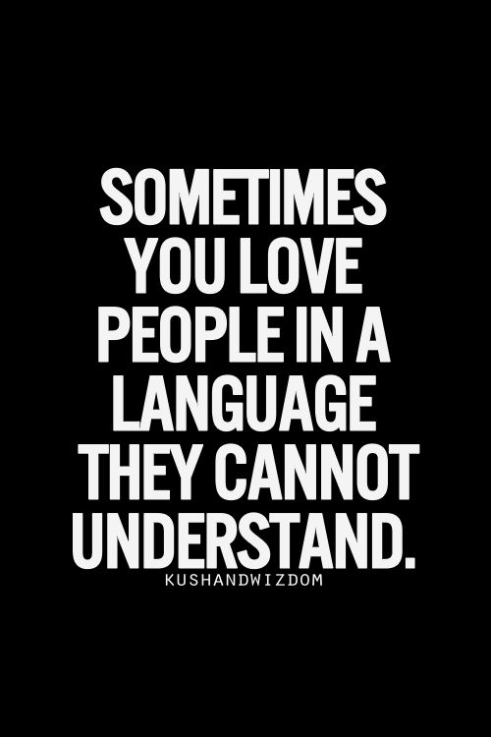
Czasem mówisz takim językiem miłości, którego inni nie mogą zrozumieć.

Slide 24
Thank you!
joannaedudek@gmail.com

