Slide 1
REDUCING BURN-OUT AND IMPROVING ORGANIZATIONAL CLIMATE EN A BPD CLINIC WITH FAP THERAPIST TRAINING
Michel André Reyes Ortega PsyD ¹
Jonathan W. Kanter PhD ²
María Magdalena Santos PhD ³
¹Contextual Science and Therapy Institute (Mexico City)
¹ National Institute of Psychiatry Ramón de la Fuente
²University of Washington
³University of Wisconsin, Milwaukee

Slide 2
QUESTIONS
How many of you do psychotherapy?
How many of you feel it is a demanding activity?
Why?
Have you ever felt exhausted?
Numb?
Unneficient?
Because of your work?

Slide 3
QUESTIONS
Suppose that you see 12 clients per day
During 5 days a week
And that any client you see comes also with:
A suffering parent
A demanding manager
A confused student
A critical co-worker,
At least...

Slide 4
PSYCHOTHERAPY AND BURN-OUT
Psychotherapy is an interpersonal activity that occurs in social contexts.
In public settings, psychotherapist usually work with:
A considerable amount of suffering clients and their families
Other busy colleagues and students
Members of other professions and managers
And dedicate a considerable amount of time doing administrative labors.
Job burnout is positively related with this working settings (Martínez et al., 2014; Ortega & López, 2004).
The introduction of burnout prevention and helping the helper programs could add a valuable condition to diminish the impact of this aversive conditions (Leiter, Day, Pricea, 2015).

Slide 5
JOB BURNOUT
Syndrome consisting of chronic exhaustion, psychological distancing, and lack of professional efficacy or diminished sense of accomplishment (Maslach, Jackson, & Leiter, 1996).
Chronic exhaustion seems to be a function of a chronic stressful working environment (see Maslach, Jackson, & Leiter, 1996).
Psychological distancing reflects attempts to cope with exhaustion (see Bakker & Demerouti, 2007; Leiter & Schaufeli, 1996; Morris & Feldman, 1996).
Lack of professional efficacy or diminished sense of accomplishment seems to be a delayed function of this coping behaviors (Reyes, Kanter, Arango & Santos, 2015)

Slide 6
OUR BURNOUT ANALYSIS (Reyes, Kanter, Arango & Santos, 2015)
(EO)
ESTABLISHING OPERATION
AVERSIVE CONDITION – Chronic stressful working environment
(A)
ANTECEDENTS
∙
(B)
BEHAVIOR
(C)
CONSEQUENCES
Approach
Intimacy and caring
(S^{CC+}) More demands
(S^{EXT}) Lack of reinforcement
STRESSFUL WORKING DEMANDS → EXHAUSTION
Of clinical, academic or
administrative nature
Avoidance / Scape
Interpersonal avoidant behaviors
(S^{CR-}) Temporal relief (immediate)
(S^{CC-}) Profesional and personal values incongruence (delayed)

Slide 7
THE FAP RATIONALE
Greater social support:
Fewer distressing interpersonal interactions among professional staff.
Lesser stressful effects of aversive interpersonal and environmental events.
More rewarding environments are associated = Greater work satisfaction = Less burnout.
FAP adapted as a “Helping the Helper” program can rebuild experiences of “safe haven” and “secure base” to build intimacy and improve secure attachment between therapists working together to reduce burnout and improve organizational climate.

Slide 8
IN OTHER WORDS
AWARE
COURAGEOUS
LOVING
THERAPISTS
SECURE BASE ENVYRONMENT
LESS BURNOUT
GREATER WORKING CLIMATE SATISFACTION

Slide 9
METHOD
AUTHORIZATION GRANTED
(INPRF research commite)
THERAPIST INVITATION
(INPRF BPD clinic)
2 THERAPIST EXCLUDED DUE TO CLINICAL TRAINING CONFLICTS
INFORMED CONSENT SIGNING
ASSESMENT
INTERVENTION
ASSESMENT
DATA CAPTURE (research asistant) AND ANALYSIS
(research asistant)

Slide 10
DESIGN AND PARTICIPANTS
DESIGN
PARTICIPANTS
GENDER | AGE | TRAINING | WORKING STATUS
Male | 44 | Licenced Psychiatrist (MD, MPs) | Full time clinician
Male | 42 | Licenced Psychologist (MPs) | Full time clinician
Male | 32 | Licenced Psychologist (PhD) | Half time clinician Half time profesor
Female | 30 | Licenced Psychologist (PhD) | Half time clinician Half time professor
Male | 28 | Licenced Psychologist (MPs) | Student
Female | 42 | Licenced Psychologist | Student
PRE |  | X |  |  | POST
O1 | O2 | O3 | O4 | O5 | O6 | O7
Maslach Burnout Inventory (MBI; Meda Lara et. al. 2008) Multidimensional Scale of Organizational Climate (MSOC; Patián Perez & Flores Herrera, 2012) World Health Organization Quality of Life-BREFF (WHOQOL-BREF; Sánchez-Sosa & González Celis, 2002) Adult Attachment Questionnaire (AAQ; Melero & Cantero, 2006)

Slide 11
FAP ADAPTED AS HELPING THE HELPER PROGRAM
PROGRAM STRUCTURE
SESSION STRUCTURE
Based on a previously published FAP online training protocol (Kanter et al., 2012).
Five weekly online sessions, 2 hours each, with 6 participants and two group leaders.
Included a pre-program preparation with program participants.
And half and hour meetings between leaders to review intervention integrity (achieved through correspondence with the intervention manual).
Program delivered on Skype.
Technical problems occurred (non significant), was delivered in both English and Spanish.
Brief meditation to increase contact with the present momento
Feedback/reflections on logs.
Participants disclosed details of their lives and identity, and responded to each others’ disclosures
Feedback/reflections on evocative excercise.
Framed as practicing awareness and the exchange of courage and love to build a secure base through authentic and loving behavior.
Each session ended with description of specific homework assignments for the following week.
First sesión included expectations assesment and introduction to the program.

Slide 12
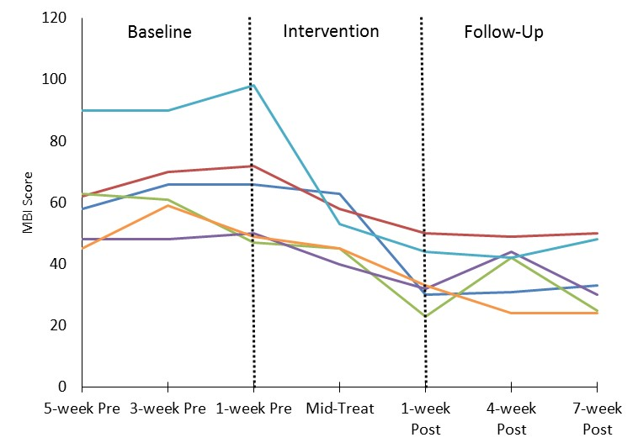
BURNOUT IMPACTS
Significant decrease in total scores
F(2.3, 11.5)=12.82, p=.001, partial η²=.72.
Paired-samples t­-tests showed significant decrease
Pre-post: t (5)=5.38, p=.003, η²=.85,
Pre-Follow-up, t(5)=7.07, p=.001, η²=.91.
Reliable change index showed that all therapists achieved reliable change
Pre-post: RCIs=-6.95 to -2.38
Pre-Follow-up = RCIs=-6.38 to -2.57

Slide 13
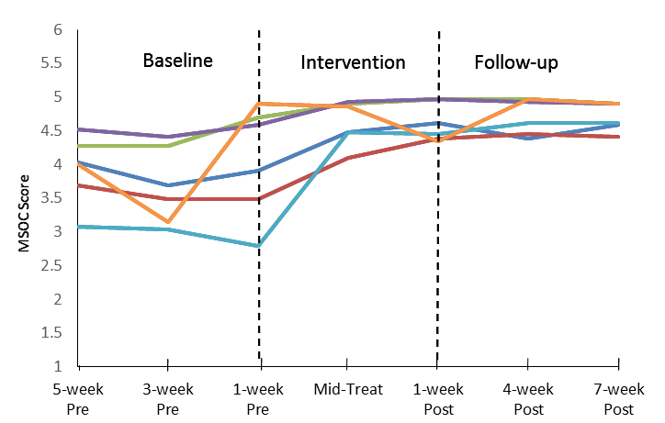
ORGANIZATIONAL CLIMATE IMPACTS (Multidimensional Scale of Organizational Climate)
Significant increase in total scores
F(2.1, 10.5)=10.91, p=.003, partial η²=.69.
Paired-samples t­-tests showed improvements
Pre-post: t(5)=-4.39, p=.007, η²=.79)
Pre-Follow-up: t(5)=-4.53, p=.006, η²=.8.
RCI showed that all therapists experienced clinically significant change
Pre-Post: RCIs=2.53 to 11.34
Pre-Follow-up: RCIs=2.99 to 6.82.

Slide 14
DISCUSSION
FAP adapted as helping the helper program seems to be a promising intervention for burnout prevention and organizational climate improvement in health care settings.
More research is justifiable and needed to asses this possibility.
Sample characteristics may not be representative of other clinIcal scenarios.
Therapist burnout rates where low at baseline possibly due to lack of awareness or symptoms denial (verbally reported).
Therapist disposition to the program could be unusual.
Therapists experience and training could impact positively.
FAP group leader expertise and prestige could impact possitively but being unusual of other replications.
Considerations for next studies:
Longer follow-ups to asses change durability.
Bigger samples, Comparision with other treatments and Mediators and mechanisms of change analysis are needed.

Slide 15
DISCUSSION
More research is justifiable and needed to asses this possibility.
Sample characteristics may not be representative of other clinIcal scenarios.
Therapist burnout rates where low at baseline possibly due to lack of awareness or symptoms denial (verbally reported).
Therapist disposition to the program could be unusual.
Therapists experience and training could impact positively.
FAP group leader expertise and prestige could impact possitively but being unusual of other replications.
Considerations for next studies:
Longer follow-ups to asses change durability.
Bigger samples, Comparision with other treatments and Mediators and mechanisms of change analysis are needed.

