Slide 1
Using Awareness, Courage, and Love to Improve Social Functioning: A Theoretical Model to Improve the Lives of Those with Visible Chronic Conditions
Joanna E. Dudek, M.A.
Jonathan W. Kanter, Ph.D.
Mavis Tsai, Ph.D.
Adam M. Kuczynski, B.S.
Paweł Ostaszewski, Ph.D.

Slide 2
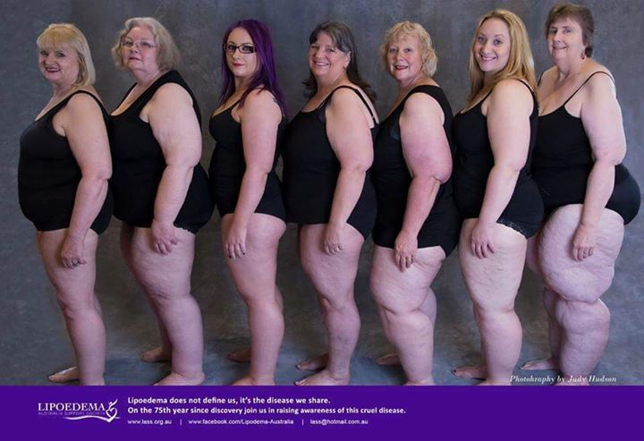

Slide 3
What is a visible chronic difference (VCD)?
“…any condition altering individual appearance in a way that is different from the perceived norm”
These differences can be:
Congenital
Acquired (e.g., chronic illness, accident, surgery)
Cleft palate
Acne
Burns
Lipedema
Psoriasis

Slide 4
Why do VCDs matter to us?
Stigmatization
Sociocultural norms define ‘acceptable’ appearance
Evolutionary psychology: attractiveness is important in choosing potential partner
The more visible and aesthetically displeasing the condition, the greater risk of stigmatization
Discrimination
Staring
Unsolicited questioning
Name calling
Humiliation
Rejection
Devaluation
Disgust
Aggression

Slide 5
Don’t Look Down on Me Video
https://www.youtube.com/watch?v=mD_PWU6K514

Slide 6
I don't feel sexually attractive. I have a hard time believing my spouse truly wishes to engage me in true intimacy. I have to ward off awful thoughts of just being a receptacle. My spouse has never treated me in this way, but it is my own idea of myself.
“Dating was almost impossible as was close friendships with other girls who didn't want to ruin their own chances of dating.”
…men and young men or teenage boys run up to me and insult my appearance. I've been called Shamu the Whale. I've been encircled by a group of males while walking and laughed at…It seems I can never go out anywhere, even to my medical appointments without having an incident.
I also do not wish to go out because of my past experiences with nasty people. I'm very tired of the public humiliation because of what my body looks like.
With the surge of smartphones, I now have lovely young men snapping my photo or recording me sometimes. I have no idea why, but they are sometimes caught taking my picture. It feels like a complete violation….
…when I'm out strangers tend to avoid me. They will sit on a different bench. They will wait for the next elevator. They avoid making contact with me at all costs if possible, and certainly not touching.”

Slide 7
Stigmatization
→
Shame
→
Avoidance & Escape
→
Social Isolation

Slide 8
Increase in odds of mortality due to various public health conditions
Social connection is fundamental to health, well-being, and longevity
and is identified as one of the most important public health problems in the world.
Holt-Lunstad J, Smith TB, Layton JB (2010) Social Relationships and Mortality Risk: A Meta-analytic Review. PLoS Med 7(7): e1000316. doi:10.1371/journal.pmed.1000316

Slide 9
FAP maximizes the natural functional mechanisms of social connection in psychotherapy

Slide 10
ACL model of social functioning in people with VCD Problems and improvements defined by ACL language

Slide 11
The ACL Model
Awareness
Your present-moment self (your body, thoughts, feelings)
Your values, needs, goals, identity
The other: empathy
Your impact on the other person
Courage
Expressing vulnerability and emotion
Speaking your truth (speaking from the heart)
Asking for what you need
Closeness and Connection
Setting boundaries
Asking for support
Asking for difficult feedback
Giving difficult feedback
Asking for appreciation
Love
Acceptance, providing safety & reciprocal vulnerability
Expressing understanding, empathy, and validation
Giving others what they need (specific things)
Providing closeness and connection
Respecting boundaries
Providing support, promising
Providing feedback
Receiving difficult feedback
Expressing appreciation
Self-Love
Acceptance of yourself (awareness, self-compassion)
Accepting caring and loving feelings from others
Cultivating positive feelings in yourself (appreciations, pride)
Self-care (activities that soothe, calm, rejuvenate, recharge, or bring pleasure)

Slide 12
A,C&L deficits in people with VCD
Awareness
Paying attention only to some parts of experience (for example hyperfocused on their bodies or self-stigmatizing thougts or/and ignoring certain feelings, impact on others, during an interpersonal interaction)
Missing or misinterpret signals of attention and care

Slide 13
A,C&L deficits in people with VCD
Awareness
Paying attention only to some parts of experience (for example hyperfocused on their bodies or self-stigmatizing thougts or/and ignoring certain feelings, impact on others, during an interpersonal interaction)
Ignoring or misinterpret signals of attention and care
Courage
Avoiding social interactions, intimacy, and vulnerability due to fear of being hurt or rejected
Behaving in a submissive ways (e.g. not expressing needs, no boundaries setting in relationships (e.g., to be accepted)

Slide 14
A,C&L deficits in people with VCD
Awareness
Paying attention only to some parts of experience (for example hyperfocused on their bodies or self-stigmatizing thougts or/and ignoring certain feelings, impact on others, during an interpersonal interaction)
Ignoring or misinterpret signals of attention and care
Courage
Avoiding social interactions, intimacy, and vulnerability due to fear of being hurt or rejected
Behaving in a submissive ways (e.g. not expressing needs, no boundaries setting in relationships (e.g., to be accepted)
Love
Acting with hostility in order to protect themselves from being hurt
Difficulties in responding with love to problems of people who don’t have similar experiences

Slide 15
A,C&L deficits in people with VCD
Awareness
Paying attention only to some parts of experience (for example hyperfocused on their bodies or self-stigmatizing thougts or/and ignoring certain feelings, impact on others, during an interpersonal interaction)
Ignoring or misinterpret signals of attention and care
Courage
Avoiding social interactions, intimacy, and vulnerability due to fear of being hurt or rejected
Behaving in a submissive ways (e.g. not expressing needs, no boundaries setting in relationships (e.g., to be accepted)
Love
Acting with hostility in order to protect themselves from being hurt
Difficulties in responding with love to problems of people who don’t have similar experiences
Self-Love
They may disregard their own needs and have difficulties with receiving love and help from others.

Slide 16
A,C&L improvements in people with VCD
Awareness
Noticing what is happening in their bodies - fear, disgust shame, and also love, curiosity, thoughts, inner sensations
Recognizing their own needs and values, impact of their learning history
Noticing and interpreting signals from other people (discriminating: signals of attention, care, interest; with whom they can take risks and self disclose, signals from others indicating that they are struggling too)
Noticing how they impact others

Slide 17
A,C&L improvements in people with VCD
Awareness
Noticing what is happening in their bodies - fear, disgust shame, and also love, curiosity, thoughts, inner sensations
Recognizing their own needs and values, , impact of their learning history
Noticing and interpreting signals from other people (discriminating: signals of attention, care, interest; with whom they can take risks and self disclose, signals from others indicating that they are struggling too)
Noticing how they impact others
Courage
Engaging in social interactions, including new social interactions (expanding social network)
Initiating conversations, asking questions that build closeness, self-disclosing appropriately
Engaging in interactions involving vulnerability, closeness, and trust
Asking for what they need openly, tolerating conflicts, setting boundaries, and not engaging in violent relationships

Slide 18
A,C&L improvements in people with VCD
Awareness
Noticing what is happening in their bodies - fear, disgust shame, and also love, curiosity, thoughts, inner sensations
Recognizing their own needs and values
Noticing and interpreting signals from other people (discriminating: signals of attention, care, interest; with whom they can take risks and self disclose, signals from others indicating that they are struggling too)
Noticing how they impact others
Courage
Engaging in social interactions, including new social interactions (expanding social network)
Initiating conversations, asking questions that build closeness, self-disclosing appropriately
Engaging in interactions involving vulnerability, closeness, and trust
Asking for what they need openly, tolerating conflicts, setting boundaries, and not engaging in violent relationships
Love
Giving positive feedback, giving appreciation
Acting with empathy and love towards people even if they don’t share similar painful experiences
Being open to different interpretations of others’ reactions
Shaping others’ behaviors (i.e., reinforcing desired pro-social responses in others); modeling awareness, courage, and love; actively building a social support network

Slide 19
A,C&L improvements in people with VCD
Awareness
Noticing what is happening in their bodies - fear, disgust shame, and also love, curiosity, thoughts, inner sensations
Recognizing their own needs and values
Noticing and interpreting signals from other people (discriminating: signals of attention, care, interest; with whom they can take risks and self disclose, signals from others indicating that they are struggling too)
Noticing how they impact others
Courage
Engaging in social interactions, including new social interactions (expanding social network)
Initiating conversations, asking questions that build closeness, self-disclosing appropriately
Engaging in interactions involving vulnerability, closeness, and trust
Asking for what they need openly, tolerating conflicts, setting boundaries, and not engaging in violent relationships
Love
Giving positive feedback, giving appreciation
Acting with empathy and love towards people even if they don’t share similar painful experiences
Being open to different interpretations of others’ reactions
shaping others’ behaviors (i.e., reinforcing desired pro-social responses in others); modeling awareness, courage, and love; actively building a social support network
Self-Love
Self-appreciation when lacking reinforcement from others, self-pride
Receiving love and care from others
Showing self-compassion, attending to own needs, self-care, body care (healthy habits)

Slide 20
All these behaviors have in-session behavioral indicators (CRBs)

Slide 21
During FAP intervention we focus on increasing CRB2s and generalizing these improvements outside the session

Slide 22
Intervention
Awareness
Courage
Love
Self-Love

Slide 23
Example
Title/reading/discussion | A | C | L | SL
Your body is a brush that you paint your life with (reading before session) | Mindful attention to the body, body related stories, shame | Sharing shameful memories, feelings, and moments of stigmatization about the body | Answering with love, validation, vulnerable sharing | What does my body need to be nurtured and loved?

Slide 24
“A deep sense of love and belonging is an irreducible need of all people. We are biologically, cognitively, physically, and spiritually wired to love, to be loved, and to belong. When those needs are not met, we don't function as we were meant to. We break. We fall apart. We numb. We ache. We hurt others. We get sick.”
Notes:
=

Slide 25
Thank you
joannaedudek@gmail.com

