Slide 1
Payroll
Brown Bag 2015-02-11 ☺

Slide 2
Introduction
Cris Cruz, Payroll Coordinator, 206-221-6204, cgcruz@uw.edu, Box 356355, Office C-414L
Bob Ennes, Director - Finance & Administration, 206-543-7918, ennes@uw.edu, Box 356355, Office C-414F
HSA website: “Contact Us” = hsashare@uw.edu

Slide 3
HSA Shared Services website http://depts.washington.edu/hsashare/services/

Slide 4
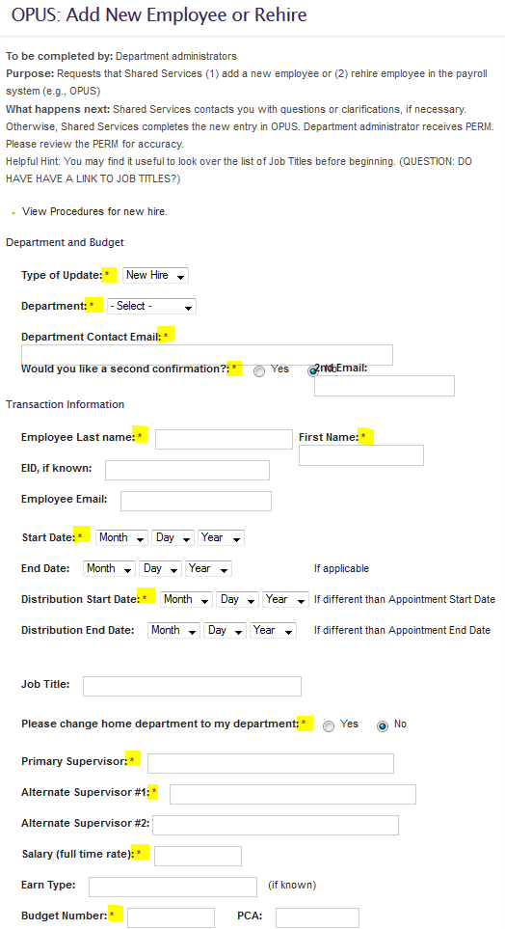
OPUS: Add New Employee or Rehire

Slide 5
HSA Shared Services
http://depts.washington.edu/hsashare/services/
Procedures: New Hire
OPUS: Add New Employee or Rehire:
(1.) Form submission [New Hire, or Rehire]
(2.) I-9 verification [in-person; within 3 days of hire]
(3.) OPUS New Hire Entry
(4.) UW NetID
(5.) Payroll orientation [45min-1hour]
(6.) OWLS/LTR

Slide 6
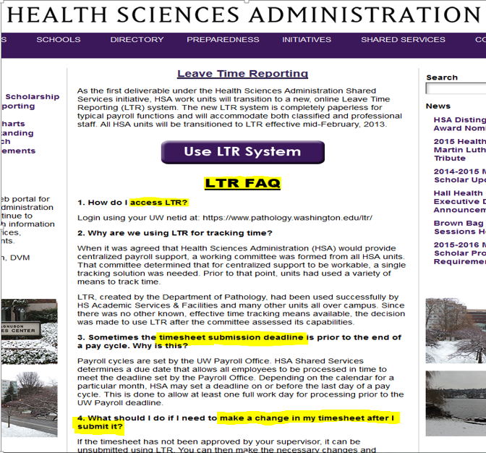
LEAVE TIME REPORTING [LTR] http://depts.washington.edu/uwhsa/shared-services/ltr/

Slide 7
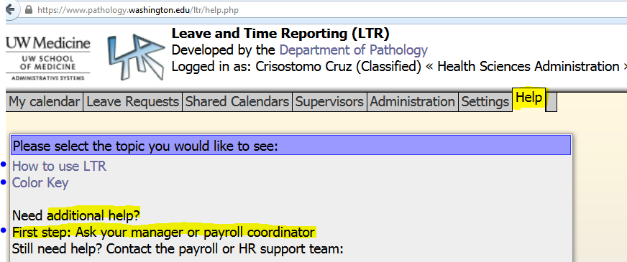
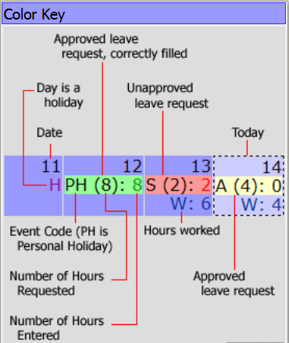
LTR: “Help” Guide https://www.pathology.washington.edu/ltr/help.php

Slide 8
LTR: Common Issues [Leave Requests & Holiday usage]

Slide 9
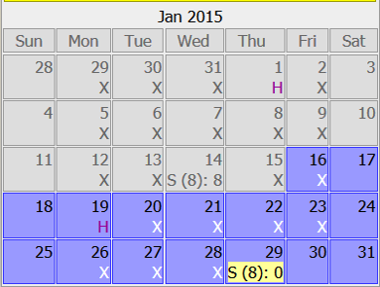
LTR: Common issues – Leave Requests: Sick & Annual/Vacation request & usage. Situation 1.
Leave request = “S(8):0”?! Incorrect.
Leave request = “S(8):8” Correct!

Slide 10
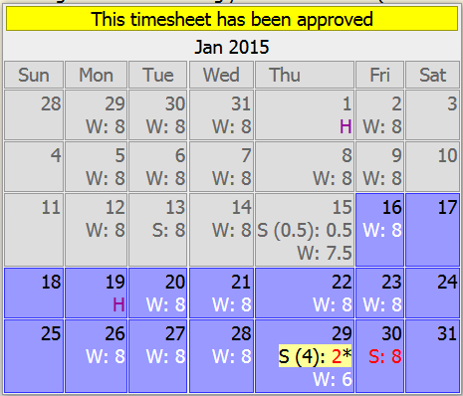
LTR: Common issues – Leave Requests: Sick & Annual/Vacation request & usage. Situation 2.
Leave request = “S(8):0”?! Incorrect.
Leave request = Correct entry!

Slide 11
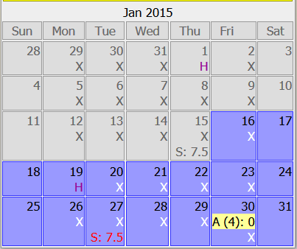
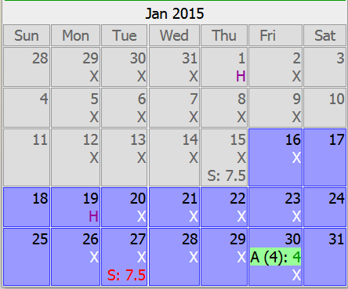
LTR: Common issues – Leave Requests: Sick & Annual/Vacation request & usage. Situation 3.
Leave request = “A(4): 0”?! Incorrect.
Leave request = Correct entry!

Slide 12
A few Holiday Scenarios

Slide 13
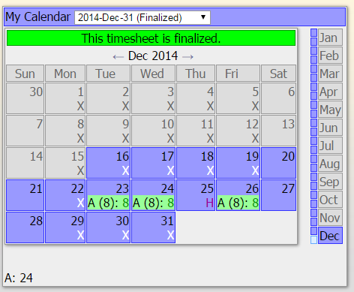
The University provides a credit of hours for a holiday depending on your FTE (percentage of time employed). 100% employees are credited with 8 hours for a University holiday. Lesser FTEs are credited as follows: FTE percentage X 8 hours.
Employee works 8 hrs/day, M-F, 100% FTE = Leave it blank.

Slide 14
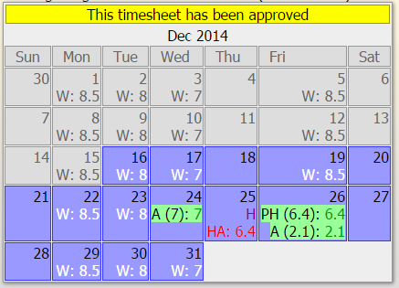
The University provides a credit of hours for a holiday depending on your FTE (percentage of time employed). 100% employees are credited with 8 hours for a University holiday. Lesser FTEs are credited as follows: FTE percentage X 8 hours.
Employee works varied schedule – 80% FTE, 32 hrs/week
Holiday falls on a scheduled day off = [Option using: “HA:6.4” or “H/S:6.4”]

Slide 15
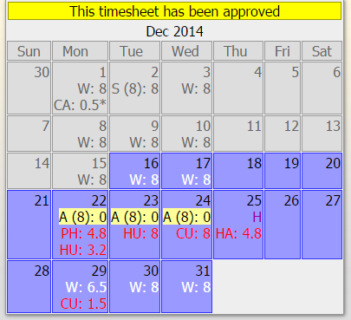
The University provides a credit of hours for a holiday depending on your FTE (percentage of time employed). 100% employees are credited with 8 hours for a University holiday. Lesser FTEs are credited as follows: FTE percentage X 8 hours.
Employee works 8 hrs/day, M-W – 60% FTE, 24 hrs/week, “HA:4.8” hours:

Slide 16
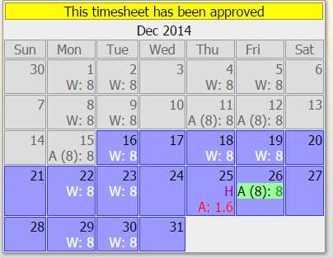
The University provides a credit of hours for a holiday depending on your FTE (percentage of time employed). 100% employees are credited with 8 hours for a University holiday. Lesser FTEs are credited as follows: FTE percentage X 8 hours.
Employee works 8 hrs./day M,Tu,Th,F – 80% FTE, 32 hrs/week
Holiday falls on work day – 6.4 hours credit = Added “A:1.6”.

Slide 17
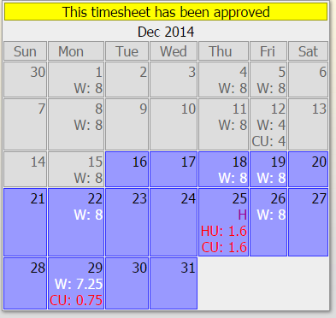
The University provides a credit of hours for a holiday depending on your FTE (percentage of time employed). 100% employees are credited with 8 hours for a University holiday. Lesser FTEs are credited as follows: FTE percentage X 8 hours.
Employee works 8 hrs./day M,Th,F – 60% FTE, 24 hrs/week
Holiday falls on work day – 4.8 hours credit = Added “HU:1.6” & “CU:1.6” hours.

Slide 18
Questions?

