Slide 1
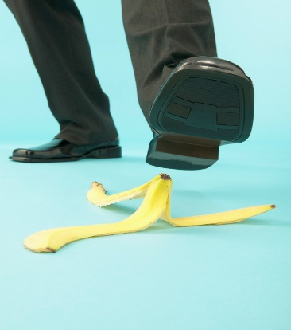
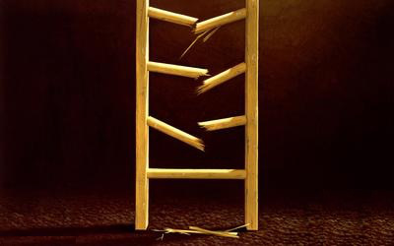
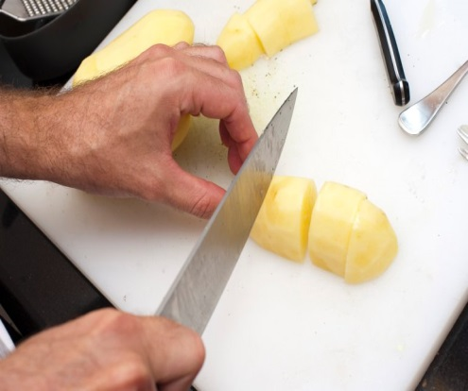
Accident Investigation Training How to Conduct a Workplace Accident Investigation
Emma Alder, Health and Safety Programs Specialist
EH&S, Research and Occupational Safety

Slide 2
Goals for this Training
Learn simple tools that can be used to investigate simple and complex accidents.
Learn the importance of root cause analysis.
Walk away with resources that can help minimize the occurrence of accidents in your department.

Slide 3
What is an Accident?
Unplanned and unwanted event that disrupts work processes by causing injury or damage.
Accidents are caused occurrences,
rarely due to an a random
happening or “Act of God.”
Accidents are preventable and even predictable events.

Slide 4
Why Investigate?
Investigations can uncover deficiencies in procedures and training or draw attention to needed repairs/maintenance.
Investigations lead to corrective actions that prevent reoccurrence of accidents.
Investigations are required by law for serious accidents (WAC 296-800-32020).

Slide 5
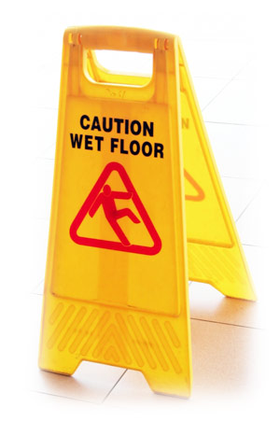
Most Common Injuries at UW
Type of Injury
Sprains, Strains, or Twist
Open Wounds: Laceration, Puncture, Scratch
Injury Cause
Slip or Trip
Overexertion, Repetitive Motion,
or other Poor Ergonomic Design

Slide 6
Leading Root Causes at UW
Online Accident Reporting System (OARS) reports from 2013 (N = 1,086), excluding Medical Centers, were categorized by the causes identified by the supervisor.
The leading root causes for accidents reported at UW are people, policies/procedures/training, and environmental causes.
“People” includes inattention, lack of awareness, rushing, or failure to follow established procedures.
Only 9% of accidents have more than one cause identified.

Slide 7
Supervisor Comments
“Carelessness”
“Human error”
“Inattention”
“Rushing”
“N/A”
“Accidental injury? I wasn't present.”
“When the determinations of the causal chain are limited to the technical flaw and individual failure, typically the actions taken to prevent a similar event in the future are also limited: fix the technical problem and replace or retrain the individual responsible. Putting these corrections in place leads to another mistake: The belief that the problem is solved. – Columbia Investigation Board, NASA 2003

Slide 8
Accident Investigation Process
Preserve and document the scene.
Collect facts through interviews.
Develop event sequence.
Initiate online report.
Determine causes.
Recommend improvements
Complete report.

Slide 9
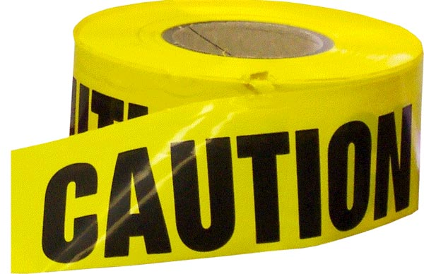
1. Preserve and Document the Scene
Take immediate action to prevent injury or damage.
Secure and preserve the scene.
until the investigation is complete.*
Communicate with employees in the area.
Take (many) photos from various view points.
*For injuries that result in hospitalization or fatality, it is against the law to move any equipment until L&I gives the okay unless you must move the equipment to remove victims or prevent further injury.

Slide 10
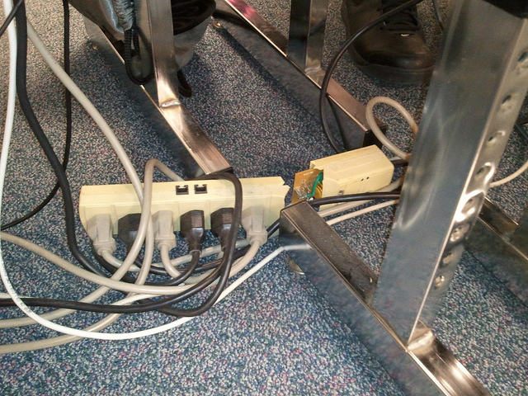
“Employee was shocked by electrical outlet while unplugging cord.”

Slide 11
2. Collect Facts Through Interviews
Interview affected employee(s) and witnesses as soon as possible.
Interview at the accident scene, if possible.
Keep the purpose of the investigation in mind. Make sure the interviewee understands as well.
Ask for the interviewee’s suggestions.

Slide 12
3. Develop the Sequence of Events
Analyze the accident by breaking down
Events prior to accident
Events during
Events immediately after
Identify gaps in your timeline and gather additional facts and information as needed.

Slide 13
4. Initiate Report
Accidents at the university are reported via the Online Accident Reporting System (OARS).
Report all accidents within 24 hours.
OARS serves several purposes:
Meeting reporting requirements
Documenting your investigation
Requesting assistance from EH&S, if needed
Accidents resulting in a fatality or hospitalization must be reported by calling EH&S at 206.543.7262. EH&S must notify L&I within 8 hrs.

Slide 14
4. Determine the Causes
Direct Cause – The immediate source of the accident, often quickly identified
Indirect Cause – An unsafe action or condition
Root Cause – Policies, decisions, environmental or personal factors
“Accidents usually result from multiple and interacting causal factors that may have organizational, cultural, technical or operational systems origins. If accident investigations do not relate to actual casual factors, corrective actions taken will be misdirected and ineffective.” (Manuele, 2011)

Slide 15
The “Accident Weed”
Hazardous
Hazardous
Conditions
Injury
Practices
Missing guard
Rushing
Cluttered work area
Ignored safety rules
Defective tools
Not following procedures
Equipment failure
Failure to use safety equipment
Poor lighting
Inattention
No funds to purchase equipment
Procedures not developed
Poor workspace design
No follow-up/feedback
Rules not enforced
Lack of Training
Limited staffing
No safety leadership
PPE not purchased/provided
Root Causes
5/13/2015
15

Slide 16
Ishikawa (Fishbone) Diagram
Cause
Effect
Machines
Methods
Materials
Accident
Measurements
Mother Nature
Manpower

Slide 17
Ishikawa (Fishbone) Diagram
Cause
Effect
Equipment/Materials
People
Rushing
Broken lights
Inattention
Missing banister
Chip in the floor
Accident
Wearing high heels
Slipped and fell while walking up stairs, spraining ankle
Must arrive at 8:00 sharp
Early morning
Stairs encouraged
Slick flooring
Strict dress code
Raining
Policies/ Procedures
Environment

Slide 18
The Five Whys
Repeatedly asking the question “Why” may lead you to the root cause of an accident. You will find that the most obvious cause will only lead to more questions.
Example: You are on your way to work and you car stops in the middle of the road.
Why did your car stop?
Because it ran out of gas.
Why did it run out of gas?
Because I didn’t buy gas on my way to work.
Why didn’t you buy gas on your way to work?
Because I didn’t have any money.
Why didn’t you have any money?
Because I lost it all during a poker game last night.
Why did you lose at poker?
Because I’m terrible at bluffing.

Slide 19
5. Recommend Improvements
Using your root cause analysis, look ahead to see how the risk of similar incidents can be reduced.
Identify solutions that are practical, specific, effective, and based on consultation.
Rank your solutions in order of priority.
Make a plan and take the first step.
Follow-up.

Slide 20
6. Complete the Report
Document your findings in the OARS report.
Set a target date to complete your suggested corrective actions.
Once you complete the corrective actions or take the first step to completing the corrections, the report can be closed.
Continue to follow-up and make steps towards improvement.

Slide 21
EH&S and Investigations
EH&S may assist with the investigation when an accident involves a:
Hospitalization or fatality
Chemical spill and/or exposure
Bloodborne pathogen exposure
Recombinant/synthetic DNA exposure or spill.
Fires
Physical hazard such as a damaged sidewalk
EH&S is available to assist with an investigation upon request.

Slide 22
Room to Improve

Slide 23
Resources
EH&S website: http://ehs.washington.edu/
Online Accident Reporting System (OARS)
http://ehs.washington.edu/ohsoars/index.shtm
Safety Manuals and Publications
http://ehs.washington.edu/manuals/index.shtm
Safety Committees
http://www.ehs.washington.edu/ohssafcom/index.shtm

