Slide 1
NAVIGATING CHANGE
HSA Supervisors
July 16, 2015
Notes:
PS
Thanks for the survey input –RECAP
Why?
TENSION – FRICTION – DYSFUNCTION
Ground rules
No tablets, phones unless on emergency call
Respect
silo
Survey feedback via Catalyst

Slide 2
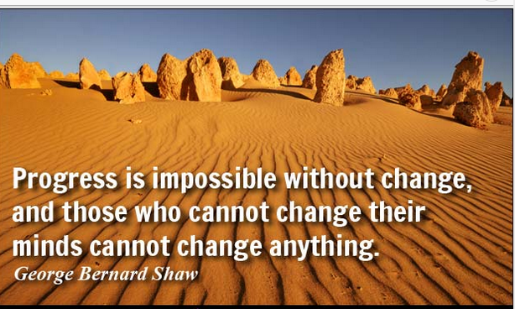
Notes:
TS
Time spent on development and ongoing check-ins results in less time on corrective actions
Underperformers are typically not stressed by their approach to work/team
Do not overlook high performers

Slide 3
  CHANGE: Opportunity or Obstacle?
  Questions to Answer – What, Why, Who, When, How
  WHAT is the change?
  WHY is it happening
  WHO will be impacted
  WHEN will it happen
  HOW will it be implemented
Notes:
TS
Time spent on development and ongoing check-ins results in less time on corrective actions
Underperformers are typically not stressed by their approach to work/team
Do not overlook high performers

Slide 4
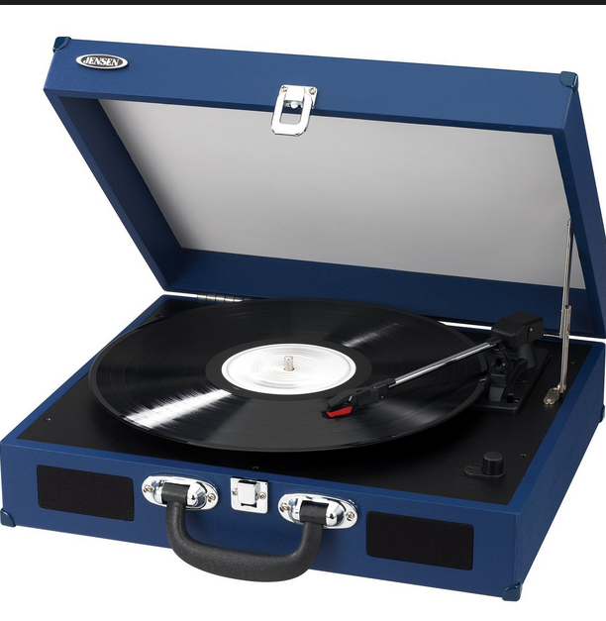
Turntable with 33 LP Album about 30 songs

Slide 5
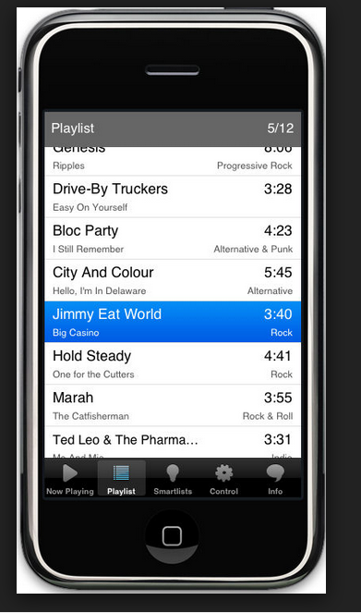

Playlist on your phone = Thousands of songs
To
The Cloud

Slide 7
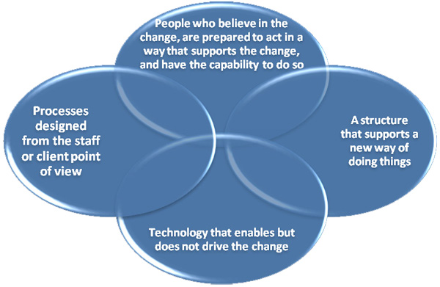
Notes:
TS
Time spent on development and ongoing check-ins results in less time on corrective actions
Underperformers are typically not stressed by their approach to work/team
Do not overlook high performers

Slide 8
  Successful employees will embrace and lead change
  Key Factors for Change Management
  Clarity of Vision and Purpose
  Strong Champions
  Sufficient Resources
  Clarity of Roles
  Engagement
  Communication ------show “coins” video
Notes:
TS
Paperwork not personalities
Ask for other resources units may have

Slide 9
Most Change Efforts Fall Short
  Reasons aren’t understood or communicated
  No clear picture of future
  Not enough buy-in
  Under estimate amount of work involved
  Lack of sustained leadership, ownership and focus
  Under manage the people part of change
Notes:
PS
Audience remembers 3 key pts
HRC approach p-e-i
If audience remembers 3, the first better catch attention, not derail it
Volume-Tone-Clarity-Pace
Posture-Facial expressions-Eye contact-Gestures-Personal space

Slide 10
Passivity Paranoia
4 P’s
  People
  Policy – Practice
  Perception
  Becoming comfortable with the unknown
Notes:
KJ
Late due to chemo treatment
Project delayed due to approved leave
Mental health counseling schedule
Carelink
Legal
UCIRO, Ombud, Union, Mediations……
Rate against others
Style
Scope
Personality
Relationships
AVOID
Planned events may not occur, lose the opportunity to address immediately
Ignoring…lame ducks, retirement, vacation

Slide 11
H X 3
Hope is not a strategy
Hostility is not a default strategy
Hugs are not a reasonable outcome
Notes:
TS

Slide 12

Four Generations in the Workplace
First time ever in history – Gen Flex
  Traditionalists
  Boomers
  Generation Xers
  Millennials
  Role Play Table Activity Summary
Notes:
KJ
Stray or drawn off key message
“everyone else does that” “You were late last week”
Language - vague
“Always late”
“Never does it”
“Outstanding at every aspect of her job”
Provide specific examples,
“late to senior mgt meeting 3 times in June and July, impacting agenda”
“Assigned 10 benchmark tasks, completed 5 with no extenuating circumstances communicated”
“Accurately delegated responsibilities, prepared staff, communicated 1 week prior to departure re: 5 approved leaves”
HALO
So expertly managed national conference or Lean Initiative that rest of performance not accurately measured
One pinnacle achievement overshadows underperformance
Supervisor reacts to one outstanding characteristic which influences our total judgment about person and performance
Ascribe a range of related traits that may not now or ever exist
HORN
Flip side – lacking in one trait ( or one spectacular failure) influences all others
Over reassurance: Don’t worry, you’ll be ok (usually in response to tears, emotion)

Slide 13
Problem
Expectation
Impact

Slide 14
Point staff to the vision, not the change
Key takeaways:______________ 3 things.
What are you going to do different?
1._______________________________
2._______________________________
3._______________________________
Notes:
KJ

Slide 15
Thank you for your time
Notes:
TS

Slide 16
Problem
Expectation
Impact

