Slide 1
An Introduction to SharePoint For the Non-IT Professional
Sarah Starr
Office of Animal Welfare

Slide 2
What Is SharePoint?
A Business Solutions Platform
Its Is not specific to a single product or technology→ refers to several aspects of solutions (much like Microsoft Office)
Can serve multiple functions
Integrates with Microsoft Office
Uses “Sites” to host business solution applications
SharePoint is available in 3 main ways or “Types of Platforms”:
On Premise (offline; servers are on site )
In the cloud (online, servers are managed by Microsoft)
Hybrid (both On Premise and online)
License based product→ regardless of the “type” of platform you choose your licenses will determine what you can do on your platform.

Slide 3
Which SharePoint is right for you?
 | On Premise (on site) | Online (in the Cloud) | Hybrid (Best of Both Worlds)
Highlights | Full Customization* Robust Security and Confidentiality High Data Integrity | Much Less Management High Availability Less cost Does not Require an IT Team | Pick and Choose what fits your needs.
Use If: | You require customization You are concerned with Compliance and legal restrictions. Data Integrity is a concern | You don’t have dedicated IT personnel Don’t have a large IT budget Using out of box solutions to meet your needs | Pick and Choose what fits your needs.
Do Not Use if: | No dedicated IT Team Have the funds for 3rd party support if no In house IT. Don’t have a very large budget! | You have to adhere to heavy Compliance Regulations or other legal restrictions If you want/need to Customize- customization is not available | You don’t have an IT Team dedicated to managing the server(s).
UW Department | Type of SP
I-School | Online
Radiology | Online
UW School of Law | Online
Records Management | On Premise
School of Medicine | On Premise
A note about Customization vs Configuration
Customization involves changing the code of the SharePoint to change or extend functionality.
Configuration modifying pre-existing tools or apps using the built in tool sets

Slide 4
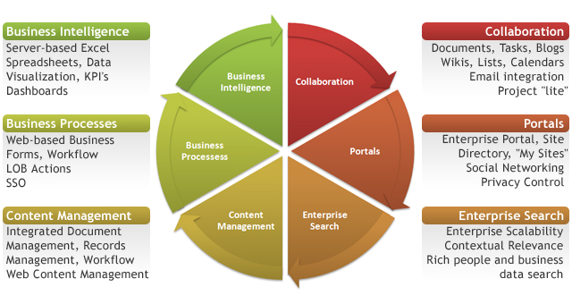
What can I use SharePoint for?
Regardless of whether your organization uses SharePoint Online, On Premise or Hybrid, SharePoint gives you the tools to manage your business processes in one place.
Image Source: http://computertrainingcenters.com/10-ways-sharepoint-can-help-your-business

Slide 5
SharePoint Architecture High Level View
Site Collection: Root of your Sites
Site: Your Main Team Site or Function Site
Subsite: Additional Subject sites below your Team Site or Function Site
Pages: Project pages or subject pages that don’t need to be sites or subsites
Apps and Web Parts: These are your out of box solutions.
i.e. Calendar, Document Library, Task Lists
Site Collection
Site
Pages
Apps, Web Parts
Subsite
Pages
Apps, Web Parts
Apps, Web Parts
Apps, Web Parts

Slide 6
SharePoint Content and Management Site Collections, Sites, subsites and pages
Site Collections, Sites, and Subsites provide the framework for your SharePoint platform:
Department Organizational Hierarchy
Manage Permissions
Manage Content Structure
Much more…
They also lay the foundation for Apps and Web Parts to meet business needs through content and function.
Manage Site Features***
Manage Workflow
Development and Design
Pages expand on Site or Subsite architecture but its content and function are dependent on the Site or Subsite.
Site Collection
Site
Pages
Apps, Web Parts
Subsite
Pages
Apps, Web Parts
Apps, Web Parts
Apps, Web Parts

Slide 7
SharePoint Content and Management Apps and Web Parts
The content and the a lot of the business process functionality resides within the Apps and Web Parts. These are the main sources of your “Out of Box Solutions”
Out of Box Solution→ Feature in SharePoint that requires little to no “adjustment” to meet your business needs.
Some Site Features are also OOBS
Site Collection
Site
Pages
Apps, Web Parts
Subsite
Pages
Apps, Web Parts
Apps, Web Parts
Apps, Web Parts

Slide 8
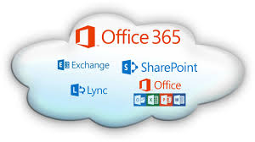
Using an OAW SharePoint Online Site Collection to demonstrate solution capability
OAW’s SharePoint Online is hosted through Microsoft 365
What is Microsoft 365?
In the cloud subscription plan that includes:
Microsoft Office
Skype for Business
Exchange online
OneDrive for Business
+SharePoint (optional)
Since everyone with a UW NetID has a Microsoft 365 license, this makes onboarding to SharePoint seamless
Image source: http://en.community.dell.com/techcenter/sharepoint-for-all/b/blog/archive/2013/07/31/watch-a-video-on-how-to-migrate-sharepoint-to-office365-with-dellsoftware

Slide 9
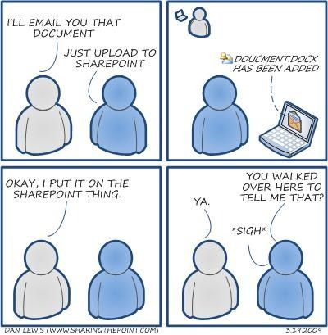
Using an OAW SharePoint Online Site Collection to demonstrate solution capability Continued..
Work Room- Modified Document Library
Streamline Business Process
One comprehensive view
Multi-departmental
Easy tracking
OAW Meetings- Modified List
No more emailing agenda items
Anybody can add agenda items
Easier to search topics and look up decisions
Virtual Filing Cabinet
Increased Transparency for Customers
Filing of Protocols
Records Retention
Automatic Business Process
Reduces Administrative Burdon

Slide 10
Out of Box Solution: The Document Library
Most people use a document library to simply store documents. In SharePoint, you can use it to do so much more! For example, Oaw uses a document library to keep track of the status of our current projects and tasks, as well as to grant visibility to the office of the status of our work.
Ways you can Modify and/or use a Document Library (other than storing documents)
Add Columns to display certain metadata
Add Work Flows for automated Notifications and Approvals
Create different “views” to display certain information (like a dashboard)
Assign tasks and link them outlook for individuals
Assign record policies
Store sets of documents with specific sets of metadata assigned to them (cannot do this with folders)

Slide 11
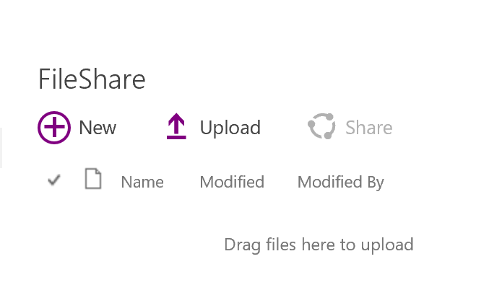
Example of a Modified Document Library
This is What a document library looks like when you add it to a page:
Below is what The Work Room modified Document library looks like. This library has custom metadata, columns, workflows, document sets and custom views.
These are all custom columns.

Slide 12
Out of Box Solution: Modified List
Lists are very similar to document libraries in terms of what you can do with them. The difference is that instead of working with documents or “files” you are working with “data”.
Ways you can Modify and/or use a List
Add Columns to display certain metadata
Add Work Flows for automated Notifications and Approvals
Create different “views” to display certain information (like a dashboard)
Assign tasks and link them outlook for individuals
Attach Files
Use in Business Intelligence

Slide 13
Example of A Modified list
OAW is using a List in an unconventional way- as a way to manage or office meetings. Our custom list has replaced the conventional way of submitting agenda items and typing of meeting minutes in word document.
How it works:
Individual creates a new agenda item, fills out the meeting and topic
Decision is recorded with the agenda item during the meeting
List is searchable by topic or meeting date (or other metadata value) so easy to look-up for reference.
Custom Columns

Slide 14
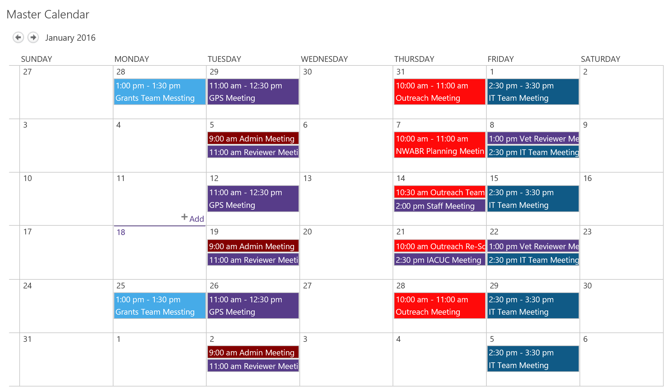
Out of Box Solution: Calendar
Great uses of Calendars in SharePoint include:
Project Calendars
Team Calendars
Out of Office/Leave Calendars
Office/Department Calendars
Features
Overlays- overlay up to 10 calendars in a single calendar view
Integrates with your outlook calendars
Custom views
Integrate with Tasks in Sharepointor in Outlook
Each color on the calendar represents a Team Calendar that has been overlayed on the Master Calendar

Slide 15
Sites: THE Virtual Filing Cabinet Example
Sites can be used countless ways: as teams sites, project sites, document storage, and information pages to name a few. One of the ways OAW uses sites is a combination of all of the above to provide a service to our Researchers
OAW’s Virtual Filing Cabinet (VFC) contains over 400 sub collections of sites, one collection for each researcher we serve). Each one of these collections include:
A PI and Contact Level Sites that contains
Protocol Approval and Expiration Table
Protocol Tracking for submitted Items
A Protocol level Site for each Protocol that contains:
Approved Protocol Documents
Helpful Link
Researchers and their teams can access their collection of sites at any time to get information on their protocol.

Slide 16
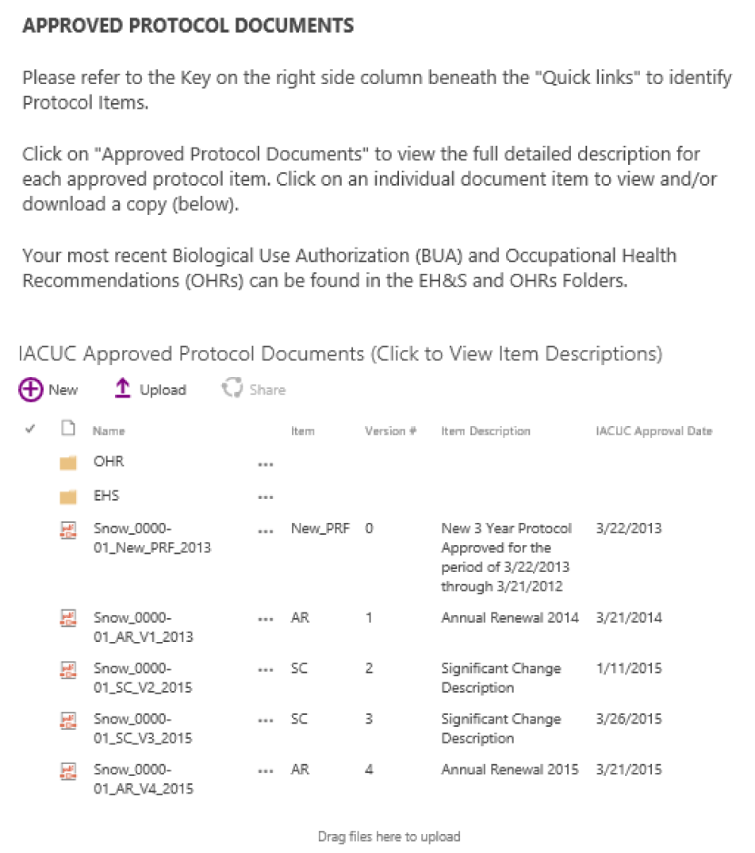
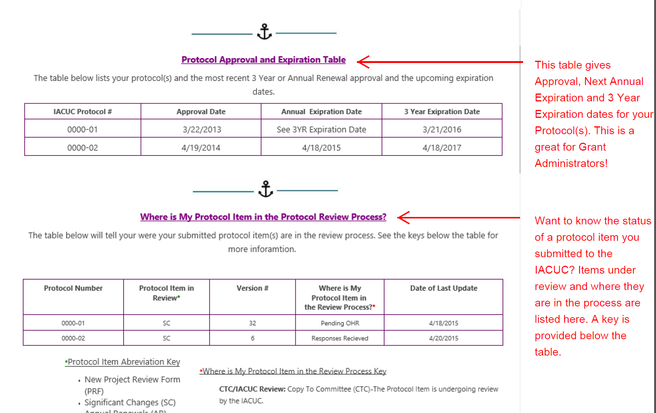
Virtual Filing Cabinet Snapshots

Slide 17
OneDrive for Business
OneDrive for Business is your personal online document library (1 terabyte of storage) , but you can also use it to explore the capabilities of SharePoint to see if SharePoint is right for your business needs:
Open your one Drive for Bussiness
Go to Site Settings
Click on Site Contents
Click on +Subsite
Start playing around!

Slide 18
Great Resources
SharePoint Community of Practice: UW SharePoint users attending this meeting Every other Friday from 12:00-2:00 pm in the Tower to talk about All things SharePoint. Contact Gregory Frick (gdfrick@uw.edu)
ShareGate: ShareGate offers services but they also put out excellent free tutorials for general SharePoint content: http://en.share-gate.com/support/tutorial-videos.
Lynda.com courses: If you have the money, this service has some great introductory tutorials as well.
Microsoft: Sometimes there is no better source then the parent!
The internet: Thousands of free tutorials and discussion boards!

Slide 19
Thank you!

