Slide 1
Creating Your Video
Presentation from UW Video
RICK GARZA
DIRECTOR OF PRODUCTION
206.685.8404
REGARZA@UW.EDU
MICHAEL WELTY
VIDEOGRAPHER

Slide 2
Overview
The Idea
Video Concept
Script
Storyboard
Outline
Production Plan
Schedule
Filming
Editing

Slide 3
The Idea
Keep it simple
How much time do you have?
Objective
Who is the audience

Slide 4
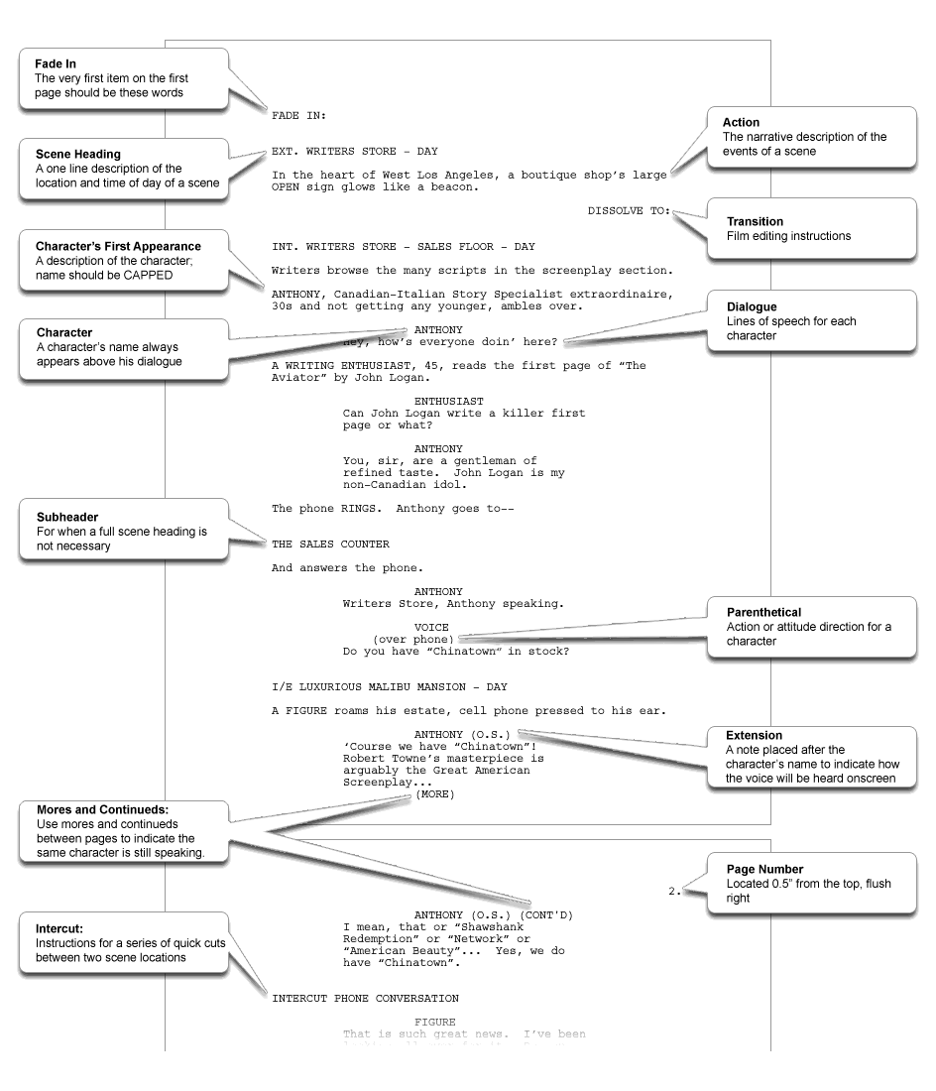
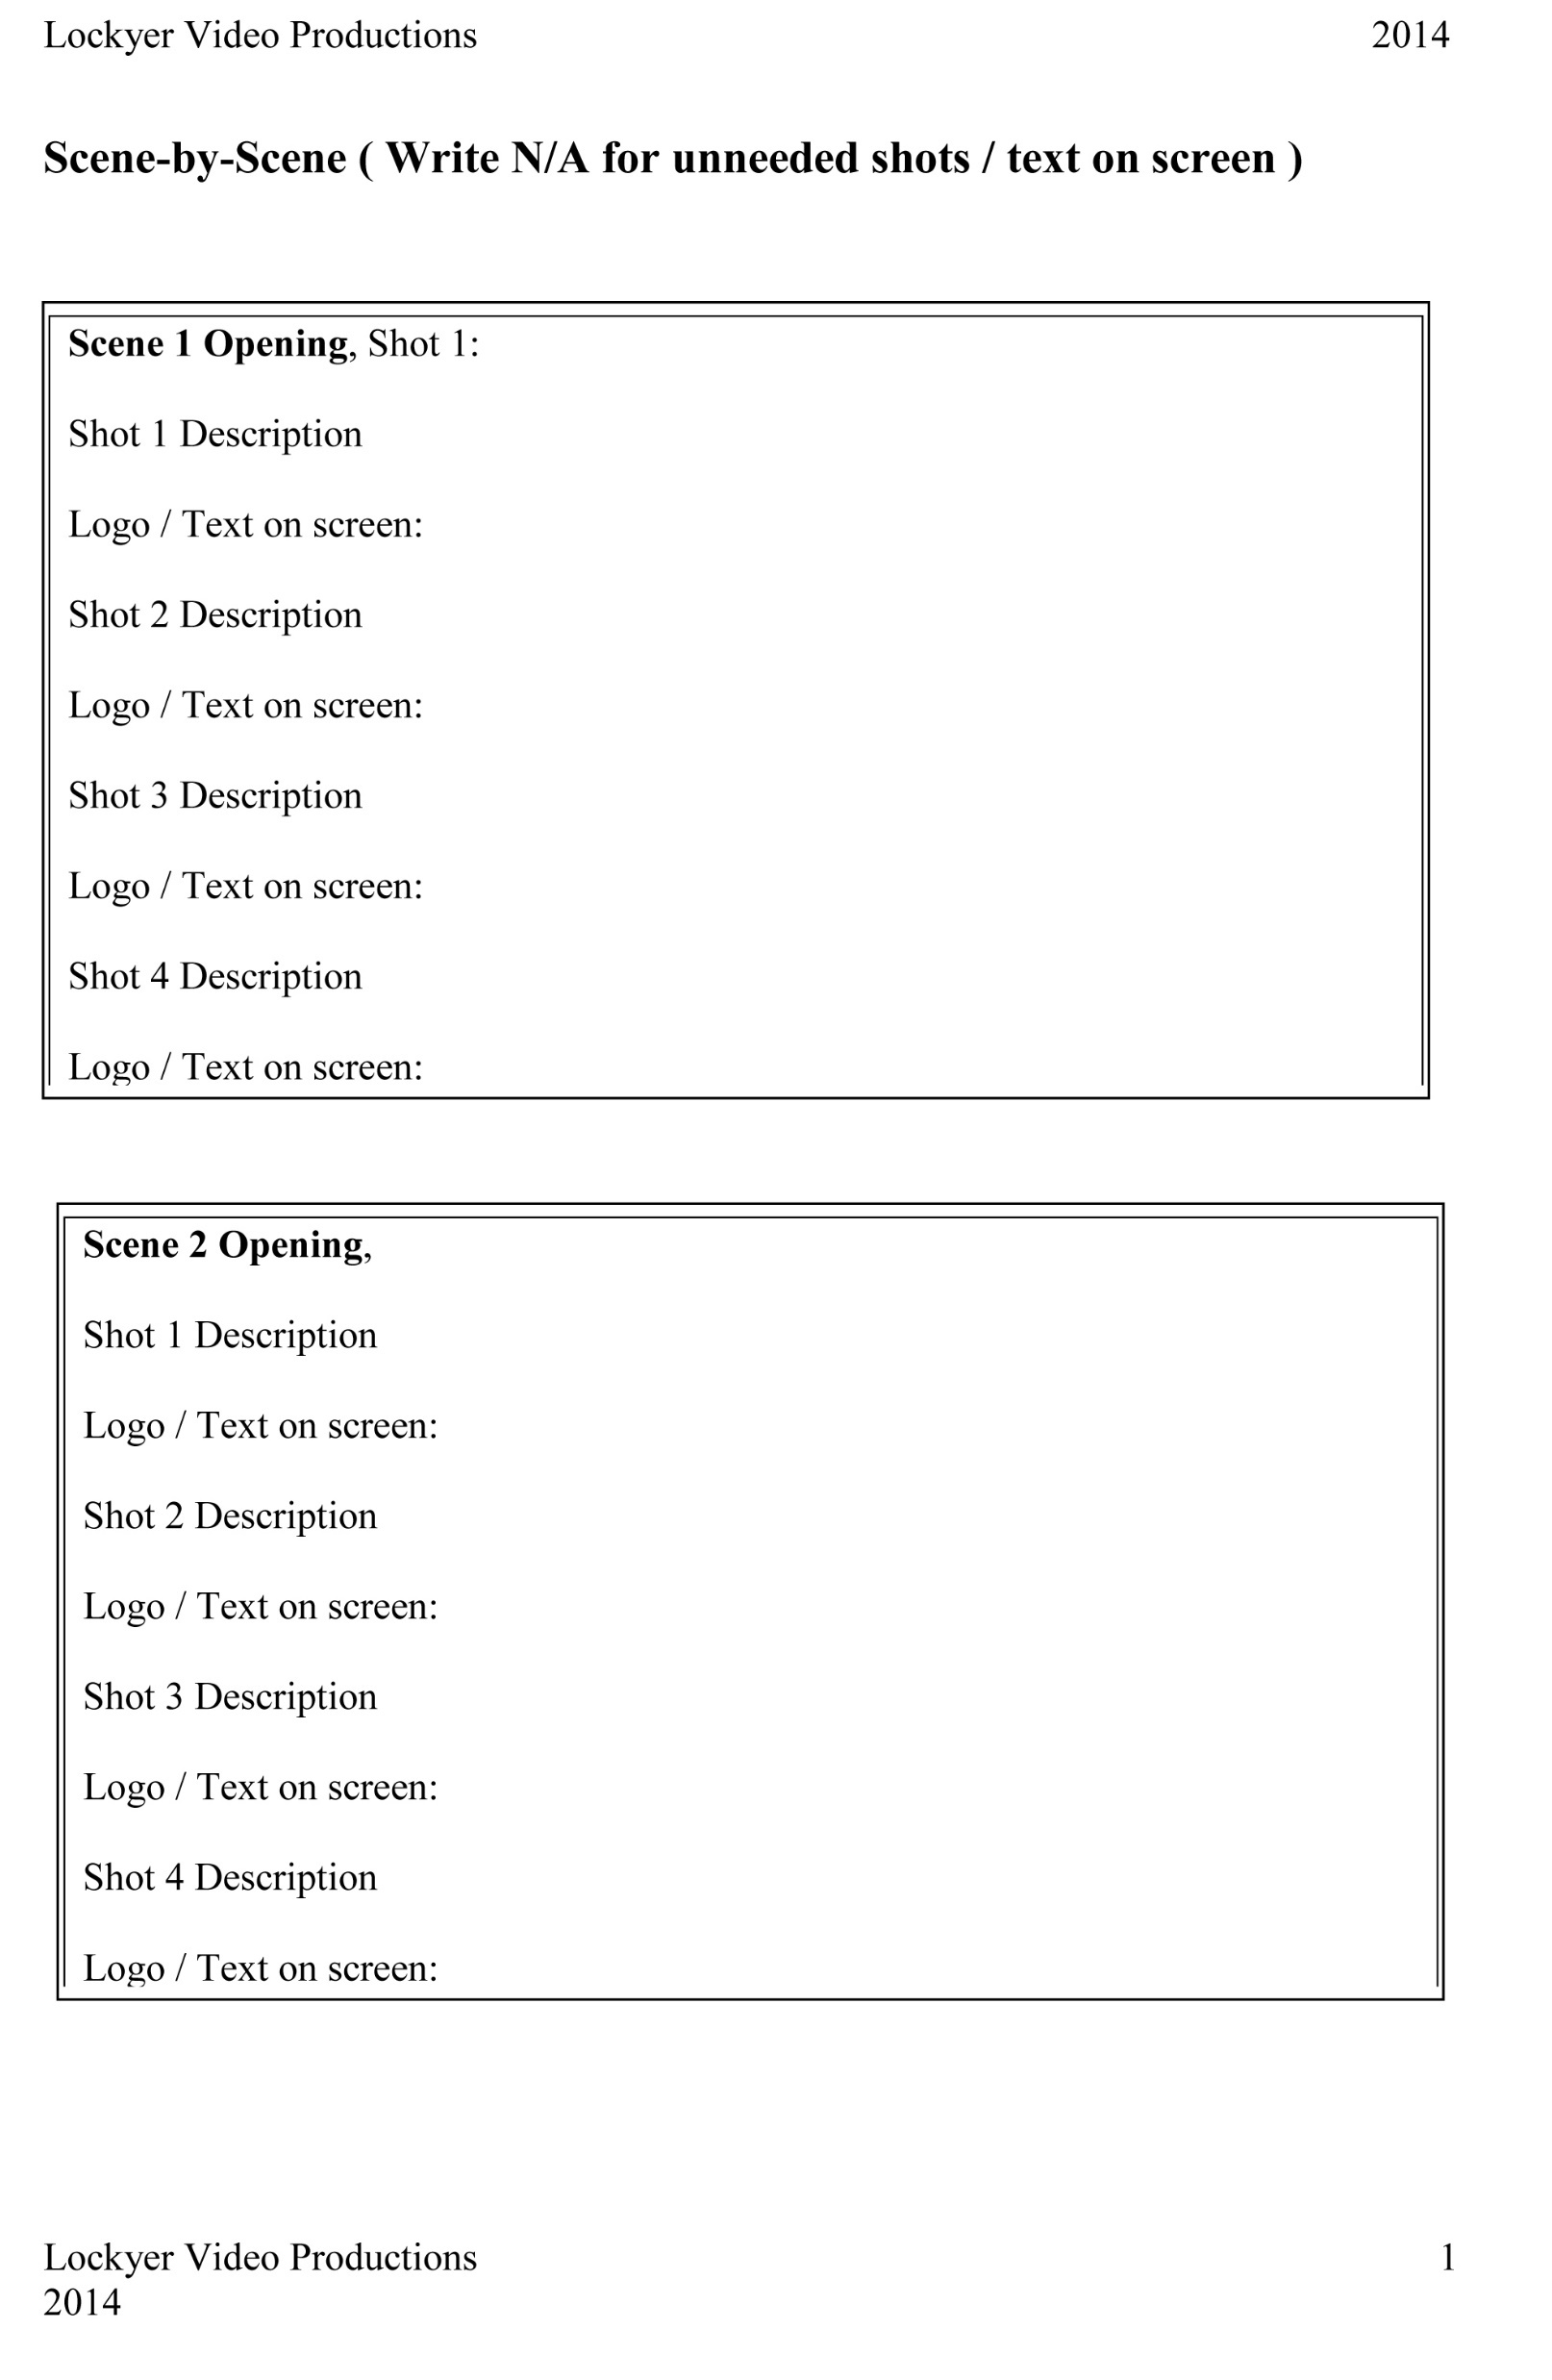
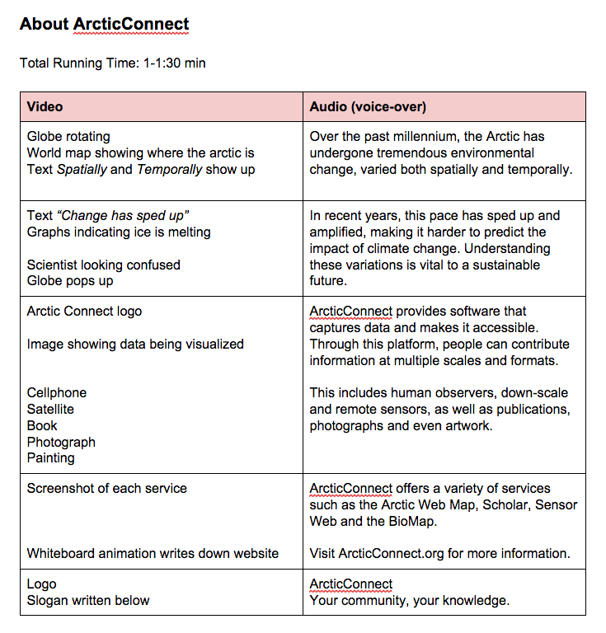
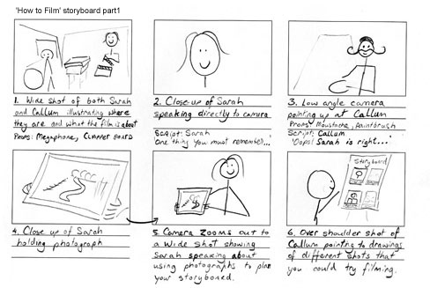
Video Concept
What video format will you use?
Scripted video
What type of script?
TV/Documentary style
Film Style
Storyboard
Outline

Slide 5
Production Plan
Your Team
Who is the videographer
Who is the director
Who is the scriptwriter
How much time can you devote (remember keep it simple)
It always takes longer then you think it will
Make a shot list from your script or outline

Slide 6
Filming (ok actually it’s video)
Equipment
Camera
Tripod
Audio
Media
Accessories
Batteries
Battery Charger
SD Cards
External monitor

Slide 7
Filming (ok actually it’s video)
Use a tripod
Avoid zooming
Camera Basics
Focus
Manual vs auto focus
Exposure
White Balance (daylight, tungsten
Skin tone
Shots:
Composition
Rule of Thirds (conventional
Frame Size (Field of View)
Depth of Field (Shallow vs deep)

Slide 8
Filming (ok actually it’s video)
Directing the Viewer’s eye
Focus (Depth of field)
Composition (Balance)
Eye Fix (transitions)
Think about where you want the viewer’s eye to go
Transitions – cuts or dissolves
Screen Direction (Crossing the line)
Clean entrances and exits
Overshoot – You’ll need it
B-roll (what is it?)
Cutaways
Interviews (documentary style)
Scene Coverage (narrative style) – Different setups
Lighting

Slide 9
Editing
A topic for next time

