Slide 1



Moving from a Team of Experts to an Expert Team
TeamSTEPPS

Slide 2
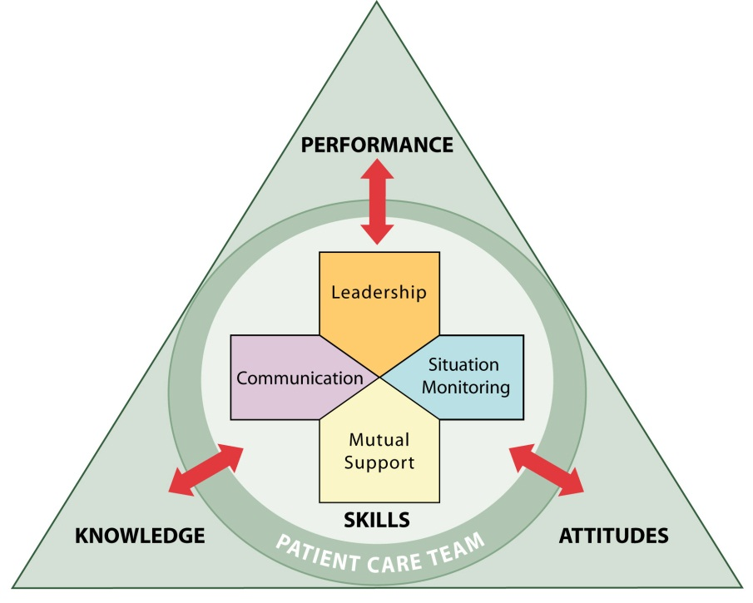
What is TeamSTEPPS?

Slide 3
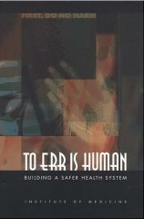
Institute of Medicine
November, 1999
Approximately 100,000 patients die in
the hospital each year from medical
errors and 72% resulted from
communication errors
This report lays out a comprehensive strategy by which government, health care providers, industry, and consumers can reduce preventable medical errors. Concluding that the know-how already exists to prevent many of these mistakes, the report sets as a minimum goal a 50 percent reduction in errors over the next five years.

Slide 4
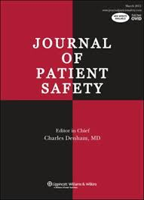

….14 Years Later
September, 2013
Journal of Patient Safety, John T. James, PhD
IOM figure was probably underestimated
  210,000 – 440,000 deaths due to preventable medical errors
May, 2016
BMJ, (Markary & Daniel)
Third-leading cause of death in America, behind heart disease and cancer

Slide 5

Medical Error and Harm
Causes of Death 2013 – US
Based on our estimate
medical errors is the
3rd most common
cause of death in the US
Two Jumbo Jet Crashes/Day
• 29 airline passengers dying/hour
• 688 airline passengers dying/day
Cancer
585 K
Medical
Error
251 K
Heart
Disease
611 K
All Causes
2,597 K
COPD
149 K
Suicide
41 K
Motor Vehicles
34 K
Firearms
34 K
© 2016 BMJ
Date source:
http://www.cdc.gov/nchs/
data/nvsr64_0.2.pdf
medical errors
not reported on US death certificates

Slide 6


Culture change
Expert Team
Team of Experts

Slide 7
Review of SKILLS
100 Level Skills Request Call-Out Cross-Check Check-Back SBAR Brief |  | 200 Level Skills Huddle Debrief Handoff Cross- Monitoring STEP Task Assistance Shared Mental Model |  | 300 Level Skills CUS Two-Challenge Rule DESC I’M SAFE

Slide 8
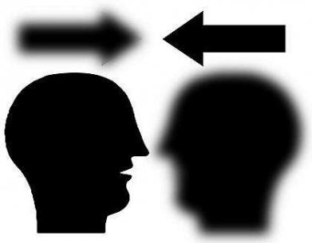
communication
Communication
Effective Communication must be:
complete: relevant information avoiding unnecessary detail
clear: standard terminology, minimize acronyms
brief: be concise
timely: avoid delays, verify, validate or acknowledge

Slide 9
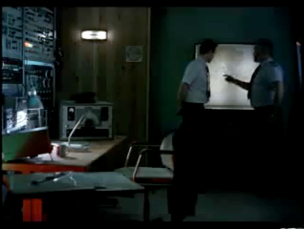
CREDIT: Berlitz, https://www.youtube.com/watch?v=yR0IWICH3rY
Notes:
Good demonstration of breakdown in communication

Slide 10


Slide 11
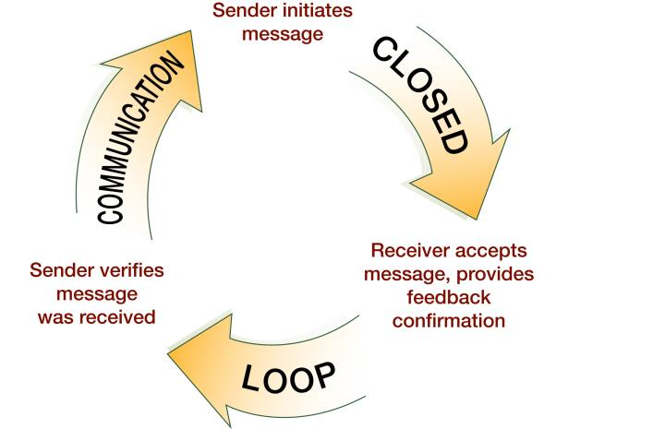
Closed Loop Communication
Request
Call-out
Sender notified of task completion
Cross-Check

Slide 12
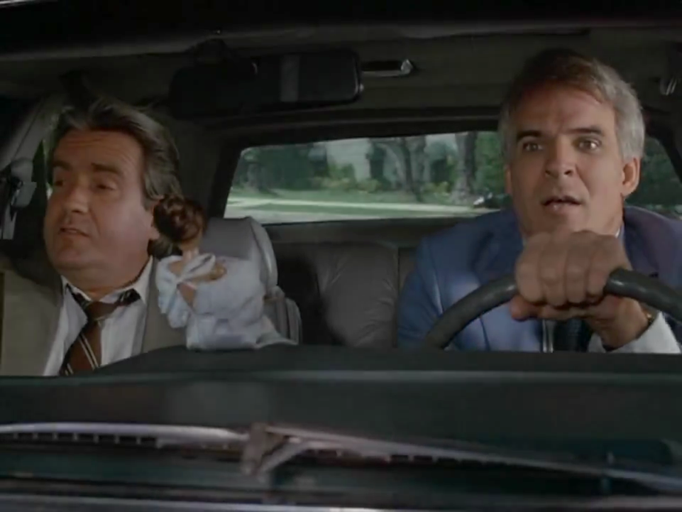
CREDIT: Man with Two Brains, The Warner Bros. Studios
Notes:
Excellent demonstration of closed loop communication

Slide 13


Slide 14

Closed Loop Communication
Request
Call-out
Sender notified of task completion
Cross-Check
Check-Back

Slide 15
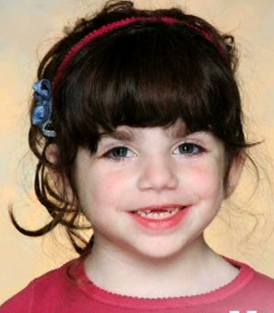
IMPACT of communication on Patients
CREDIT: Afrin story, www.king5.com/story/news/local/2014/08/04/13275082/

Slide 16
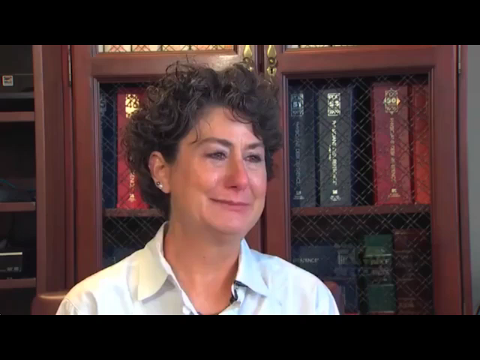

Slide 17
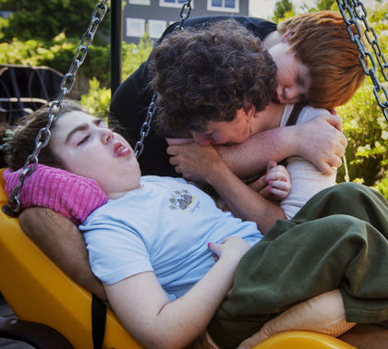
IMPACT of communication on team performance
“It still seems incomprehensible to her that such a seemingly minor thing – a brief miscommunication between two doctors…could have had such a disastrous impact…”
“Ironically, the University of Washington has been a pioneer in recognizing that communication is the ‘cornerstone of patient safety.”
“…failed in their duty to communicate with each other…”
“…it will take training…for the closed-loop style [of communication] to become ingrained in medical culture and the norm in all settings.”
*Source: Seattle Times
Notes:
Purpose of Slide: Provides context and UW Medicine connection to team communication and public perspective of communication.

Slide 18

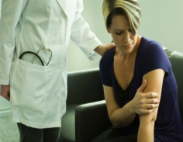

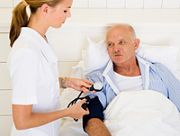

SBAR
SBAR:
A communication technique which provides a standardized framework to communicate about a patient’s condition. (Can also be referred to as ISBAR, where I stands for introductions)
INTRODUCTION
SITUATION
BACKGROUND
ASSESSMENT
RECOMMENDATION

Slide 19
sbar
Minti, a 58 year old female with a history of A-fib and hypertension arrives to the clinic (echo lab) as a new patient. She has been living in Spokane until recently and was inconsistent, according to her daughter, with compliance with her meds and attending her appointments. So, her daughter has recently had her move in with her in West Seattle.
Minti’s daughter, who serves as her mom’s interpreter, tells the front desk person that Minti has been lethargic and has had a cough for three days. The MA finishes rooming the patient and takes admit vitals which are: Temp 37.8, HR 122 and irregular, BP 178/98, Sats 88% and RR is 28. The mom appears to be having some difficulty breathing. Her daughter is concerned because she thinks her mom is not taking her meds consistently. She also has three children, which will make it hard for her to care for her mom.

Slide 20
Situation:
  A 58 year old woman has arrived hypertensive, is lethargic, has a cough and is short of breath
Background:
  She is a new patient who moved here from Spokane with hx of Afib and hypertension. Has been inconsistent with taking meds and attending appointments. Doesn’t speak English – daughter interpreting
Assessment:
  BP 178/98, Sats 88%, lethargic. HR 122 and irregular
Recommendation:
  Needs to be seen right away and we should consider transferring to ED

Slide 21
Review of SKILLS
100 Level Skills Request Call-Out Cross-Check Check-Back SBAR Brief |  | 200 Level Skills Huddle Debrief Handoff Cross- Monitoring STEP Task Assistance Shared Mental Model |  | 300 Level Skills CUS Two-Challenge Rule DESC I’M SAFE

Slide 22
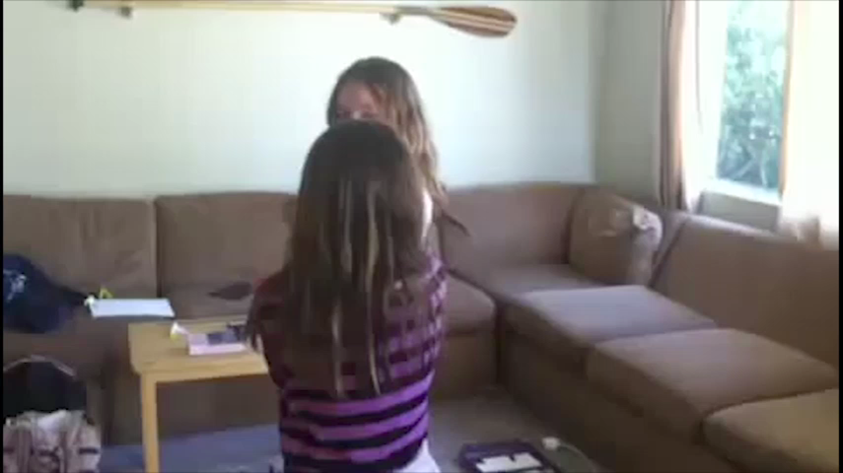
Shared mental model
CREDIT: TrustFall, https://www.youtube.com/watch?v=wPOgvzVoQig
Notes:
Demonstrates how one piece of information can make a difference in shared mental model

Slide 23
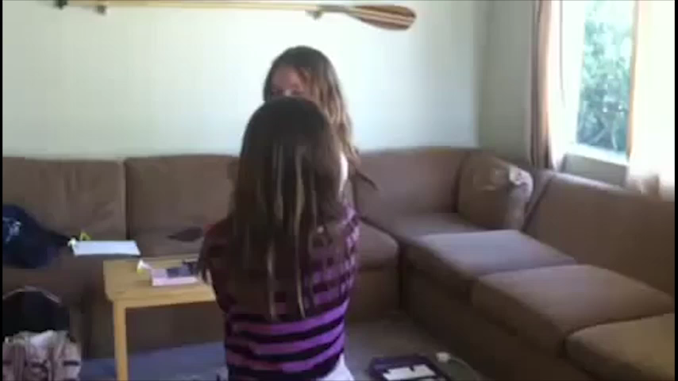

Slide 24
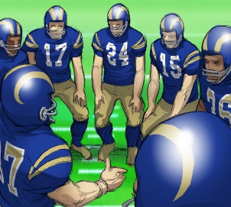
Leading teams
Briefs
  Short session to plan
  Assign roles, establish expectations, anticipate outcomes
Huddles
  Ad hoc planning to reestablish/reinforce and assess or adjust plans
Debriefs
  Information exchange after the action

Slide 25




Informational vs. Personal Conflict
≠
Personal Conflict
(Hostile and harassing behavior)
Information Conflict
(We have different information!)
CUS
Two-Challenge Rule
DESC script

Slide 26
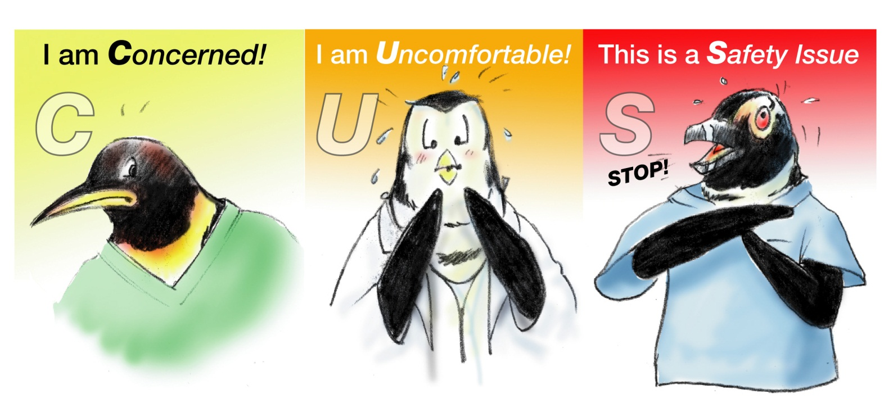
PLEASE USE CUS WORDS
I need Clarification

Slide 27
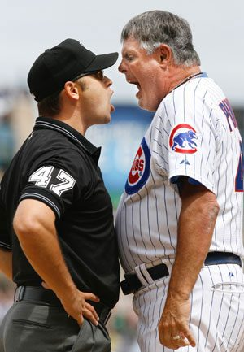
Two-Challenge Rule
Invoked when an initial assertion is ignored…
It is your responsibility to assertively voice your concern at least two times to ensure that it has been heard.
The member being challenged must acknowledge
If the outcome is still not acceptable
  Take a stronger course of action
  Use supervisor or chain of command
Designed to Stop The Line

Slide 28
Review of SKILLS
100 Level Skills Request Call-Out Cross-Check Check-Back SBAR Brief |  | 200 Level Skills Huddle Debrief Handoff Cross- Monitoring STEP Task Assistance Shared Mental Model |  | 300 Level Skills CUS Two-Challenge Rule DESC I’M SAFE

Slide 29

Thank you!
Tonya Martino tmartino@uw.edu

