Slide 1

Americans with Disabilities Act STATE OF THE SCIENCE
ADA National Network
April 13 – 15, 2021
#ADAStateOfScience

Slide 2

Disability & Implicit Bias Jill Bezyak, PhD Emily Shuman

Slide 3
Project Background and Research Questions
Employment opportunities for people with disabilities are limited.
Negative attitudes are the largest impediment to full inclusion of people with disabilities.
Addressing implicit bias provides an alternative approach to addressing negative attitudes.
Research Questions:
What are the effects of demographic characteristics on implicit bias toward individuals with disabilities?
What are the effects of implicit bias training on attitudes of HR professionals and employers toward individuals with disabilities?
Notes:
Develop and test an information, outreach, and support framework for individuals and families to plan for integrated employment.

Slide 4
Methodology
Data from Project Implicit was used to investigate automatic preference for people without disabilities with attention to demographic characteristics.
Project Implicit - https://implicit.harvard.edu/implicit/
Rocky Mountain ADA Center (RMADAC) created an implicit bias training which incorporated the Implicit Association Test (IAT).
Participants completed the IAT and explicit measures of employer stigma, acceptance of people with disabilities in the workplace, recruitment, and intention to hire before and immediately following the training.

Slide 5
Implicit Bias Training
Course Structure
Understand how social and cultural identity shapes our perceptions and attitudes.
Define implicit bias and understand its impact.
Learn about different types of implicit bias.
All unconscious biases fall into five categories
Decision-making bias
Belief bias
Behavioral bias
Social bias
Memory errors and bias
Discover strategies for mitigating bias in employment situations.

Slide 6
Findings
Results indicate men over 55 without a disability and people without a disability who are politically conservative and religious have higher automatic preferences for individuals without disabilities.
Over 300 individuals completed the training, and 180 of those people were in hiring or management positions (i.e. HR staff, supervisor, etc.)
High levels of employment stigma are related to negative attitudes toward disability, decreased support of recruitment efforts, and decreased intention of hiring people with disabilities.

Slide 7
What Can We Learn From The Findings?
Results provide support for the use of implicit association measures to assess latent attitudes toward people with and without disabilities.
Tailored interventions directed at specific areas of concern for employers may be most beneficial (e.g. implicit bias, recruitment, intention to hire, etc.)

Slide 8
Next Steps
Online training opportunities will more carefully target implicit bias and be extended to additional populations outside of employment.
Increasingly sensitive outcomes measures will be used in order to assess improvements and change over time.
Three-month follow-up assessments may provide an indication of change in implicit bias.

Slide 9

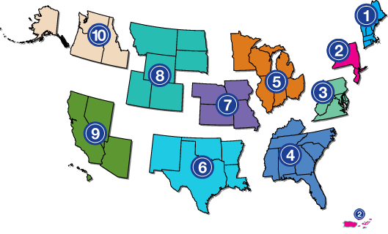
Project Partners
www.adata.org | 1-800-949-4232

