Slide 1

Americans with Disabilities Act
STATE OF THE SCIENCE
ADA National Network
April 13 – 15, 2021
#ADAStateOfScience

Slide 2
Access, Inclusion, and the Aftermath of 2020
Michelle Bishop

Slide 3
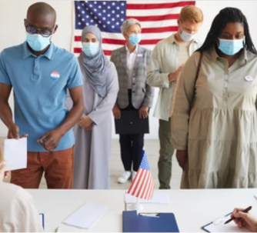
2020 had it all…
Wildfires
Civil unrest
The worst pandemic in 100 years
….and a Presidential Election that turned out a historic number of voters, six feet apart.

Slide 4

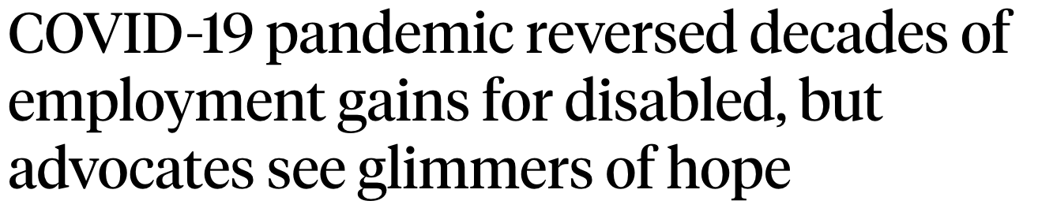

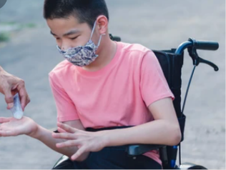
The promise of the ADA was tested
“Are we comfortable sacrificing this group in exchange for saving more lives?”
-Stuart Sherman,
During tenure as Executive Director of the New York State Task Force on Life and the Law

Slide 5
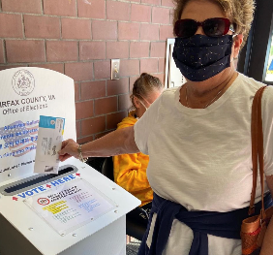
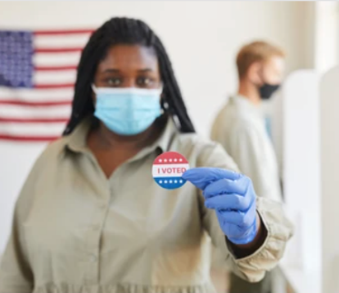

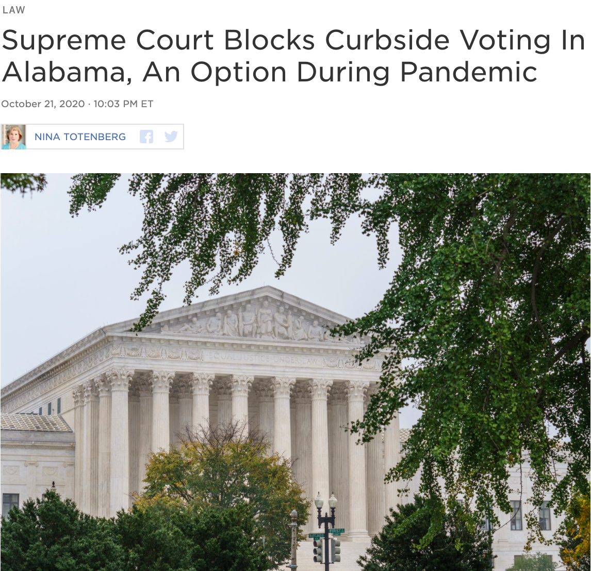

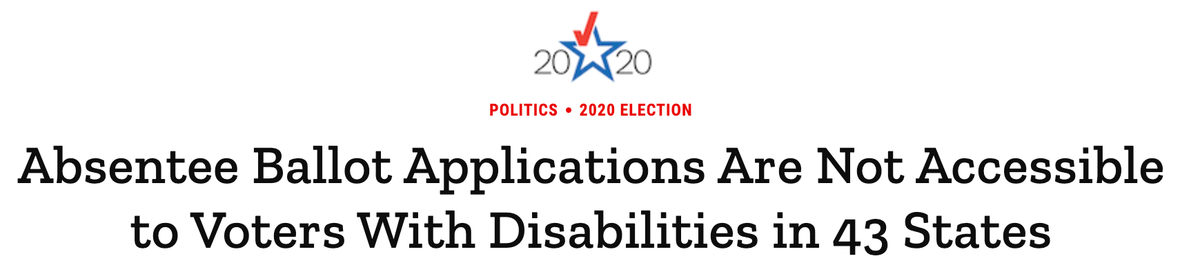

Access to the ballot was challenged

Slide 6
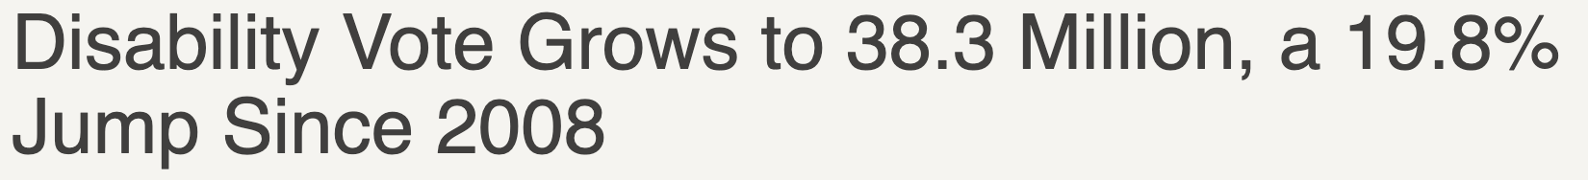
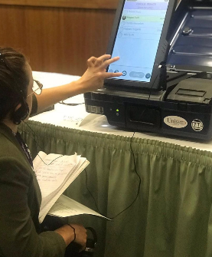

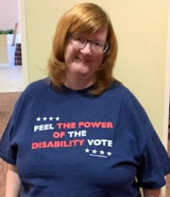



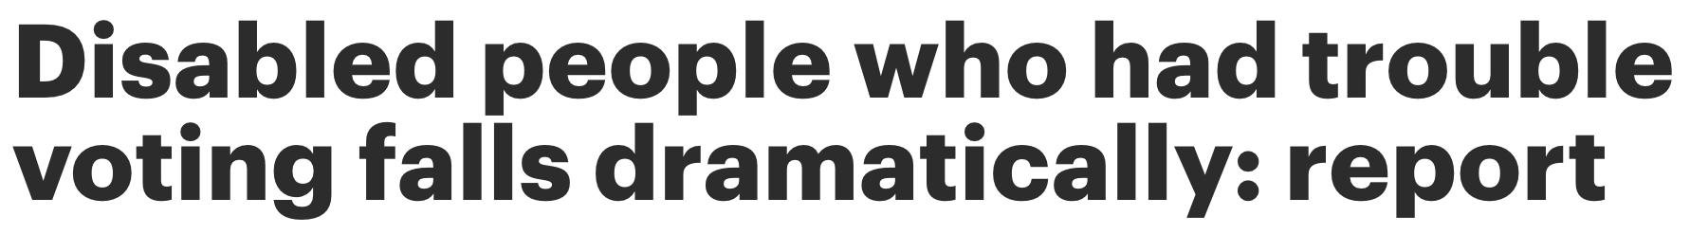
And yet, we persevered

Slide 7
Where do we go from here?
Everywhere.

Slide 8

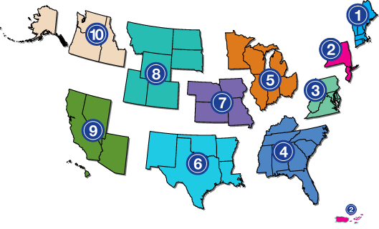
Project Partners
www.adata.org | 1-800-949-4232

