Slide 1

Americans with Disabilities Act
STATE OF THE SCIENCE
ADA National Network
April 13 – 15, 2021
#ADAStateOfScience

Slide 2
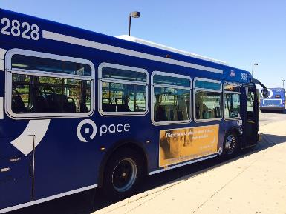
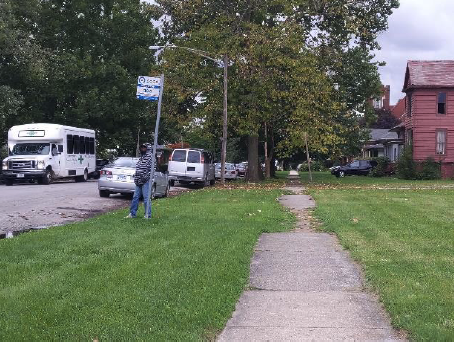
Bus Stops and Beyond: Connecting Riders to Transit Service in the Chicago Suburbs
Lindsay M. Braun, University of Illinois at Urbana-Champaign
Bumsoo Lee, University of Illinois at Urbana-Champaign
Jesus M. Barajas, University of California, Davis

Slide 3
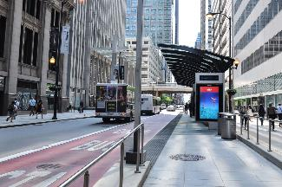
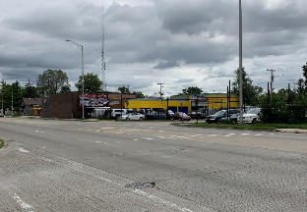
Pedestrian Access to Transit
Pedestrian infrastructure is critical to transit and overall mobility
ADA standards for transit focus on vehicles and stops/stations
  Less emphasis on the broader pedestrian network
Building pedestrian infrastructure is a challenge (especially in suburban areas) due to physical and institutional barriers

Slide 4
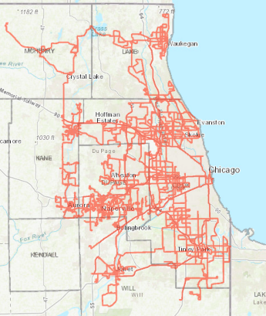
Chicago Suburbs: Context + Challenges
Served by Pace Suburban Bus
Large and diverse service area (6 counties, 284 municipalities)
Past efforts to improve pedestrian access have had limited success
What are the barriers to building pedestrian infrastructure near suburban transit services, and how can they be overcome?

Slide 5
Project Approach
Objectives | Methods
Document existing plans, policies, and funding sources | Document review, planner survey
Understand physical barriers to pedestrian access | Rider interviews, field audits
Understand barriers to project implementation | Stakeholder interviews (Pace, planners, engineers, advocates)
Examine the practices of other suburban transit agencies | Survey and case studies of peer agencies in 10 regions
Outcome: Policy recommendations for building pedestrian infrastructure near transit

Slide 6
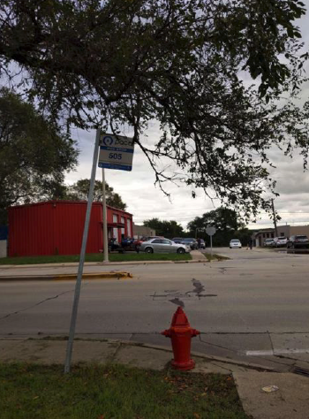
Physical Barriers: Sidewalks
Gaps in connectivity
Poor condition/maintenance
Obstructions
Inadequate separation from vehicles
“There are no sidewalks to walk across or the street that they are on are always busy. So it's hard to get to the stop. Some of them are not accessible to people with disabilities.”
Notes:
Outline: sidewalks, curb ramps, crosswalks, bus stops

Slide 7
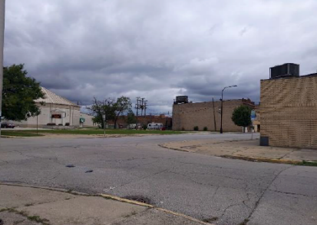
Physical Barriers: Crossings
Worn or unlabeled crosswalks
Missing/steep curb ramps
Lack of detectable warning materials
“The bus stop by my house, there is only one side of the street that you can walk across on safely, through a crosswalk, and the other side doesn’t have a crosswalk where the bus stop is. You have to walk all the way around, which could be, for someone [with a disability], a little bit more difficult.”
Notes:
Outline: sidewalks, curb ramps, crosswalks, bus stops

Slide 8
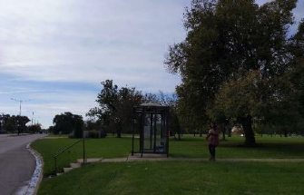
Physical Barriers: Bus Stops
Lack of shelters and seating
Limited lighting and signage
ADA accessibility issues
[We need] somewhere [we] can sit down comfortably and … wait there for the bus. You know how sometimes you have to sit there and stand? And I mean, there’s older people that can’t stand. … I’m a senior citizen, I know how that feels.
Notes:
Outline: sidewalks, curb ramps, crosswalks, bus stops

Slide 9
Implementation Barriers
Funding is a critical barrier to building pedestrian infrastructure
  Pedestrian funding remains limited and uncertain
  Ongoing maintenance costs are a barrier
  Many communities have difficulty funding required ADA improvements
Jurisdictional issues get in the way
  Responsibility is often avoided when state and local roads intersect
“They pawn it off on the state, because it’s Route 31. And then, they pawn it off on the city, but the sidewalks are crumbling and they’re tilting. … And it’s sad, because we have older people here. The director encourages people … not to go on those sidewalks.”
Notes:
Although attention to pedestrian issues is growing, …

Slide 10
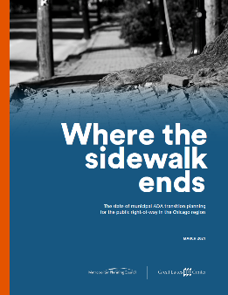
Implementation Barriers (continued)
There is often a lack of ADA compliance
  Only 11% of municipalities in the region have current transition plans
  Plan quality varies, with fewer than half providing public input opportunities and outlining a schedule for removing barriers
There is usually a lack of ADA centrality
  Advocates have to be the “squeaky wheel” in order to bring about change
  Accessibility is an “uphill battle” that repeats with every project and community
  Decision-makers have limited awareness of ADA-related issues and needs
Notes:
Although attention to pedestrian issues is growing, …

Slide 11
Selected Recommendations
Document existing infrastructure conditions
Conduct equity and accessibility analyses
Develop an “access to transit” plan
Planning
Build capacity for ADA compliance and emphasis
  Provide guidance, technical assistance, funding
  Shift approach from regulatory compliance to routine and meaningful integration
Encourage completion of ADA audits and transition plans
Policy
Notes:
Although attention to pedestrian issues is growing, …

Slide 12
Selected Recommendations (continued)
Implement a “Better Bus Stops” program
  Prioritize improvements, but ensure ADA accessibility
Review process for reporting stop issues
Bus Stops
Maintain list of pedestrian funding sources
Create platform for knowledge sharing
Develop training and awareness campaigns
Revise prioritization and funding formulas
Other
Notes:
Although attention to pedestrian issues is growing, …

Slide 13

Next Steps
Full report available at https://ict.illinois.edu/research/publications
Outreach to decision makers and advocates at the state, regional, and local levels to support implementation

Slide 14

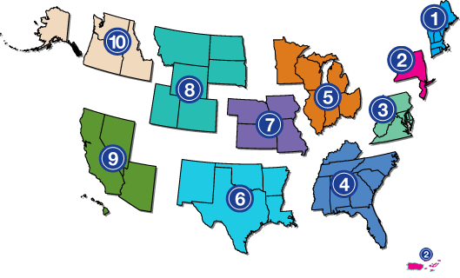
Project Partners
Thank you! For questions, please contact Lindsay Braun at lmbraun@Illinois.edu
www.adata.org | 1-800-949-4232

