Slide 1

Americans with Disabilities Act STATE OF THE SCIENCE
ADA National Network
April 13 – 15, 2021
#ADAStateOfScience

Slide 2
An elephant, an apple and million dollar lawsuits: synthesizing the strengths and limitations of current efforts to plan for pedestrians with disabilities
Yochai Eisenberg, PhD
Amy Heider, MS
Delphine Labbe, PhD
Rob Gould, PhD
Robin Jones, MS

Slide 3
Background
Pathways for walking and wheeling are important for people to get to the places they want to go to and to be a part of their community.
However, pathways that are broken or not built in ways that are easy for people with disabilities to use make walking or wheeling difficult.
Notes:
Develop and test an information, outreach, and support framework for individuals and families to plan for integrated employment.

Slide 4
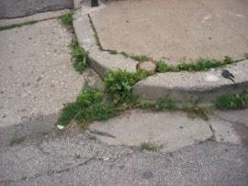
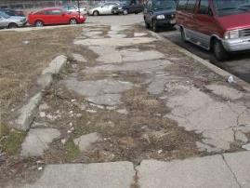
The Problem
The problem is that these barriers don’t seem to be going away.
Numerous class-action lawsuits highlight the enormity and wide-spread scale of the problem.
Our research on communities reporting barriers found that 65% of curb ramps and 48% of sidewalks were not accessible.
Notes:
Develop and test an information, outreach, and support framework for individuals and families to plan for integrated employment.

Slide 5
More Problems
Under Title II of the Americans with Disabilities Act (ADA), local public agencies are required to develop barrier removal plans for pathways, called ADA transition plans.
However, in our systematic review of plans, we found that only 13 % of communities in the US have plans for pathways and that the quality of the plans was not strong.
Plans that are low quality are not likely to be effective in making pathways more accessible.
Notes:
Develop and test an information, outreach, and support framework for individuals and families to plan for integrated employment.

Slide 6
What Did We Want To Know?
After learning about the lack of plans, we wanted to understand more about what goes into making a high-quality plan so that other communities that do not have plans can learn what they need to be successful.
We sought to learn from individuals who work in cities, towns and other local governments, called ADA coordinators about how they developed high-quality plans.
We wanted to answer: what are the community, organizational, and interpersonal factors that support the development and implementation of high-quality ADA transition plans for pathways?
Notes:
Develop and test an information, outreach, and support framework for individuals and families to plan for integrated employment.

Slide 7
Methods 1
We:
Identified municipalities who developed high-quality ADA transition plans
Recruited ADA coordinators and their teams
Conducted a one-hour interviews using a structured interview guide.

Slide 8
Methods 2
We:
Organized the findings from our interviews using a template that other researchers developed to study successful practices that organizations use when putting new services or interventions into practice.
This template, called the Consolidated Framework for Implementation Research (CFIR), helped us organize the successful practices of ADA coordinators into categories that are important for carrying out a plan effectively.
Notes:
Consolidated Framework for Implementation Research (CFIR)

Slide 9
Findings 1
Organizational change is needed to build support and buy-in for the plan and implementation
Notes:
First Organizational change is needed to build support and buy-in for the plan and implementation

Slide 10
Inner setting
“It's not just a block on a checklist, right? That's not what the intent of the ADA is in my opinion, it's a complete philosophy change in the way that we look at and treat other people. It’s a sense of awareness that someone who might have a disability still has the same rights and accessibility to everything that we provide as a city.”
“It’s amazing how a 30-year-old law requires so much handholding and educating, but yeah, that is consistently being reinforced.”
Notes:
IN the Inner Setting domain of the CFIR, here is an example quote: “It's not just a block on a checklist, right? That's not what the intent of the ADA is in my opinion, it's a complete philosophy change in the way that we look at and treat other people. It’s a sense of awareness that someone who might have a disability still has the same rights and accessibility to everything that we provide as a city.”

Slide 11
Findings 2
Organizational change is needed to build support and buy-in for the plan and implementation
Involvement of people with disabilities in planning
Notes:
Involvement of people with disabilities in planning was key

Slide 12
Implementation process
“And they're instrumental in us developing the plan. We communicate to them what the plan is and where they really got into the meat of the plan was how we're addressing our barriers in our transition plan and what we're prioritizing.”
Notes:
Here is an example of the implemendation process domain - “And they're instrumental in in us developing the plan. We communicate to them what the plan is and where they really got into the meat of the plan was how we're addressing our barriers in our transition plan and what we're prioritizing.”

Slide 13
Findings 3
Organizational change is needed to built support and buy-in for the plan and implementation
Involvement of people with disabilities in planning
Experience/training of ADA coordinators
Notes:
Finally, the Experience/training of ADA coordinators is crucial

Slide 14
Characteristics of ADA Coordinators
“I understand it, I grew up near Berkeley, so I know about the independent Living Movement.”
Notes:
Here is an example of characteristics of ADA coordinators: “I understand it, I grew up near Berkeley, so I know about the independent Living Movement.”

Slide 15
Findings 4
Organizational change is needed to built support and buy-in for the plan and implementation
Involvement of people with disabilities in planning
Experience/training of ADA coordinators
Just get started and adapt to your community!
Notes:
Finally, the Experience/training of ADA coordinators is crucial

Slide 16
Adaptability
“Eat the elephant one bite at a time, take baby steps. Okay. What is the first thing you need to do? And then, when you do that, find someone, for example, for me, it was, let's get this data collection. Let's try an engineer. But for other communities, that don't have that money. We've gotta get this data collection. Let's find a partner with our schools or our volunteer groups to make this happen."

Slide 17
Findings 5
Organizational change is needed to built support and buy-in for the plan and implementation
Involvement of people with disabilities in planning
Experience/training of ADA coordinators
Just get started and adapt to your community!
But be strategic and realistic
Notes:
Finally, the Experience/training of ADA coordinators is crucial

Slide 18
Executing
“My recommendation to any community, regardless of size, getting ready to take on an inventory is, it's not productive for them to take the approach that they're gonna eat the Apple all at one time... Taking it and manageable pieces is reasonable for everyone, right? And it goes back to that concept of good faith."

Slide 19
What Can We Learn From The Findings?
Communities that have not developed plans or with lower-quality plans can learn important lessons from those with high-quality plans.
Certain resources, networks, and voices can help support communities in creating high-quality plans.
Creating a high-quality plan means the whole organization needs to change.

Slide 20
Next Steps To Strengthen The Study’s Findings
We want other communities to learn from these successful communities.
We plan to share our research findings in various forms, including on the internet and through case studies.
Our aim is for more communities to use the successful practices that were identified in this study to develop high-quality ADA transition plans and ultimately more accessible communities.

Slide 21

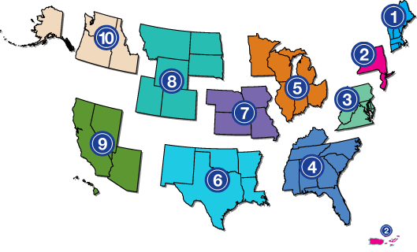
Project Partners
www.adata.org | 1-800-949-4232

