Slide 1

Americans with Disabilities Act STATE OF THE SCIENCE
ADA National Network
April 13 – 15, 2021
#ADAStateOfScience

Slide 2
The Road to Work: Youth with Disabilities and their Views on Employment and the ADA
Ellen Fabian, PhD, University of Maryland
Ann Deschamps, EdD, Mid-Atlantic ADA Center

Slide 3
What is the current context of CIE and youth with disabilities?
Laws, such as the ADA and the Workforce Innovation and Opportunity Act (WIOA) of 2014 are enacted to improve access and opportunity to competitive integrated employment for all people with disabilities; and WIOA has specific provisions for youth.
Bureau of Labor Statistics(BLS) data before COVID-19 show disparities in labor force participation of youth with disabilities compared to their counterparts; and the pandemic only increased the disparity.
BLS 2021 data show a 30 percentage point difference in labor force participation for youth ages 20-24 (40.1% vs. 70%).
Studies indicate youth with non-apparent disabilities, and those with poor self-advocacy skills, among other factors, are less likely to request workplace accommodations (Lindsay, Cagliostro & Carafa, 2018) under the ADA.
Notes:
Develop and test an information, outreach, and support framework for individuals and families to plan for integrated employment.

Slide 4
Method
The purpose of this qualitative study was to explore perceptions of a cross-sample of youth with disabilities regarding employment-related barriers, and knowledge/utilization of Title I protections to address them
We conducted five focus groups in three different states using a variety of recruitment sources (e.g., LEAs, ILCs, and state VR)
42 youth participated; 52% from racial/ethnic minorities; 55% were male; and 60% were ages 18-21
Intellectual/developmental disability was the most frequently identified; followed by mental health (emotional and behavioral disorders, anxiety disorders), and learning disability
Youth were recruited from various sources; and screened by staff for eligibility

Slide 5
Procedures
Each focus group had two facilitators from the research team, and was conducted over 60-90 minutes
Each participant completed an informed consent and a demographic/background survey (anonymous)
Focus groups were audio-recorded and transcribed
Focus groups were conducted from fall 2018 to fall 2019
The protocol included 9 questions, such as:
What is the ADA?
What is an accommodation?
What are your experiences in getting a job?
Have you requested workplace accommodations?
Youth who completed the focus group received a $25.00 gift card, and a packet of information on the ADA

Slide 6
Findings
Five themes emerged from analysis of over 300 pages of focus group transcripts
Themes were categorized as barriers or facilitators to employment
Barriers
Stigma - employers have negative attitude about disability
Disability/health condition – creates performance issues; but reluctant to request accommodations
Anxiety – easier to request academic accommodations; anxiety about requesting job accommodations
Supports/Facilitators
Coworkers/supervisors who ‘step in’ and help-out
Self-management behaviors (coping with generalized anxiety/stress at work)
Workplace accommodations (customizing jobs; job coaches)

Slide 7
What Can We Learn From The Findings?
In schools and other settings – pair information about the ADA with that of 504 accommodations, or even IDEA services to address gaps in knowledge
Increase emphasis on self-advocacy training with specific focus on workplace accommodation benefits, managing requests, and understanding the “interactive process” of job accommodation requests
Make sure ADA messages, messengers and methods are congruent with cultural competence and needs of minority youth
Notes:
Youth from racial/ethnic minorities were highly represented in our sample; and access to quality jobs are even more disparate for these youth –

Slide 8
Next Steps To Strengthen The Study’s Findings
Conduct pilot interventions using rigorous research methods to evaluate the most effective practices to increase transitioning youth knowledge and use of the ADA that can inform outreach, training and technical assistance across stakeholder groups
Conduct research on the demand side by soliciting feedback from employers regarding youth employment and ADA requests in the workplace in order to identify employer recommendations and practices associated with positive request outcomes

Slide 9

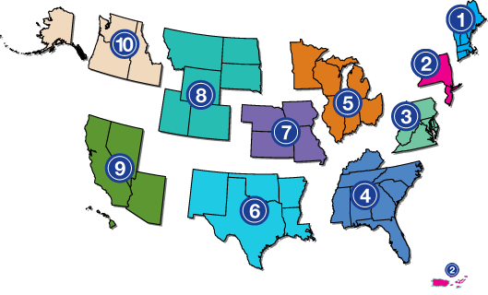
Project Partners
www.adata.org | 1-800-949-4232

