Slide 1

Americans with Disabilities Act
STATE OF THE SCIENCE
ADA National Network
April 13 – 15, 2021
#ADAStateOfScience

Slide 2
Participation, Accessibility, and Aging with Physical Disability
Michelle Putnam, PhD, School of Social Work, Simmons University, Boston, MA
Kerri Morgan, PhD, School of Medicine, Washington University, St. Louis, MO
Additional authors: Margaret Campbell PhD, Marian Keglovits OTD OTR/L,
Rachel Heeb OTD OTR/L, Szu-Wei Chen PhD, Susan Rice MSOT/S & Susy Stark, PhD

Slide 3

What did we want to know?
To develop a better understanding of the interaction of aging, disability, and participation over time.
To understand if changes are related to growing older, their functional ability, factors in their community - such as accessibility, services and supports that help them to participate or other personal or community resources – or all three.
Longitudinal Study of Aging with a Long-term Physical Disability
www.ceadermidwest.org
Notes:
Develop and test an information, outreach, and support framework for individuals and families to plan for integrated employment.

Slide 4
Why did we want to know it?
People aging with long-term physical disabilities are an understudied population
  Aging with a physical disability: people living with the long-term effects of physical disabilities acquired from birth to middle-age who are surviving into mid- and late life (Verbrugge & Yang, 2002; Molton et al., 2012; Iezzoni et al., 2014)
  When the aging process begins: as they age, people with physical disability start reporting greater difficulty associated with their main condition starting closer to ages 45-55 (Verbrugge & Yang, 2002; Molton et al., 2012; Verbrugge et al., 2007)

Slide 5
Method: Multi-year internet/phone survey
Cohort participants
Survey questions/measures
Inclusion criteria
  45-65 years of age
  Physical disability for 5+ years
  English-speaking
Exclusion criteria
  Cognitive impairment that precludes accurate self-report or ability to answer survey questions
Recruitment
  Community-based research network, social media
  N=475 at Year 1
    Survey repeated at 2 and 3 years.
Demographics
Health
Participation
Resources
  Including supports & services
Environment

Slide 6
Findings – Participants reported a wide range of health conditions/impairments
Primary disability
Demographics
Most frequently reported condition contributing to disability
  Musculoskeletal
  Neurological
  Immunological
Average age: 56.8
Average number of years with disability: 19.1
36% non-White participants
65% women
35% income of $10,008 or less
  68% receive SSDI
60% have disability leave; 18% employed; 10% retired; 3% seeking work

Slide 7
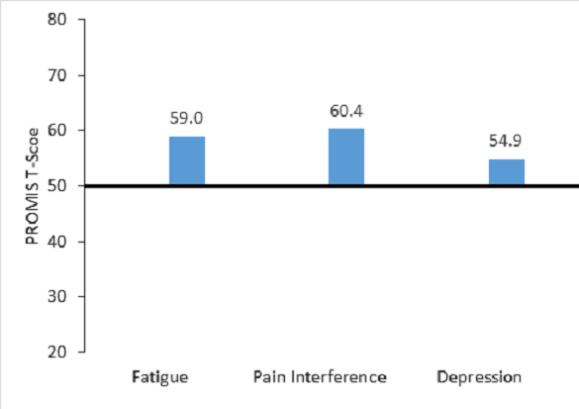
Findings – The cohort reported three common aging symptoms higher than the general population.
General population average is 50
All levels are much higher than reported in the general population
Notes:
A score of 50 is the average for the United States general population with a standard deviation of 10. A higher PROMIS t-score represents more of the concept being measured; ^{b} NIH Toolbox Instrumental Support Scale; 8-item scale, uses a 5 point Likert-type scale, summed. ^{c} UCLA Loneliness is generally groups people who score 3 – 5 as “not lonely” and people with the score 6 – 9 as “lonely”; ^{d} The Pittsburgh Sleep Quality Index is a 19-item self-rated questionnaire for evaluating subjective sleep quality over the previous month. Seven component scores are added to obtain a global score ranging from 0–21, with higher scores indicating worse sleep quality
NIH Toolbox Instrumental Support Survey Description: This self-report measure assesses instrumental support for ages 18-85, using an 8- item fixed-length form. No versions for other ages are available. Scoring Process: Each item administered has a 5-point scale with options ranging from “never” to “always.” The survey is scored using IRT methods. An IRT-derived theta score is generated for each participant, which is then converted to Toolbox Age-Adjusted, Fully Adjusted and Unadjusted Scale Scores for PROs – Mean of 50, SD of 10 – as well as a national percentile rank that corresponds to the age-adjusted scale score. The Unadjusted Scale Scores are provided in a column labeled T-Score on the Assessment Scores output file (see Appendix B4). Interpretation: For the NIH Toolbox Instrumental Support Survey, higher scores are indicative of more reported support. Scores 1 SD or more below the mean (T ≤ 40) suggest low levels of instrumental support and scores 1 SD or more above the mean (T ≥ 60) suggest high levels of instrumental support. T-scores ≤ 40 may warrant heightened surveillance or concern. Additional work remains to examine the predictive and concurrent validity of these measures and to identify clinically meaningful thresholds.
http://www.healthmeasures.net/images/nihtoolbox/Training-Admin-Scoring_Manuals/NIH_Toolbox_Scoring_and_Interpretation_Manual_9-27-12.pdf
https://nihtoolbox.my.salesforce.com/sfc/p/#2E000001H4ee/a/2E000000Ub7C/9UzNbxkwc9khhqKaYkXmAYUVZaniThvUkA16Ddkp6eY

Slide 8
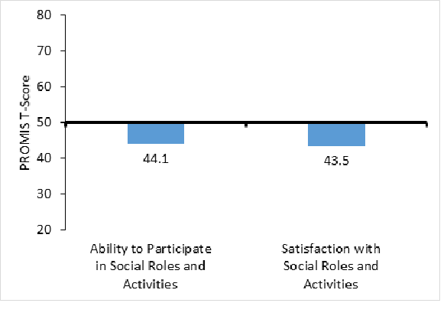
Findings – The cohort reported participation scores in social roles and activities lower than the general population.
General population average is 50
All levels are lower than reported in the general population
Participants with lower scores more often live alone, have less income, worse physical and mental health
Notes:
A score of 50 is the average for the United States general population with a standard deviation of 10. A higher PROMIS t-score represents more of the concept being measured; ^{b} NIH Toolbox Instrumental Support Scale; 8-item scale, uses a 5 point Likert-type scale, summed. ^{c} UCLA Loneliness is generally groups people who score 3 – 5 as “not lonely” and people with the score 6 – 9 as “lonely”; ^{d} The Pittsburgh Sleep Quality Index is a 19-item self-rated questionnaire for evaluating subjective sleep quality over the previous month. Seven component scores are added to obtain a global score ranging from 0–21, with higher scores indicating worse sleep quality
NIH Toolbox Instrumental Support Survey Description: This self-report measure assesses instrumental support for ages 18-85, using an 8- item fixed-length form. No versions for other ages are available. Scoring Process: Each item administered has a 5-point scale with options ranging from “never” to “always.” The survey is scored using IRT methods. An IRT-derived theta score is generated for each participant, which is then converted to Toolbox Age-Adjusted, Fully Adjusted and Unadjusted Scale Scores for PROs – Mean of 50, SD of 10 – as well as a national percentile rank that corresponds to the age-adjusted scale score. The Unadjusted Scale Scores are provided in a column labeled T-Score on the Assessment Scores output file (see Appendix B4). Interpretation: For the NIH Toolbox Instrumental Support Survey, higher scores are indicative of more reported support. Scores 1 SD or more below the mean (T ≤ 40) suggest low levels of instrumental support and scores 1 SD or more above the mean (T ≥ 60) suggest high levels of instrumental support. T-scores ≤ 40 may warrant heightened surveillance or concern. Additional work remains to examine the predictive and concurrent validity of these measures and to identify clinically meaningful thresholds.
http://www.healthmeasures.net/images/nihtoolbox/Training-Admin-Scoring_Manuals/NIH_Toolbox_Scoring_and_Interpretation_Manual_9-27-12.pdf
https://nihtoolbox.my.salesforce.com/sfc/p/#2E000001H4ee/a/2E000000Ub7C/9UzNbxkwc9khhqKaYkXmAYUVZaniThvUkA16Ddkp6eY

Slide 9
Findings – Physical activity
59% of participants were physically active, reporting reported fewer secondary conditions and greater social participation than participants who were not physically active.
  66% of all participants wished they could do more physical activity, including 76% of those saying they didn’t do any.
What participants said would help them most included: personal assistance, environmental modifications, improved health, assistive technology.

Slide 10

Findings - A balance of intrinsic and extrinsic factors impact the community participation of people aging with long-term physical disabilities
Extrinsic
Intrinsic
- Intrinsic factors
(1357 mentioned instances) include body structures and function, symptoms, and mental and emotional state
- Extrinsic factors
(1407 mentioned instances) include physical, social, temporal, economic, and political environments

Slide 11
Findings - COVID-19 pandemic and mental health
Sub-sample (N= 186)
Analyzing this data now – initial indicators are that:
  Small percent of participants have been diagnosed with COVID-19
  Most participants are engaging in social distancing
  There is increased food insecurity
  Notable change in their ability to complete ADLs due to lack of available human assistance

Slide 12
What Can We Learn From The Findings?
Many of our study cohort members are not satisfied with their social roles or ability to participate in social activities.
Most wish they could engage in more physical activity than they currently do.
There are both intrinsic and extrinsic factors that affect their ability to participate in a range of activities.
  Physical environment and technology play a notable role.
The pandemic is effecting daily living activities.

Slide 13
Next Steps to Understanding the Study’s Findings?
To continue to analyze our Wave 1 data and to begin to analyze Wave 2 to understand changes in participation
Take a deeper look into issues of accessibility as well as services and supports that facilitate participation and engagement
  Expect that the COVID-19 pandemic will change participation in ways that we did not anticipate when we began data collection
    As we continue to collect and analyze data, we will attempt to understand how this unexpected and historical event is shaping what people aging with disability do and how accessibility affects their ability to do the things they want to do

Slide 14

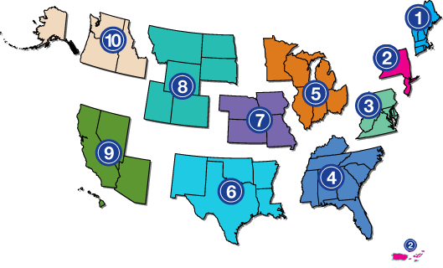
Project Partners
www.adata.org | 1-800-949-4232

