Slide 1

Americans with Disabilities Act STATE OF THE SCIENCE
ADA National Network
April 13 – 15, 2021
#ADAStateOfScience

Slide 2

The National Equal Employment Opportunity Commission Americans with Disabilities Act Research Project (NEARP): Key Findings and Ongoing Studies Related to Workplace Discrimination
Phillip Rumrill, Ph.D., CRC
University of Kentucky
Human Development Institute
Phillip.Rumrill@uky.edu

Slide 3
Long Before COVID-19, NEARP Started in 2003 as a Public Health Research Community of Practice that Perceives Workplace Discrimination as an Insidious and Un-American Virus
Given health and life outcome disparities between employed and unemployed people, employment of people with disabilities is a national public health concern
The disability community, the American economy, and society as a whole are healthier when people with disabilities participate in the labor force
Workplace discrimination against people with disabilities is a common threat to labor force participation, and therefore a threat to public health
To eliminate the public health threat of workplace discrimination, we must study it and understand its etiology, symptoms, spread, protective and inhibiting factors, and overall impact

Slide 4
The NEARP Collaborative: 2003 – Present
97 published studies in press or in print
101 different co-authors from 25 universities
12 dissertations completed
Over $6 million in research support
Currently operated by the University of Kentucky, EEOC, and the National Opinion Research Center at the University of Chicago—with funding from the National Multiple Sclerosis Society

Slide 5
NEARP and the EEOC’s Integrated Mission System Database: More than 1.1 Million Unique and Closed ADA Title I Allegations between Mid-1992 and 2020 (28.5 years)
Charging Party Characteristics
Age in years
Gender
Race/ethnicity
Impairment type
Issues
41 actions that are prohibited by ADA Title I
Often categorized as job acquisition (e.g., hiring, application procedures, postings), working conditions (e.g., terms of employment, benefits, harassment, intimidation), and job retention (e.g., discharge, promotion, constructive discharge, reasonable accommodation)
Employer Characteristics
Size – number of employees
Location – state, region
Industrial classification
EEOC Resolution (Outcome)
Merit – favors charging party – discrimination did occur
Non-merit – favors employer – allegation of discrimination was not upheld

Slide 6
NEARP Researchers Examine…
Characteristics of employers and charging parties
Differences in discrimination experiences between and within impairment groups
Issues (type of discrimination)
Predictors of merit case resolutions
Discrimination patterns over time

Slide 7
Important Finding #1: Predicted Tsunami of Title I Allegations Following ADA Amendments Act of 2008 Did Not Occur
Slow and steady increase since 2009
Similar pattern to that observed in employment allegations under the Civil Rights Act
An employer with 1000+ employees (2% of all employers) has a 1:4800 risk of being named in an ADA Title I allegation in any given year

Slide 8
Important Finding #2: The Big Five Issues Represent 84% of All Allegations
Discharge (Firing) – 34%
Reasonable Accommodation – 19%
Hiring – 11%
Terms/Conditions – 10%
Harassment/Intimidation – 10%

Slide 9
Important Finding #3: Employers Prevail at a 3:1 Ratio in ADA Title I Allegations
Overall merit resolution rate – 24%
Overall non-merit resolution rate – 76%
People with hearing loss and vision loss have highest merit rates – approximately 30% each
People with substance use disorders have lowest merit rates – 18%

Slide 10
Important Finding #4: Charging Parties with Intellectual Disabilities, Brain Injuries, and Hearing Loss Have Highest Rates of Harassment/Intimidation Allegations

Slide 11
Important Finding #5: Charging Parties with Substance Use Disorders & Mental Illness have Highest Rates of Discharge Allegations

Slide 12
Important Finding #6: Charging Parties with Speech Impairments, Burns, Amputations, and Disfigurement have the Highest Rates of Hiring Allegations

Slide 13
Important Finding #7: Charging Parties with Chronic Health Conditions have the Highest Rates of Reasonable Accommodation Allegations

Slide 14
Important Finding #8: Impact of Labor Unions
Adjusted for total population in each state, for every 100 ADA Title I allegations in union security states there are 160 allegations in right to work states

Slide 15
NEARP’s Recent and In-Progress Studies
Hearing loss x vision loss
Age x multiple sclerosis
Learning disability x other disabilities
Age x cancer
Pre/post ADAAA x multiple sclerosis
Alcohol abuse x drug abuse
Anxiety/stress disorders x other disabilities
Regional profiles, 5 studies of 2 regions each

Slide 16
Thank You for Your Time and Attention – Collaboration Welcome!

Slide 17

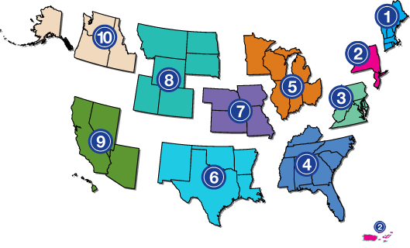
Project Partners
www.adata.org | 1-800-949-4232

