Slide 1

ADA State of the Science
Research Conference
Day 2: March 12, 2026
Presented by the ADA National Network

Slide 2
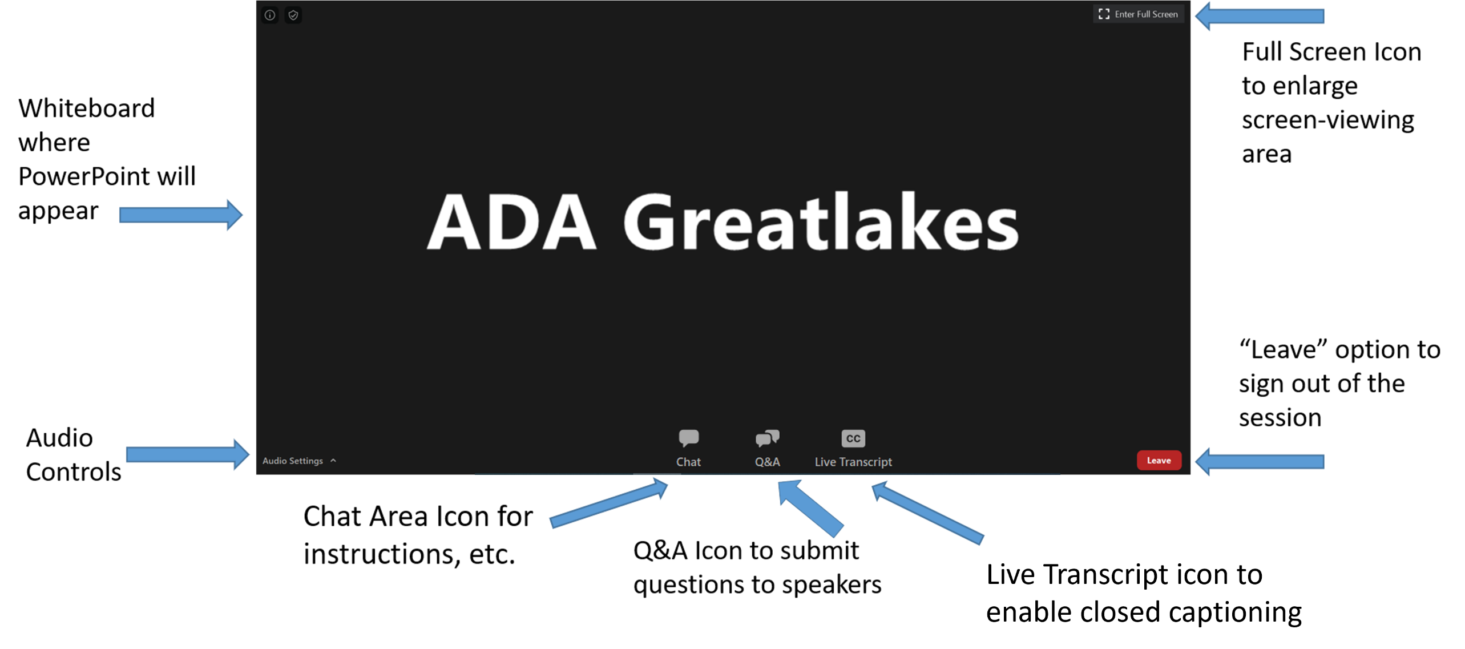
ZOOM WEBINAR Interface

Slide 3
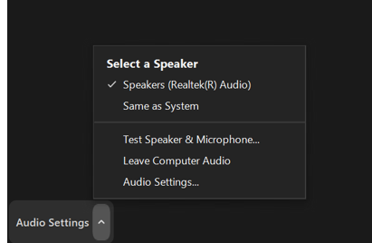
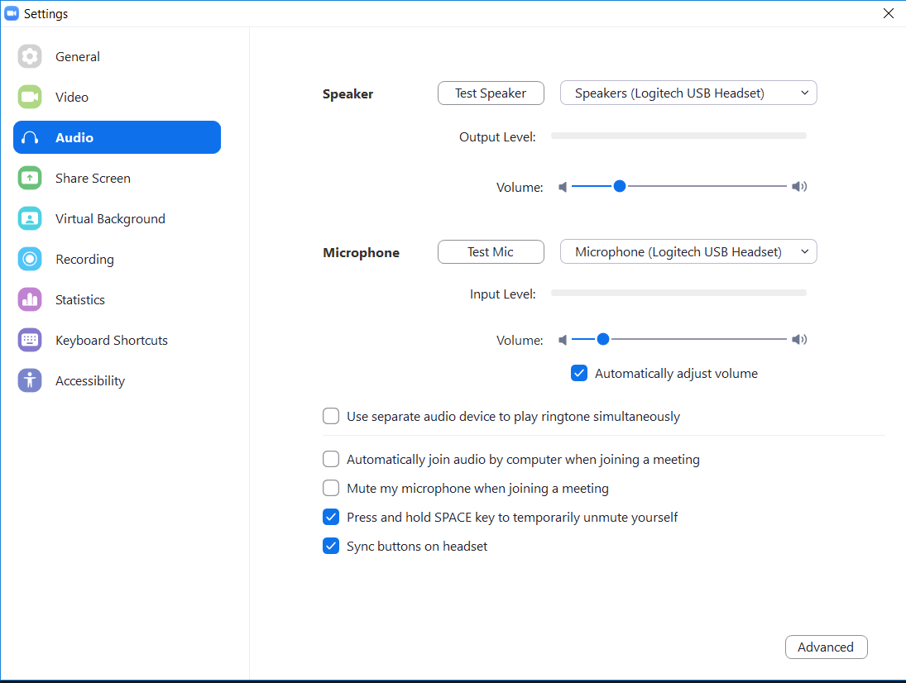
Listening to the Webinar via Your Computer
Please make sure your speakers are turned on or your headphones are plugged in.
You can verify your audio settings using the Audio Settings Option in the lower left corner of the screen.
You can adjust your volume using the Audio Settings option.

Slide 4
Real-Time Captioning
  Real-time captioning is provided both within Zoom Text and via StreamText Link. Individuals may make their own choice of which to utilize based on preference. StreamText Link will be shared in the Chat area.
  If using StreamText link you will need to open a separate browser to view the captioning. You can resize your screen so that you are able to view both the StreamText and the Zoom platform if you are using a desktop computer.
  Zoom has upgraded their Captioning program. You can now mouse over and “Move” the captioning box anywhere on your screen that you desire it to be.
  Within Zoom you can choose to view the full transcript by moussing over the cc icon and selecting “View Full Transcript” option.

Slide 5
Video Sign Language Interpreter
Sign Language is being provided via Video Spotlight
There will be two Sign Language Interpreters. They will be “swapping” their images as they switch interpreters during the session. This will cause a “pause” or brief interruption in the Sign Language.
Individuals can change their view of the Sign Language Interpreter on a desktop/Laptop computer by choosing the “Swap Video and Shared Screen” option from your viewing options menu. Tablet and Phone options for viewing the video will differ depending on the device.

Slide 6
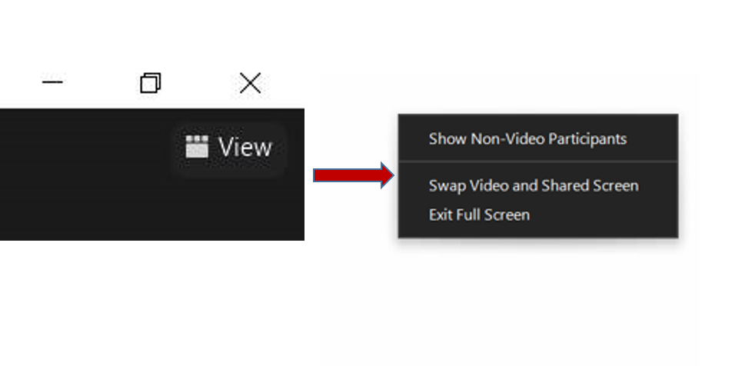
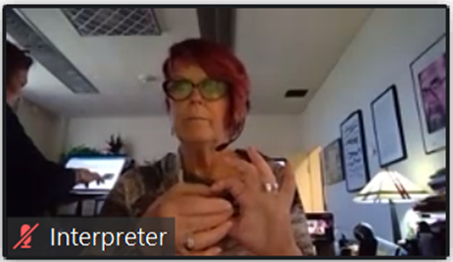
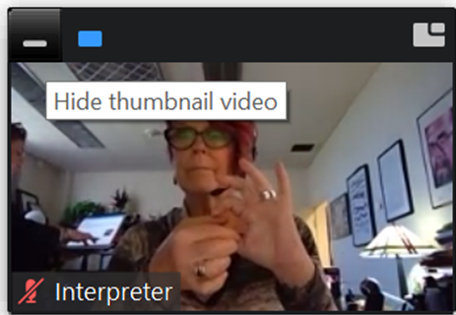
Changing Screen View
To change your View so that you see the full video image on your screen (Sign Language Interpreter) select “Swap Video and Shared Screen”.
To enlarge the image of the Sign Language Interpreter, mouse over the edge of the video box and once the double-ended arrow appears, stretch the image to the desired size.
To hide video, click on the “underline” symbol found in the upper left corner of the video

Slide 7
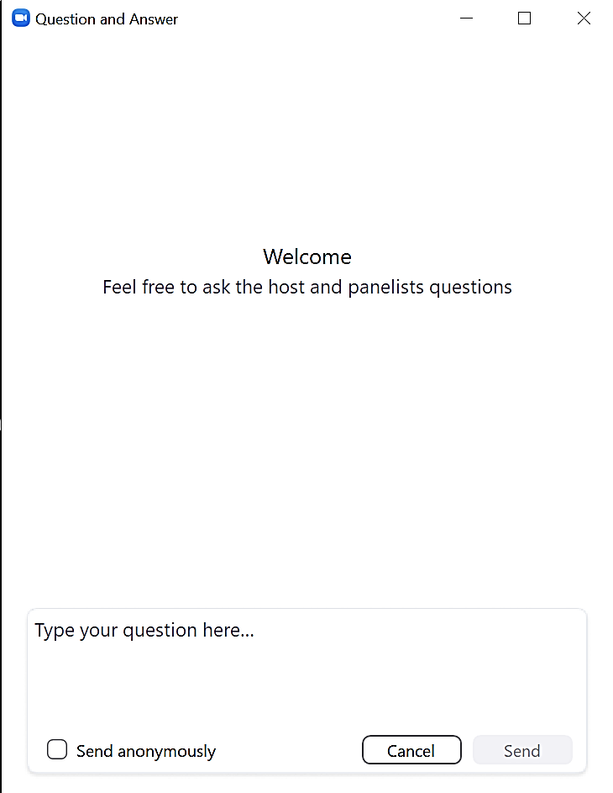
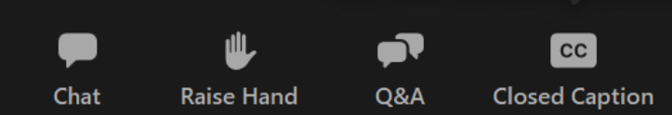
Submitting Questions
Questions should be submitted via the QUESTION AREA (ICON). You will have the option to submit your question “anonymously.”
DO NOT submit questions in the Chat Area. We will not be monitoring it for questions.
Please refrain from submitting any commentary, responses, etc. via the chat area. This is distracting to other participants. We reserve the right to remove you from the session if you use the chat area inappropriately.
If you are listening on the phone and are not connected to the webinar platform, email your questions to webinars@adaconferences.org

Slide 8
Welcome to the 2026 ADA State of the Science Research Conference
Day 2

Slide 9
Funding Statement and Disclaimer
Funding Statement:
This conference is coordinated by the ADA Knowledge Translation Center with support from the ADA National Network Research Committee, and funded through the National Institute on Disability, Independent Living, and Rehabilitation Research (NIDILRR) (NIDILRR grant number 90DPAD0004). NIDILRR is a Center within the Administration for Community Living (ACL), Department of Health and Human Services (HHS).
Disclaimer:
The views and opinions expressed in this conference are those of the speakers and do not necessarily reflect the views, positions, or policies of any entities they represent, the ADA Knowledge Translation Center, the ADA National Network, the University of Washington, or the federal government. Statements, views, and opinions expressed during any presentation or in any materials are those solely of the presenter. The information and assistance provided is not legal advice.

Slide 10
Overview of Day 2
Session A: Health and Society.
  Four lightning presentations.
  Moderator summary.
  Questions and answer period.
Break.
Session B: Community Needs and Access.
  Four lightning presentations.
  Moderator summary.
  Questions and answer period.
Day 2 wrap-up.

Slide 11
Health and Society

Slide 12


Improving accessibility of hospital facilities using immerging computational methods
Research Team
  Jong Bum Kim, Ph.D. kimjongb@missouri.edu
  Janna Lancaster, Ph.D. (PI)
  Debora Verniz, Ph.D.
  Rabia Faizan, Ph.D.
  Md Obidul Haque, Ph.D. candidate
  Nora Hong-Yi Shih, Ph.D. student
Region 7
  Great Plains ADA Center (Director: Julie Brinkhoff)
  Architectural Studies, University of Missouri

Slide 13
Purpose & Method
Project description
  Promote a barrier-free healthcare environment and improve user experiences through evidence-based design and computational code compliance methods.
Purpose
  Identify common barriers to physical accessibility at healthcare facilities in the region, and common strategies used to overcome them.
  Understand how accessibility barriers impact the hospital experience.
  Study how computational analysis methods can identify accessibility issues from the design stage.
Method
  Survey of individuals with disabilities
  Focus group with stakeholders
  Software Creation and Computational Analysis
  Architectural Observation and Analysis

Slide 14
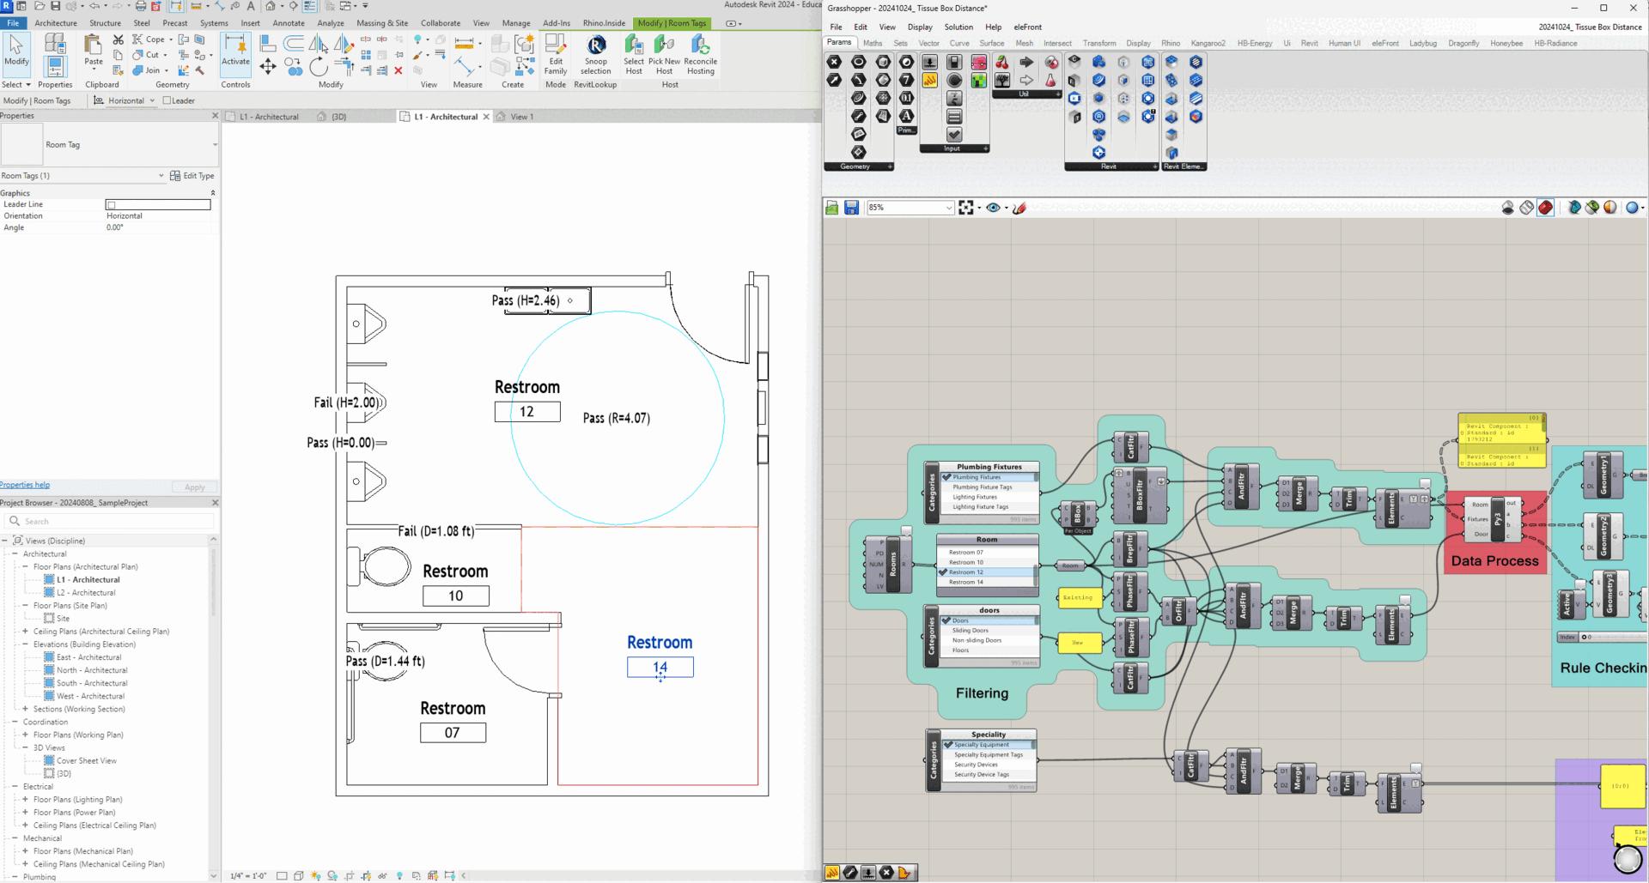
Results and Findings
Key takeaways
  Computational Compliance Checking methods were studied.
  Applications embedded in the design platform (Autodesk tools) can help designers with ADA compliance checking and design changes.
  Reduced and/or eliminated time and error-intensive interpretation and use of ADA standards in healthcare design.
  Great potential to be paired with AI/ML methods.
Future directions
  Investigate an integration of AI/ML methods for computational compliance checking.
  Expand the research findings to outdoor space
  More rigorous usability test and broader dissemination
Publication and presentations
  NARST 2026
  CAADRIA (2026 Taiwan, 2025 Tokyo, 2024 Singapore)
  IDEC 2025 (Chicago)
  University of Missouri RCAF 2025 (Third place in Social and Behavioral Sciences)
  Disability-focused Research Showcase, University of Missouri
  Show Me Research Week 2025, 2024 (First place in Applied Design)

Slide 15

Access to Quality Health Services under the ADA
Pacific ADA Center, Region 9 - PI, Jerri Davison (Email: jerrid@adapacific.org)
Presenter and Project PI: Rosielyn Babauta, DNP, MS,RN-BNCP (Email: rbabauta@triton.uog.edu)
Project team (University of Guam):
  Kristine Qureshi, PhD, RN, FAAN, CEN, PHNA-BC, CGNC (Co-PI)
  Megan Broadbent, BSN, RN (Research Coordinator)
  Tera Blas, BSN, RN – (Research assistant)
  Michael Cajigal, BS (Research assistant)
  Grazyna Badowski, PhD (Statistics Consultant)

Slide 16
Project Summary
Purpose
To examine the access to quality healthcare for people with disabilities by healthcare workers.
To develop strategies to reduce barriers to healthcare access under the ADA.
Setting: ADANN Region 9 (Arizona, California, Guam, Hawaii, and Nevada).
Methods
  Phase 1 Qualitative data with healthcare workers, people with disabilities, and caretakers (N=59).
  Phase 2 Online surveys with healthcare workers, people with disabilities, and caretakers (N=757).
  Phase 3 Member checking and development of action items with subsample of participants (N=27).
Action and Dissemination
  Developed RN education curriculum for people with disabilities: Lecture plus disability expert panel discussions, simulation scenarios, and community outreach.
  12 conferences presentation at various academic and community-based venues.
  Peer review publications (in progress).

Slide 17
Findings & Recommendations
Barriers experienced by healthcare workers
Recommendations to increase access for people with disabilities
Lack of education and knowledge
Lack of technology (medical, communication, telehealth)
Financial and administrative policies (CPT, Dx coding)
Significant time constraints of clinicians
Negative attitudes of disability
Physical environment- space & egress
Transportation to/from point of care
Include disability specific training within healthcare workers education
Policy advocacy to increase regulation and funding for technology, communication equipment and telehealth services
Further research on clinician time and different types of disabilities
Enforcement of existing regulations regarding space and egress
Education of people with disabilities and caretakers about their rights under the ADA

Slide 18

Findings from ADA PARC:
Using Scorecards to Compare States on Participation Opportunities
Joy Hammel, University of Illinois Chicago, CoPI ADA PARC; hammel@uic.edu
The ADA PARC consortium of ADA Centers and Community Collaborators
ADA PARC website available at: https://adaparc.shinyapps.io/ADA_PARC/
The work of this Center was developed under a grant from the National Institute on Disability, Independent Living, and Rehabilitation Research (NIDILRR grant numbers 90DP0026 and 90DPAD0001). NIDILRR is a Center within the Administration for Community Living (ACL), Department of Health and Human Services (HHS). The contents of this presentation do not necessarily represent the policy of NIDILRR, ACL, HHS, and you should not assume endorsement by the Federal Government.

Slide 19
Purpose & Method (ADA PARC)
Purpose:
  To test a methodology for creating scorecards that disability communities and policymakers can use to compare and rank states on participation opportunities in specific areas.
Method:
  Using data from the ACS, multiple indicators of participation are standardized using Z scores, and converted to a 0-100 score, similar to a score card or report card.
  Higher scores = higher participation opportunity. Lower scores = worse opportunity.
  These disability participation scorecards are an easy to understand way to compare and rank states from best to in the middle (average) to worst.

Slide 20
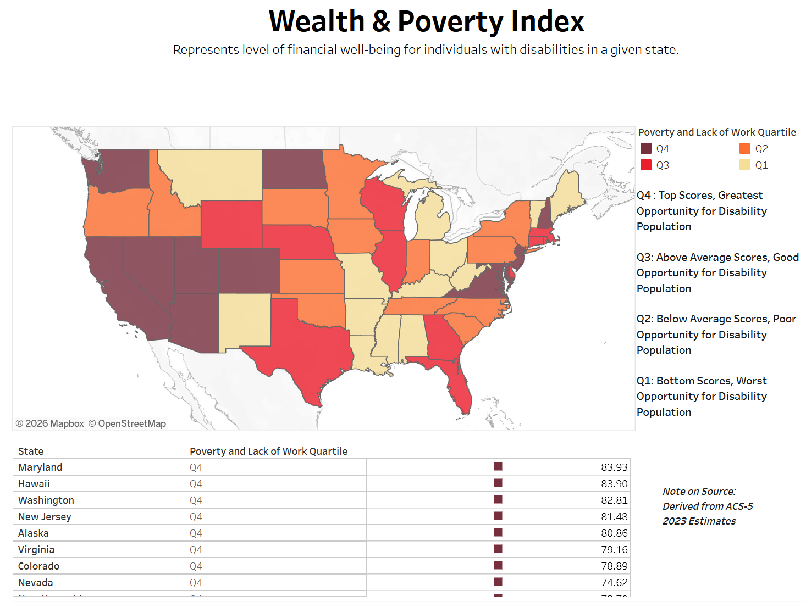
Economic Scorecard
(accessible table available at: https://adaparc.shinyapps.io/ADA_PARC/#section-scorecards)

Slide 21

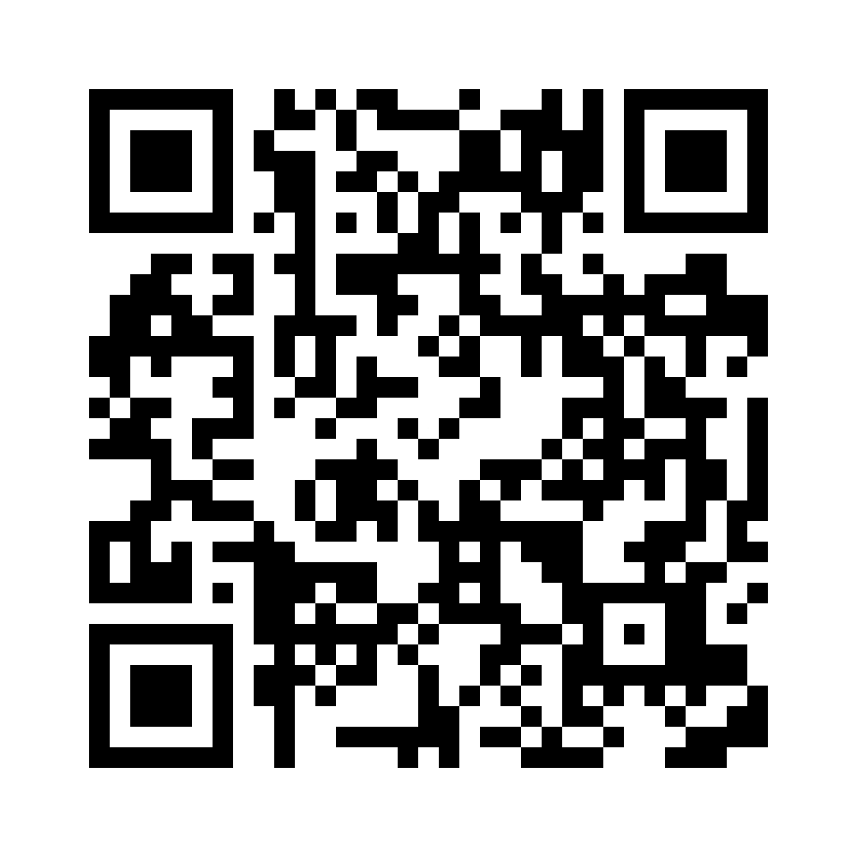
Family Support Research and Training Center
Sumithra Murthy, PhD
smurthy@uic.edu
https://linktr.ee/fsrtc

Slide 22








Overview
FSRTC advances research, policy, and practice that support family caregivers of people with disabilities across the lifespan.
Research Projects
R1 | Strive to Thrive: Supporting Families across the Aging and Disability Networks
R2 | Future Planning for Adults with Developmental Disabilities and Aging Families
R3 | WAVE Program: Wellness Action Via Engagement for Older Family Caregivers
R4 | Analysis of National Datasets on Family Support
R5 | Policy Analysis and Development to Improve Family Support
Website | fsrtc.ahs.uic.edu
Webinars | Family Support Topics (Partnership with IDHD/LEND/TAP) Supportng Families Best Practice Series (Partnership with UMKC) Self-Advocate Family Support Webinars (Partnership with SABE)
Podcast | “Family Support Stories” go.uic.edu/FamilySupportStories Available on Spotify & other platforms
Social Media | @FSRTC_UIC facebook.com/FamilySupport ResearchandTrainingCenter linkedin.com/company/fsrtc
Newsletter | go.uic.edu/FSRTCNewsletter

Slide 23

Key Takeaways
Results are ongoing:
Research Activities/Findings
R1 | Environmental scan revealed barriers and facilitators to thriving for people with IDD The thriving of family members was interconnected
R2 | Working with Area Agencies on Aging to deliver virtual future planning intervention
R3 | Developing a health promotion curriculum for aging family caregivers
R4 | Report “Family Caregiving Counts” released November 2025
R5 | First workgroup met to discuss family caregiving policy
Dissemination and Other Activities
Webinars | Conducted 5 webinars, 4 Supporting Families Best Practice Webinars 1 Self-Advocate Webinar 3 upcoming webinars on 2/11, 2/24, & 2/26
Podcast | Released 5 bi-monthly episodes
Social Media | Regularly post on topics relevant to family caregivers
Newsletter | Sent 13 newsletters to relevant stakeholders, these are delivered monthly
Conference Presentations | Presented at NARRTC, Charting the Lifecourse, and AUCD Conferences in 2025 More anticipated in 2026

Slide 24
Moderator Summary:
Health and Society
Moderated by: Kara Ayers

Slide 25
Q&A
Health and Society

Slide 26
Break
Time to stretch!

Slide 27
Community Needs and Access

Slide 28



Current Needs of ADA Coordinators Among Title II Entities
Dr. Jill Bezyak
Dr. Brian Phillips
Emily Shuman
Abigail Lister
Contact Information: Dr. Jill Bezyak, jill.Bezyak@unco.edu

Slide 29
Purpose and Method
This project involved a careful investigation of Title II entities related to the implementation of self-evaluations and transition plans (SETPs).
The specific purpose was to identify the needs and barriers related to the implementation of SETPs to create increasingly accessible environments for people with disabilities.
Following exploratory focus groups to design the quantitative survey, 181 ADA coordinators completed the web-based survey.

Slide 30
Results
Primary barriers to implementation include limited time available for ADA coordination, numerous outside responsibilities, limited staff, and limited training.
Participants did report high levels of support from leadership.
Identified needs of ADA coordinators include training for ADA coordinators and leadership, as well as the development of professional networks.

Slide 31
Access to Justice: A Review of ADA Notice Requirements on State Court Websites
Heather D. Evans, PhD
Research Director for NW ADA Center
hdevans@uw.edu
NW ADA Center Study Co-Authors:
Katie Warden, JD, PhD
Kaitlin Spidell

Slide 32
Research Question & Method
RQ: Do courts post meaningful notice of right to accommodations on their public facing websites? If so, do they provide instructions on how to request accommodations?
Data: Examined a “best case scenario” - WA State passed its own law to standardize how to post this info on their court websites
Method:
Developed “coding protocol” (form) to use to assess how easy it is to find this info
Reviewed and completed form for all 178 WA State court websites
Summarized information collected from websites

Slide 33
Key Findings & Recommendations
Findings
Recommendations
Only 36% of courts posted any ADA-related information on their websites; 64% had no information at all
Only 22% of court websites listed contact information for ADA inquiries and access questions
Less than 2% of courts provided instructions on grievance procedures for appealing concerns related to an accommodation request.
Courts who listed an ADA Coordinator on their website were 32 times as likely to provide accommodation request instructions
Designate and publicize an ADA Coordinator for each court
Create a dedicated ADA accommodations webpage with clear, consistent, and descriptive labels
Include essential information such as definitions, eligibility, request instructions, forms, and appeal/grievance procedures
Ensure websites and forms meet WCAG 2.1 Level AA standards
Provide ongoing ADA training for all court staff and professionals

Slide 34


Accessible Cities 4 All: Where are we?
Yochai Eisenberg, PhD
Delphine Labbe, PhD
Rob Gould, PhD
Robin Jones, PhD
Department of Disability and Human Development at the University of Illinois at Chicago
Email: yeisen2@uic.edu
Website: https://www.adagreatlakes.org/Research/AccessibleCities.asp

Slide 35
The Challenge
Cities
Disability advocates
Focused on compliance
May not want to know about infrastructure problems
Lack of knowledge and resources
Accessibility is an underprioritized problem until it isn’t.
Want change yesterday
Want to share lived experience and have it valued
Have lawsuits as tool to defend civic rights when advocacy does not work and are using that tool!

Slide 36
State of Research:
State of Cities
State of Civic Engagement
13%
had an ADA transition plan
Cities need resources:
Quality Assessment of Transition Plans
Casebook examples of high-quality transition plans
Performance metrics
Story map to help tell the story internally
Need for training and onboarding resources
Developing knowledge around accessibility and policy
Developing communication and social skills
65%
of curb ramps had barriers
Accessibility scores were higher for communities with plans compared to those without.

Slide 37
The built environment, social connection, and ways of knowing in disabled peoples’ campaigns for accessibility in Chicago
Kara M. Mannor; kmannor@umich.edu

Slide 38
The built environment isn’t a neutral
It actively shapes the conditions of everyday life and who belongs in cities
What does it mean for disabled people to claim belonging in a city?
This is a knowledge translation question:
  Requires exploring how the built environment shapes the conditions of everyday life and how it shapes the processes through which people try to change it

Slide 39
For everyone?: Rethinking universality in practice
Disabled advocates frame built environment interventions that would benefit many groups as opportunities for:
  Connection through specificity
  Shared social life
For other stakeholders advocating “for everyone” becomes a way to:
  Avoid engaging disability and disabled people
  Frame access as an individual-level problem and stall structural change
These tensions matter because they help us understand:
  How universality is contested in translating knowledge to action
  How the built environment shapes whose knowledge counts

Slide 40
Moderator Summary:
Community Needs and Access
Moderated by: Heather Ansley

Slide 41
Q&A
Community Needs and Access

Slide 42
Wrap-up

Slide 43
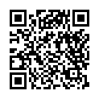
Thank you for attending the 2026 ADA State of the Science Research Conference!
Please remember to fill out your evaluation.
  Click the link in the chat or
  Scan the QR code.
To watch presentation recordings or see the slides:
  Visit the conference webpage www.adata.org/sos-2026.
  Recordings will be uploaded to the webpage in the next few weeks.

