Slide 1

Americans with Disabilities Act
STATE OF THE SCIENCE
ADA National Network
April 13 – 15, 2021
#ADAStateOfScience

Slide 2
Financial Inclusion of People with Disabilities: “Objective” Indicators and Subjective Experiences
Meera Adya, Pam Williamson, Barry Whaley, Michael Morris

Slide 3
What Did We Want To Know?
Our program of research includes 3 studies examining the issue of financial inclusion for people with disabilities broadly speaking:
How are people with disabilities able to access and benefit from financial services through banks, credit unions, and alternative financial service providers?
How does the financial service community engage in local communities? What barriers do individuals with disabilities face that are unique or exacerbated?
How is this impacted by geographical availability?
Notes:
Study A – objectively understand financial inclusion: a quantitative, structured assessment and intervention study to assess and improve financial institutions’ accessibility of facilities, communications, and financial services and programs.
Study B – subjectively understand financial inclusion: a qualitative study that uses semi-structured interviews to probe the experiences of people with disabilities who use mainstream and alternative financial services programs across SE communities.
Study C – contextually understand financial inclusion: a spatial analysis of the locations of mainstream and alternative financial service programs in SE communities to examine geographical inaccessibility.

Slide 4
Method
Study A: Development of QI-FIT
Our Goal:
  Understand the benchmarks of effective financial services provision from experts.
  Convert the benchmarks to a standardized list of quality indicators.
Our Guiding Principles:
  Experts are those providing services.
  Experts are those using services.

Slide 5
Method
Study A: Development of QI-FIT (Continued)
Step One
  Checklists
  Best Practice Reports
  Government Standards
  Prior Research/Studies
  Individual Experiences and Ideas
Step Two
  Eliminate overlap (SE ADA)
  Reframe/reword to serve as indicator (SE ADA)
  Sort into categories (SE ADA and PAR)
  Rate importance and utility in 2 rounds: (PAR)
    Each person individually
    As a panel (subcommittees)

Slide 6
Method
Study A: QI-FIT
48 indicators in 8 categories
  Strategy and Internal Leadership,
  Accessibility in Customer Support and Communications,
  Physical Accessibility and Customer Support,
  Traditionally Delivered Banking Products and Financial Services,
  Financial Education and Counseling,
  Inclusion and Disability Relations Group,
  Inclusive Community Development, and
  Alternative Credit Scoring and Lending

Slide 7
Method
Study A – Application of QI-FIT
82 banks’ & credit unions’ websites in 8 states
2 Groups:
  PAR Teams in each state
  SU Research Assistants
    2 RAs will do comprehensive review of all using same keywords
Status and Preliminary Process Findings
  Some researchers found more information than others
  PAR researchers found experience valuable
  Banks would not allow site visits
    Also analyzing notes from discussion with regional bank executives in accessibility
Notes:
Challenges:
Getting permission to visit banks in-person to conduct research
Finding comprehensive information on websites (particularly for internal policies and practices on websites designed to be customer-facing and for smaller banks with less robust websites in general)

Slide 8
Preliminary Analyses
Looking at just “yes/no” for found information we created total scores for each of the 8 QI-FIT categories
We examined which category scores were higher between rural versus urban financial institutions and banks versus credit unions

Slide 9
Preliminary Findings
There is variation in information found for 2 of the QI-FIT categories of:
  “Accessibility in Customer Support and Communications”
  and
  “Financial Education and Counseling.”

Slide 10
Preliminary Findings (continued)
Accessible customer support and communications was scored higher (more relevant information available) for rural financial institutions as compared to urban ones and for banks as opposed to credit unions.
Financial education and counseling was scored higher (more relevant information available) for urban financial institutions as compared to rural ones and for credit unions as opposed to banks.

Slide 11
What Can We Learn From The Findings?
In general, because these are public-facing websites information about a financial institutions’ policies and practices for its employees or community engagement activities are difficult to determine.
In terms of information about its services and practices relevant to customers, information was generally easier to find, but local and regional banks often had limited information in comparison to larger, national banks.
This seems obvious, but local and regional banks offer personalization and “community” to customers and the relative dearth of information for people with disabilities who may have particular needs related to access or specialized financial needs leaves them with a paucity of information, is disenfranchising, and ultimately creates a disparate experience.

Slide 12
Next Steps To Strengthen The Study’s Findings
Round out data collection:
  PAR process meant organic process of looking for information on websites – when comparing sites, how do they fare when same search terms are used?
  Institutions did not allow site visits/discussions with staff to find missing information – what are regional financial institutions doing w/r/t the QIFI?

Slide 13

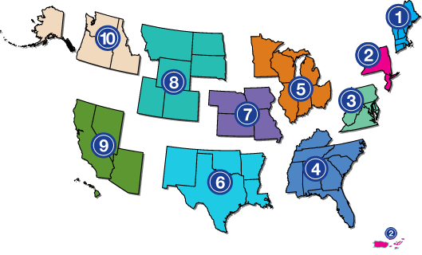
Project Partners
www.adata.org | 1-800-949-4232

