Slide 1
Americans with Disabilities Act STATE OF THE SCIENCE
ADA National Network
April 13 – 15, 2021
#ADAStateOfScience

Slide 2
Acknowledgements
The work of this Center was developed under a grant from the National Institute on Disability, Independent Living, and Rehabilitation Research (NIDILRR grant numbers 90DP0026 and 90DPAD0001). NIDILRR is a Center within the Administration for Community Living (ACL), Department of Health and Human Services (HHS). The contents of this presentation do not necessarily represent the policy of NIDILRR, ACL, HHS, and you should not assume endorsement by the Federal Government.

Slide 3
Translating Participation Disparities Findings into Community Action Reports: Findings from the ADA PARC project
Joy Hammel: UIC & ADA PARC
Jacqueline Kish: UIC & ADA PARC
Robin Jones: Great Lakes ADA Center, UIC & ADA PARC
Brian Tomkins: Metropolitan Mayors Caucus

Slide 4
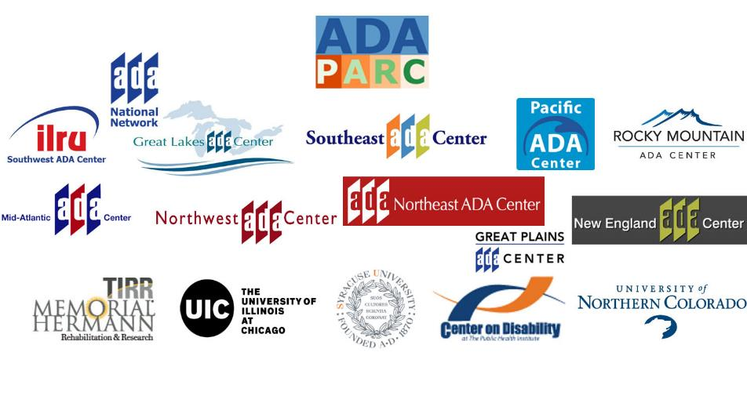
ADA Colaborators

Slide 5
What Did We Want To Know?
Participation disparities people with disabilities experience 30+ yrs. since the passage of the ADA
Community living (CL) Community vs. institution living, HCBS spending, Money Follows the Person Transitions
Community participation (CP) Health care access, affordable & accessible housing, access to community & disability resources, transportation, crime rates, livability indicators, education access
Work/economic participation(WE) Employment, economic status, poverty rates, cost of living
Notes:
Develop and test an information, outreach, and support framework for individuals and families to plan for integrated employment.

Slide 6
What Did We Want To Know? (Cont.)
Partnered with Metropolitan Mayors Caucus & Great Lakes ADA Center to better understand the needs and issues facing people with disabilities in this region
MMC represents 275 cities, towns and villages throughout Chicagoland region
Diverse stakeholders such as mayors, politicians, policy makers, government, urban planners, transportation, social services & disability groups
In a strong position to effect systems changes in their communities and across the region
Notes:
Develop and test an information, outreach, and support framework for individuals and families to plan for integrated employment.

Slide 7
Method
Used appreciative inquiry participatory action approach to identify participation issues and strengths in communities, vision dreams and aspirations, and set concrete action goals
MMC chose diverse communities to feature
Chicago, IL
Naperville, IL
Arlington Heights, IL
Hazelcrest, IL
Invited key stakeholders to participate in community forums
ADA PARC gave short presentation on participation disparities
Comparing people with and without disabilities
Comparing at national, state and city levels
MMC facilitated breakout groups to strategize how to use findings and prioritize actions to address disparities
ADA PARC generated community reports for MMC to bring back to the full caucus for action

Slide 8
Community Disparities Reports (#1)
 | % With a Disability
Naperville | 7.4%
Arlington Heights | 12.3%
Hazel Crest | 13.6%
Chicago | 12.4%
Illinois | 13.2%
United States | 15.1%
Notes:
No disability Employment ~70-80%
No disability Not in Labor Force ~14-21%

Slide 9
Community Disparities Reports (#2)
 | % People with Disabilities: Employed | % People with Disabilities: Not in Labor Force
Naperville | 48.0% | 42.9%
Arlington Heights | 49.7% | 43.9%
Hazel Crest | 31.1% | 56.8%
Chicago | 30.8% | 61.85%
Illinois | 36.6% | 56.9%
United States | 36.2% | 58.4%
Notes:
No disability Employment ~70-80%
No disability Not in Labor Force ~14-21%

Slide 10
Community Disparities Reports (#3)
 | % Living Below Poverty: Disability | % Living Below Poverty: No Disability
Naperville | 12.5% | 3.7%
Arlington Heights | 16.3% | 3.3%
Hazel Crest | 32.2% | 11.4%
Chicago | 34.5% | 15.7%
Illinois | 26.3% | 10.9%
United States | 26.7% | 11.7%
Notes:
Below poverty indicates income that is insufficient to meet minimal food and other basic needs.
2018 Weighted Average Thresholds: One person $12,784; Four people: $25,701

Slide 11
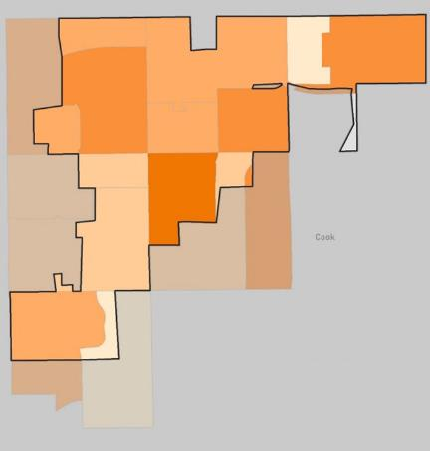
Community Disparities Reports (#4)
Where do people with disabilities live in Hazel Crest, IL?
Population: 16,314
Persons over 18 with disability: 2, 168 (13.3%)
Higher % living in north and middle communities

Slide 12
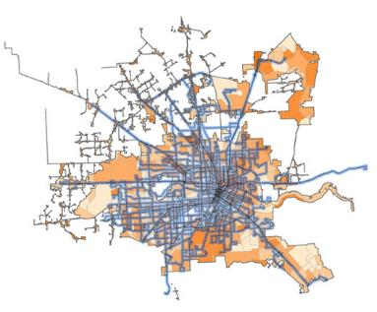
Community Disparities Reports (#5)
Chicago Bus: 99% Coverage for PWD Houston Bus: 71% Coverage for PWD

Slide 13
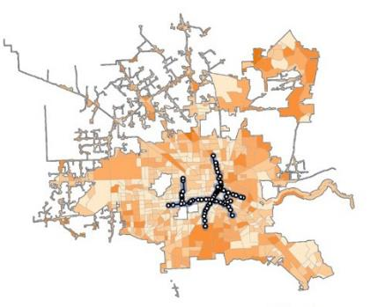
Community Disparities Reports (#6)
Chicago Train: 49% Coverage for PWD Houston Train: 10% Coverage for PWD

Slide 14
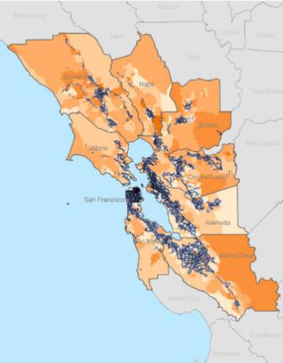
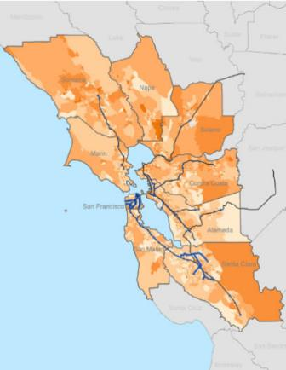
Community Disparities Reports (#7)
Regional Bus Coverage for SF Bay Area : 97% Regional Rail Coverage: 32%

Slide 15
Community Disparities Reports (#8)
Community Action Planning: Break-out Groups 1. What areas of participation are high priorities to address in your community/city and to people with disabilities in it? 2. How could you use the ADA PARC data in your community to improve participation opportunities and decrease disparities experienced by people with disabilities? 3. How can we all work together to create communities that have equitable participation opportunities for people with disabilities?

Slide 16
Findings
Transportation Actions
Need regional transportation maps as most people travel across region- can ADA PARC generate these?
Identify transit gaps and “black holes” where disparities exist and who they affect most across region
Evaluate coordination between and among transit services across region with transportation agencies
Champion communities that are addressing accessibility and access to share across 275 communities in Mayors Caucus
Other Participation Actions
Affordable, accessible and integrated housing across a community
Access to key resources in communities (e.g., healthy food, internet, centers for independent living, civic and community sites)
Access to low cost/free community participation opportunities
Social isolation and participation
Employment & post secondary education strategies

Slide 17
What Can We Learn From The Findings?
Need for community reports like these across all MMC communities so can action plan and leverage resources and power across MMC
Need to continue collaboration between ADA PARC, ADA Centers and Mayors Caucus to plan, executive and document action outcomes and impact
Need to coordinate with transportation, housing and city planner organizations to share info publicly
Need to involve disability rights communities and diverse constituents in these forums and actions

Slide 18
Next Steps To Strengthen The Study’s Findings
Update ADA PARC website so communities can get this city and neighborhood level info easily and quickly as infographics
Create an online format for holding and documenting community forums
Generate community reports for any cities interested in joining the consortium
Redo the transportation survey, oversampling in these cities so they get consumer perspectives
Replicate this appreciative inquiry approach with cities throughout ADA regions
Evaluate action outcomes and impact across cities that participate and add these to our website as examples

Slide 19
Thank you to all of our ADA PARC consortium collaborators and participants, including the Metropolitan Mayors Caucus.
For more information about ADA PARC, go to adaparc.org or contact Joy Hammel: hammel@uic.edu

Slide 20
ADA National Network Regional Centers Map
www.adata.org | 1-800-949-4232

