Slide 1
Americans with Disabilities Act STATE OF THE SCIENCE
ADA National Network
April 13 – 15, 2021
#ADAStateOfScience

Slide 2
Acknowledgements
The work of this Center was developed under a grant from the National Institute on Disability, Independent Living, and Rehabilitation Research (NIDILRR grant number 90DP0088 NIDILRR is a Center within the Administration for Community Living (ACL), Department of Health and Human Services (HHS). The contents of this presentation do not necessarily represent the policy of NIDILRR, ACL, HHS, and you should not assume endorsement by the Federal Government.

Slide 3
Supporting Small Organizations in Title I Implementation: An Intervention Development Study
Hsiao-Ying (Vicki) Chang, Sarah von Schrader, Wendy Strobel Gower
Notes:
[Sarah]

Slide 4
What Did We Want To Know?
What are the barriers to effective implementation of Title I of the ADA among small employers?
How do small business learn about and incorporate information about the ADA into their work?
How can we use the study findings to inform the "Small Business at Work Toolkit” development?
Notes:
[Sarah] Develop and test an information, outreach, and support framework for individuals and families to plan for integrated employment.

Slide 5
Method
Phase 1
Research
Phase 2
Toolkit Development
Phase 3
Toolkit
Testing & Refinement
Phase 4
Dissemination
Notes:
[Sarah]
Literature Review
Secondary data
Interview: 14 interviews
Survey: 315 respondents

Slide 6
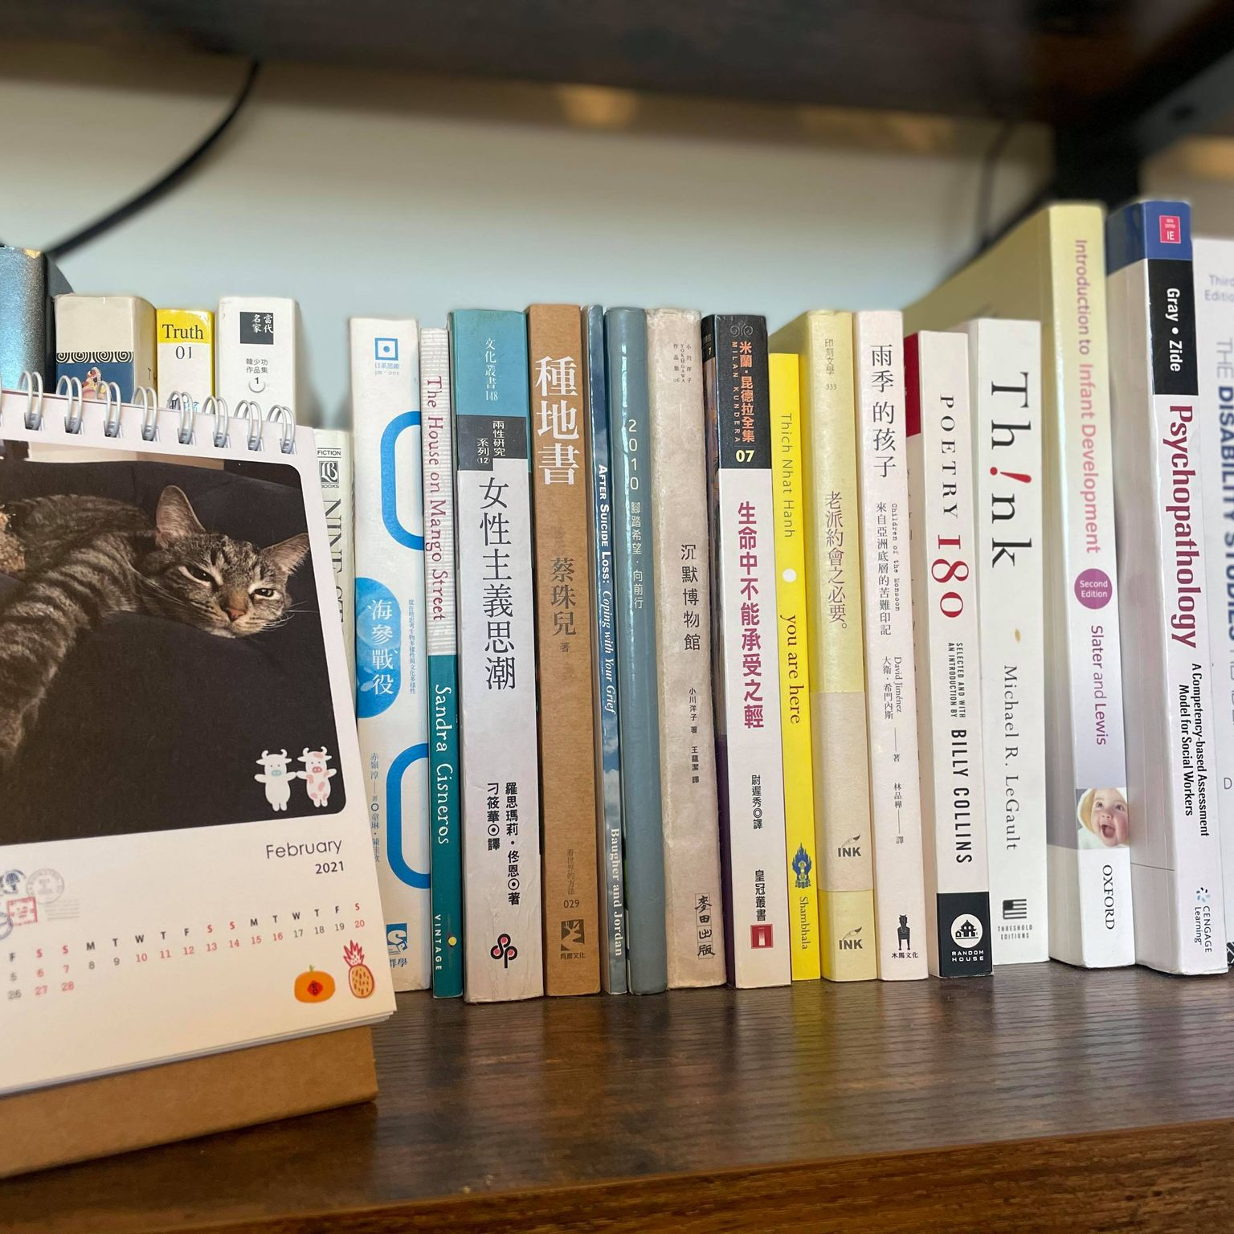
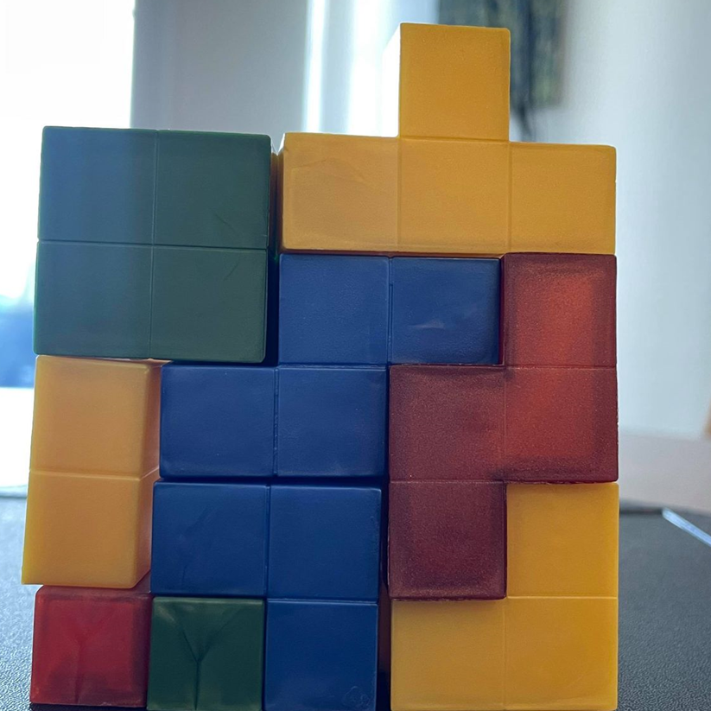
Research Findings
What are the barriers to effective implementation of Title I of the ADA among small employers?
Grey Areas in Interactive ADA Accommodation Process
Culture
Knowledge
System
Notes:
[Vicki]
Chair story

Slide 7
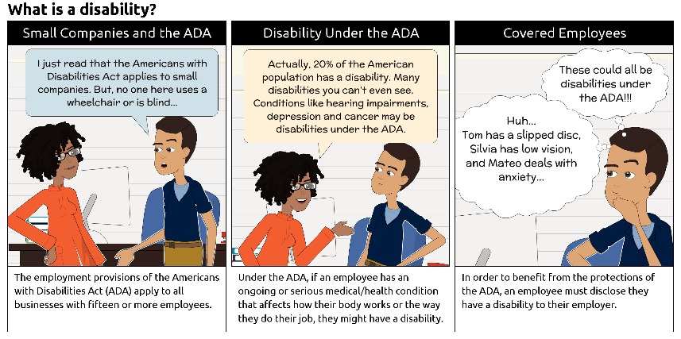
Research Findings (1)
Notes:
The lesson learned from our interviews with small business employers, we recognized a need to educate respondents about the terms we will be using before they begin to respond to the survey. Therefore, we developed two comics to help survey respondents establish a basic understanding of disability and accommodation under the ADA in plain language
COMIC DESCRIPTION:
What is a disability? The comic shows two office workers; one is the owner of a small business (the man), the other is someone who works in HR (the woman).
Panel #1. Business owner: I just read that the Americans with Disabilities Act applies to small companies. But, nobody here uses a wheelchair or is blind… Supporting text: The employment provisions of the Americans with Disabilities Act (ADA) apply to all businesses with fifteen or more employees.
Panel #2. Someone who works in HR: Actually, 20% of the American population has a disability. Many disabilities you can’t even see. Conditions like hearing impairments, depression and cancer may be disabilities under the ADA.
Supporting text: Under the ADA, if an employee has an ongoing or serious medical/health condition that affects how their body works or the way they do their job, they might have a disability.
Panel #3. Business owner (thought bubble): Huh, Tom has a slipped disk, Silvia has low vision, and Mateo has anxiety. These could all be disabilities under the ADA!
Supportting text: An employee has to tell their employer that they have a disability before they are covered under the ADA.
94.3% found the comics at least somewhat helpful in explaining disability and accommodation.

Slide 8
Research Findings (2)
How do small business learn about and incorporate information about the ADA into their work?
Notes:
[Vicki] 52% online
Employers utilize various resources to guide their accommodation process; however, these resources were not consistent among small businesses. The most common way to access information about the ADA was via Google search.

Slide 9
Toolkit Development (1)
How can we use the study findings to inform the "Small Business at Work Toolkit” development?
Playbook
Situation Room
What To Do
Deep Dive
Notes:
[Vicki] Image Description:
Screenshot of page listing tools. Tool 1 is Business Case, 2 is What Is Disability?, 3 is Productivity, 4 is Inclusion, 5 is the ADA, 6 is Hiring, 7 is Accommodation, 8 is Coronavirus.
The elements of Tool 3 are circled and highlighted, labeled Centralized Informational Tool. The last tool, Coronavirus, is labeled as Meeting the Current Needs.
The toolkit is developed based on the understanding of
Topic Needs – that is what topics and information that are most fundamentally relevant to small businesses organizations. Also, we take into account on limited time and resources that small business employers highlighted in our research.
Specifically
We design a centralized informational tool
And information that will meet your current needs

Slide 10
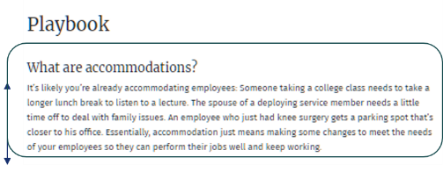
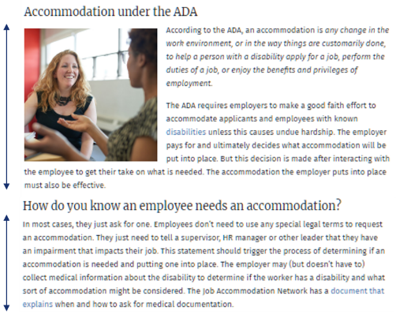
Toolkit Development (2)
Plain Language
Microcontent to Facilitate Learning
Notes:
[Vicki] Image Description:
Top part of Playbook page for Tool 7, Accommodations. The first paragraph features a plain language definition and is emphasized with an arrow.
Below that, are the next two sections, titled Accommodation Under the ADA and How do you know an employee needs an accommodation? These sections are labeled Microcontent to Facilitate Learning and also emphasized with arrows.
We use plain language – removed to jargon, or include section that explain terms that are important and needed to be understood.
We create microcontent to adapt learning – information is presented in short segments that is easier for mental digestion
We made information relevant by including realistic case examples

Slide 11
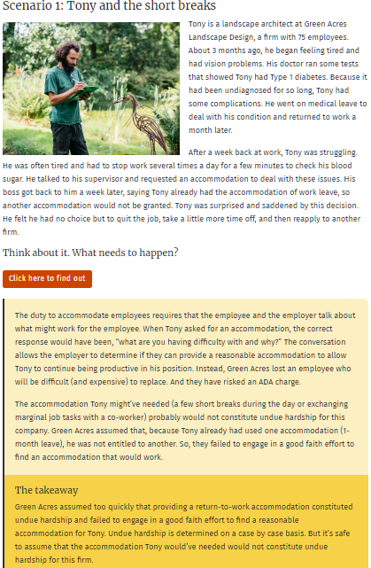
Toolkit Development (3)
Real-World Case Example
Concrete Solutions
Readers Takeaway
Notes:
[Vicki] Image Description:
Screenshot of Scenario page. The top part, labeled Real World Case Example features an image of a person and a scenario outlining their experience as an employee. The next section is titled Concrete Solutions and features information for the business. Finally, there is a summary titled Readers Takeaway that outlines the scenario as well as the responses.
We made information relevant by including realistic case examples

Slide 12
Toolkit Testing and Refinement
Our users have told us that this tool provides a quick response to the questions that they search for and that it is “the most accessible, comprehensive, easy to navigate, and engaging tool, which “will become a go-to resource for them moving forward.”
“Make difficult things simple,
simple things interesting, and
interesting things meaningful.”
– Hisashi Inoue, Japanese playwright
Notes:
[Vicki] This quote by hisash inoue captures our work, which the goal for developing this toolkit is to
I think the idea is also reflected in many of the work we do in the northeast ada, and the work of developing this toolkit and getting user feedback really echos this quote.

Slide 13
Next Steps
Improvements Needed
Clarity on Instruction Page and Labeling
Continue to collect pilot data
Update the toolkit
Dissemination
Visit the Small Business at Work
https://smallbusinessatwork.org/
Notes:
[Vicki]

Slide 14
Project Partners
www.adata.org | 1-800-949-4232

