Slide 1
Americans with Disabilities Act STATE OF THE SCIENCE
ADA National Network
April 13 – 15, 2021
#ADAStateOfScience

Slide 2
Acknowledgements
The work of this Center was developed under a grant from the National Institute on Disability, Independent Living, and Rehabilitation Research (NIDILRR grant number 90DP0086). NIDILRR is a Center within the Administration for Community Living (ACL), Department of Health and Human Services (HHS). The contents of this presentation do not necessarily represent the policy of NIDILRR, ACL, HHS, and you should not assume endorsement by the Federal Government.

Slide 3
Improving Access for Service Animal Users
Vinh Nguyen, JD, MBA & Monique R. Pappadis, MEd, PhD
Southwest ADA Center

Slide 4
Service Animals
Dogs trained to perform tasks to assist people with disabilities.
Allowed where the person is allowed to go in public. No surcharge.
Establishment can ask only 2 questions:
Is the animal required because of a disability?
What work or task is it trained to perform?
Entity can not:
Probe about disability
Require documentation or proof of training
Most frequent TA topic for the ADA National Network (ADANN)
Most downloaded publications from ADANN website
Notes:
Develop and test an information, outreach, and support framework for individuals and families to plan for integrated employment.

Slide 5
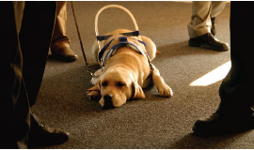
Phase 1: Survey of Dog Users (n=1250)
Trained to assist:
Physical tasks – 46.4%
Balance – 34.5%
Vision – 24.6%
Hearing – 12.6%
Medical Alert – 26.6%
Psychiatric – 43.7%
Training:
Professional – 51.3%
User trained – 33.5%
Someone else – 12.0%
Untrained emotional support animal – 3.2%
Disability:
Hidden – 65.3%
Obvious – 34.7%
Identifying Gear – 90.8%
Obtained Gear from:
Trainer - 52.9%
Non-trainer - 40.3%
Self-made – 5.8%

Slide 6
Barriers Reported
Have they been denied access or felt unwelcome?
Never -14.2%
Rarely – 43.1%
Sometimes – 37.2%
Frequently – 5.5%
Questioning:
Probed about disability – 38.5%
Asked for certification or license of animal – 89.3%
Denied access or felt unwelcome at:
Food services – 82.2%
Transportation entities – 46.4%
Medical facilities – 31.9%
Lodging – 10.0%
Factors leading to frequency of barriers experienced:
Female
Ethnic minority (non-white)
Hidden disability
No identifying gear on the animal
User trained dog

Slide 7
Phase 2: Deliberative Dialogue
Stakeholders composition (7):
4 service animal users (dogs performing different tasks)
Lodging (2), food service (1), health care (2), transportation (2)
General barriers identified:
Explosion of fraudulent animals
Concerns about pets causing danger to their trained service animals
Individuals and industries not understanding ADA rules regarding service animals
Majority of industries, business owners, and employees do not know how to identify service animals as opposed to pets

Slide 8
Stakeholder recommendations:
Revision to the ADA to address the misrepresentation of pets as service animals
Certification or accreditation process to confirm the training of the animal
Process that entities can use to verify that the animal is a service animal
Trainers should be licensed by the state or federal government to train or accredit service animals. Government could recognize certain organizations as qualified to certify both the service animals and the trainers.
Educating Service Entities and the Public about the ADA and service animal use
Ad Campaigns

Slide 9
Next Steps To Strengthen The Study’s Findings
Persons with disabilities will have a better understanding of potential challenges with Service Animal (SA) use before seeking ownership of a SA, as well as support the conversations between providers and clients prior to prescribing a SA.
A Fact Sheet could be disseminated to increase awareness regarding SA use in a variety of settings.
Online training modules could be developed to increase knowledge of ADA and service animal use, which are designed for industries were barriers frequently occur.
Next steps will be to explore the strengths and barriers to SA use in the workplace settings.

Slide 10
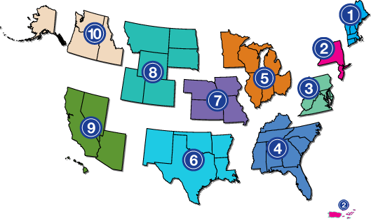
Project Partners
www.adata.org | 1-800-949-4232

