Slide 1
Session 4: Data analysis
Marcia Weaver, PhD
Department of Global Health

Slide 2
5. Data analysis
1. Planning your economic evaluation
Tool available for mapping out study
3. Data collection forms
Excel or Word document, or both
4. Data collection plan
Field visit, operational plan with work plan, timeline, sources
2. Protocol
Part of larger proposal or stand alone document
5. Data analysis and dissemination

Slide 3
Demonstrate data analysis for:
1. Calculating personnel cost of participants’ time
2. Estimating travel costs
3. Allocating management costs

Slide 4
Cost of clinical mentoring of HIV Care in Namibia
In 2006, the MoHSS asked I-TECH Namibia to provide clinical mentoring to enhance HIV Care. The program’s objectives were:
1. Build capacity of primary care providers in comprehensive and integrated HIV, TB and OI care, treatment and prevention including PMTCT and early infant diagnosis
2. Support decentralized delivery of HIV care, treatment and prevention, and continuous improvement of clinical care and patient outcomes
3. Support development of systems improvements to maximize quality of care
4. Provide didactic HIV-related training sessions to health professionals according to established curricula and using various methodologies (including distance learning)
5. Provide guidance and support in HIV-related operational research
As Namibia’s national ART program completed it’s first decade, I-TECH Namibia wanted to conduct an economic analysis of the clinical mentoring program.

Slide 5
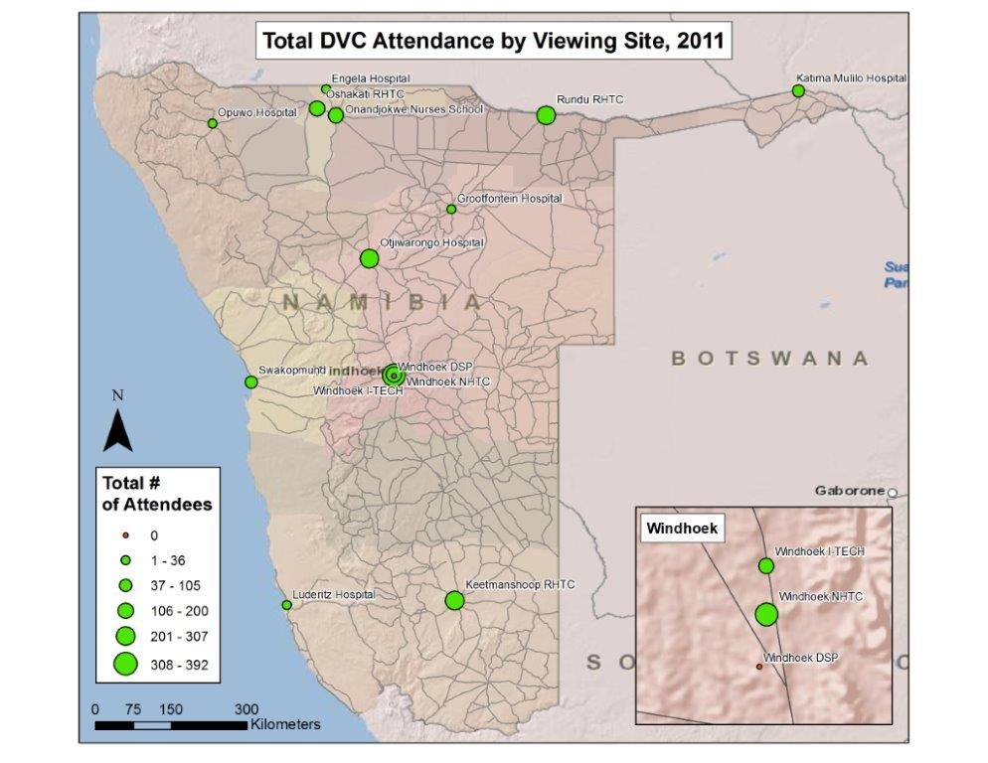
Background

Slide 6
Defining the economic evaluation
Describe | Cost analysis of clinical mentoring of HIV Care in Namibia
Project objective | Clinical mentoring (CM)– See previous slides.
Economic evaluation objective | 1) Budgeting: MOHSS budget for CM in the future 2) Advocacy: MOHSS appreciate value of CM 3) Dissemination: Publish experience with program transition
Perspective | I-TECH Namibia (Donor–funded), MOHSS, society
Study design | Estimate the cost of the clinical mentoring program using secondary data sources
Sample | “Universe” of CM sites and uses, i.e no sampling

Slide 7
Defining the economic evaluation
Describe | Cost analysis of clinical mentoring for HIV care in Namibia
Intermediate health outcomes | ART patients treated by mentees
Costs | Intervention costs ART drug costs
What will this data reveal? | CM cost per ART patient treated CM cost as a share of ART drug costs

Slide 8
Data sources (1)
Data on I-TECH and employment agency costs were collected from project accounts. A driver was available for each mentor for 0.5 FTE.
MOHSS cost were in-kind contributions of the value of time for mentees and class participants, and office space. Data were available on the number of people mentored within each area each year.
TrainSMART data were available on the number of people who attended classes by area and profession.

Slide 9
Data sources (2)
Overland travel costs were calculated with the number of kms between the hospital where the clinical mentor was based and facilities visited. An overnight stay was added whenever one-way distance was > 175 kms.
The exact expenditures on management were available from project records for 2010.
MoHSS Division of Pharmacy Services reported the number of patient on ART at each site in the annual “Antiretroviral Treatment: Pharmaceutical Management Information System Feedback Report”

Slide 10
Data analysis
The cost and patient data were organized by mentoring area, because the primary costs are personnel costs for the mentors and drivers, MOHSS trainees, as well as the vehicle and travel costs.
Leadership and management costs at I-TECH Namibia, I-TECH headquarters, and the MOHSS were allocated to each mentoring area based on the number of months that the mentor was employed each year.

Slide 11
Total cost of Namibian clinical mentoring program
 | 2010 |  | 2011
Financial cost – ITECH | $US |  | $US
Salaries & benefits | $606,575 | 37% | $556,341 | 38%
Other | $367,493 | 22% | $248,717 | 15%
Mgmt & overhead | $381,592 | 23% | $324,959 | 20%
UW subtotal | $1,355,660 | 83% | $1,130,017 | 69%
Economic Cost- MOHSS | $US |  | $US
Salaries & benefits | $246,686 | 15% | $283,652 | 17%
Other | $12,933 | 1% | $12,915 | 1%
Mgmt & overhead | $25,962 | 2% | $29,657 | 2%
MOHSS subtotal | $285,581 | 17% | $326,225 | 20%
Total | $1,641,241 |  | $1,456,242

Slide 12
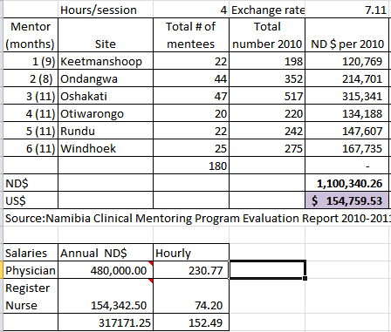
Personnel: Mentee cost
# mentees * # months = Total
Total * 4 * hourly salary = Cost in ND$
Cost in ND$ / ND$7.11 per US$

Slide 13
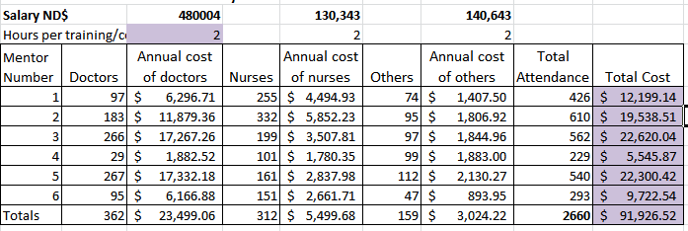
Personnel: Trainee cost

Slide 14
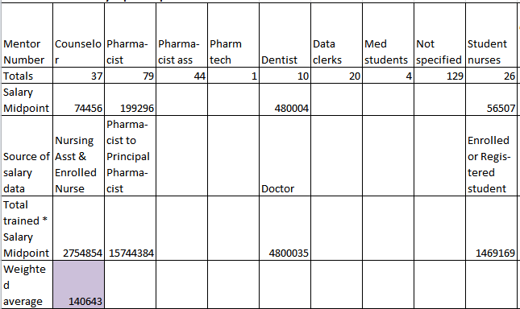
Personnel: “Other salary”
Number trained * salary midpoint = Total salary of trainees
Sum of total salaries/Sum of total trainees

Slide 15
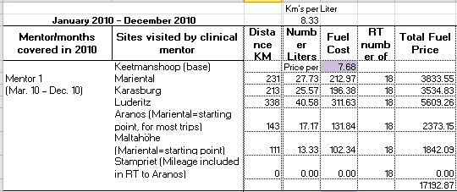
Travel costs - gasoline
Distance/8.33 = Number of liters
Number of liters * 7.68 = Fuel cost/trip
Fuel cost/trip * Number of trips = Total fuel price

Slide 16
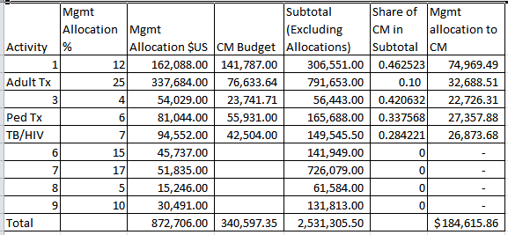
Allocating management cost
CM budget/Subtotal = Share of CM in subtotal
Share of CM in subtotal * Mgmt Allocation in $US = Mgmt allocation to CM
Sum of mgmt allocations to CM is total

Slide 17
Cost per patient enrolled in ART by mentoring area
Notes:
MoHSS Division of Pharmacy Services reported that 80,375 patients were enrolled in ART in December of 2010 and 90,122 patients were enrolled in December 2011. Using these data, the cost of the clinical mentoring program per patient treated was $20.19 in 2010 and $15.98 in 2011

Slide 18
Conclusion
The cost of CM program was $20.19 and $15.98 per patient enrolled in ART in 2010 and 2011, respectively.
According to the MoHSS Division of Pharmacy Services the cost of ART drugs in Namibia was $163.14 per person in 2010, and 133.15 in 2011.
The cost of CM could be considered an additional 12% charge for improving and maintaining the quality of care.

Slide 19
Acknowledgements
Laura Brandt, I-TECH Namibia, University of Washington
Laura Hahn, I-TECH, University of Washington
Ottilie Kutenda, Ministry of Health and Social Services, Namibia
Sean Oslin, I-TECH Namibia
Maria Ponz, University of Washington

Slide 20
Questions?
Thank you!
Contact: Marcia Weaver, PhD
mweaver@uw.edu

