Slide 1
Session 5: Standard reporting of results
Carol Levin, PhD
Department of Global Health

Slide 2
Disseminating your results
1. Planning your economic evaluation
Tool available for mapping out study
3. Data collection forms
Excel or Word document, or both
4. Data collection plan
Operational plan with work plan, timeline, sources
2. Protocol
Part of larger proposal or stand alone document
5. Data analysis and dissemination

Slide 3
Reference case guidelines on presenting results
Basic information
Intervention & Sample
Time Frame
Output Unit
Currency & Year
Cost table
Resource
Input unit
Price
Total cost

Slide 4
Example of reporting results template

Slide 5
Examples of summary cost tables & figures
Should have detailed tables available.
May also want to show data in other ways
More aggregate cost tables
Figures show cost profiles (allocation of percentage of cost to different inputs)
Graphs

Slide 6
Example of summary cost table

Slide 7
HPV economic program cost per dose and cost components

Slide 8
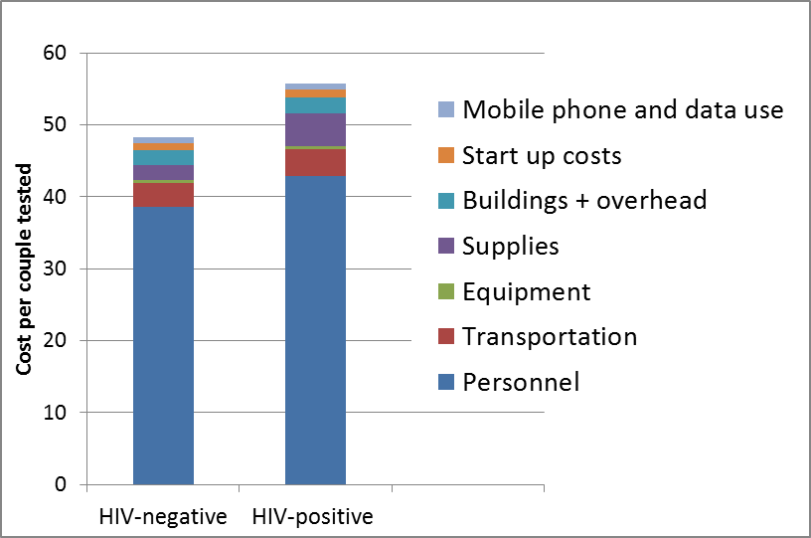
Costs per tested: Partner notification for HIV in Kenya
$56.00
$48.00

Slide 9
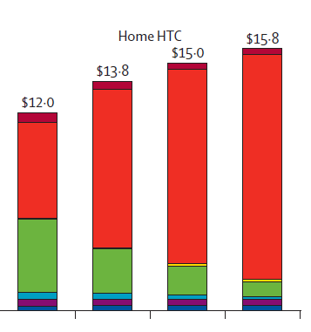
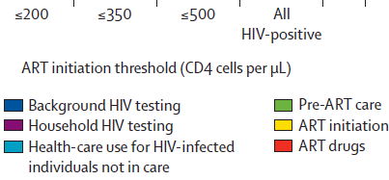
Total program costs: Home HIV testing and counseling in South Africa Results projected from mathematical model, include all costs associated with intervention as well as costs averted by preventing HIV infection.
Total program costs accrued over 10 years for the home HIV counseling and testing for a modeled population of 10 000 individuals.

Slide 10
Questions? Thank you!
Contact: Carol Levin, PhD
clevin@uw.edu

