Slide 1
Preliminary Results from Out-of-Care Investigations: A Collaborative Project of the Northwest Health Dept. – CFAR Consortium
Julie Dombrowski, MD, MPH
Department of Medicine, University of Washington
HIV/STD Program, Public Health – Seattle & King County

Slide 2
Collaborative Out-of-Care Analysis
Goal: Lay the foundation for collaborative research on key steps in the HIV care continuum
Specific Aim: Enhance investigation of previously reported HIV cases to increase accuracy of estimates of retention in care and virologic suppression
Correct surveillance-based estimates of the number of HIV-diagnosed persons residing in an area
Evaluate the impact of migration on population-level estimates of retention and virologic suppression
Hypothesis: Accounting for migration will increase the estimates of the proportion of HIV-infected persons retained in care and with virologic suppression by ≥ 25% in all areas
Anticipated Future Direction: Region-wide, population-based interventions to improve engagement in care

Slide 3
Preliminary Data
Everyone completed the work!
Very early analysis
Plan for manuscript and next steps

Slide 4
Case Investigations
State | Number of PLWHA | Number of Cases with No CD4 or VL ≥ 12 months | % “Out of Care” Before Investigation
Alaska | 1,137 | 220 | 19%
Idaho Boise Pocatello | 1,385 120 | 337 37 | 31%
Montana | 548 | 110 | 20%
Multnomah* | 3,886 | 756 | 19%
Washington** | (11,142) | 2715 | 24%
Wyoming | 222 | 7 | 3%
TOTAL | 17,855*** | 4,182 | 23%
*OR State data forthcoming, data shown for 18 month period
**Washington data to be presented in more detail separately
***Assuming Boise has ~800 patients for the purposes of rough estimation

Slide 5
Demographics of “No Labs” Cases
State | Male (%) | Race/Ethnicity (%) |  |  | MSM % | Yrs Since Dx | Yrs Since last lab
 |  | NHW | NHB | H |  | Median | Median
Alaska | 85 | 60 | 18 | 10 | 52 | 13 | 3
Idaho Boise Pocatello | 81 78 | 71 65 | 9 3 | 11 5 | 44 43 | 10 11 | 6 5
Montana | 87 | 85 | 6 | 3 | 53 | 15 | 3
Wyoming | 71 | 43 | 0 | 29 | 43 | 9 | 3
TOTAL | 83 | 69 | 11 | 9 | 48 | 13 | 4.5

Slide 6
Final Case Dispositions
State | Cases | Moved (%) | Died (%) | In Care (%) | Out of Care* (%) | Unable to Locate
Alaska | 220 | 56 | 5 | 21 | 6 | 12
Idaho Boise Pocatello | 337 37 | 69 52 | 9 19 | 3 17 | 13 2 | 3 10
Montana | 109 | 86 | 3 | 6 | 13 | 1
Multnomah | 756 | 11 | 2 | 82 | 5
Washington | 2715 | 27 | 4 | 38 | 21 | 9
Wyoming | 7 | 29 | 0 | 14 | 14 | 43
TOTAL | 4181 | 31 |  |  | 16
*Confirmed or presumed

Slide 7
Adjusted Retention Estimates*
State | Number of PLWHA | “Out of Care” Before Investigation |  | Out of Care After Investigation
Alaska | 1,137 | 220 | 19% | 13 | 1%
Idaho Boise Pocatello | 1,385 ?800 120 | 337 37 | 42% 31% | 44 1 | 6% 1%
Montana | 548 | 110 | 20% | 14 | 3%
Multnomah | 3,886 | 756 | 19% | 38 | 1%
Washington | (11,142) | 2715 | 24% | 570 | 5%
Wyoming | 222 | 7 | 3% | 1 | <1%
TOTAL | 17,855 | 4,182 | 23% | 681 | 4%

Slide 8
Preliminary Summary
~20% without labs in the past year region-wide
Median time since last lab = 4.5 years
30% moved (wide range 11-86%)
Hypothesis confirmed: adjustment for migration decreased out-of-care fraction by >25% in all areas

Slide 9
Questions
Why only 11% out-migration in Multnomah investigations?
Did we all handle “spontaneous re-engagement” the same way?
Differentiate out-of-care during surveillance period then re-engaged “spontaneously” from in-care
How do we interpret the comparison between health department-based and clinic-based?

Slide 10
Implications
Out of care
Much less common than national estimates suggest
We might be using the wrong criteria to find the target population
“Data to Care” initiatives that focus on persons with no labs may have limited population-level effect
Future directions need to be reassessed

Slide 11
Retention in Care
Recent CDC Report from 19 jurisdictions
Examined following metrics:
Any care: Engaged or retained, per definition below
Engaged in care: ≥ 1 lab in past year
Retained in continuous care: ≥ 2 labs/visits ≥ 90 days apart in past year
Retained in care, HHS Core Indicator: ≥ 1 lab/visit in each 6-month period of a 24 month measurement period with ≥ 60 days between the 1st visit in the prior 6 month period and the last visit in the subsequent 6 month period
Source: Cohen S et al, JAIDS 2014; Valiserri et al, Public Health Reports 2013

Slide 12
Viral Suppression by Retention Measure, 19 US Jurisdictions
 | N | % | Virally suppressed | % of row virally suppressed
Total | 338,959 | 100 | 147,015 | 43.4
Any Care | 214,734 | 63 (of total) | 147,015 | 68.5
Engaged | 42,363 | 20 (of “any care”) | 20,192 | 47.7
Retained in continuous care | 172,371 | 80 (of “any care”) | 126,823 | 73.6
Source: Cohen S, et al, JAIDS 2014, Epub ahead of print

Slide 13
History of ART initiation and continuing ART use and viral suppression at the end of 2010 among patients who received care at a CNICS clinic in2010 (N=8633)
 | N (% of total) | % Ever on ART | % on Continuing ART (at end of 2010) | % with Viral Suppression
Any Care in 2010 | 8633 (100) | 94 | 89 | 70
Retained in continuous care (≥2 visits ≥3 mo apart)
No | 1396 (16) | 90* | 81* | 55*
Yes | 7237 (84) | 94* | 91* | 73*
* p<0.05
Source: Dombrowski JC et al, JAIDS 2013

Slide 14
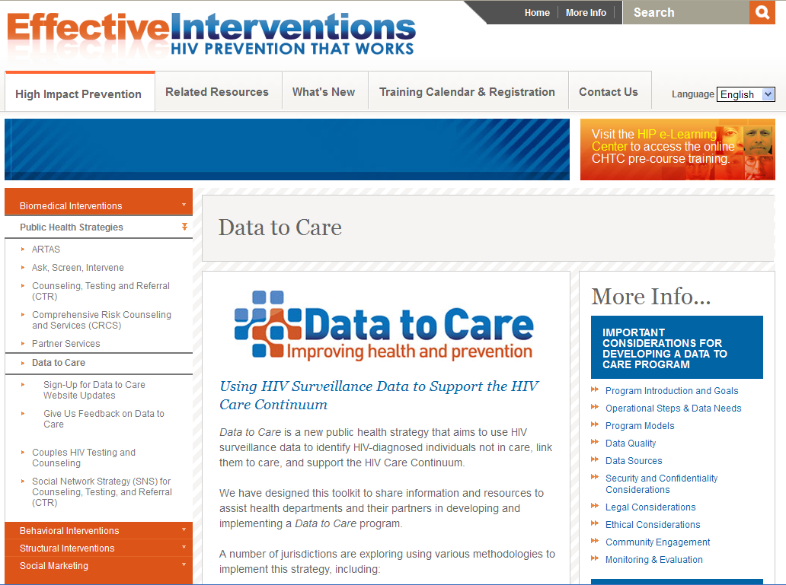

Slide 15
Next Steps to Complete this Project
Manuscript Timeline
Core Author Group | Today
First Draft Manuscript | End of 2014
Revisions to manuscript from large group | Jan 2015
Present findings to National Cross-CFAR HIV Care Continuum Work Group | Jan-Feb 2015
Submit to Journal | March 2015

Slide 16
Next Step for Consortium
Discuss future research directions
Rural MSM
HIV testing infrastructure
LGBT care infrastructure
Role of home-testing
Web-based surveys and tools
American Indian/Alaska Native populations
Interventions to reduce disparities in HIV/STD

Slide 17
WA State Data
Jason Carr

