Slide 1
From Research to Policy or What’s the point of all the graphs and charts?
Kenny Sherr
ksherr@uw.edu
July 27, 2012

Slide 2
Overview of Presentation
Brief introduction to policy-related elements of research
Examples of where research has failed and succeeded in impacting policy
Concrete policy/research linkage considerations

Slide 3
Why policy?
I’m a researcher, why do I have to consider policy?
Goal of research is not the results, but to lead to change
Evidence base for decision making
Tool to improve operations

Slide 4
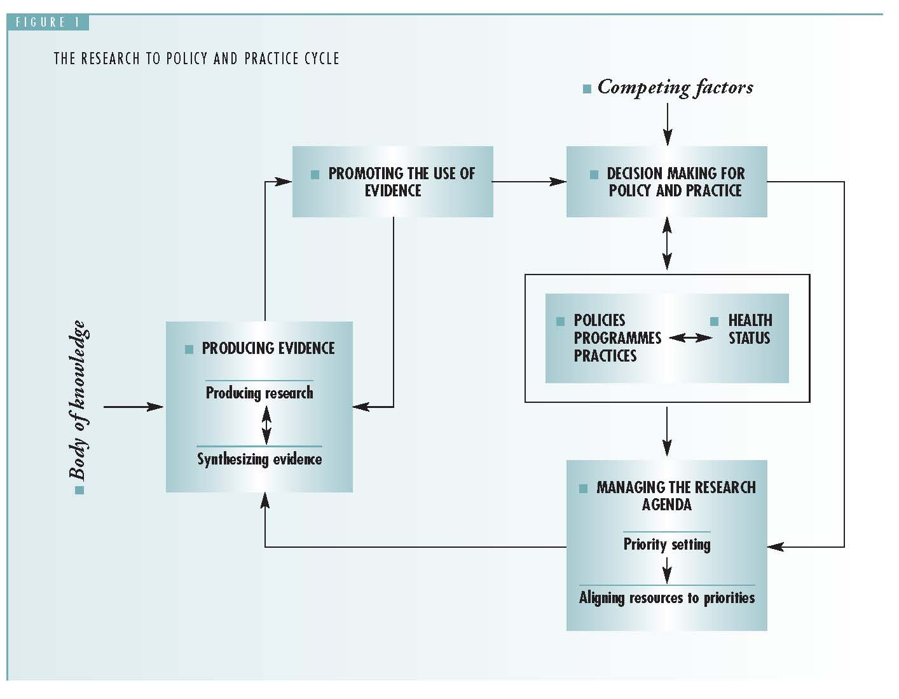
Ideal policy cycle
Haines A, Kuruvilla S, Borchet M. Bull WHO 2004;82:724-732
Alliance for Health Policy and Systems Research. Strengthening health systems: the role and promise of policy and systems research. Geneva, 2004

Slide 5
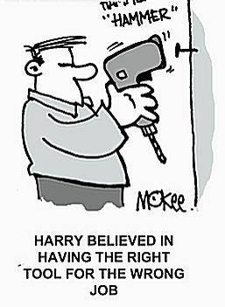
Research as a problem-solving tool depends on the policy context
Is it the right job? Does it make life easier?
Is it the right tool?
Does everyone know how the tool works?
Are there resources to run the tool?

Slide 6
Research/Policy Linkage Examples
Traditional birth attendants (low policy impact)
Evaluation of established program
Congenital syphilis prevention (high policy impact)
Constant operations research

Slide 7
Evaluation of Impact of Traditional Birth Attendants in Rural Mozambique (1)
With donor support/pressure, the MOH implemented a TBA program to reduce maternal/neonatal mortality
Over 8 years, a NGO trained >300 TBAs; support included supervision, equipment, refresher courses
Post training surveys showed that TBAs had improved knowledge of obstetric emergencies and skills to manage them
An evaluation was planned to assess whether the program had met its initial goals

Slide 8
Evaluation of Impact of Traditional Birth Attendants in Rural Mozambique (2)
Design:
retrospective cohort study comparing maternal and newborn outcomes in
communities with TBAs
communities without trained TBAs;
communities with a health post and a midwife
Women interviewed on
Type of provider during last pregnancy/birth
Outcome of pregnancy/childbirth for mother/child
Preference for future birth attendance
Source: Gloyd S, Floriano F, Seunda M, Chadreque M, Nyangezi J, Platas A. Impact of traditional birth attendant training in Mozambique: a controlled study. J Midwifery Womens Health. 2001 Jul-Aug;46(12): 210-6.

Slide 9
Evaluation of Impact of Traditional Birth Attendants in Rural Mozambique (3)
Results:
For women with access to a trained TBA
43% birthed at health facility
33% birthed with trained TBA
24% birthed with an untrained person
For women with no access to trained TBA
58% birthed at health facility
42% birthed with an untrained person
For women with access to a health facility with a midwife
77% birthed at a health facility
22% birthed with an untrained person
No differences in mortality across three groups

Slide 10
Preference for future births
Experience | Group 1 (trained TBA) | Group 2 (no trained TBA) | Group 3 (HF with midwife) | Total weighted average
% prefer health facility for next birth | 61% | 83% | 93% | 79%
Policy eventually shifted over time away from the TBA and towards improving maternities
5 years after study…
Notes:
Key descision-maker moved to another position in the MOH

Slide 11
TBA OR to Policy
Right tool, right question, but wrong timing
TBA training initiated despite evidence on efficacy
Key decision-maker rejected it because of her investment in the program and donor support
Insufficient engagement of the right people from the outset
Findings not adopted or integrated until there was a change in staff at the MOH level
And global transition away from TBAs

Slide 12
Congenital Syphilis Prevention (1)
Unequivocal evidence on efficacy of intervention
1978: Universal antenatal syphilis screening made national policy in Mozambique; screening sporadic & uneven
1993: Feasibility study in 11 health facilities demonstrated rapid increase in RPR screening (<5% to 70%)
Advocacy:
Presentations (provincial & national level conferences, Minister of Health, Council of National Directors)
Article and editorial in national medical/health journal
Multiple informal meetings with MOH, UN, Bilaterals

Slide 13
Congenital Syphilis Prevention (2) pilot intervention, 1993-94 11 Health Posts - Manica Province, Mozambique

Slide 14
Congenital Syphilis Prevention (3)
1996: Syphilis screening made a key element in national 5-year plan
Provincial Medical Director in Manica province adopted program as a priority
Increased total screening rate of pregnant women to 50-60% in health facilities with laboratories (one province)

Slide 15
Congenital Syphilis Prevention(4)
1998: Syphilis screening extended to all districts in neighboring province
Percentage of ANC attendees tested increased to 80% at the health facilities with laboratories
Over 4,000 RPR positive women identified per year (~70% treated)
1999: Sustained results with no donor input

Slide 16
Congenital Syphilis Prevention(5)
2000: Free treatment for pregnant women as a national norm & MCH nurses empowered to treat RPR+
Treatment rate increased to 90%
2003: Introduction of rapid treponemal Immunochromatographic strip (ICS) test pilot project (with MOH/Gates Foundation)
Number of facilities screening increased from 45 to 132 (100% of those with ANC)
Percentage of ANC attendees tested increased to 93%
Over 80,000 women tested annually
Over 8,000 syphilis positive women identified per year (96% treated)
Notes:
Standard of tx is 3 doses of PCN if you don’t know when you were infected

Slide 17
Congenital Syphilis Prevention (6) ANC screening Manica and Sofala provinces, 98-04

Slide 18
Congenital Syphilis Prevention(7)
Health Worker Satisfaction Survey
30
27
25
20
Which test do
You prefer to
Use in this
Facility?
15
13
Number of Answers
10
5
4
0
0
RT
RPR
RT
RPR
Laboratory Technicians
Nurses
“Takes less time…” “…Can be used in health facilities without laboratories…” “…Is easy to read…” “…Doesn’t require much blood…” “…Reduces the waiting time of the mothers…”

Slide 19
Congenital Syphilis Prevention (8) Economic analysis of RPR/strip test (US$)
Source: Levin C, et al. Analysis of the operation costs of using rapid syphilis tests for the detection of maternal syphiliis in Bolivia and Mozambique. Sexually Transmitted Diseases. 2007;34(7):S47-S54

Slide 20
Congenital Syphilis Prevention(9)
2006: Rapid test became national policy
For use in facilities without laboratories
Procured directly by the MOH

Slide 21
Congenital Syphilis Prevention (10) Determinants of Success
Constant advocacy
Close partnership with MOH
10 years of iterative operations research to:
Implement policy
re-shape policy
Right tool for the right job at the right time
Problem was a priority of policymakers
Tests were available and cheap (RPR), or innovations were appropriate, responded to need, and made life easier (rapid test)

Slide 22
How does this apply to you?
Data don’t stand alone; your challenge is to figure out how to maneuver data most effectively in your system
Who to engage?
What dynamics are present?
What constraints to consider?

Slide 23
Who to engage?
Whose policy is it?
Who defines the problems & priorities?
Consider role of researchers, clinicians, managers, donors, advocates
Usually differs by health system level, domestic vs. international
Careful of frequent changes

Slide 24
Who to engage → Consider Level of Involvement
Ministry of Health | Who’s in charge of the program? What’s the scope of change? How centralized are decisions? Other government involvement?
Local Health Authority | Role in defining policy? Geo-political considerations?
Health Facility | Often the best ideas
Community | Who are true leaders? Political structures? Religious leaders? Consensus leaders? Who are the beneficiaries?

Slide 25
What dynamics are present?
Place research evidence within complicated, locally dependent dynamics
Personal agendas?
Interests?
Personal & professional histories?
Researcher/policymaker networks?

Slide 26
What Constraints to Consider?
Contextual factors define parameters
“Political Will” (what is it?)
Resource constraints
Where (who) do they come from and what’s the probability they will change?
Donor priorities
SAPs, wage bill caps
Process constraints – budget & planning process, procurement systems

Slide 27
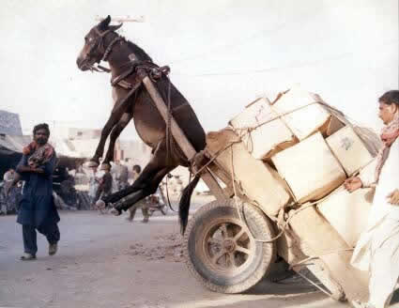
Balance the needs of multiple stakeholders!

Slide 28
Constraints →Consider Level of Involvement
Ministry of Health | National priorities Equity between regions Budget process Procurement systems
Local Health Authority | Local priorities Management burden Procurement systems Infrastructure requirements
Health Facility | Human resources Supervision capacity Working conditions & satisfaction Material resources
Community | Awareness Acceptability Affordability & access

Slide 29
You can do it!

