Slide 1
Community, Academic, and Public Health Partnerships: the Key to Ending the HIV Epidemic in the U.S
Aadia Rana, MD, FIDSA
Professor of Medicine UAB Heersink School of Medicine
Director, Ending HIV in Alabama Scientific Working Group UAB CFAR
University of Washington Fred Hutch CFAR
Nov 2, 2023

Slide 2
Objectives
Overview of the HIV Epidemic in the United States
Ending the HIV Epidemic Initiative (EHE)
EHE in Alabama, highlighting projects incorporating academic, public health, and community partnerships
Notes:
Highlight some projects – tremendous work being done collaboratively by our institution, could not possible include all of them

Slide 3
HIV IN THE U.S.

Slide 4
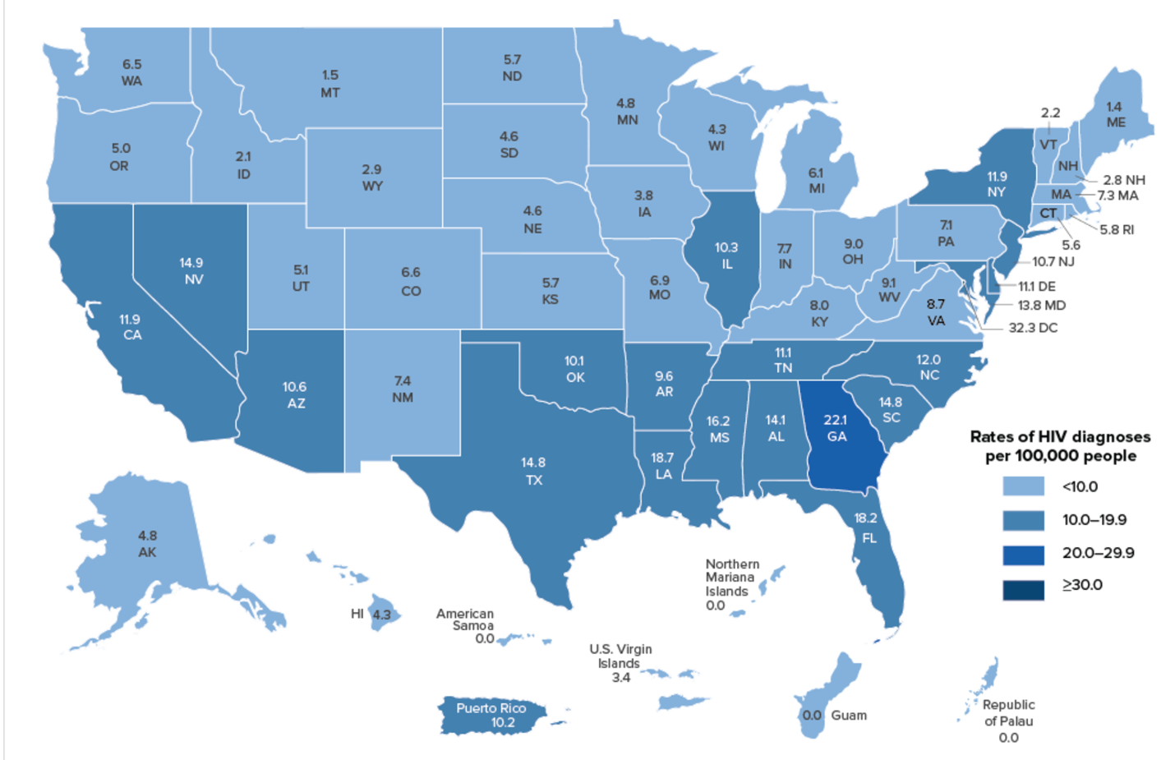
HIV Epidemic in the United States, 2020
Source: CDC. Diagnoses of HIV infection in the United States and dependent areas, 2020. HIV Surveillance Report 2022;33
Notes:
>1.2 million people living with HIV, >700K deaths since the beginning of the Epidemic
~40,000 new infections each year; 30K in 2020 covid, 17% reduction related to sig drop in testing.
Disproportionate impact on certain populations, particularly racial and ethnic minorities and gay and bisexual men and other men who have sex with men
Regionally, the South accounted for about half the number of HIV diagnoses in 2017; by incidence rate, 8 of top 10 states are in the South.
HIV, is increasingly concentrated in the U.S. South and Southeast, among racial/ethnic minority and sexual and gender minority communities,¹⁵ and as Kates et al have noted, among lower income and under- or uninsured Americans.¹⁴ Some have called for a “PEPFAR for the United States,” a bold and to-scale commitment to address the U.S. epidemic.
Women of color are particularly affected, and in 2017, Black women accounted for 6 in 10 (59%) of new HIV diagnoses among women; white women accounted for 20% and Latinas accounted for 16%

Slide 5
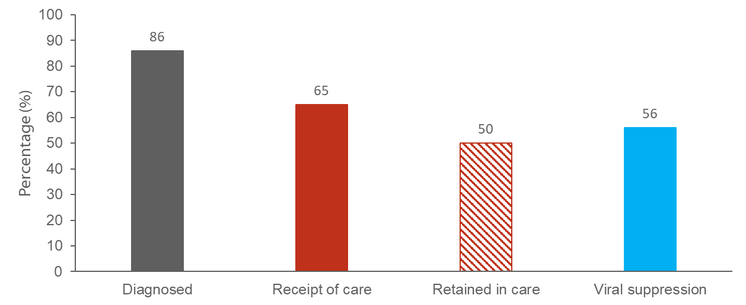
Persons Living with Diagnosed or Undiagnosed HIV Infection
HIV Care Continuum Outcomes, 2019—United States
87
66
57
Note. Receipt of medical care was defined as ≥1 test (CD4 or VL) in 2018. Retained in continuous medical care was defined as ≥2 tests (CD4 or VL) ≥3 months apart in 2018. Viral suppression was defined as <200 copies/mL on the most recent VL test in 2019. CDC, Monitoring selected national HIV prevention and care objectives by using HIV surveillance data—United States and 6 dependent areas, 2019. HIV Surveillance Supplemental Report 2021; 26(No. 2). Published May 2021.
Notes:
This slide presents the prevalence-based HIV care continuum for 2019 for persons living with diagnosed or undiagnosed HIV infection in the United States. Among the estimated 1.1 million people living with HIV in the United States, 86% have received a diagnosis, 65% received HIV medical care in 2018, 50% were receiving continuous care, and 56% were virally suppressed.
Receipt of medical care was defined as ≥1 test (CD4 or VL) in 2018. Retained in continuous medical care was defined as ≥2 tests (CD4 or VL) ≥3 months apart in 2018. Viral suppression was defined as <200 copies/mL on the most recent VL test in 2018.

Slide 6
Persons Living with Diagnosed or Undiagnosed HIV Infection, HIV Care Continuum Outcomes, 2018
Source: CDC. HIV Surveillance Report. Supplemental Report. 2017;22(2)

Slide 7
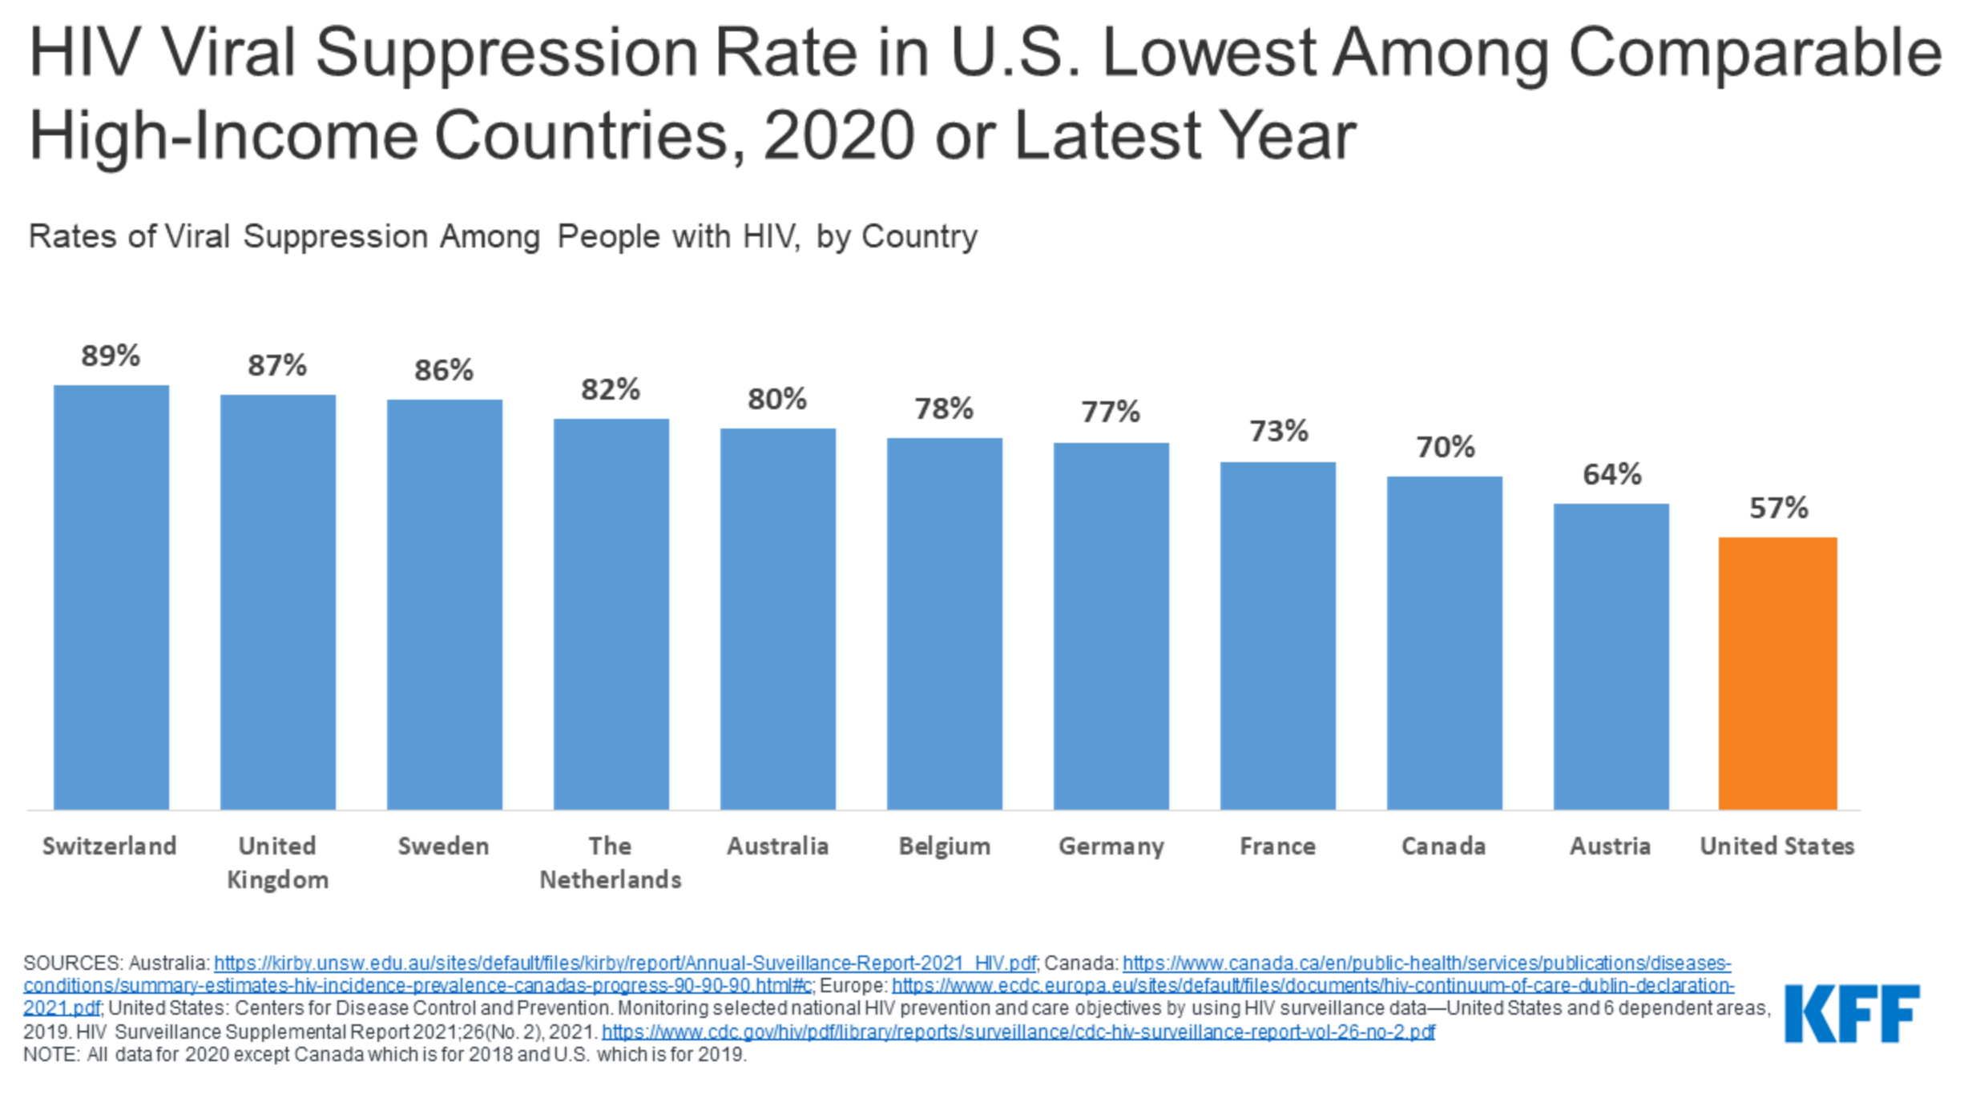

Slide 8
Engagement in Care is Dynamic
“Consistently High” (26%)
“Steadily Declining” (16%)
“Early Increasing” (17%)
“Late Increasing” (15%)
“Consistently Low” (26%)
Powers et al, Longitudinal HIV Care Trajectories in North Carolina JAIDS 2017; 74(S2)
Notes:
Barriers not CROSS SECTION

Slide 9
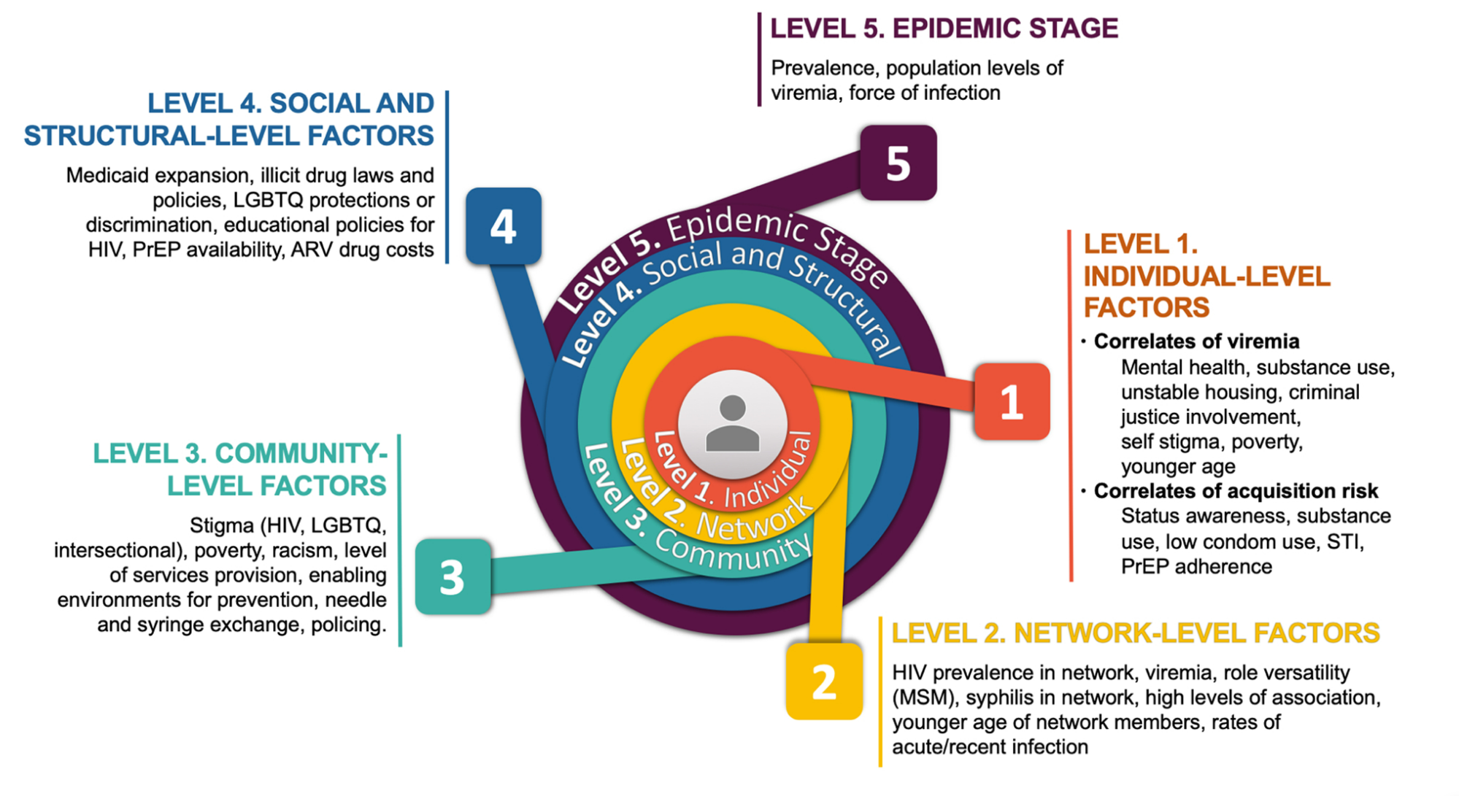
Social-ecological Model of HIV risk and vulnerability in the US
Beyrer C et al. Call to action: how can the US Ending the HIV Epidemic initiative succeed? Lancet. 2021 Mar 20;397(10279):1151-1156.

Slide 10
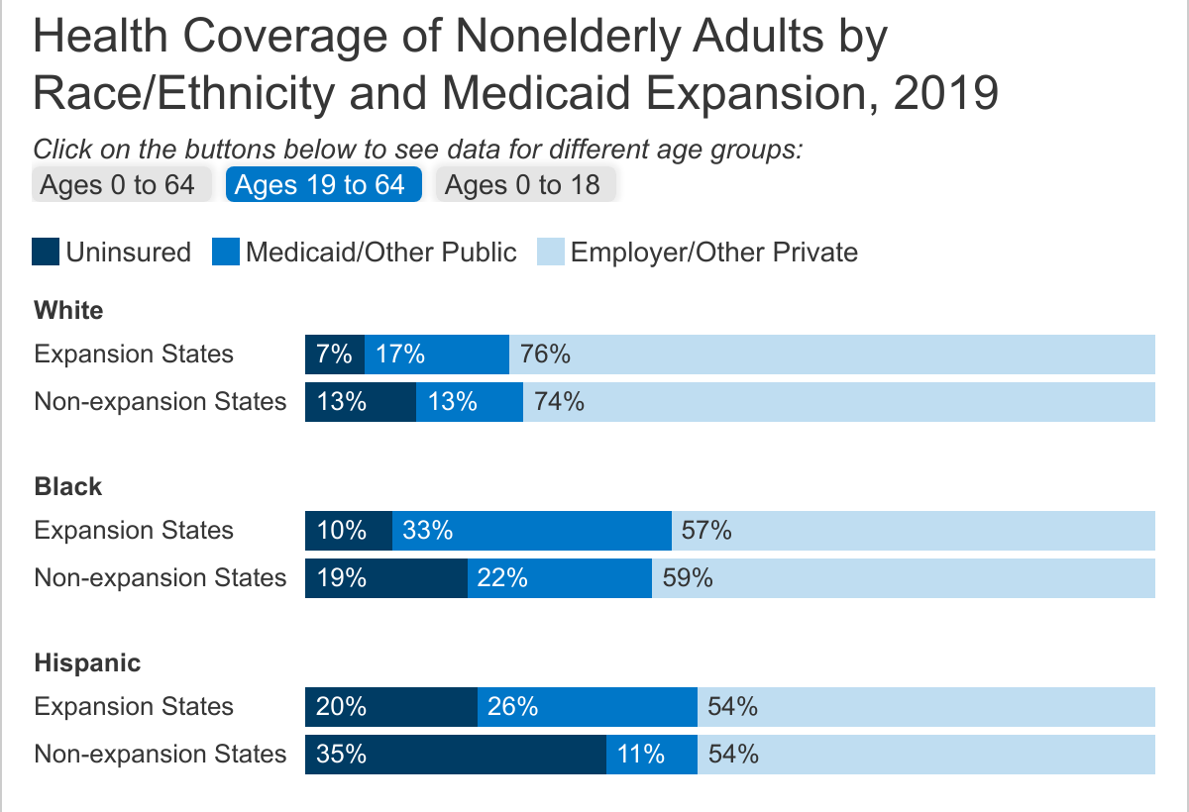
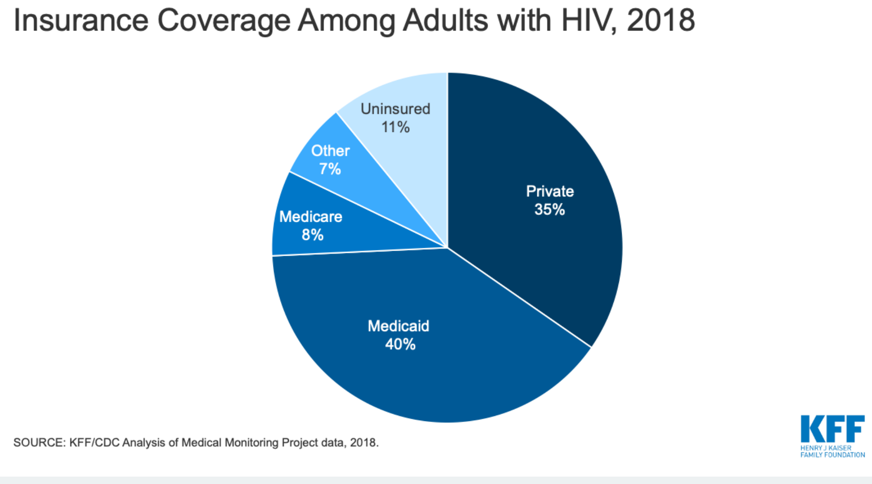
Fragmented Health Care Delivery in the U.S.
HIV Testing, Prevention, and Care:
  Private Clinics
  Public Health Clinics
  Federally Qualified Health Centers (Primary Care)
  Academic Health Centers
  Pregnancy care, HIV care, Infant care in 3 different locations
Funded by:
  Private Insurance
  Medicare >65 years
  Medicaid – state determines eligibility
  Federal Ryan White Program Clinics
    Only covers HIV Care; program can be used to purchase private health insurance but regular certifications required.
    Ryan White Clinics CANNOT use funds to provide PrEP services
Notes:
The overall uninsured rate is 10% but higher in proportion of those who are at highest risk of HIV, ie
In 2018, almost half of all people with HIV (46%) relied on Ryan White, including more than eight in ten (82%) of those who are uninsured.

Slide 11
ENDING THE EPIDEMIC IN THE UNITED STATES

Slide 12
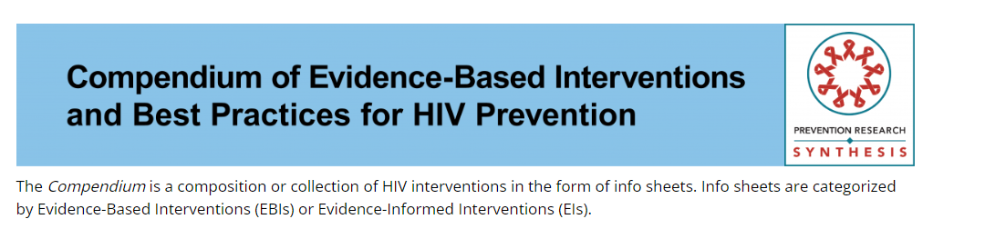
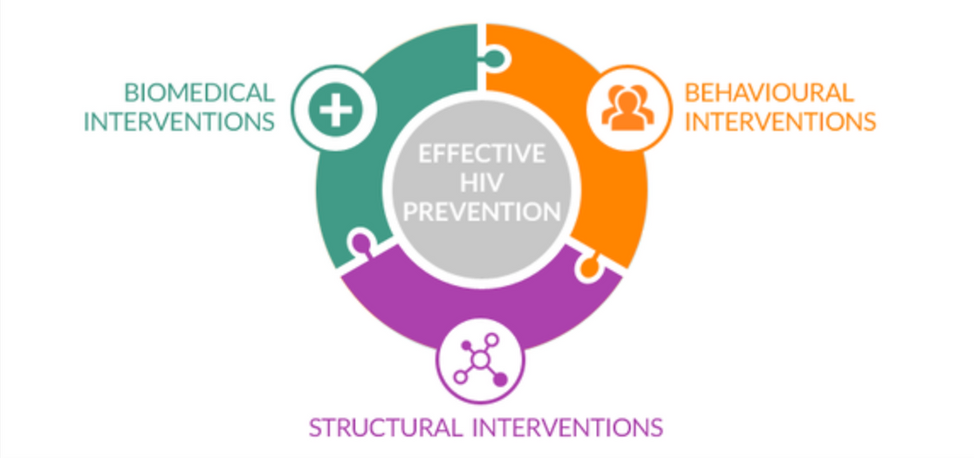
We have the evidence-based tools, but implementation is critical
https://www.cdc.gov/hiv/research/interventionresearch/compendium/index.html

Slide 13
Academic Institutions
Public Health Agencies
Community Partners
PWH, Community
Municipal/Policy Makers
Care Delivery Organizations
Notes:
Successful pathaway to EHE takes into consideration local contesxt of key stakeholders -, the expertise of the academic parterns , and the mission/mandates of public health institutions

Slide 14
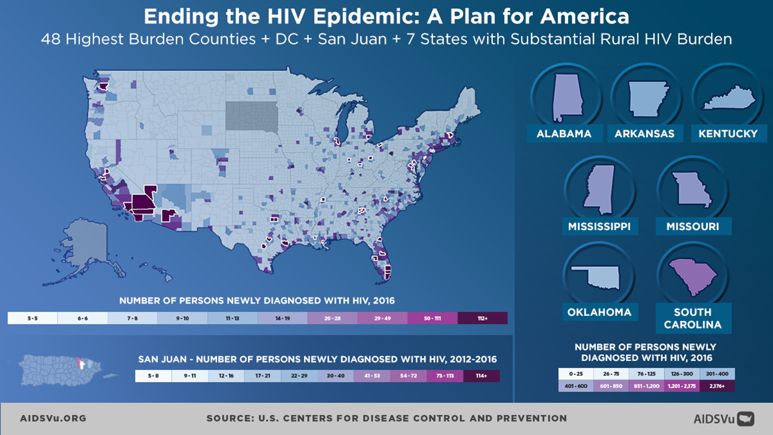
Notes:
>1.1 million people living with HIV, >700K deaths since the beginning of the Epidemic
~40,000 new infections each year
Disproportionate impact on certain populations, particularly racial and ethnic minorities and gay and bisexual men and other men who have sex with men
Regionally, the South accounted for about half the number of HIV diagnoses in 2017; by incidence rate, 8 of top 10 states are in the South.

Slide 15
ENDING THE EPIDEMIC IN ALABAMA

Slide 16
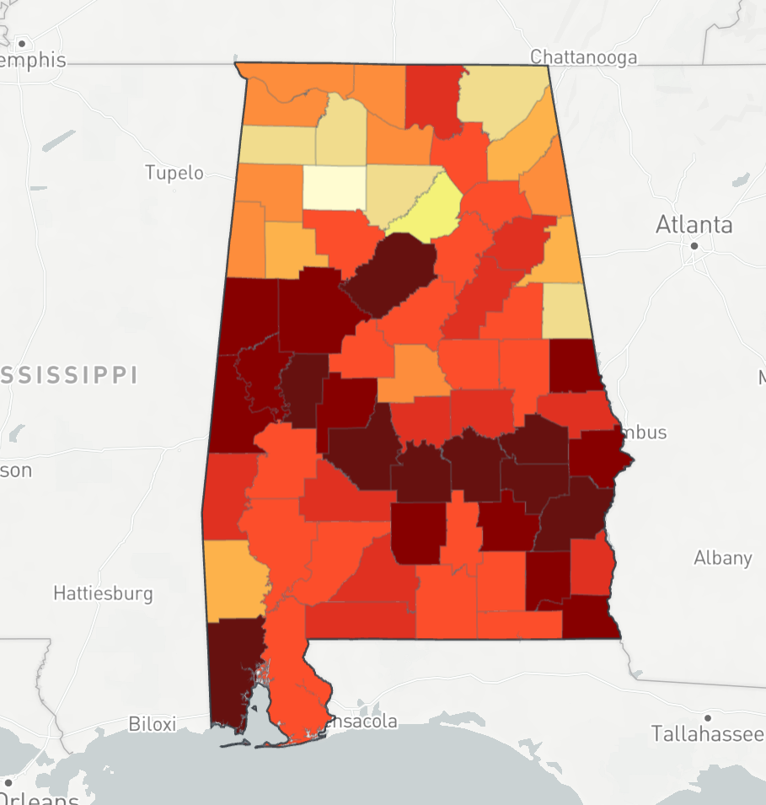
Rates of Persons living with HIV in Alabama, 2019
BHM
Montgomery
Mobile
https://aidsvu.org/local-data/united-states/south/alabama/
Notes:
Almost 14K ppl living with HIV in AL, 650 cases/year
Some stats on Alabama.
Population
4.8M
1.15M
Median age
39
38.8
Poverty Rate
17.1%
29.4%
Primary Care Physicians/ 100K
64
107
Mental Health Providers /100K
79
134
Uninsured rate
27% ages 25-34
20% ages 35-44
33% ages 25-34
20% ages 35-44
Homeless
3,793
1092

Slide 17
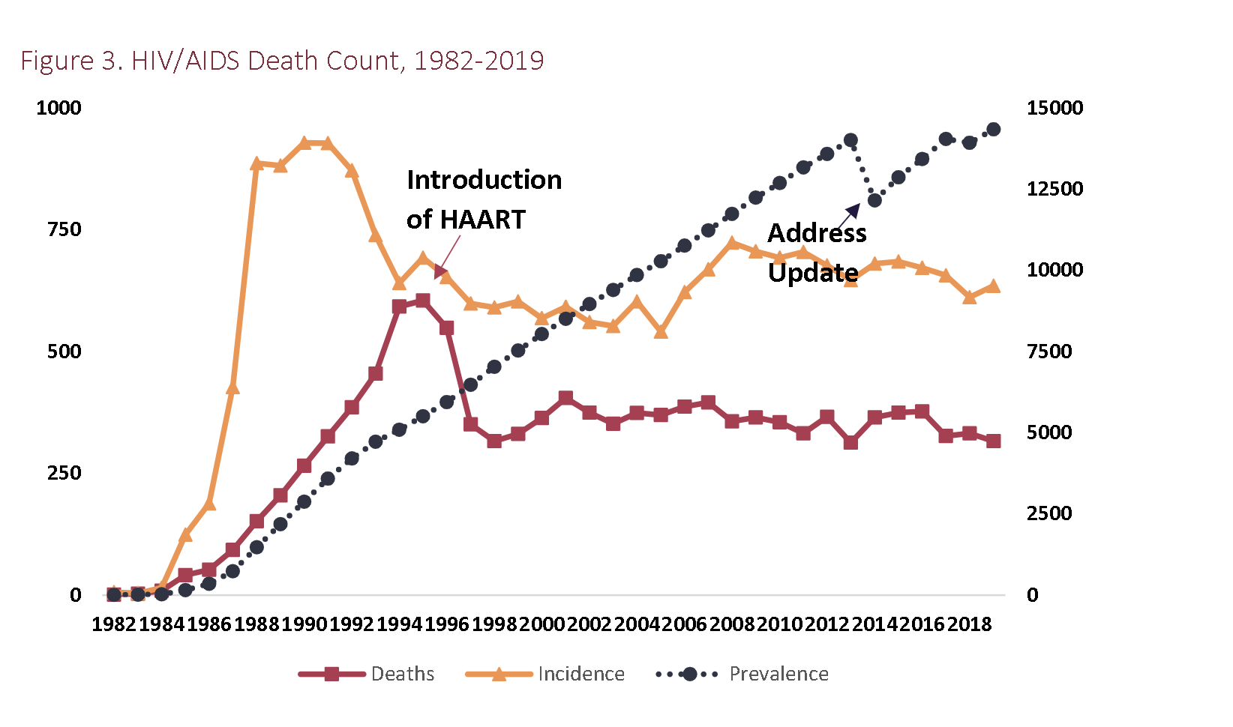
Alabama HIV Incidence, Prevalence, and Deaths, 1982-2019
www.alabamapublichealth.gov/hiv/assets/hivsurveillanceannualreport_2019.pdf
Notes:
2019, the rate of HIV diagnoses among Black males was eight times that of White males, while that of Black females was nine times that of White females (Figure 6, Table 2). The newly diagnosed HIV rate among blacks(35.1)in 2019is nearly three times that of the total state rate(13).1.84.76.313.835.1-416111621263136Black, Non-HispanicMultiracialHispanicWhite, Non-HispanicOtherBlackMultiracialHispanicWhiteOther

Slide 18
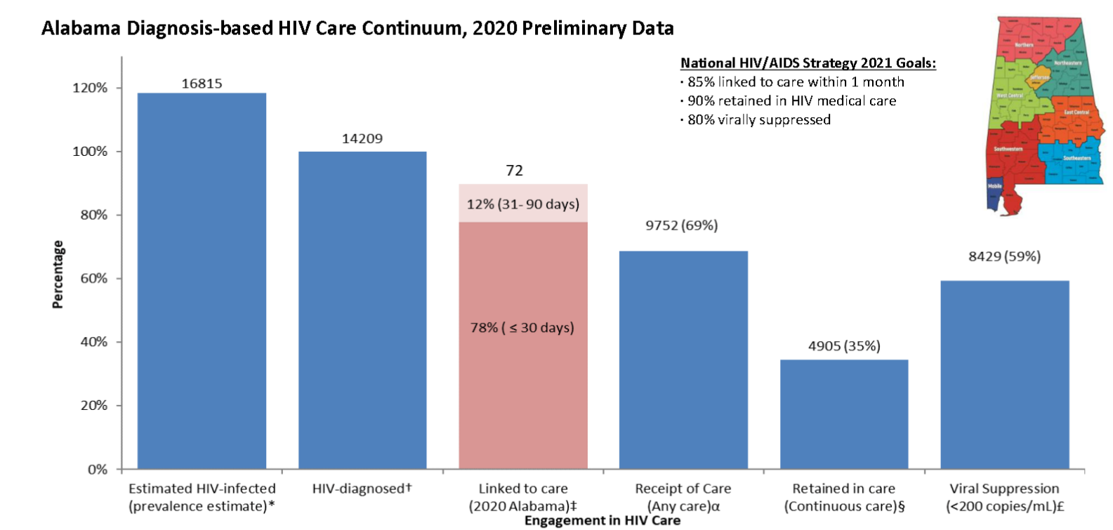
Ending the HIV Epidemic:
A Plan for Alabama
2019 data
https://www.alabamapublichealth.gov/hiv/assets/hivcontinuumcare_2020_preliminary.pdf
Notes:
On 86% statewide are aware of their dx but who are they and where are they

Slide 19
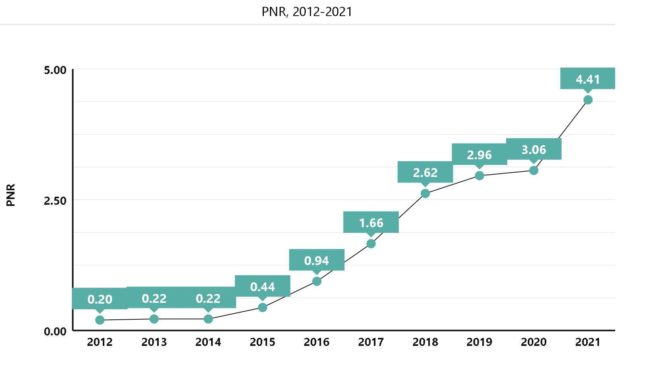
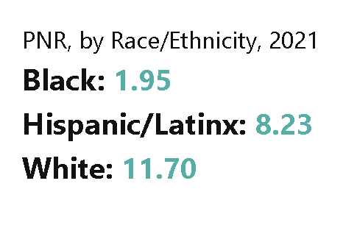
Alabama PrEP to Need Ratio
Sullivan P et al. Trends in PrEP Inequity by Race and Census Region, United States, 2012-2021. 24thInternational AIDS Conference (AIDS 2022), Montreal, oral abstract session OALBX01, 2022.https://aidsvu.org/local-data/united-states/south/alabama/
Notes:
Sullivan and colleagues used commercial pharmacy data to count PrEP users by US Census region from 2012 to 2021 presented this summer at World AIDS 2022. . RPrEP-to-Need Ratio (PnR), which is the number of PrEP users divided by the number of new diagnoses in that group in the same year. ace and ethnicity data were available for 124,835 PrEP users (34%) in 2021. The researchers assumed that the racial distribution was the same in PrEP users with missing data as those who had provided this information.
In order to determine if PrEP access was equitable, the researchers calculated a For 2020 and 2021, the number of new diagnoses used was the 2019 number, the most recent year with available data.
For instance, 47 White individuals were taking PrEP for every new HIV diagnosis among White people in this region compared to only 4.5 Black people on PrEP for every new diagnosis. I

Slide 20
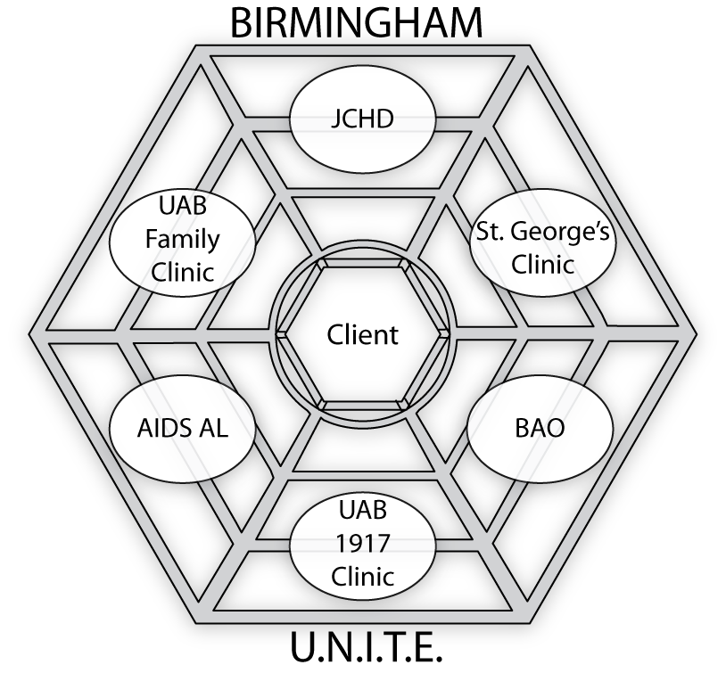
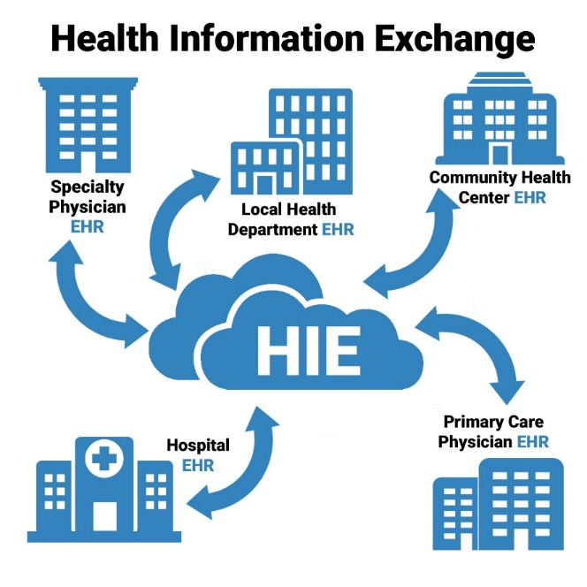
Birmingham U.N.I.T.E.; circa 2010
Vision: Health information exchange
Client-level data from HIV medical and supportive service providers
Enhanced tracking to inform services to address gaps in treatment cascade
Courtesy Michael Mugavero MD MHSc
Notes:
About 10 years ago – formation of bham unite, centered around wanting to better inform services to address gaps in tx cascade – ASOs after testing referred to jcdh, then referred to clinic; could we develop a healt info exchange - so jchd (where Birmingham is located )

Slide 21











HIV Coalition Building in Birmingham, AL
HIV front line providers meeting, BAO, Dec 2015
CDC PS15-1502, CDC PS15-1509
Single agency ~$450K/yr
Coalition ~850K/yr
Birmingham, AL
April 2015
Courtesy Michael Mugavero MD MHSc
Notes:
Jc hiv community coalation with these same organization monthly meetings hosted at jcdh attended by reps from each of these organizations – leading to regulary meetings interface of community/public health/uab cfar – including front line provider meeting, ending aids in 2015,; submission of 2 cdc high impact prevention grants by the community organizations with UAB CFAR in a supportive role to provide tehnical assistance

Slide 22


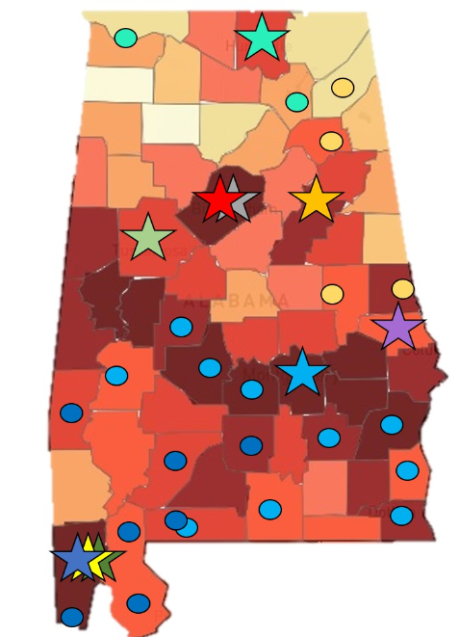

Alabama Regional Quality Management Group (AQMG)
  Statewide consortium of HRSA Ryan White funded clinics
  Quality improvement focus with quarterly sharing of aggregate data
  “This collaboration aims to continuously improve the quality of HIV care consistent with recognized national standards and current HIV research”
Courtesy of Ashley Tarrant, MAO, and Jitesh Parmar, Thrive Alabama
Courtesy Michael Mugavero MD MHSc
Notes:
Miichael Around the same time, we have formalization of alambama regional quality mgmt. group –
Focused on cqi outcomes, hosted at UAB CFAR – technical assistance on data reporting, clinics met to share best practices, review data, interface with public health partners

Slide 23
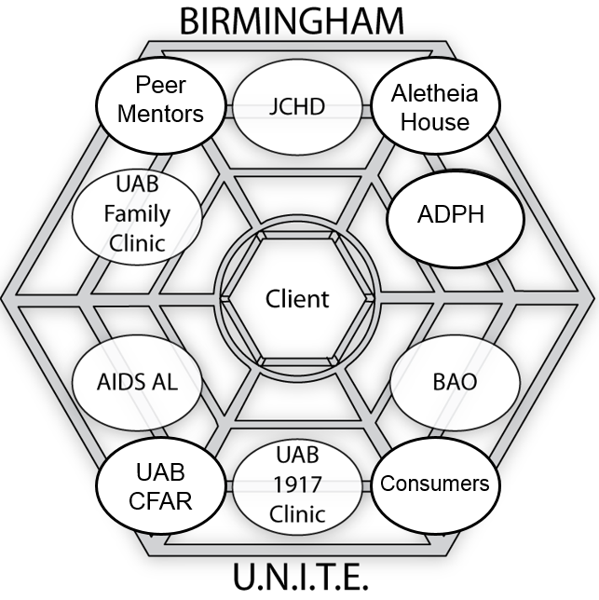
Birmingham U.N.I.T.E.; circa 2017
Universal release to allow information sharing across agencies
Enhanced tracking to inform service delivery to address gaps in treatment cascade
Two collaborative CDC prevention grants
Integrated service delivery across agencies
25% reduction in new HIV cases in Jefferson County, 2013-17
Courtesy Michael Mugavero MD MHSc

Slide 24
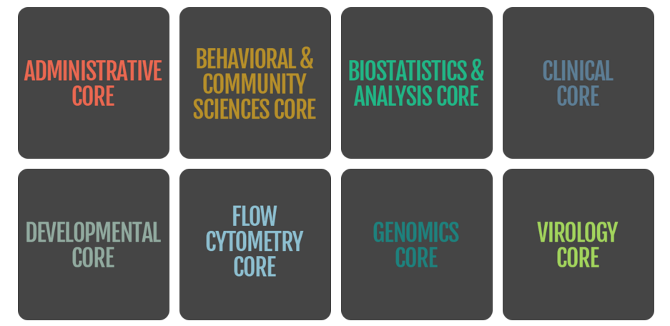

UAB CFAR Ending HIV in Alabama SWG
UAB CFAR SWG
Jeanne Marrazzo, Director
Aadia Rana, Co-Director
Alyssa Carodine, Program Coordinator
“90” Testing & Prevention
Mirjam Kempf
“90” On ART & Care Engagement
Aadia Rana
“90” Viral Suppression
Turner Overton
Community Engagement
Biostatistics & Analytics
Notes:
In 2017 using the recently released unaids 90-90-90 initiative 0 which the Mayor of Birmingham signed onto in Aug 2017 (strategicially timed right before an election) formed SWG; support development/implementation of research focused on the goals of the 90-90-90 initiative led by investigators with expertise in this area, leveraging established services and scientists from behavioral/clinical core to focus on innovative research in AL
Goal: Answer fundamental questions about HIV care in AL
What aspects of our approach to HIV prevention and care are effective?
What populations are not being served sufficiently or at all?
How can we comprehensively yet cost-effectively improve access to and engagement with HIV care?
How can we improve outreach to increase knowledge of services available?
What broad community assets, resources, or programs are necessary to achieve these goals?

Slide 25

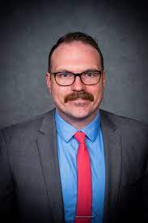


SWG Developmental Grant Awardees
Dustin Long PhD, Associate Professor, Biostatistics
EHE Supplement (with Lynn Matthews)
“Using Big Data to Estimate Undiagnosed HIV Infection and Inform Testing Interventions in Alabama”
R.Matt Gravett MD, Asst. Professor Infectious Diseases
“Does the Crowd Want to Crowdsource? Exploring Opinions on Using Crowdsourcing among MSM in the Deep South.”
K23 NIMH May 2021 “Amplifying Our Voice: Understanding HIV PrEP Promotional Messaging to Create Authentic PrEP Content by Men Who Have Sex with Men in the Deep South.”
Samantha Hill MD MPH, Assistant Professor Adolescent Medicine “Evaluating parental support as a strategy to increase PrEP adherence among adolescents and young adults.”
NIMH K23 Sept 2022 Integration of Trusted supports into the Health Mpowerment app to improve black adolescent and young adult PrEP use.
Oliva Van Gerwen MD Assistant Professor Infectious Diseases
“It’s behaviors, not identity”: Attitudes and beliefs related to HIV risk and pre-exposure prophylaxis among transgender women in the Southeastern United States”

Slide 26
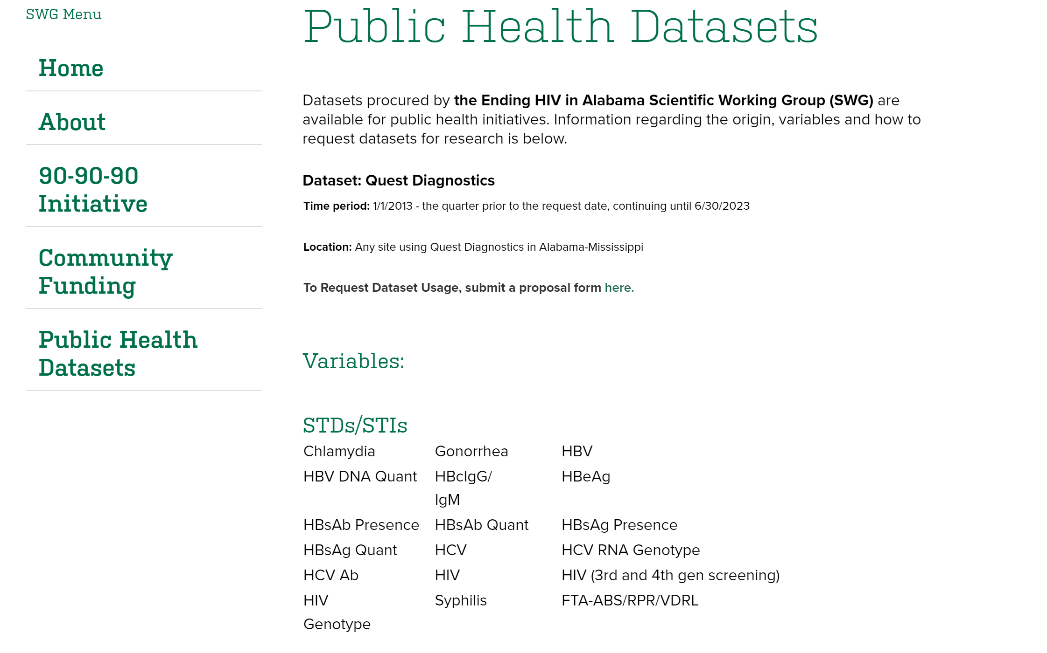
HIV and STI Public Health Data Sets
Notes:
Data driven approaches – disjointed health systems, multiple sources of data – support investigators in preliminary data - Quest, labcorp. State funded testing data

Slide 27
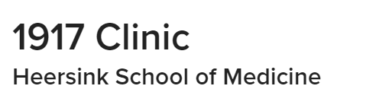
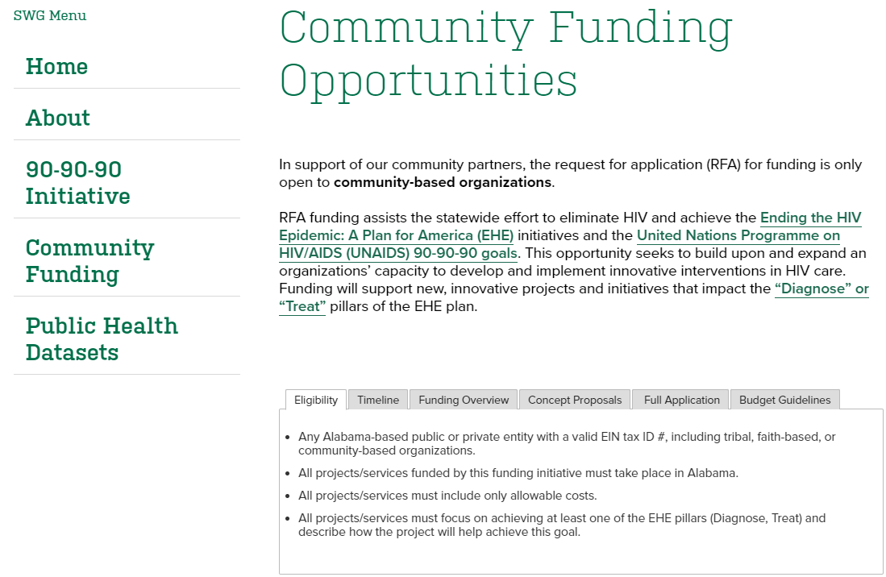




Community Funding Grants
Collaboration of 1917 Clinic 340B funding and UAB CFAR SWG to fund community organizations for developmental and innovative programs addressing Diagnose and Treat pillars of EHE
Notes:
EHE unique opportunity for us to be entreprenuial in our approach – federal agencies must work together! 1917 340B funds, funding opportunity for community organizations submit based on dx /treat; concept proposals, paired with cfar investigator for t.a. evaluation, a

Slide 28
Community Organizations | Project Title | CFAR Collaborator | Impact
AIDS Alabama (2019) | Supporting Healthy Individuals through Engagement, Leadership, and Discussion (SHIELD) | Robin Lanzi, PhD, MPH | Monthly Latinx-focused support group, sponsorship for clients to attend conferences geared towards PLWH SWG presentation: 11/10/21
Birmingham AIDS Outreach (2019) | Hepatitis C 3 (HC3) | D. Scott Batey, DSW Emma Kay, PhD | Additional funding awarded through 1917 Clinic 340B program to focus on HIV, HCV, and substance use prevention & treatment SWG presentation: 1/19/22
Five Horizons Health Services, Tuscaloosa (2020) | Comprehensive Outreach and Retention Program for African Americans (CORA) | Mirjam-Colette Kempf, PhD, MPH | STI/PREP education at HBCUs 2021/2023 EHE CFAR Supplement, “Implementation of HIV Testing and Linkage to PrEP at an HBCU in Alabama” SWG presentation: 10/13/21 (ongoing)
Firehouse Ministries – Developmental with BAO (2020) | Addressing HIV, Health, and Homelessness (AH3) | D. Scott Batey, DSW Emma Kay, PhD | Establishment of new onsite mechanism for testing and linking unhoused PLWH in the Jefferson Co. area by co-locating a BAO case worker SWG presentation: 2/16/21 (ongoing)
Selma AIR (2022) | When Men Talk (WMT) | Matt Gravett, MD Henna Budhwani, PhD | Community HIV education and testing forums in Black Belt Alabama
Health Services Center (2022) | Project FIERCE (Forging Infrastructure for EHE at Rural Colleges and Elsewhere) | Sarah MacCarthy, PhD | HIV/STI testing and PrEP linkage at area colleges in eastern Alabama SWG Presentation 11/18/23
Notes:
3 new grants : Health Services Center Dr. Sarah McCarthy , Selma Air Dr. Matt Gravett , and AIDS Alabama South Dr. Mandy WiligSelma AIR (2022)
When Men Talk (WMT)
Matt Gravett, MD
Henna Budhwani, PhD
Health Services Center (2022)
Project FIERCE (Forging Infrastructure for EHE at Rural Colleges and Elsewhere)
Sarah MacCarthy, PhD

Slide 29

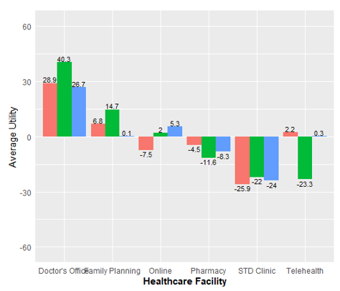
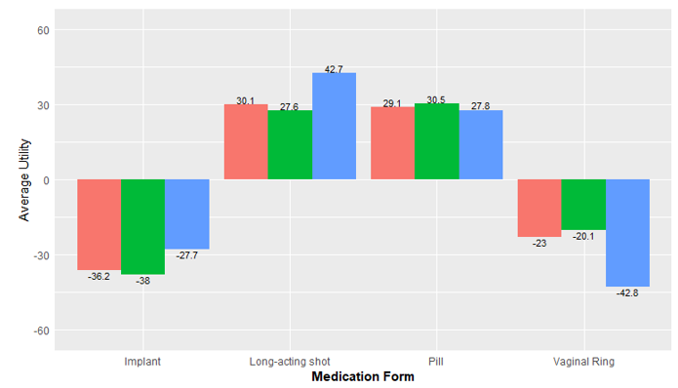

Prevent: HIV PrEP Preferences, African American Women in Rural AL (n=304)
Latesha Elopre, MD, MSPH
Elopre et al. JAIDS 2017;74, Elopre et al. AIDS Pt Care STDs 2018;32

Slide 30

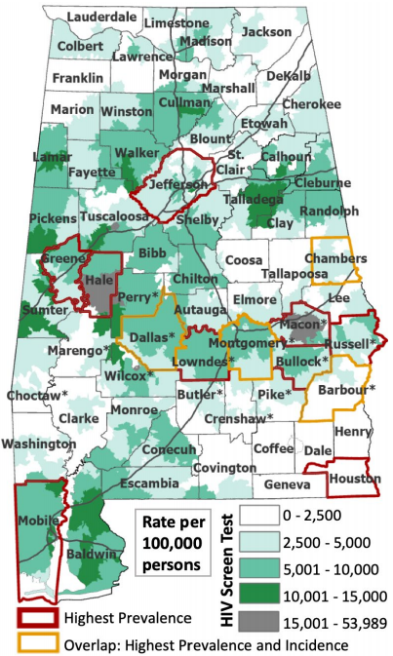


Diagnose: Data Driven, Community-Engaged Mobile Testing in Rural AL
Identification of “cold spots” with low HIV testing rates
Community-engagement: stakeholder interviews to refine stigma reducing PrEP messages
Mobile-based HIV testing in “cold spot” rural counties with community partner MAO
In-depth interviews after roll-out to inform scale-up and dissemination
Lynn Matthews, MD
CFAR EHE Supplement

Slide 31

Geographic Variability in Time from HIV Diagnosis to Viral Suppression in the Deep South: A Roadmap to Accelerated Treatment Initiation
Rana/Batey MPI, R01AI142690

Slide 32
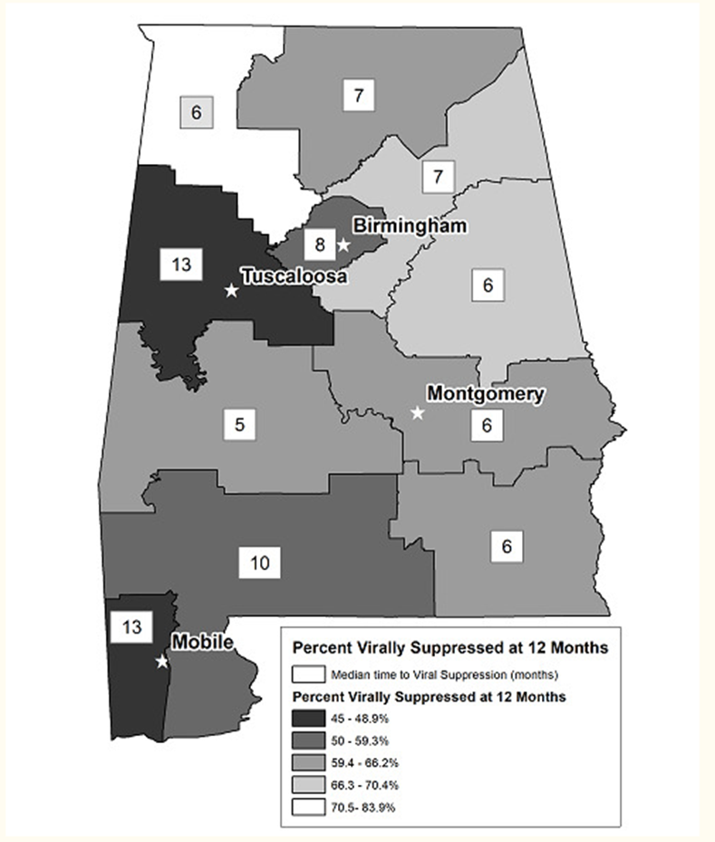
Background
Time to VS is an indicator that captures the collective effectiveness of HIV prevention and treatment activities, including testing, clinical care, ART, and supportive services provided by public health, community-based organizations, and clinical entities, to move persons across the steps of the Continuum.
Dramatic geographic variability in time from HIV diagnosis to VS exists within the US including the Deep South.
Understanding drivers of this heterogeneity is essential to inform individual and population health approaches to ending the epidemic.
Batey et al. Time From HIV Diagnosis to Viral Suppression: Survival Analysis of Statewide Surveillance Data in Alabama, 2012 to 2014 JMIR Public Health Surveill. 2020 Apr-Jun; 6(2)

Slide 33
Methods
We conducted a retrospective, population-based cohort study of all persons ≥ 13 years with newly diagnosed HIV from 2012-2019 in Alabama (AL), Louisiana (LA), and Mississippi (MS), using data collected in the Enhanced HIV/AIDS Reporting System (eHARS).
A common data structure was developed across the three states. Detailed analysis protocols and statistical code were developed by study investigators at UAB in collaboration with HDs, and analyses conducted at the HDs. HDs transmitted summary statistics to UAB where they were combined using meta-analytic techniques.
We used the Kaplan-Meier Method to describe time to VS by year of diagnosis (2012-2015, 2016-2019) in each state.
We conducted state specific and meta-analysis of state-specific Cox Proportional Hazards models to examine associations with age, race/ethnicity, sex at birth, mode of HIV transmission, AIDS Stage at diagnosis, and year of diagnosis.
Notes:
Our first steps were partnering directly with the state health departments in Alabama, Mississippi and Louisiana to conduct a retrospective population based cohort study of of all persons ≥ 13 years with newly diagnosed HIV from 2012-2019 using data collected in the Enhanced HIV/AIDS Reporting System (eHARS), a standardized document-based surveillance database used by all state health departments (HDs) to report to the National HIV Surveillance System.
A common data structure was developed across the three states. Detailed analysis protocols and statistical code were developed by study investigators at UAB in collaboration with HDs, and analyses conducted at the HDs. HDs transmitted summary statistics to UAB where they were combined using meta-analytic techniques.
We used the Kaplan-Meier Method to describe time to VS by year of diagnosis (2012-2015, 2016-2019) in each state. We chose these time periods to reflect changes in national treatment guidelines supporting universal test and treat, as well as shift to integrase inhibitors class as first line regimens which do have a faster time to VS compared to other classes. [in addition, IN mid 2016, Lousiana expanded eligibility for Medicaid, a federal program that provides health coverage to low-income individuals, the only one of these 3 states to do so.
We conducted state specific meta-analysis of Cox Proportional Hazards models to examine associations with available eHARS variables includinggggg age, race/ethnicity, sex at birth, mode of HIV transmission, AIDS Stage at diagnosis, and year of diagnosis.
We conducted state specific meta-analysis of Cox Proportional Hazards models to examine associations with available eHARS variables includinggggg age, race/ethnicity, sex at birth, mode of HIV transmission, AIDS Stage at diagnosis, and year of diagnosis.

Slide 34

 | Mississippi |  |  | Alabama |  |  | Louisiana
 | Year Diagnosed |  |  | Year Diagnosed |  |  | Year Diagnosed
 | 2012 - 2015 (N = 1873) | 2016 - 2019 (N = 1750) | Total (N = 3623) | 2012 - 2015 (N = 2552) | 2016 - 2019 (N = 2444) | Total (N = 4996) | 2012 - 2015 (N = 4366) | 2016 - 2019 (N = 3833) | Total (N = 8199)
Age Group at HIV Diagnosis, n (%)
13-24 | 628 (33.5) | 492 (28.1) | 1120 (30.9) | 776 (30.4) | 699 (28.6) | 1475 (29.5) | 1192 (27.3) | 926 (24.2) | 2118 (25.8)
25-44 | 845 (45.1) | 872 (49.8) | 1717 (47.4) | 1213 (47.5) | 1228 (50.2) | 2441 (48.9) | 2162 (49.5) | 2095 (54.7) | 4257 (51.9)
44+ | 400 (21.4) | 386 (22.1) | 786 (21.7) | 563 (22.1) | 517 (21.2) | 1080 (21.6) | 1012 (23.2) | 812 (21.2) | 1824 (22.2)
Sex at Birth, n (%)
Male | 1461 (78.0) | 1358 (77.6) | 2819 (77.8) | 2023 (79.3) | 1929 (79.0) | 3952 (79.1) | 3222 (73.8) | 2896 (75.6) | 6118 (74.6)
Female | 412 (22.0) | 392 (22.4) | 804 (22.2) | 529 (20.7) | 515 (21.1) | 1044 (20.9) | 1144 (26.2) | 937 (24.4) | 2081 (25.4)
Race/Ethnicity, n (%)
Hispanic/Latino | 50 (2.7) | 54 (3.1) | 104 (2.9) | 82 (3.2) | 59 (2.4) | 141 (2.8) | 185 (4.2) | 236 (6.2) | 421 (5.1)
Black | 1457 (77.8) | 1365 (78.0) | 2822 (77.9) | 1723 (67.5) | 1686 (69.0) | 3409 (68.2) | 3201 (73.3) | 2716 (70.9) | 5917 (72.2)
Other races | 68 (3.6) | 25 (1.4) | 93 (2.6) | 140 (5.5) | 81 (3.3) | 221 (4.4) | 81 (1.9) | 47 (1.2) | 128 (1.6)
White | 298 (15.9) | 306 (17.5) | 604 (16.7) | 607 (23.8) | 618 (25.3) | 1225 (24.5) | 899 (20.6) | 834 (21.8) | 1733 (21.1)
Method of Transmission, n (%)
Heterosexual Contact | 437 (23.3) | 275 (15.7) | 712 (19.7) | 343 (13.4) | 305 (12.5) | 648 (13.0) | 1406 (32.2) | 1022 (26.7) | 2428 (29.6)
IDU Only | 18 (1.0) | 10 (0.6) | 28 (0.8) | 49 (1.9) | 52 (2.1) | 101 (2.0) | 206 (4.7) | 152 (4.0) | 358 (4.4)
Unknown or Other | 369 (19.7) | 591 (33.8) | 960 (26.5) | 716 (28.1) | 805 (32.9) | 1521 (30.4) | 677 (15.5) | 735 (19.1) | 1412 (17.2)
MSM or MSM & IDU | 1049 (56.0) | 874 (49.9) | 1923 (53.1) | 1444 (56.6) | 1282 (52.5) | 2726 (54.6) | 2077 (47.6) | 1924 (50.2) | 4001 (48.8)
Stage, n (%)
Stage 3 | 468 (25.0) | 463 (26.5) | 931 (25.7) | 595 (23.3) | 545 (22.3) | 1140 (22.8) | 1125 (25.8) | 884 (23.1) | 2009 (24.5)
Not Stage 3 | 1405 (75.0) | 1287 (73.5) | 2692 (74.3) | 1957 (76.7) | 1899 (77.7) | 3856 (77.2) | 3241 (74.2) | 2949 (76.9) | 6190 (75.5)
Table statistics are presented as Frequency (Column Percentage)
Notes:
A total of 16,818 people were included in this analysis, with ~3600 in MS, ~5000 in AL, and ~8000 in LA. Across all 3 states, appx ½ of new diagnoses were age 25-44, ¾ reported male sex at birth, over 70% identified as black race. The primary method of transmission was men who have sex with men in slightly less than ½, with 30% reporting heterosexual transmission. Appx ¼ of these new dx presented with advanced dx at CDC stage 3
In all three states, the proportion of those CDC Stage # or higher did not change significantly between the 2 time periods, remaining ~25%.
Stage, n (%)
Stage, n (%)
Not Stage 3
1406 (74.9%)
1288 (73.6%)
2694 (74.3%)
1957 (76.7%)
1899 (77.7%)
3856 (77.2%)
3241 (74.2%)
2949 (76.9%)
6190 (75.5%)
Stage 3
470 (25.1%)
461 (26.4%)
931 (25.7%)
595 (23.3%)
545 (22.3%)
1140 (22.8%)
1125 (25.8%)
884 (23.1%)
2009 (24.5%)
Not Stage 3
1406 (74.9%)
1288 (73.6%)
2694 (74.3%)
1957 (76.7%)
1899 (77.7%)
3856 (77.2%)
3241 (74.2%)
2949 (76.9%)
6190 (75.5%)
Stage 3
470 (25.1%)
461 (26.4%)
931 (25.7%)
595 (23.3%)
545 (22.3%)
1140 (22.8%)
1125 (25.8%)
884 (23.1%)
2009 (24.5%)

Slide 35
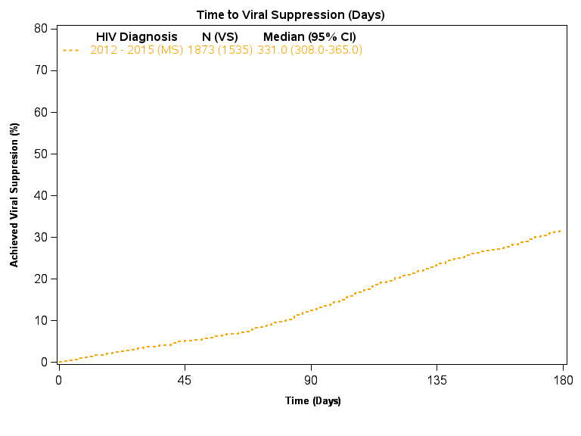
Notes:
Starting of with MS, median time to VS was 331 days in 2012-2015 with <30% achieving VS in 180 days.

Slide 36
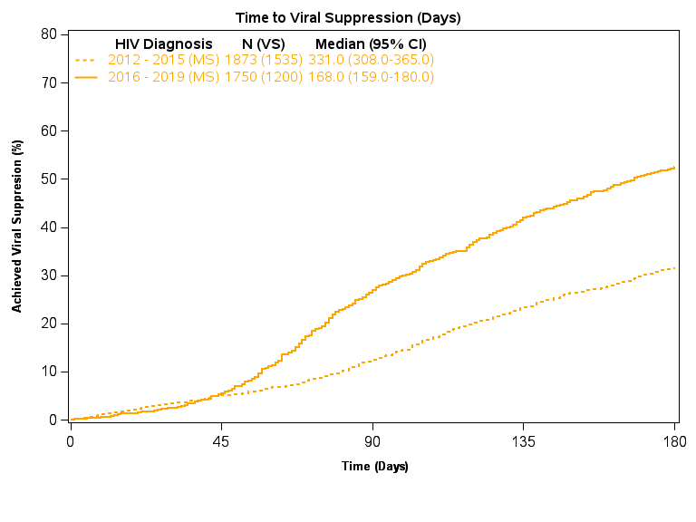
Notes:
This improved a median time of 168 days. With almost 50% achieving VS within 180 days after dx

Slide 37
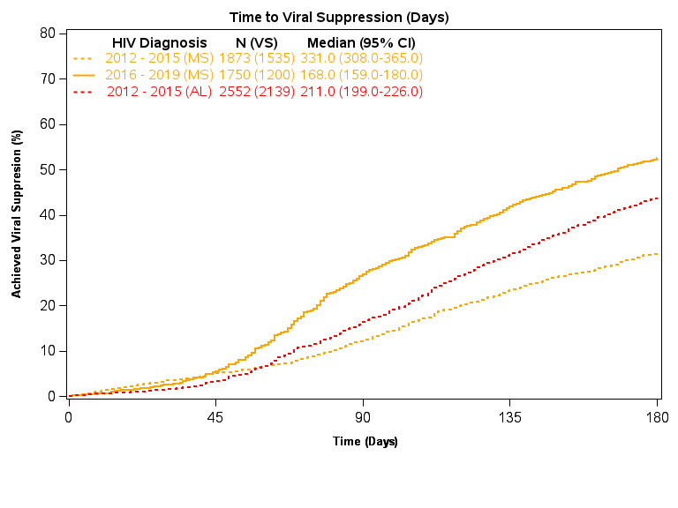
Notes:
Alabama’s initial media ntime to VS was 211 days, with almost 40% achieved VS within 180 days

Slide 38
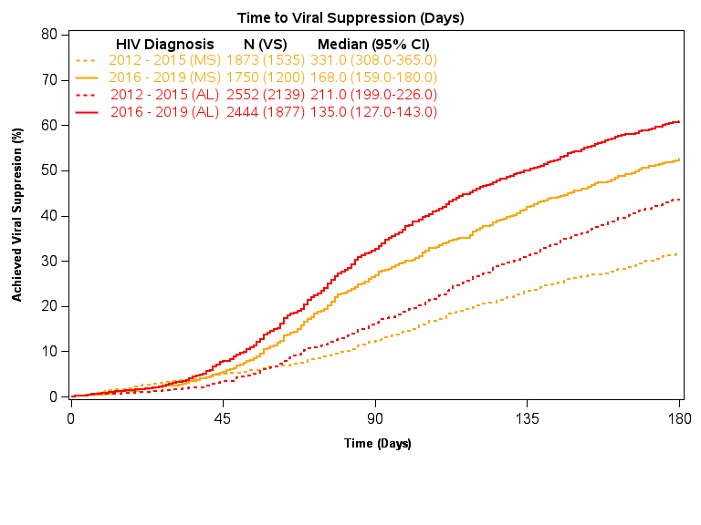
Notes:
This improved to median time to VS reduced to only 135 days with almost 60% achieving VS in 180s

Slide 39
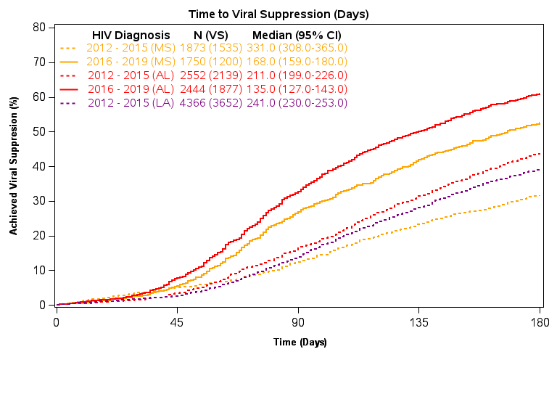
Notes:
Finally, Lousiana, the most populous state in our sample, with a median time of 241 days. With only about 30% of people dx with HIV b/t 2012-2015 achieved VS within 180 days,

Slide 40
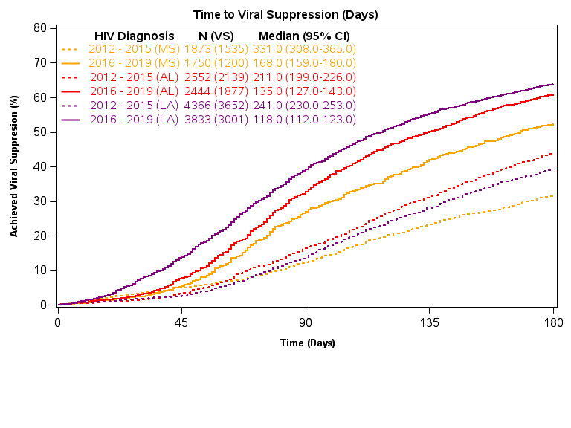
Notes:
We see the most dramatic change in Lousiana with over 60% of new dx achieving VS within 180 days, and a sharply reduced median time to VS of only 118 days. Of note, Louisisana is the only state of these three to expanid medicaid, that occurred on June 1, 2016. ,

Slide 41
Predictors of Time to Viral Suppression (Meta-Analysis)
 | Combined HR ² (95% CI)
Age Group at HIV Diagnosis, n (%)
13-24 | 0.871 (0.826, 0.918)
25-44 | 0.917 (0.876, 0.959)
44+ | Reference
Sex at Birth, n (%)
Male | 0.811 (0.776, 0.846)
Female | Reference
Race/Ethnicity, n (%)
Hispanic/Latino | 0.859 (0.780, 0.946)
Black | 0.819 (0.786, 0.853)
Other races | 0.971 (0.869, 1.086)
White | Reference
Method of Transmission, n (%)
Heterosexual Contact | 0.588 (0.559, 0.619)
IDU Only | 0.638 (0.570, 0.713)
Heterosexual Contact | 0.925 (0.874, 0.979)
MSM or MSM & IDU | Reference
Stage, n (%)
Stage 3 | 1.370 (1.315, 1.428)
Not Stage 3 | Reference
* Adjusted for all other covariates in summary table, with an additional covariate for the year category of diagnosis (2012 – 2015 as the reference) ² Cox Proportional Hazard model
Notes:
In our analyses of variables available in the surveillance data, our findings confirm previously reported predictors of outcomes across the care continuum in the South. Namely, younger age, male sex at birth, non-white race, and non-MSM transmission were associated with longer time to VS; while presenting with advanced and likely symptomatic dz at at diagnosis, was associated with shorter time to VS in both time periods.

Slide 42
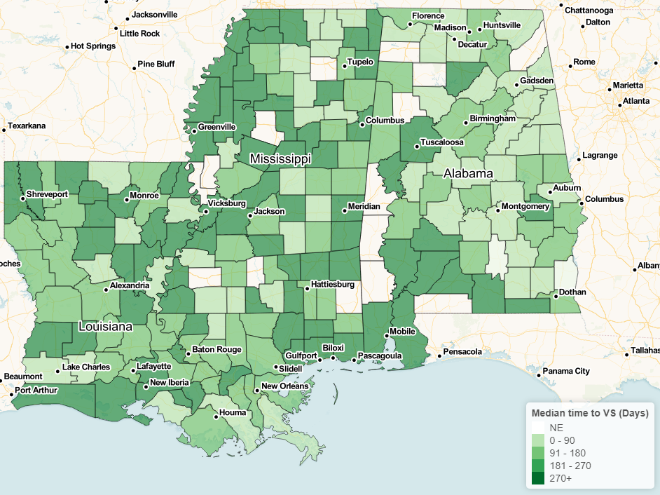
Frailty Model, County (HIV Diagnosis 2012-2015)
Notes:
While the cox proportional hazards model does account tfor some hertorgenity in distribution, individuals with the same value of covariates may not have the same distriubution. To account for unsboserved heterogeneity we peformed a random effects or frailty model with geography as our frailty term.
This handles some unobserved heterogeneity of the hazard distributions
This accounts for correlation of individuals that share the frailty term

Slide 43
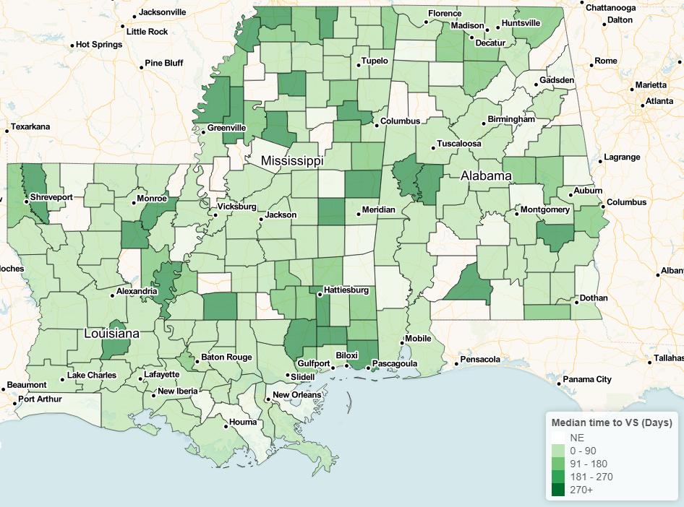
Frailty Model, County (HIV Diagnosis 2016-2019)

Slide 44
Limitations
Southern US region only
Surveillance data may be incomplete due to delays in reporting, or missing data.
Individual-level characteristics will be limited to those ascertained by HIV surveillance and thus will not include factors such as poverty, mental health diagnoses, substance use, as well as community and policy level influences on time to VS
Notes:
There are some limitations to this study. We only analyzed states in the US South so our findings may not be generalizable to other regions of the country. However, this is an area most impacted by the HIV epdimic and prioritized in the EtHE initiative.
This analysis was of surveillance data which has its own limitations. First, the data may be incomplete due to delays in reporting. While all 3 states mandate CD4 and VL reporting, earlier data prior to mandates may be missing.
Also, Individual-level characteristics will be limited to those ascertained by HIV surveillance and thus will not include factors such as poverty, mental health diagnoses, substance use, as well as community and policy level influences on time to VS.
Overall trends in time to VS are improving in AL, LA, and MS which may reflect changing guidelines recommending universal test and treat strategies and better tolerated treatment.
A significant change in earlier time to VS in LA may be related to additional interventions including Medicaid expansion in 2016; localized interventions including rapid start programs can also play a role.
Academic and public health partnerships are vital to directing evidence-based interventions to impact the HIV epidemic. LADPH presented this data at a stregizing meeting to address linkage to care mong new dx, and brought together local leadership and field staff to develop action itemss in particular PHAs with longer time to VS, which may include recruitment of HIV workforce and potential expansion of rapid start programs.
We will next use geospatial analytic tools to assess the impact and interplay of individual, structural, and community level socio-contextual variables on time to VS in these areas of the Deep South

Slide 45

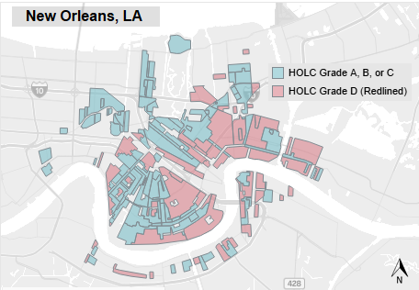
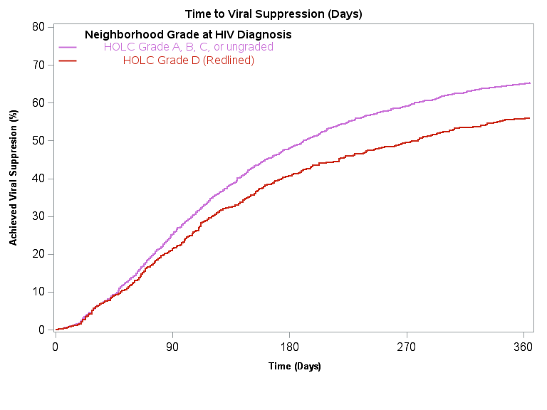

IMPACT OF REDLINING ON TIME TO VIRAL SUPPRESSION AMONG PERSONS DIAGNOSED WITH HIV
877
Lauren Ostrenga¹, John R. Bassler², Dustin M. Long ² , Mariel Parman ³, Michael J. Mugavero ³, Ariann F. Nassel ⁴, Emily B. Levitan⁵, Aadia Rana ³, D. Scott Batey⁶
Background
Developed in the 1930s by the US government, Home Owners' Loan Corporation (HOLC) Security Maps classified residential neighborhoods with populations of 40000 or more into grades based on the alleged investment risk of resident borrowers. Grades ranged from A (mapped as green areas considered “Best”) to D (or red areas that were poorer and predominantly Black neighborhoods considered "Hazardous"), the latter colloquially referred to as “Redlined”.
We seek to assess the association of structural racism through redlining policies on current time to viral suppression (VS) among people newly diagnosed with HIV.
Survival Analysis of Time to Viral Suppression (VS) by Redline Status
 | Total (VS) | Hazard Ratio (95% CI) ^{Cox}
Adjusted survival, HIV Diagnosis within Redlined District
HOLC Grade D (Redlined) | 929 (777) | 0.88 (0.81 - 0.95)
HOLC Grade A, B, C, or ungraded | 2298 (1982) | Reference
Adjusted survival, HIV Diagnosis within Redlined District (HOLC graded only)
HOLC Grade D (Redlined) | 929 (777) | 0.89 (0.79 - 0.99)
HOLC Grade A, B, or C | 606 (523) | Reference
Cox-Gamma Frailty survival, HIV Diagnosis within a Redlined District ¥
HOLC Grade D (Redlined) | 929 (777) | 0.87 (0.78 - 0.96)
HOLC Grade A, B, C, or ungraded | 2298 (1982)
^{Cox} Cox Proportional Hazard model
¥ ZCTA used as Frailty term, and median household income is included as a covariate
Model covariates (All models): Year of HIV Diagnosis, Sex at Birth, Race/Ethnicity, Age at Diagnosis, Method of Transmission, Stage 3 at Diagnosis
Methods
City boundaries were defined by 2020 U.S. Census Bureau Zip Code Tabulation Areas and spatially joined with HOLC-graded neighborhoods. Redlined neighborhood residences of new HIV diagnoses from 2011-2019 were determined using Louisiana HIV surveillance data. Survival analysis of time to VS by redline status were calculated using Kaplan-Meier and Cox proportional hazard models, adjusted for age, race/ethnicity, sex at birth, mode of HIV transmission, and AIDS status at diagnosis (Stage 3 vs other).
Demographics by Redline Status
 | “Redlined” HOLC Grade D (N = 929) | HOLC Grade A, B, or C (N = 606) | No HOLC Grade (N = 1692) | Total (N = 3227)
Residence at HIV Diagnosis
New Orleans, LA | 848 (91.3%) | 443 (73.1%) | 1287 (76.1%) | 2578 (79.9%)
Shreveport, LA | 81 (8.7%) | 163 (26.9%) | 405 (23.9%) | 649 (20.1%)
Sex at Birth (Male) | 734 (79.0%) | 458 (75.6%) | 1266 (74.8%) | 2458 (76.2%)
Race/Ethnicity
Hispanic/Latino | 50 (5.4%) | 47 (7.8%) | 103 (6.1%) | 200 (6.2%)
Black | 688 (74.1%) | 385 (63.5%) | 1324 (78.3%) | 2397 (74.3%)
White | 177 (19.1%) | 160 (26.4%) | 233 (13.8%) | 570 (17.7%)
Other races | 14 (1.5%) | 14 (2.3%) | 32 (1.9%) | 60 (1.9%)
Method of Transmission
MSM or MSM & IDU | 487 (52.4%) | 341 (56.3%) | 890 (52.6%) | 1718 (53.2%)
IDU Only | 64 (6.9%) | 22 (3.6%) | 70 (4.1%) | 156 (4.8%)
Heterosexual Contact | 261 (28.1%) | 166 (27.4%) | 497 (29.4%) | 924 (28.6%)
Unknown or Other | 117 (12.6%) | 77 (12.7%) | 235 (13.9%) | 429 (13.3%)
Results
Of the 3227 PWH analyzed, 929 (28.8%) lived in a redlined neighborhood, 606 (19%) lived in A, B or C HOLC neighborhoods, and 1692 (52%) lived within the city but not in a HOLC graded area. In redlined areas, 74% of PWH were Black as compared to 64% in A, B, and C grade areas, and 78% in non-graded areas. Unadjusted results are presented in the figure, and PWH in redlined areas were 0.83 (95% CI: 0.77 - 0.91) times as likely to achieve VS as PWH in non-redlined areas. The adjusted median time to VS among PWH in redlined areas was 262 days (95% CI: 219 - 294), compared to 195 days (95% CI: 182 - 207) among PWH in non-redlined areas. Additionally, PWH in redlined areas were 0.88 (95% CI: 0.81 - 0.95) times as likely to achieve VS as PWH in non-redlined areas. Final analysis included the application of a Cox-Gamma Frailty model incorporating median household income (from US Census, by ZCTA) using ZCTA as the frailty term. In agreement with the previous analyses, PWH in redlined areas were 0.87 (95% CI: 0.78 - 0.96) times as likely to achieve VS as PWH in non-redlined areas.
Conclusion
Generational inequities and structural racism continue to impact present-day health outcomes. Time to VS was significantly longer for PWH in redlined vs non-redlined communities. Our analysis quantifies the importance of the physical environment on health outcomes in Louisiana, and these findings can inform local EHE strategies and beyond.
Ostrenga et al. CROI 2023
¹ Louisiana Department of Health; ² University of Alabama at Birmingham, Department of Biostatistics; ³ University of Alabama at Birmingham, School of Medicine; ⁴ University of Alabama at Birmingham, Lister Hill Center for Health Policy University of Alabama at Birmingham, ⁵ University of Alabama at Birmingham, Department of Epidemiology; ⁶ Tulane University, Department of Social Work
  NIH/NIAID grant R01AI14269 UAB Center for AIDS Research, Grant P30 AI027767-31

Slide 46

Drive to Zero: Developing a digital cohort to understand the drivers of non-sustained viral suppression in the Deep South
Rana/Batey MPI, 1UG3AI176566 NOA: 8/1/23
DRIVE TO ZERO

Slide 47
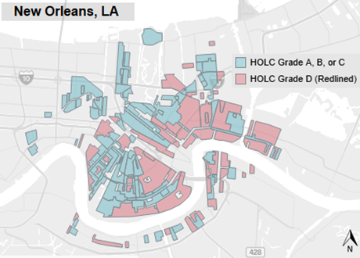
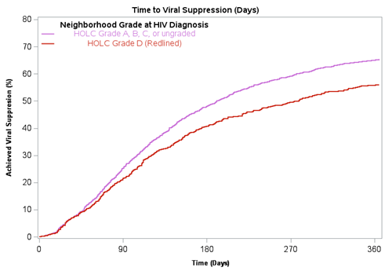
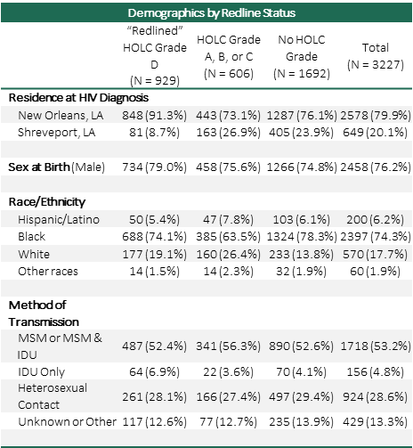
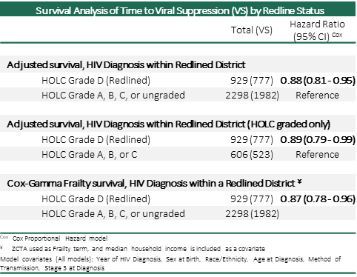

Slide 48
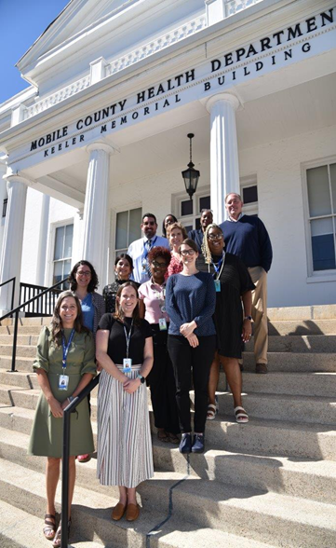




A type 2 hybrid effectiveness-implementation trial to evaluate a population health combination intervention to meet HIV testing, linkage, and viral suppression goals in coastal Alabama
Rana/Matthews MPI | R01AIAI169671

Slide 49
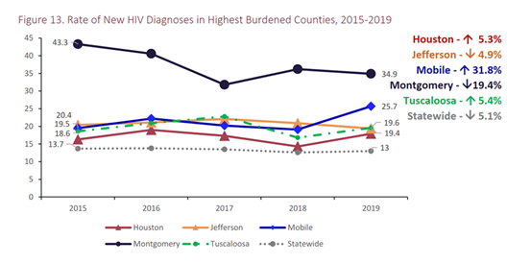

Slide 50
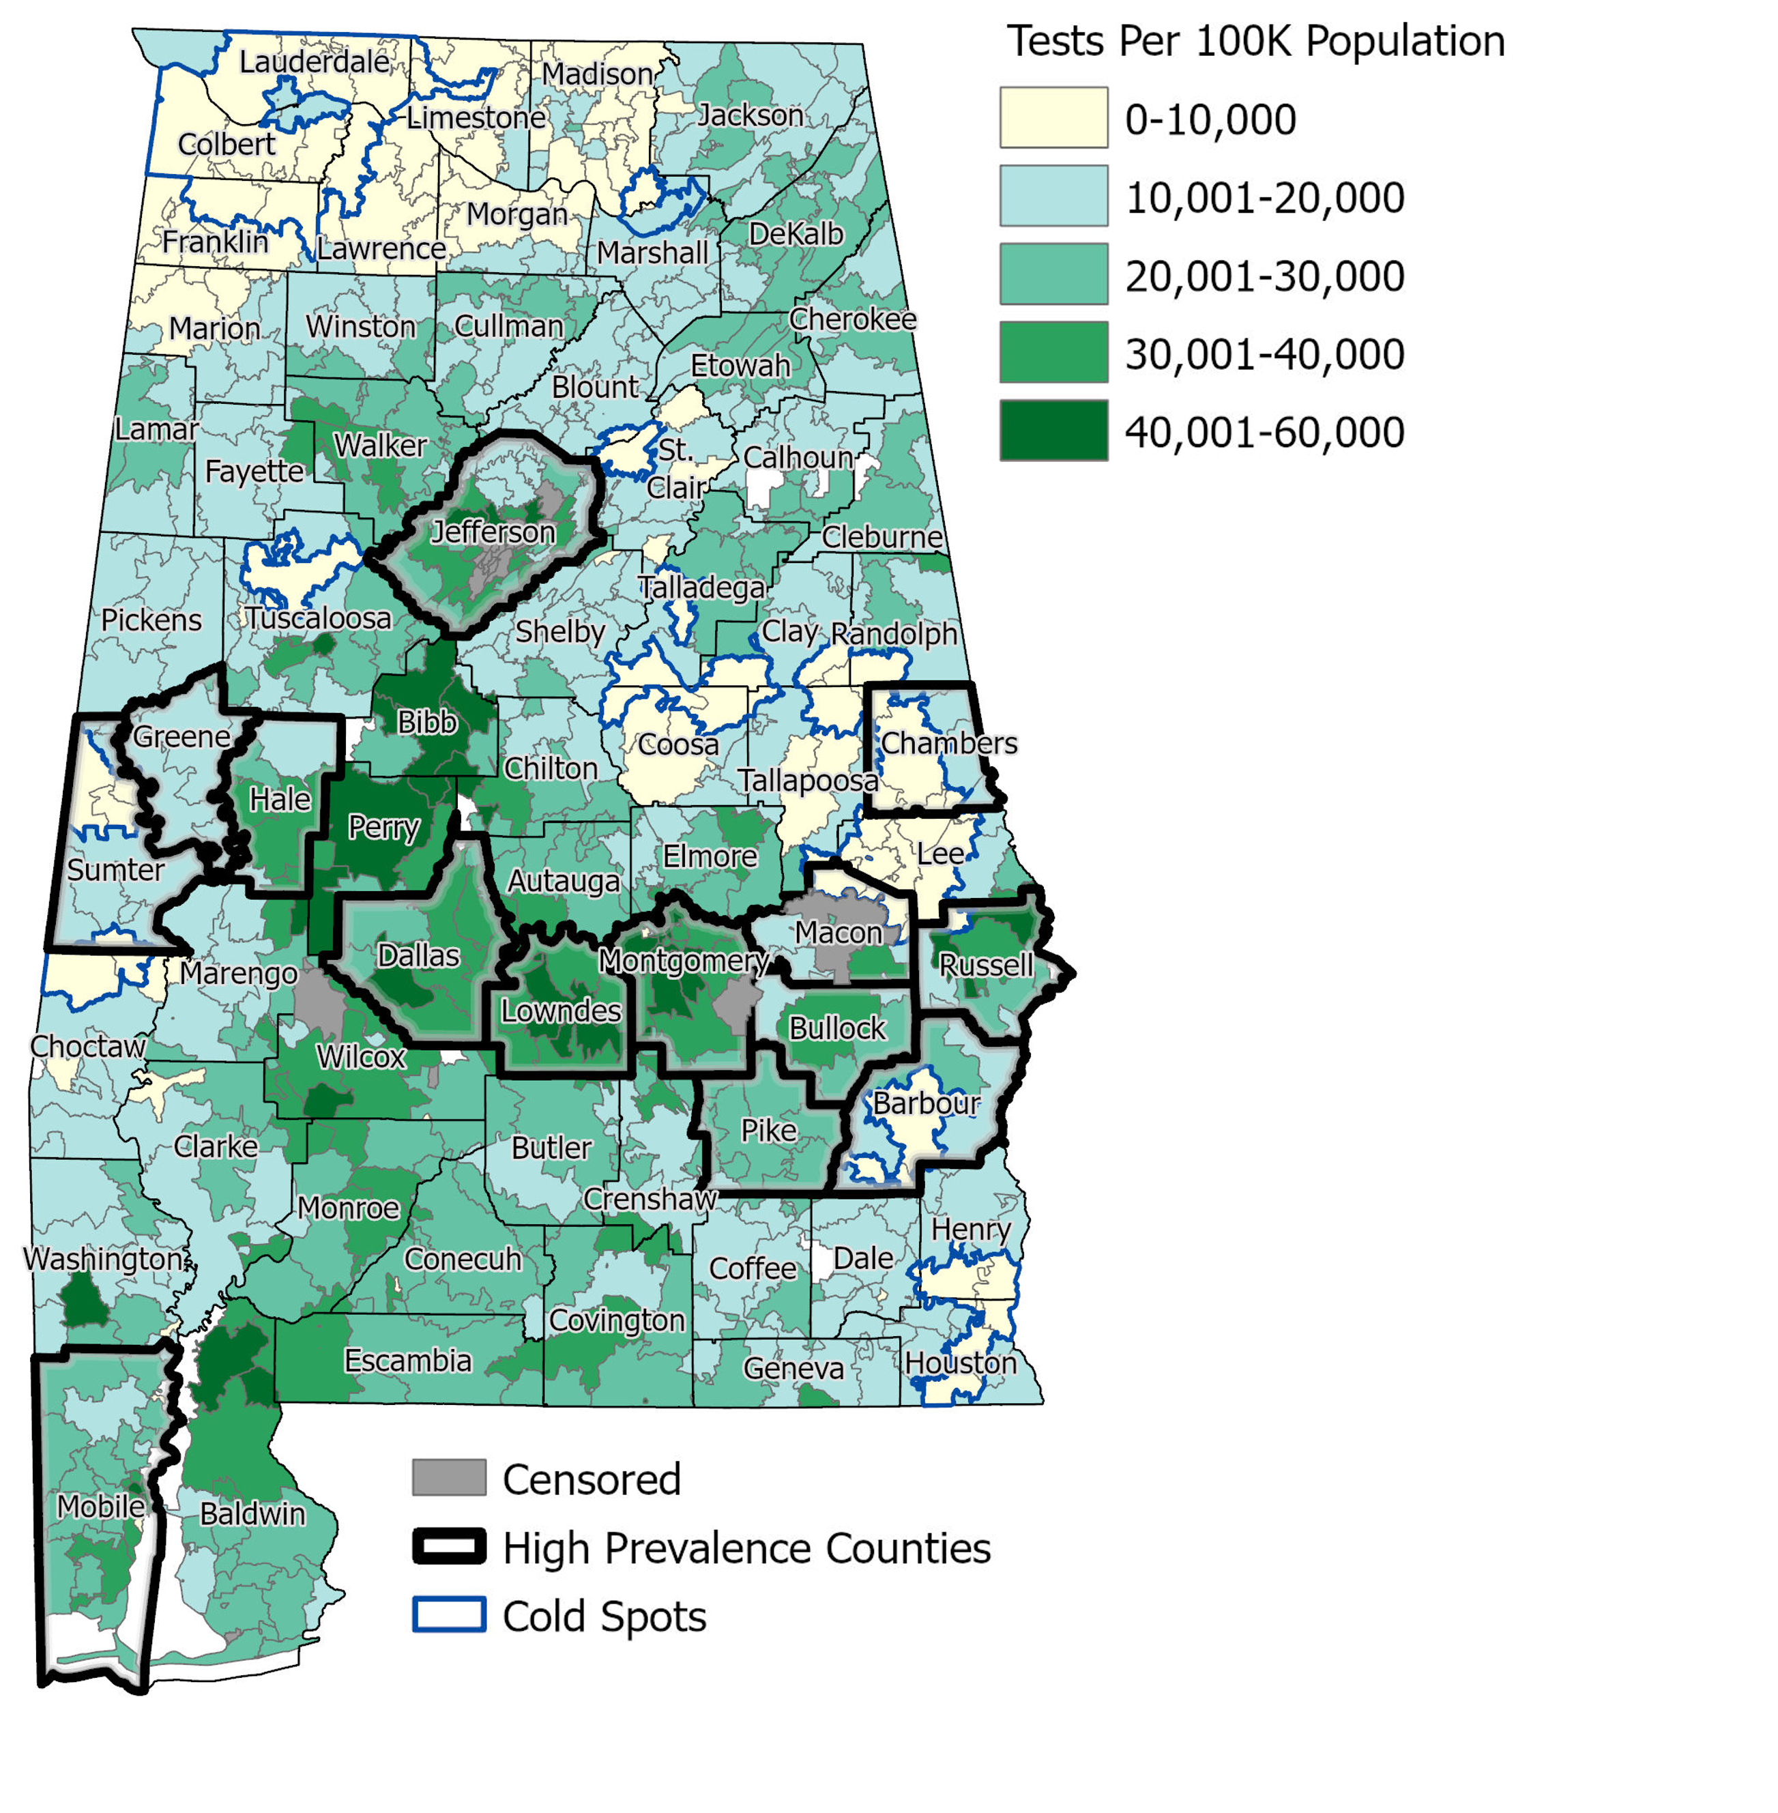

Combination Testing, Linkage, and Viral Suppression Intervention
TEST:
Data-Driven Community Based HIV Testing
Notes:
Replace map with some sort of more general mobile testing and big data cartoon. Computers and mobile tests and people knowintg their status.
This also works in a pinch but make sure it’s the right version of map!
MCP: it is the most updated version of the map – adding a copy slide with mobile testing icons graphics so you can decide to delete one or the other

Slide 51
Using Big Data to Inform Testing Outreach for COAST-AL
Datasets
Quest
2019-2023
HIV Testing Coverage
Identify testing priority areas for HIV testing using geospatial mapping
Testing Sites
Labcorp
2019-2023
HIV-Positivity
ALNBS
2023
Syphilis-Positivity
Abbreviations:
ALNBS - Alabama NEDSS Base Surveillance
Notes:
Hiv testing sites + local knowledge
Pos hiv screens all from commercial testing data
Syphilis pos tests from

Slide 52
Testing priority rankings
Population and Quest / Labcorp commercial data evaluated for
  Testing coverage
  HIV+ testing rate
  % change
4 individuals ranked each zip code’s testing prioritization
  High priority (3)
  Medium priority (2)
  Low priority (1)
 | 2017 - 2019 |  |  |  |  | 2020 - 2022 |  |  |  |  | Percent Change
Population Estimate | HIV Screens | HIV+ tests | Testing Rate per 100K Adults | HIV+ Testing Rate per 100K Adults |  | HIV Screens | HIV+ tests | Testing Rate per 100K Adults | HIV+ Testing Rate per 100K Adults |  | Percent Change in the number of tests | Percent change in the number of POSITIVE tests

Slide 53
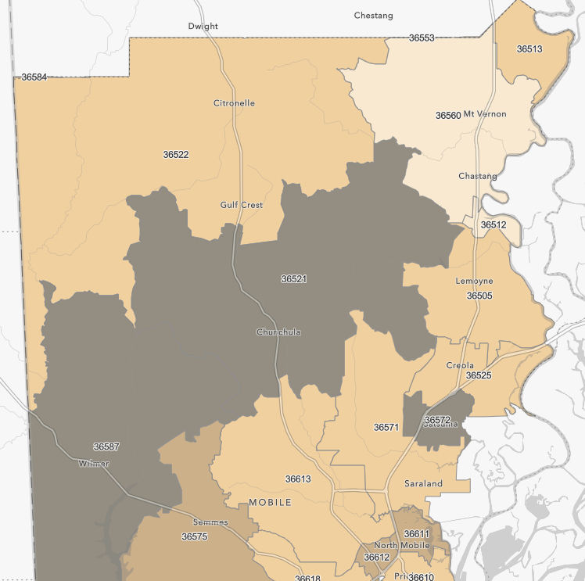
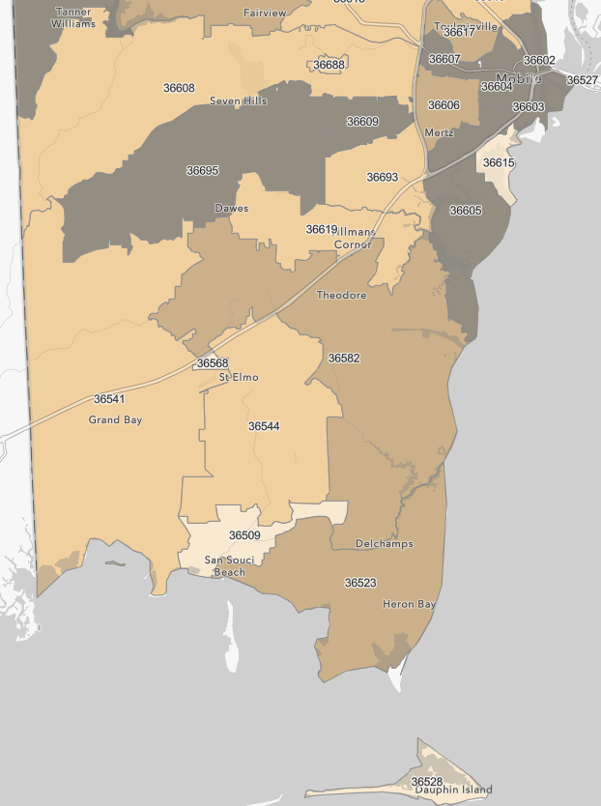
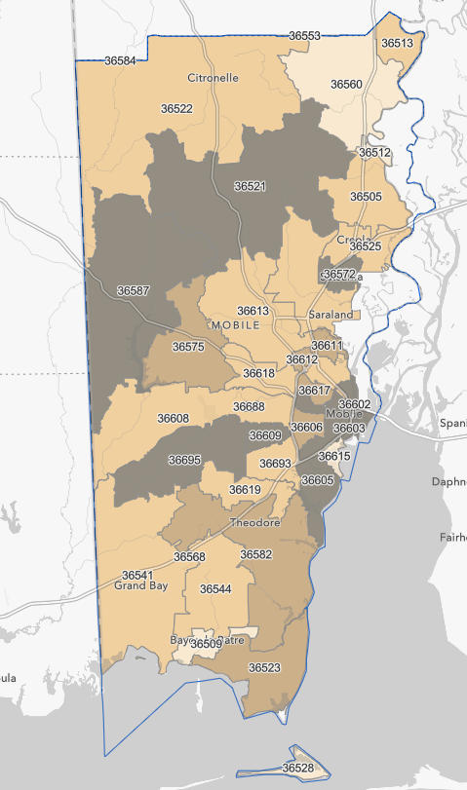
Mobile County HIV Testing Priority Zones
HIV Testing Priority Levels
  2.5 – 3
  1.75 – 2.5
  1 – 1.75
  1
Notes:
For all of these, is it possible to make this have more map and less title / white space? I know the orientation is not favorable
Also can you make the priority level have max 100ths place (e.g. 1.75 instead of 1.751). Can make it >1.75 – 2.5 and >2.5 – 3 for example.

Slide 54
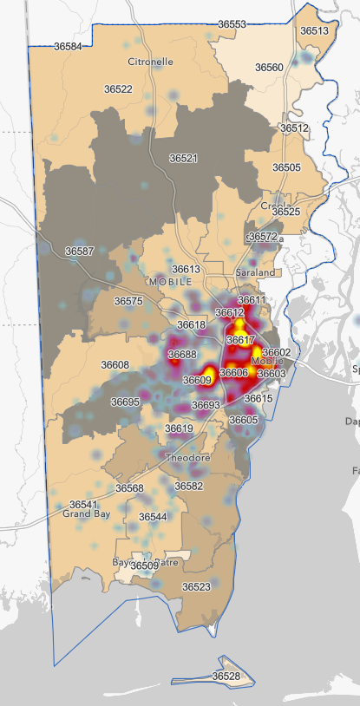
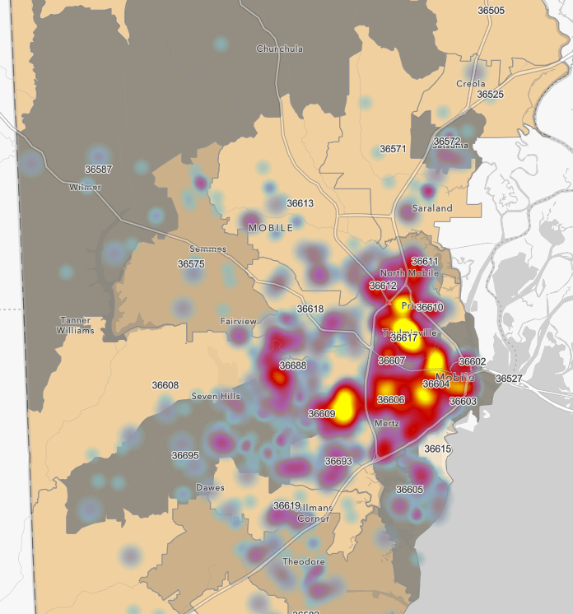
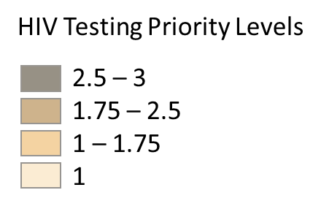


Mobile County HIV Testing Priority Zones, HIV-Positive Tests, & Syphilis-Positive Tests

Slide 55


Combination Testing, Linkage, and Viral Suppression Intervention
LINK:
Adapt Project Connect Using PRAPARE Tool Data-Driven Community Based HIV Testing

Slide 56


Slide 57



Combination Testing, Linkage, and Viral Suppression Intervention
Viral Suppression:
Implementation of Rapid ART programs
Notes:
ADPH Public Health Districts
12 – 15 16 – 19
East Central 208.5 114.8
Jefferson County 245.8 129.0
Mobile County 422.3 161.0
Northeastern 163.8 100.0
Northern 181.3 153.0
Southeastern 178.0 109.5
Southweastern 250.3 152.1
West Central 329.3 154.1
OVERALL 211.0 135.0

Slide 58
DRIVE TO ZERO

Slide 59
Recent cases seen on UAB ID Consult Service
34 year old African-American male initially diagnosed 6 months prior with PJP pneumonia, CD4 10/VL 600K; discharged on tmp/smx but did not engage in care, now admitted with acute liver failure, MRSA endocarditis, acute necrotizing encephalitis
28 year old female admitted to psych for acute psychotic break, not in care, victim of sex trafficking
34 year old male admitted to the MICU for fentanyl overdose, dx with secondary syphilis, out of care for >1 year
20 year old female presented in labor/pre-eclampsia, only 1 prenatal visit in 1st trimester (HIV negative), though did have a ‘sick’ visit in 3rd trimester for UTI symptoms which were treated but no repeat HIV test. Presented 1 month later HIV + and infant also tested positive

Slide 60

HIV Testing
Retained ON PrEP
Prescribed PrEP
Linked to PrEP
Aware of PrEP
At Risk
DHHS EtHE Key Pillars
PREVENT
DIAGNOSE
RESPOND
TREAT
Elopre – PrEP Acceptability in YBMSM (K23)
Elopre – PrEP in Rural AA Women (Harold Amos Award)
Elopre AL PREP Continuum* (EtHE Supplement)
Matthews - Adolesc PrEP (NIH Minority Health Supplement)
Kempf – PrEP in Rural Women (R34)
Harvard/JCDH/Rana – PrEP Modeling using EHR (EtHE Supplement)
Elopre/Gravett – 1917 PrEP Clinic (Care Initiative)
B Turan – Effects of Stigma on PrEP (R01)
Matthews* – Mobile Testing in Rural AL (EtHE supplement)
Kempf – HIV Testing and PrEP Linkage at AL HBCU (EtHE Supplement)
Mugavero – COVID 19 Community Engaged Testing (EtHE supplement)
Heath – DETECT HCV/OUD (CDC/ADPH)
Matthews /Long – Undiagnosed Calculation & Targeted Testing (EtHE Supplement & SWG Pilot)
Heath - UAB ED Testing & Linkage (CDC/ADPH)
Mugavero* - Data 4 Care Alabama (CDC/ADPH)
Rana/Batey - Road 2 Zero (R01)
1917 Fast Track (Care Initiative)
1917 Intensive CM (Care Initiative)
Overton - 1917 Housing/B-FED/Sub Use (CFAR funded)
Overton – Silver Fox Clinic (Care Initiative)
Batey – Birmingham A2C (CFAR Pilot)
Chapman – Mindfulness to Improve adherence in AAWLWH (K23)
Eaton* – R01 HIV+ Service delivery and Telemedicine through Effective PROs
Eaton P01 - Telemedicine for unhealthy Alcohol use in persons Living with HIV using CETA
Community HIV Pilots (CFAR Funded) – 4 Orgs Funded
Clarus Consulting – JCDH Plan (CFAR funded)
Ending the Epidemic State Planning Meeting (Care Initiative)
HIV in the Southeast Inter-CFAR Workgroup
Patterson/Fordham – Transgender Health & HIV (Care Initiative)
EHE National Meeting 2022 (EthE Supplement)
UAB CFAR Implementation Science Consultation Hub (EtHE supplement)
*AQMG partnership
Notes:
Incomplete list

Slide 61













Acknowledgements: Ending the HIV Epidemic in Alabama
Alabama Regional Quality Management Group, Oct 2017
Birmingham HIV front line providers meeting, BAO, Nov 2016

Slide 62
Thank you!
Contact: rana@uab.edu

