Slide 1
Lessons learned and value added from the 2022 King County mpox response
CFAR Seminar – New Faces Speaker
Chase Cannon, MD, MPH
1 Feb 2024

Slide 2
Disclosures
Consultant (Roche Diagnostics)

Slide 3
Overview
State of mpox
What 2022 outbreak taught us and what we don’t yet understand
Value added: research from PHSKC Sexual Health Clinic
Lessons learned here and beyond
Conclusions

Slide 4
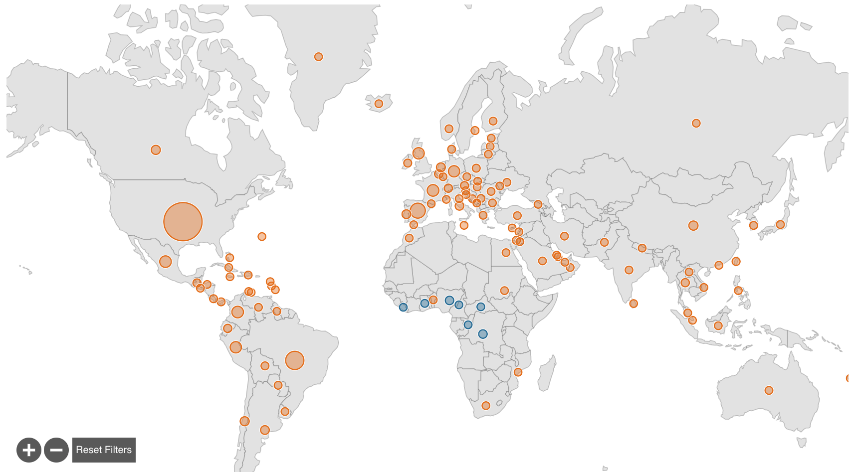
Global mpox cases
92,546 cases
2% in endemic
98% in non-endemic
cdc.gov; as of 27 Jan 2024
Notes:
Declared global emergency in July 2022 by WHO
Cases: 117 total countries (110 non-endemic, 7 endemic) – size of dot corresponds to size of outbreak. US has most cases than 2nd country Brazil by almost 3-fold
Deaths: 55 in USA, 34 in MX, <20 each in Peru & Brazil, 89 in Nigeria and fewer other places.

Slide 5
US mpox case trends: 2022-2023
cdc.gov; as of 24 Jan 2024
Notes:
Bump here from Sept to Dec with 35 cases

Slide 6
Dynamic increase in published literature on mpox since 1962
2001-2021: 754
2022: 1610
1962-2000: 205
2023: 2215
PubMed MeSH title/abstract terms: mpox OR monkeypox, 27 Jan 2024
Notes:
As a result of this most recent mpox pandemic, the amount of published literature has also impressively increased in the last 2 years compared to the last several decades.

Slide 7
What we discovered about mpox from 2022-2023
Transmission is primarily human-to-human via close, intimate contact¹
Over 95% among cis men; disproportionate impact on people of color (64%)²
Distinct clinical features of clade IIb MPXV^{3,4}
Low overall mortality ≤1%
Mild or absent prodrome may not precede rash
Lesions in varying stages of development
LAD, tonsillitis/pharyngitis, severe anogenital disease (proctitis), etc.
Mpox declared an OI – higher mortality, more severe disease among PWH with low CD4 counts or unsuppressed viral load⁵
1) Philpott, et al. MMWR, 2022; 2) US CDC Case demographics, cdc.gov (2024); 3) Adler, et al. Lancet 2022; 4) Patel, et al. BMJ 2022; 5) Mitjà et al, Lancet 2023
Notes:
Most of these are clinical or epidemiologic features

Slide 8
Other questions remain unsettled…
What is the role of human-human respiratory transmission? Low likelihood¹
Is presymptomatic transmission of mpox possible? Seems so²
Extent of undiagnosed cases in communities with low access to care? 5-8%?³
Is MVA effective for circulating clade IIb virus in this outbreak? Yes, 80-85%⁴
True population-level effectiveness of vaccine as PrEP or PEP? Challenging⁵
Is vaccination necessary after mpox infection? Probably not
Durability of immunity - will a booster for mpox be necessary? Unlikely to be recommended
1) Beeson, et al. Lancet Microbe, 2023; 2) Brosius, et al. J Med Virol 2023; 3) Minhaj, et al. Emerg Infect Dis 2023; 4) Ramchandani, et al. OFID 2023; 5) Rosen, et al. Vaccine 2024
Notes:
1: From a review of different types of studies in laboratories, among animals and humans: “Resp transmission not specifically implicated”
2: Prospective longitudinal cohort study of mpox contacts with high-risk exposure, ~50% eventually tested positive, some with replication competent virus
3: Surveillance studies and testing of remnant STI samples
4: Various studies with a range from 36-90%. Our SHC found this. CDC planning larger multisite study to further eval
5: Study looked at real world data from NYC – using time to PEP with incubation period approach overestimated PEP effectiveness

Slide 9
Other questions remain unsettled…
What is the role of human-human respiratory transmission? Low likelihood¹
Is presymptomatic transmission of mpox possible? Seems so²
Extent of undiagnosed cases in communities with low access to care? 5-8%?³
Is MVA effective for circulating clade IIb virus in this outbreak? Yes, 80-85%⁴
True population-level effectiveness of vaccine as PrEP or PEP? Challenging⁵
Is vaccination necessary after mpox infection? Probably not
Durability of immunity - will a booster for mpox be necessary? Unlikely to be recommended
Can tecovirimat be initiated based on a presumptive clinical mpox diagnosis?
How does treatment with tecovirimat for mpox affect clinical outcomes?
1) Beeson, et al. Lancet Microbe, 2023; 2) Brosius, et al. J Med Virol 2023; 3) Minhaj, et al. Emerg Infect Dis 2023; 4) Ramchandani, et al. OFID 2023; 5) Rosen, et al. Vaccine 2024

Slide 10
Clinical diagnosis predicts laboratory-confirmed mpox
Chase Cannon, Ellora Karmarkar, Meena Ramchandani, Julie Dombrowski, Matthew Golden

Slide 11
Background and rationale
Many challenges in early 2022 epidemic
Few providers were familiar with clinical manifestations of clade IIb mpox
CDC treatment criteria: most pts qualified
Treatment and testing were limited – extensive documentation, approvals, counseling, etc. required
PHSKC SHC was only 1 of 2 sites in King County evaluating and treating patients
Benefits of clinical diagnosis
Improved patient care, decreased anxiety, convenience, etc.
Earlier initiation of pharmacologic treatment is better for most viral infections (e.g., HSV, VZV, SARS-CoV-2)
WAIT?
cdc.gov; Gottlieb RL et al, NEJM 2022; Muthuri SG et al, Lancet Respir Med 2014; Tyring S et al, Ann Intern Med 1995
Notes:
Also keep patient from having to come back –infection control implications

Slide 12
Clinical mpox diagnosis: Methods
Study objectives
To evaluate the accuracy of clinical diagnosis of mpox
Determine extent to which empiric prescribing facilitated rapid treatment for persons with mpox and avoided overtreatment absent mpox
Data: REDCap demographics and clinical entered by DIS, EHR data, staff follow-up calls from July – Sept 2022
Treatment based on then CDC criteria
Clinician suspicion: high, intermediate, low/none
Analysis: Sensitivity, specificity, positive predictive value (PPV), negative predictive value (NPV) of clinical mpox dx against PCR gold standard; chi-square for presumptive vs results-based treatment, HIV vs not, etc.
Cannon, et al. STD 2024 (forthcoming)
Notes:
Clinicians had high suspicion for mpox based on the presence of three or more factors known to be associated with clade IIB mpox virus infection including current or recent constitutional symptoms (fever, myalgias, low energy, etc.); lymphadenopathy; presence of macular, papular, vesicular and/or pustular lesion(s) with increased suspicion if features were characteristic (i.e., umbilicated, well-circumscribed, painful and/or present in oropharyngeal or anogenital areas); presence of proctitis, rectal bleeding, tenesmus, pharyngitis, and/or genital swelling; and reported close intimate or sexual contact with a person diagnosed with mpox in the preceding 21 days. Clinicians had intermediate suspicion for mpox if patients had two or fewer of these factors and an alternative etiology (e.g., herpes simplex) was deemed as likely. Low suspicion was defined as presence of one or none of these factors associated with mpox in a person without epidemiologic risk.

Slide 13
Demographics
 | N=319 (%)
Age, years (median [IQR]) | 34.5 [28-44]
Birth sex
Female | 30 (9.4)
Male | 254 (79.6)
Missing | 35 (11.0)
Current gender
Cisgender man | 281 (88.4)
Cisgender woman | 27 (8.5)
Transgender, non-binary or genderqueer | 10 (3.1)
Race/Ethnicity
Latine/Hispanic | 68 (21.5)
Asian NH | 23 (7.3)
Black NH | 21 (6.6)
Multiracial, NHOPI or AI/AN | 10 (3.2)
White NH | 179 (56.7)
Unknown or refused | 15 (4.7)
Cannon, et al. STD 2024 (forthcoming)

Slide 14
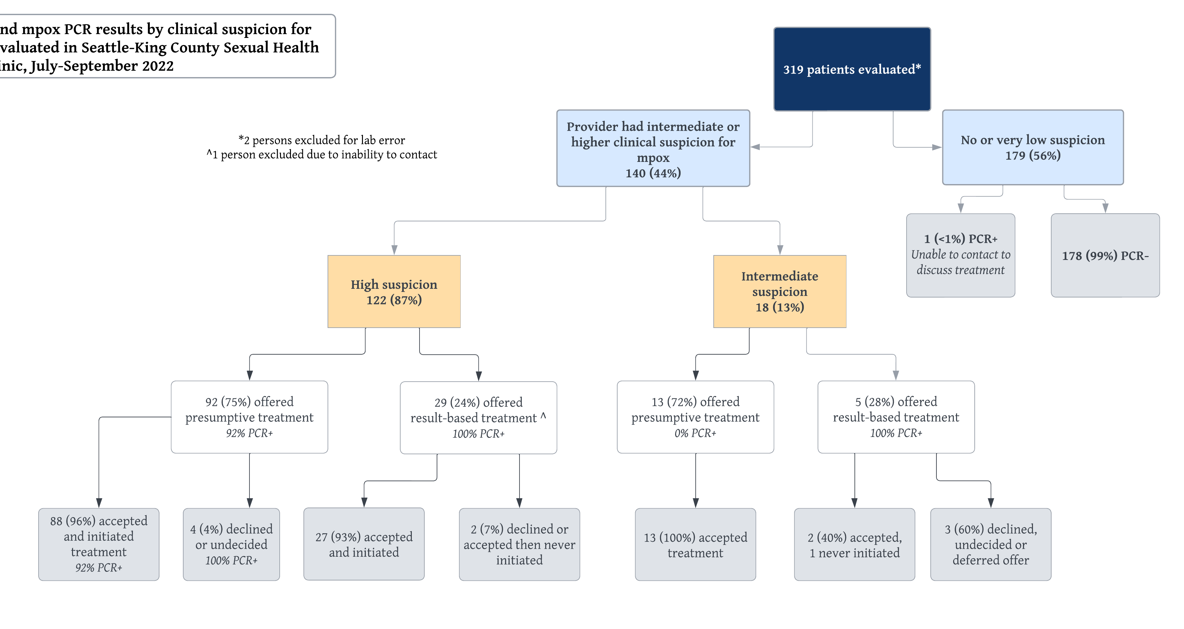
SHC mpox care cascade: July-Sept 2022
Cannon, et al. STD 2024 (forthcoming)

Slide 15
SHC mpox care cascade: July-Sept 2022
Cannon, et al. STD 2024 (forthcoming)

Slide 16
SHC mpox care cascade: July-Sept 2022
Cannon, et al. STD 2024 (forthcoming)

Slide 17
SHC mpox care cascade: July-Sept 2022
Cannon, et al. STD 2024 (forthcoming)

Slide 18
Clinical diagnosis is highly predictive of mpox
Clinical suspicion at initial evaluation | Sensitivity | Specificity | Positive predictive value (PPV) | Negative predictive value (NPV)
High | 95% | 96% | 95% | 97%
Cannon, et al. STD 2024 (forthcoming)

Slide 19
Clinical diagnosis is highly predictive of mpox
Clinical suspicion at initial evaluation | Sensitivity | Specificity | Positive predictive value (PPV) | Negative predictive value (NPV)
High | 95% | 96% | 95% | 97%
High or intermediate | 99% | 90% | 86% | 99%
Cannon, et al. STD 2024 (forthcoming)

Slide 20
Clinical diagnosis is highly predictive of mpox
Clinical suspicion at initial evaluation | Sensitivity | Specificity | Positive predictive value (PPV) | Negative predictive value (NPV)
High | 95% | 90% | 95% | 97%
High or intermediate | 99% | 90% | 86% | 99%
Intermediate | 83% | 93% | 28% | 99%
Cannon, et al. STD 2024 (forthcoming)

Slide 21
Clinical mpox diagnosis in PWH
Of 119 pts with mpox and available serostatus data, 24 (20%) had HIV
Proportion of pts diagnosed with mpox who had HIV was higher than in those without (57% vs 36%, P=0.001)
Clinicians more often had H/I suspicion in PWH (69% vs 42%, P=0.0009)
No difference in who offered presumptive therapy among PWH vs those without (77% vs 75%, P=0.63)
Sensitivity of clinical diagnosis was higher (100%) and PPV slightly lower (83%) for H/I suspicion in PWH
Cannon, et al. STD 2024 (forthcoming)
Notes:
Bullet 1: denominator is all people diagnosed with mpox
Bullet 2: denominator is all PWH vs all Pw/oH
Sens higher, PPV a little lower

Slide 22
Clinical mpox diagnosis: Results in context
Providers in our SHC were able to accurately diagnose mpox based on clinical evaluation alone and provide same-day tecovirimat to 71% of all pts with lab-confirmed mpox
101 pts were offered and initiated same-day tecovirimat; likely yielding a shorter duration of severe symptoms among those with mpox
Clinical diagnosis alone can support early treatment in eligible patients – especially important for PWH and low CD4 counts or unsuppressed VL
High clinical suspicion overall but higher among those with HIV and confirmed mpox
Would/will this differ now that epidemic has substantially diminished?
Notes:
How do we pull results together and why do I think this is important for the field?

Slide 23
Association of tecovirimat therapy with mpox symptom improvement: a cross-sectional study – King County, Washington, May-October 2022
Ellora Karmarkar, Matthew Golden, Roxanne Kerani, Sargis Pogosjans, Eric Chow, Rachel Bender-Ignacio, Meena Ramchandani, Meagan Kay, Chase Cannon, Julie Dombrowski

Slide 24
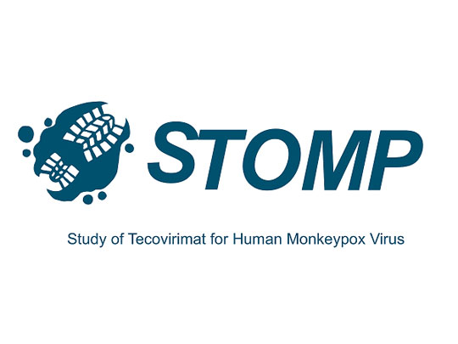
Tecovirimat for symptom improvement
Extent to which tecovirimat improves sx is not well known
Study objective: To evaluate median time to self-reported symptom improvement and illness resolution, stratified by severity and timing of tecovirimat receipt (untreated vs early [≤5d after onset] vs late [5-28d after onset])
Data: PH surveillance data + structured interviews of KC residents diagnosed with mpox who received treatment from May – October 2022
Analysis: Multivariable linear regression adjusted for co-morbidities (HIV, diabetes, etc.), age, race/ethnicity, SOGI, level of education, vaccination status; Kruskal-Wallis test
Karmarkar, et al. OFID 2024
Notes:
Most evidence from animal challenge models, which is why STOMP
Illness severity: severe defined as pain requiring narcotics or lidocaine, rectal bleeding, tenesmus or proctitis, phimosis, difficulty swallowing, >=100 lesions, hospitalization, c/f bacterial superinfection
Adjustment variables: age, race/ethnicity, HIV status, year of last SHC visit, meth use in last year, GC or syphilis in last year, >10 partners in last year. All covariates sig in bivariate model except for race/eth

Slide 25
Participant demographics
Race/Ethnicity | N=465 (all King County) | N=115 (Interviewed)
Non-Hispanic White | 205 (44.1%) | 67 (58.3%)
Hispanic/Latine | 118 (25.4%) | 30 (26.1%)
Black or African American | 45 (9.7%) | 13 (11.3%)
Multiracial | unknown | 10 (8.7%)
Asian or South Asian | 26 (5.6%) | 7 (6.1%)
Other/Unknown | 55 (11.8%) | 4 (3.5%)
Alaska Native or American Indian | 16 (3.4%) | 4 (3.5%)
Native Hawaiian, other Pacific Islr. | unknown | 2 (1.7%)
Most interviewed participants were also college educated (n=63, 55%), and cisgender men (n=103, 90%).
Karmarkar, et al. OFID 2024
Notes:
Attempted to oversample race/ethnicity groups – mostly successful apart from those with other/unk race/eth

Slide 26
Tecovirimat for symptom improvement
Tecovirimat status* | Median Days to improvement (IQR) | Difference in days [P-value] | Median days to resolution (IQR) | Difference in days [P-value]
Severe Disease (n=65)
No tecovirimat (n=20) | 15 (10-18) | Ref. | 21 (18-31) | Ref.
Any tecovirimat (n=45) | 10.5 (7-16) | -4.5 [0.27] | 20 (14-28) | -1 [0.56]
Tecovirimat within 5 days symptom onset (n=24) | 7.5 (6-13) | -7.5 [0.007]** | 17.5 (12-26) | -3.5 [0.11]
Tecovirimat 5d < T < 28d after symptom onset | 16 (10-23) | 1 [0.49] | 26 (17-28) | 5 [0.6]
Factors associated with improved outcomes
Time to symptom improvement if severe disease: early tecovirimat (-5.5d, P=0.04)
Time to illness resolution if non-severe disease
Younger age (-0.5d per year, P=0.007)
MSM identity (-8.1d, P=0.006)
*Table differences by Kruskal-Wallis testing
Karmarkar, et al. OFID 2024
Notes:
Here I’m showing data from the 65 patients with severe mpox. The table is a bit complex, but to orient you: across the top is median days to either symptom improvement or illness resolution and the difference in days compared to the referent group of people who did not receive treatment. The 3 comparison groups are persons who receive any tecovirimat, those who got early treatment or those who were treated later. Overall tecovirimat seemed to reduce the number od days to sx improvement and illness resolution, except for those who were treated late. CLICK.
The statistically significant result here is that people with severe mpox who were treated within 5d of sx onset saw improvement nearly 8d faster than people who were not treated. In the adjusted logistic regression models, this remained significant for severe disease. For non-severe mpox, younger age and MSM identity were a/w shorter time to illness resolution.

Slide 27
Tecovirimat clinical outcomes: Results in context
For severe mpox disease, initiation of tecovirimat within 5d of symptom onset is associated with faster subjective improvement but may not hasten complete illness resolution
Results support early offer and initiation of tecovirimat for severe mpox, even prior to laboratory confirmation
Like other viral illnesses, older adults may experience slower time to recovery
Power may have been limited to detect change in time to illness resolution or for non-severe disease; patient recall is limitation

Slide 28
What we learned from the 2022-2023 outbreak…
Not so good
Ok, could have been better
Disproportionate effect on GBMSM, communities of color
Bungled vaccine rollout in US; “hoarding” of vaccine
Limited $$ for public health aid
Inequitable access for treatment and prevention to key populations and entire countries
Clinical trials for primary data collection initiated too late
Fairly early declaration of public health emergency
Relatively early pivot to messaging about “intimate contact” rather than sex only
More rapid dissemination of information compared to prior epidemics
Earlier (though limited) involvement and collaboration with queer community

Slide 29
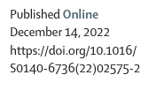
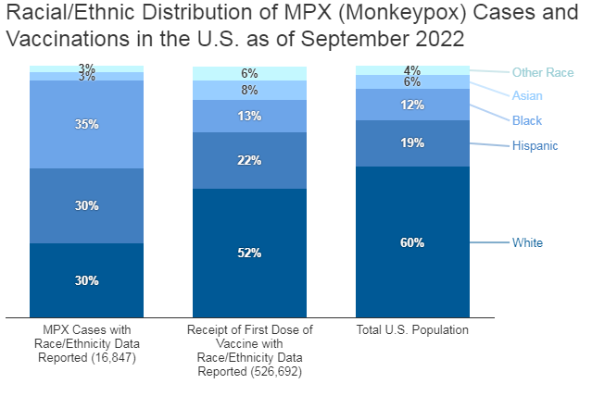
Trust and equity are 2 factors that determine a successful pandemic response.
Success was due to grassroot activities. The gay community took it upon themselves to step in when the government response was lacking…
KFF, 5 Oct 2022
Notes:
Jan 31 end of national emergency

Slide 30
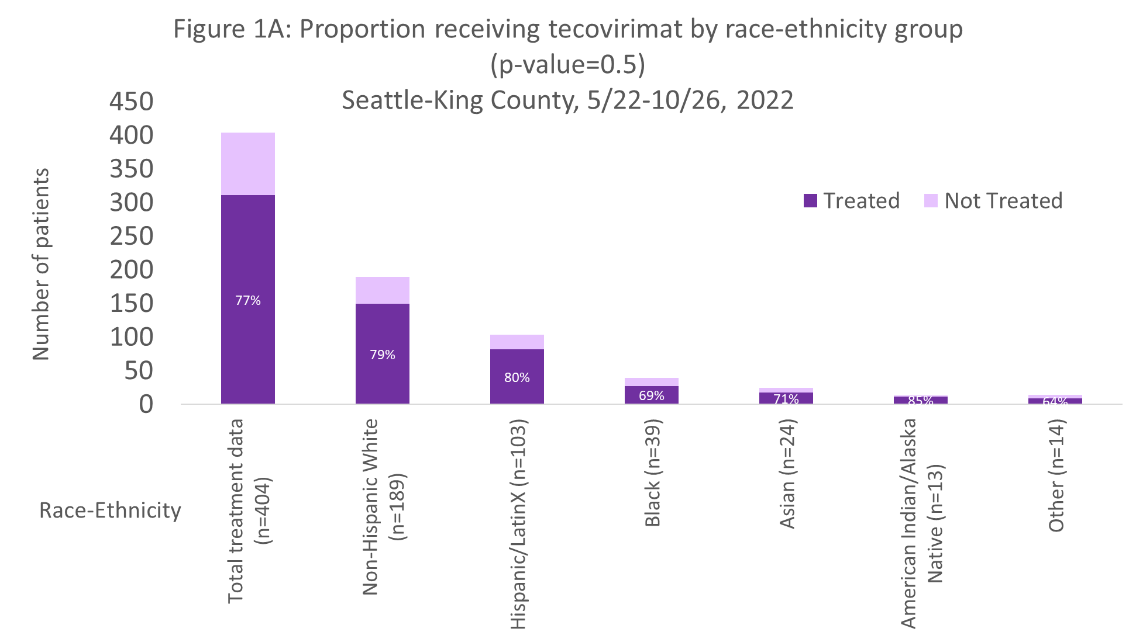
No significant difference by race/ethnicity in time to testing or treatment or tecovirimat provision in King County
Karmarkar & Cannon, et al. CROI 2023 Abstract 913

Slide 31
Asymptomatic and subclinical mpox: an association with modified vaccinia Ankara (MVA) vaccine
Matthew Golden, Olusegun Soge, Margarete Mills, Anna Berzklans, Chase Cannon, Meena Ramchandani, Julie Dombrowski, Eric Chow, Jolene Gov, Alfred Iqbal, Paul Swenson, Alex Greninger
STD 2024 (Forthcoming)
The Sexual Health Clinic role in vaccine and treatment access during the 2022 mpox outbreak in King County, Washington
Ellora Karmarkar & Chase Cannon, Matthew Golden, Christina Thibault, Kaitlin Zinsli, Joong Kim, Sargis Pogosjans, Eric Chow, Michal Blum, Susannah Herrmann, Negusse Ocbamichael, Meena Ramchandani, Julie Dombrowski
STD 2024 (Under review)

Slide 32
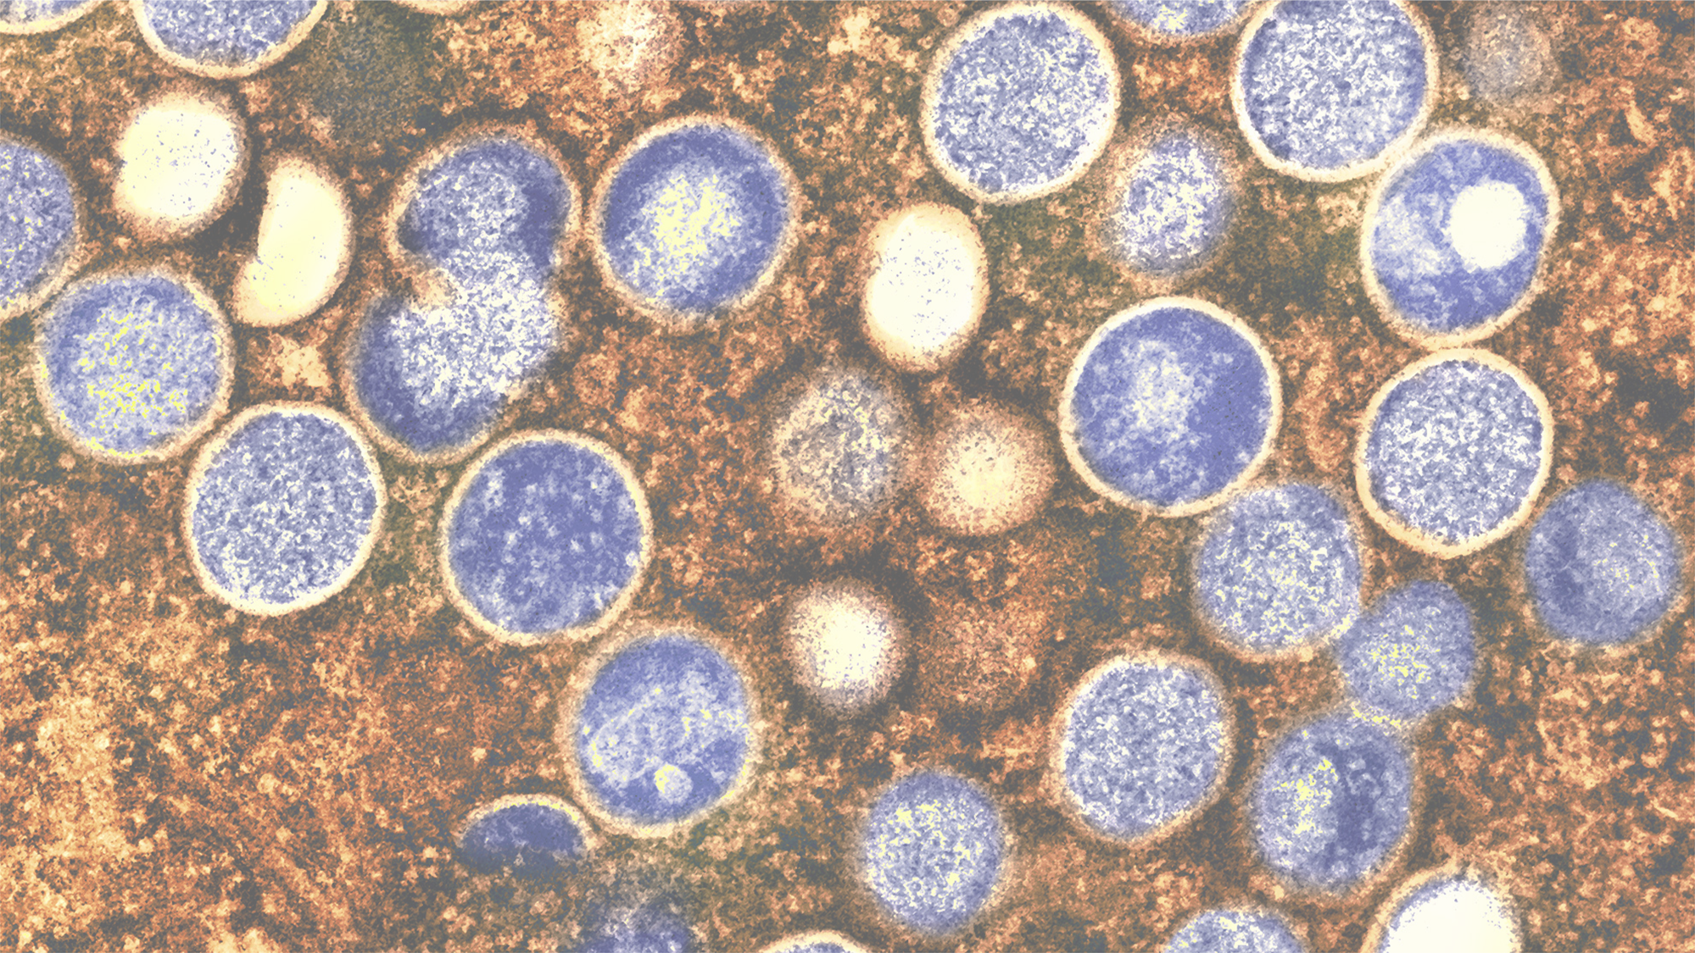
Conclusions
The 2022-2023 mpox pandemic led to the most widespread and sustained human-human transmission in history
It taught us a lot, but many questions remain
Rapid spread through sexual networks
Mpox is an AIDS-defining illness
Pre- and asymptomatic (subclinical) infection happens
MVA is effective for preventing and attenuating mpox
Sexual health clinics (and public health) played an essential role in mpox vaccination and treatment scale-up
Clinical diagnosis of mpox can support early tecovirimat initiation, especially for PWH
Tecovirimat shortens time to symptom improvement by nearly 1 week in severe mpox
Equity-focused approach is still needed to expand access to vaccination and treatment in US and globally

Slide 33
Acknowledgements
Ellora Karmarkar
Meena Ramchandani
Julie Dombrowski
Christina Thibault
Matt Golden
PHSKC SHC staff
Community and patients affected by mpox
Thank you!
Chase Cannon
ccannon5@uw.edu

