Slide 1
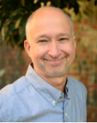
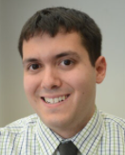



Harnessing CD8+ T cells for HIV cure: what will it take?
Rachel Rutishauser, MD, PhD
Associate Professor, Division of Experimental Medicine
University of California, San Francisco
UW/Fred Hutch CFAR
5/9/2024

Slide 2
SUMMARY FOR COMMUNITY
What is the main issue or key question(s) your work addresses?
  Do HIV-specific CD8+ T cells participate in control of HIV rebound?
  Can therapeutic interventions promote CD8+ T cell proliferative capacity?
What was the key finding or “take home message”?
  In two small studies, PWH who go on to control HIV after ART is stopped (+/- an immunotherapy) have stronger activation/proliferation of CD8+ T cells in response to early rebound.
  New T cell responses to therapeutic vaccination may have better proliferative capacity.
How is this important for HIV cure research?
  Therapeutic interventions that generate CD8+ T cells with better proliferative capacity may control HIV better.

Slide 3
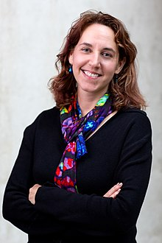
Antigen-specific CD8+ T cells provide potent antiviral defense during and after acute infection
Naïve
Effector
Memory
T_{eff}
T_{eff}
antigen
cleared
T_{eff}
T_{M}
• long-lived
• self-renew
• rapid 2° recall
T_{eff}
T_{M}
T_{N}
T_{eff}
T_{M}
T_{eff}
T_{eff}
T_{eff}
T_{eff}
+LCMV-Arm
  virus-infected
  target cell
YFV vaccine
SARS-CoV-2
terminally
differentiate, die
Sue Kaech, PhD
(PhD advisor)

Slide 4
Different factors promote effector vs memory
CD8+ T cell differentiation
Naïve
Effector
Memory
TFs:
Blimp-1
Tbet
T_{eff}
T_{eff}
antigen
cleared
T_{eff}
T_{M}
• long-lived
• self-renew
• rapid 2° recall
T_{eff}
T_{M}
T_{N}
T_{eff}
T_{M}
T_{eff}
T_{eff}
_{MPEC}
TFs:
TCF-1
FOXO1
T_{eff}
IL7Rα
+LCMV-Arm
MPEC = memory precursor effector cell
YFV vaccine
SARS-CoV-2
terminally
differentiate, die
Rutishauser et al., Immunity, 2009.
Rutishauser and Kaech, Imm Rev, 2010.

Slide 5
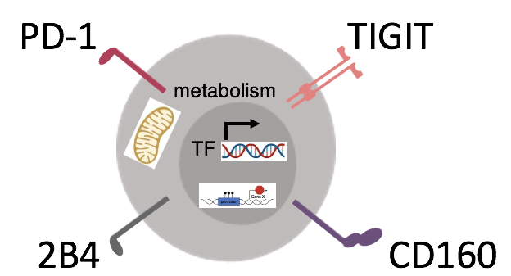
Antigen-specific CD8+ T cells become exhausted in chronic infection (+ cancer)
Naïve
Effector
Exhausted
T_{eff}
T_{eff}
antigen
persists
T_{eff}
T_{EX}
• impaired 2° responses
- cytokine production
- proliferation
- epigenetically regulated
T_{eff}
T_{EX}
T_{N}
T_{eff}
_{Stem-like}
T_{eff}
T_{EX}
T_{eff}
T_{eff}
T_{eff}
TF:
TOX
+LCMV-Cl13
+HIV, HCV, HBV, cancer
Moskophidis, Lanie and Zinkernagel, EJI, 1993.
Wherry ... Ahmed, J Virol, 2003.
Wherry … Ahmed, Immunity, 2007.
Pauken … Wherry, Science, 2016.
Sen … Haining, Science, 2016.
Chen … Cui, Nat Immunol, 2021.
terminally
differentiate, die

Slide 6
Antigen-specific CD8+ T cells become exhausted in chronic infection (+ cancer)
Naïve
Effector
Exhausted
T_{eff}
T_{eff}
antigen
persists
T_{eff}
T_{EX}
• impaired 2° responses
- cytokine production
- proliferation
- epigenetically regulated
T_{eff}
T_{EX}
T_{N}
T_{eff}
_{Stem-like}
T_{eff}
T_{eff}
T_{eff}
T_{eff}
TCF-1
αPD-1
+LCMV-Cl13
Proliferate
Clear cancer
+HIV, HCV, HBV, cancer
Moskophidis, Lanie and Zinkernagel, EJI, 1993.
Wherry ... Ahmed, J Virol, 2003.
Wherry … Ahmed, Immunity, 2007.
Pauken … Wherry, Science, 2016.
Sen … Haining, Science, 2016.
Chen … Cui, Nat Immunol, 2021.
terminally
differentiate, die

Slide 7
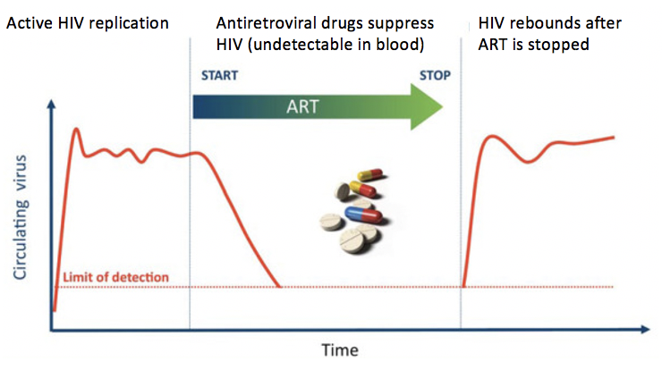
Evidence for CD8+ T cell-mediated control of HIV
Acute infection
  ↓ viral load set point
After ART discontinuation
  ↓ viral load set point
  Timing of CD8+ T cell response is important (? too late)
Spontaneous (elite) controllers (<1%)
  HLA associations
  Highly functional CD8+ T cells in ECs
  CD8+ T cell depletion in controller macaques
After intervention
  Prevention: RhCMV-vectored vaccine (HLA-E restricted)
  Therapeutic: CD8+ T cell-mediated control of SHIV after early bNAb treatment
  Therapeutic: T cell magnitude after vaccination correlates with prolonged time off ART in AELIX-002 therapeutic vaccine trial (~40% of participants with enhanced control)
ACUTE ART REBOUND
CD8
Kulpa, Chomont, J Vir Erad, 2015.
Borrow et al., Nat Med, 1997. Jin et al., JEM, 1999. Cao et al., J Immunol, 2003. Fellay et al., Science, 2007. Migueles et al., Immunity, 2008. International HIV Controllers Study, Science, 2010. Hansen et al., Nature, 2011. Hersperger et al., Blood, 2011. Ndhlovu et al., Blood, 2013. Riou et al., J Virol, 2014. Ndhlovu et al., Immunity, 2015. Chowdhury et al., J Virol, 2015. Cartwright et al., Immunity, 2016. Li et al., J Virol, 2016. Takata et al., STM, 2017. Nishimura et al., Nature, 2017. Nishimura et al., JEM, 2020. Okoye et al., JCI, 2021. Bailón et al., Nat Med, 2022.

Slide 8

Model (spontaneous controllers):
Functional HIV-specific CD8+ T cells have high proliferative capacity
ART-suppressed
(previous non-controllers)
Elite controllers
_{↑GzB}
T_{EX}
T_{EX}
off
ART
TCF-1
TCF-1
T_{ex}
T_{EX}
+antigen
TCF-1
TCF-1
• exhausted
• ↓ expansion potential
• ↓ TCF-1 expression
• ↑ terminally differentiated/exhausted
• ++ expansion potential
• high (but modulatable) TCF-1 expression
• ↓ exhaustion programs
• ↓ methylation at stemness gene targets
• ↑ responsiveness to TCR/cytokine signals
2° effector cells
• immediate effector function
• ↓ TCF-1 expression
Migueles et al, Nat Immunol, 2002
Migueles et al., J Virol, 2009
Ndhlovu et al, Blood, 2013
Collins et al, Sci Immunol, 2023
Apply to: vaccine, adoptive T cell or other T cell-based HIV cure strategy?
Control post-ART?
Rutishauser et al., JCI Insight, 2021
Rutishauser*, Frias*, Sharma* et al., bioRxiv

Slide 9
Can highly functional HIV-specific CD8+ T cells formed in spontaneous controllers control HIV after ART is stopped?
Elite
Control
Re-control ???
CD8

Slide 10
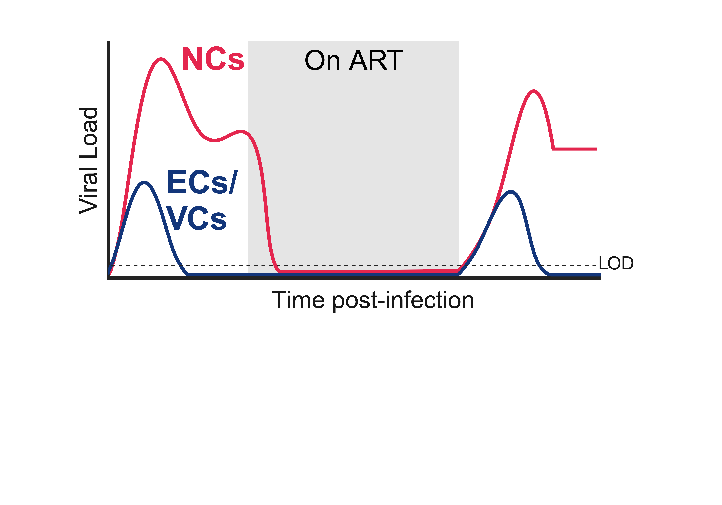
BMGF ATI (analytic treatment interruption) study:
Characterizing effective vs ineffective immune responses vs rebounding HIV
NC
re-start ART
Hypothesis:
To control HIV after treatment interruption, there must be a rapid, robust and coordinated host response to rebounding virus
Study participants (all):
n=19 PWH on ART
12 prior NC
7 prior EC/VC
NC: non-controller (prior to ART)
VC: viremic controller (VL < 2k copies/mL)
EC: elite controller (VL undetectable)
PI: Lillie Cohn, Clinical leads: Steve Deeks, Michael Peluso
Trial funded by BMGF; Immunology studies: BMGF + NIH/DARE UM1

Slide 11
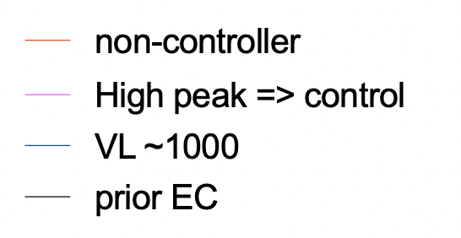
BMGF ATI study:
Different rebound kinetics of pre-ART controllers vs non-controllers
PI: Lillie Cohn, Clinical: Steve Deeks, Michael Peluso

Slide 12
BMGF ATI study:
Different rebound kinetics of pre-ART controllers vs non-controllers
PI: Lillie Cohn, Clinical: Steve Deeks, Michael Peluso

Slide 13
BMGF ATI study:
Different rebound kinetics of pre-ART controllers vs non-controllers
PI: Lillie Cohn, Clinical: Steve Deeks, Michael Peluso

Slide 14
BMGF ATI study:
Different rebound kinetics of pre-ART controllers vs non-controllers
PI: Lillie Cohn, Clinical: Steve Deeks, Michael Peluso

Slide 15
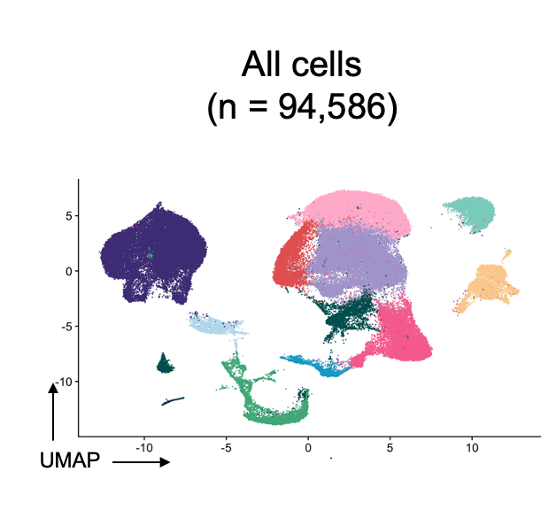
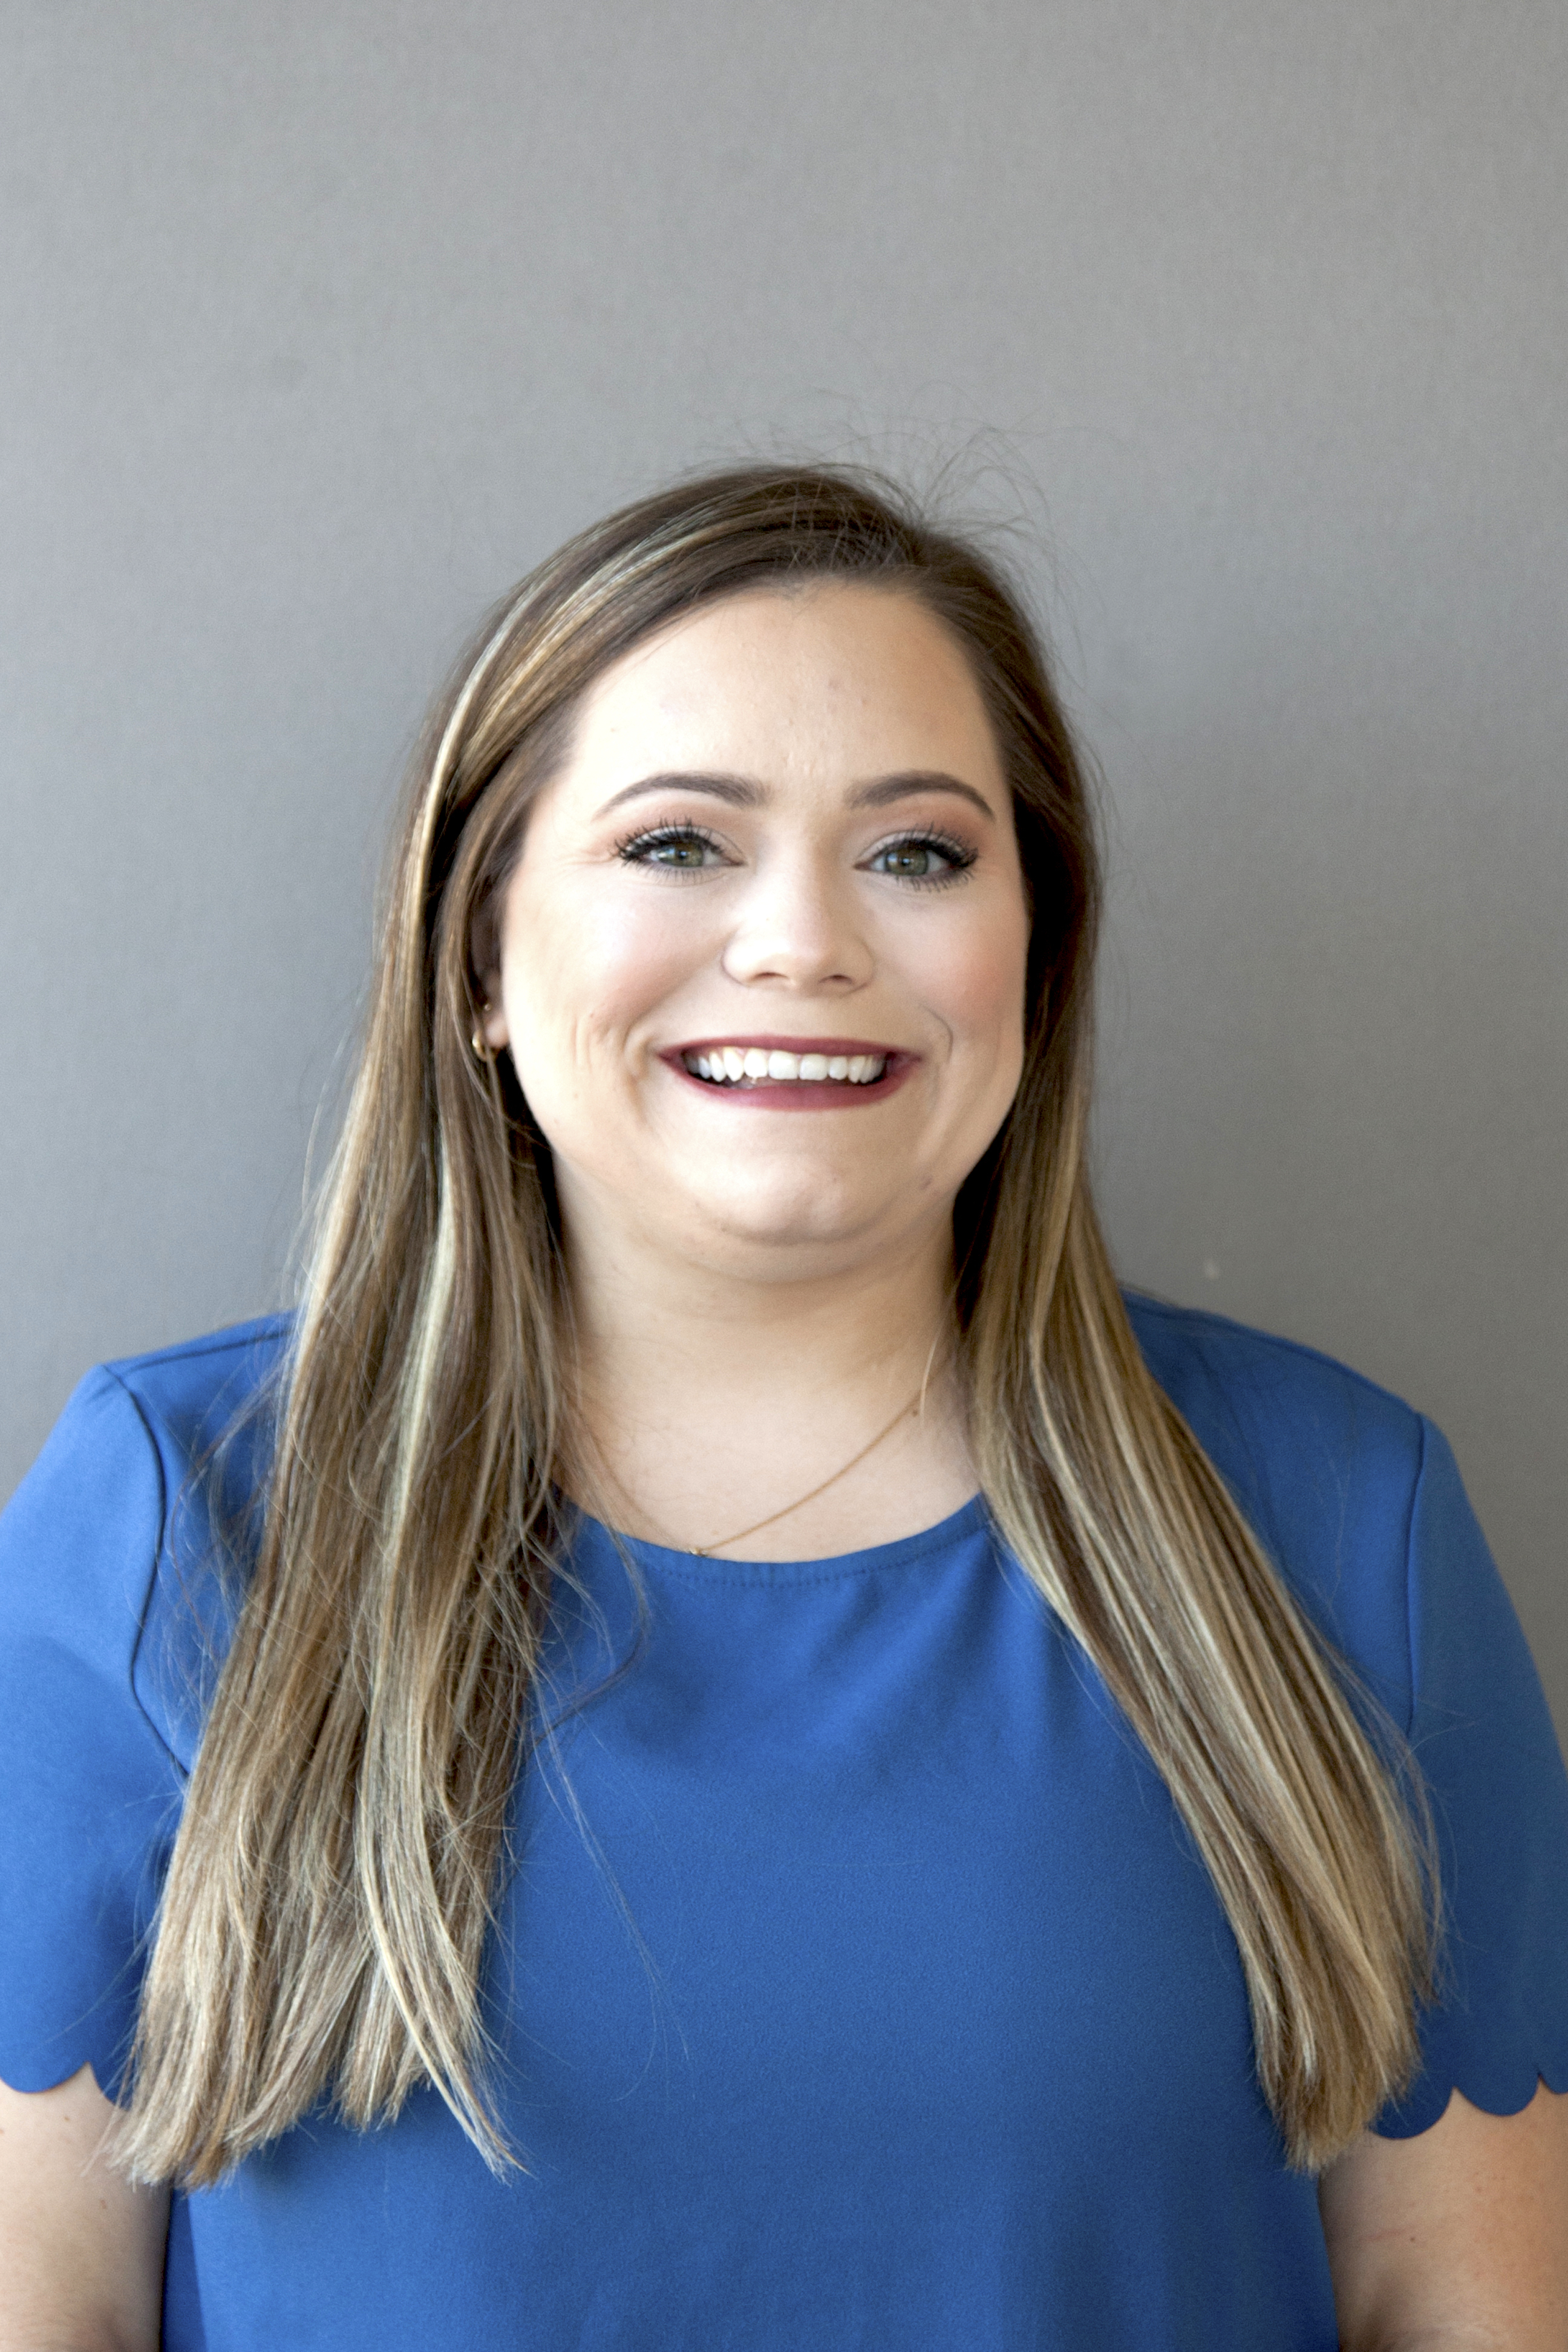
Intensive monitoring post-ATI (including in tissue)
*PBMCs every 2-3 days
* * * *
NC
re-start ART
LN FNA dataset (on a subset):
Paired pre- and post-ATI samples
  3 prior NC
  2 prior EC/VC
10X 5’ scRNA/TCRseq
LN FNA
LN FNA
Demi Sandel
Rutishauser & Spitzer Labs
NC: non-controller (prior to ART)
VC: viremic controller (VL < 2k copies/mL)
EC: elite controller (VL undetectable)
LN FNA = lymph node fine needle aspirate
PI: Lillie Cohn, Clinical: Steve Deeks, Michael Peluso

Slide 16
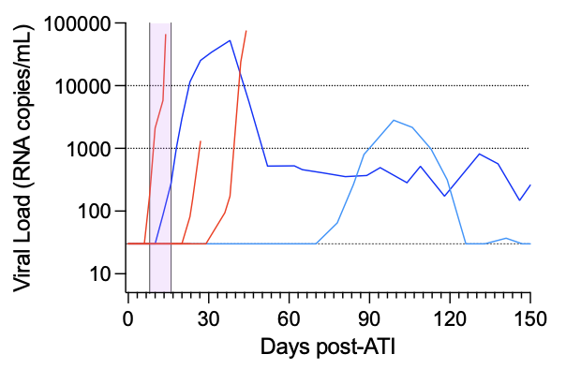
Post-ATI sampling: day 8-16, mostly (not all) aviremic
Post-ATI
sampling window
ART
1 prior VC and 1 prior NC were viremic post-ATI
(VL = 280 and 5,826 c/mL)
NC: prior non-controller (before ART)
VC: prior viremic controller (VL < 2k copies/mL)
EC: prior elite controller (VL undetectable)

Slide 17
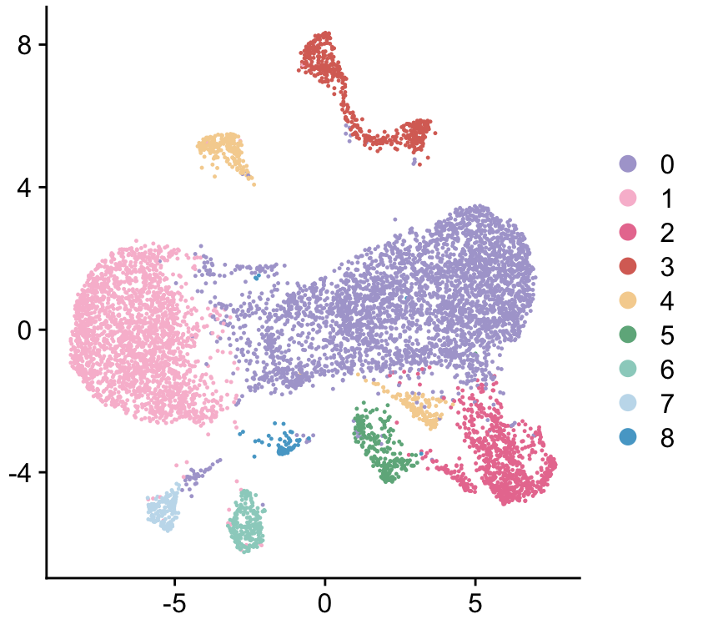
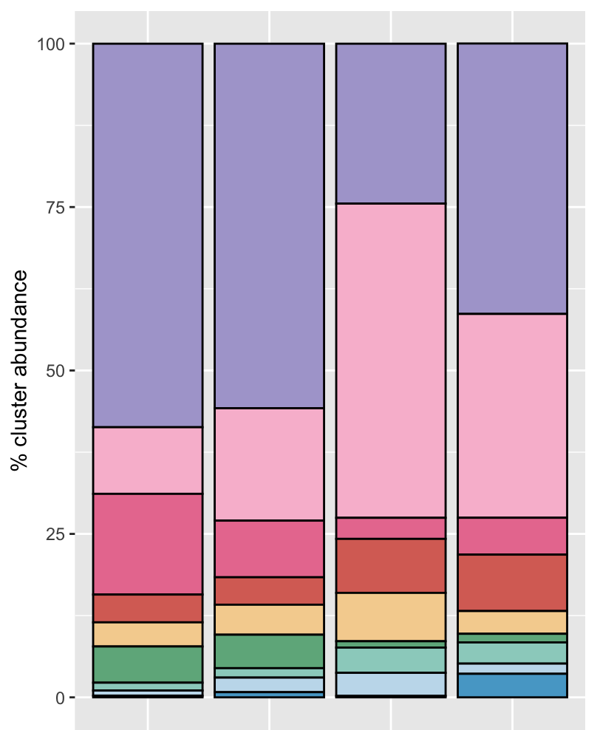
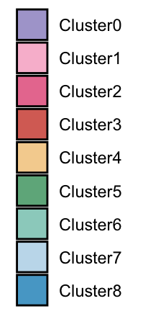
As virus emerges, a cluster of cycling CD8+ T cells (c8) expands:
Greater expansion in controller (despite lower VL)
Cell cycle genes
Sampled @ viremic timepoints post-ATI:
CD8+ T cells
(n = 10,760)
NC2
C2
Clusters
Cluster abundance
c8
BL
D15
BL
D16
3.3x↑
17x↑
Expression
Percent
Expressing
VL = 5,826 and 280 c/mL

Slide 18
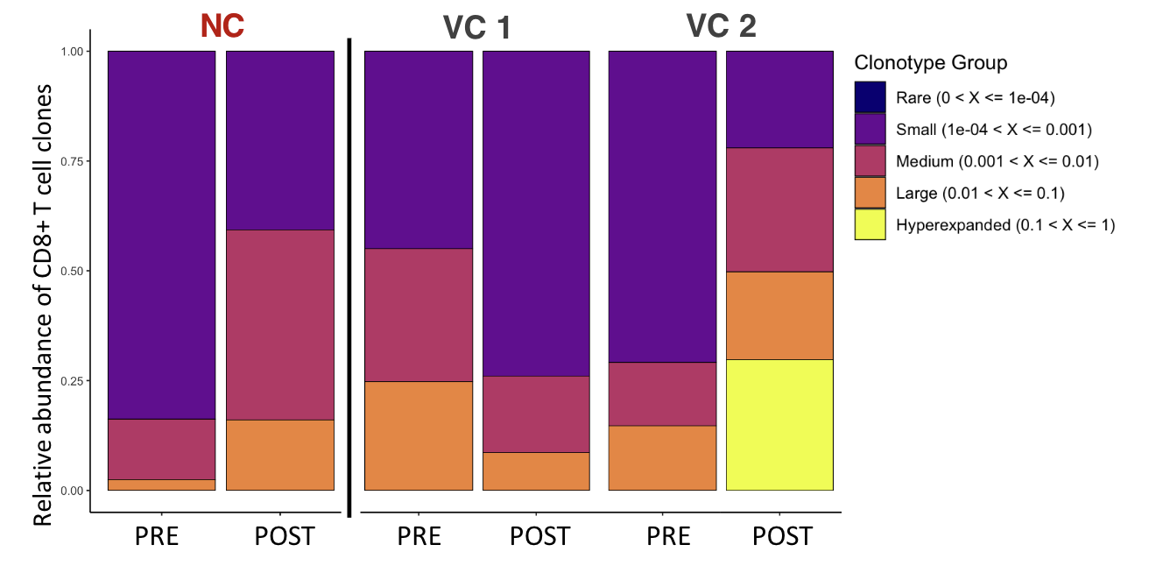
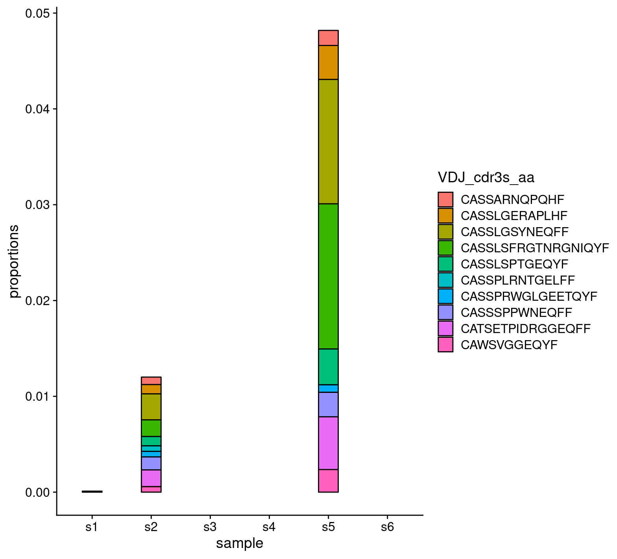
Greater clonal expansion in controller (despite lower VL)
C2
NC2
C2
Top frequency CDR3s
Proportion (of CD8+ T cells)
PRE- POST-
ATI ATI
scRepertoire

Slide 19
Both controllers have higher frequency of cycling CD8+ cells early post-ATI in the LN compared to non-controllers
ART
NC
% of total CD8 T cells
VC/EC
%MKI67+ of total CD8+ T cells
Pre-ATI
Post-ATI
NC: prior non-controller (before ART)
VC: prior viremic controller (VL < 2k copies/mL)
EC: prior elite controller (VL undetectable)

Slide 20
Can highly functional HIV-specific CD8+ T cells formed in spontaneous controllers control HIV after ART is stopped?
YES … can we manipulate this therapeutically?
Elite
Control
Re-control ???
CD8

Slide 21

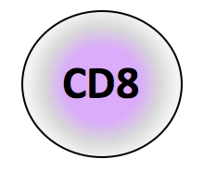


Therapeutically manipulating anti-HIV immune responses
intervention
treatment
interruption
control
HIV
New specificity
Not exhausted
↑ proliferative capacity
Home to sites of reservoir persistence
PLWH
on ART
Can this be done with therapeutic vaccination?

Slide 22
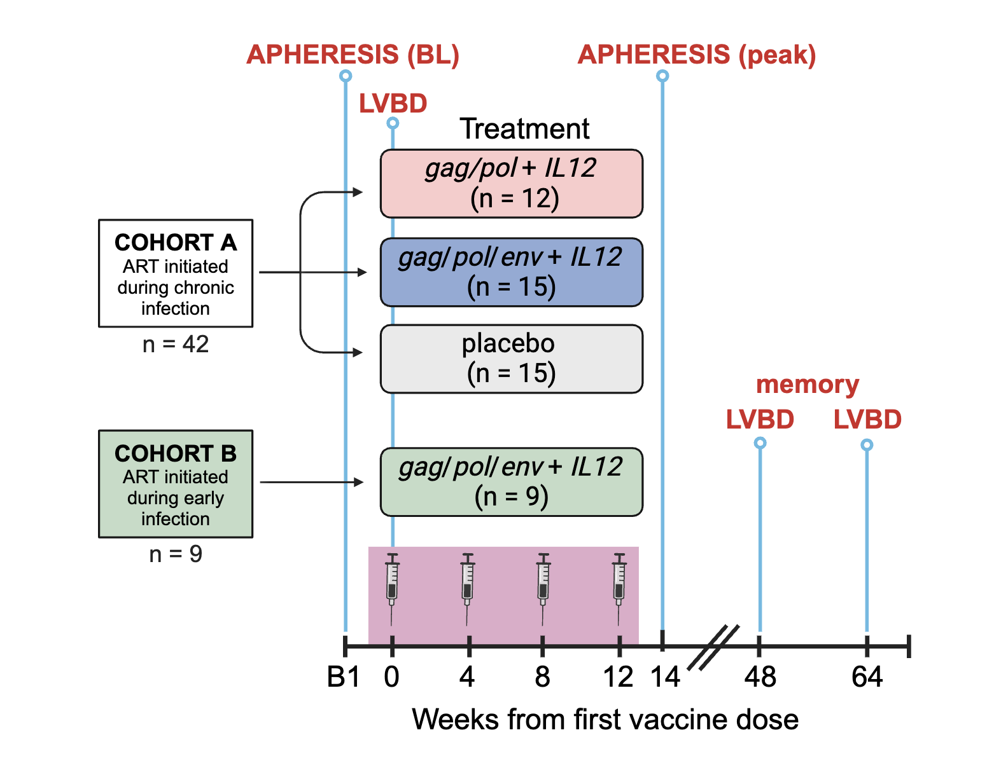
PENNVAX therapeutic vaccine clinical trial
Questions:
Does including env detract from Gag and Pol T cell responses?
What is the impact of early ART on immunogenicity?
Can the vaccine elicit de novo T cell responses or does it only boost preexisting responses?
What are characteristics of vaccine-elicited de novo/boosted T cell responses?
PENNVAX-GP DNA vaccine:
multiclade consensus: gag/pol (A, B, C, D) 2mg +/- env (A, C) 6mg
+IL12 DNA (1mg)
administered IM
with electroporation (CELLECTRA® 2000)
Vaccine: David Weiner (Inovio)
Also used in HVTN098
Clinical: Kara Chew, Steve Deeks
Shown: participants with available samples
Key Eligibility Criteria: Adults 18-65 years, CD4 T cell count ≥350 cells/mm³, creatinine clearance >60 mL/min, HIV-1 RNA <50 copies/mL for ≥24 months, continuous ART for ≥24 months, no recent immunomodulatory or immunosuppressive therapy
LVBD = large volume blood draw
NCT03606213
NIH U01AI131296

Slide 23
Gag-specific T cell responses (IFNγ ELISpot): Boosted in gag/pol arm but not gag/pol/env arms
Magnitude
(Week 14/baseline)
Durability
(Week 48/baseline)
Fold-change ↑
in Gag-specific
T cells
ICS: CD4 and CD8
PBO g/p g/p/e g/p/e
(early)
PBO g/p g/p/e g/p/e
(early)
PENNVAX-GP (Inovio) multiclade consensus gag/pol (A, B, C, D) 2mg +/- env (A, C) 6mg, IL-12 1mg DNA/dose administered IM with electroporation (CELLECTRA® 2000)
Wistar: Meagan Wise, Emma Reuschel, Mansi Purwar, David Weiner
Chew, CROI 2022, Poster #284

Slide 24
Higher % “overall vaccine responders” in GP arm
GP=gag/pol
GPE=gag/pol/env
“overall vaccine responder”: ≥ 2-fold increase in overall* vaccine-matched T cell response
* Overall = (FCgag+FCpol)/2 if GP arm; (FCgag+FCpol+FCenva+FCenvc)/4 if GPE arm

Slide 25
? Better memory responses in early ART group
GP=gag/pol
GPE=gag/pol/env
Stable % responders in
early ART arm
at Wk48 (vs Wk14)
“overall vaccine responder”: ≥ 2-fold increase in overall* vaccine-matched T cell response
* Overall = (FCgag+FCpol)/2 if GP arm; (FCgag+FCpol+FCenva+FCenvc)/4 if GPE arm

Slide 26
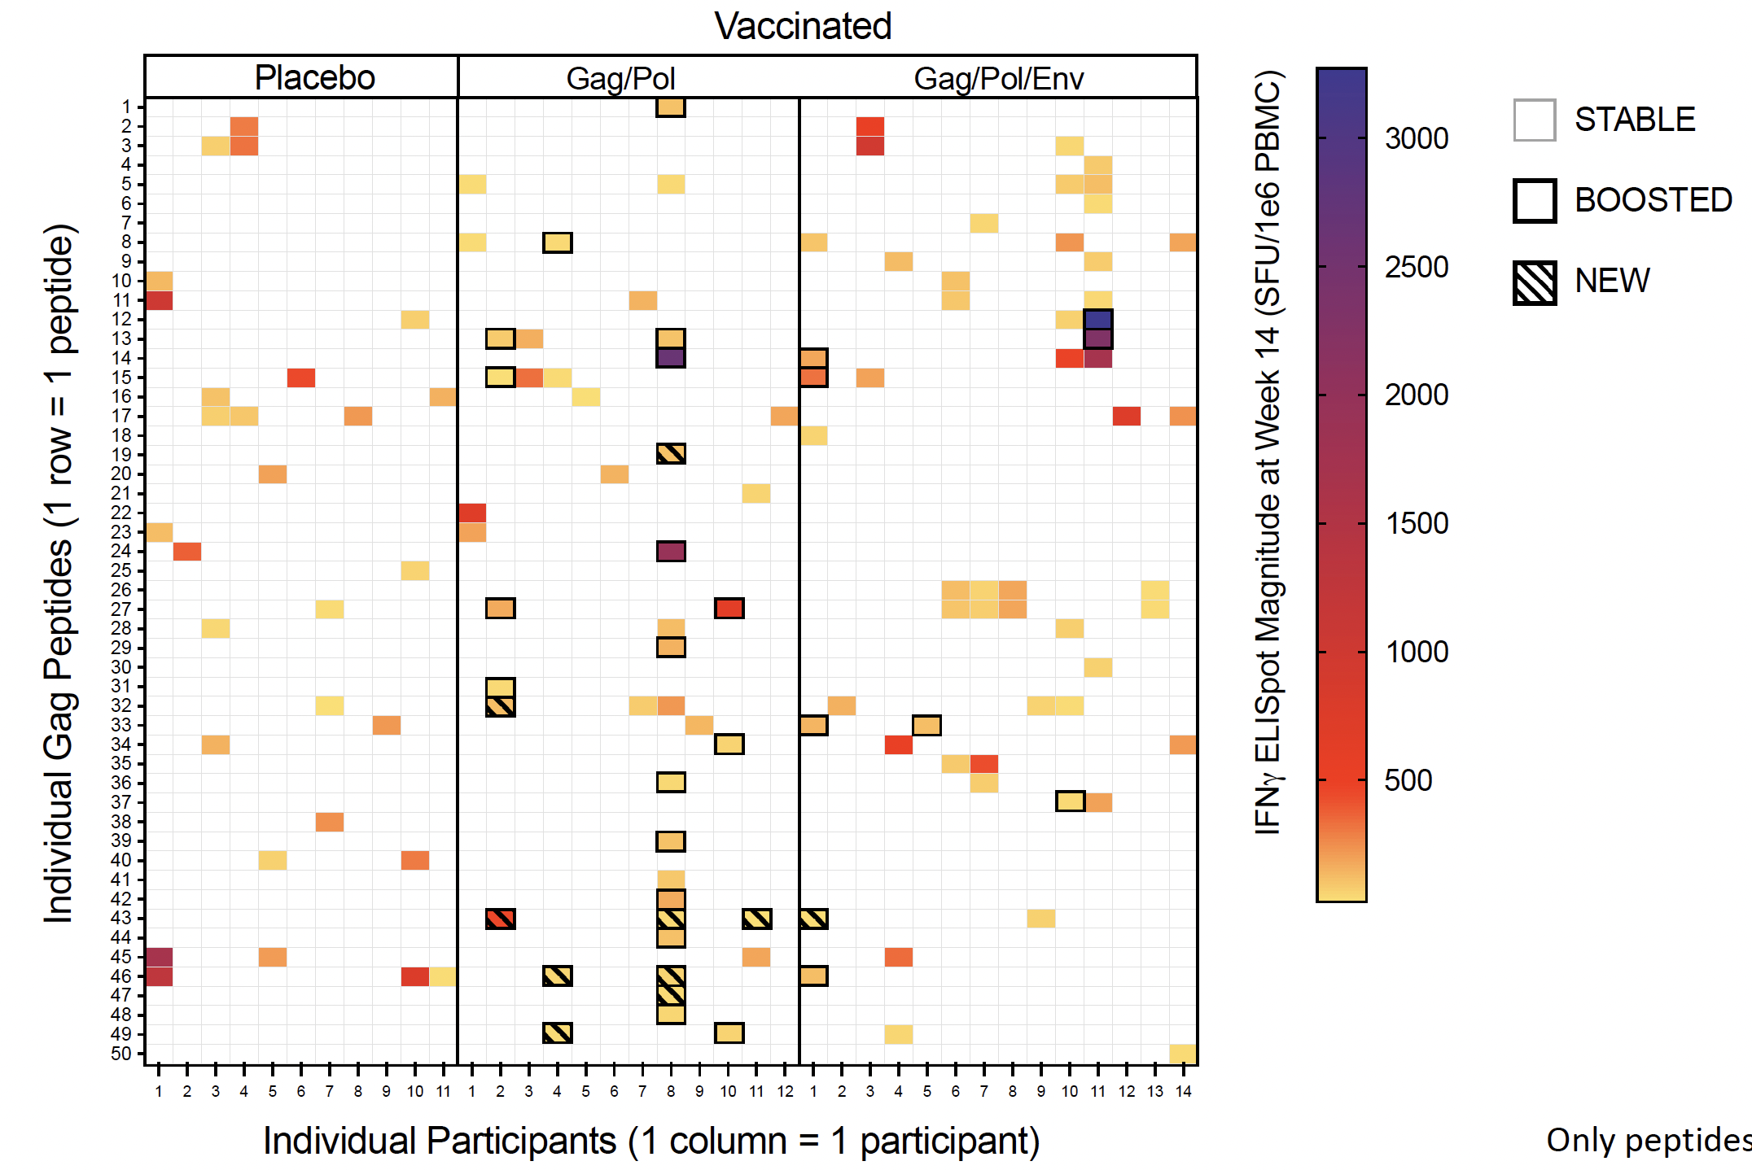
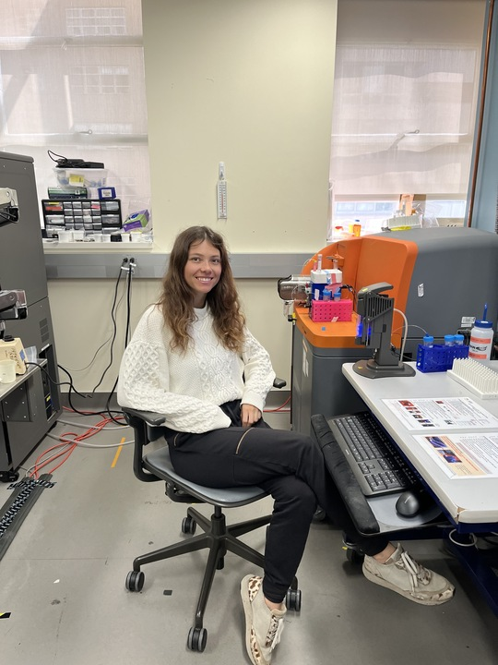
PENNVAX therapeutic vaccine elicited some new T cell responses
Epitope mapping (Gag)
IFNγ ELISpot
Vaccine-matched 15mers
Baseline, Wk14
NEW: absent* at BL, ≥2FC LOQ
BOOSTED: present at BL, ≥2FC vs BL
* even after 10d in vitro stim
Mansi Purwar (Wistar)
Zemelko, CROI 2024
PENNVAX Cohort A (chronic) only

Slide 27
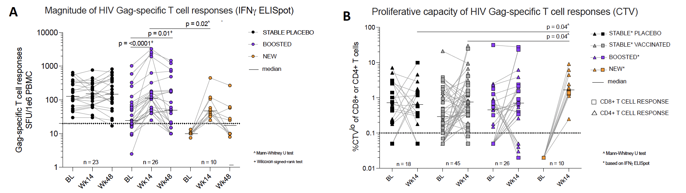
New vs boosted responses at peak (Wk14):
Lower magnitude, similar proliferation
Magnitude
(IFNg ELISpot)
Proliferation
(%CTV^{lo})
Mansi Purwar (Wistar) and Lily Zemelko (UCSF)
Zemelko, CROI 2024
PENNVAX Cohort A (chronic) only

Slide 28


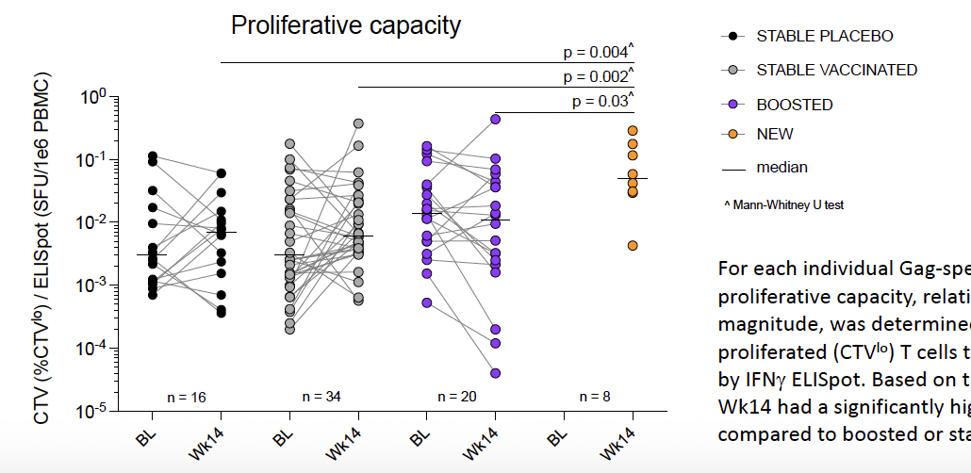
New responses: Higher proliferative capacity
(relative to magnitude: %CTV^{lo}/SFU)
Mansi Purwar (Wistar) and Lily Zemelko (UCSF)
Zemelko, CROI 2024
PENNVAX Cohort A (chronic) only

Slide 29
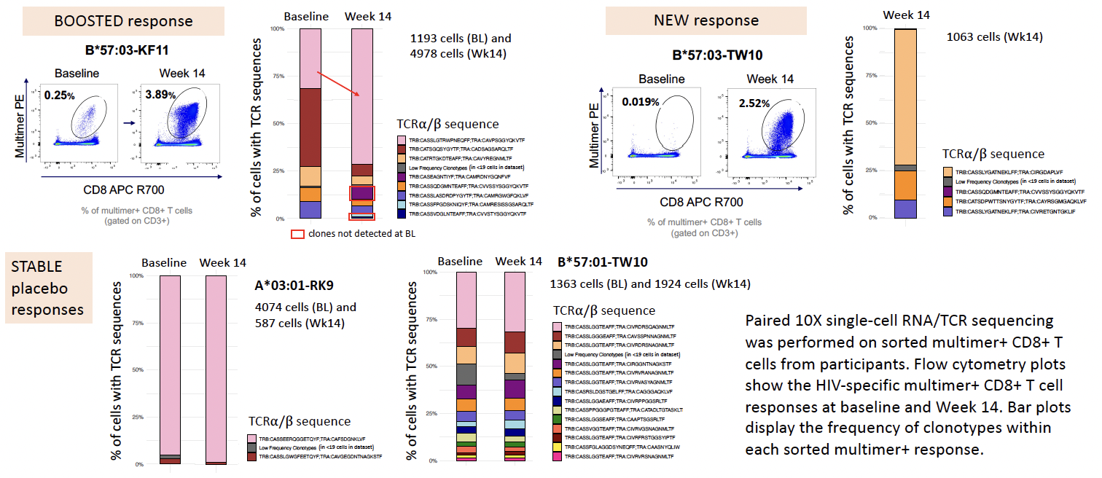
PENNVAX: scRNA/TCRseq of HIV-specific CD8+ T cells
NOTE: some tetramer responses remained “stable” despite vaccination
?exhausted
10X 5’ scRNA/TCRseq
Sorted multimer+ cells
Lily Zemelko, Rafa Tibúrcio, George Gruenhagen, Ravi Patel
Zemelko, CROI 2024

Slide 30
scTCR sequencing identifies some newly-recruited clonotypes
What’s different?
BL vs Wk14 expansion (%of live cells):
Pink Clonotype = 5.1x ↑
Red Clonotype = no expansion
Lily Zemelko, Rafa Tibúrcio, George Gruenhagen, Ravi Patel
Zemelko, CROI 2024

Slide 31
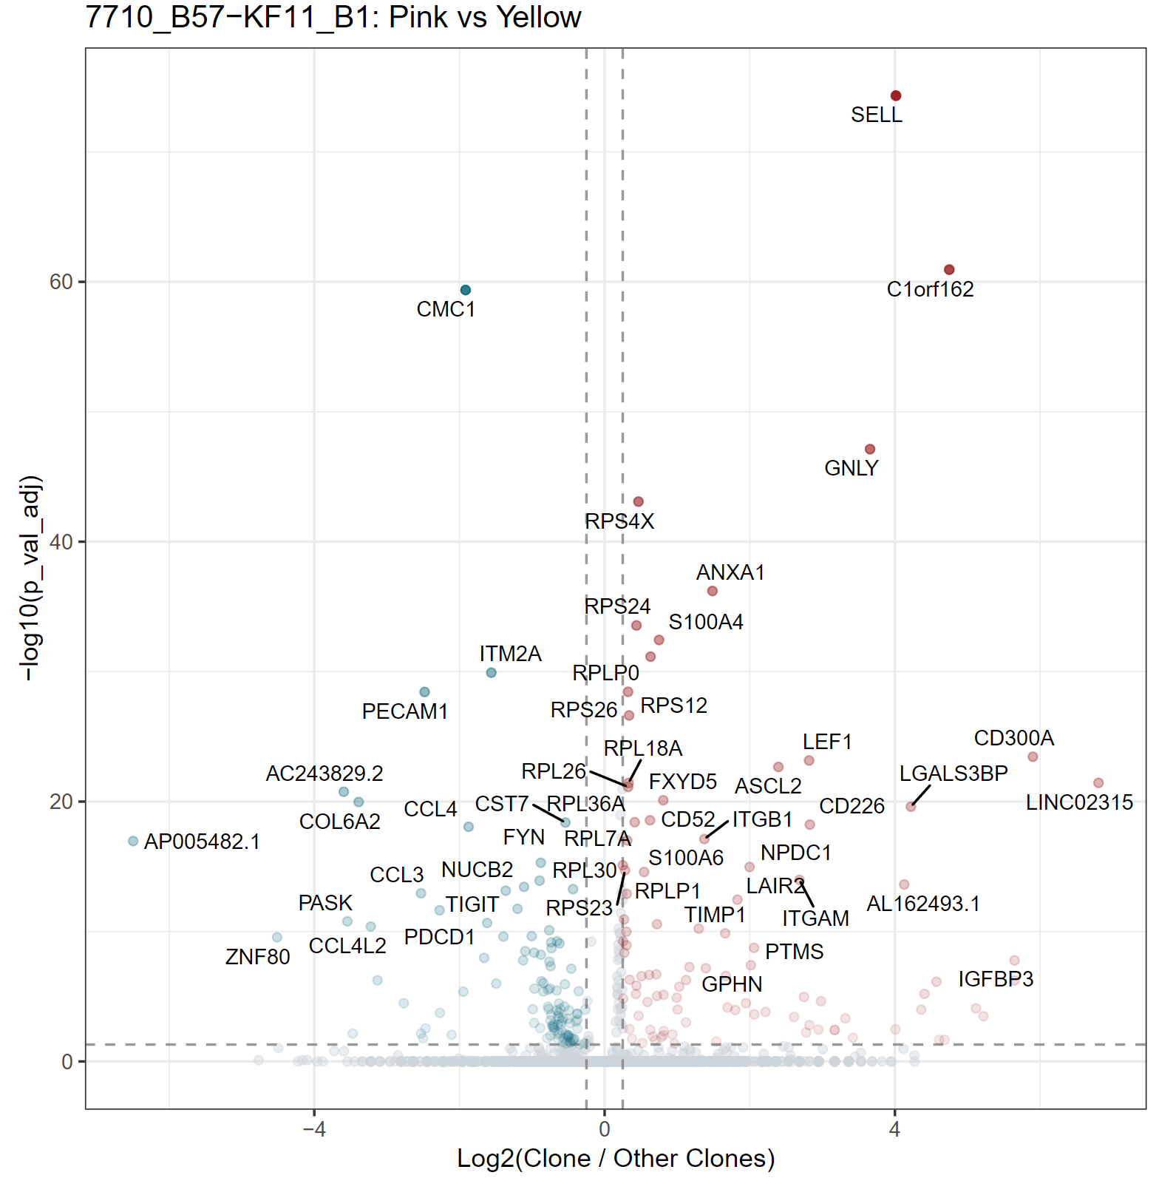
Differential gene expression at BL between clonotypes with high vs low expansion capacity
DEG at Baseline
Up in Red Clonotype
Up in Pink Clonotype
BL vs Wk14 expansion (%of live cells):
Pink Clonotype = 5.1x ↑
Red Clonotype = no expansion
SELL
CMC1
GNLY
LEF1
TIGIT
PDCD1
Lily Zemelko, Rafa Tibúrcio, George Gruenhagen
Log2 FC (pink/red)

Slide 32
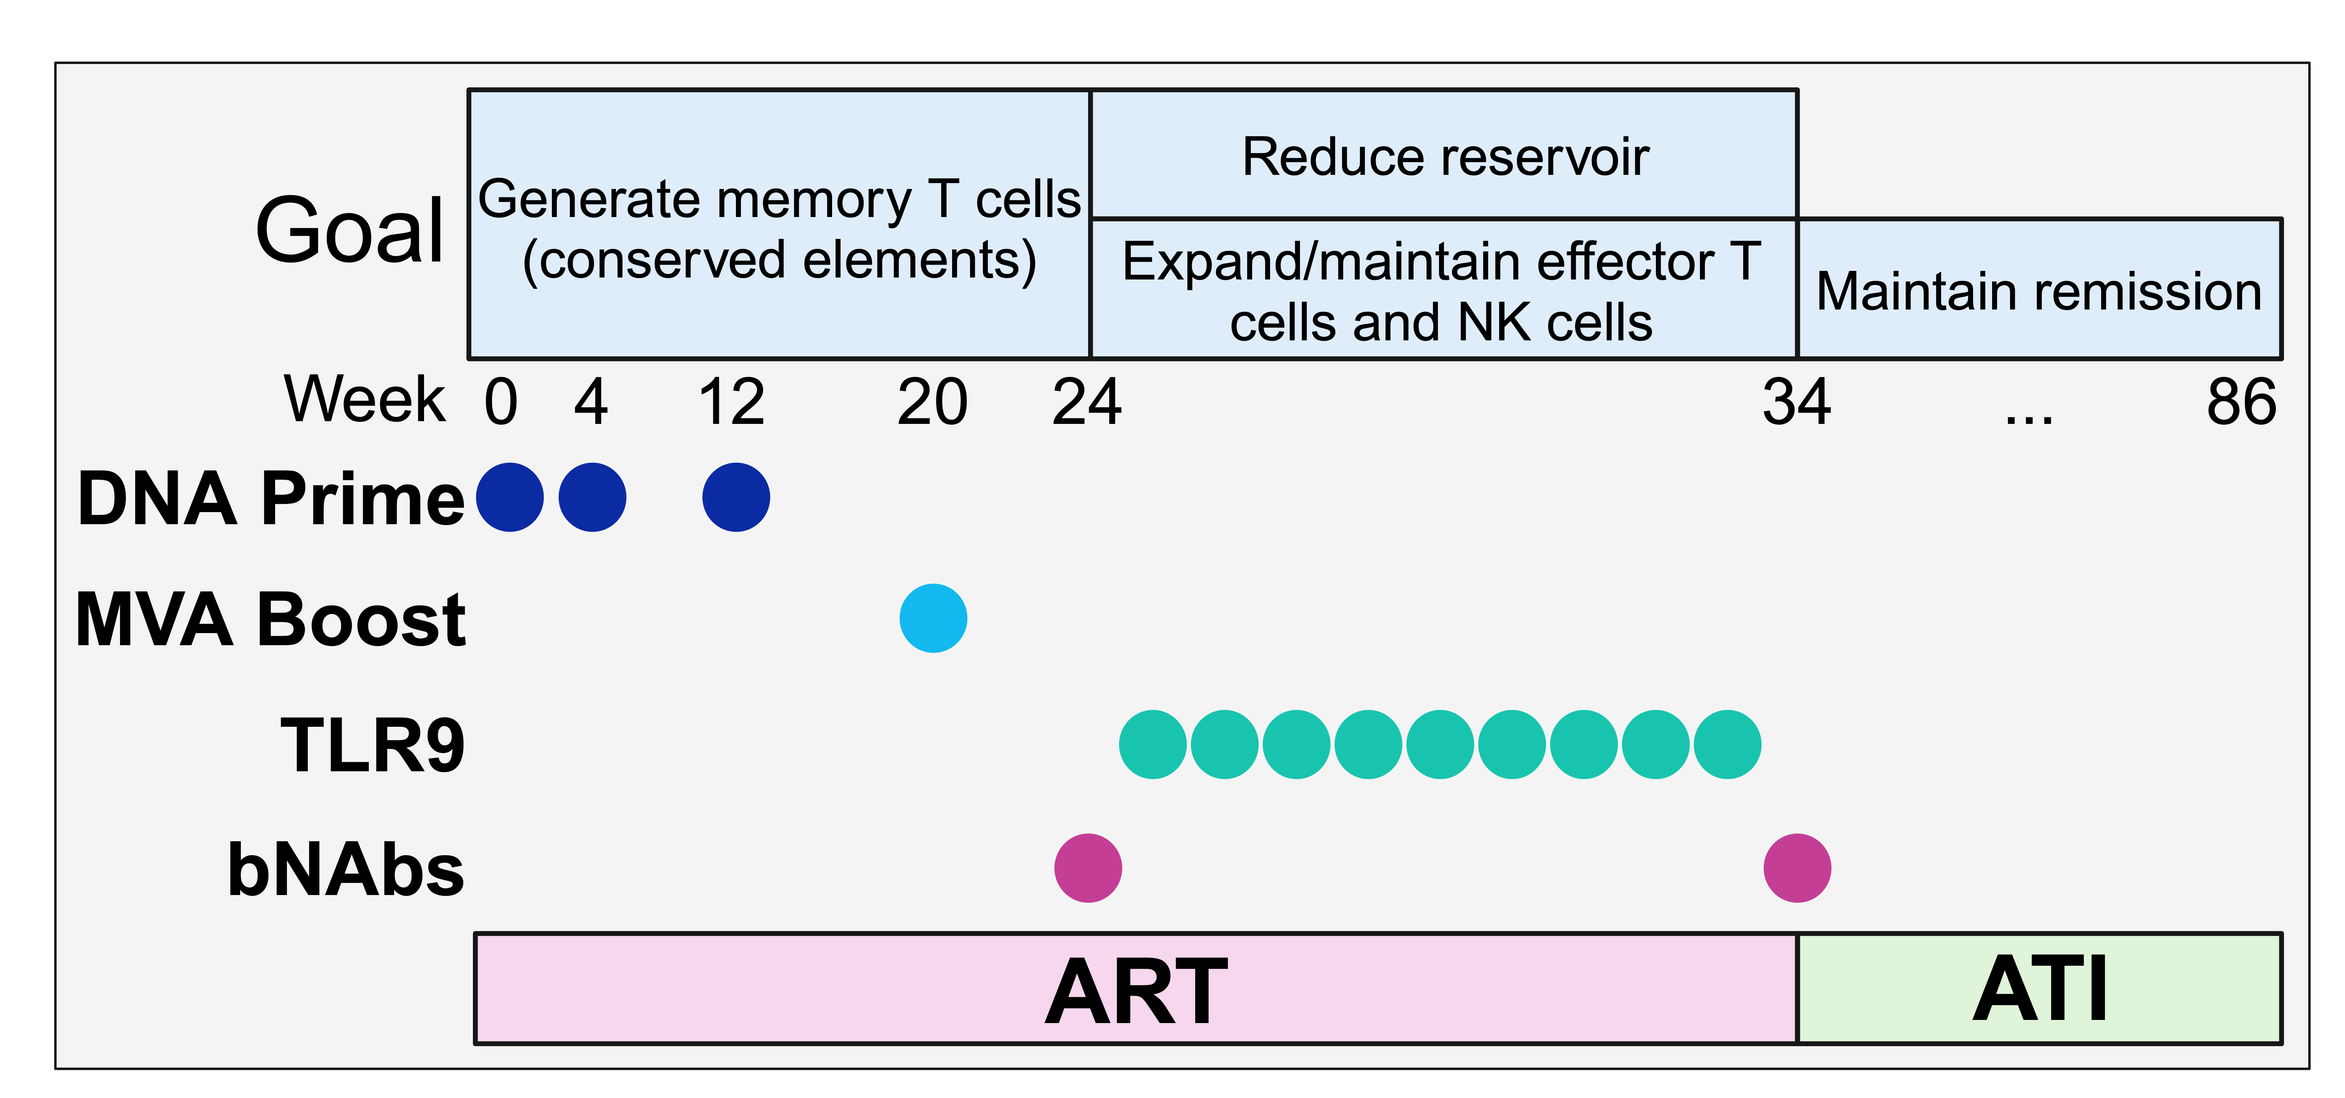

amfAR combination immunotherapy HIV cure clinical trial
(“the kitchen sink study”)
Levels:
ART
Steve Deeks, MD
Michael Peluso, MD
N=10 people with HIV on ART (7 early ART, 3 late ART)
Rationally designed (NHP data) to induce post-ART control
bNAbs
VACCINE: Conserved Element
(CE) DNA vaccine (IM-EP, w/IL12) + boost full-length Gag
(DNA then MVA)
Jim Mullins, Barbara Felber, George Pavlakis
bNAbs:
10-1074
VRC07-523LS
Study opened: February, 2020

Slide 33
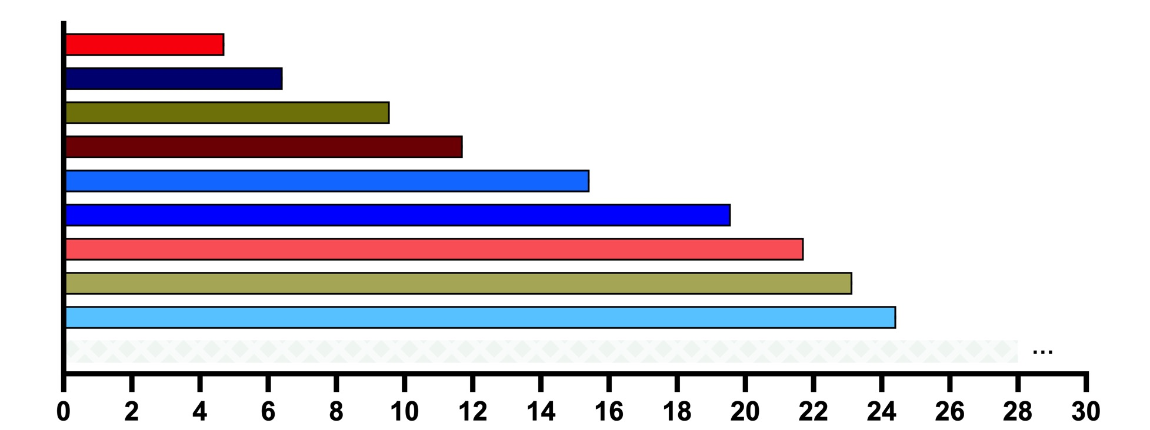
Time to Rebound (Weeks)
18m
(no rebound)
Weeks since ART Pause
Rebound occurred at a mean of 15 weeks after ART interruption
(time to rebound was related to bNAb PK and susceptibility)
Deitchman, CROI 2024

Slide 34
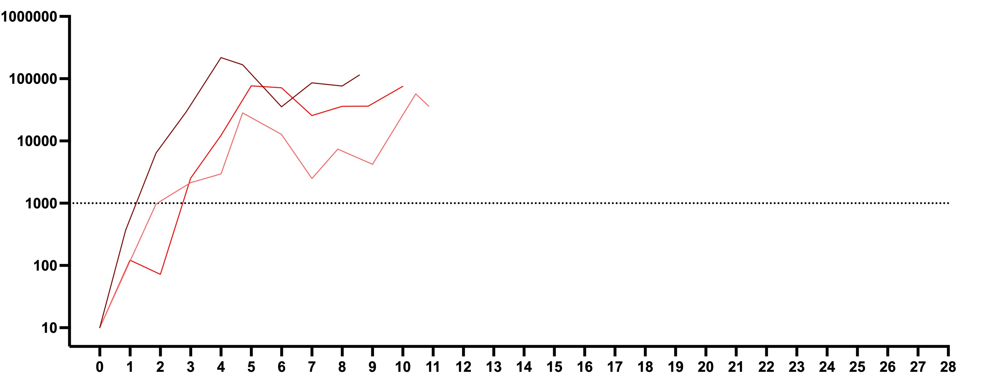
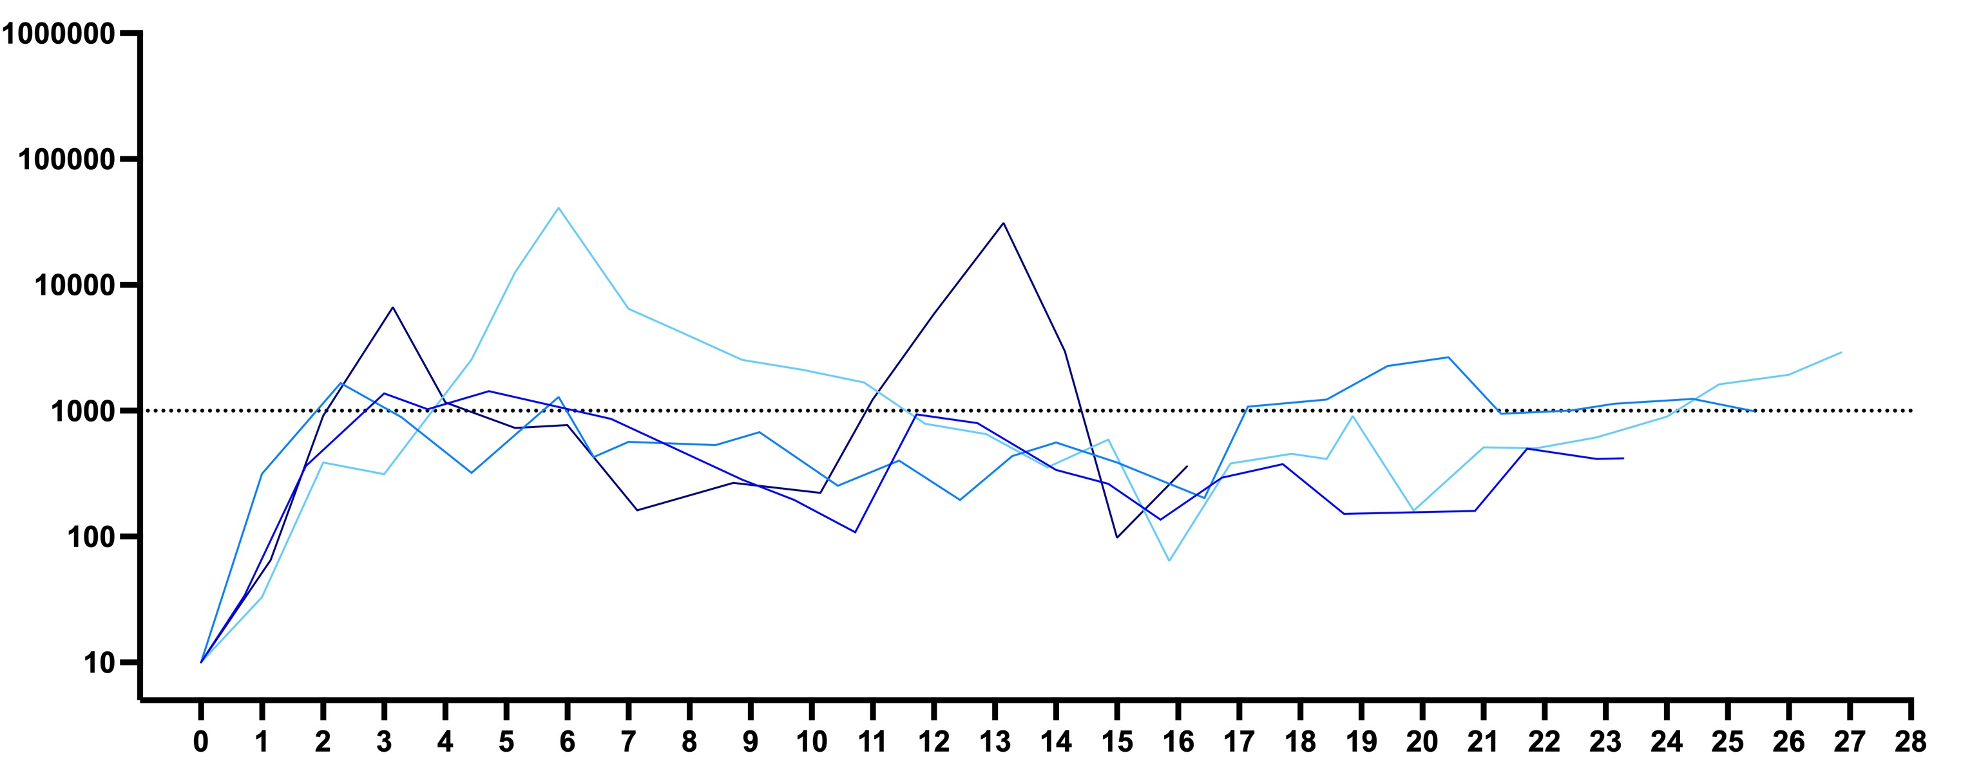
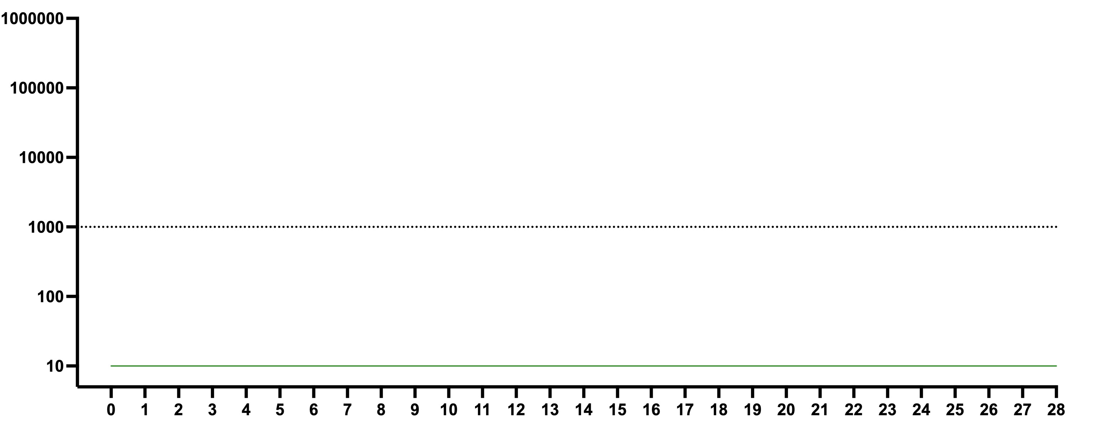
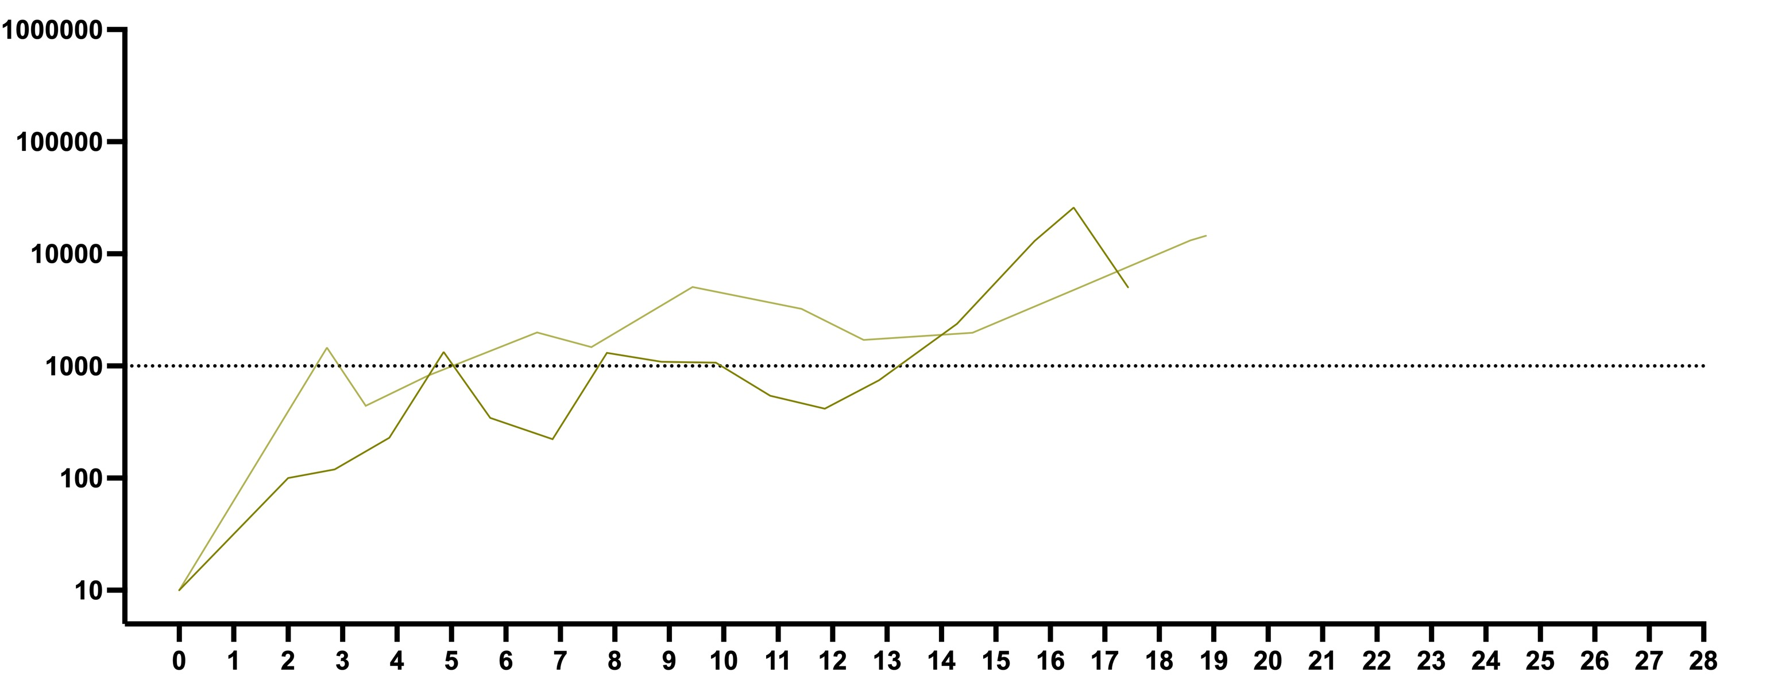
7 of 10 participants had unusual HIV rebound kinetics
Typical (n=3)
Durable partial control (n=4)
HIV plasma viral load (copies/mL)
None (n=1)
Slow/non-exponential (n=2)
Weeks since rebound
All graphs synced to start at participant-specific time of rebound (last plasma HIV RNA <LOQ)

Slide 35
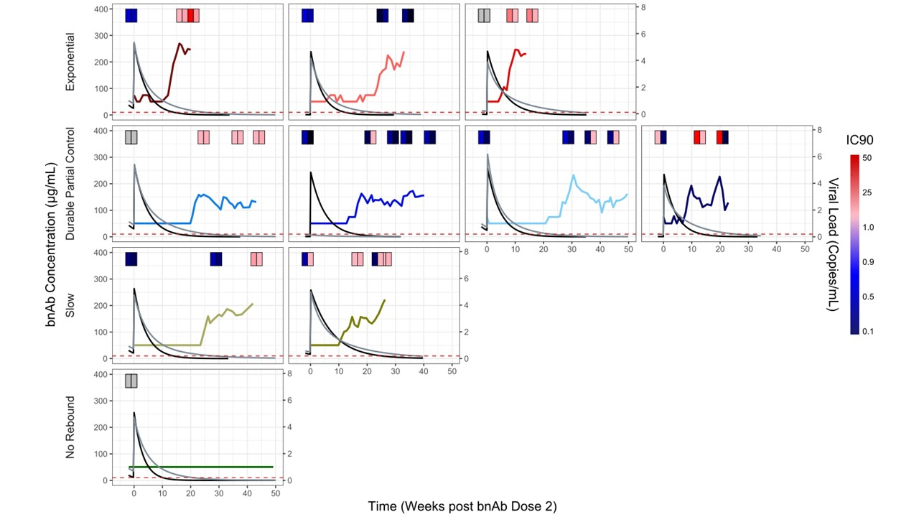
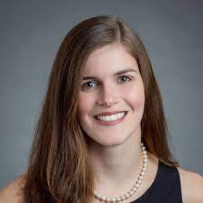
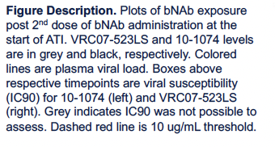
PK modeling: VL setpoints can’t be explained by PK alone
Late ART
Late ART
Amelia Deitchman
Late ART
B*57
acute ART
acute ART
Deitchman, CROI 2024

Slide 36
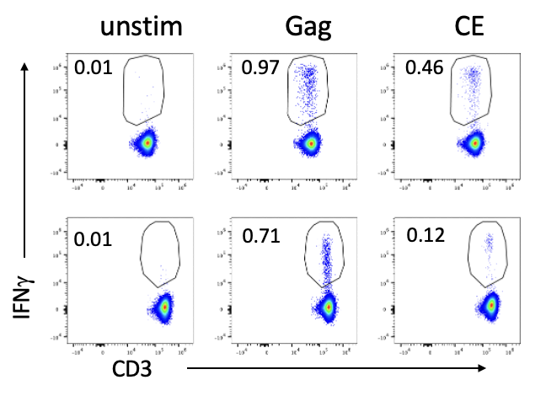
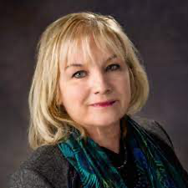
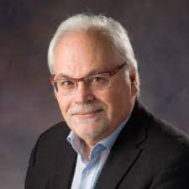
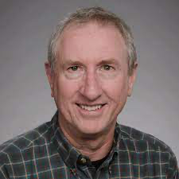
CE responses
Nef responses
(not in vaccine)
CE DNA+MVA boost therapeutic vaccine elicited/boosted CE-specific CD4+ and CD8+ T cell responses
16x ↑
Memory:
2.5x ↑
CD4
Gated on live, dump-, CD3+
CD4
CD8
5.6x ↑
Memory:
NSD from
BL
CD8
Peluso, CROI 2023

Slide 37
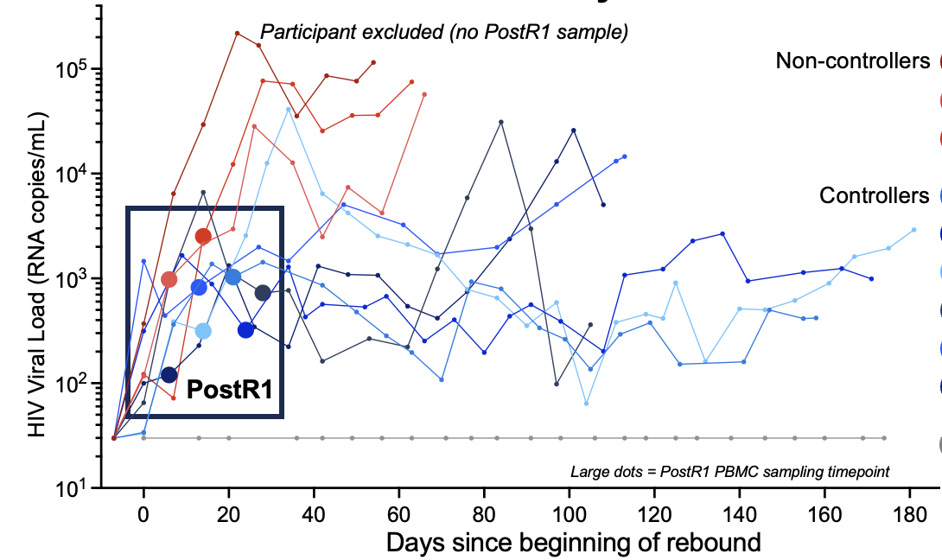
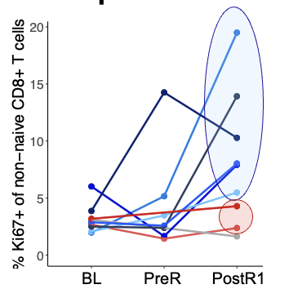
Post-intervention HIV control linked to early in vivo CD8+ T cell proliferative response to rebound
  PBMC phenotyping by CyTOF
  Sampling timepoints:
  BL: Baseline (prior to intervention, on ART)
  PreR: last PBMC prior to rebound (~1-2wk)
  PostR1: 1st PBMC sampling, within 30d of rebound, at similar (low) HIV VL
Sandel, CROI 2024

Slide 38
Post-intervention controllers have a larger proportion of TCF-1+ responding (Ki67+) CD8+ T cells

Slide 39
Conclusions – combination immunotherapy study
Combination immunotherapy => altered HIV rebound patterns
Early analyses suggest participants with better post-ART control have a more robust, early proliferative CD8+ T cell response
Additional analyses are ongoing

Slide 40
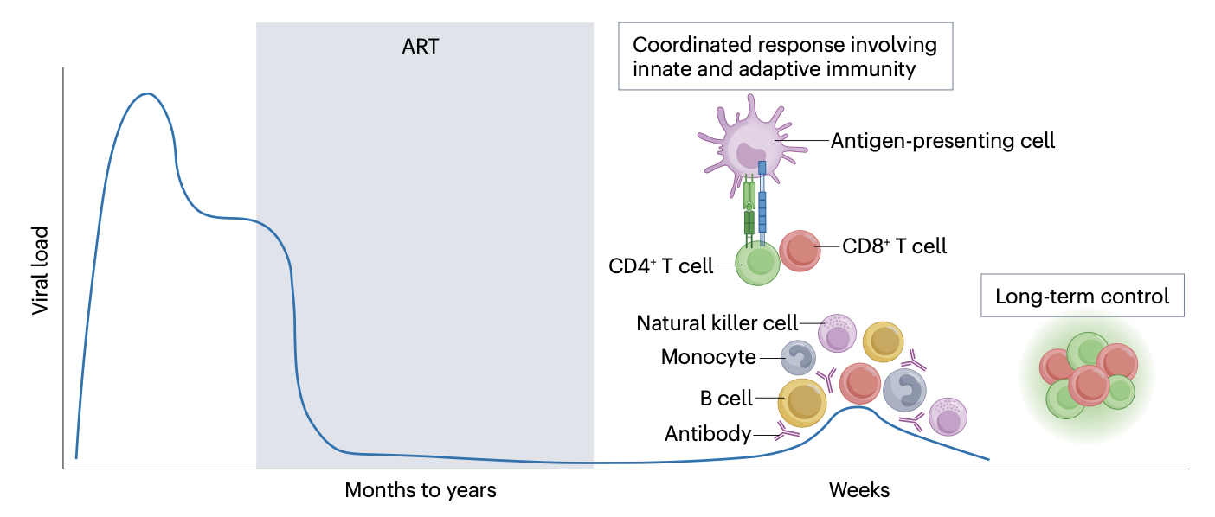
Host-responses associated with control will be complex!
Ongoing Studies
Virology CA-RNA/DNA, IPDA, sequencing rebound virus
T cell assays (including LN FNA) ICS (+ deep phenotyping), epitope map, proliferation, tetramer, scRNA/TCRseq
Autologous antibodies levels, neut/non-neut functions
Systems immunology CyTOF (B/T/innate), plasma proteomics, CITEseq
Landovitz/Scott/Deeks, Nature Rev Micro 2023

Slide 41
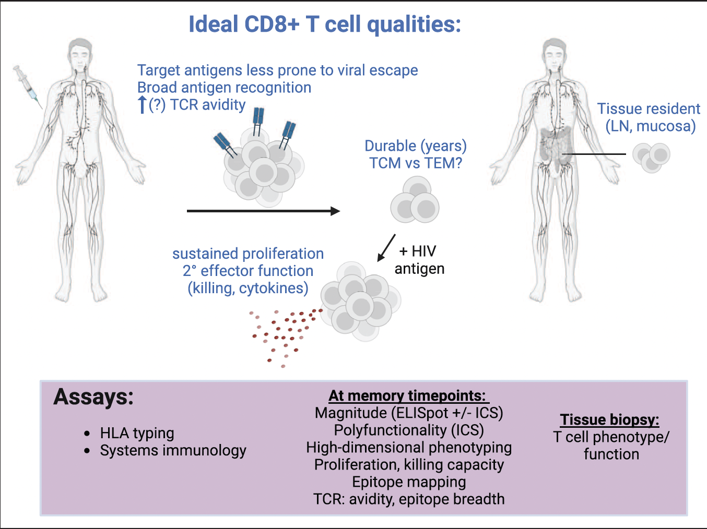
Harnessing CD8+ T cells for HIV cure: what will it take?
FUNCTIONAL:
responsive to antigen
proliferative capacity
form 2° effectors
memory-like
“stem-like”
Borgo and Rutishauser, Curr Opin HIV/AIDS, 2023

Slide 42

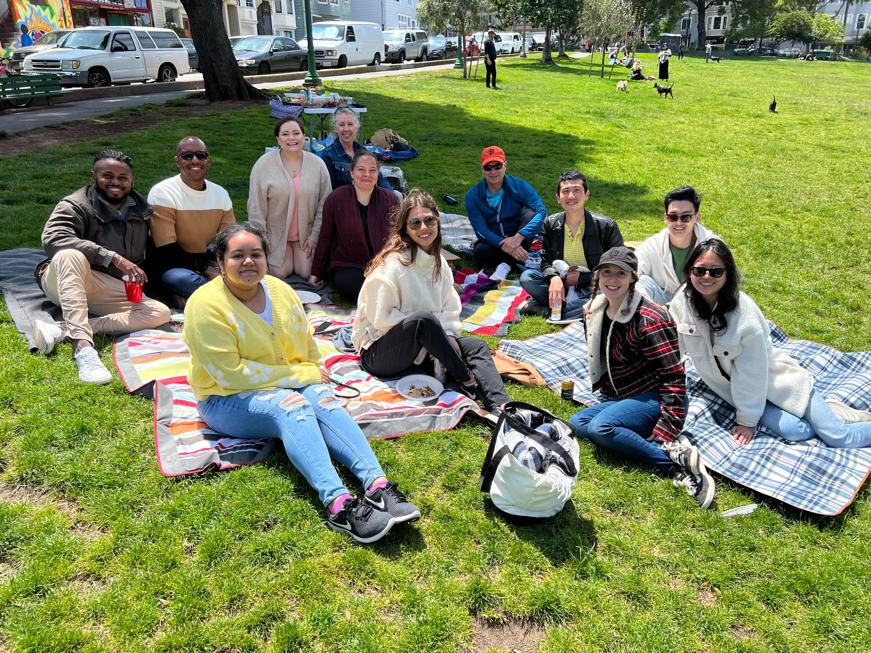

THANK YOU!
Rutishauser Lab @ UCSF
All study participants
SCOPE/other study teams
CFAR-supported Core Immunology Lab/flow core/bioinformatics core
UCSF
Steve Deeks, Michael Peluso, Amelia Deitchman, Peter Hunt, Mike McCune, Dave Glidden, Tim Henrich, Gabi Fragiadakis, Al Abdellatif
UCLA
Kara Chew
Fred Hutch, University of Washington
Lillian Cohn, Anna Farrell-Sherman, Michael Gale, Jenny Go, Jim Mullins
OHSU
Lydie Trautmann, Julie Mitchell, Afam Okoye, Louis Picker
Emory
Rafick Sékaly, Ashish Sharma
Wistar
David Weiner, Mansi Purwar, Emma Reuschel, Meagan Wise
NCI
Barbara Felber, George Pavlakis
VRC
Lucio Gama
MGH/Ragon
Gaurav Gaiha, Charlie Crain
Gina Borgo
George Gruenhagen
Wendy Hung
Gabby Kimmerly
Demi Sandel
Kaiti Schwartz
Shayleen Singh
Rafael Tibúrcio
Lily Zemelko
+ many
others
Funding
R01 AI170239 DARE UM1 AI126611 (Deeks)
K23 AI134327 PENNVAX U01 AI131296 (Deeks)
P01 AI178375 UCSF/Bay Area CFAR
amfAR: Institute for HIV Cure Research;110560-74-RPRL
Bill & Melinda Gates Foundation (Cohn; Rutishauser)
UCSF CFAR-supported Core Immunology Lab, flow core/bioinformatics cores
https://experimentalmedicine.ucsf.edu/laboratories/rutishauser-lab
https://www.daretofindacure.org/

Slide 43
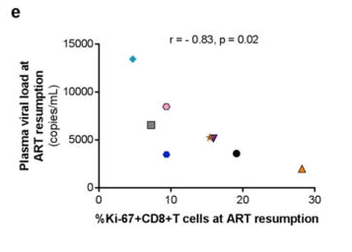
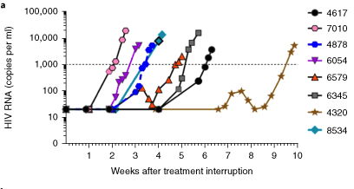
Lessons:
Both in vitro and in vivo, individuals who control HIV better have enhanced CD8+ T cell proliferative responses upon re-encountering virus/antigen.
Hint of a similar
observation post-ATI
From RV411
Colby et al, Nat Med, 2018

Slide 44
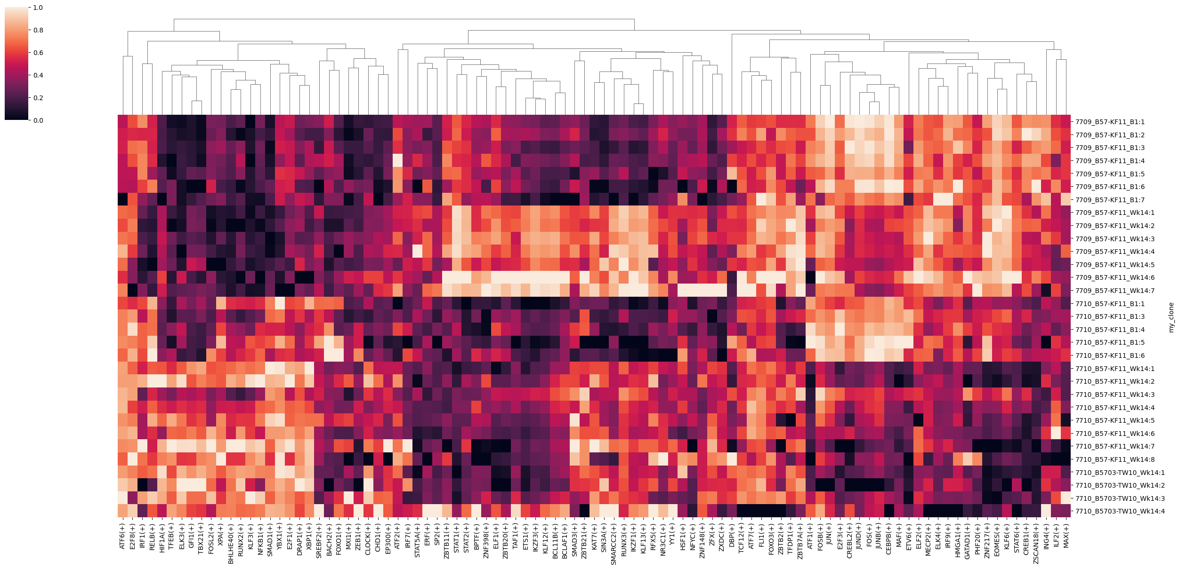
GOOD effectors
Uniquely UP
7710 Wk14
BAD effectors
Uniquely UP
7709 Wk14
7709 BL
7709 Wk14
7710 BL
7710 Wk14
7710 other Wk14

Slide 45
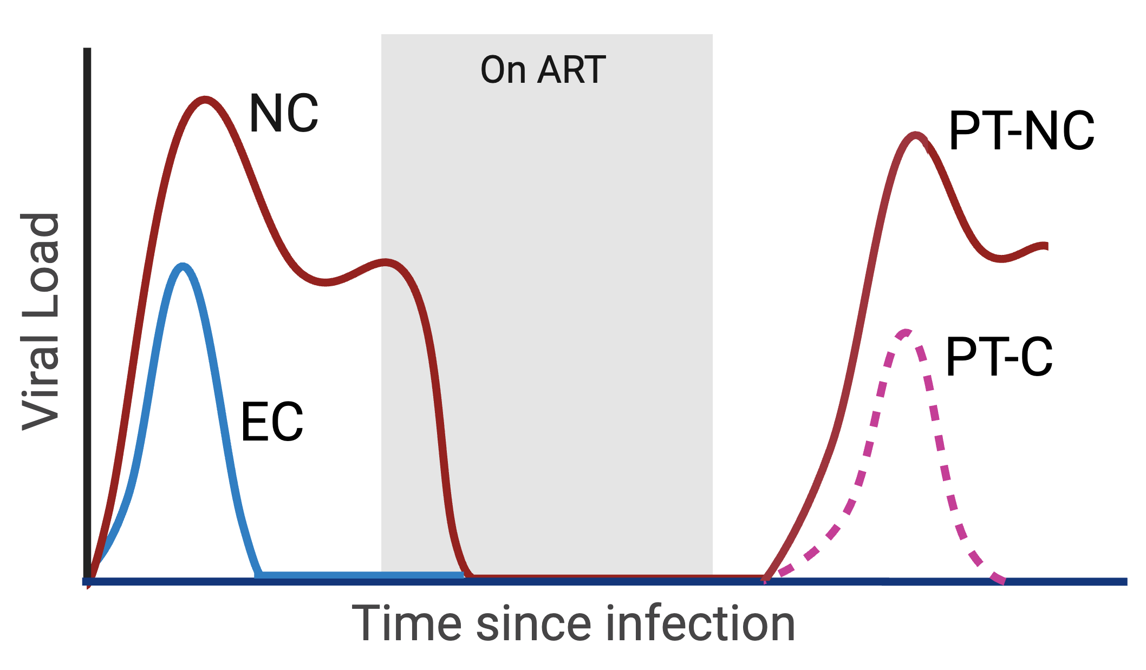
Rare individuals control HIV prior to or after ART
(elite control, EC or post-treatment control, PT-C)
Possible mechanisms
of post-ART control
Smaller reservoir
  Early ART
Innate
  DC, mono
  NK
Antibodies
  nAb
  non-n Ab
  Memory B
CD8+ T cells
CD4+ T cells
  Help to B/CD8?
  Th1? Tctl?
  Tfh (good/bad?)
5-13%
<1%
NC = non-controller
PT-NC = post-treatment non-controller
EC = elite controller
PT-C = post-treatment controller
PI-C = post-intervention controller

Slide 46
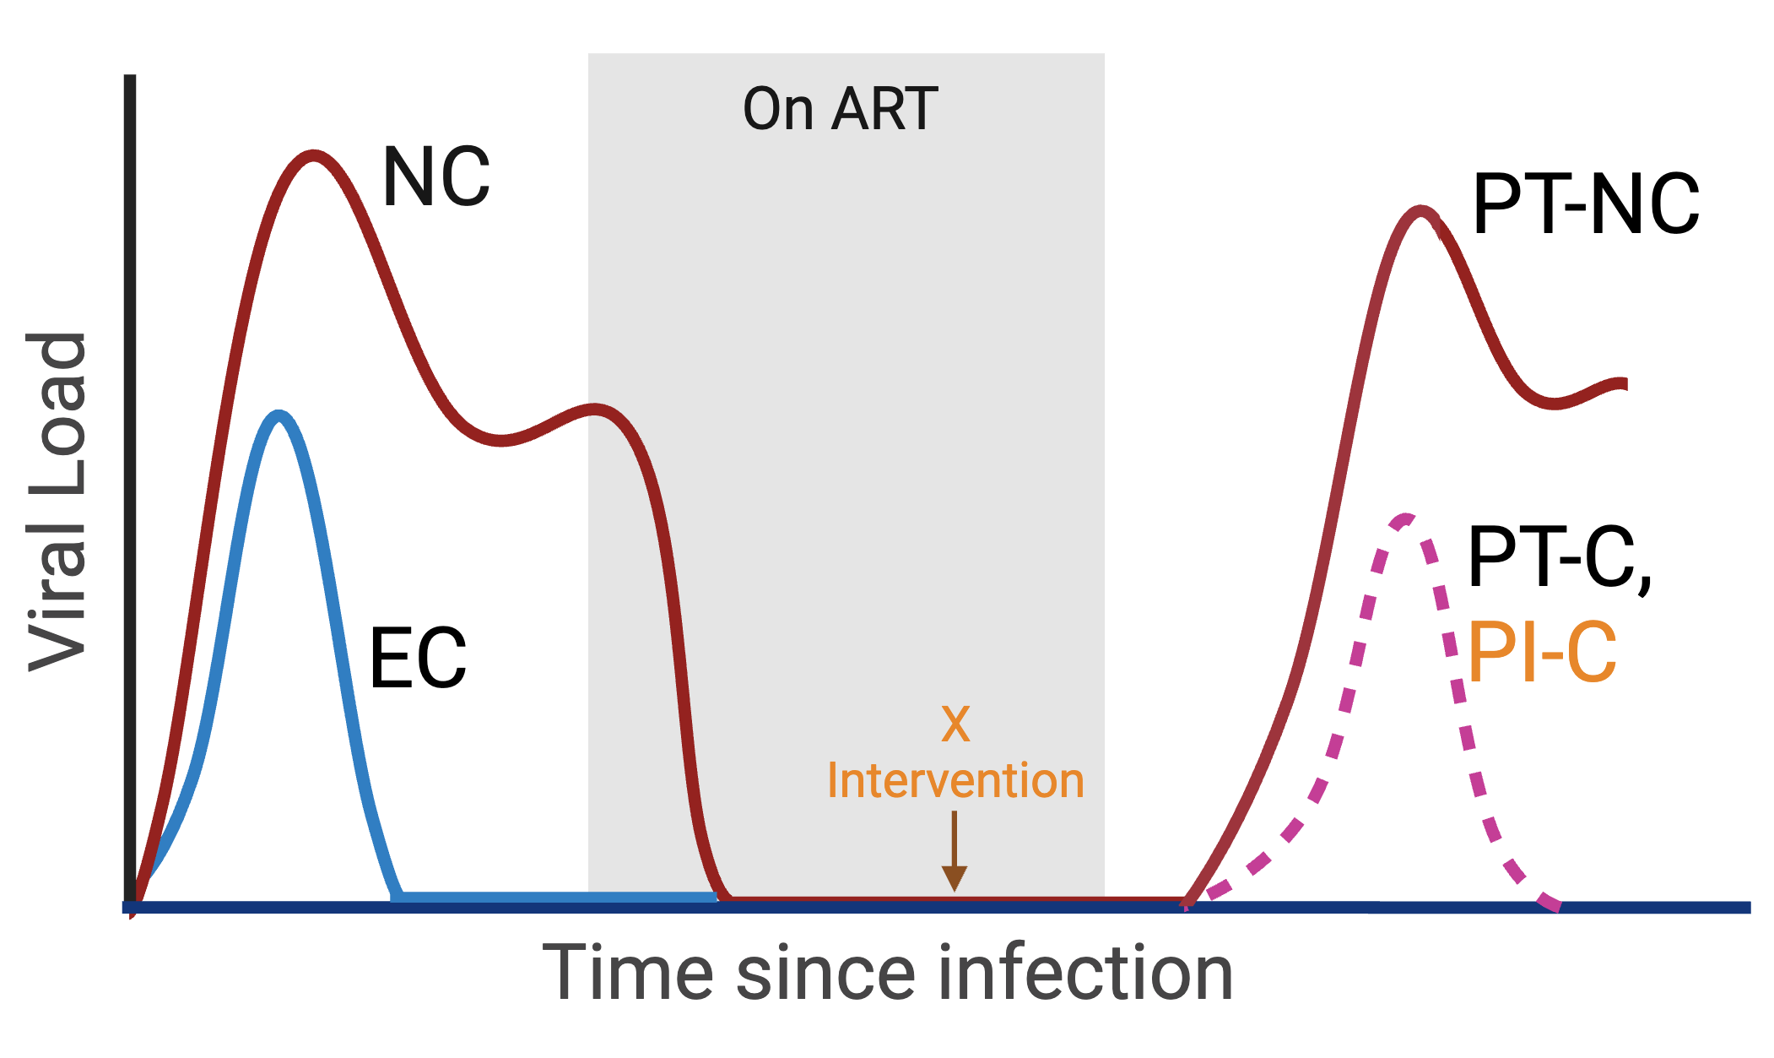
What factors promote
post-ART/post-intervention control?
Possible mechanisms
of post-ART control
Smaller reservoir
  Early ART
Innate
  DC, mono
  NK
Antibodies
  NAb
  non-N Ab
  Memory B
CD8+ T cells
CD4+ T cells
  Help to B/CD8?
  Th1? Tctl?
  Tfh (good/bad?)
NC = non-controller
PT-NC = post-treatment non-controller
EC = elite controller
PT-C = post-treatment controller
PI-C = post-intervention controller

Slide 47
What factors promote
post-ART/post-intervention control?
Possible mechanisms
of post-ART control
Smaller reservoir
  Early ART
Innate
  DC, mono
  NK
Antibodies
  NAb
  non-N Ab
  Memory B
CD8+ T cells
CD4+ T cells
  Help to B/CD8?
  Th1? Tctl?
  Tfh (good/bad?)
NC = non-controller
PT-NC = post-treatment non-controller
EC = elite controller
PT-C = post-treatment controller
PI-C = post-intervention controller

Slide 48
Extra slides

Slide 49

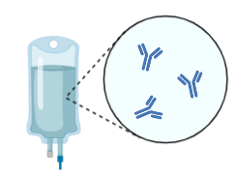
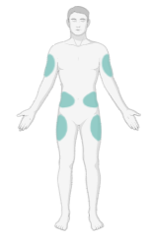
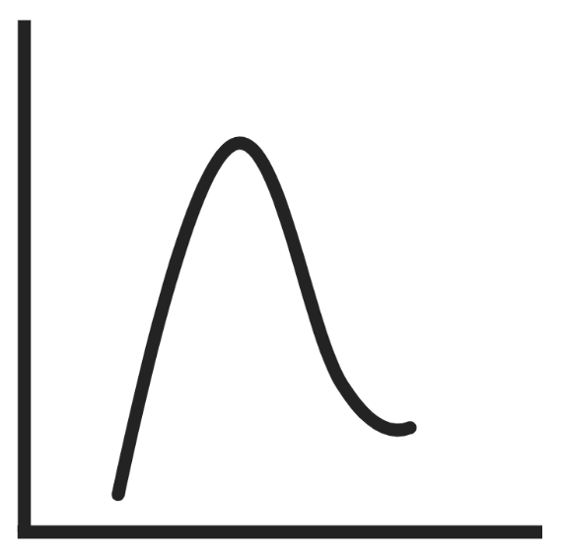

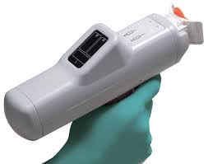


amfAR combination clinical trial
N=10 people with HIV on ART >12 months; 7 initiated on ART during early infection (<6 months from estimated infection date)
Opened: February, 2020
OFF
ART
Therapeutic vaccination
(CE-specific T cells)
Vaccinal effect (?)
blunted rebound -- ?
? Reservoir reduction
Weeks 0, 4, 12
Week 20
Weeks 24-34
Weeks 34-80
Conserved element (Gag) vaccine
(DNA, via electroporation)
MVA boost
bNAbs
10-1074
VRC07-523LS
TLR9 Agonist
Lefitolimod
bNAbs
10-1074
VRC07-523LS
Analytic treatment interruption
(set-point)

Slide 50
Time to Rebound (Weeks)
18m
(no rebound)
Weeks since ART Pause
Rebound occurred at a mean of 15 weeks after ART interruption
(not surprising given long-acting bNAb)

Slide 51
Viral load dynamics from beginning of rebound
Typical (n=3)
Durable partial control (n=4)
HIV plasma viral load (copies/mL)
None (n=1)
Slow/non-exponential (n=2)
Weeks since rebound
All graphs synced to start at participant-specific time of rebound (last plasma HIV RNA <LOQ)

Slide 52
amfAR study: PBMC sampling timepoints
ATI
+bNAbs
ART
bNABs
on ART
Vaccine
bNAbs + TLR9*
X X X X X X X
BL post-prime/boost pre-ATI bNAb “only”** post-rebound***
*participants
received
1-9 doses
of lefitolimod
**3-7 weeks
post-bNAb
dose
(VL UD)
“vaccinal”
***Actual
1st post-rebound
timepoints
(within 1st month
post-rebound):

Slide 53
amfAR study: PBMC sampling timepoints
ATI
+bNAbs
ART
bNABs
on ART
Vaccine
bNAbs + TLR9*
X X X X X X X
BL post-prime/boost pre-ATI bNAb-only** post-rebound***
*participants
received
1-9 doses
of lefitolimod
**3-7 weeks
post-bNAb
dose
(VL UD)
“vaccinal”
***Actual
1st post-rebound
timepoints
(within 1st month
post-rebound):

Slide 54
amfAR study: PBMC sampling timepoints
ATI
+bNAbs
ART
bNABs
on ART
Vaccine
bNAbs + TLR9*
X X X X X X X X
BL post-prime/boost pre-ATI bNAb-only** pre- post-rebound***
*participants
received
1-9 doses
of lefitolimod
**3-7 weeks
post-bNAb
dose
(VL UD)
“vaccinal”
***Actual
1st post-rebound
timepoints
(within 1st month
post-rebound):

Slide 55
amfAR trial assays (broad overview, not precise/comprehensive)
VACCINE
bNAb/TLR9
bNAb/ATI
 | Baseline* | Wk1 (early) | Wk22 (peak post-boost) | "Wk24" (pre-bNAb/TLR9) | "Wk24-34" (bNAb+TLR9) | "Wk34”* (pre-bnAb/ATI) | During ATI (pre-rebound) | During REBOUND
bNAb PK | X |  |  | --------- x x x x --------- | X | X | X
WHAT DID THE INTERVENTIONS DO?
HIV Reservoir IPDA, CA-RNA/DNA, PRIPseq | X |  |  | X |  | X | X
T cell assays ICS (+phenotypes), epitope map, proliferation, tetramer | X |  | X | X |  | X | XX | XXX
Systems Immunology CyTOF (B/T/innate); sc-seq | X | X | X | X | XX | X | XX | XXX
LN FNA (n=5) ICS, 10X scRNA/TCRseq | X |  |  | X |  | X
HOW IS VIRUS CONTROLLED POST-ATI?
HIV sequencing Ab + CTL escape | (X) |  |  |  |  |  |  | XXX
*n=6 participants with leukapheresis baseline and pre-ATI

Slide 56
amfAR trial: Spectral flow panel (ICS)
Purpose: Measure the magnitude, polyfunctionality, phenotype, and CE-specific T cell response breadth
Lineage markers
Live/dead
CD14+CD19+γδTCR dump
CD3
CD4
CD8𝜶
Cytokines/degranulation
IFN𝜸
TNF𝜶
IL-2
CD107a
Transcription Factors
Tbet
TCF-1
Tox
Cytokine/Chemokine Rs
CD127
CXCR5
CX3CR1
CXCR3
Effector proteins
Granzyme B
Perforin
Effector-memory subsets
CD45RA
CCR7
CD27
CD95
Inhibitory Receptors
PD-1
CD39
TIGIT
“TRM” marker
CD103
Stim: CE, Gag, Pol, Env, Nef pools (controls: unstim, CEF)
With UCSF Core Immunology Lab
(Nitasha Kumar, Michiko Shimoda)

Slide 57
CE DNA+MVA boost therapeutic vaccine elicited/boosted CD4+ and CD8+ T cell responses
CE responses
Nef responses
(not in vaccine)
16x ↑
Memory:
2.5x ↑
CD4
CE-specific T cell responses increased after DNA prime and again after MVA boost
Gated on live, dump-, CD3+
CD4
CD8
5.6x ↑
Memory:
NSD from
BL
CD8
Peluso, CROI 2023

Slide 58
Therapeutic vaccination => ↑%PD-1+ CE-specific CD4+ and CD8+ T cells
CD4 CD8
transient increase
(maybe meaningful?)
CE
Nef
Post-prime = 2w post last DNA
Post-boost = 2w post MVA
Gated on IFNγ+
CD4+ or CD8+ after
CE or Nef peptide pool stim

Slide 59
Therapeutic vaccination activates/effector-differentiates CE-specific CD8
CD39
activation/exhaustion
CD127
memory
Post-prime = 2w post last DNA
Post-boost = 2w post MVA
Gated on IFNγ+ CD8+ after
CE peptide pool stim

Slide 60
HIV-specific CD8+ T cells: No clear “vaccinal” effect
CE-specific
Total (Gag+Pol+Nef+Env)
“vaccinal” timepoint: 3-7 weeks post-bNAb dose (VL UD)

Slide 61
HIV-specific CD8+ T cells: total (not CE) responses expand with rebound
CE-specific
Total (Gag+Pol+Nef+Env)
(not shown: HIV-specific CD4+ T cells do not expand much)

Slide 62



In the context of acute ZIKV infection, we have found that CyTOF:
Is a useful tool to profile/categorize cellular immune signatures and correlations between immune features occurring uniquely during acute infection
Can be used to identify changes in low-abundance cellular features over time
Can identify meaningful correlations between broad/systems-wide cellular immune features and qualities of antigen-specific adaptive immune responses
McCarthy … Spitzer*, Rutishauser*, Cell Reports, 2022.

Slide 63


amfAR trial CyTOF: 2 Panels
Demi Sandel, Lily Zemelko
Panel 1: Innate and B cell phenotypes
Panel 2: CD4, CD8, γδ T cell phenotypes

