Slide 1
Exploring avidity in HIV vaccine design
Iain MacPherson, PhD
Assistant Professor
University of Hawaii, Department of Tropical Medicine, Medical Microbiology and Pharmacology
Hawaii Center for AIDS

Slide 2
Talk outline
Vaccine design inspiration
Vaccine design
Design characterization
Future work

Slide 3
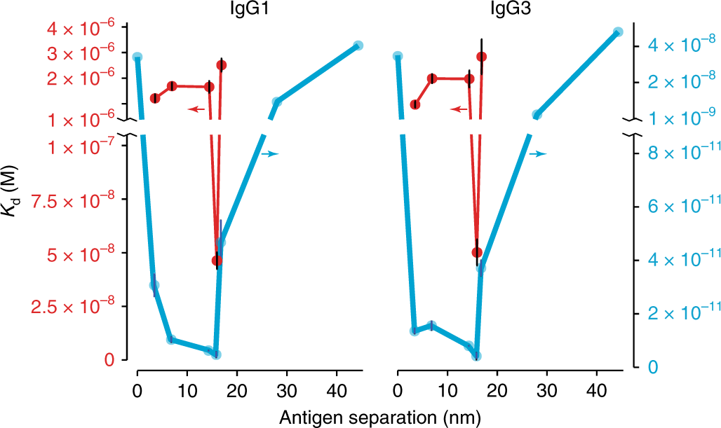
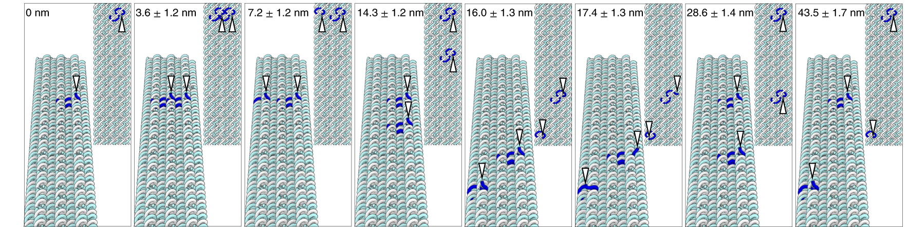
Divalent antibody binding at high and low monovalent affinity
Divalent antigens patterned onto DNA nanostructures
Shaw et al. 2019. Binding to nanopatterned antigens is dominated by the spatial tolerance of antibodies. Nature Nanotechnology 14, 184-190
Notes:
Love this and the next slide as the opening

Slide 4
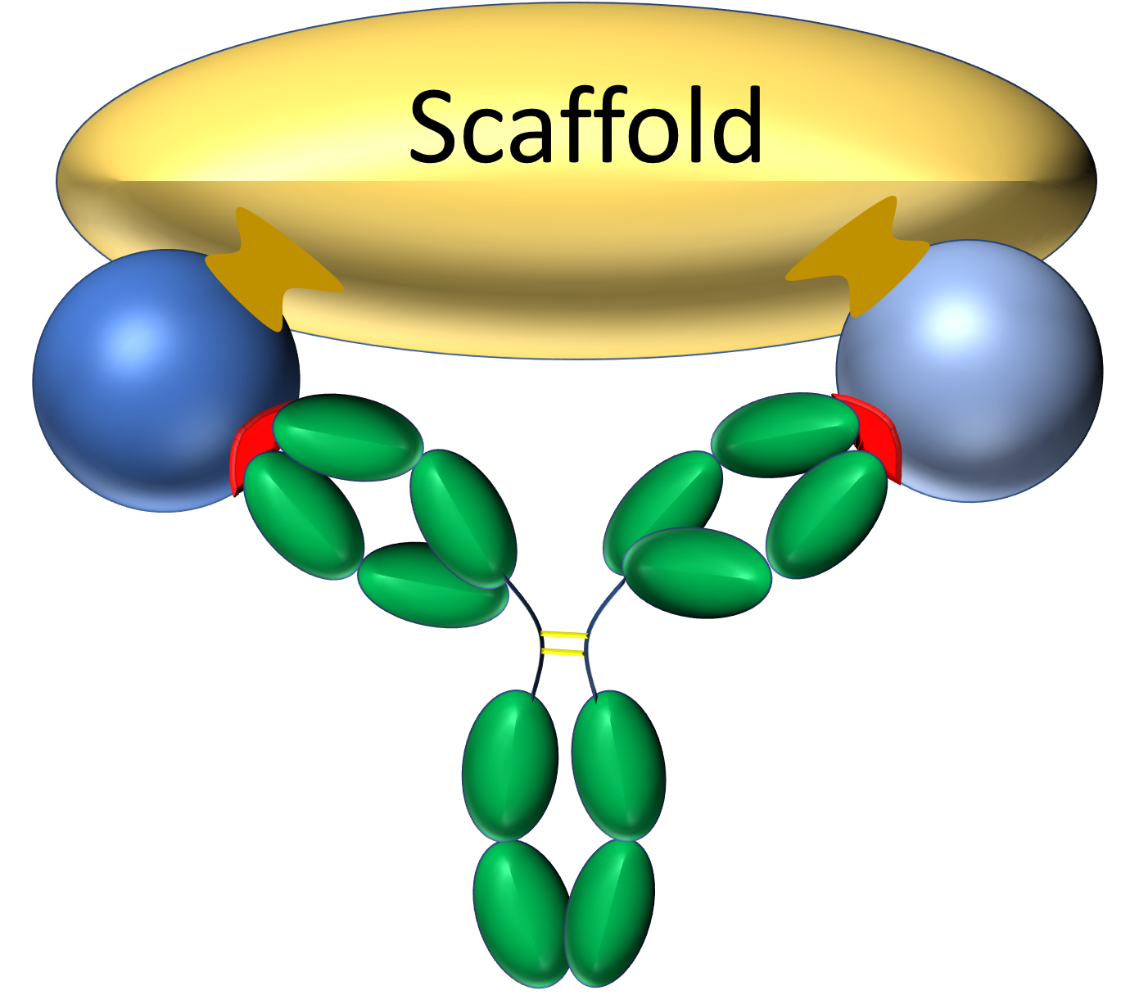
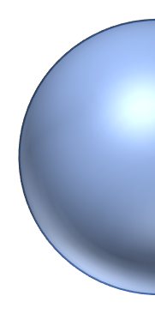
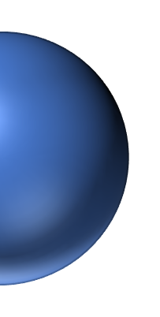
Goal: Fix two antigens for optimal divalent binding by a specific B-cell receptor
Ideal scaffold
  Minimizes antigen positional and rotational freedom
  Antigenic spacing 14-16 nm
  Minimally immunogenic
Effects
  Minimizes the entropic penalty for divalent binding
    Promotes high avidity binding
  Limits divalent binding to only a select few B-cell receptors
Epitope
Target B-cell receptor
Antigen
Notes:
I would switch the order of the effects but this is where we have a bit of differing opinion on the relative importance :)
Not sure the expression level comment is necessary

Slide 5
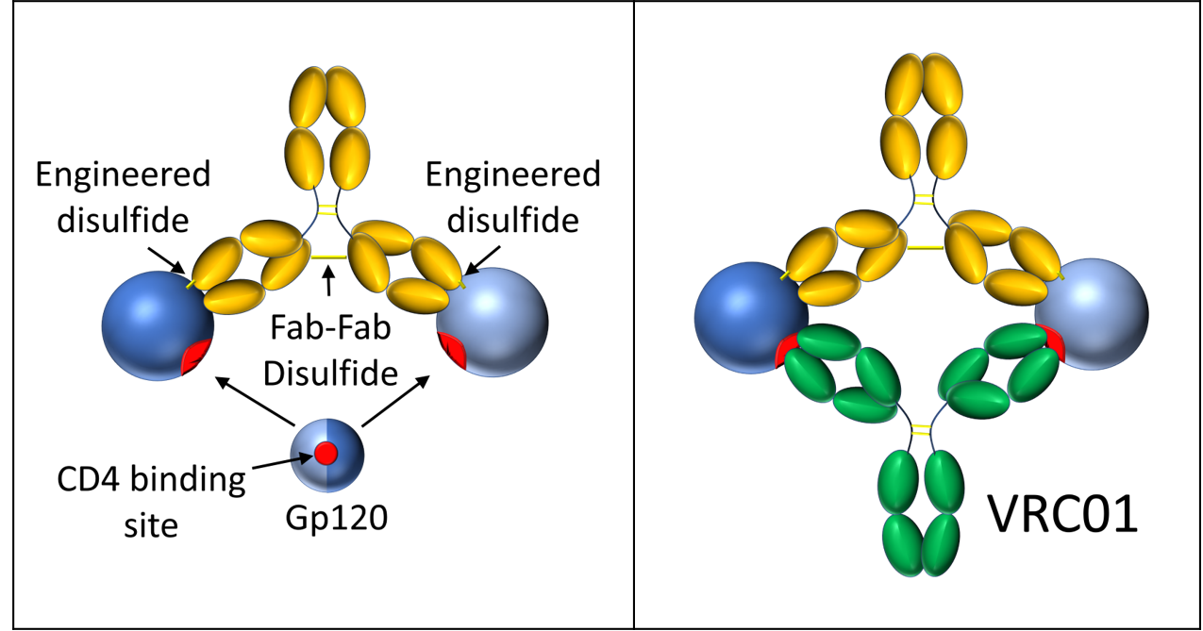
Goal: Fix two antigens for optimal divalent binding by a specific B-cell receptor
Ideal scaffold
  Minimizes antigen positional and rotational freedom
  Antigenic spacing 14-16 nm
  Minimally immunogenic
Effects
  Minimizes the entropic penalty for divalent binding
    Promotes high avidity binding
  Limits divalent binding to only a select few B-cell receptors
Notes:
I would switch the order of the effects but this is where we have a bit of differing opinion on the relative importance :)
Not sure the expression level comment is necessary

Slide 6
Immune focusing methods
Antigen binding
Hyperglycosylation, mosaic, epitope masking, heterologous boosting
Epitope binding
Angle of approach enabled by fixed divalent immunogens
Target
bnAb

Slide 7
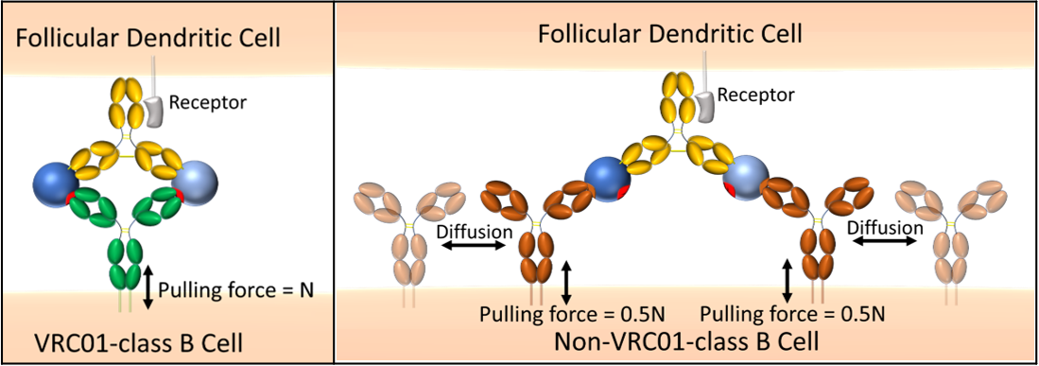
Proposed immune focusing mechanisms
Entropic penalty minimization
  Binding equation: ΔG = ΔH – TΔS
  where ΔG = Gibbs Free energy change, ΔH = enthalpy change, T=temperature, ΔS = entropy change
Germinal center
  Greater affinity discrimination
  Stronger pulling forces signaled through the B-cell receptor
Notes:
I think our goal should be to minimize the ability of non-VRC01-class B cells to bind divalently using distant gps and glycosylations and also the minimization of entropic penalty as point 2 - basically this would be an illustration of the effects discussed on slide 4. Do we know whether 1 signal at amplitude N definitely sends a greater signal than 2 signals at 1/2N? I think our goal should be to create an immunogen that avoids divalent binding on non-VRC01-class b cells

Slide 8
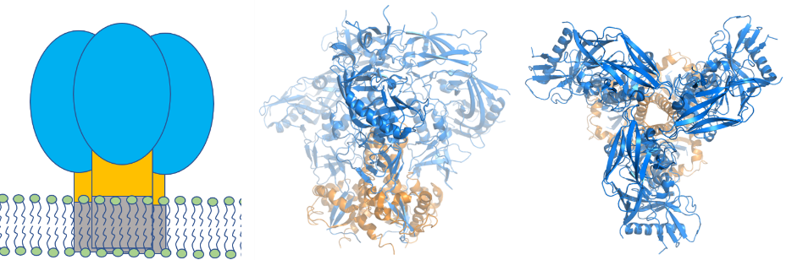
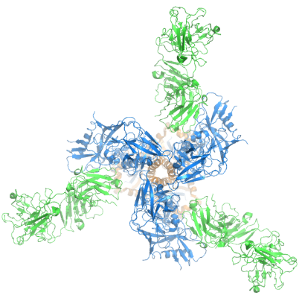
VRC01
Model system
  Best characterized HIV bnAb
  Humanized animal models
Shown to confer resistance to HIV infection (AMP trials)
Targets the CD4 binding site of gp120
Germline BCR does not bind to gp120
  Germline targeting approach
  N276 glycan roadblock
Notes:
This would seem to me to be a candidate for deletion if we are running over time

Slide 9
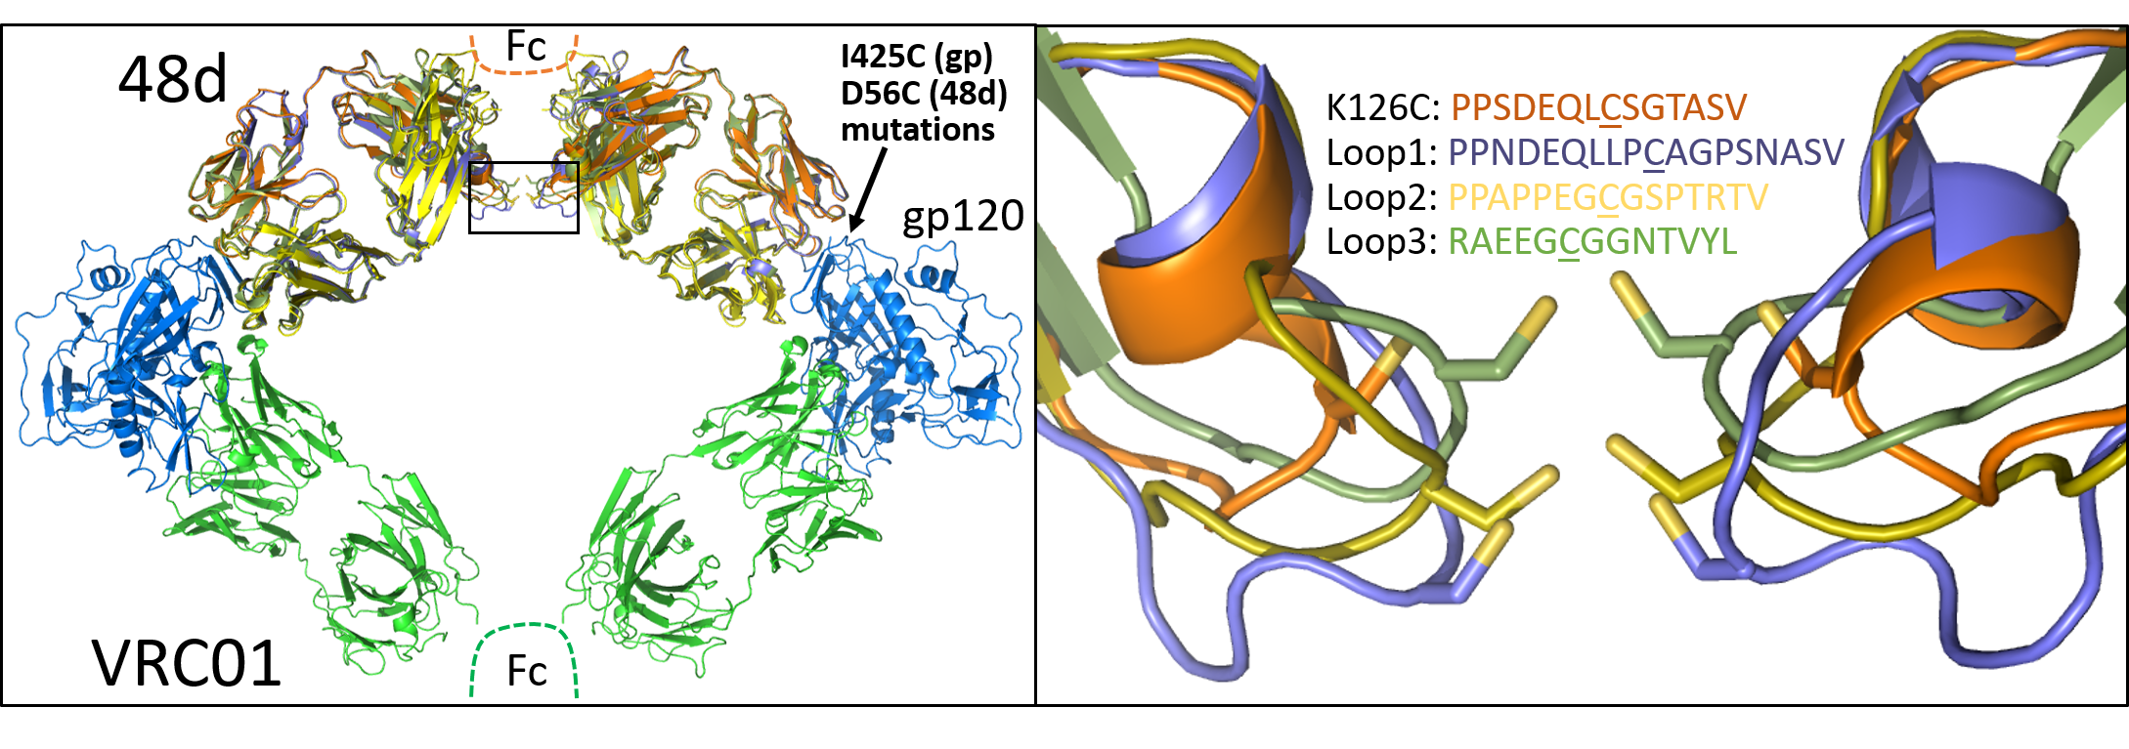
Immune complex design using Ab 48d
Antibody 48d
  Binds to the co-receptor binding site of gp120
  Engineered disulfide between 48d and gp120
  Fab-Fab crosslinking via disulfide formation
    Redesign of the light chain loop containing K126
Notes:
How was 48d selected? What properties does it have? This is interesting and relevant

Slide 10
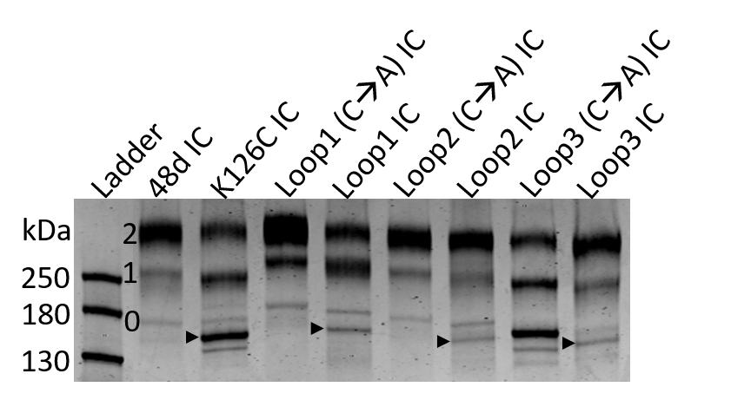
Expression and characterization
Protein A chromatography
SDS-PAGE
Disulfide formation resulting in 0, 1, or 2 gp120s bound to 48d

Slide 11
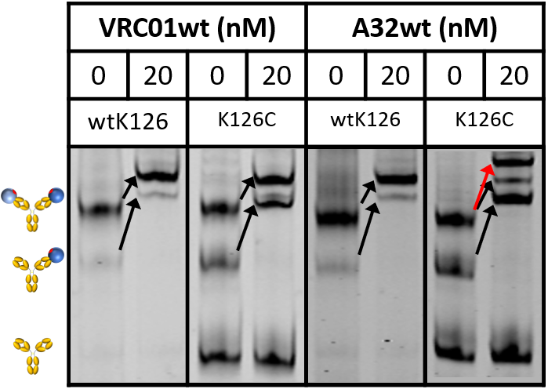
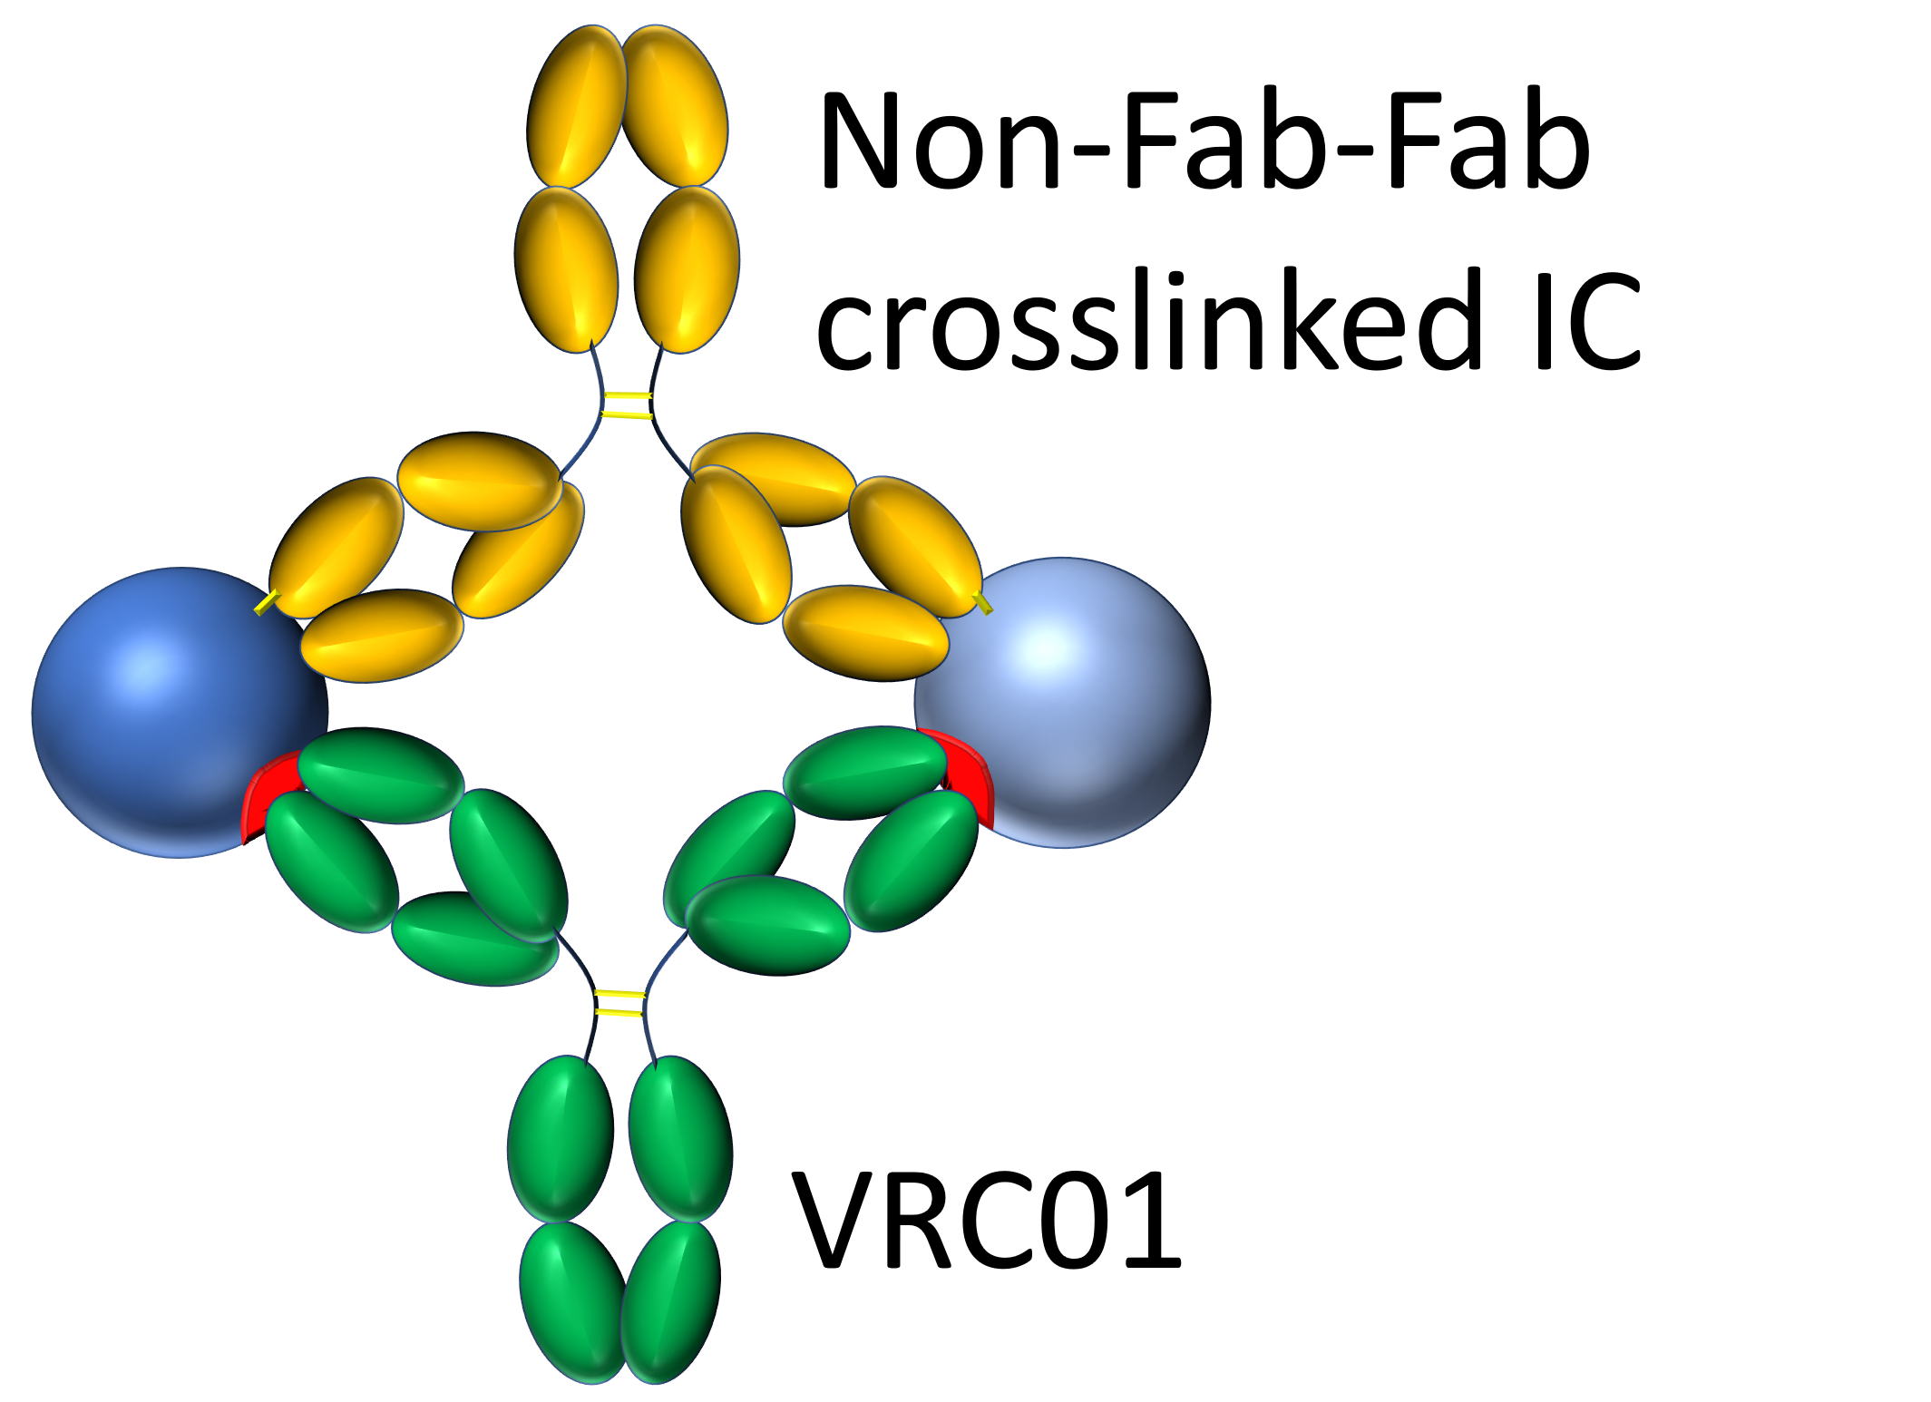
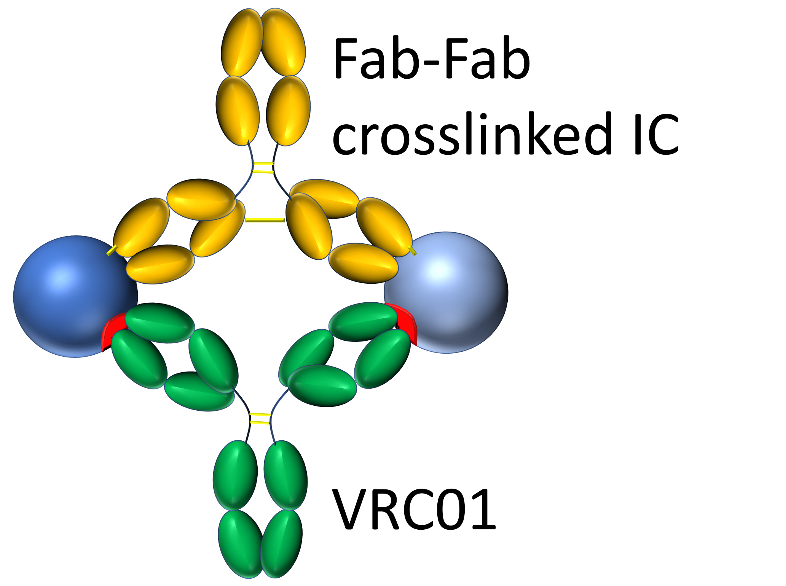
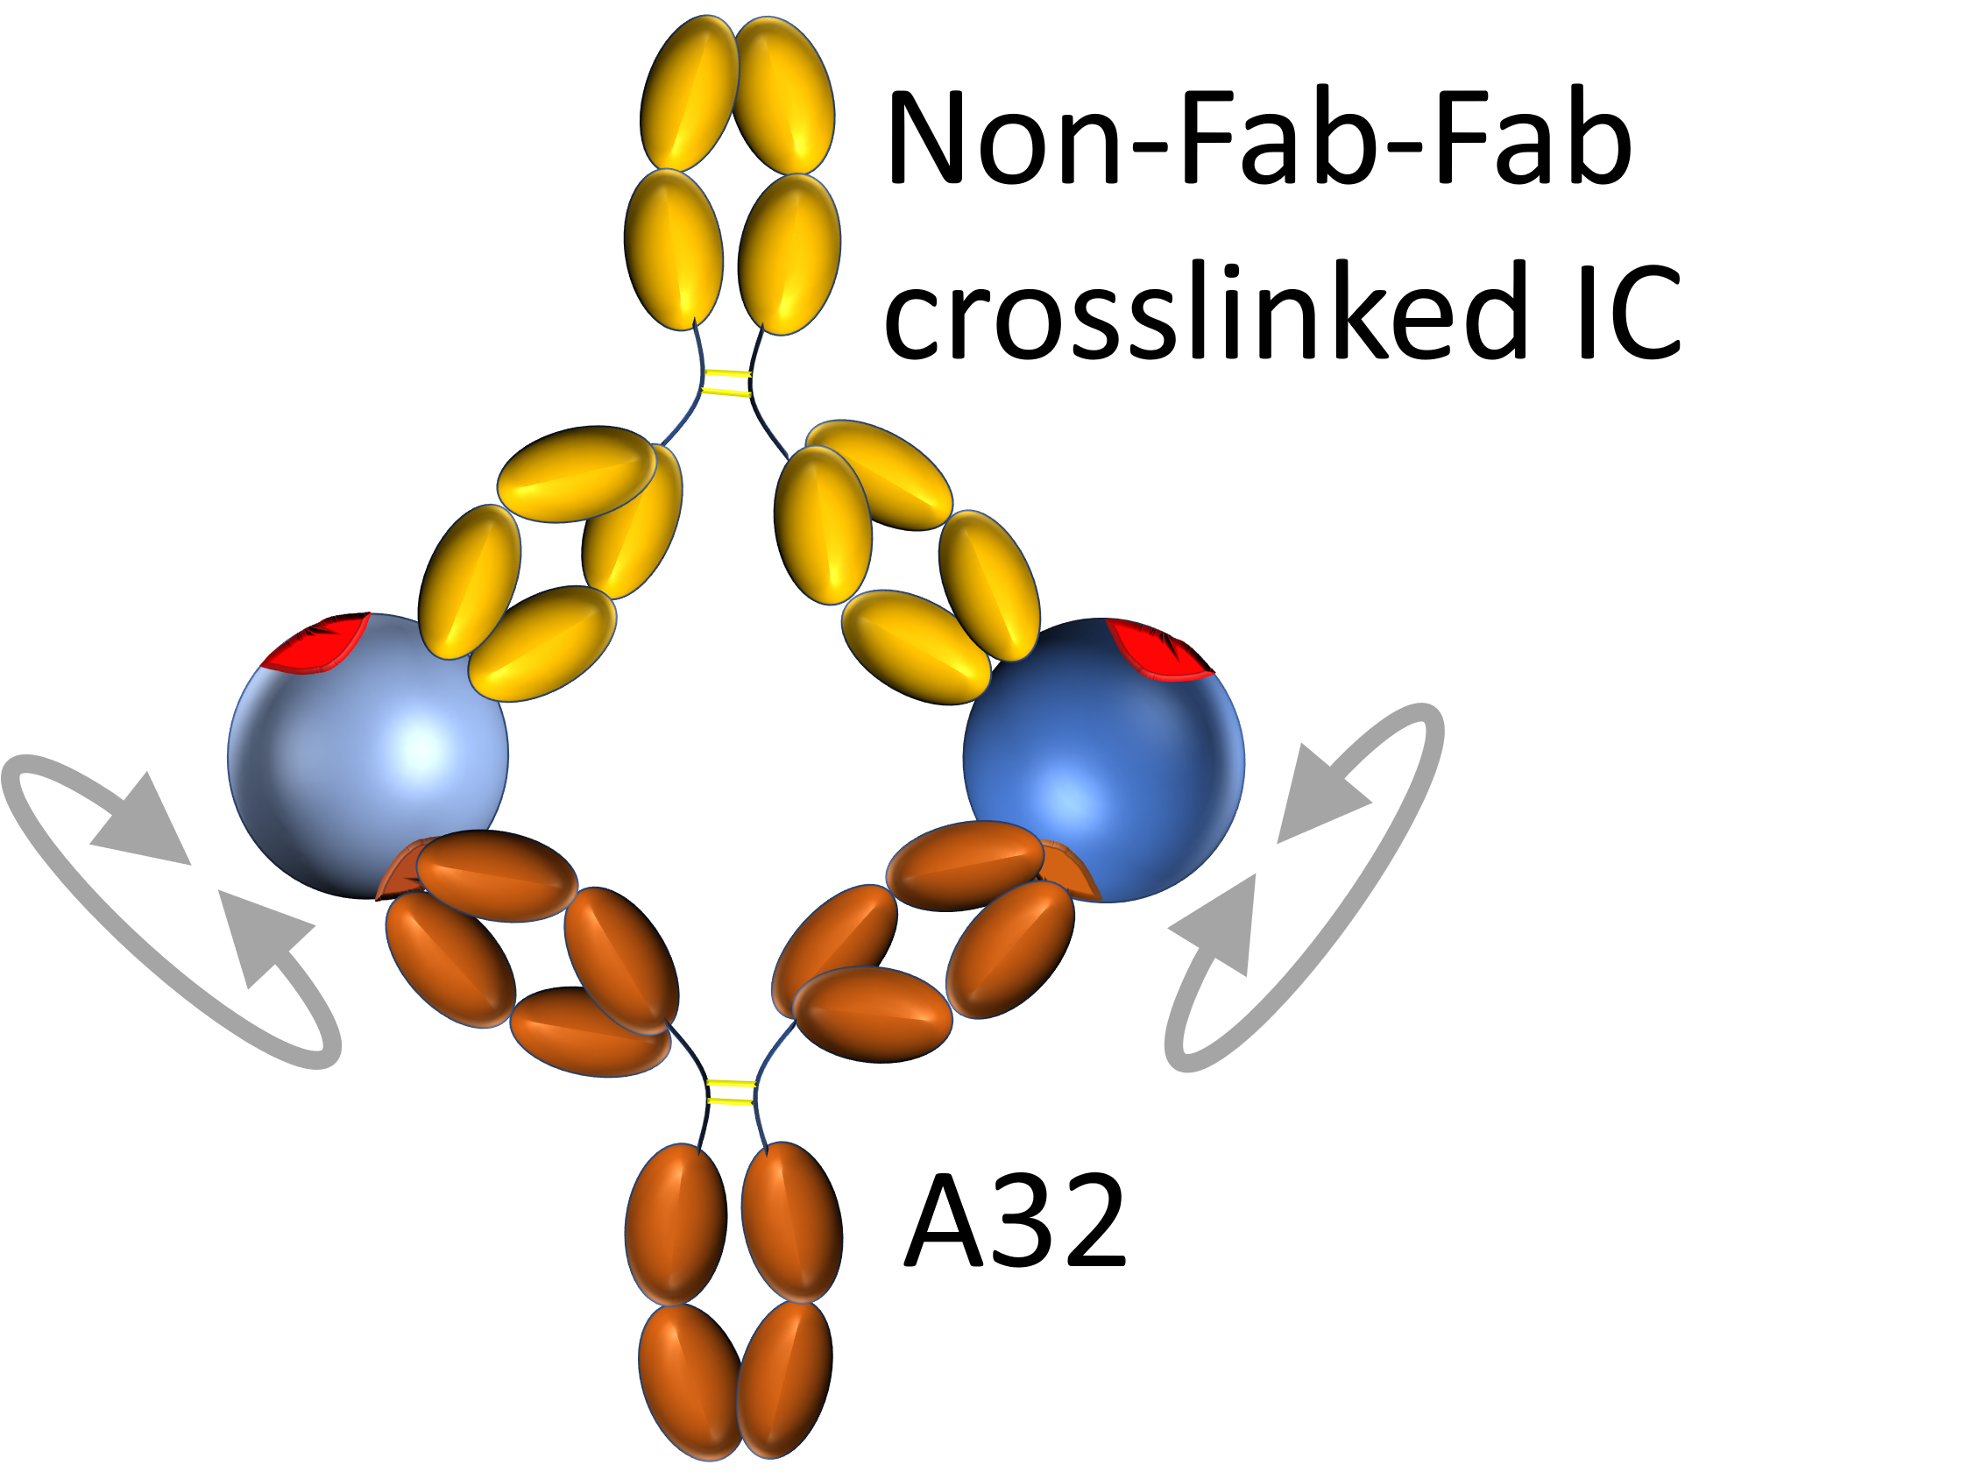
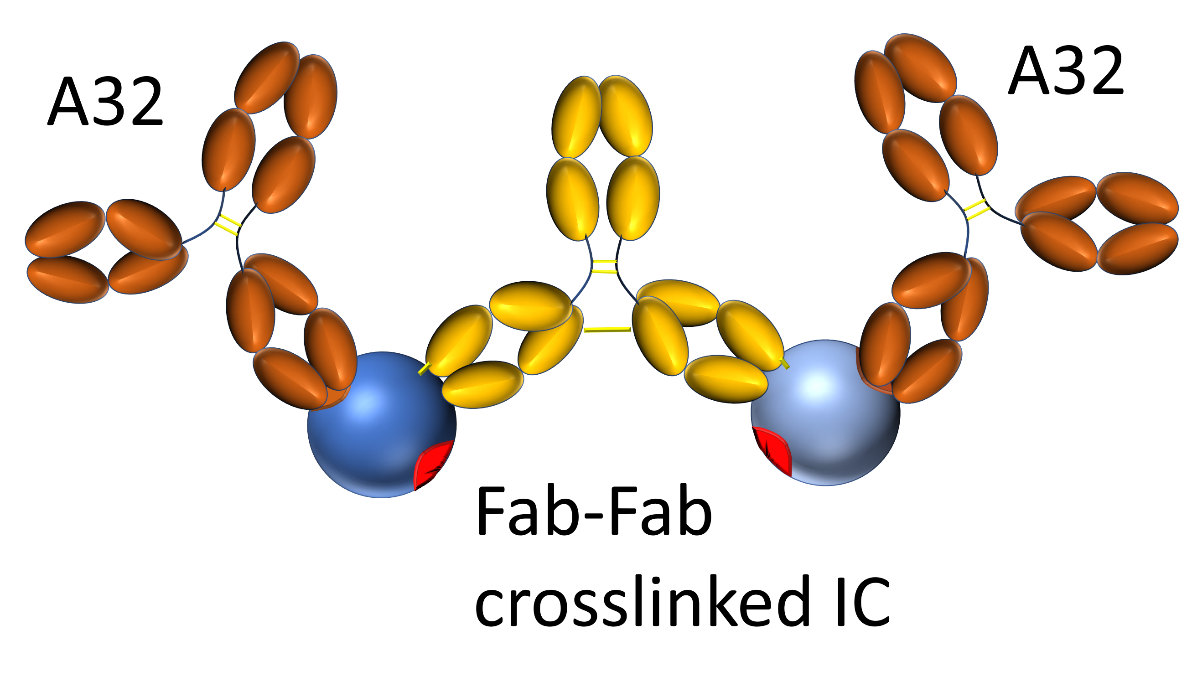
IC binds divalently to VRC01 but monovalently with non-VRC01-class Ab, A32
Attach a fluorophore-labeled covalent DNA aptamer to the Fc, enabling electrophoresis through polyacrylamide
Soxpollard, N., Strauss, S., Jungmann, R., MacPherson, IS. Selection of antibody-binding covalent aptamers. bioRxiv, 2023: p. 2023.03.09.530504.
Notes:
Should you put the headline takeaway on this slide? That VRC01 binding divalently but non-VRC01 can only bind monovalently - we need to hit folks over the head with the key messages

Slide 12
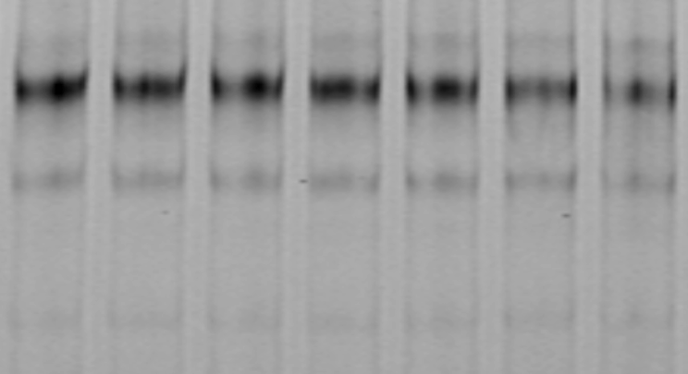
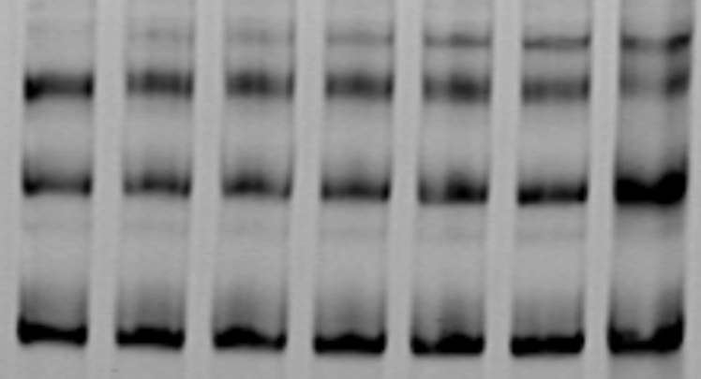
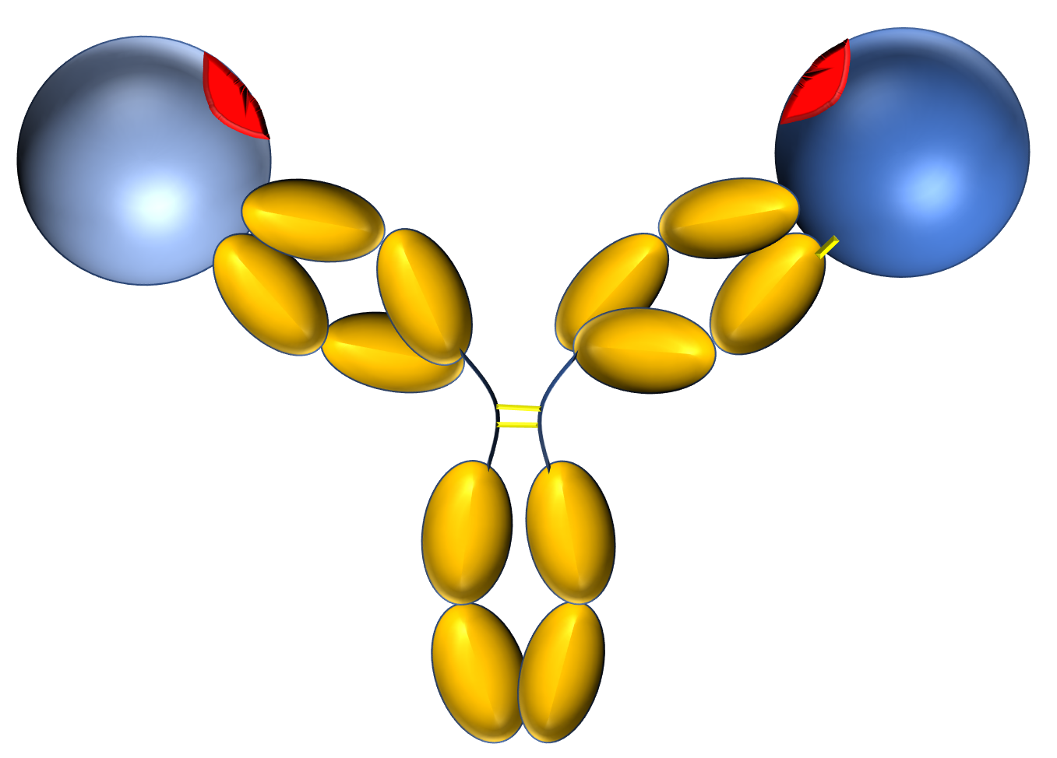
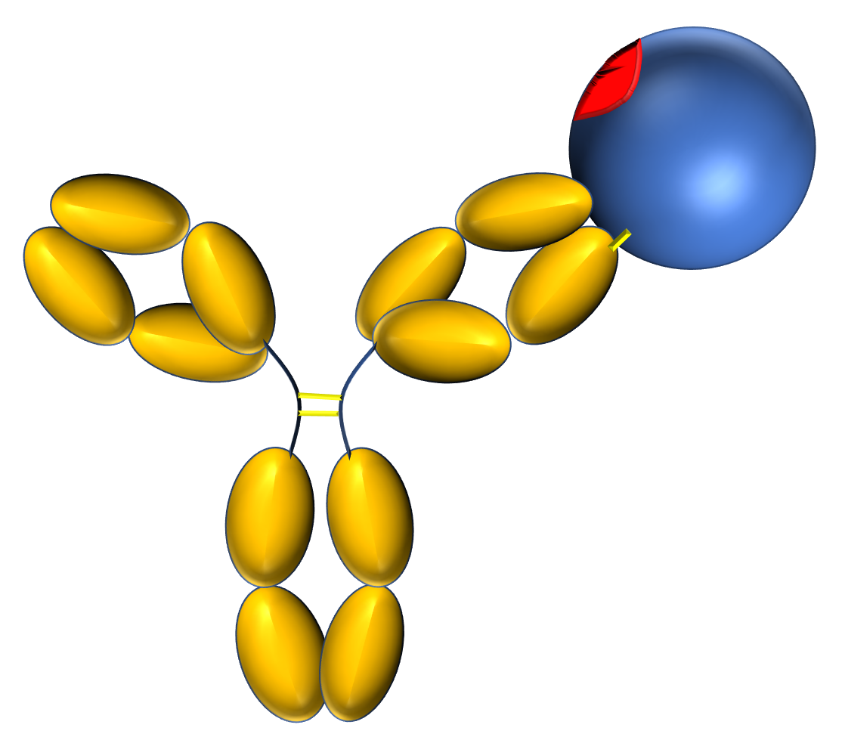
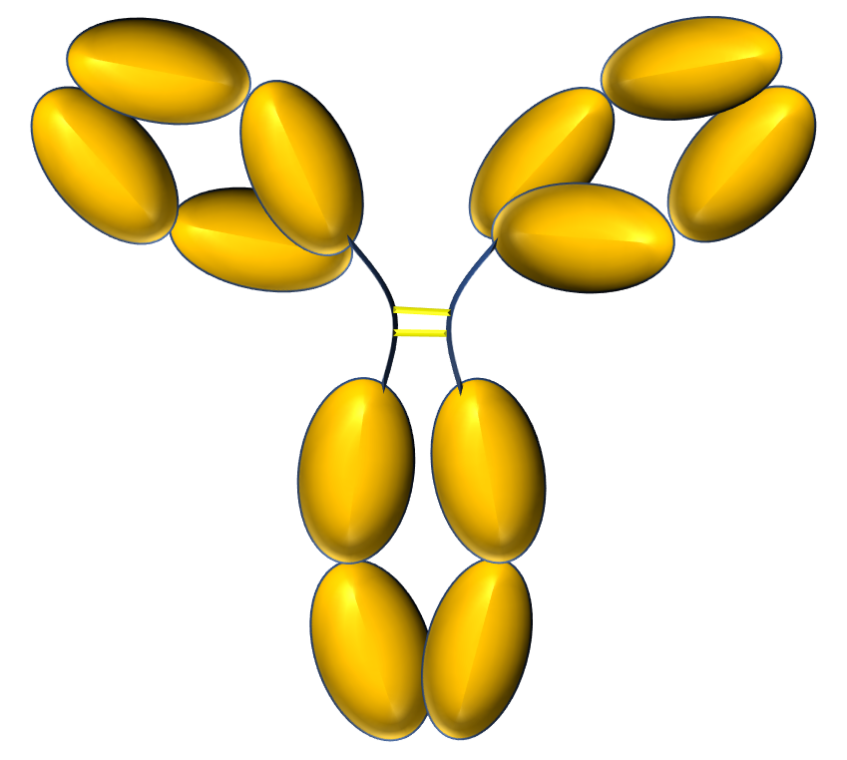
Incubation of ICs with VRC01 revertants (lower monovalent affinity)
Hypothesis
  ICs will engage strongly with VRC01 revertants having a lower monovalent affinity
  Fab-Fab-crosslinked ICs will bind with higher affinity than non-Fab-Fab-crosslinked ICs due to a lower entropic penalty
7mutVRC01 (nM)
0 | 0.2 | 0.4 | 0.8 | 1.6 | 3.2 | 6.4 | 0 | 0.2 | 0.4 | 0.8 | 1.6 | 3.2 | 6.4
K126C (Fab-Fab-crosslinked) |  |  |  |  |  |  | wtK126 (No Fab-Fab-crosslink)

Slide 13
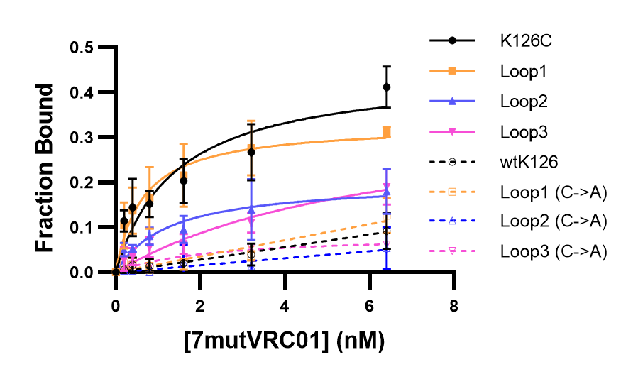
7mut-VRC01 gel shift assay for K126C, Loop1-3
All Fab-Fab-crosslinked mutants outperformed their non-crosslinked variants.
K126C, Loop1 frontrunners
  Loop1 has a lower crosslinking efficiency

Slide 14
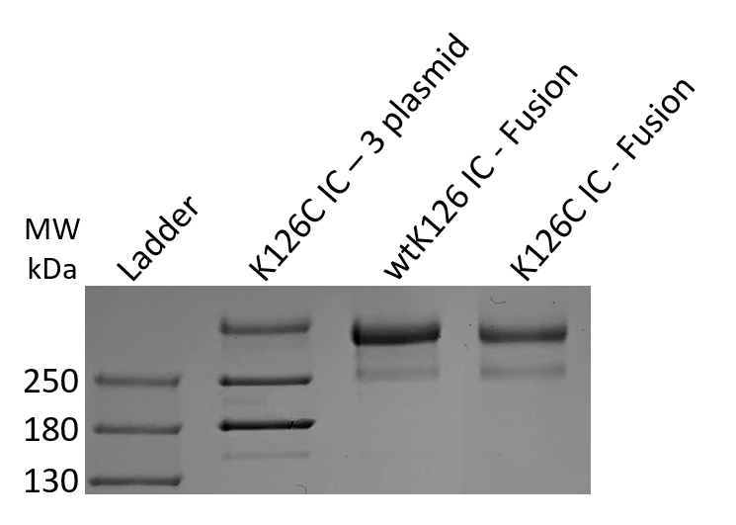
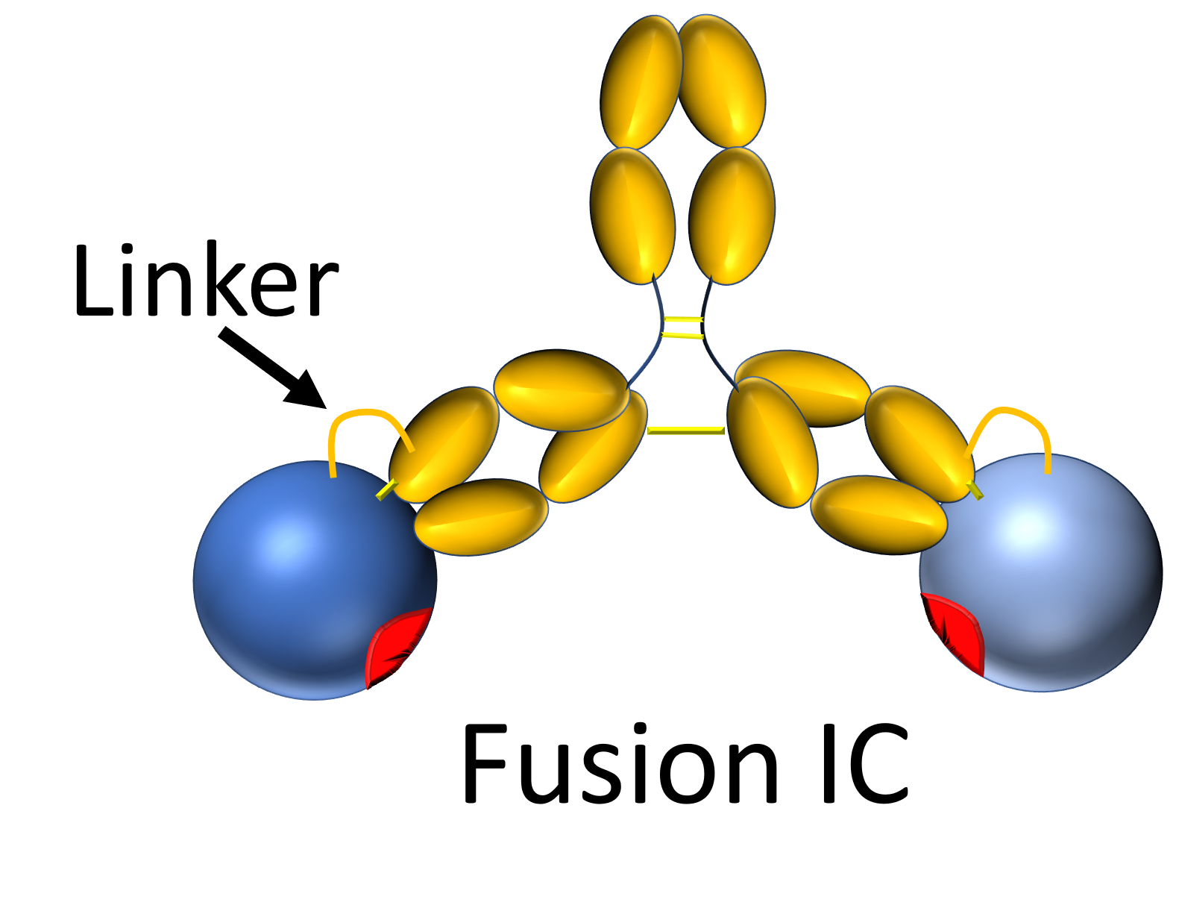
Fusion simplifies IC expression
We designed covalent immune complexes by fusing gp120 to the heavy chain of 48d
  Circular permutation of gp120
  Linker connecting new C-terminus of gp120 with N-terminus of 48d heavy chain

Slide 15
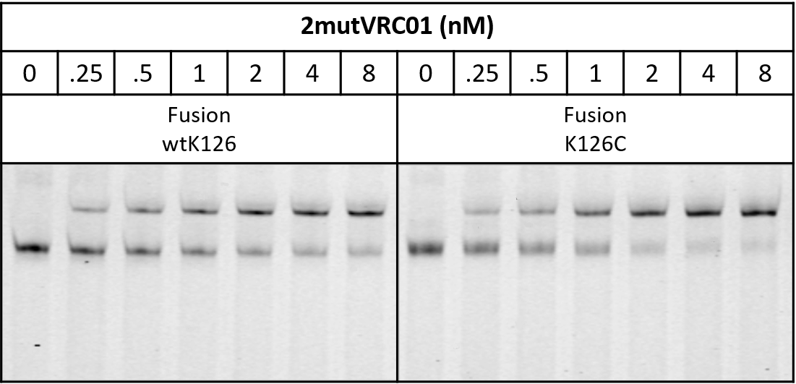
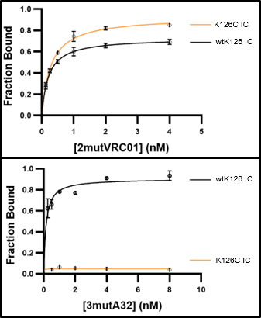
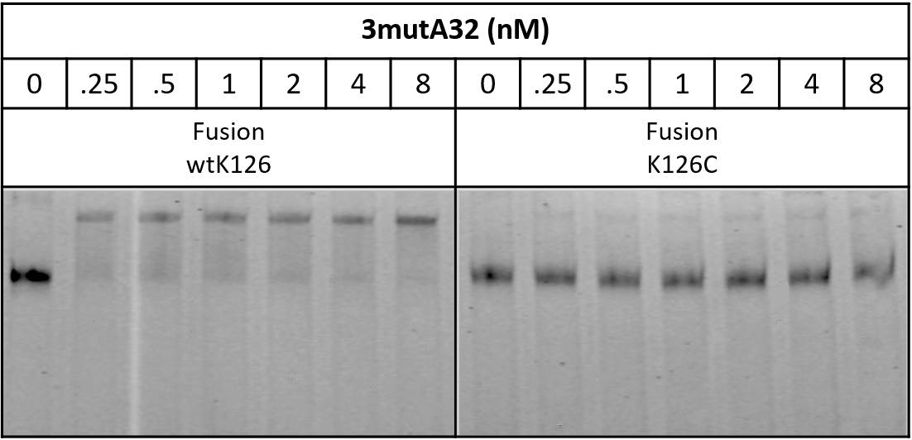
Fab-Fab-crosslinked ICs demonstrate selective avidity
VRC01 revertant
Non-VRC01-class
Notes:
Need to relabel the top graph as 2mutVRC01. Also I would label them clearly as bnAb vs non bnAb

Slide 16
Conclusions
We created a covalent immune complex that fixes the positions of two copies of gp120 for ideal divalent binding by VRC01
  Fab-Fab crosslinking lowers the entropic penalty for divalent binding
  Fab-Fab crosslinking prevents divalent binding by non-VRC01-class Abs
  Low monovalent affinity versions of A32 bind much more weakly to the Fab-Fab-crosslinked IC than to VRC01 revertants with similar monovalent affinity
The immunogen may have potential as an immune focusing vaccine
  If successful, the design is broadly applicable
Notes:
Fab-fab cross linking also prevents divalent binding to non-VRC01-class blabs

Slide 17
Future directions- in vivo testing
Does fixing antigens for 1:1 divalent binding enable immune focusing?
  Test as a prime or boost in a VRC01 knock-in mouse model
    Monomer, dimer, trimer
  Controls
    Non-Fab-Fab-crosslinked
    Multimerized gp120

Slide 18




Thanks
Hawaii Center for AIDS
  Cecilia Shikuma (Director)
  Ryan Bailey
  Kalista Kahoekapu
Department of Tropical Medicine, Medical Microbiology and Pharmacology
  Axel Lehrer
    Ludwig Mayerlen
    Albert To

Slide 19
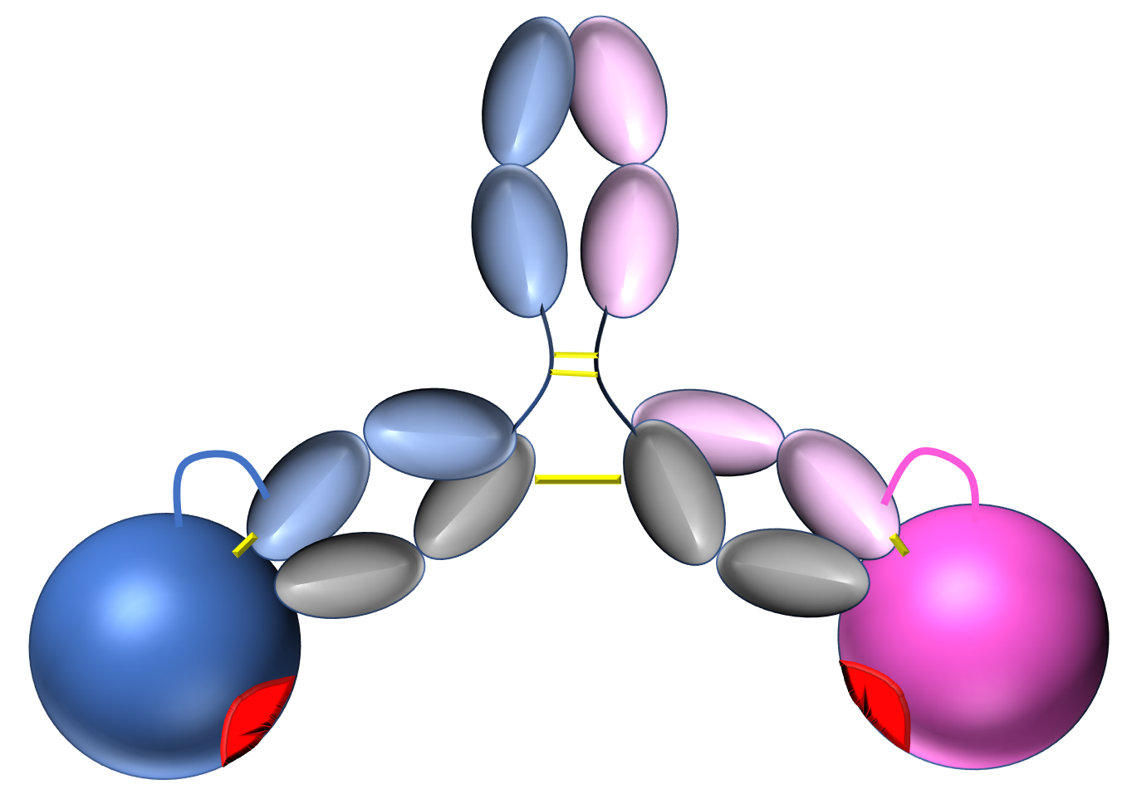
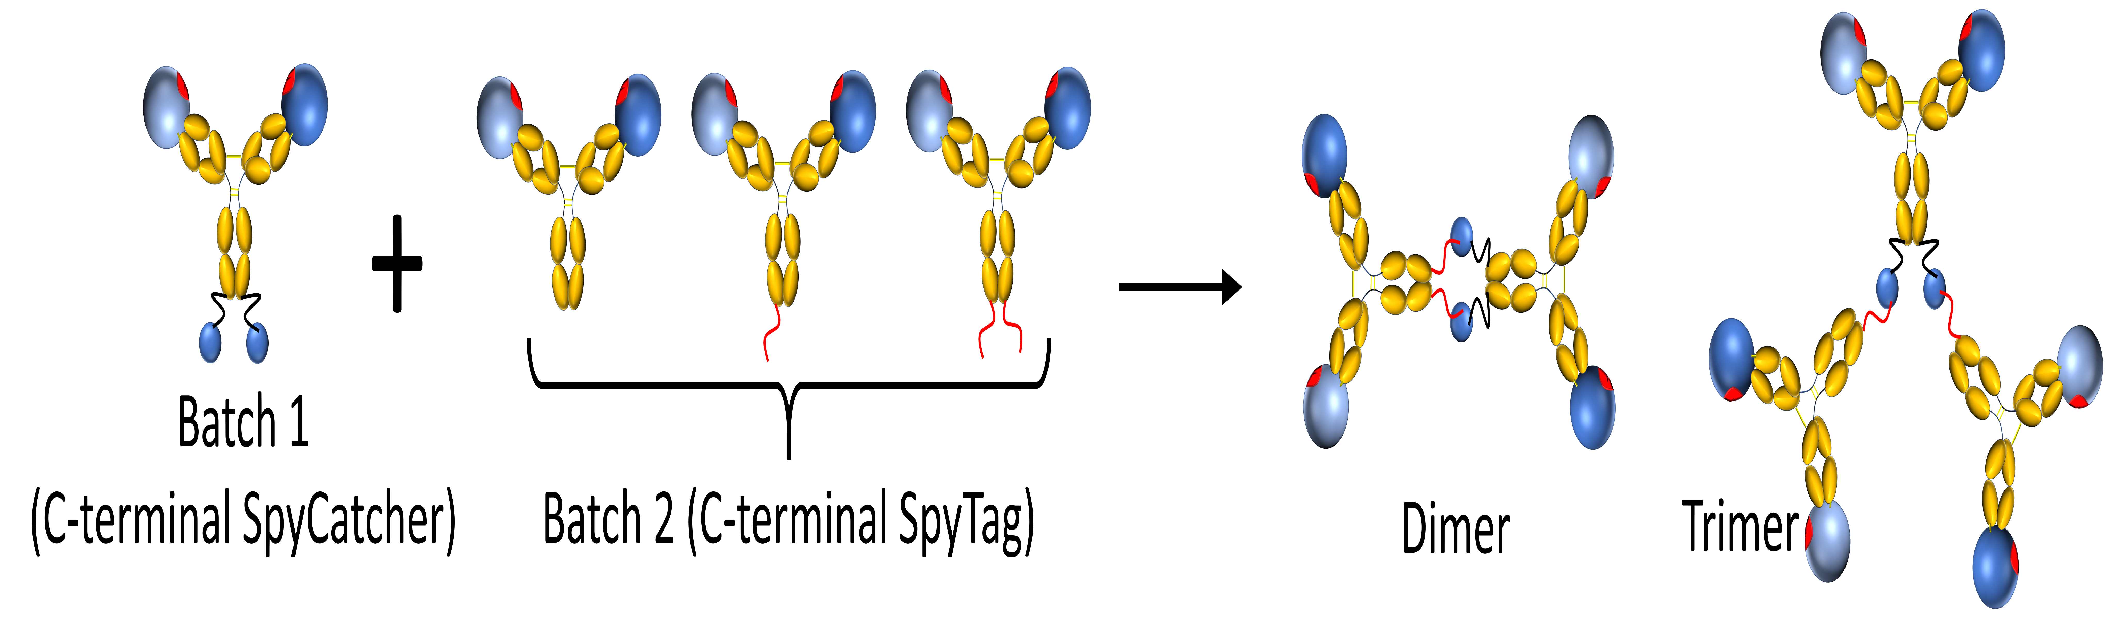
Future directions- engineering and in vitro testing
Minimize off-target divalent binding
  Hyperglycosylation
  Incorporate distantly related gp120s
    Bispecific antibody technology enabled by fusion construct
Dimers and Trimers
  May maintain immune focusing
Surface Plasmon Resonance
  Vertical orientation of antibodies critical
Cell based assays
Incorporation of distantly related gp120s

