Slide 1
Advancing HIV and STI Prevention And Equity Among US MSM and TGW
Hyman M. Scott, MD MPH
Bridge HIV, San Francisco Department of Public Health
Assistant Clinical Professor, University of California, San Francisco

Slide 2
Outline
Current status of HIV & PrEP use in the US
Challenges and strategies to improve oral and injectable PrEP implementation and equity
DoxyPEP for STI prevention

Slide 3
Disclosures
I have no relevant financial disclosures to report.

Slide 4
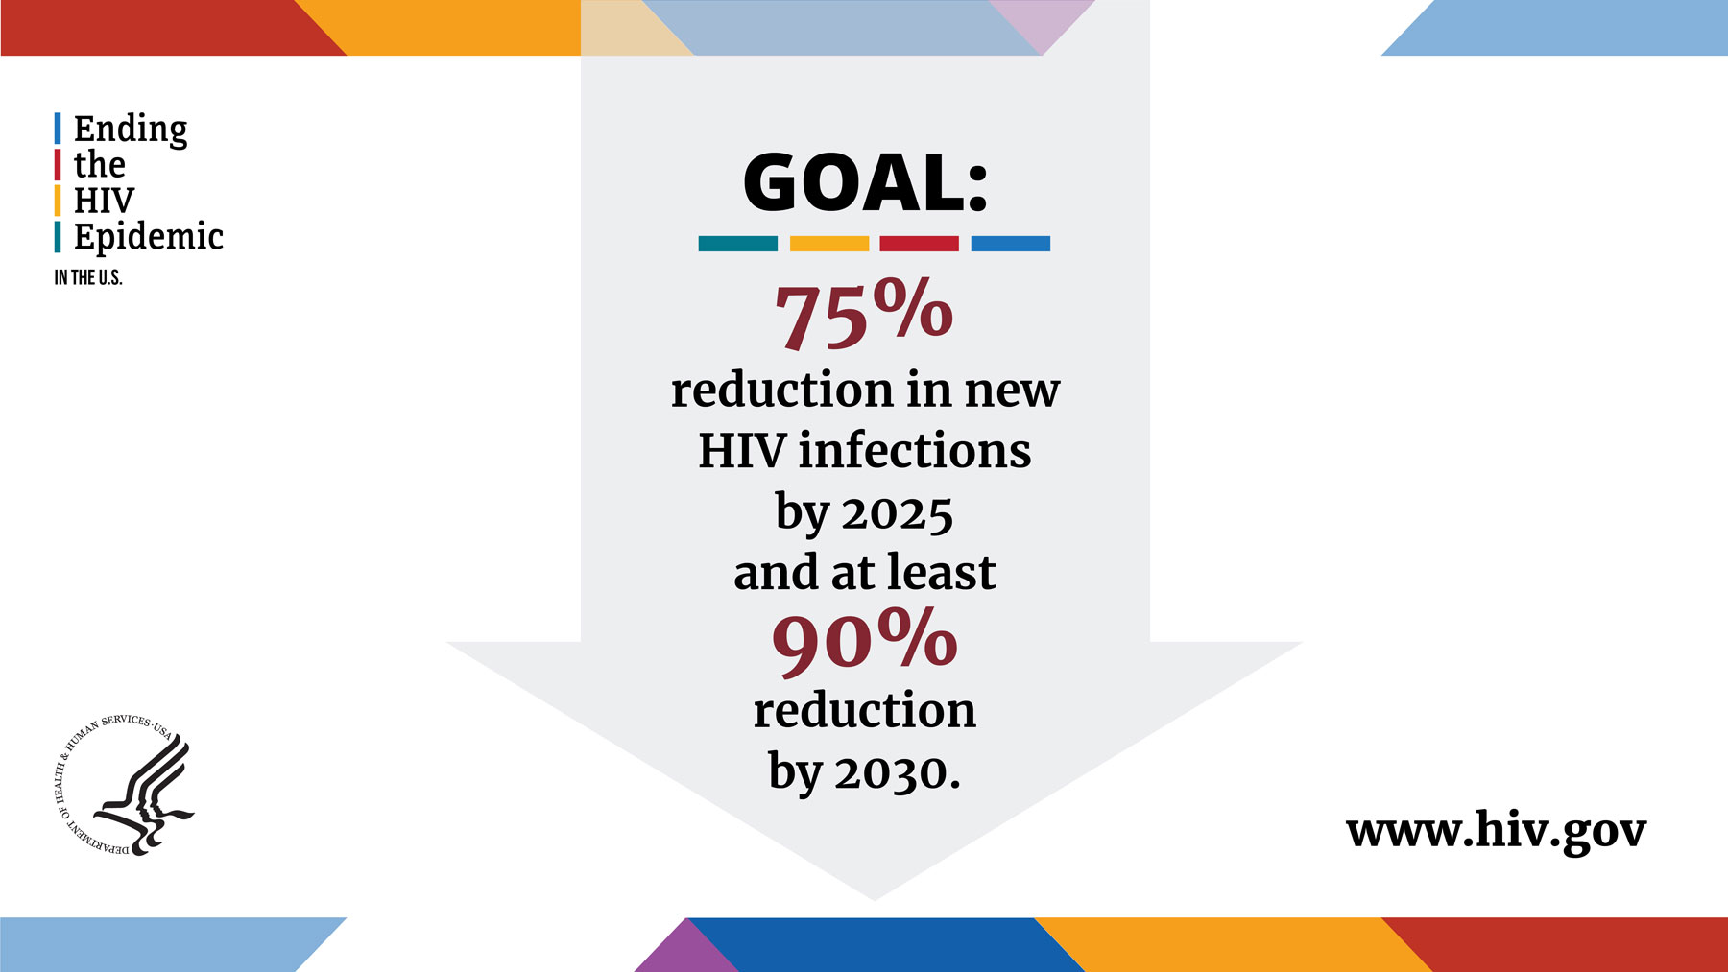
How well (or poorly) are we doing?

Slide 5
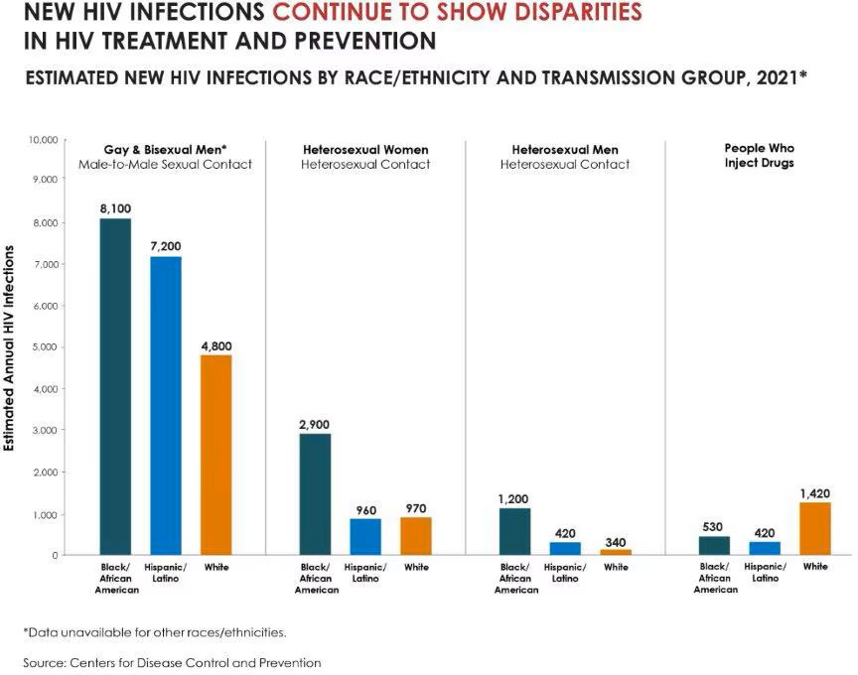
12% Overall Decline in HIV (2018-2022)
Among MSM
  Declined:
  16% Black MSM
  20% White MSM
  No change for Hispanic MSM

Slide 6
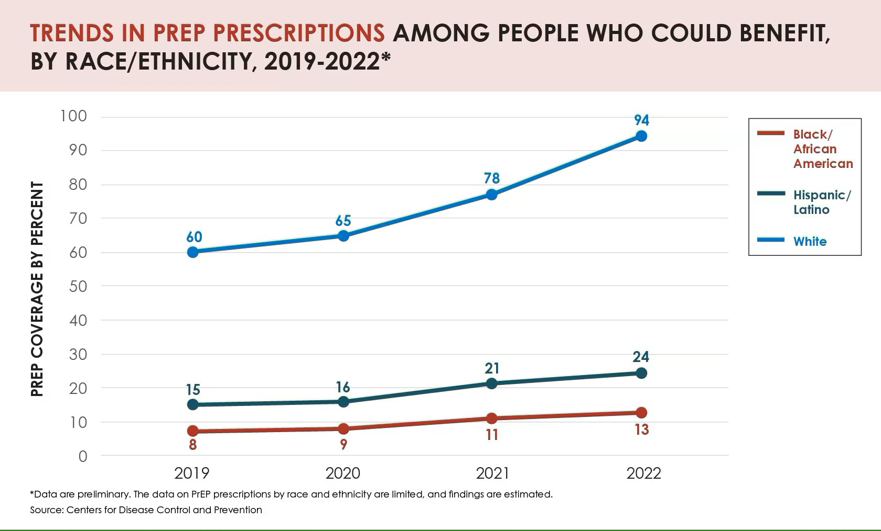

Slide 7
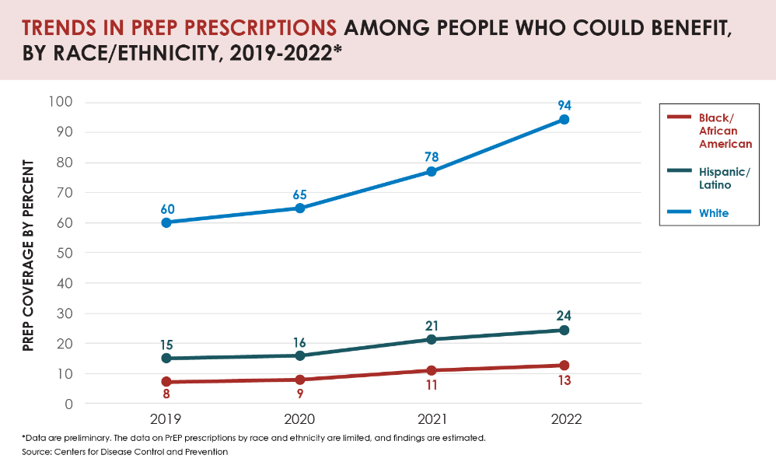

Slide 8
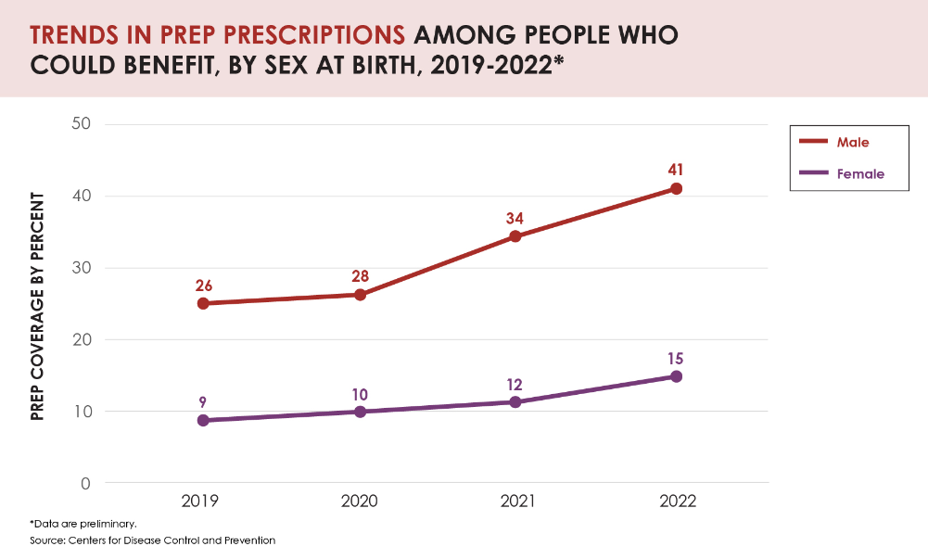
32% of transgender women and 28% of transgender men without HIV used PrEP
Reisner et al, LGBT Health 2021
https://www.cdc.gov/hiv/group/gender/transgender/hiv-prevention.html

Slide 9
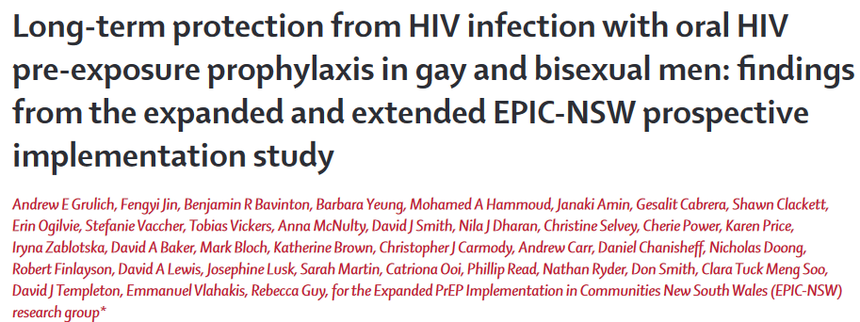
The Promise of Oral PrEP Implementation Impact
Single arm pragmatic implementation study of ~10,000 MSM
HIV incidence was 92% lower than would have been predicted w/o PrEP
Grulich Lancet HIV 2021

Slide 10
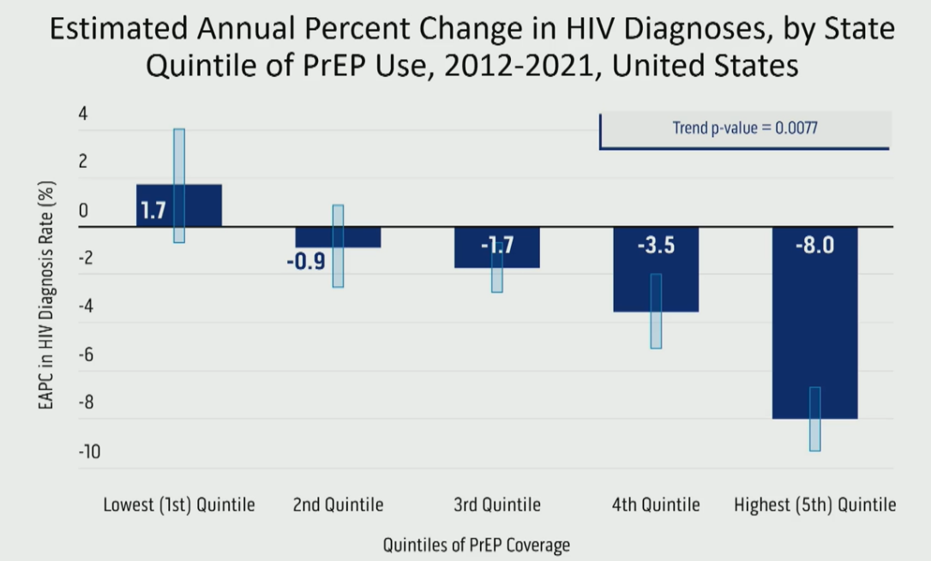
Structural Barriers - PrEP Coverage and HIV Diagnoses
PrEP Coverage was low across all states and ranged from 5.8% in the lowest quintile to 15.7% in the highest quintile.
HIV diagnoses decline 8% in states with highest PrEP Coverage
No change among states in the lowest quintile.
Sullivan et al CROI 2024 #165

Slide 11
PrEP Implementation Challenges in the US
Implementation Challenges | Engaged in PrEP n=106 | Not engaged in PrEP n=174
Lack of PrEP awareness among staff | 47% | 23%
Lack of support from Health Department leaders | 15% | 6%
Uncertain about PrEP effectiveness | 22% | 6%
Limited staff capacity to implement | 61% | 27%
Lack of HCP willing to deliver PrEP | 46% | 9%
Concern about financial access to PrEP | 53% | 17%
Concern about low reimbursement from 3rd party payers | 27% | 11%
Not sure what health department could or should do | 29% | 18%
No significant challenges | 17% | 52%
Weiss et al PloSONE 2018

Slide 12
Lessons from slow Oral PrEP rollout in the US
Community
  Coordinated education and outreach
  Inclusive language that reflects the science AND is inclusive of all who can benefit
Providers
  Education and standards of practice. Public Health Detailing
  Addressing concerns about risk compensation, resistance, and side effects
Messaging
  Non-stigmatizing and clear
  Need to address myths and community/client concerns
Expand access
  Mitigate medication costs
  Increase provider willingness and clinic capacity

Slide 13
Disparities of PrEP uptake in priority populations in SF
Race/ethnicity data from 2018-19 Quickie Survey (n=592). Data on women and PWID from NHBS 2019 (n=294) and NHBS 2018 (n=397). Homeless data from NHBS 2017-2020 and TEACH (n=1245).
Namara International Journal of STD & AIDS 2021; McFarland AIDS and Behavior 2020; Raymond HF AIDS and Behavior 2019; Personal communication: McFarland

Slide 14
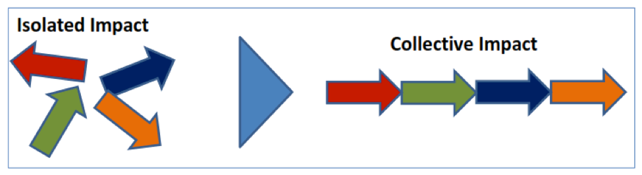
Getting to Zero SF Consortium: A Collective Impact Initiative
Individuals/ Community Members
Community-based organizations
HIV Community Planning Council
Advocates & Organizing Groups
Policy Makers & Local Govt: Mayor, Board of Supervisors
Department of Public Health
Our overall goals are to:
Improve health for persons at risk for or living with HIV/AIDS in San Francisco
Secure multi-sector funding and support for existing and new programs
Develop and implement innovative programs with a priority placed on equity and demonstrate impact with measurable objectives
Exchange best practices with other cities
UCSF
& other
research institutions
Private Sector
e.g. Kaiser
Industry
Notes:
Start with an introduction to SF Getting to Zero
Consortium Grounded in the principles of collective impact – you can see from the arrows the goal is to coordinate and align efforts of our partners to have the biggest impact
Multisector consortium with over 300 members from the community, CBOs, local government, UCSF and other research institutions, public health, and industry
Overall goals of SF GTZ are to improve health for people impacted by HIV
Our focus is on developing and implementing innovative programs with a priority placed on equity and demonstrating impact with measurable objectives
Also exchange best practices with other cities

Slide 15

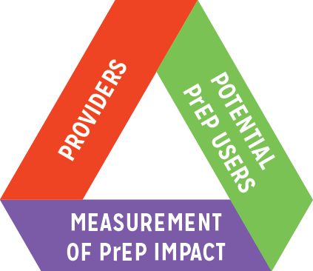
















GTZ PrEP Committee
Mission Statement: To Promote the Equitable Uptake and Persistence of PrEP Use through User and Provider Support, based on PrEP Metrics
Co-Chairs: Albert Liu, MD, MPH, Aurora Chavez, MPH, and Nikole Trainor, MPH
Notes:
Within GTZ we have a PrEP committee with over 50 members from a variety of clincis and organizations in SF
Mission of this committee is to promote the Equitable Uptake and Persistence of PrEP Use through User and Provider Support, based on PrEP Metrics

Slide 16
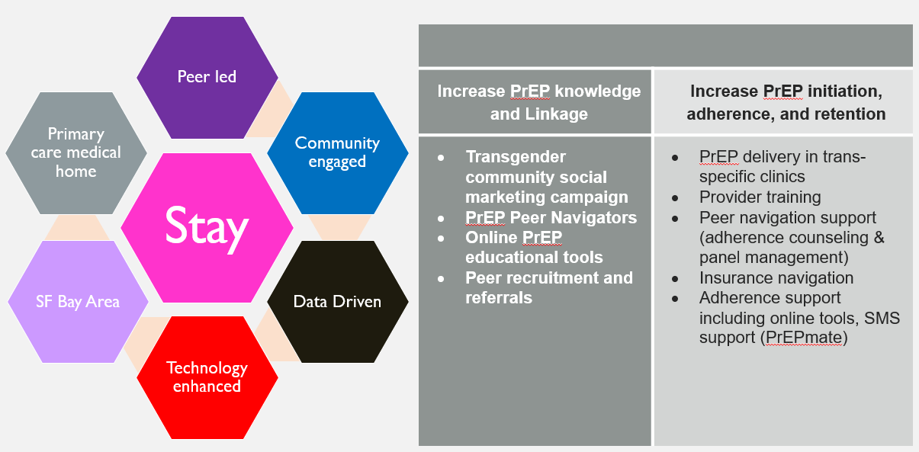

Stay Study: PrEP Demonstration Project for Transgender People
To develop, implement, and evaluate a comprehensive PrEP outreach and support strategy to maximize PrEP uptake and adherence among trans people
Notes:
The first project is the Stay Study – Demonstration Project centering transgender people, funded by the California HIV Research Program
Goal was to integrate PrEP delivery into trans-specific primary care clinics
Included community social marketing campaign, peer navigation to support outreach and adherene support, and some technology-based adherence support tools

Slide 17

Notes:
The STAY Study developed a social marketing campaign involving 12 diverse Bay Area T&NB social influencers. The STAY campaign harnessed the power of PrEP to show diversity, beauty, vibrancy, and resilience of T&NB communities, rather than to employ messaging that focuses on HIV risk. For example, “Adding PrEP to your daily routine will not lead to huge changes in your life, but it will help you STAY magical.” Social influencers developed and incorporated their own personal messages about PrEP with engaging hashtags. The campaign was featured on our website (www.staystudy.org), posters/palmcards, and distributed via social media.

Slide 18
Unanticipated challenges with PrEP implementation
Turnover of staff
Peers and medical provider turnover is common
Intake process is a barrier to starting primary care at SFDPH clinics
SFDPH clinics have particularly high barriers to entry into care
Orientation process can be a 6-week process
Who is a good candidate for PrEP?
Differences between Stay team and clinic staff
Information
Eligibility
Quarterly follow-up visits burden for providers and clinic staff

Slide 19

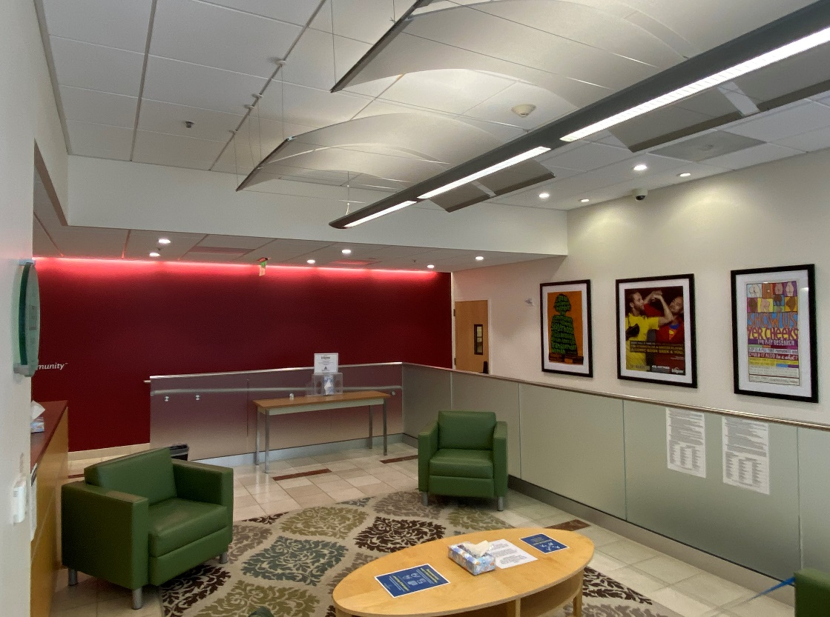
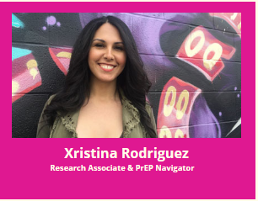

Trans specific PrEP clinic Model
Bridge HIV: HIV Prevention Research Clinic within San Francisco Department of Public Health
Dedicated waiting room, more flexible hours
Patient visits coordinated and led by trans peer navigator
NP-led clinical staff experienced in PrEP delivery and prevention needs of trans populations

Slide 20
Key Findings: Stay Study
Diverse cohort: 78% woman/transwomen, 6% man/transmen, 16% nonbinary/ other gender identity; 27% Latine, 14% Black; 23% homeless or marginally housed, 74% food insecurity, 23% current sex work, 42% depression, 39% anxiety
High level of PrEP uptake: 87% (among 158 participants enrolled)
Retention: 60% at 12 months
  Higher retention associated with PrEP-only clinic, older age (>35), PTSD
  Lower retention among Latine ppts and those reporting condomless anal sex
Adherence: 54-64% had protective TFV-DP levels at weeks 4-48
  Higher adherence associated with having a college education and having stable housing
  Lower adherence associated with food insecurity
PrEP only clinic had faster enrollment and pts had higher reported sexual risk, drug use, and mental health issues, and were less likely to be on PrEP

Slide 21
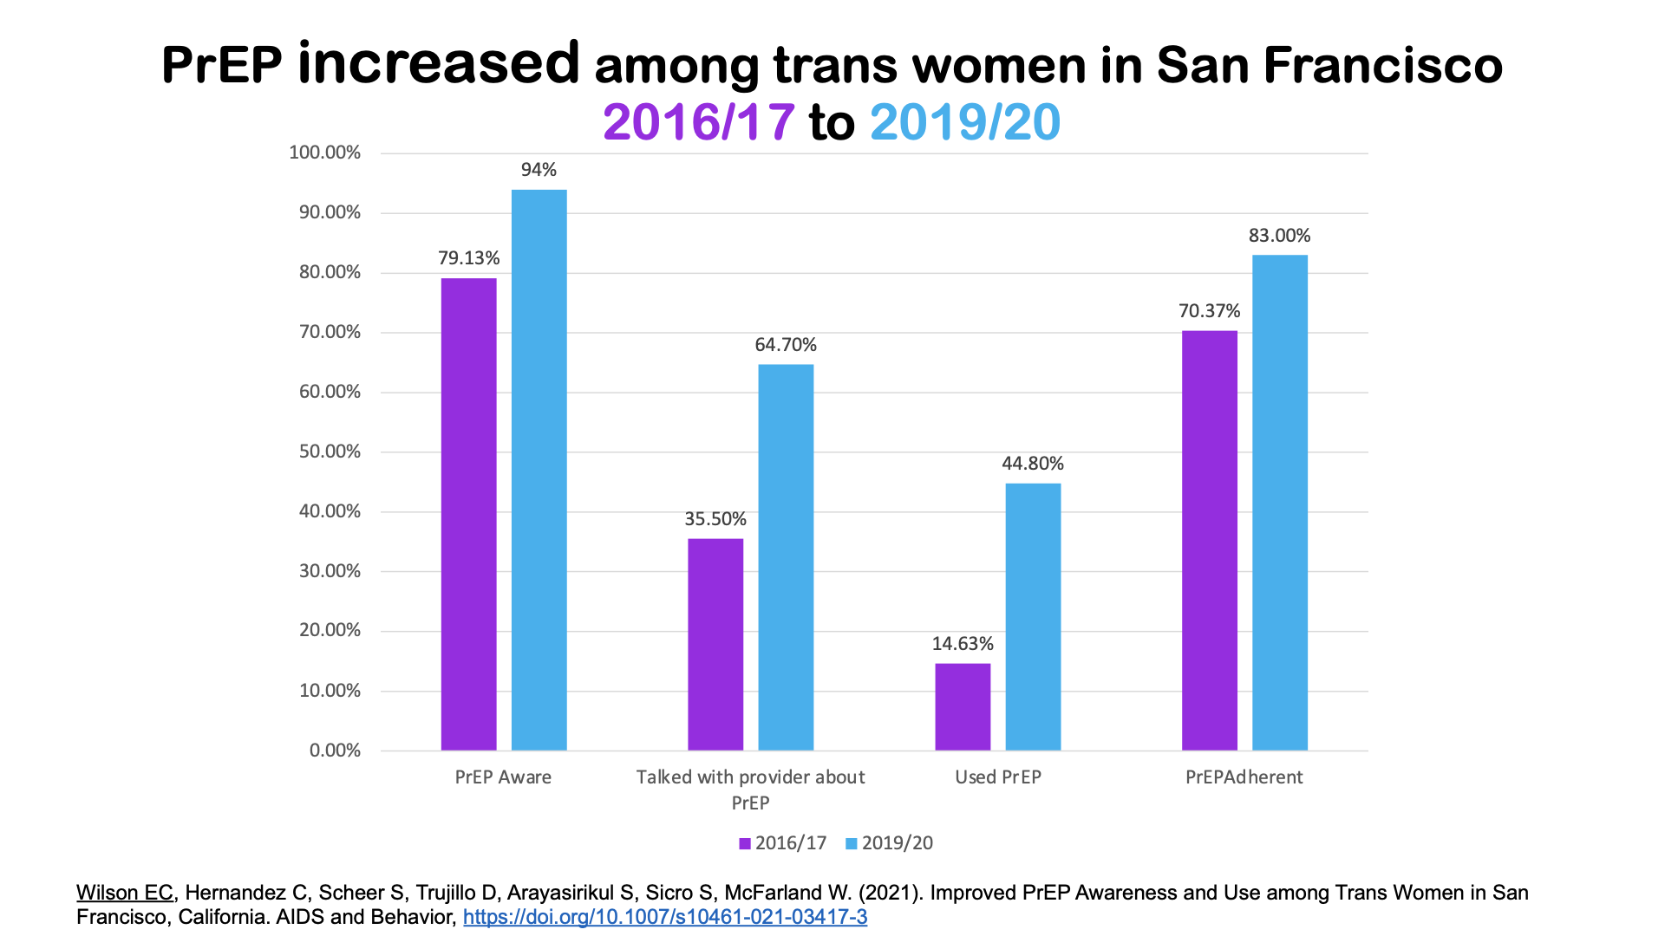
Notes:
The paper shows PrEP use was associated with being a part of stay.

Slide 22
High interest in non-Daily PrEP among MSM
Australian study of PrEP-experienced MSM showed higher interest among those concerned about side effects and daily adherence.
  Long acting injectable (LAI) – 59.7%
  Daily – 52.0%
  Implant – 45.3%
  Event driven – 42.8%
US study of interest in different PrEP options among MSM recruited online
  Daily – 35.4%
  Implant (non-visible) - 34.3%
  LAI – 25.2%
  Implant (visible) – 4.3%
Chan et al AIDS and Behavior 2022 volume 26, 88–95
Greene et al AIDS and Behavior 2017 volume 21, 1336–1349

Slide 23
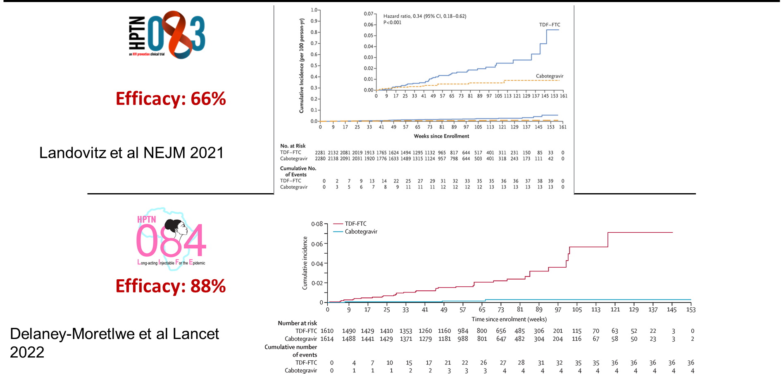
CAB-LA is superior to TDF/FTC

Slide 24
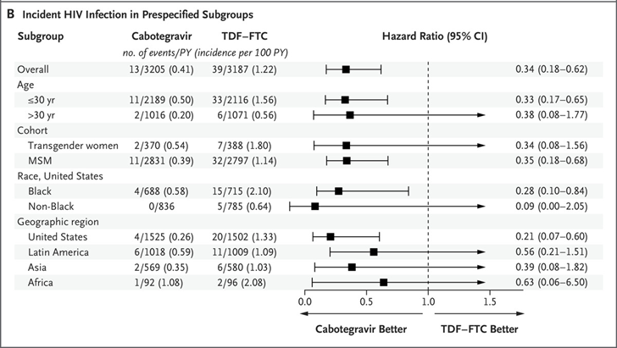
HPTN 083 Subgroup Analysis
CAB-LA associated with lower HIV incidence among:
  Youth <30 yrs
  MSM
  US Black participants
Landovitz et al NEJM 2021

Slide 25
HIV Incidence and Efficacy among US Black MSM and TGW
HR: 0.28 (0.096-0.834)
HR: 0.086 (0.004-2.060)
15 Infections
4 Infections
5 Infections
0 Infections
CROI 2023 Abstract #161

Slide 26
Clinical Considerations
HIV testing
  Turnaround time for HIV Ab testing
  POC rapid HIV testing availability at healthcare sites
  Viral load testing at every visit – availability and cost
Visit structures
  Potentially additional visits and staff – provider, lab, and injection visits
  Same day starts will be more challenging
Missed or delayed injections
  Coverage with oral CAB or TDF/FTC or TAF/FTC
  PEP regimens

Slide 27
Coverage and Cost Considerations
Cost: Medical vs Pharmacy benefit
  Generic TDF/FTC has reduced cost substantially
    CAB-LA ~ $3,700 per dose (~$25,900 per year)
  Will determine patient and up-front provider costs
  Covered by national program and PrEP-AP
Access and Assistance Programs
  Manufacture programs are often available in US
  Availability through national programs globally
CAB-LA Cautionary Tale:
  Cost/Insurance navigation for CAB-LA is often so complex and time-consuming that access is limited even when it’s “covered”.
https://www.apretudecopayprogram.com/terms-and-conditions
Neilen et al Ann Intern Med. 2022 Feb 1

Slide 28





Developing a Regional Approach for Equitable
Implementation of Long-Acting Injectable
PrEP in the Bay Area
Al Liu, MD, MPH | Bridge HIV, San Francisco Dept. of Public Health
Kim Koester, PhD | Center for AIDS Prevention Studies, UCSF
Cat Dancing Alleyne | Bridge HIV, San Francisco Dept. of Public Health
Janie Vinson | Bridge HIV, San Francisco Dept. of Public Health
Notes:
BAYLAP – Bay Area Long Acting PrEP Alliance

Slide 29
Key prioritized groups for LA-PrEP in Bay Area
To promote equitable LA-PrEP implementation by:
African American individuals
Latinx individuals
Cisgender and Transgender women
People experiencing homelessness
People who inject drugs

Slide 30
Key Takeaways from BAYLAP Stakeholder and Client Engagement
High level of enthusiasm for LA-PrEP among stakeholders and clients
Toolkit concept is perceived as having high value among stakeholders
Clients are most concerned about efficacy and access issues
Stakeholders are most concerned about lack of capacity to offer LA-PrEP
Notes:
Advantages of LA-PrEP for Prioritized Communities
Reduce pill-taking burden, enhanced privacy, reduced stigma
Lack of awareness of LA-PrEP among clients and providers
Questions about where to access it, cost, and side effects and efficacy
Importance of social/structural determinants of
Important to integrate PrEP delivery into programs addressing these determinants to promote equitable uptake and access to PrEP
Provider and clinic-level barriers to LA-PrEP delivery
Lack of clinic systems, workflows, and clinic staffing in place for delivery of LA-PrEP
Insurance challenge as a major barrier to LA-PrEP delivery
Simple, easy-to-understand patient-facing educational materials and campaigns to increase knowledge about LA-PrEP
Importance of the role of trusted PrEP navigators and providers
Need for multiple access points for LA-PrEP including community clinics, hospitals, pharmacies, and mobile clinics/sites to reduce access barriers
Develop workflows with clear delineation of roles and responsibilities
Develop provider trainings on LA-PrEP prescribing, counseling, and insurance navigation

Slide 31
BAYLAP findings
Advantages of LA-PrEP for Prioritized Communities
  Reduce pill-taking burden, enhanced privacy, reduced stigma
  Helpful in clients living in multigenerational households, PEH
Lack of awareness of LA-PrEP among clients and providers
  No one in peer group talking about it
  Questions about where to access it, cost, and side effects and efficacy
Importance of social/structural determinants of health
  Housing/food insecurity, transportation barriers, care deserts, racism, stigma, immigration status, homophobia/transphobia, language barriers, and cost/insurance
  Important to integrate PrEP delivery into programs addressing these determinants to promote equitable uptake and access to PrEP
  For PEH: Services under one roof and available via drop-in, expert phlebotomists, coordinate with Street team, go to the pt and provide services in field
Provider and clinic-level barriers to LA-PrEP delivery
  Lack of clinic systems, workflows, and clinic staffing in place for delivery of LA-PrEP
  Insurance challenge as a major barrier to LA-PrEP delivery

Slide 32
BAYLAP Recommendations
Need for simple, easy-to-understand patient-facing educational materials and campaigns to increase knowledge about LA-PrEP
Importance of the role of trusted PrEP navigators and providers
Need for multiple access points for LA-PrEP, including community clinics, hospitals, pharmacies, and mobile clinics/sites to reduce access barriers
Develop workflows with clear delineation of roles and responsibilities
Develop provider trainings on LA-PrEP prescribing, counseling, and insurance navigation
Provide regular check-ins with patients between injection visits, transportation support to/from clinics, ongoing insurance navigation support, support from community pharmacists

Slide 33
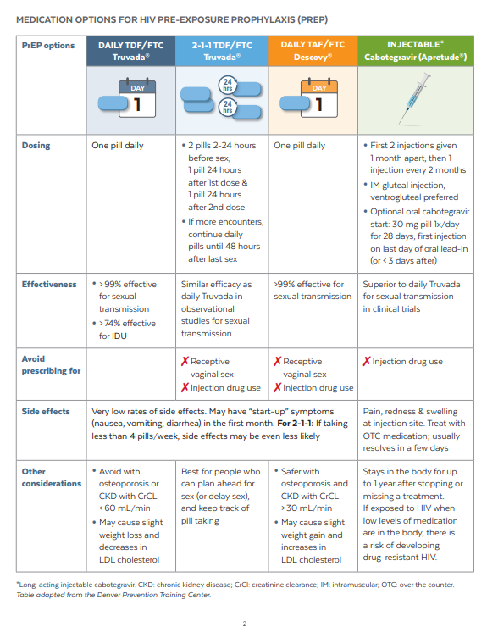
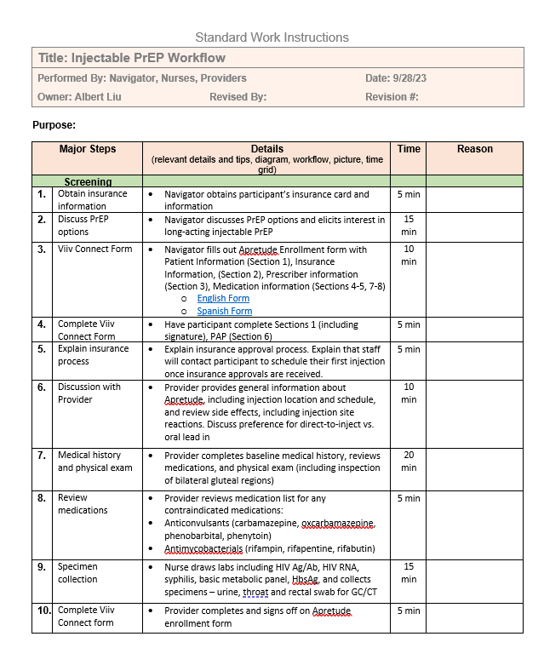
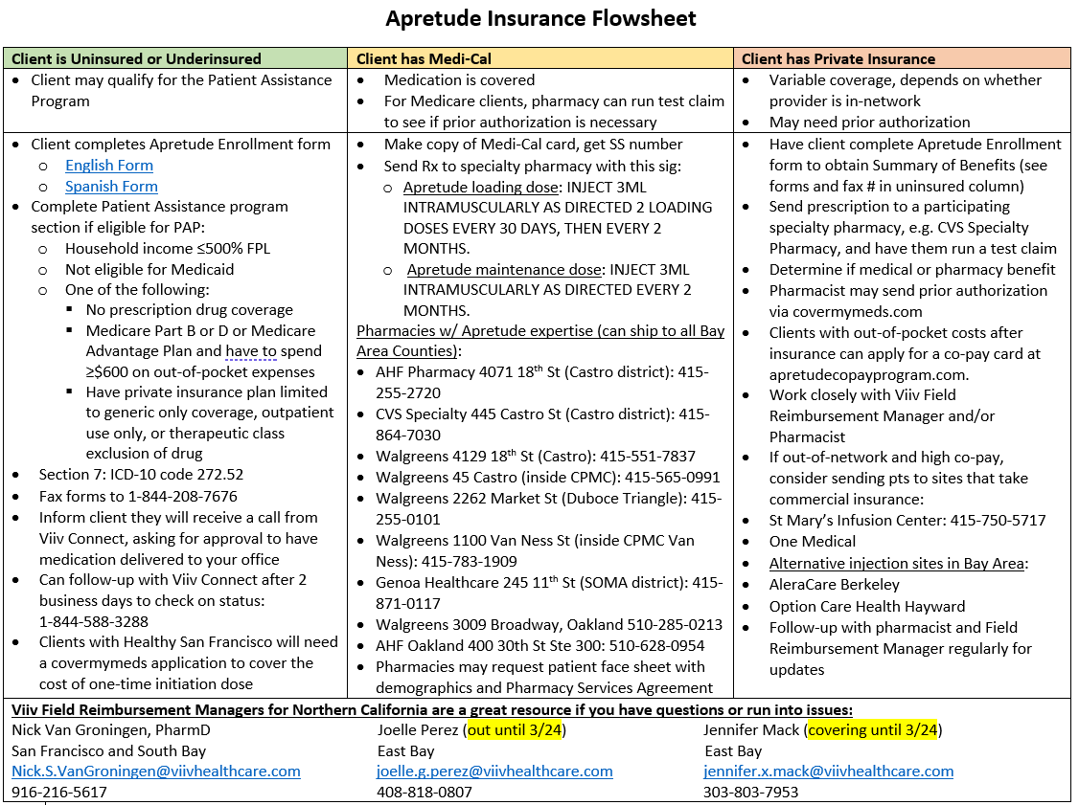
Example Provider Tools

Slide 34
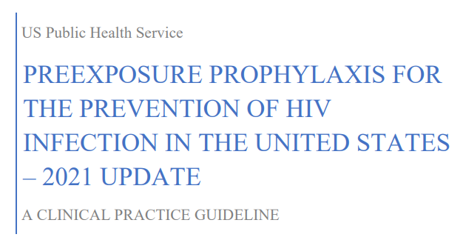
Universal PrEP Discussion Recommendation in US
All sexually active adults and adolescents should have PrEP discussed/considered as an option
 | Daily Oral TDF/FTC | Daily Oral TAF/FTC | 2-1-1 Oral TDF/FTC | CAB-LA
Cis Men | √ | √ | √ | √
Cis Women | √ |  |  | √
Trans women | √ | √ | (√) | √
Trans men | √ |  |  | √
PWID | √
Renal dz (↓CrCl) |  | √ |  | √

Slide 35
Providing Choice In PrEP – Lessons from Contraception
Contraception Example:
  No single method serves the needs of every subgroup.
  Greater use when more methods are available to more people.
  Each additional option associated with 4-8% increase in uptake.
  HCP are integral to increasing uptake of long-acting contraception
Ross J, Stover J. Use of modern contraception increases when more methods become available: analysis of evidence from 1982-2009. Glob Health Sci Pract. 2013 Jul 26;1(2):203-12; Mahony H et al. Social Network Influences on Young Women's Choice to Use Long-Acting Reversible Contraception: A Systematic Review. J Midwifery Womens Health. 2021 Nov;66(6):758-771

Slide 36
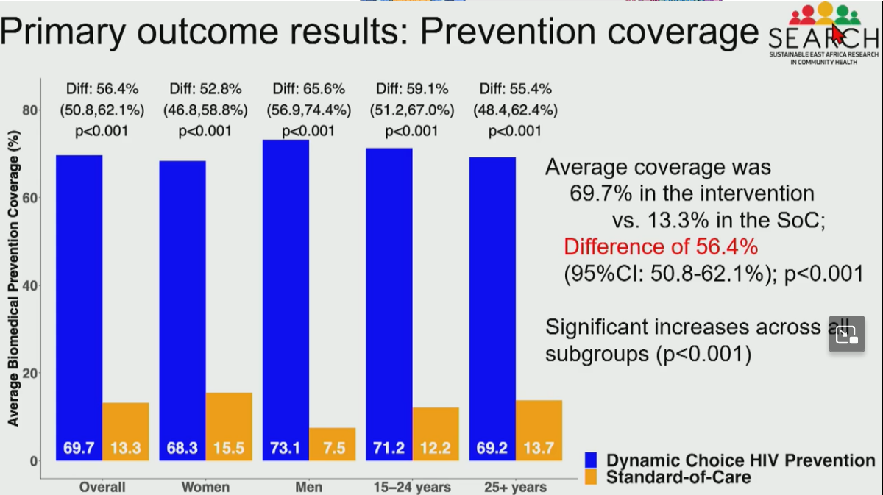
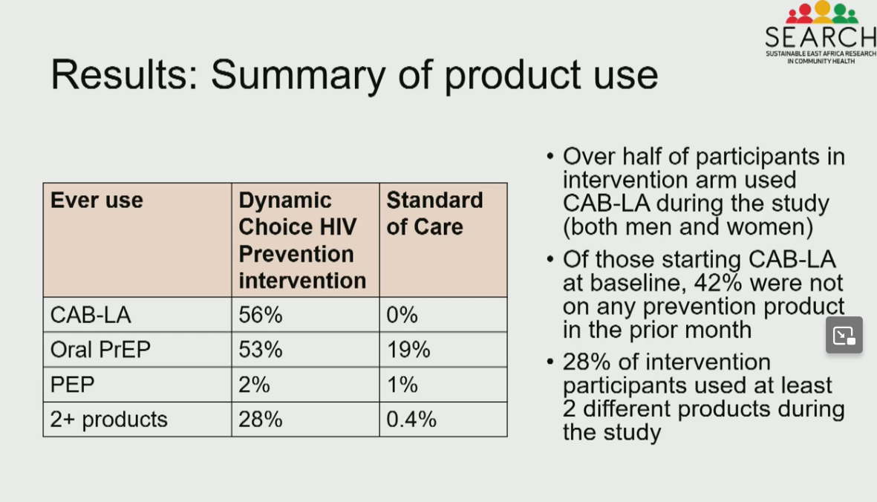
PrEP Choice Dynamic HIV Prevention
Moses, et al. CROI 2024 #172

Slide 37
Are we doing better with STIs?

Slide 38
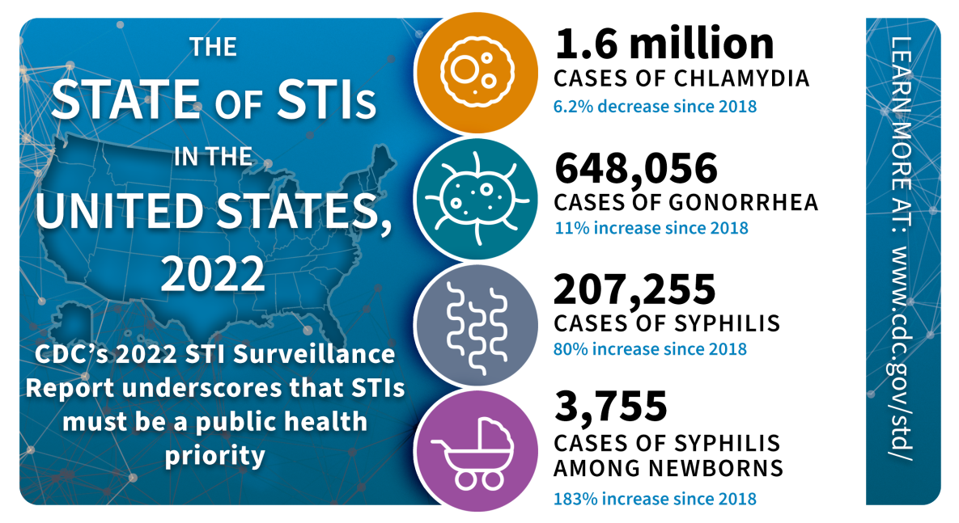
https://www.cdc.gov/std/statistics/infographic.htm

Slide 39
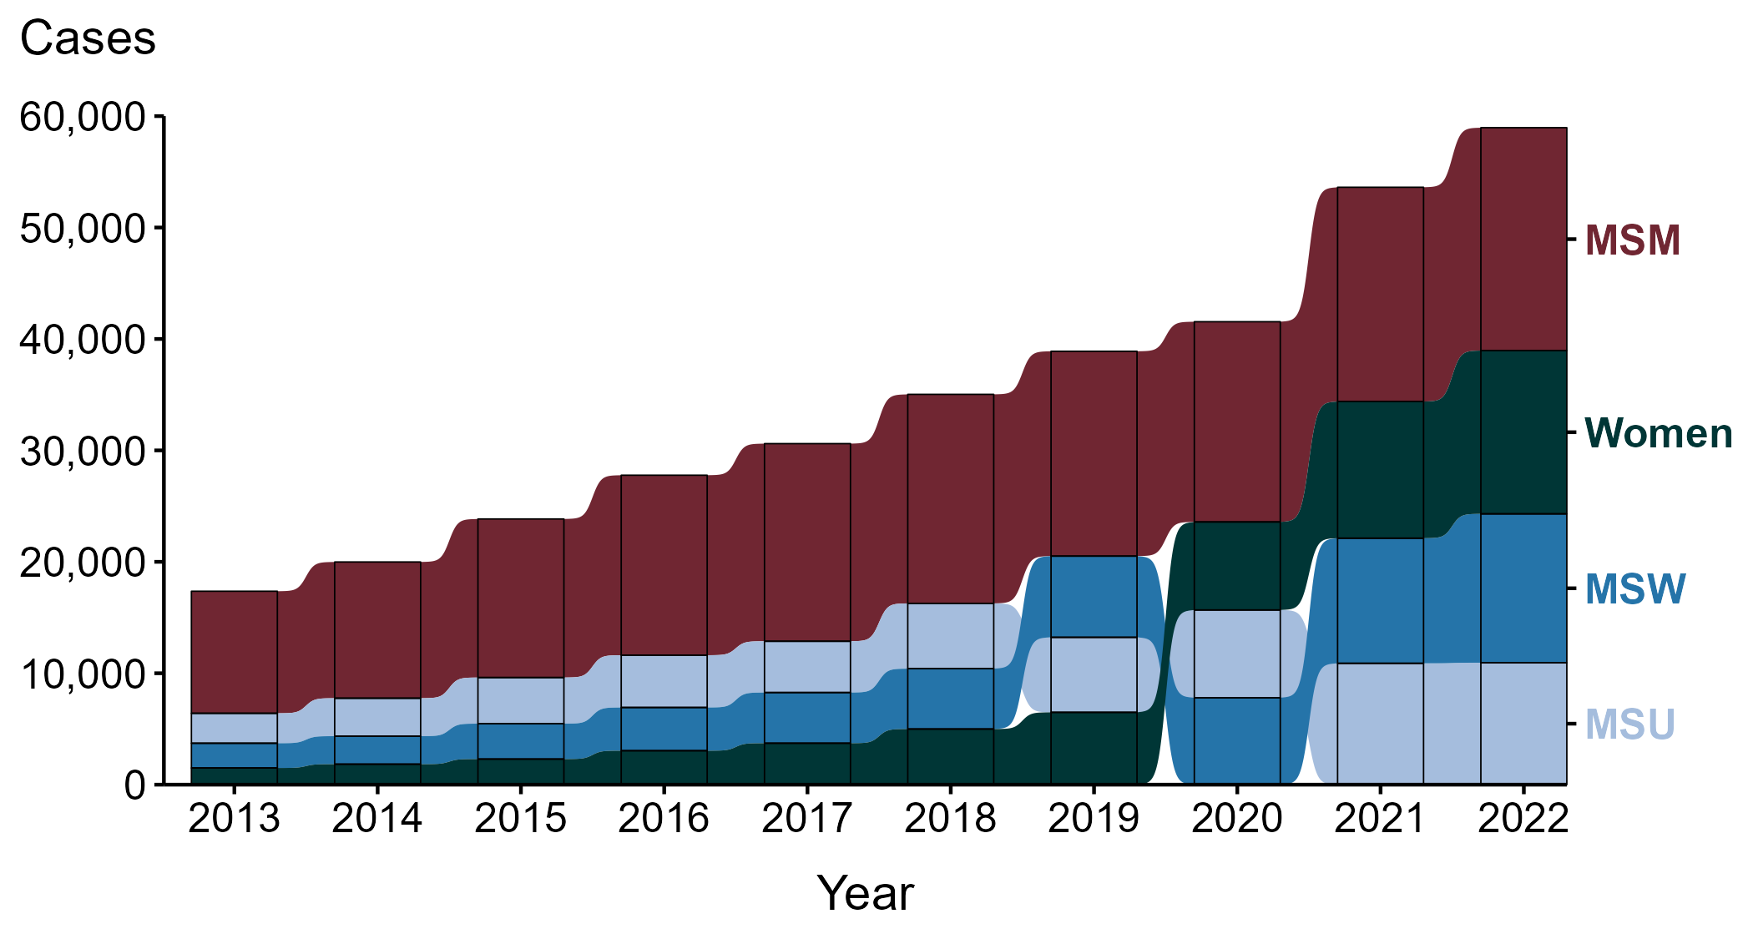
Primary and Secondary Syphilis — Reported Cases by Sex and Sex of Sex Partners, United States, 2013–2022
ACRONYMS: MSM = Men who have sex with men; MSU = Men with unknown sex of sex partners; MSW = Men who have sex with women only
Notes:
During the period from 2013 to 2022, a plurality (47.7%) of primary and secondary syphilis cases were among men who have sex with men (MSM; 165,642 cases).
During 2021 to 2022, the number of cases among MSM increased 4.0% (19,229 in 2021 to 20,004 in 2022), while the number of cases did not change substantially (<1.0% change) among men with unknown sex of sex partners (MSU; 10,892 in 2021 to 10,946 in 2022), increased 19.0% among men who have sex with women only (MSW; 11,228 in 2021 to 13,359 in 2022), and increased 19.5% among women (12,265 in 2021 to 14,652 in 2022).
During the five-year period from 2018 to 2022, the number of cases among MSM increased 6.6% (18,760 in 2018 to 20,004 in 2022), while the number of cases increased 86.9% among MSU (5,858 in 2018 to 10,946 in 2022), 146.7% among MSW (5,416 in 2018 to 13,359 in 2022), and 193.3% among women (4,995 in 2018 to 14,652 in 2022).
During the 10-year period from 2013 to 2022, the number of cases among MSM increased 82.6% (10,954 in 2013 to 20,004 in 2022), while the number of cases increased 307.4% among MSU (2,687 in 2013 to 10,946 in 2022), 501.8% among MSW (2,220 in 2013 to 13,359 in 2022), and 876.8% among women (1,500 in 2013 to 14,652 in 2022).
This report includes data from years that coincide with the COVID-19 pandemic, which introduced uncertainty and difficulty in interpreting STI surveillance data. See Impact of COVID-19 on STIs for more information.
See Technical Notes (https://www.cdc.gov/std/statistics/2022/technical-notes.htm) for information on syphilis case reporting. Table A1 (https://www.cdc.gov/std/statistics/2022/tables/a1.htm) provides information on unknown, missing, or invalid values of select variables.
Data for all figures are available at https://www.cdc.gov/std/statistics/2022/data.zip. The file “PS Syphilis - Cases by Sex and Sex of Sex Partners (US 2013-2022).xlsx” contains the data for the figure presented on this slide.

Slide 40
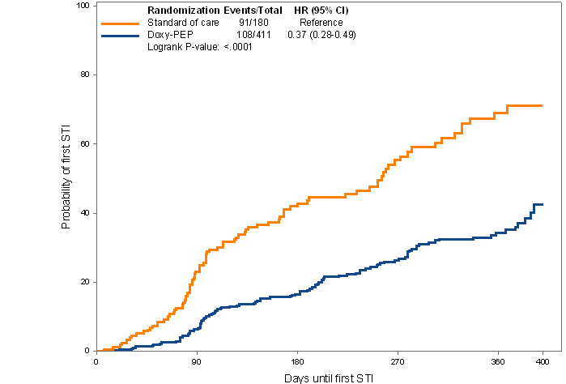

DoxyPEP study design and results
CROI 2024 Abstract #125
Intervention: Open label doxycycline 200 mg as PEP within 72 hours after condomless sexual contact, max 200mg /daily
MSM & TW
living with HIV or
without HIV on PrEP
Doxy PEP
2:1 randomization
No PEP
Month 0 3 6 9 12
STI testing
  DoxyPEP Results
  Overall 65% ↓ reduction in bacterial STIs each quarter
  ≈ 80% ↓ chlamydia & syphilis
  ≈ 50% ↓ gonorrhea
  Effectiveness independent of HIV serostatus
HR 0.37 (0.28-0.29)
Logrank p-value < 0.0001
Probability of first STI
Days until first STI
Notes:
Transgender/Gender diverse
Double the central schema.

Slide 41
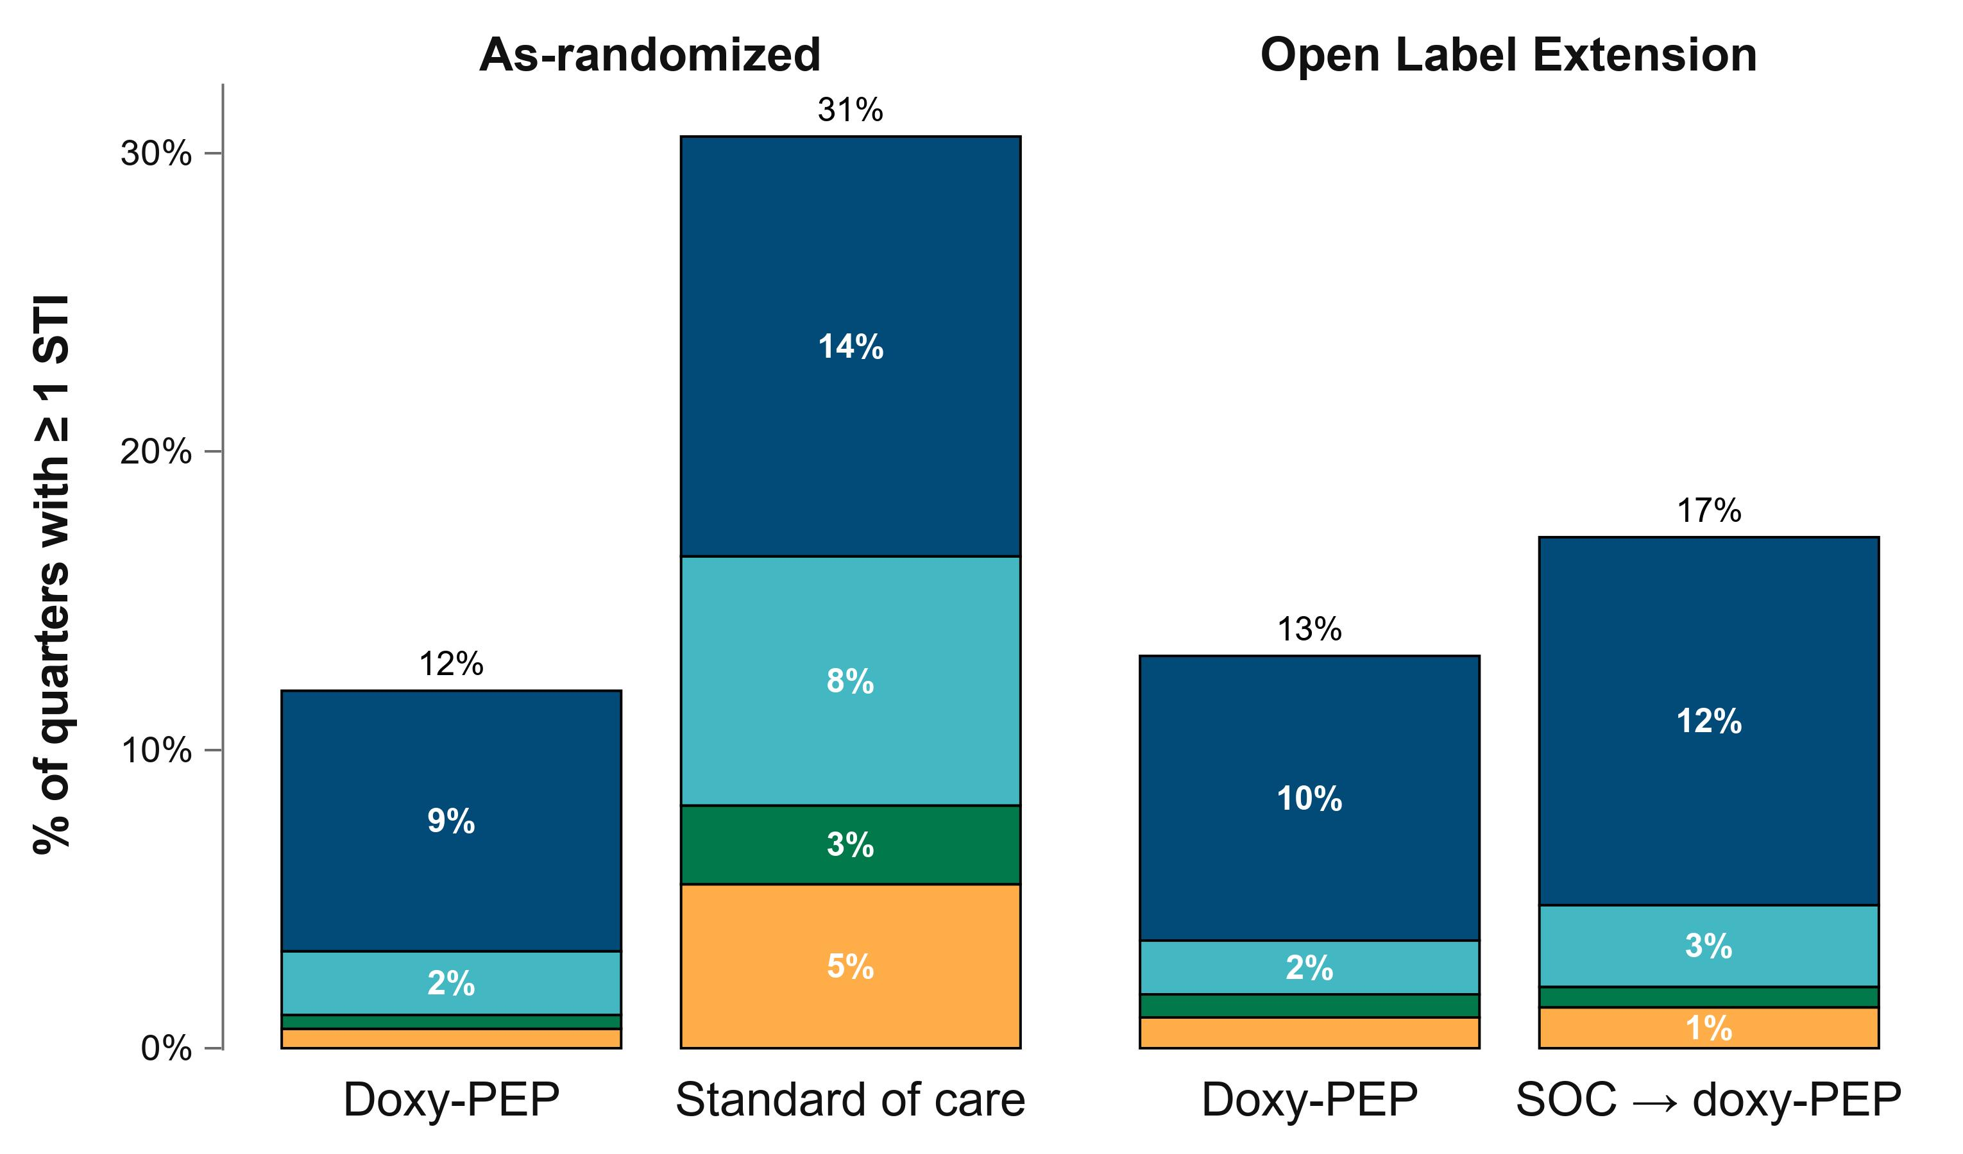
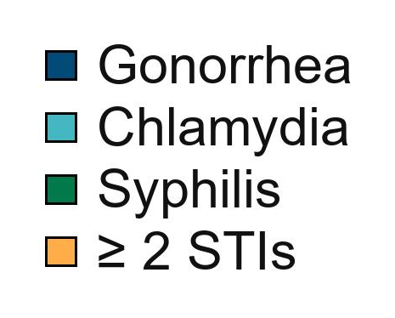
Sustained reduction in STIs during OLE
CROI 2024 Abstract 125

Slide 42
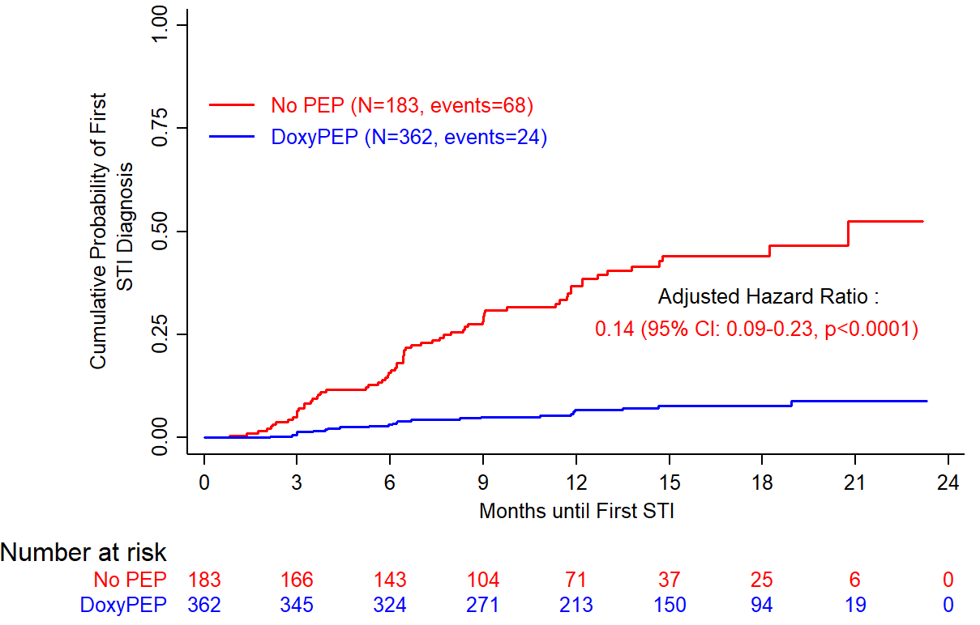
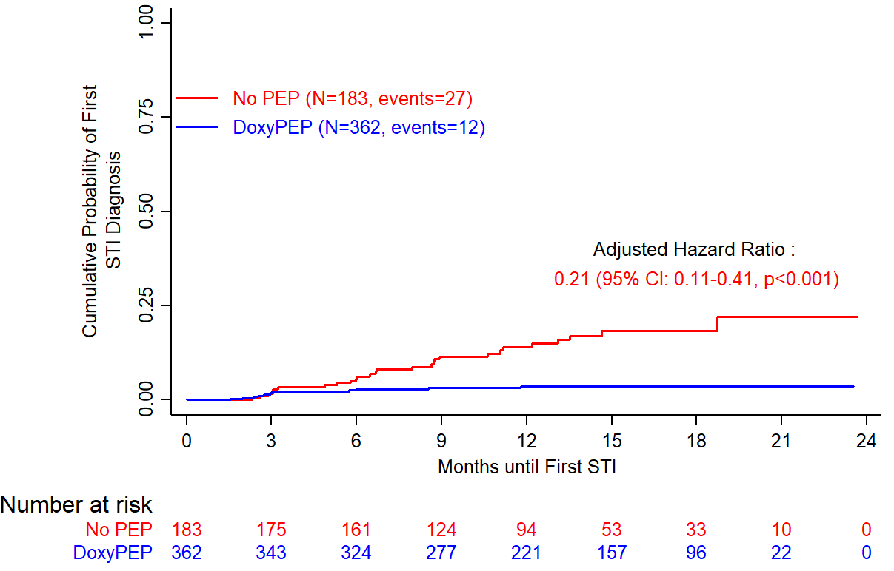
Doxycycline PEP
Time to First CT and Syphilis Infection
CT
Syphilis
92 subjects infected
68 in No PEP arm (incidence: 42.1/100 PY),
24 in Doxy PEP arm (incidence: 5.9/100 PY)
39 subjects infected
27 in No PEP arm (incidence: 14.5/100 PY),
12 in Doxy PEP arm (incidence: 2.9/100 PY)
CROI 2024 Abstract 124

Slide 43
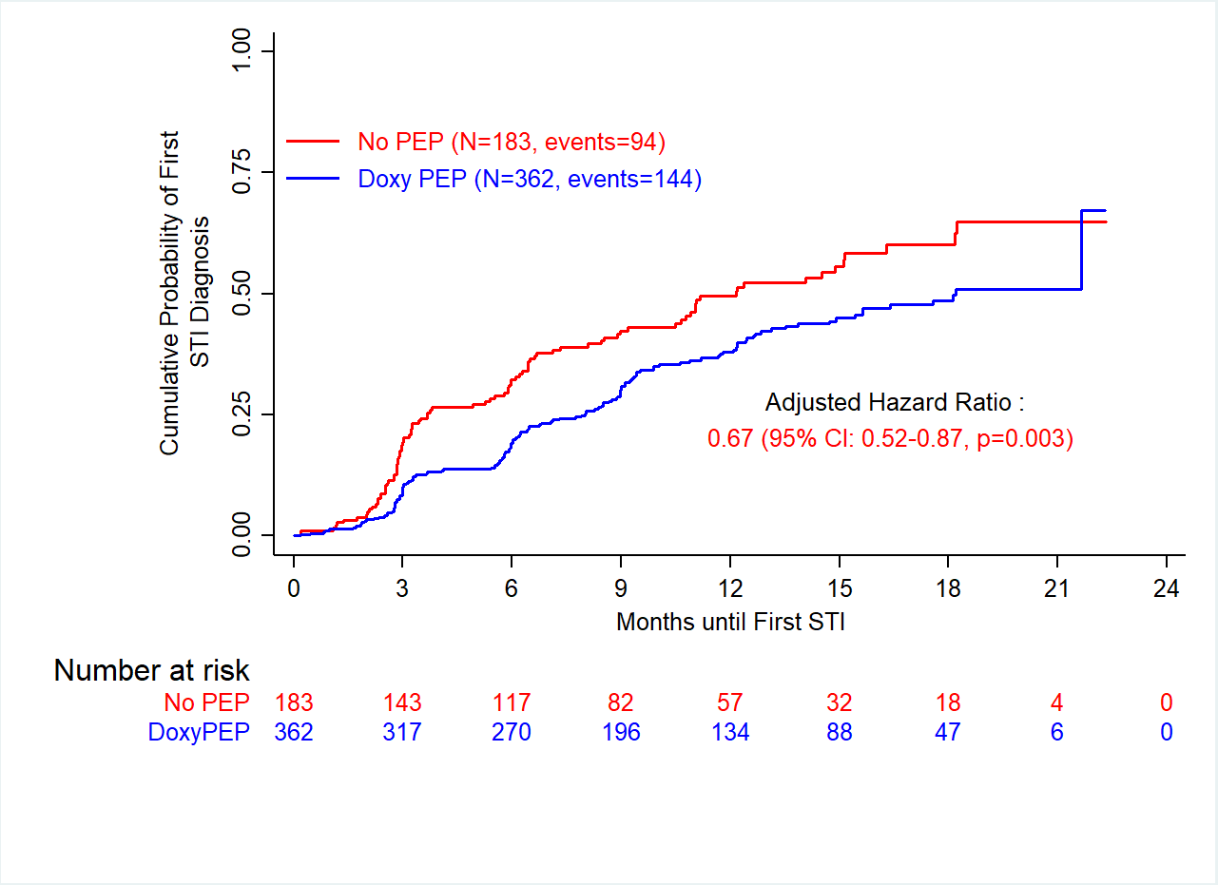
Doxycycline PEP
Time to First GC
GC
Interim analyis:
84 subjects infected, aHR: 0.49
238 subjects infected
94 in No PEP arm (incidence: 68.4/100 PY)
144 in Doxy PEP arm (incidence: 45.5 /100 PY)
CROI 2024 Abstract 124

Slide 44
Doxy-PEP Uptake by Race/Ethnicity at
2 Sexual Health Clinics (SHC) and 1 HIV Care Clinic
San Francisco, Oct 2022 – Dec 2023
Uptake lower in HIV care clinic setting
Similar uptake across racial/ethnic groups within existing clinic cohorts
% of MSM and TGW prescribed doxy-PEP
Notes:
Eligible here includes all MSM and TGW
Strut: 22.4
City Clinic: 25.3
W86: 6.4

Slide 45
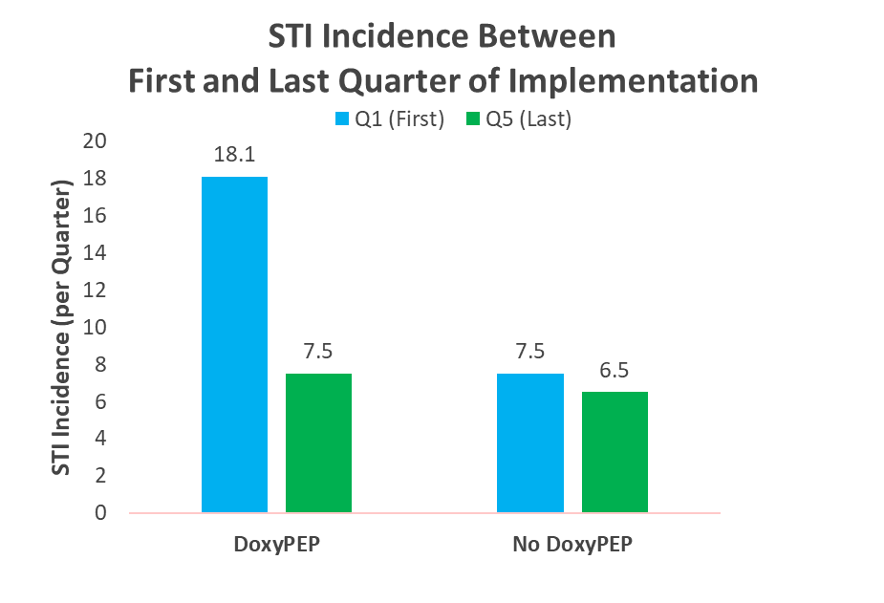
Reduced STI Incidence among DoxyPEP Users
Implementation at SFAF PrEP Clinic – 39% of PrEP users started DoxPEP in <9 months.
Uptake was equitable by race/ethnicity
 | IRR | 95% CI | p-value
Any STI | 0.42 | 0.24 - 0.74 | 0.003
Chlamydia | 0.33 | 0.23 - 0.46 | <0.001
Syphilis | 0.22 | 0.09 - 0.54 | 0.001
Gonorrhea | 0.89 | 0.69 - 1.15 | 0.383
Any STI: Chlamydia, Syphilis, or Gonorrhea
CROI 2024 Abstract 126
Notes:
The model includes the no DoxyPEP group to account for secular trends in mean STI incidence.
Any STI: 58% reduction
CT: 67% reduction
Syphilis: 78% reduction
Gonorrhea: 11% reduction

Slide 46
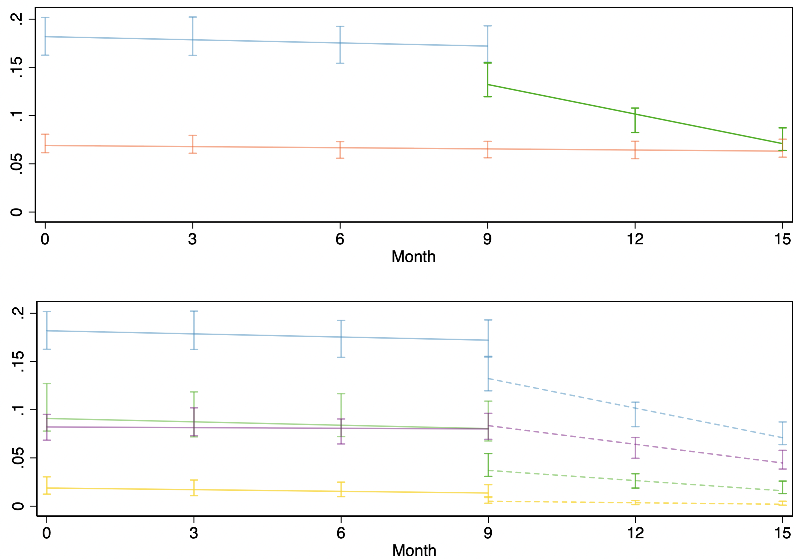
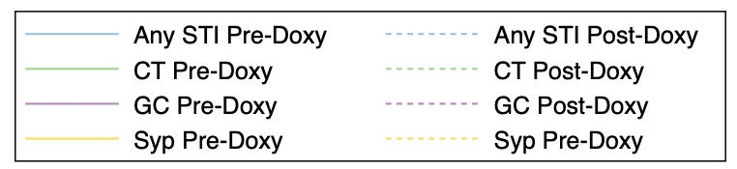
Interrupted Time Series: STI Incidence Pre- Post-DoxyPEP
A
Specific STI Incidence Per Quarter
ITS: Any STI: p=0.032; Chlamydia: p=0.021; Gonorrhea: p=0.003; Syphilis: p=0.360
CROI 2024 Abstract 126
Notes:
We saw similar declines for gonorrhea, chlamydia, and syphilis in the post-DoxyPEP period
For Gonorrhea: Before DoxyPEP GC was declining slightly, and afterwards the decline was steeper. The means are pretty close, so the lack of change in STI incidence may be secondary to follow-up time.
For Syphilis – the slope was lower in the post-DoxyPEP period, but there were fewer syphilis cases and this analysis has lower power to detect significant changes compared to the pre-post analysis of the means are lower

Slide 47
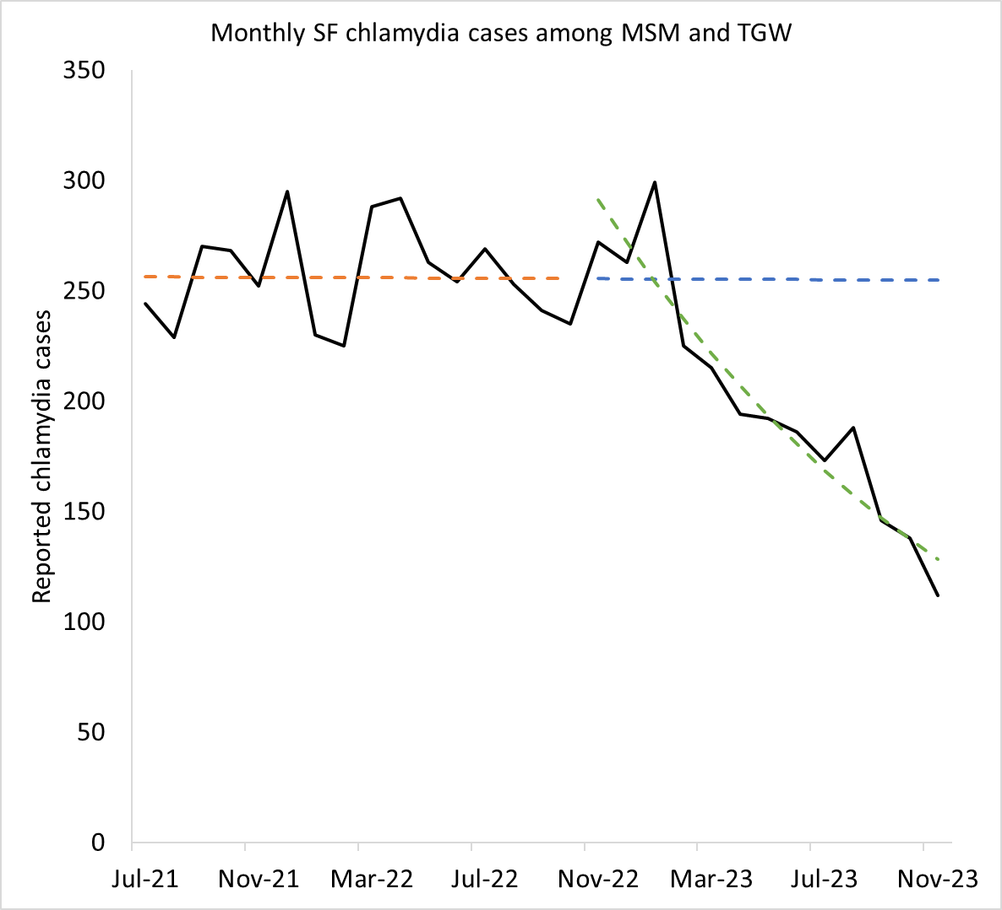
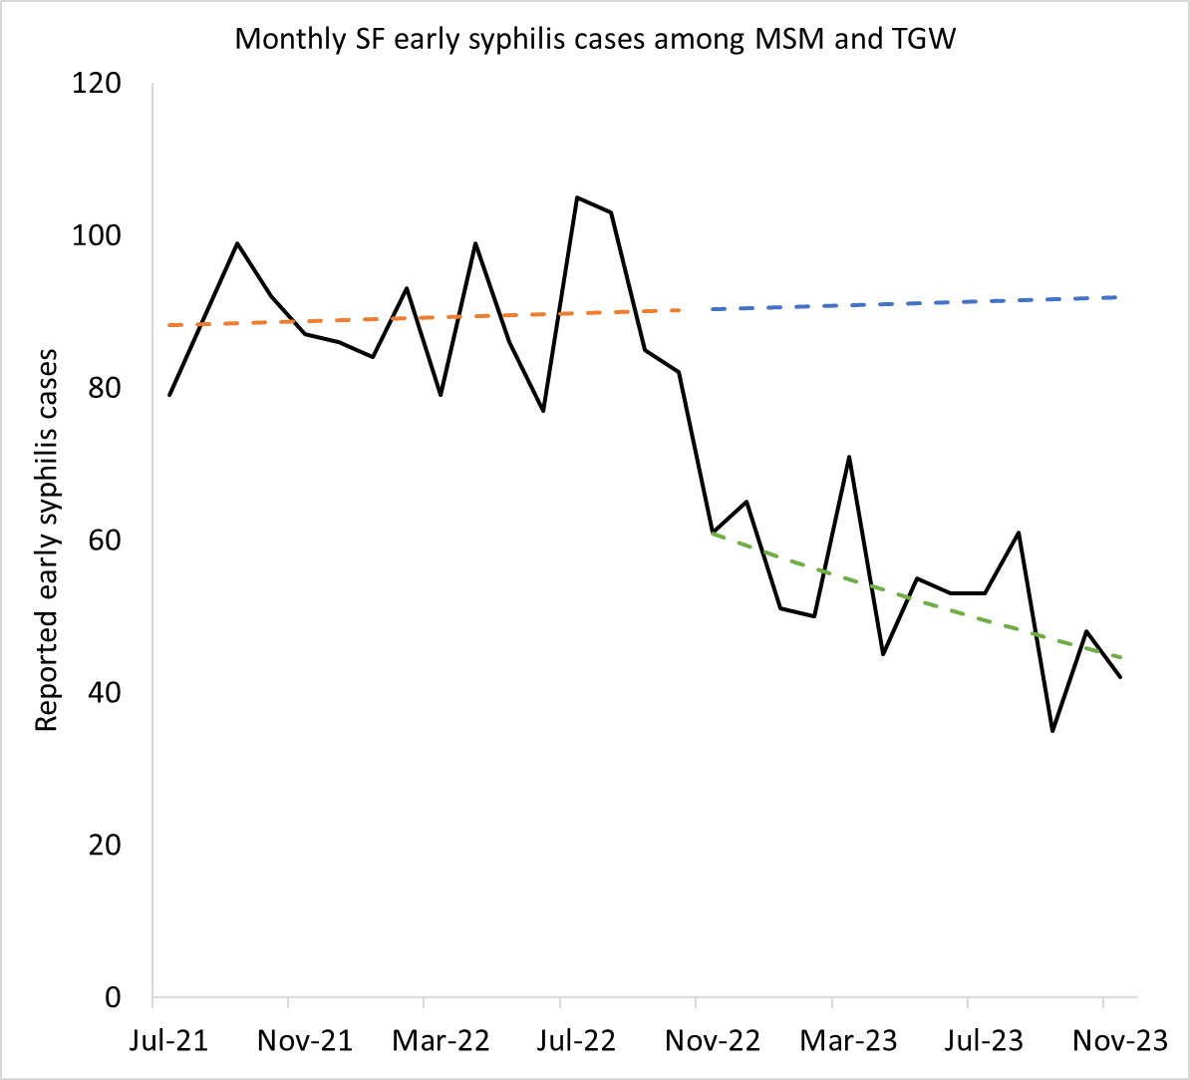
Early analyses from SF suggest doxy-PEP is having an impact on citywide CT and early syphilis rates (not GC)
After 13 months, observed cases were 50% (95% CI 38%-59%) lower than model forecasts
After 13 months, observed cases were 50% (95% CI 38%-59%) lower than model forecasts
Sankaran M, CROI 2024 (abstract #3361)

Slide 48
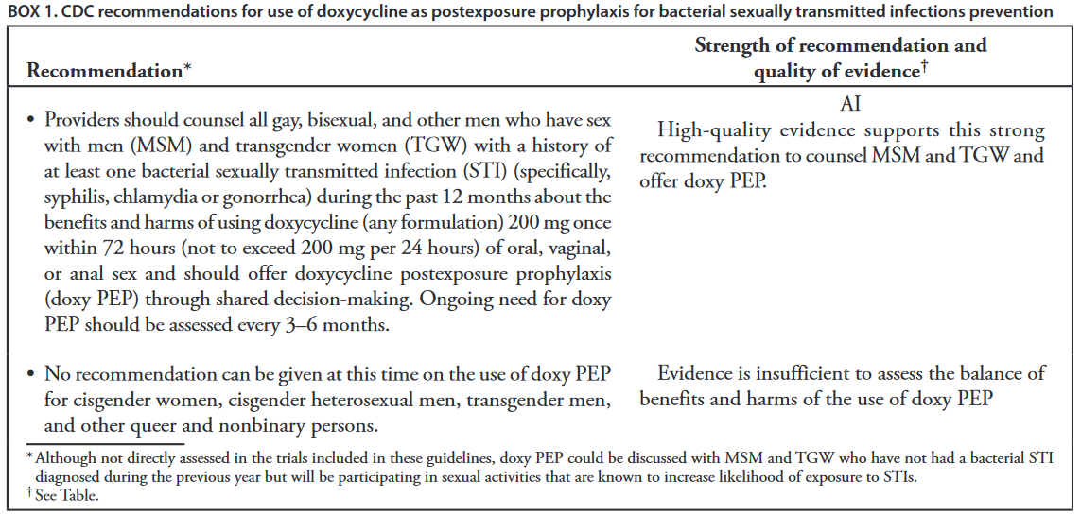
CDC DoxyPEP Guidelines (6/6/2024)

Slide 49
Drug-Resistant Gonorrhea is a CDC “Urgent Threat”

Slide 50
4CMenB Vaccine
Secondary Efficacy Outcomes
Positive | 4CMenB vaccine (N=274) | No vaccine (N=270) | Adjusted hazard ratio (95% CI) | p-value
 | Events (Incidence per 100 p-y) | Events (Incidence per 100 p-y)
First episode
Gonorrhea (all sites) | 103 (58.3) | 122 (77.1) | 0.78 (0.60-1.01) | 0.06
Anal Gonorrhea | 61 (29.7) | 64 (33.1) | 0.90 (0.64-1.28) | 0.57
Pharyngeal Gonorrhea | 58 (27.6) | 74 (37.7) | 0.75 (0.53-1.05) | 0.09
Urinary Gonorrhea | 13 (5.4) | 10 (4.3) | 1.29 (0.56-2.94) | 0.55
Symptomatic Gonorrhea | 12 (5.0) | 14 (6.1) | 0.82 (0.38-1.78) | 0.62
Culture Positive Gonorrhea | 26 (14.7) | 25 (15.8) | 0.95 (0.55-1.65) | 0.86
Cumulative incidence |  |  | Adjusted IRR (95% CI)
Gonorrhea (all sites) | 132 (52.6) | 151 (62.4) | 0.84 (0.67-1.07) | 0.16
Anal Gonorrhea | 88 (35.1) | 82 (33.9) | 1.04 (0.77-1.40) | 0.82
Pharyngeal Gonorrhea | 80 (31.9) | 92 (38.0) | 0.84 (0.62-1.13) | 0.25
Urinary Gonorrhea | 18 (7.2) | 12 (5.0) | 1.45 (0.70-3.01) | 0.32
Symptomatic Gonorrhea | 12 (4.8) | 15 (6.2) | 0.77 (0.36-1.65) | 0.51
Culture Positive Gonorrhea | 29 (11.6) | 28 (11.6) | 1.00 (0.59-1.68) | 1.00
CROI 2024 Abstract 124

Slide 51
Why Outer Membrane Vesicle (OMV) vaccines?
Molecular and Epidemiologic data support that outer membrane vesicle vaccines (OMV) may protect against gonorrhea
  Vaccination campaigns aimed at N. meningitides have been linked with declines in gonococcal disease
  Outer membrane vesicle of N. meningitides elicits cross-reactive antibodies to N. gonorrhoeae
Mass vaccination of college students and staff in Oregon in response to a meningitis outbreak – 15,760 OMV vaccine recipients and 15,212 non-OMV vaccine recipients.
  Vaccine effectiveness of 47% (95% CI, 13%-68%) among 18-29 year olds
  Vaccine effectiveness of 59% (95% CI: 20%-79%) among 18-19 year olds
Petousis-Harris Lancet 2017; Semchenko CID 2019 Robison JAMA Netwk Open 2023

Slide 52
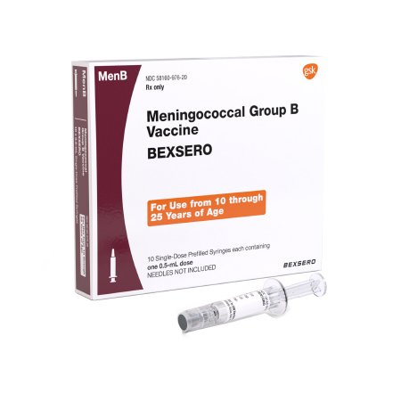
Meningococcal Vaccine Against Gonococcal Infection (MAGI) Study
Primary Objective
To demonstrate efficacy of Bexsero in prevention of urogenital and/or anorectal gonococcal infection.
Secondary Objectives
To estimate efficacy of Bexsero in prevention of overall gonococcal infection and by anatomical site (urogenital, anorectal or pharyngeal).
To assess safety of Bexsero.

Slide 53
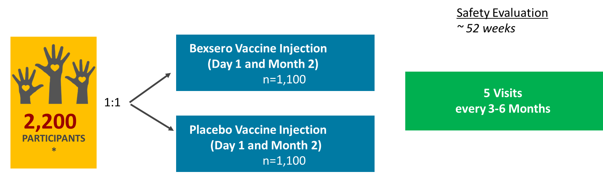
Meningococcal Vaccine Against Gonococcal Infection (MAGI) Study
Who will enroll?
  18-50 years old people who are in good health and at increased risk for gonorrhea infection.
  Cannot have received Men B vaccine in the past;
  No GC or CT diagnosis in the past 14 days; or antibiotics to GC in past 14 days

Slide 54
Conclusions
We are off track to meet our EHE targets
Despite modest declines in HIV cases in the US, racial/ethnic disparities are expanding
Strategies are needed to support expanded PrEP uptake and equity.
Addressing structural and social determinates will be essential to improving HIV/STI prevention outcomes.
DoxyPEP has led to rapid and substantial declines in CT and early syphilis in SF.

Slide 55








Thank You
Rivet Amico
Sean Arayasirikul
Oliver Bacon
Jennifer Brothers
Janessa Broussard
Susan Buchbinder
Christopher Cannon
Pierre Cedric-Crouch
Stephanie Cohen
Kenneth Coleman
Susanne Doblecki-Lewis
Jonathan Fuchs
Monica Gandhi
Steve Gibson
Sarit Golub
Rafael Gonzalez
Kate Greer van Praag
Orlando Harris
Sybil Hosek
George Jackson
Andrew Kerkhoff
Kim Koester
Nicole Laborde
Richard Lester
Maria Lopez
Samali Luebega
Kristin Ming
Janet Myers
Anne Nelson
Jim Pickett
Christina Rodriguez
Parya Saberi
Aaron Siegler
Matt Spinelli
Eric Vittinghoff
Nicole Walker
Erin Wilson
Natalie Wilson
Janie Vinson

