Slide 1
From Simulation Modeling to Developing Interventions: A Multipronged Approach to the HIV, HCV and OUD Syndemic
Sabrina A. Assoumou, MD MPH
Louis W. Sullivan, MD, Endowed Professor of Medicine
Associate Professor of Medicine
Boston University
Boston Medical Center
November 7th, 2024

Slide 2
Outline
Background on the syndemic of OUD, HCV and HIV
Cost-effectiveness of HCV screening among young adults
Developing model of care
Conclusions/next steps

Slide 3
Syndemic of opioid use disorder, drug overdose, HIV and HCV
Source: Pearlman et al. 2018
Notes:
Syndemic which denotes multiple epidemics seen in the same population that cause worse outcomes than if each had presented separately

Slide 4
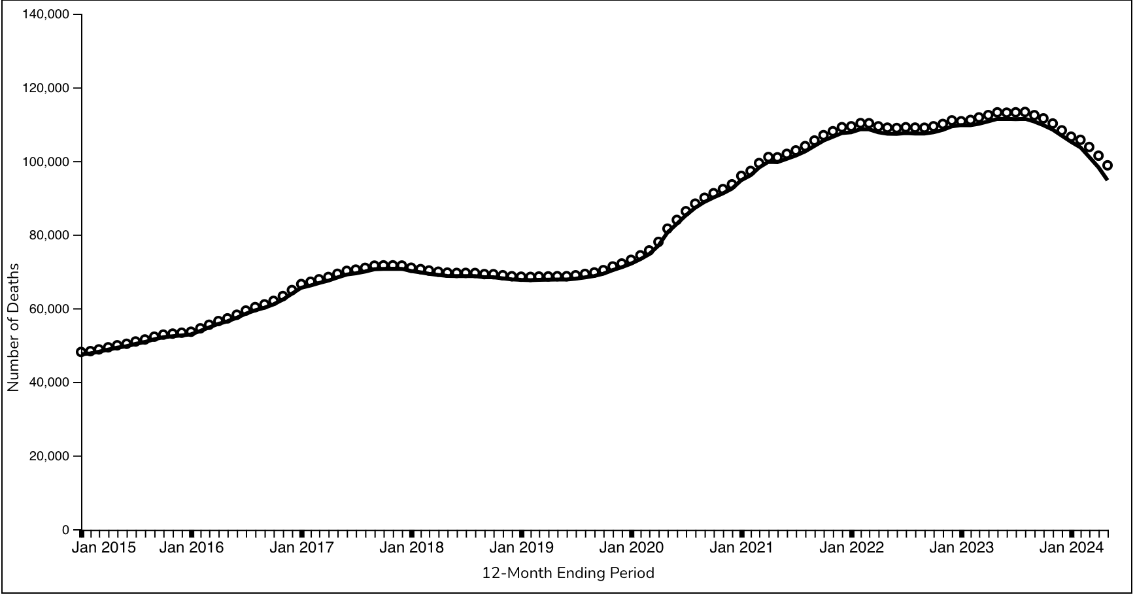
Drug Overdose Deaths, October 2024
Source: National Center for Health Statistics, 2024

Slide 5
Overdose crisis accompanied with HIV outbreak among person who inject drugs, Indiana 2014-2015
Source: Peters et al. NEJM, 2015
Notes:
From November 18, 2014, to November 1, 2015, HIV infection was diagnosed in 181 case patients. Most of these patients (87.8%) reported having injected the extended-release formulation of the prescription opioid oxymorphone, and 92.3% were coinfected with hepatitis C virus.

Slide 6
Overdose crisis accompanied with rise in HCV cases
Source: CDC, 2018

Slide 7
1.Developing data to inform national HCV testing and treatment guidelines

Slide 8
Progress in HCV treatment
Source: Innovations.org

Slide 9
HCV treatment cascade, 2013
Source: Yehia et al. Plos one, 2014

Slide 10
Notes:
A lot of excitement with seeing this article, but
But our team saw this slide, so we know that changes had to be made to the guidelines given what seeing in MA

Slide 11
Increase in newly reported HCV cases among individuals younger than 30 years of age in MA
Source: MMWR, 2011
Notes:
Given med-peds background interested in CEA of HCV testing among young adults

Slide 13
What is cost-effectiveness analysis?
Evaluates an intervention by asking:
“How much health benefit do we get for our money?”
Seeks to efficiently allocate limited health resources

Slide 14
Cost-effectiveness analysis
Two outcome measures
Cost ($)
Effectiveness (quality-adjusted life years)
Incremental cost-effectiveness ratio (ICER):
Additional Resource Use ($)
Additional Health Benefits (QALY)
Notes:
9
20

Slide 15
Cost-effectiveness analysis
Maximizes population-level benefits of medical therapies
DOES NOT seek to minimize cost
Requires an explicit willingness-to-pay threshold

Slide 16
What are we willing to pay?
$/QALY*
ART for HIV infection¹ $34,400
Statins for primary prevention² $52,100
Implantable defibrillators³ $89,400
* Converted to 2020 currency year
¹ Freedberg et al. NEJM
² Pletcher et al. Annals Internal Medicine 2009
³ Sanders et al. NEJM 2005
Notes:
10
22

Slide 17
Cost-Effectiveness Analysis Steps
Literature and clinical studies primary data are synthesized
1. Natural History
2.Test characteristics
3.Cost
4.Utility
Info used to populate a simulation model
ICER commonly cited threshold
$50,000- $100,000
Additional cost
ICER = -----------------------------
Additional clinical benefit

Slide 19
Background
Increasing rate of HCV among 15 to 30-year-olds in the United states
Risk-based screening was the recommendation for people who inject drugs (PWID)
Alternative approaches might be necessary

Slide 20
Study objective
Goal: Evaluate clinical benefit and cost-effectiveness for screening among adolescents and young adults
Study population: 15 to 30-year-olds
Setting: Urban community health centers in neighborhoods with a high overall number of reported HCV cases

Slide 21
Methods (1 of 2)
We developed a decision analytic model to project:
Quality-adjusted life years (QALYs)
Lifetime costs (2014 US $)
Incremental cost-effectiveness ratios (ICER)
Proportion reaching steps along the HCV cascade
(proportion of cases identified, linked to care, and reaching sustained virologic response)

Slide 22
Methods (2 of 2)
We evaluated 9 strategies
Strategies differed in 3 ways:
Type of test:
rapid finger stick vs. standard venipuncture diagnostics
Individual ordering the test:
clinician vs. counselor/tester using standing orders
Approach to testing:
Targeted vs. routine testing

Slide 23
Base case results
Testing Strategy | Total cost per person ($) | Total QALY per person (QALY) | Incremental cost-effectiveness ratio ($/QALY)
Current Practice | 120,475 | 43.7700 | ---
Clinician ordered, counselor performed targeted rapid testing | 120,485 | 43.7702 | 40,000
Counselor-initiated targeted rapid testing | 120,500 | 43.7706 | 44,000
Counselor-initiated routine rapid testing | 120,550 | 43.7713 | 71,000
*Base case results after removal of inefficient strategies

Slide 24
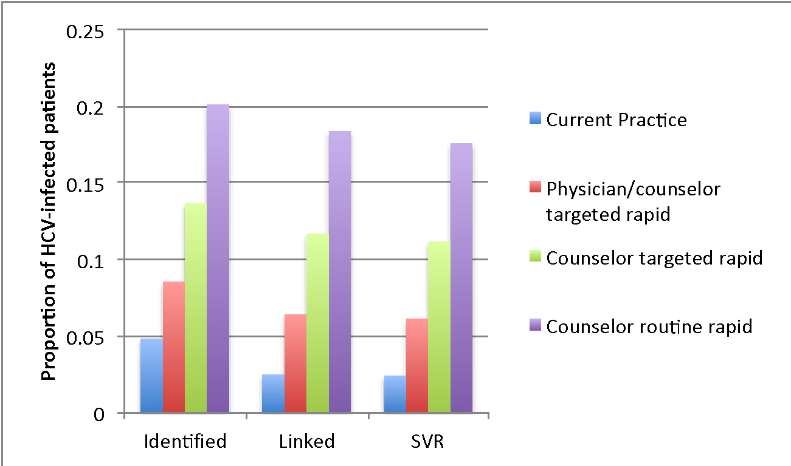
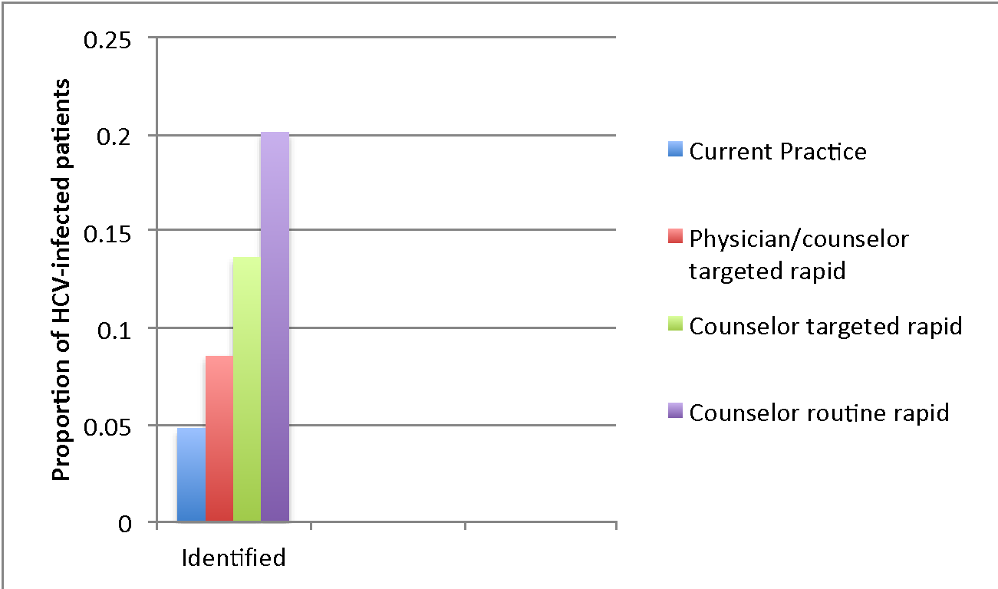
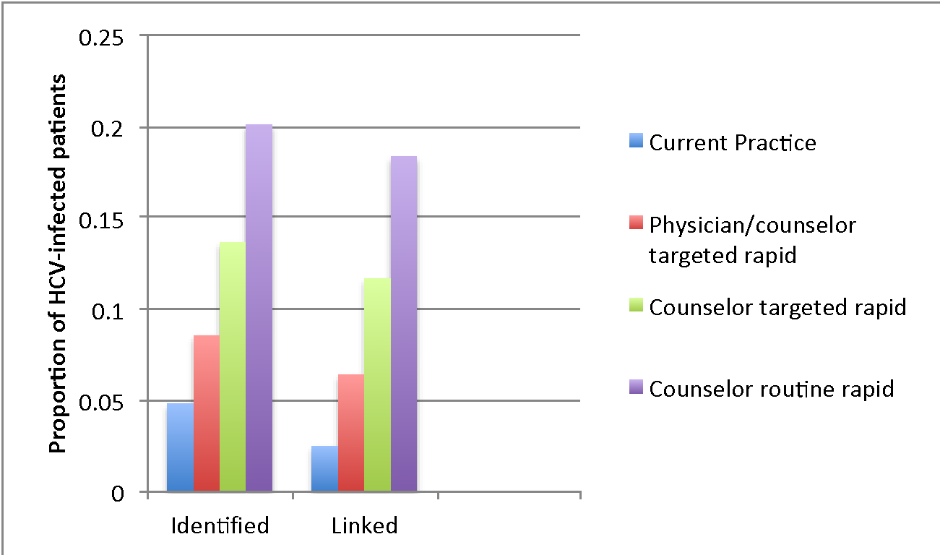
HCV cascade of care
Notes:
Result from sensitivity analysis slide
Counselor-initiated routine rapid testing was cost-effective at the $100,000/QALY gained threshold unless:
PWID prevalence < 0.59%
HCV prevalence <15% among 15 to 30-year-old PWID
The lifetime re-infection rate >95%
--
Routine testing is cost-effective for 15 to 30-year-olds in communities with a prevalence of young PWID > 0.59%

Slide 25
Selected sensitivity analyses
Counselor-initiated routine rapid testing was cost-effective at the $100,000/QALY gained threshold unless:
PWID prevalence < 0.59%
HCV prevalence <15% among 15 to 30-year-old PWID
The lifetime re-infection rate >95%

Slide 26
Limitations
Limited information on rate of HCV testing rates for youth in primary care settings.
Limited information on cascade of care for youth during the era of direct-acting antiviral therapy.

Slide 27
Conclusions
Routine testing is cost-effective for 15 to 30-year-olds in communities with a prevalence of young PWID > 0.59%
Rapid point-of-care testing should be considered instead of standard venipuncture testing
If routine rapid testing is not feasible, then targeted testing by a dedicated counselor/tester should be considered

Slide 28
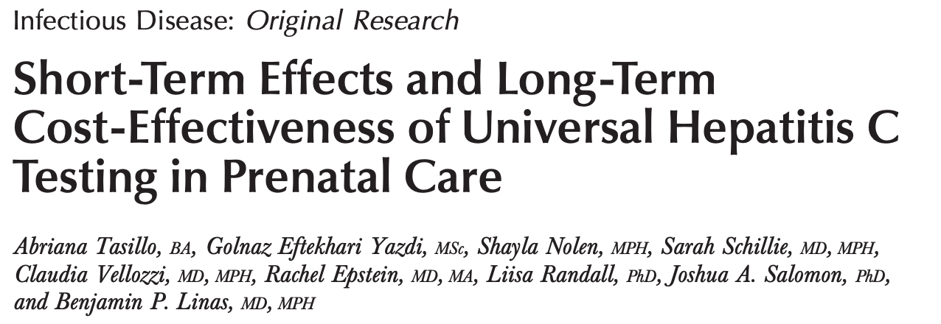

Slide 29
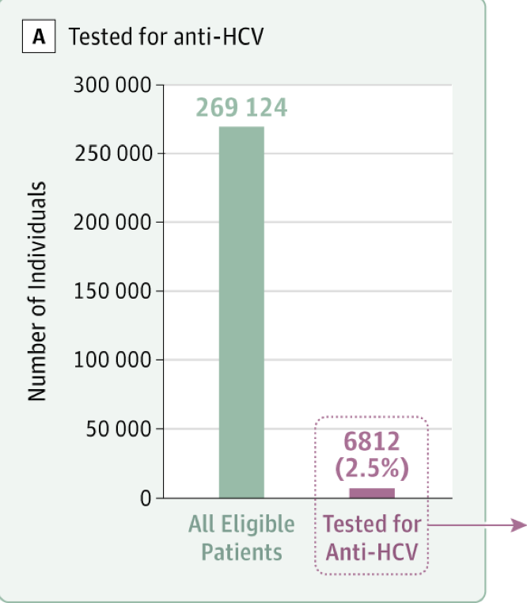
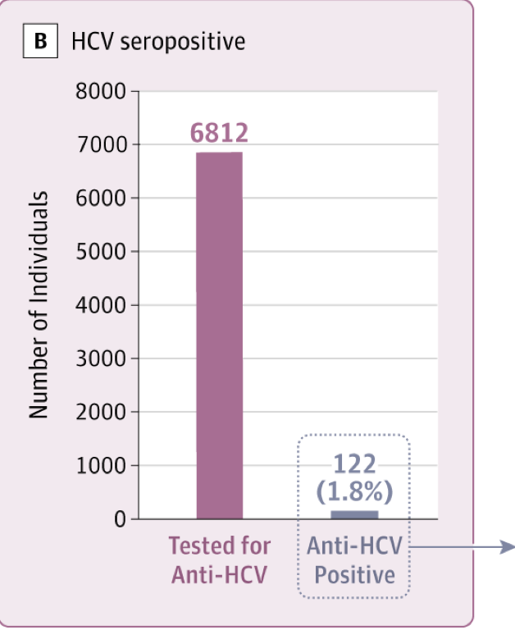
Hepatitis C Virus Antibody Testing Among Youth in a Large Sample of US FQHCs, 2012-2017
Source: Epstein et al. JAMA, 2019

Slide 30
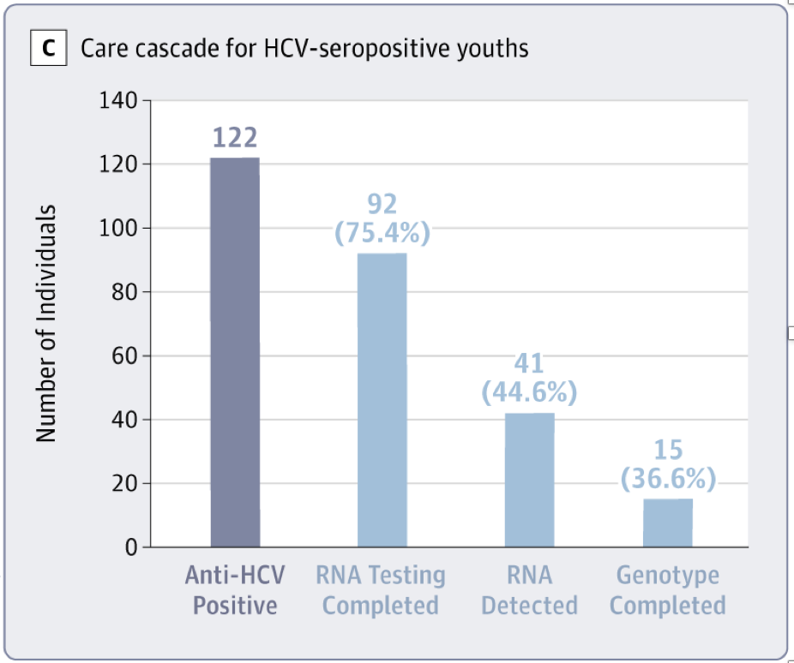
Hepatitis C Virus Antibody Testing Among Youth in a Large Sample of US FQHCs
Source: Epstein et al. JAMA, 2019

Slide 31
Hepatitis C Virus Antibody Testing Among Youth in a Large Sample of US FQHCs
During the overdose crisis, less than 1/3 of patients with opioid use disorder were tested for hepatitis C
Source: Epstein et al. JAMA, 2019

Slide 32
Section Summary
Simulation modeling showed that routine HCV screening is cost-effective.
Data set showed that there are gaps in the continuum of care

Slide 33
2.Developing models of care to improve outcomes

Slide 34
Rapid HIV testing can help to reach individuals who have remained unreached

Slide 35
Study Aim
To develop a testing algorithm for combined HCV and HIV testing at a drug detoxification center:
To compare laboratory-based 4th generation HIV testing to rapid point-of-care testing for HIV
To compare laboratory-based testing to rapid point-of-care testing for HCV
Notes:
HIV laboratory-based testing
Advantage: allows identification of acute HIV cases
Drawback: test results might take 2 to 3 days
Rapid testing
Advantage: Allows for test results within 20 minutes
Drawback: Does not enable identification of acute HIV cases
The CDC recommends HIV pre-exposure prophylaxis (PrEP) for individuals who are HIV negative and at risk for acquiring HIV
A randomized controlled trial showed that HIV PrEP is effective among persons who inject drugs
Uptake of HIV PrEP has been low, especially among persons who inject drugs

Slide 36
Outcomes
Primary outcome: Test result delivery within two weeks after testing at a drug detoxification center
Additional assessment:
Real-world identification/notification
Interest in HIV pre-exposure prophylaxis (PrEP)

Slide 37
Methods
Design:
Single site
Two-arm randomized trial
Site:
Boston Treatment Center (BTC)
Largest detox in Boston (~ 1500 visits/year)
N=200

Slide 38
Results
In the past 6 months:
87% had condomless sex
58% injected drugs
41% shared needles/works
54% used substance use treatment services
23% prescribed buprenorphine
10% identified as gay or bisexual
27% with unstable housing
Rapid testing (OR, 22.38; 95% CI, 7.65-63.55) and
Black race (OR, 0.26; 95% CI, 0.08- 0.84) were associated with result delivery

Slide 39
Real-world identification and notification
Diagnostic test sensitivity multiplied by the proportion with test result delivery
Rapid testing
HIV: 95% (0.99 X 0.96)
HCV: 93% (0.97 X 0.96)
Laboratory-based testing
HIV: 41% (0.99 X 0.41)
HCV: 41% (0.99 X 0.41)

Slide 40
Other results
One participant was newly diagnosed with HIV and was linked to HIV care
PrEP awareness only 22%
PrEP interest 74%
Linkage to HCV care within 4 months of testing was 6%

Slide 41
Conclusions
Real-world identification and notification for laboratory-based testing was < 50% in a community setting with a transient population
Rapid testing should be considered over laboratory-based testing in comparable settings with individuals with unstable housing
Lack of awareness of PrEP, but interest in this biomedical approach

Slide 42
Using qualitative data to inform interventions
Notes:
In-depth, semi-structured qualitative interviews (N=24) at a drug detoxification
Determine facilitators and barrier to HCV treatment uptake
Elicit solutions as proposed by participants
Thematic analysis of coded data

Slide 43
Study main take aways
Active substance use was a major barrier linkage to care
Potential suggestions proposed by participants included:
Low-barrier access to substance use treatment
High-touch care with same-day walk-in options
Focus on patient autonomy to select an approach that best fits individual needs and circumstances

Slide 44
1. Active substance use was an important barrier to linkage to care
Active substance use was a major barrier to HCV treatment because of disruptions to everyday activities
“But when I'm using or, you know, rippin' and runnin', I don't really care about my health. I don't care about anything.”
(30-year-old, White woman)

Slide 45
2. Solution: low-barrier walk-in treatment access
Low-barrier access to substance use treatment with high-touch care and same-day/walk-in clinician visits was described as a potential solution
“…more of like an open schedule…‘cause I feel like anytime you call the doctors it’s like, ‘Oh, this one’s booked until, like, April’ and it will be, like, January. Or…, ‘We only have this time or this time.’”
(30-year-old, White woman)

Slide 46
3. Solution: High touch care
“So, it's somebody that is through your insurance that basically they help if you need help getting to your appointments or they'll help represent you court or just, you know, somebody that's a part of the community that is there to help, you know, support you in times of need.”
(32-year-old, Latino man)

Slide 47
4. Solution: Patient navigation
Assistance with navigating the health care system and attention to immediate needs such as housing and transportation were mentioned as important components of an intervention to improve treatment uptake
“I need a counselor or somebody to help me to do my things. Do what I need to do, step-by-step... Just sittin' down and doin' it myself, I wouldn't know where to start and when I have tried to get insurance, it was always stopped and then other people helped me try to get it, because I wasn't qualified or approved for it, because of my age or my income.”
(35-year-old, White woman)

Slide 48
Section Summary
To address the syndemic of HIV and HCV among persons with opioid use disorder the following are needed:
Rapid identification/notification of HIV and HCV
Comprehensive care with navigation of the health care system with wraparound services and high-touch care
Addressing substances use is key to making progress in the care of patients with or at-risk for HIV and HCV

Slide 49
Building interventions to address the syndemic of OUD and HIV

Slide 50
Peer coaching can facilitate HIV prevention

Slide 51
Results
Study Flow
33 individuals approached
31 participants enrolled
End of 6-month intervention
48% participants on medications for opioid use disorder (MOUD)
43% eligible participants initiated PrEP
22% eligible participants initiated HCV treatment
Notes:
We approached 33 individuals at Faster Paths and enrolled 31. By the end of the intervention, 3 participants were lost to follow up or unenrolled by self-request. At the end of the intervention 48% (15) of individuals were on MOUD , 43 % (6) of eligible participants initiated PrEP, and 22% (2) of eligible participants initiated HCV treatment. Of those on MOUD, 87% (13) were on buprenorphine and 13% (2) were on methadone.

Slide 52
Survey Results
95% satisfied or very satisfied with working with a recovery coach
100% would recommend the peer recovery coaching to other individuals with substance use disorder
95% strongly agree or agree that the intervention was helpful
Notes:
We were able to get into contact with 20 of our participants for a satisfaction survey following the intervention. 95% (19) of participants reported being either satisfied or very satisfied working with a recovery coach. 100% (20) of the participants who completed our survey indicated that they would recommend the peer recovery coaching intervention to other individuals with substance use disorder, and 95% (19) strongly agree or agree that the intervention was helpful.
From conclusion
We show that during the COVID-19 pandemic we recruited individuals at-high risk for overdose deaths, HIV and HCV, and offered a comprehensive approach to address opioid use disorder and its infectious complications. Our findings are especially timely given increases in overdose deaths during the COVID 19 pandemic and a rise in HIV cases among persons who inject drugs in recent years. We found that the CHORUS intervention is feasible and acceptable. we also recorded encouraging preliminary findings related to medications for opioid use disorder and HIV pre-exposure prophylaxis with nearly half of participants on MOUD and over 40% on PrEP. This PrEP finding is especially exciting given that a retrospective chart review done with Faster Paths patients shows only 14.6 of eligible participants on PrEP. In our sample, HCV treatment initiation within 6 months was more limited. This may be due to the additional steps required to initiate HCV treatment compared to PrEP.
I will quicky touch on one of the things that helped make our intervention successful, and that is the nontraditional engagement techniques employed by our recovery coach Tyshaun. Tyshaun not only provided recovery support, but he worked to help address other social determinants of health like housing, identification, and employment. Tyshaun also took care to connect with participants that were more diffuclt to contact by walking around locations like melena cass boulevard where he knew he may run into them. This was helpful for us to connect to participants who may have lost their phones, or otherwise disconnected from the study.
Future studies should focus on evaluating CHORUS’ efficacy and determining its possible implementation in other real-world clinical settings.
https://journals.lww.com/journaladdictionmedicine/Abstract/9000/HIV_Exposure_Prophylaxis_Delivery_in_a_Low_barrier.98912.aspx

Slide 53
Notes:
We partnered with the community

Slide 54
Tools in our HIV prevention toolbox

Slide 55
HIV Testing Results and PrEP-Related Data (N=40)
3 (8%) participants had a positive HIVST test
32 (82%) participants knew that HIV PrEP is recommended by the CDC for individuals who inject drugs and are HIV negative
32 (82%) participants reported interest in receiving HIV PrEP
100% reported they would recommend the HIV self-testing to others
100% agreed that they liked the HIV self-test

Slide 56
Conclusion
Partnering with a community-based organization to expand HIV self-testing is feasible and acceptable
Identified new HIV cases
HIVST could be a “game-changer”
Addressed two Ending the HIV Epidemic in the US (EHE) pillars
Rapid diagnosis
HIV cluster identification

Slide 57
The CHORUS+ Study: An NIH-funded R01 study

Slide 58
Conclusions
Tool kit with:
Simulation modeling to inform policy
Intervention development to have an impact at the patient-level in the real-world
Next steps: Implementing an intervention to improve syndemic-related outcomes

Slide 59
Acknowledgement:
BMC/BU
Benjamin Linas
Jeffrey Samet
C. Robert Horsburgh
Abriana Tasillo
Shayla Nolen
Samantha Paniagua
Laura White
Jenny Wang
Jonathan Hall
Samantha Johnson
James Evans
Rachel Peirchert
Carlos Sian
Judith Bernstein
Christina Gebel
Vanessa Bonilla
Anna Martin
Glory Ruiz
Ricardo Cruz
Carolyn Damato-MacPherson
Sarah Miller
Raegan Alexander
Terrence Rolle
Beverly Thomas
Jessica Taylor
Brown
Curt Beckwith
Thank you to participants
Boston Treatment Center
William Sinton
Cynthia Wigfall
Cornell
Bruce Schackman
Jared Leff
Stanford
Joshua Salomon
UCSF
Jim Sorensen
Carmen Masson
CDC
Bill Thompson
Liesl Hagan
VP
Meg von Lossnitzer
Rich Baker
Funding:
NIDA K23 DA044085, NIDA R01 DA058367
NIAID 5P30AI042853, NIDA R25 DA035163, NIDA P30 DA040500, CDC 1U38PS004644, DOM Evans Research and Invest Award
BUCTSI 1UL1TR001430

Slide 60
Questions?

