Slide 1
The Ethics and Practice of Analytical HIV Treatment Interruption in the Context of HIV Prevention Research
January 9, 2025
Kathryn Stephenson, MD, MPH
Center for Virology and Vaccine Research
Beth Israel Deaconess Medical Center
Harvard Medical School

Slide 2
State of HIV Prevention Research
2019 ATI Consensus Guidelines
HVTN 807 Trial
Participant Perspectives
What is an Analytical Treatment Interruption?
B Cell Approaches
ATIs in Africa and LMICs

Slide 3
Analytical Treatment Interruption (ATI)
A structured and temporary cessation of antiretroviral therapy
Since 2000, more than 150 clinical trials have included an ATI, testing:
Immunotherapy
Therapeutic vaccination
Latency reversal agents
Study endpoints include:
Time to viral rebound, changes to viral setpoint and decreases in HIV reservoir
Generation of potentially protective HIV-specific immune responses
Treatment interruption is performed in a monitored research setting
ART is suspended for a finite period of time with strict restart criteria
Lau AIDS 2019; Stephenson Curr Opin HIV AIDS 2018

Slide 4
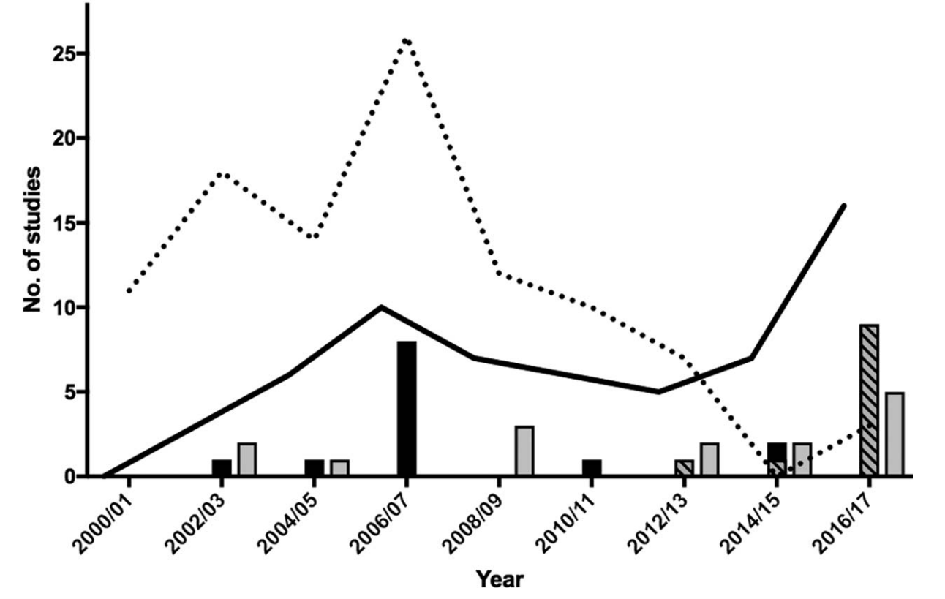
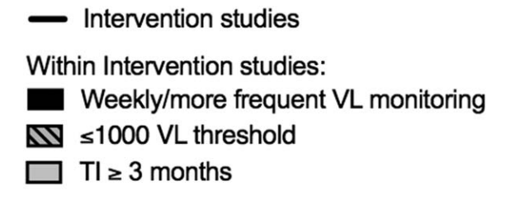
ATI Studies Since 2000
Lau AIDS 2019

Slide 5
Example ATI Study Looking at Time to Rebound
broadly neutralizing antibodies
Julg Nat Med 2024

Slide 6
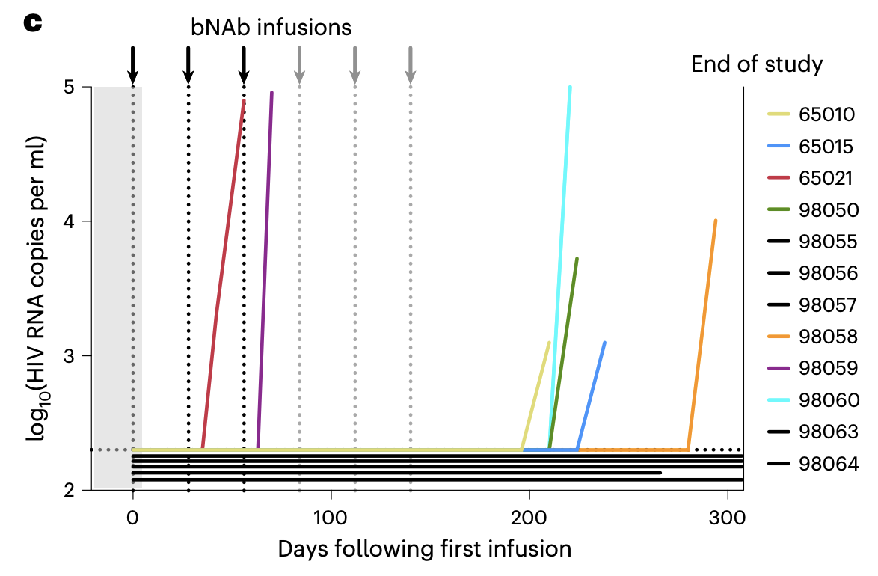
Example ATI Study Looking at Time to Rebound
Julg Nat Med 2024

Slide 7
Benefits of Antiretroviral Therapy (ART)
ART is recommended for all people living with HIV
Reduces mortality
Reduces serious AIDS complications
Reduces serious non-AIDS-related complications
Reduces risk of transmission of HIV to others
Benefits are regardless of CD4 count or symptoms at ART initiation
Once initiated, ART should be continued indefinitely

Slide 8
Risks of ART Cessation or Prolonged Interruption
Viral rebound and/or acute retroviral syndrome
Immune decompensation
Clinical progression
Emergence of new drug-resistance mutations
HIV transmission to sexual partners or during pregnancy/breastfeeding
Expansion of the viral reservoir

Slide 9
Pivotal SMART Study
SMART trial established the importance of maintaining ART indefinitely as part of routine clinical care
Participants (N=5000+) were randomized to the following groups:
Drug conservation → use ART only when CD4+ count <250 cells/mm³
Viral suppression → continuous use of ART
Very broad inclusion criteria
Monitoring was every 2 months for first year, then every 4 months
Duration of first period of interruption was median 16.8 months
El-Sadr NEJM 2006

Slide 10
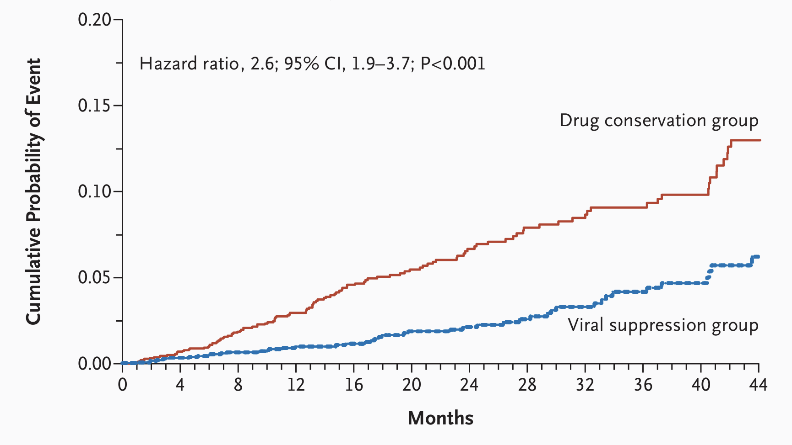
SMART Study Results – OIs and All Cause Mortality
El-Sadr NEJM 2006

Slide 11
Follow Up Analysis of SMART Data
All serious adverse events occurred when CD4+ counts <300 cells/mm³
Data was re-analyzed using stricter criteria:
Limit to 16 weeks of treatment interruption
Include only participants with CD4+ counts >400 cells/mm³
Exclude participants with hepatitis B, hepatitis C or diabetes at study entry
ART re-initiation at CD4+ count of 350 cells/mm³
In this analysis:
No difference in AIDS-related or non-AIDS-related events
No deaths or renal/hepatic events in either group
Routy J Med Virol 2012

Slide 12
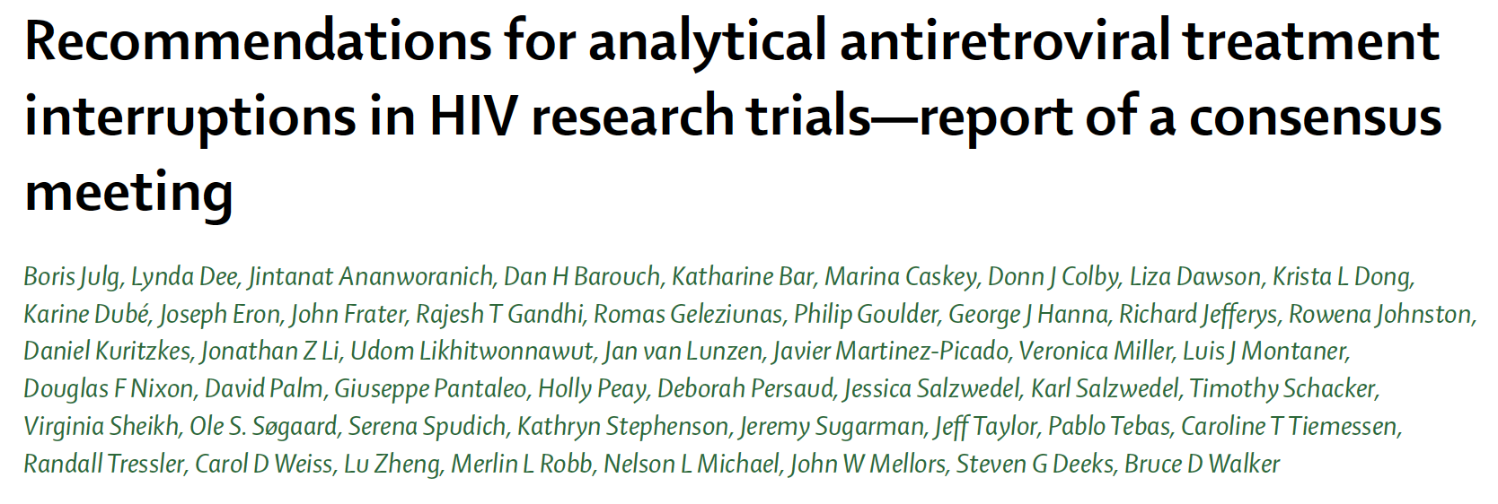
ATI Consensus Meeting in Boston
Hosted at Ragon Institute of MGH, MIT and Harvard
41 experts on HIV research, and reps from US FDA, NIH and industry
Julg Lancet HIV 2019

Slide 13
When is an ATI appropriate?
If the risk is adequately understood by the participant
If the study design will answer a scientific question that could not be solved otherwise or can be solved more efficiently
“The responsibility is on the investigators to show, before the ATI, that a strong scientific rationale exists for why the intervention might conceivably affect time-to-rebound, post-interruption setpoint, or other meaningful biological or clinical endpoints.”
Julg Lancet HIV 2019

Slide 14
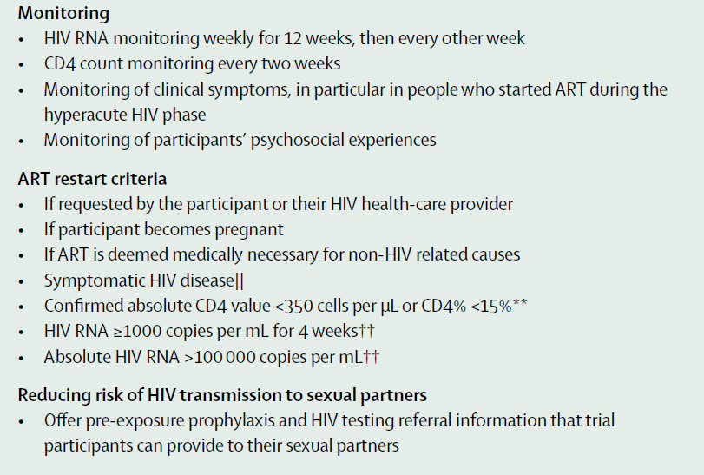
Julg Lancet HIV 2019

Slide 15
Ethical Justification for Use of Placebo
If a placebo group is necessary for the findings of a study to be properly interpreted
Power calculations and sample size requirements are required
Strictly defined outcome, e.g., time to rebound or viral setpoint
Julg Lancet HIV 2019
Magalhaes J Virus Erad 2023

Slide 16
Meta-Analysis of Safety of ATI Trials
22 studies with differences in design, sample size, target group, follow up
Pooled proportion of adverse events during ATIs was 3% (95% CI, 0%-7%)
AE rate was highest in patients with lower CD4 counts
8 studies reported new viral resistance mutations
Almost exclusively during long ATI duration and wide follow up interval
Could not say if associated with NNRTI use (no data)
Disease progression occurred only in studies with long ATI duration
Significantly associated with baseline CD4 levels
There were no reported cases of HIV transmission
Stecher Clin Infect Dis 2020

Slide 17
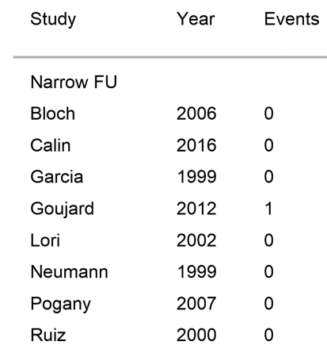
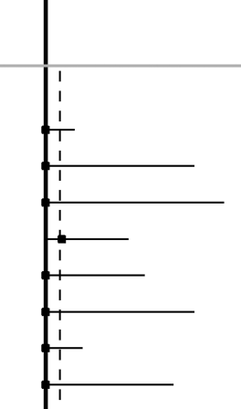
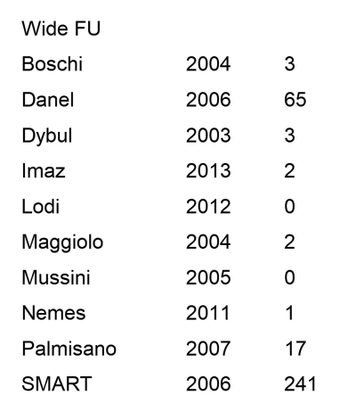
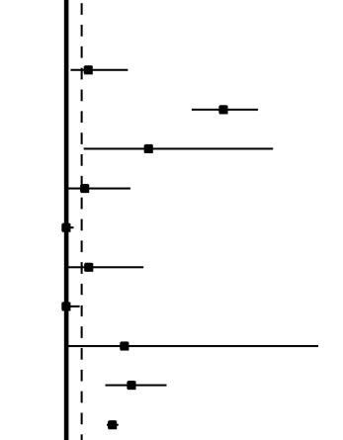
Adverse Events by Frequency of Follow Up
Narrow Follow Up (<14 Days)
Wide Follow Up (>14 Days)
Stecher Clin Infect Dis 2020

Slide 18
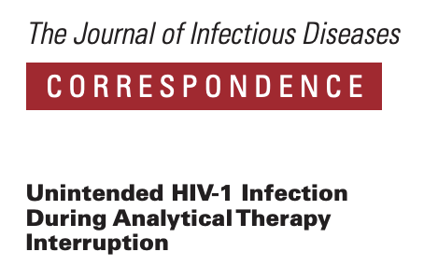
HIV Transmission in Setting of ATI – 2 Case Reports
Transmission occurred between a male research participant and female partner and was attributed to oral sex
Transmission occurred between a male research participant and a male partner, no mode of transmission specified
Lelièvre J Infect Dis 2020; Ugarte J Infect Dis 2020

Slide 19
Risk Mitigation for HIV Transmission
Make condoms available throughout the ATI
Emphasize importance of participant discussing study with partner(s)
Facilitate access to pre-exposure prophylaxis for partner(s)
Offer to assist with counselling for participant partner(s)
Make post-exposure prophylaxis available if needed
Monitor for other sexually transmitted infections
Dubé ARHR 2022; Peluso J Virus Erad 2020, updated 2024

Slide 20
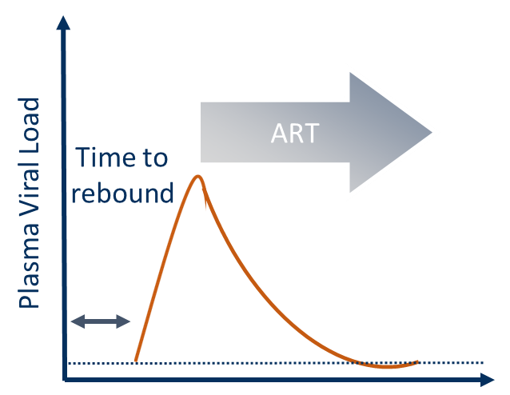
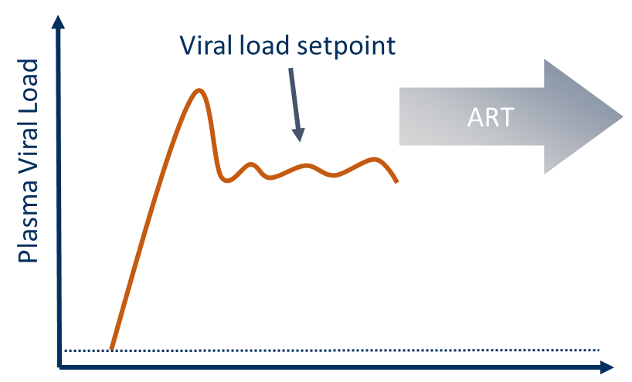
Time to Rebound ATI versus Setpoint ATI
 | Time to Rebound ATI | Viral Setpoint ATI
Duration of viremia | Minimal | Potentially prolonged
ART resumption | At viral rebound | If agreed set point is not reached
Courtesy of Sharon Lewin & Lydie Trautmann

Slide 21
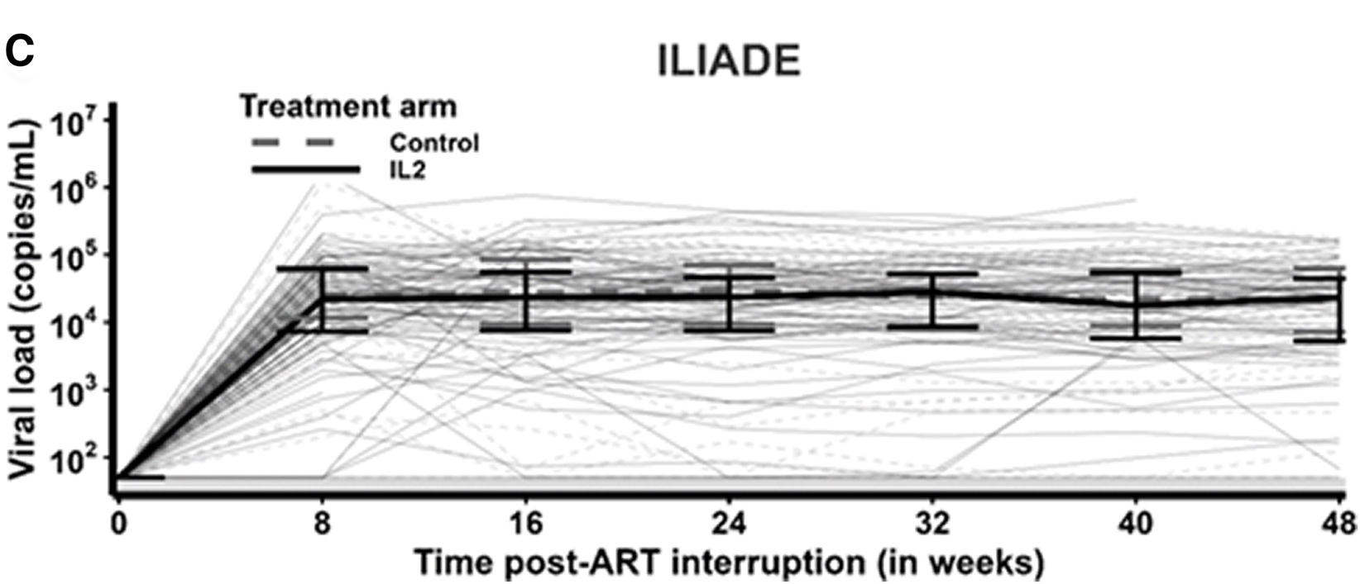
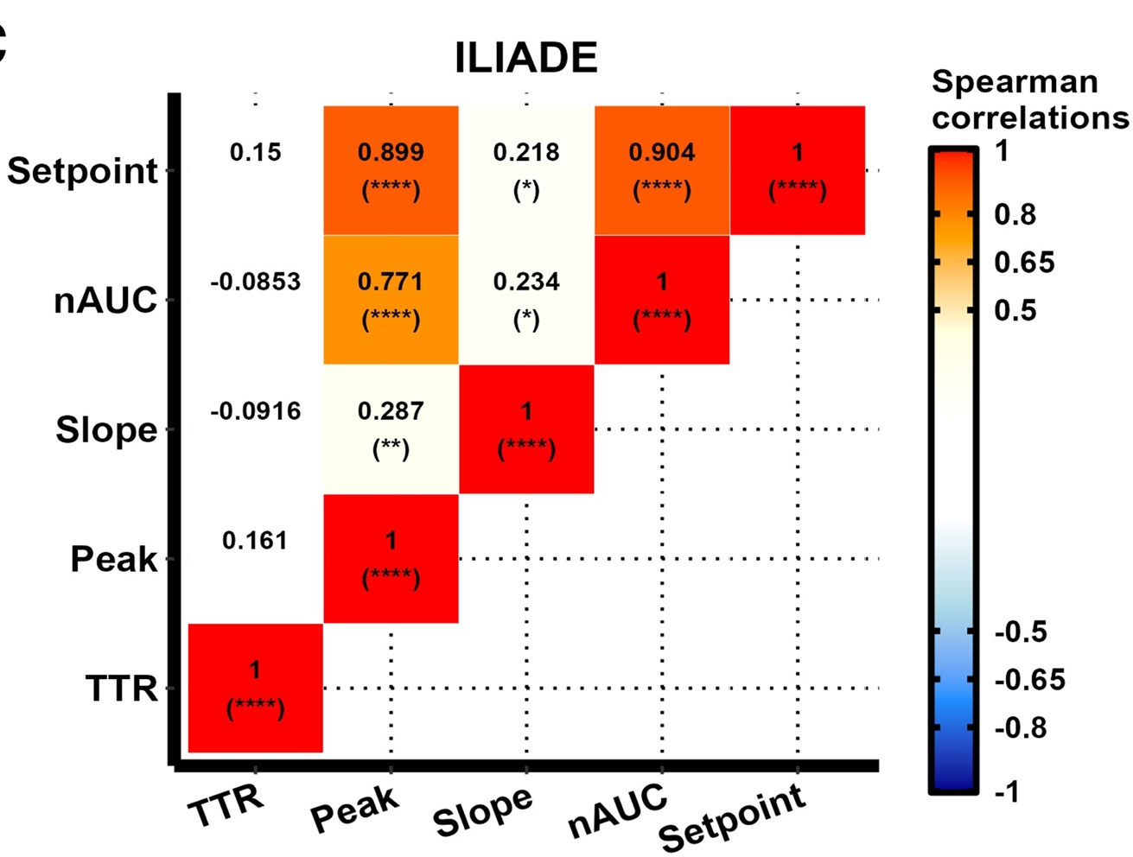
Surrogate Markers for Viral Setpoint
Analyzed viral dynamics in 235 people with HIV from 3 ATI trials
Time to rebound, peak, setpoint
Time-averaged area under curve (nAUC)
nAUC most strongly correlated with setpoint, with correlations >0.70
Proposed >100,000 copies/mL for 2 consecutive measures as ART restart criteria
Alexandre CID 2024

Slide 22
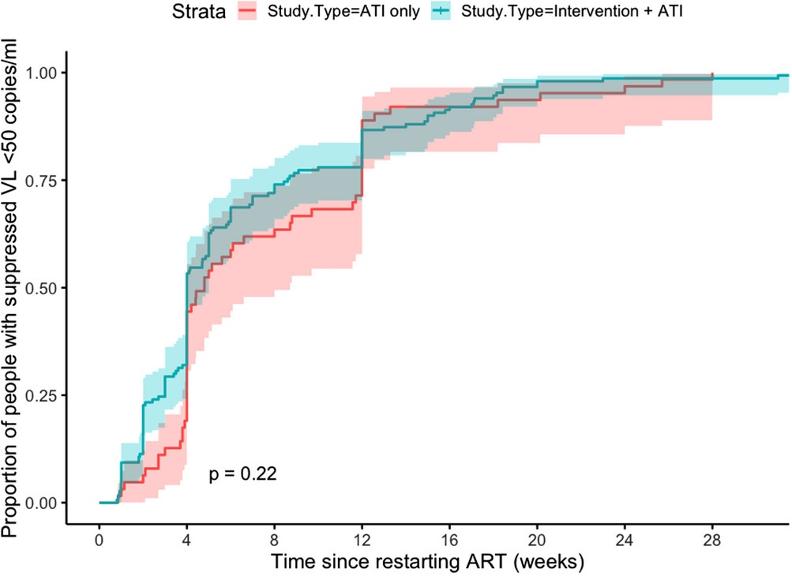
Time to Viral Re-suppression after Rebound
~90% suppressed by 12 weeks
~50% by 4 weeks
Integrase inhibitors led to more rapid re-suppression, esp. for those with higher VLs at restart
Lee JIAS 2024

Slide 23
Participant Perspectives on Joining an ATI
Motivations
General altruistic desire to help scientific research
Improve the lives of community members; ‘pay forward’
Help find a cure for HIV/AIDS
Desire to know more about HIV and new treatments
Positive feeling from being a good candidate for research
Concerns
The primary concern across studies is the risk of HIV transmission
Long term health getting worse or developing symptoms
Potential for ART resistance post-rebound
Lau ARHR 2020; Lee J Virus Erad 2023; Neergaard ARHR 2023

Slide 24
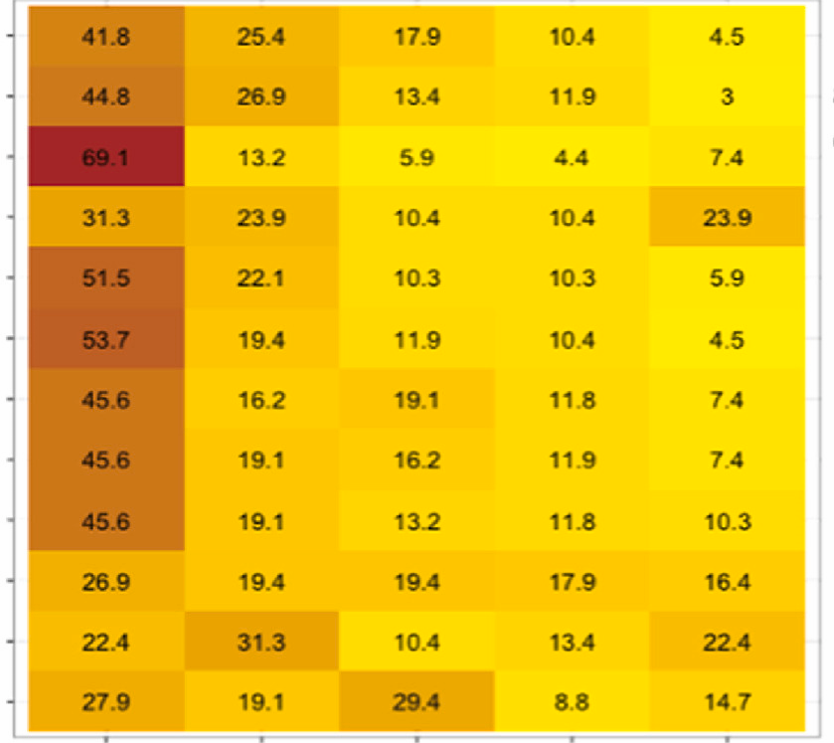
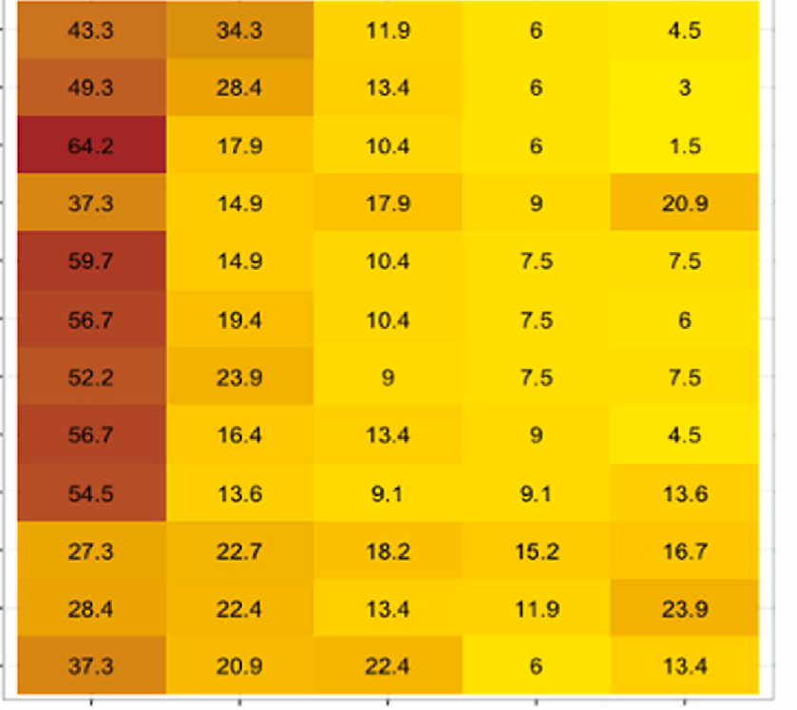
Concerns Similar Whether Restarting ART at a Viral Load of 500 or 50,000 copies/ml
500 copies/ml
50,000 copies/ml
1. My CD4 count going down
2. My HIV viral load becoming detectable
P-value = NS
across all domains
3. Passing HIV onto someone else
4. The anxiety of telling sexual partners that I am not on ART
5. Becoming unwell
6. HIV spreading throughout my body
7. My HIV meds not working at all when I restarted treatment
8. My long term health getting worse
9. Developing symptoms of HIV/AIDS
10. Not being able to join future HIV cure trials
11. The time for extra clinic visits
12. Being generally worried about everything whilst I was not taking meds
1. Very concerned
4. A little concerned
1. Very concerned
4. A little concerned
3. Somewhat concerned
5. Not at all concerned
3. Somewhat concerned
5. Not at all concerned
2. Moderately concerned
2. Moderately concerned
Lee J Virus Erad 2023

Slide 25
Participant Experiences Following ATI
Positive
Reported feeling self-confident, empowered, with newfound appreciation for ART
Reactions involved a mixture of curiosity and satisfaction from contributing to science
Did not feel pressured to participate; risks well-described
Negative
Anxiety during the ATI
Sense of failure with rebound
Challenging to assess whether partners on PrEP
Underestimated emotional impact
Bilger HIV Res Clin Pract 2023; Dube ARHR 2022
Korolkova AIDS and Behavior 2024; Dube HIV Res Clin Pract 2024

Slide 26
State of HIV Prevention Research
2019 ATI Consensus Guidelines
HVTN 807 Trial
Participant Perspectives
What is an Analytical Treatment Interruption?
B Cell Approaches
ATIs in Africa and LMICs

Slide 27
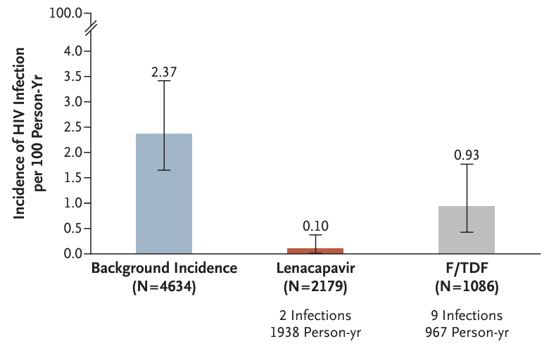
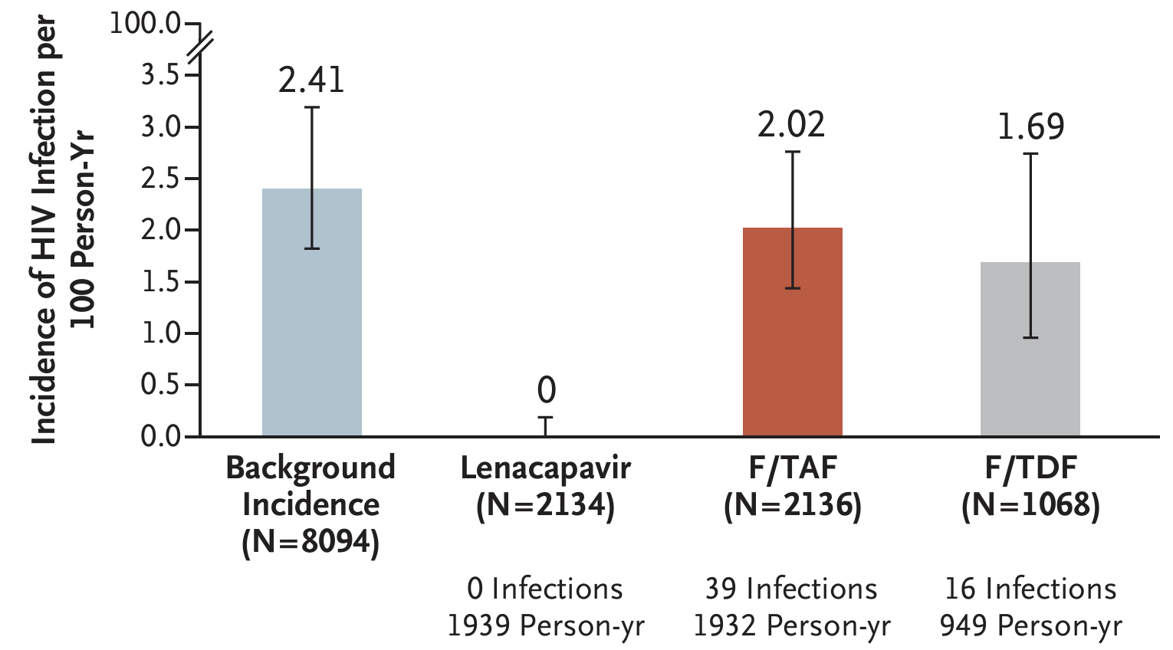
A New Era in HIV Prevention Research
PURPOSE 1
PURPOSE 2
Bekker NEJM 2024
Kelley NEJM 2024

Slide 28
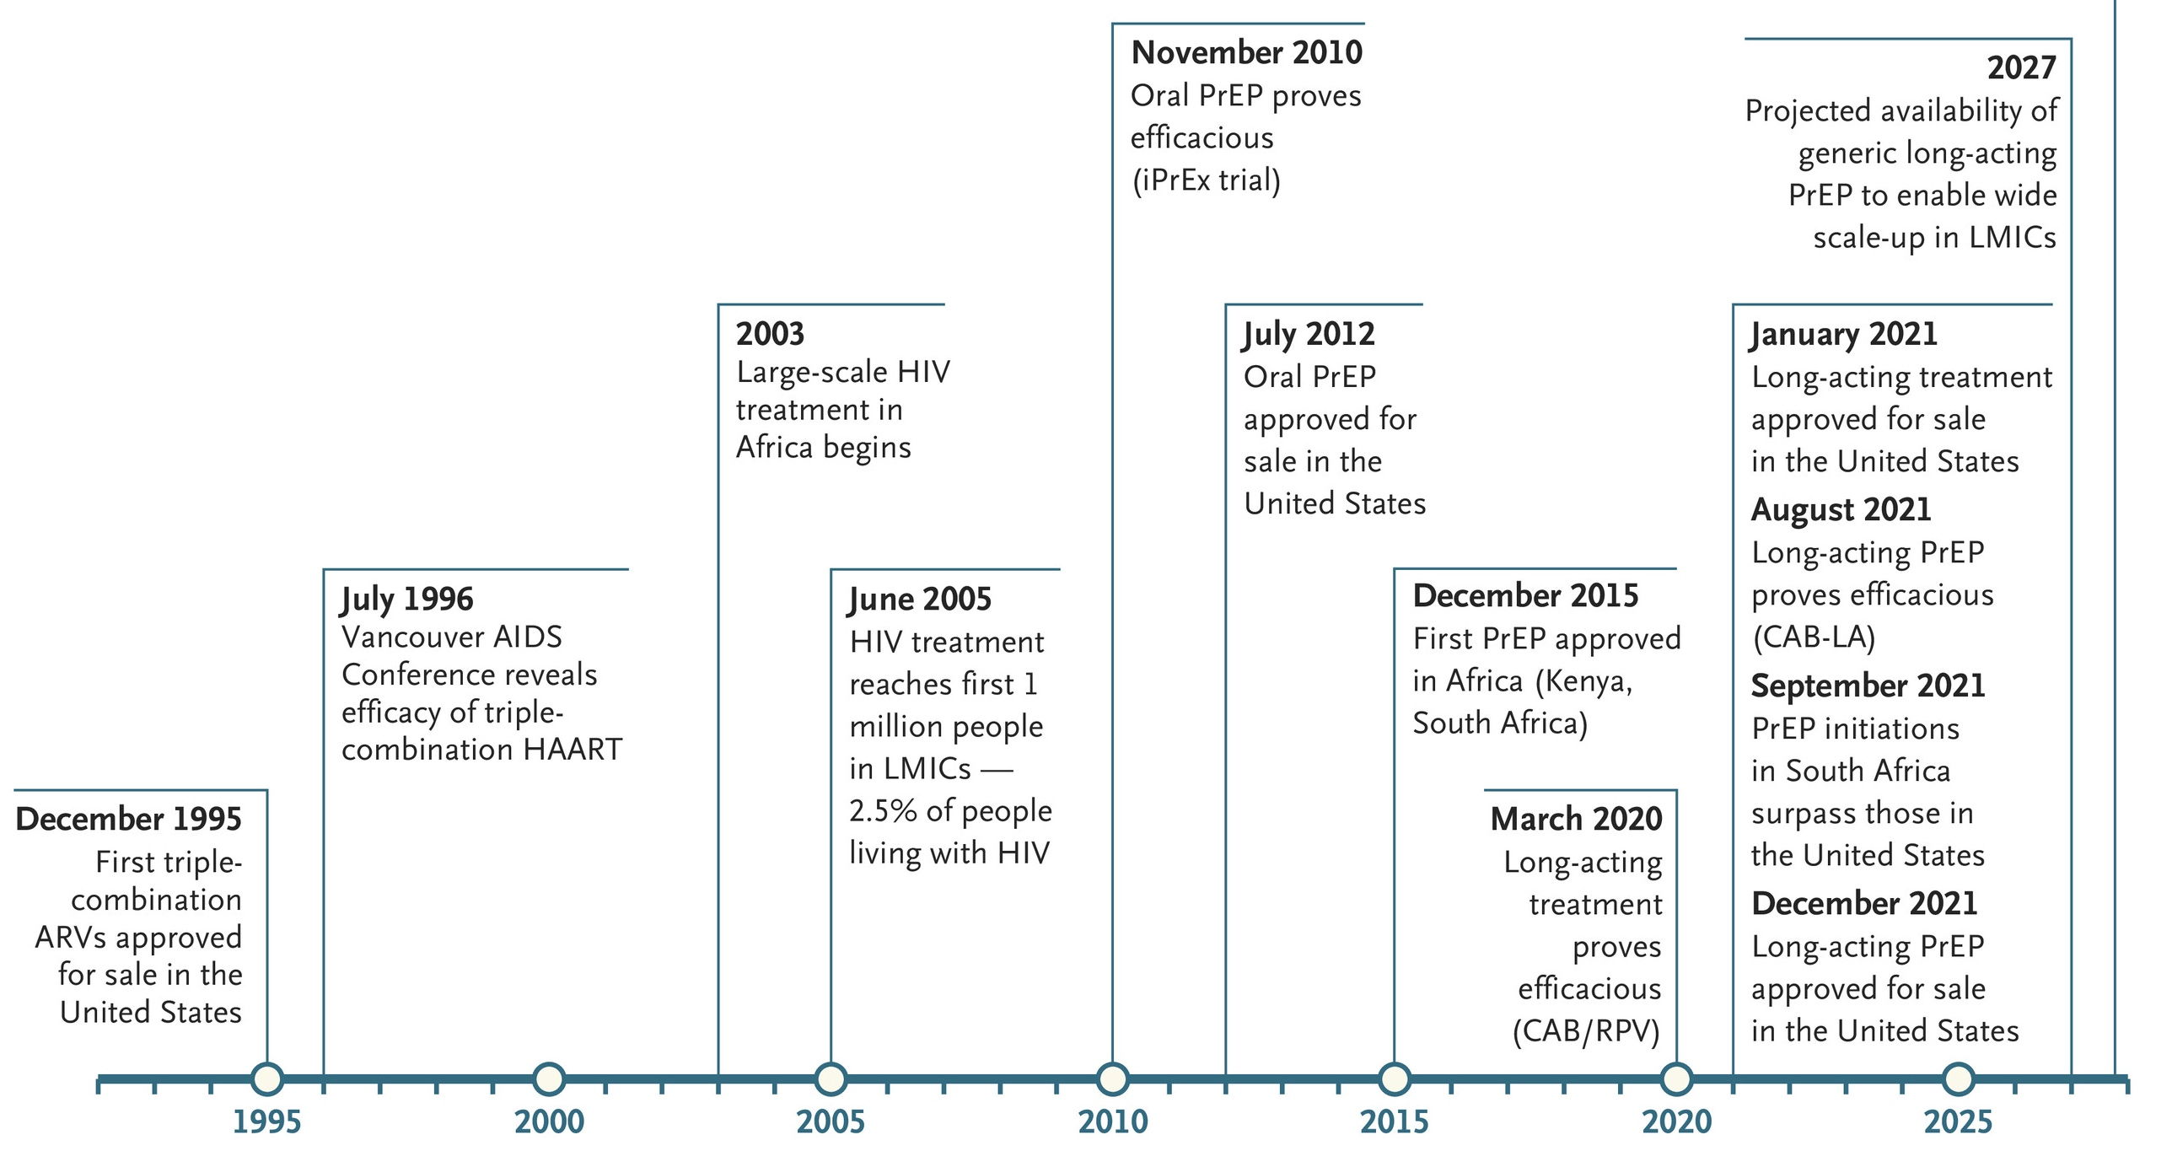
Time Lags for ARVs and PrEP to Reach Africa and Low and Middle-Income Countries
Long-acting ARVs and PrEP?
Time lag for oral PrEP
Time lag for ARVs
Byanyima NEJM 2024

Slide 29
Benefits of an Effective and Durable HIV Vaccine in the Era of Lenacapavir
Unlikely to elicit ARV resistance in the general population
Obviate the need for adherence, monitoring, and testing
Potentially fewer side effects
Would not require indefinite repeat dosing and associated costs
Less risk of disruption due to conflict, disasters and human rights abuses

Slide 30
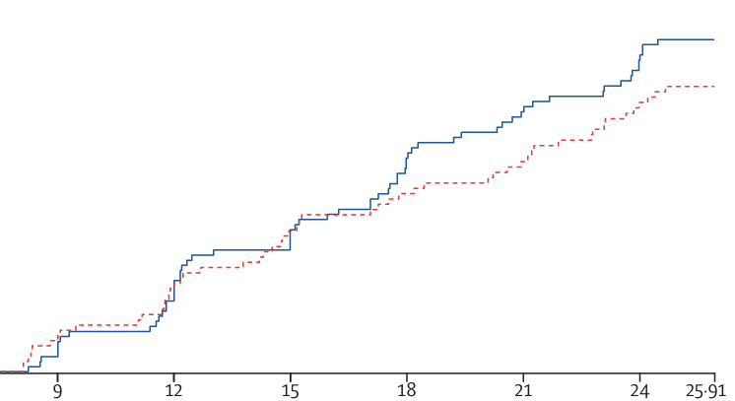
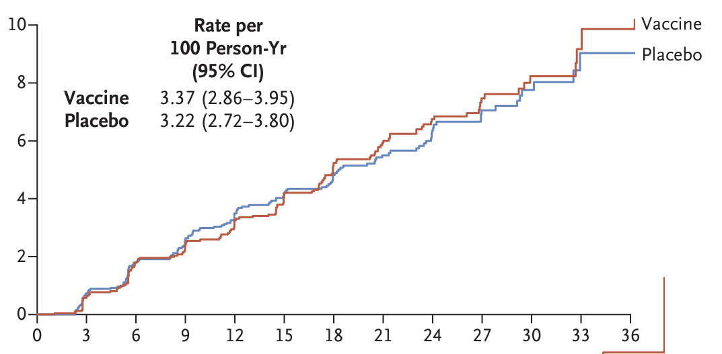
Recent Negative HIV Vaccine Efficacy Trials
UHAMBO – HIV Vaccine
IMBOKODO – HIV Vaccine
(and MOSAICO)
Gray NEJM 2021
Gray Lancet ID 2024
Antibody Responses Were Not Neutralizing and Lacked Breadth

Slide 31
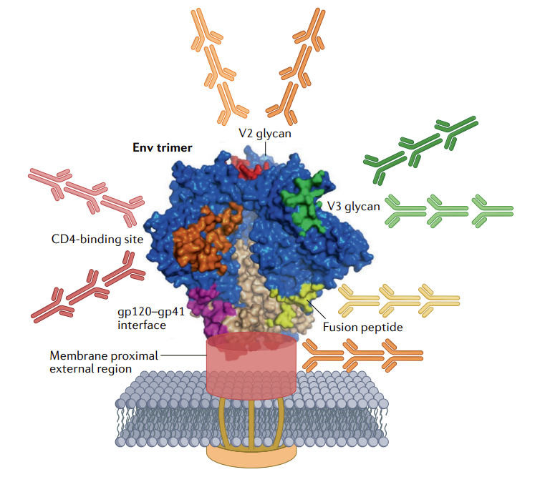
Broadly Neutralizing Antibodies Exist in Nature – Identified in People Living with HIV
VRC01
Adapted from Haynes Nat Rev Immunol 2023; hive.scripps.edu

Slide 32
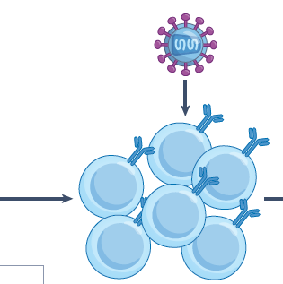
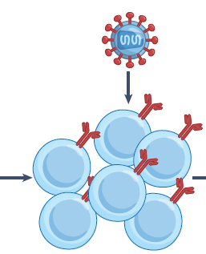
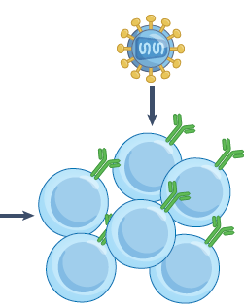
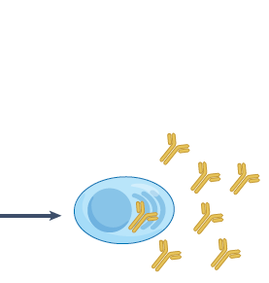
bNAbs Occur When HIV and B cells Evolve Together Over Time
Broadly Neutralizing Antibodies (bNAbs)
Transmitted/
founder viruses stimulate weakly neutralizing antibodies
Plasma cells with functional, rare mutations secrete one or a few bNAbs
Transmitted/
founder mutants expand these B cells, maturing antibodies
Upon diversification of HIV-1 in chronic infection, mutated Envs select for multiple functional mutations required for bNAb potency and breadth
Adapted from Haynes Nat Rev Immunol 2023

Slide 33
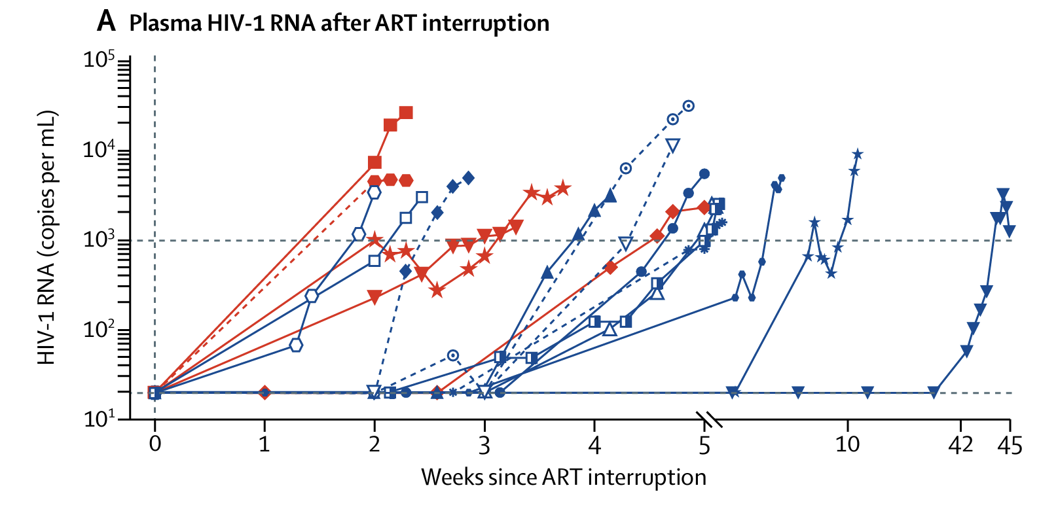
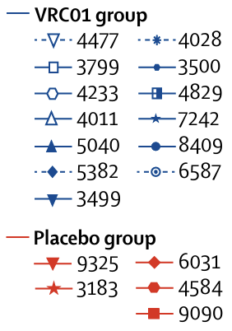
ATI Trials Established the Antiviral Activity of bNAbs
Crowell Lancet HIV 2019

Slide 34
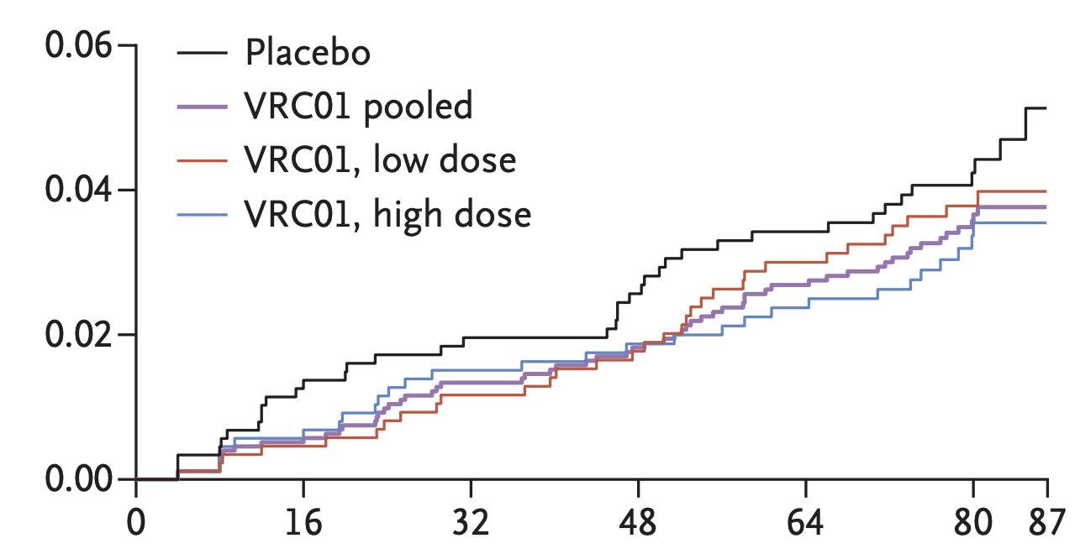
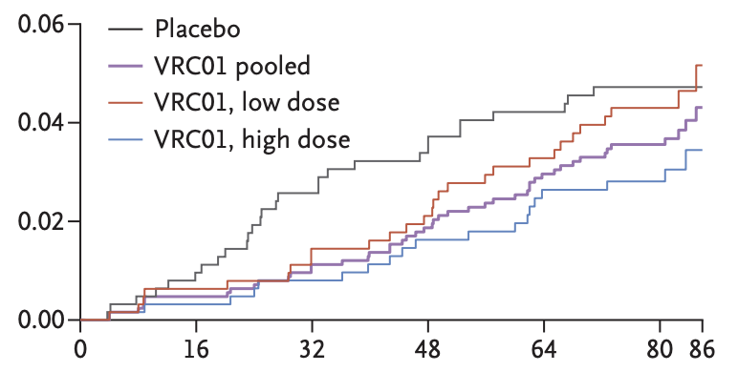
Recent VRC01 Prevention Trials
HVTN 704
HVTN 703
Antibody Infusions were Neutralizing but Lacked Sufficient Breadth and Potency to Protect Against Global HIV Diversity
Corey NEJM 2021

Slide 35
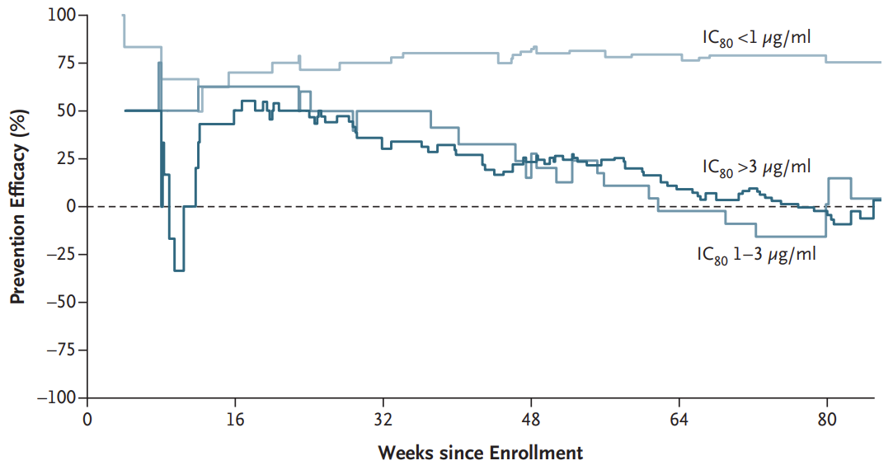
VRC01 Did Protect Against Sensitive HIV-1 strains
Preventive Efficacy of VRC01 Over Time
~75% Efficacy
Sensitive Strains
~0% Efficacy
Resistant Strains
Weeks since Enrollment
Corey NEJM 2021

Slide 36
Uses of ATI Trials for HIV Prevention Research
Demonstrate in vivo antiviral activity of a particular intervention
Test whether vaccine-induced immunity can delay viral rebound
Help down-select monoclonal antibodies before large efficacy studies
Use viral dynamics to reveal critical immunologic insights

Slide 37
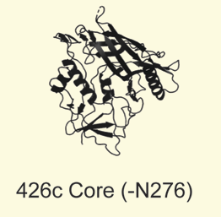
HVTN 807 HIV Vaccine Trial
Multicenter, phase 1 trial in persons living with HIV
Two immunizations with adjuvanted 426c.Mod.Core-C4b
Participants have option to undergo analytical treatment interruption
Vaccine designed by the Stamatatos group at UW/Hutch
Goal is to develop a vaccine series that can elicit broadly neutralizing antibodies similar to VRC01
Scharf eLife 2016

Slide 38
HVTN 807 Vaccine Trial
Seattle, WA
U of Pittsburgh, PA
BIDMC Boston, MA
Columbia P&S, NY
U of Pennsylvania, PA
Hope Clinic and Ponce de Leon Clinic
Atlanta, GA
Birmingham, AL

Slide 39
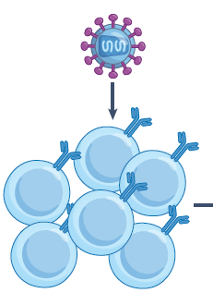
Hypothetical Maturation of VRC01-Like Abs in 807
VRC01-like Intermediate Stage Abs
Identify the viruses that matured Abs to design the right Env booster
Plasma cells with functional, rare mutations secrete Abs further down the maturation pathway
426c.Mod.Core activates naïve B cells that express germ-line VRC01 B cell receptors
Upon exposure to HIV-1 viruses from chronic infection (during viral rebound), mutated Envs select for multiple functional mutations required for bNAb potency and breadth
Scharf eLife 2016; adapted from Haynes Nat Rev Immunol 2023

Slide 40
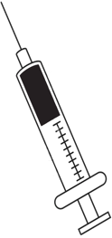
Group 1: Vaccines + ATI
Vaccination
Vaccination
Health Contact
Leukapheresis
Leukapheresis
Vaccination while on HIV medicine
Stopping HIV medicine for up to 6 months
Follow-up on HIV medicine
for at least 5 months
Study Month:
0
1
3
5
6
14
15
= clinic visit
22 to 30 visits spread out over about 14 months

Slide 41
ATI Considerations in Study Design
Adhered very closely to the 2019 consensus guidelines
Strict inclusion/exclusion criteria
Clear ART re-start rules
Inclusion of psychosocial impact questionnaires throughout study
ATI decision guide at screening
Counseling and PrEP referral for participant partner(s) if requested

Slide 42
Status of HIV Prevention Research
2019 ATI Consensus Guidelines
HVTN 807 Trial
Participant Perspectives
What is an Analytical Treatment Interruption?
B Cell Approaches
ATIs in Africa and LMICs

Slide 43
Participant ATI Perspectives in South Africa
Twenty community members participated in three focus groups
Strong motivating factor was to help discover an HIV cure
Concerns were similar to reported in other surveys
Negative health effects
Development of resistance
Transmission risk
Notable perspective on disclosure:
Participants should have the right to decide whether to inform their sex partners about their HIV status and ATI participation
Research teams should not make disclosure mandatory
Dubé HIV Res Clin Care 2023

Slide 44
2024 Analytical Treatment Interruption (ATI) Consensus Workshop
8-10 May 2024 ·Trademark Hotel, Nairobi, Kenya

Slide 45
New Criteria Not Previously Included in Recommendations
Upper age threshold:
Not necessary, as age-associated morbidities are in exclusion criteria; protocols should define age criteria based on the profile of investigational products being studied (69%)
Long-acting ART:
When available, define drug-specific recommendations based on established PK data for each long-acting agent (68%)
History of antiretroviral drug resistance or treatment failure:
Exclude only those who have no other options than their current regimen (30%)
Too context dependent; the study should follow local guidelines (24%)
Courtesy of Lydie Trautmann, presented at AIDS 2024
Percentages in parentheses represent the majority options voted on by the workshop attendees

Slide 46
Notable Suggested Revisions to ATI Trial Entry Criteria
 | 2019 | 2024
CD4 T cell count | ≥500 cells per μL | Region-specific thresholds
CD4 nadir | Exclusionary < 200 cells/mm3 | Non-exclusionary
h/o AIDS | exclusionary | Less restrictive
CD4 monitoring | Every 2 weeks | Every 4-12 weeks
STI monitoring | N/A, but monthly common | Every 8-12 weeks
Viral load ART restart criteria | >1,000 cps/mL x 4 wks | >1,000 cps/mL x 8 wks
Courtesy of Lydie Trautmann, presented at AIDS 2024

Slide 47
Pediatric ATI Trials
Placebo arm: ATI trials in infants, children and adolescents could include a placebo arm if there is a reasonable chance of success in any arm
Adolescents:
Can be included in ATI trials
Those with behaviorally acquired HIV, with appropriate resources in the research team, could be considered in adult ATI trials
Extensive psychosocial support for ATI study participants & families should be provided by personnel within the study team who have training in ATI studies
Courtesy of Lydie Trautmann, presented at AIDS 2024
Kuhn Lancet HIV 2024

Slide 48
Future of ATIs in HIV Prevention Research
Analytical treatment interruptions are an important tool in HIV research
2019 consensus guidelines outlined key risk mitigation strategies
HIV prevention research can also benefit from ATIs
Test proof-of-concept antiviral activity
Down-select products for efficacy trials
Make basic discoveries for immunogen design
ATIs are being used in broader populations: pediatrics and LMICs
Pendulum is swinging to make ATIs more permissive

Slide 49
Acknowledgements
Clinical trial participants and community advisory boards
HVTN 807 Team
James Kobie, UAB
Katie Bar, UPenn
Valeria Cantos, Emory Univ.
Fatima Laher, PHRU South Africa
Manuel Villaran, HVTN
Leo Stamatatos, UW/Hutch
HVTN 807 Protocol Team
Stephenson Group
Audrey Nathanson
Maura Crowley
Janet Morgan
Anthony Lee
Victoria Su
Thi Nguyen
HVTN Leadership
Larry Corey
Jim Kublin
CVVR / BIDMC
Dan Barouch
Mike Seaman

