Slide 1
Advances in HIV Programming and Research in Low-and Middle-Income-Countries: Opportunities and Challenges at University Teaching Hospital in Zambia
Dr Suilanji Sivile MD, MMed, MHS
Head of Infectious diseases unit
University Teaching Hospital Lusaka
National HIV Program Manager
Ministry of Health-Zambia
March 2025, University of Washingon, Seattle USA

Slide 2
No relevant conflict of interest to disclose

Slide 3
Objectives of the presentation
Brief outline of HIV response in Zambia
Brief outline of infectious diseases services at University Teaching Hospital
Brief overview of infectious diseases research opportunities at Lusaka University Teaching Hospital and Zambia National HIV Program landscape
Brief examples of research findings and their impact on policy and guidelines
Brief comment on the withdrawal of United States Government Aid

Slide 4
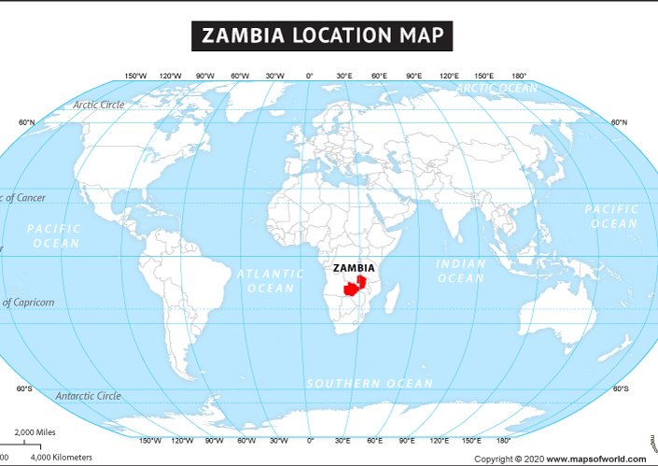
Introduction
Population: 20 million
Nominal GDP: USD 31 Billion
Mining and agriculture based economy
Culture: 72 indigenious ethnic groups
Religion: Christian Nation
Safety: Never been at war

Slide 5
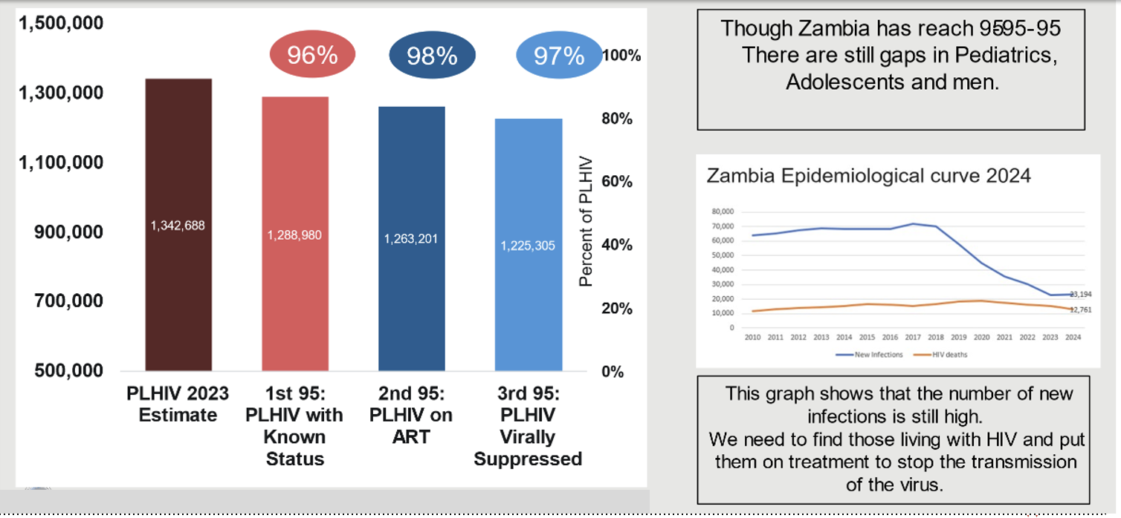
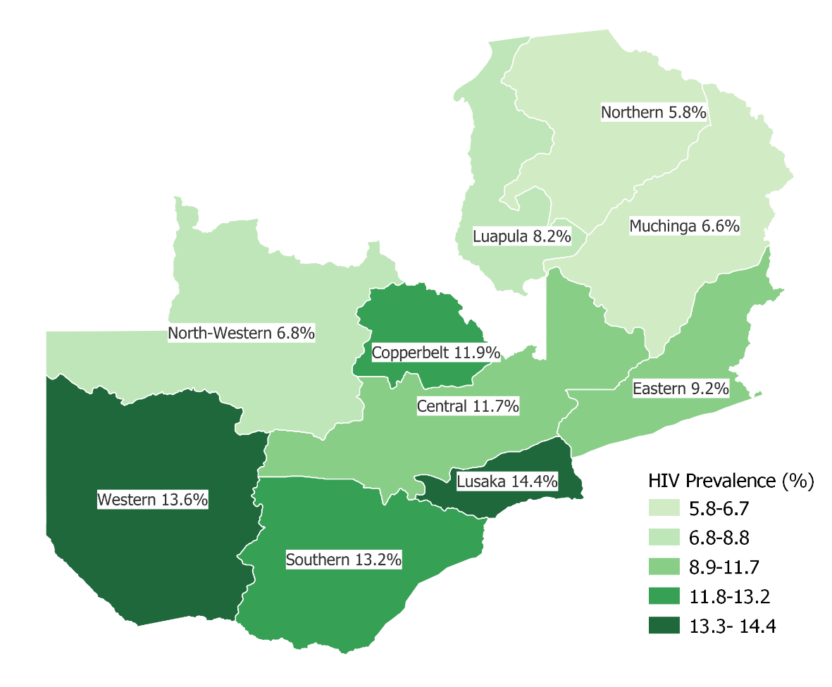
HIV Epidemic Overview
National HIV Prevalence at 11%
Generalised Epidemic
Transmission mostly Heterosexual
Key drivers
  Multiple concurrent sexual partners
  AGYW dis-empowerment
  Low awareness levels
  Partners of sexworkers
  Poor prevention services for Key populations
Low antiretroviral treatment coverage among children, men (24-34) and older individuals (<50years old)
PMTCT is 4- 6% Nationally
UNAIDS 2023 REPORT
Source: ZAMPHIA 2021. Data are for persons aged ≥15 years

Slide 6
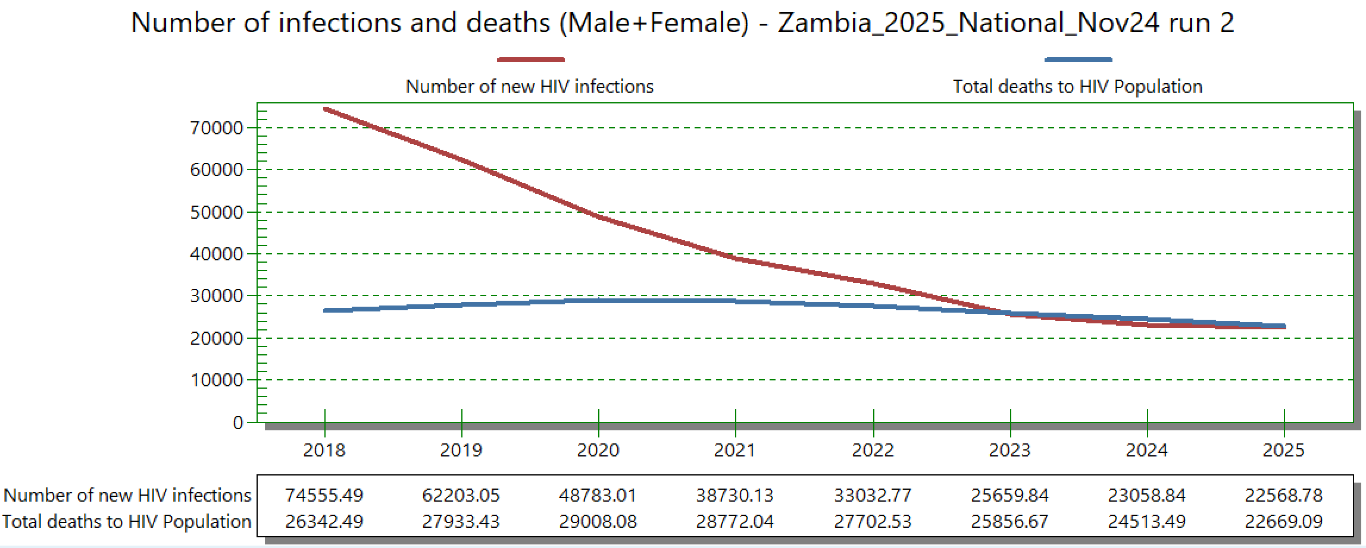
HIV Epidemic Overview
Trends in treatment current
98% of Cohort is on Tenofovir, Lamivudine and Dolutegravir
Retention is 96% of the cohort at national level
Incidence: 23,000 new case for year against a target of less than 15, 000 (spectrum estimates)
HIV accounts leading (18%) cause of deaths in the Zambia (IHME)

Slide 7
Major Gaps in HIV Repsonse and Research Opportunities in Zambia
Gaps
High Incidence of HIV especially among young women (15-24 year)
HIV services inequities for key populations and children
High HIV associated deaths
Need for person centered care to facilitate life long treatment
Ageing HIV cohort
Health systems to support response including health financing which is heavily donor dependant
HIV Research Opportunities
HIV Prevention research including long acting injectable PrEP
key populations and children related implementation research
HIV opportunistic infections and there outcomes including advanced HIV disease and care pathways
Non-communicable/ metabolics diseases in HIV including
  Pregnancy
  Breastfeeding
HIV treatment optimisation for life long treatment including Long acting agents
Health systems research, mathematical modeling for systems efficiencies

Slide 8
Overview of Infectious Diseases Division services at Lusaka University Teaching Hospital

Slide 9
Organisation of University Teaching Hospital
Ministry of Health
National HIV Program
Overall oversight of health services
University Teaching Hospital
(Infectious Diseases Division under Internal Medicine)
Infectious diseases clinical services
Linked to University of Zambia School Medicine, Levy Mwanawasa Medical University
University Teaching Hospital Research and Grants Center
Conduct research Activities
Linked to University Teaching Hospital HIV Access Program
National Public Health Institute
Separate board and Management

Slide 10
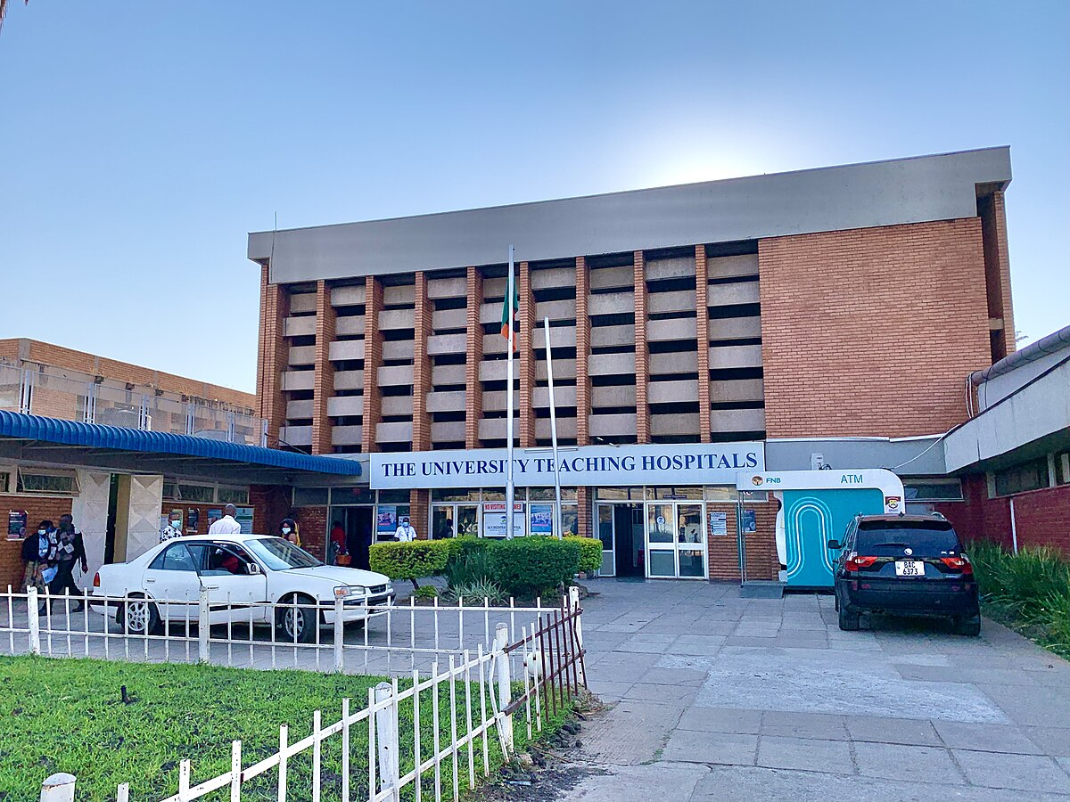
Infectious Disease Services Provided University Teaching Hospital Infectious Diseases Division
Support National HIV Program Management
Support national infectious diseases epidemic clinical response
In-patient general Infectious disease service
Infectious diseases consult service
HIV out-patient clinic
Advanced Treatment Center for HIV ( third line clinic)
Infectious Disease Research
Infectious Diseases Educations (Undergraduate and Postgraduate level)
HIV implementations Service
Travel clinic (vaccinations of yellow fever, C-19 etc)
HIV Tele-ECHO and Mentorship Program
2,000 bed capacity hospital is the site for trial
Country’s largest and most advanced tertiary hospital

Slide 11
Overview of Infectious Diseases Research Opportunities at Lusaka University Teaching Hospital and Zambia National HIV Program landscape

Slide 12
Categories of Research
Clinical Research
Epidemiological, disease outbreak control and global health security research
Implementational science research, Product introduction research and program implementations
Educational and Training Grants/Research
Basic Science Research including HIV cure/vaccine research

Slide 13
Opportunities in clinical Research
Competative advantages Lusaka University Teaching Hospitals
Presence of patients and infections diseases conditions
External validity for infectious diseases clinical requires enrolment from LMIC
Growing capable man-power, infrastructure and equipment
Relatively flexible redtape
Examples of Major Clinical Research
VISEND Trial
DATURA
EARNEST Trial
TAFRIF
ACTA Trial (Antifungal Combinations for Treatment of Cryptococcal Meningitis in Africa)
Tympani
AMR
PROMISE 1 and 2
CHAPAS
NL-PrEP
LC-Optimize (Zambia , Brazil, US, Canada)
LC-Revitalize ( repurposed L-C drugs in Zambia , Brazil, US, Canada and Uganda )

Slide 14
Opportunities in Clinical Research
Relevant HIV Clinical Research Questions
HIV treatment optimisations including use of long injectable agents
HIV and metabolic diseases outcomes
Salvage therapy for HIV
Optimisation of opportunistic infections diagnostics and treatment
HIV and AMR including HIV drug resistant
Co-morbidity disease progression and outcomes (KS, HPV, Cervical Cancer and Sars COV-2)
Collaborators and Sponsors
NIH sponsored
EDTCP
Wellcome trust
Pharmaceuticals ( e.g Gilead and Mylan/Viatris)
Philanthropist (e.g SILC foundation Erick schmidt)
Gates Foundation

Slide 15
VISEND: Wk 144 Efficacy of Switching From NNRTI-Based to PI-Based ART vs DTG + Recycled NRTIs
Randomized, open-label, noninferiority phase III study^{1,2}
In Wk 144 analysis, DTG + 3TC/TDF and DTG + FTC/TAF were noninferior to the combined PI/RTV arm¹
Wk 144 Results | HIV-1 RNA <1000 c/mL |  | HIV-1 RNA ≥1000 c/mL
 | DTG + 3TC/TDF (n = 209) | DTG + FTC/TAF (n = 209) | DTG + 3TC/TDF (n = 208) | DTG + FTC/TAF (n = 211) | LPV/RTV or ATV/RTV + 3TC/ZDV (n = 364)
HIV-1 RNA (ITT), % <1000 c/mL <50 c/mL | 88 84 | 87 81 | 83 75 | 79 71 | 67 58
Confirmed HIV-1 RNA rebound ≥1000 c/mL, n | 2 | 2 | 3 | 7 | 31
At least 1 major resistance mutation present, n | 0 | 0 | 0 | 0 | 15
Mean CD4 count, cells/mm³ (SD) | 539 (258) | 521 (237) | 396 (203) | 427 (207) | 388 (219)
1. Sivile. AIDS 2024. Abstr OAB3806LB. 2. Mulenga. CROI 2022. Abstr 135.
Notes:
3TC, lamivudine; ART, antiretroviral therapy; ATV, atazanavir; DTG, dolutegravir; FTC, emtricitabine; ITT, intention-to-treat; LPV, lopinavir; NNRTI, nonnucleoside reverse transcriptase inhibitor; NRTI, nucleos(t)ide reverse transcriptase inhibitor; PI, protease inhibitor; RTV, ritonavir; SD, standard deviation; TAF, tenofovir alafenamide; TDF, tenofovir disoproxil fumarate; ZDV, zidovudine.

Slide 16
Epidemiologic, outbreak control and global health security research

Slide 17
Epidemiologic, outbreak control and global health security research
Competative advantages Lusaka University Teaching Hospitals
We are a government institution and host a huge dataset and Biobank for a number of conditions
Strong links with health secudity and disease response systems ( National Public Health Institutes)
Growing capable man-power, infrastructure and equipment
Relatively flexible redtape
Examples of Major Research
HIV population impact surveys (ZAMPHIA 1 and 2)
COVID-19 Sero-surveys
COVID-19 outcomes studies
Burden of NCDs in HIV
COVID-19 vaccinations outcomes
Demographic health Surveys
Post Acute COVID-19 surveys
Burden of HIV co-morbidities ( TB Surveys, Renal Disease in HIV survey)
HIVDR resistant surveys
Collaborators and Funders
CDC
WHO
USAID
Global FUND
Africa CDC

Slide 18
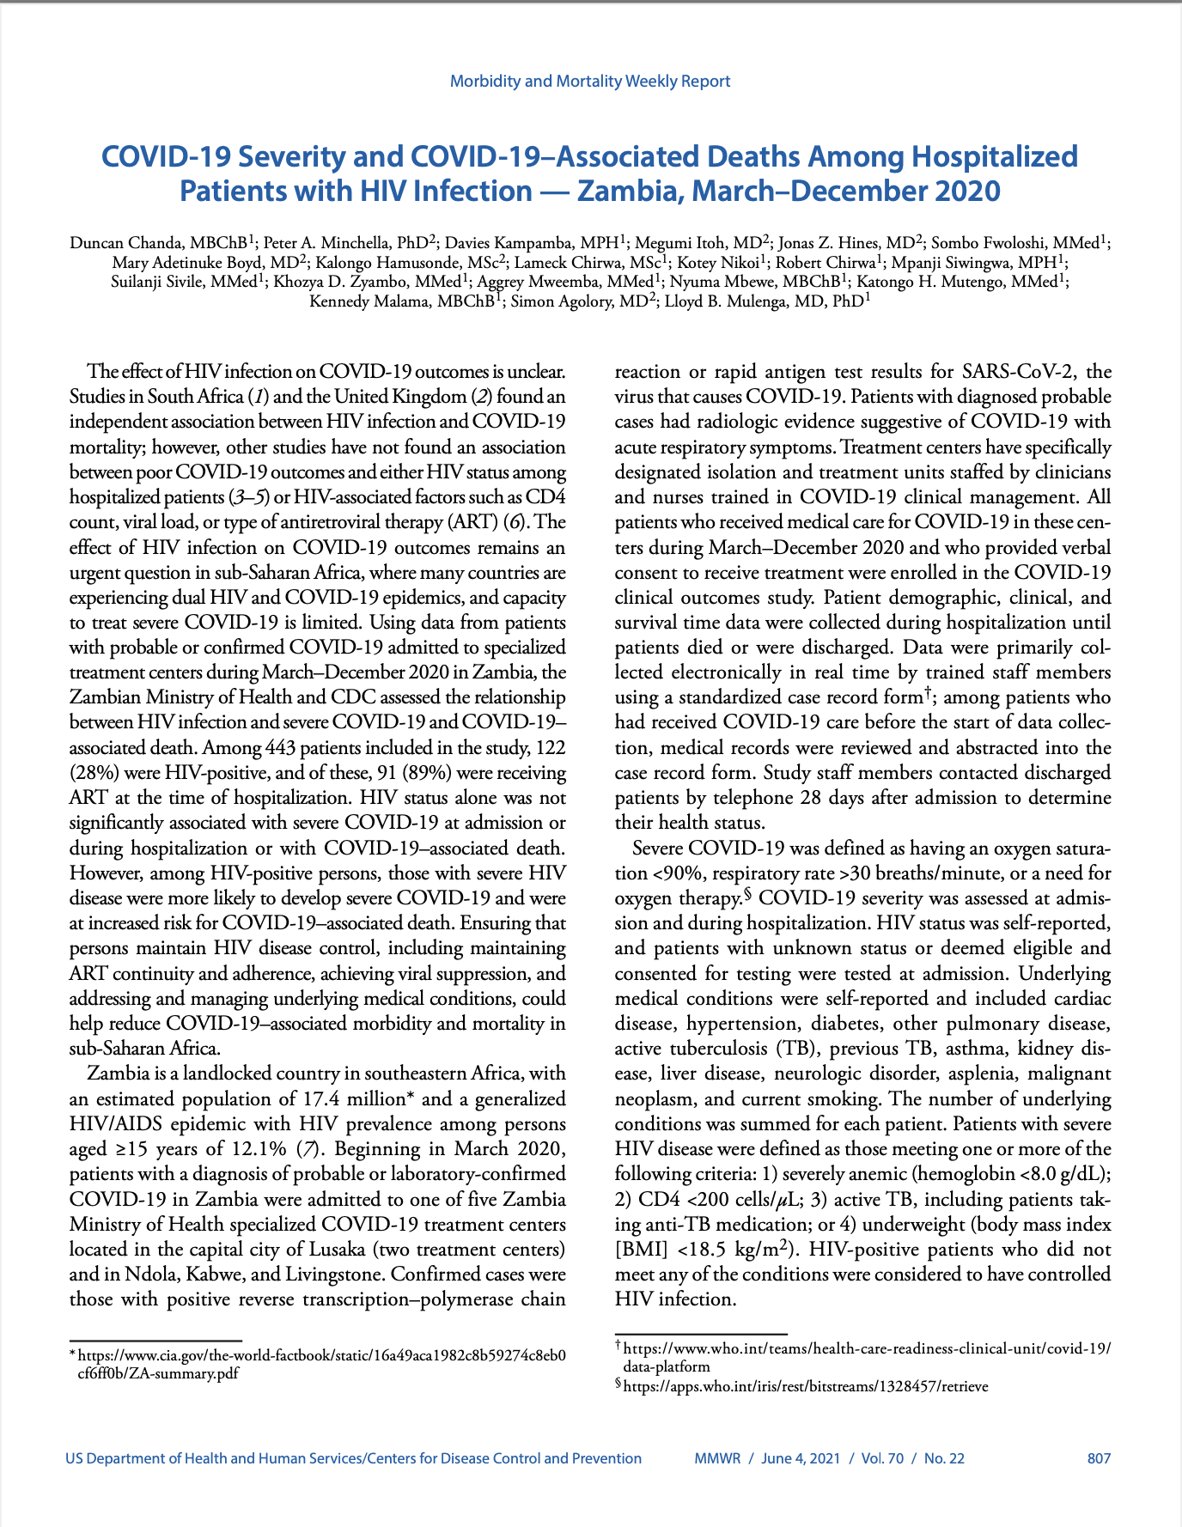
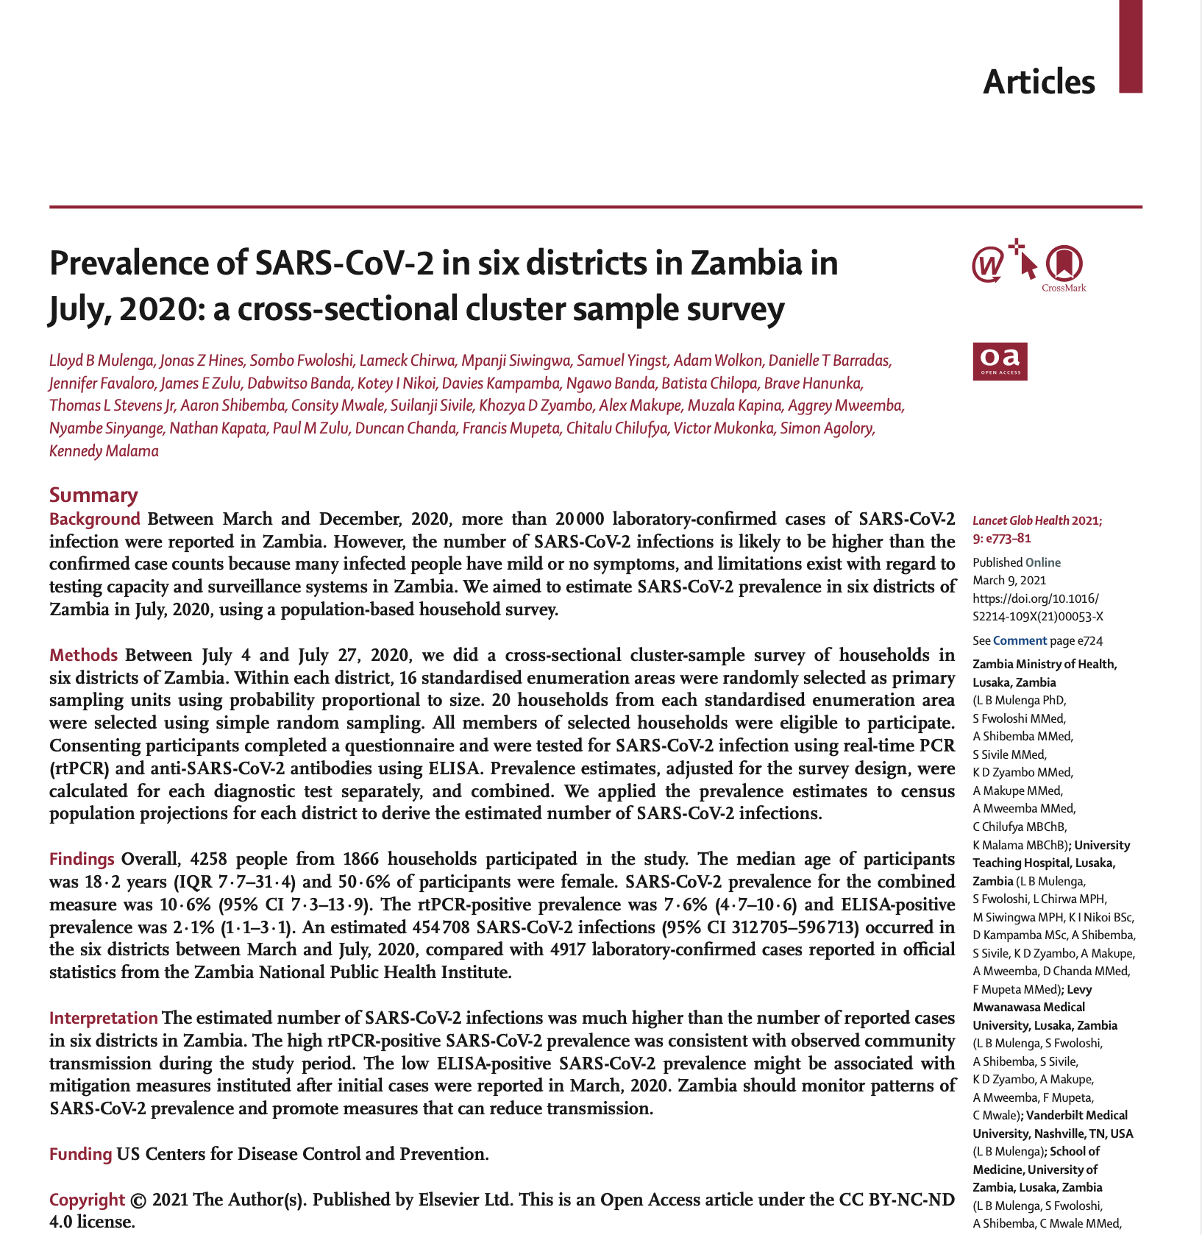

Slide 19
Implementational science research, product introductions research and program implementations

Slide 20
Implementational science research, product introductions research and program implementations
Competative advantages Lusaka University Teaching Hospitals
Program implementations is major responsibilities as a government arm
A lot of experience in implementing programs for a long time
We have a lot of manpower including community health workers
Relatively flexible redtape
Examples of Major Research
Advanced HIV package of care implementations project
ZENITH- Implementations science projects
Paxlovid product introductions
Darunavir for Second line Implementations
PEPFAR, Global Fund HIV programming projects across the cascade
Kola Study on AHD outcomes
ARROW Study on HIV Malignancies in Adolescents
Collaborators and Funders
CDC
WHO
USAID
Global FUND
UNITAID
CHAI
University of Maryland Baltimore
RTI

Slide 21
Educational and Training Grants/research

Slide 22
Educational and Training Grants/research
Competative advantages Lusaka University Teaching Hospitals
We house the infectious diseases division for University of Zambia, Levy Mwanawasa University and Zambia Specialist College
We have a lot of manpower and experience
Variety of installing the eductions program
Examples of Major Research
ZEPACT Project (HIV medicine training and Infectious diseases specialist training)
ZENITH- Implementations science projects
Exchanges programs with NYU, UMB, Vanderbilt, UAB, Copenhagen and others
Introducing Diploma in Tropical Medicine Course
Collaborators and Funders
Vanderbilt
London School of Hygiene and tropic medicine
New York University
Univerity Alabama at Birmingham
University of Maryland Baltimore
NIH
CDC/PEPFAR

Slide 23
Some Research findings and their impact on policy and guidelines
Use of Bactrim Prophylaxis in children
Transtioning to TLD without a viral load
Use of Short Regimen of Cryptococcal Treatment
TAF Introduction in the WHO guidelines and metabolic associated with TAF
Recycling of NRTIs with DTG
Advanced HIV Package for hospitalised Patients
Phasing out of NNRTIs
Repurposing for JAK Inhibitors for LC

Slide 24
Summary of research Work
Future of Research Work
Diversification of sponsor to include Philanthropists (eg Gates foundations), universities and Eastern world support
Expand basic science research
Expand data analytics and modeling
Challenges
Data analystics capabilities
Basics science laboratory studies
HIV cure studies and vaccines
Funding and Aids Freeze external threat

Slide 25
HIV SERVICE PROVISION IN ZAMBIA FOLLOWING USG AID FREEZE

Slide 26
Timeline of events over USG Aid Freeze
January 20th, 2025: President of the United States of America (POTUS) signed an Executive Order on Reevaluating And Realigning United States Foreign Aid Reevaluating And Realigning United States Foreign Aid – The White House
There has been mixed messages and unclear communication or guidance from the USG to the national HIV program and Implementing partners
Notes:
This

Slide 27
USG Supported Projects/Services

Slide 28
CDC Supported Projects
Health Projects Under USG support for period October 2024 to September 2025
Service Type | Receiving Institution | Geographical Coverage | Agency
Coordination, Policy Development, Mentorship and Training | MOH HQ | National | CDC
Coordination, Direct Service Delivery | Southern PHO | Southern | CDC
Coordination, Direct Service Delivery | Western PHO | Western | CDC
Coordination, Direct Service Delivery | Lusaka PHO | Lusaka | CDC
Coordination, Direct Service Delivery | North Western PHO | Northwestern | CDC
Coordination, Direct Service Delivery | Eastern PHO | Eastern | CDC
Surveillance, Health Security | ZNPHI | National | CDC
Direct Service Delivery, Research | UTH | UTH, National | CDC
DREAMS, HIV Prevention, Survey | Ciheb | Southern/National | CDC
Technical Assistance (TA) | CIDRZ | Lusaka | CDC
Technical Assistance | FHI 360 | Eastern | CDC
Technical Assistance | ICAP | Western | CDC
Technical Assistance | ICAP | North-Western | CDC
Community TA | DAPP | National | CDC
Laboratory TA | CIDRZ | National | CDC
Health Information TA | IHM | National | CDC
Community TA | Circle of Hope | Lusaka, Copperbelt | CDC
TA for Tuberculosis (TB) | PATH | Lusaka, Eastern | CDC
Community TA for TB | Community Partners | National | CDC

Slide 29
USAID Supported Projects
Health Projects Under USG support for period October 2024 to September 2025
Service Type | Receiving Institution | Geographical Coverage | Agency
Direct Service Delivery | PACT | Copperbelt,Central, Northwestern | USAID
Direct Service Delivery | Right to Care (Action HIV ) | Luapula, Northern, Muchinga | USAID
DREAMS, HIV Prevention | Discover Health | Lusaka, Central, Copperbelt | USAID
DREAMS, HIV Prevention | CIDRZ | Copperbelt, Northern | USAID
Supply Chain Management | PSM | National | USAID
TA for Tuberculosis | MOH HQ | National | USAID
TA for Tuberculosis | CIDRZ (TB-LON) | Southern, Lusaka, Central, Northern, Luapula, Muchinga, Copperbelt, Northwestern | USAID
Distribution of supplies | PASCO | National | USAID
Software management to ZAMMSA | PSM | National | USAID
HR support to ZAMMSA | PSM | ZAMMSA | USAID
Logistics Management System | eSCMIS | National | USAID

Slide 30
Other USG Supported Projects
Health Projects Under USG support for period October 2024 to September 2025
Service Type | Receiving Institution | Geographical Coverage | Agency
DREAMS, HIV Prevention | PeaceCorps | National | PeaceCorp
TA, Direct Service Delivery | CIDRZ | Lusaka, Copperbelt | DOD
Community TA | Community Partners (DAPP, Ciheb, NAC, CSOs) | National | Department of State
TA for Malaria elimination and vector control | PATH | National | Presidential Malaria Initiative (PMI)
TA for Malaria elimination and vector control | Evidence for Health | National | PMI

Slide 31
Health Facilities Providing HIV Services in Zambia
Current on Treatment | Number of facilities | No. facilities Cumulative | Percentage of facilities | Percentage of facilities cumulative | Tx Curr | Percentage of Tx Curr | Tx Curr Cumulative
> 5000 | 29 | 29 | 1% | 1% | 241,379.00 | 19% | 19%
3000-4999 | 45 | 74 | 2% | 3% | 167,936.00 | 13% | 31%
1000-2999 | 247 | 321 | 9% | 11% | 408,880.00 | 31% | 63%
500-999 | 272 | 593 | 9% | 21% | 188,461.00 | 14% | 77%
100-499 | 1054 | 1647 | 37% | 57% | 249,500.00 | 19% | 96%
1 - 99 | 1238 | 2885 | 43% | 100% | 47,344.00 | 4% | 100%
Total | 2,885 |  |  |  | 1,303,500.00
Facility type | Sex | Current on Treatment
Faith Based HF | Female | 48,730
Faith Based HF | Male | 29,490
Private | Female | 52,006
Private | Male | 34,117
Total |  | 164,344
ALL FACILITIES HAVE CONTINUED TO PROVIDE ART SERVICES WITH VARIATIONS IN SCOPE

Slide 32
Effect of USG Aid withdrawal on HIV services

Slide 33
Focus Area | Current situation | Mitigation Measure | Impact and request
Human Resource | All PEPFAR have been withdrawn Services requiring community based volunteers have the greatest impact | MoH staff have been reassigned to work in ART. | Reassigned staff are still inadequate in number and skill Other services like counseling , appointment and retention tracing have been suspended Urgenot supplementation of Human resource is required
Sample courier system | PEPFAR supported Project motor bikes and vehicles have been packed affecting inter and intra district sample courrier. No fuel funds for courier from PEPFAR | Districts are iimprovising transportation with ambulance , GRZ motor bikes and bicycles. | Many patients especially children and pregnant women will not have viral load tests done Mobilization of vehicles, motor bikes required urgently. Alternative fuel funds required

Slide 34
Focus Area | Current situation | Mitigation Measure | Impact and request
Laboratory services | DSD Lab staff withdrawn | Staff reassigned to the lab Selected Staff being oriented to work in the PCR LAB | Labs and PCR department will continue operating Fewer than ideal staff working on art samples Increase in TAT anticipated.
HIV Prevention Services and community services | VMMC providers and consumables withheld community HIV services have all been paused | Work with the existing MC providers while we plan to train more providers Maximise Utilization of global fund support | Feared increase in HIV incidence More CBVs are needed

Slide 35
Focus Area | Current situation | Mitigation Measure |  | Impact and request
Health information systems ,and monitoring and evaluation | Project laptops used for smart care have been withdrawn Smartcare on desk top still being used in a few high-volume facilities. Data clerks withdrawn | Few MoH data clerks redeployed Limited paper-based data collection | Only about 5% from 80% (for Luapula) of our facility will remain on smartcare Anticipating challenges in data management using paper-based documents. Loss of visibility of our program performance Urgent training and deployment of data clerks
Drug stock status at facility level | ARV - Only 3 months stock is available We have run out of DTG 50mg 1 month stock of 10 mg DTG is available | Districts to monitor closely ARV stock levels and submit weekly updates. ZAMMSA has promised to deliver more stock. | Use the available stock Address anxiety among RoC of the perceived/anticipated stock out

Slide 36
Sample Referral Support – Integrated Courier

Slide 37
PEPFAR Supported Wellness Centers with CSOs implementation
RECEIVING ORGANISATION | GEOGRAPHIC LOCATION
CDC & USAID (CIDRZ & CIHEB) | SOUTHERN AND COPPERBELT PROVINCES ( 8 Districts)
CDC,USAID (CIHEB, JSH) | WESTERN AND LUSAKA PROVINCES ( 6 Districts)
CDC,USAID | MUCHINGA, COPPERBELT AND EASTERN PROVINCES ( 6 Districts)
USAID (JSH) | LUSAKA PROVINCE ( 1 District )
CDC (CIDRZ) | LUSAKA PROVINCE ( 2 Districts)
CDC, USAID (CIHEB, CIDRZ) | LUSAKA, COPPERBELT & SOUTHERN PROVINCES (7 Districts)
USAID (JSH) | LUSAKA & CENTRAL PROVINCES ( 2 Districts)
32 wellness centers across the country have been closed
Over 20,000 KP are on ART
Over 15,000 KPs are on oral PrEP
Over 1,500 are on injectable PrEP

Slide 38
Immediate Recommendations for Continuity of HIV Services
Human Resource for Health (Health care worker and community based volunteers)
    Re-deployment of Health care workers in HIV service points
    Permanent employment by GRZ of PEPFAR supported staff
      Gradual manner
    Lobbying support from non-PEPFAR supported NGOs
    Leverage on HR support from GF and make re-distribution
Stabilise Laboratory and Pharmaceutical Commodity Supply chain
    Fast-tracking GRZ, Global Fund and CHAZ procurements in the pipeline
    Supplemental funding for laboratory commodities from GRZ
    Reprogramming of Global fund resources to commodities
    Withdrawal of free ARVs supplies to private clinincs

Slide 39
Immediate Recommendations for Continuity of HIV Services
3. Stabilize courier and distribution of commodities and Lab Samples
    Mobilisation of supplemental vehicles for commodity distribution from works and supply or defense forces etc
    Mobilize Supplemental funds for fuel for distribution and courier
    Intra-district/intra-provincial redistribution of vehicles/motor bikes from other GRZ and local government organs to assist with courier
4. Stabilise the health information system (SmartCare/eLMIS,LIMS)
    Urgent training/orientation of GRZ healthcare workers in SmartCare/eLIMS,LIMS
    Mobilisation of extra data clerks from non-PEPFAR supported partners
    Funding for licenses and internet services
    Short term hires for consultant IT experts for eLMIS/DISA/e-Labs
    Retrieval of data equipment from PEPFAR Partners for use

Slide 40
Medium-term Recommendations for Sustainability of HIV Services

Slide 41
Medium-term Recommendations for sustainability of HIV services
1. Pharmaceutical and laboratory commodities
  Local manufacturing of ARVs and other medical consumables
    Leverage on existing local capacity while technology transfer is promoted
  Inclusion of ARVs and TB drugs as part of the Health insurance package (NHIMA)
  Increase funding to cover the gap in the cost of ARVs/HIV and HIV laboratory commodity procurement
2. Health Information Systems
  Transition ownership of all health information systems to the government

Slide 42
Medium-term Recommendations for sustainability of HIV services
3. Human Resource for Health
  Increase the budgetary allocation for the annual recruitment of Health workers
  Incorporate HIV training in the Pre/In-services training curriculum
4. Commodity distribution & Courier system
  Sub-contracting of national commodity Distribution entity
  Expansion of point of care testing platforms in the districts
  Enhance the Integration of the courier with ZAMPOST

Slide 43
Long term Recommendations for Sustainability of HIV Services

Slide 44
Summary of Proposed Long-term Solutions:
SEVEN BROAD AREAS
Create Health Fund & Strengthen NHIS to take up HIV services
  Policy adjustments -Advocacy
Increase National Budget allocation for HIV services
  Constrained by current fiscal space (debt & climate issues)
Local Manufacturing of ARVs and other Commodities
Legal & Policy reforms to create an enabling environment
  For HIV service provision to KVP (protect HCW & recipients of care)
Re-design service delivery modalities as well as integrate services where feasible
  Will require assessments, guidelines etc.
Build resilient systems for health
  Storage & distribution infrastructure, lab diagnostic and monitoring capacity (QMS & LIS)
  Inter-operable information systems, government stewardship, acceptable coverage across HF, including communities
  Support community led actors in service delivery and monitoring-Social contracting
Private Sector Participation
  Leverage on comparative and competitive advantages across the areas (services & systems)

Slide 45
Immediate Recommendations for Continuity of HIV Services
Human Resource for Health (Health care worker and community basd volunteers)
    Re-deployment of Health care workers in HIV service points
    Short term recruitment of Health care Workers for HIV for continuity of Services
    Permanent imployement by GRZ
    Encouraging volunteers from CSOs
Stabilise Laboratory and Pharmaceutical Commodity Supply chain
    Fast-tracking GRZ, Global Fund and CHAZ procurements in the pipeline
    Supplemental funding for laboratory commodities from GRZ
    Reprogramming of Global fund resources to commodities
    Withdrawal of free ARVs supplies to private clininc s

Slide 46
Total Cost Needed Continue Services
Table 1.1: Costed Minimum HIV Services Package
Minimum HIV Services Package | Current Cost (US$) | Adjusted Cost (US$)
HIV/STI Testing Services | 380,000.00 | 152,000.00
HIV Prevention Services | 3,035,420.00 | 632,065.00
Prevention of Mother to Child Transmission (PMTCT) | 505,300.00 | 227,385.00
HIV Treatment and Care Services | 11,280,180.00 | 3,308,853.00
HIV Clinical Monitoring and Retention Services (Laboratory Services) | 8,549,086.00 | 1,409,463.00
Community HIV Services | 1,877,000.00 | 332,000.00
HIV Information Health Systems | 39,298,257.00 | 9,180,343.00
Pharmaceutical and Laboratory Commodities for HIV, TB and Malaria Services | 97,900,315.32 | 97,900,315.32
Donor Supported Staff (Site level and Above Site Level) | 55,253,072.00 | 34,510,264.00
Total (US$) | 218,078,630.32 | 147,652,688.32

Slide 47
Summary
University Teaching Hospital Research and Grants Institute lays on the intersectional of programmatic, clinical, implementational, educational and global security research.
University Teaching Hospital is ready for collaboration with in research with University of Washington.

Slide 48
Acknowledgements
Prof Lloyd Mulenga
Dr Sombo Fwoloshi
Dr Khozya Zyambo
Dr Duncan Chanda
Prof Adrienne Shapiro

Slide 49
-End-

