Slide 1
Uptake and Completion of Weekly Rifapentine and Isoniazid (3HP) vs. Isoniazid Preventive Therapy (6H) for TB prevention among People With HIV in western Kenya
UW/Fred Hutch Centre for AIDS Research (CFAR)
New Faces Talk March 6, 2025
Dickens O. Onyango¹; Jerphason Mecha²; Lilian N. Njagi²; Samson Aoro³; John Kinuthia³; Grace John-Stewart⁴; Sylvia M. LaCourse⁴
Affiliations: ¹Kisumu County Department of Health; ²Kenya Medical Research Institute; ³Kenyatta National Hospital; ⁴University of Washington

Slide 2
Background
1.7 billion infected with Mycobacterium tuberculosis globally (WHO 2024)
Annual risk of TB in people living with HIV (PLHIV) – 5%-10% (Akolo et al 2010)
TB preventive therapy (TPT) reduces risk of TB by up to 60% (Ayieko et al 2014)
Isoniazid preventive therapy (IPT) - poor uptake, suboptimal adherence and completion (Karanja et al 2020; Onyango et al 2022)
Kenya 2022: introduction of weekly INH with rifapentine for 3 months (3HP) – 15+ PLHIV
Development of novel INH adherence measures
Urine dipstick detecting INH urine metabolites - UW Dept for Bioengineering (Lutz Lab)
Validated in western Kenya (sensitivity 98%; specificity 95%) (Onyango et al 2024)
Has not been used to assess adherence to weekly 3HP

Slide 3
Objectives
Evaluate the programmatic TPT cascade for PLHIV (eligibility screening, uptake, and completion) comparing 6H vs. 3HP
Assess the feasibility of using a urine dipstick test in confirming adherence to weekly 3HP in PLHIV

Slide 4
Study site and design
Study site: 7 HIV clinics in Kisumu County
HIV prevalence – 17.5%
PLHIV ~120,000 people
Retrospective data review newly enrolled PLHIV from Jan 2022 through June 2023
Prospective cohort
Adherence assessment – cohort of 200 PLHIV on 3HP
Urine dipstick testing

Slide 5
Study participants
Category | Inclusion
Retrospective abstraction N=1930 | PLHIV aged ≥15 years Newly enrolled on care during study period With at least 12 months of follow up time
Prospective cohort N = 200 PLHIV | PLHIV aged ≥15 years Newly initiating 3HP Informed consent Followed up for 3 months

Slide 6
Retrospective data abstraction
Data source - medical charts and TPT registers
Strutured data abstraction tool - RedCap
Variables captured
Socio-demographic - age, sex, level of education and occupation
Clinical - WHO stage, viral loads within 6 months of enrolment in care, ART regimen
Screening for TPT eligibility
TPT initiation, TPT regimen
Completion (completion, loss to follow up, death or transfer out)

Slide 7
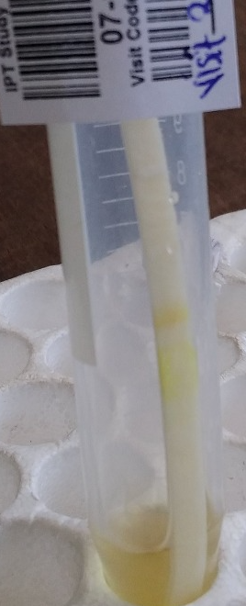
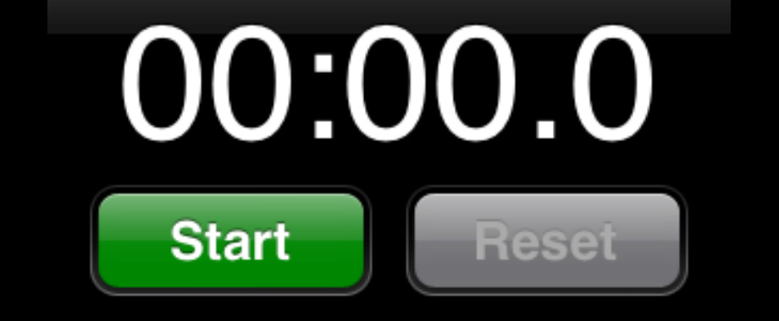
Adherence assesments
Self-reports of missed pills within the last 30 days
Dipstick - INH metabolites in urine react with biomarker to produce color change to bluish or purple
Urine dipstick assay – validated among CLHIV on 6H in western Kenya
Optimal adherence - positive dipstick at all time-points
Assesment | Month 1 | Month 2 | Month 3
Self-reports | X | X | X
Dipstick | X | X | X
Color change with INH metabolite detection within 48 hours
20 participants – 24 hourly serial testing for 7 days after a DOT 3HP dose

Slide 8
Data analysis
 | Retrospective | Prospective
Outcomes | Completion of cascade steps - Screening - TPT initiation - TPT completion - Comparison (6H vs. 3HP) –X² | Self-reported adherence – 80% of pills Biomarker-confirmed adherence
Correlates of non-initiation & non-completion | Poisson regression with generalized linear models Factors with p values of ≤0.1 included in multivariate analysis P-values of 0.05 considered significant | Consistent biomarker-confirmed adherence

Slide 9
Retrospective study results
6H vs. 3HP

Slide 10
Demographic characteristics
Characteristic | Number (%) [N=1930]
Median age (IQR) | 33 (27-41)
Sex
Male | 661 (34.2)
Female | 1269 (65.8)
Year of enrolment
2022 | 1062 (55.0)
2023 | 868 (45.0)
Highest level of education
Primary and below | 503 (30.0)
Secondary and above | 1171 (70.0)
Occupation
Formal employment | 236 (13.6)
Informal employment | 1120 (64.3)
Unemployed | 297 (17.1)
Student | 88 (5.1)

Slide 11
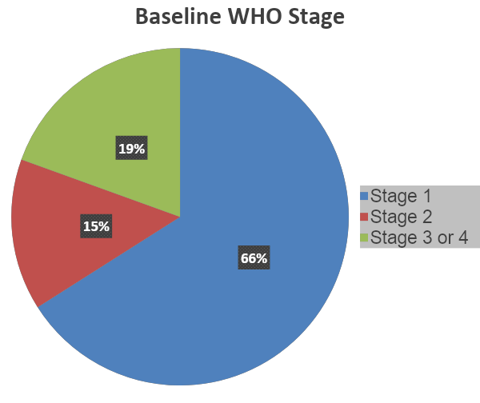
HIV clinical characteristics
Viral load available within 6 months of enrolment for 61% (n=1174)
Median VL – 50 cml; range – 0 to 461000
Suppressed (<200cml) 90% (n=1059)
Low detectable level (200-999 cml) 6% (n=66)
High-risk viraemia (≥1000cml)
4% (n=49)

Slide 12
Overview of participants
PHIV newly enrolled in care
(n=1930)
Not screened (n=8; 0.4%)
Screened for active TB
(n=1922; 99.6%)
Active TB
(n=132; 6.9%)
Eligible for TPT
(n=1,790; 97.5%)
Not initiated TPT (n=213; 21.9%)
Initiated TPT
(n=1577; 88.1%)
6H
(n=704; 44.6%)
3HP
(n=873; 55.4%)

Slide 13
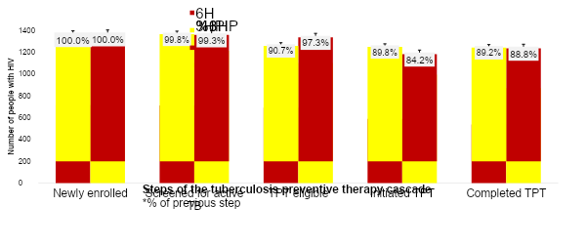
3HP vs. the 6H cascade
TPT initiation was significantly higher with 3HP than 6H period
(90% vs. 84%; p<0.001)

Slide 14
HIV treatment outcomes
HIV treatment outcome | Number (%)
Active on ART | 1,545 (80.1)
Loss to follow up | 161 (8.3)
Transferred out | 118 (6.1)
Died | 106 (5.5)
Cumulative mortality in 12 months
Never initiated TPT – 15.7 per 1,000
Iniated but not completed TPT – 12.6 per 1,000
Completed TPT – 4.5 per 1,000
Logrank (p<0.001)

Slide 15
Correlates of non-initiation of TPT
Correlate | Adjusted Risk ratio (95% CI) * | p-value
Educational level
Primary and below | 2.20 (1.64-2.94) | <0.001
Secondary | 1.52 (0.93-2.50) | 0.095
Tertiary | Ref
WHO Stage
Stage 1 or 2 | Ref
Stage 3/4 (AHD)** | 2.05 (1.44-2.92) | <0.001
Facility type
Non-referral hospitals | Ref
Large referral hospitals | 1.69 (1.25-2.29) | 0.001
*Adjusted for factors which were significant during bivariate analysis
**AHD – Advanced HIV disease

Slide 16
Correlates of 6H & 3HP non-completion
 | Six month regimen (6H) |  | Three-month regimen (3HP)
Coorrelate | Adjusted Risk ratio* (95% CI) | p-value | Adjusted Risk ratio* (95% CI) | p-value
WHO stage
Stage 1/2 | Ref |  | Ref
Stage 3/4 (AHD) | 4.89 (1.91-12.49) | <0.001 | 2.36 (1.04-5.37) | 0.04
Occupation
Informal employment |  |  | Ref
Formal employment |  |  | 2.42 (1.12-5.21) | 0.02
*Adjusted for factors which were significant during bivariate analysis
**AHD – Advanced HIV disease

Slide 17
Prospective cohort

Slide 18
Baseline characteristics N=200
Characteristic | Number (%)
Sex
Male | 65 (32.5%)
Female | 135 (67.5%)
Age category
15-24 years | 25 (12.5%)
25-34 years | 66 (33.0%)
35-44 years | 61 (30.0%)
45+ years | 48 (24.0%)
Level of Education
Primary | 76 (38.0%)
Secondary/tertiary | 124 (62.0%)
Marital Status
Single/Divorced/Separated/widowed | 96 (48.0%)
Married/living with partner | 104 (52.0%)
HIV service category
Standard of care | 181 (90.5%)
Differentiated models | 19 (9.5%)
CD4 count, median (IQR) | 311.0 (165.0, 556.0)
WHO Stage
Stage 1 | 121 (60.5%)
Stage 2 | 53 (26.5%)
Stage 3/4 (AHD) | 26 (13.0%)

Slide 19
Adherence assessments
Enrolled (n=200)
Died/LTF (1%; n=2)
Adherence assessed (99%; n=198)
Completed (80%; n=158)
Dead/LTF (2%; n=4)
Active follow up (18%; n=36)

Slide 20
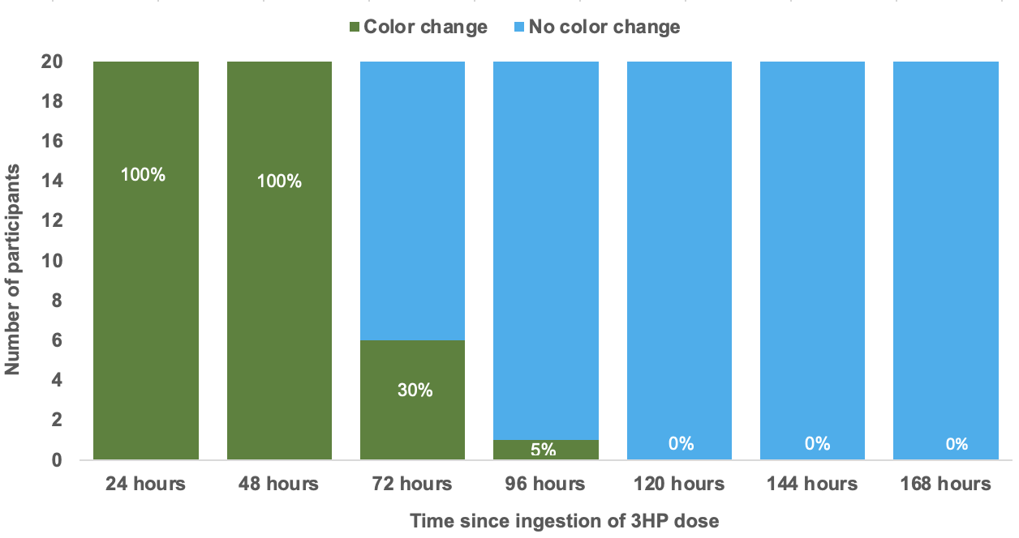
Urine dipstick positivity after DOT 3HP dose

Slide 21
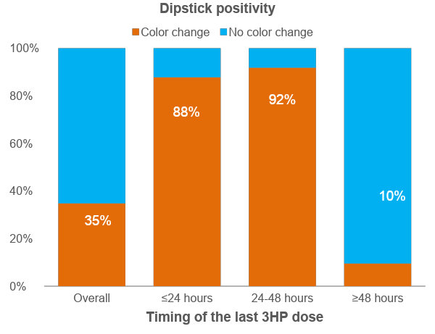
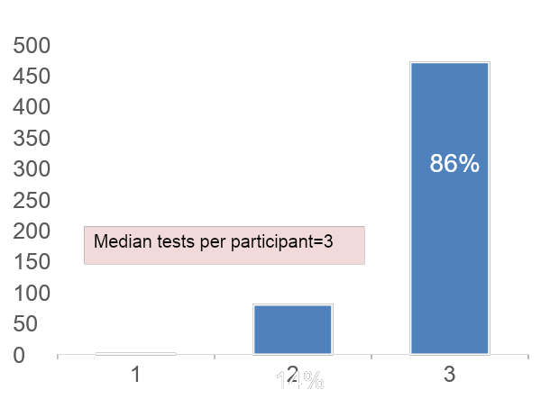
Dipstick positivity following self-administered 3HP
198 PLHIV had 552 dipsticks conducted
≤48 hours 89%

Slide 22
Urine dipstick results versus self-reported adherence
 | Missed 3HP dose |  | Proportion of 3HP doses ingested
Dipstick color change | No | Yes | ≥80% | <80%
 | n=510 | n=42 | n=82 | n=470
No | 328 (64.3) | 32 (76.2) | 0 (0) | 360 (76.6)
Yes | 182 (35.7) | 10 (23.8) | 82 (100) | 110 (23.4)

Slide 23
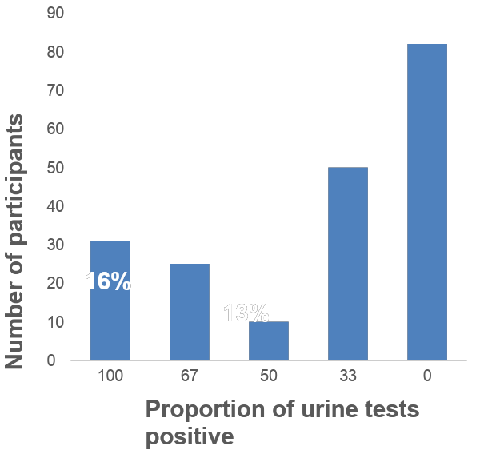
Consistent biomarker-confirmed adherence
Timing of dose prior to dipstick | Month 1 | Month 2 | Month 3
≤48 hours | 63 (32%) | 62 (32) | 50 (31)
>48 hours | 135 (68%) | 133 (68) | 112 (69)
Total | 198 (100) | 195 (100) | 162 (100)
41%
25%
5%

Slide 24
Conclusions – 3 HP vs. 6H
3HP implementation significantly increased TPT initiation.
Completion rates were high and adverse events leading to discontinuation were low and similar for 3HP and 6H.
TPT non-completion was substantially higher among PHIV with AHD for both regimens.
3HP non initiation and non-completion was associated with:
Advanced HIV disease
Facility type
Interventions are needed to support treatment completion among PHIV with AHD and referral facilities

Slide 25
Conclusions – adherence to 3HP
The urine dipstick test can be used to assess adherence to 3HP
However, majority of PHIV report taking 3HP >48 hours before routine 3HP refill visits
Routine urine biomarker confirmation of adherence to 3HP may require community testing strategies

Slide 26
Acknowledgements
This study was supported by funding from the Firland Foundation
Research assistants who diligently abstracted data PHIV who participated in this study
TBHTP/D43 (PI Tom Hawn) for supporting my travel
CFIR MIIA
The Lutz lab – Prof. Barry Lutz; Nuttada Panpradist; Daniel Leon; Annika Sahota
Mentors – Dr. LaCourse, Dr. John-Stewart, Dr. Kinuthia

Slide 27
Thank you!

Slide 28
References
World Health Organization. Global tuberculosis report 2024.
Akolo C, Adetifa I, Shepperd S, Volmink J. Treatment of latent tuberculosis infection in HIV infected persons. Cochrane database of systematic reviews.
Ayieko J, Abuogi L, Simchowitz B, Bukusi EA, Smith AH, Reingold A. Efficacy of isoniazid prophylactic therapy in prevention of tuberculosis in children: a meta–analysis. BMC infectious diseases. 2014;14(1):1-10
Karanja M, Kingwara L, Owiti P, Kirui E, Ngari F, Kiplimo R, et al. Outcomes of isoniazid preventive therapy among people living with HIV in Kenya: A retrospective study of routine health care data. PloS one. 2020;15(12):e0234588.
Onyango DO, Sande MABvd, Yuen CM, Mecha J, Matemo D, Oele E, et al. Drop-offs in the isoniazid preventive therapy cascade among children living with HIV in western Kenya, 2015-2019. Journal of International AIDS Society. 2022.
Onyango DO, van der Sande MAB, Yuen CM, Were J, Mecha J, Njagi LN, Panpradist N, Matemo D, Leon D, Lutz B, Kinuthia J, John-Stewart G, Lacourse SM. Biomarker-confirmed suboptimal adherence to isoniazid preventive therapy among children with HIV in western Kenya. AIDS. 2024 Jan 1;38(1):39-47. doi: 10.1097/QAD.0000000000003719. Epub 2023 Sep 28. PMID: 37773037; PMCID: PMC10840836.

Slide 29
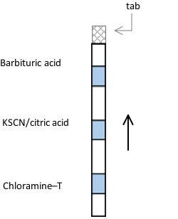
Metabolite of INH can be detected in urine
Development of low-cost urine INH dipstick - modified Arkansas method (Amlabu et al 2014)
UW BioEngineering (Lutz lab) optimized stoichiometry by reversing reagent order
Lower concentration of reagents required (safer)
Less costly compared to commercial tests
Potassium thiocyanate + chloramine T → cyanogen chloride
Splits INH metabolites (isonicotinic acid) → glutaconaldehyde derivative
Condenses with barbituric acid → dark blue polymethine dye
Notes:
SML Would move to end as extra slide and don’t present unless questions arise
In collaboration with the Lutz lab at the University of Washington Department of Bio Engineering we developed a low cost calorimetric urine dipstick using a modified Arkansas method, which leverages a series of chemical reactions as urine wicks up the dipstick.

