Slide 1
Cancer and HIV in East and Southern Africa
The Pathway to integrated SERVICE delivery
CFAR New Faces Talk, April 2025
Michalina Montaño, PhD, MS
Vaccine and Infectious Diseases Division, Fred Hutchinson Cancer Center
mmontano@fredhutch.org

Slide 2
Dual burden of HIV and Cancer
Burden of cancer is increasing, as people with HIV are living longer due to expansion of access to ART
People living with HIV at higher risk of developing certain cancers
Cancer-specific morbidity and mortality is higher among people living with HIV
Consistent engagement in HIV care and continuation of ART integral to successful cancer treatment

Slide 3
Resulting recommendations and guidelines
Integration of NCD screening and management within HIV primary care settings
Co-management of HIV and cancer care, including uninterrupted ART during cancer therapy and involvement of HIV specialists in oncology care management

Slide 4
Siloed services, limited cancer treatment facilities
HIV CARE DELIVERY
  Primary care settings
  Widely available, proximal to people’s homes
  Utilized to improve access to some types of NCD care
CANCER TREATMENT DELIVERY
  Hospital settings
  Limited locations with radiotherapy and oncology capacity
  Often require travel

Slide 5
A New Goal:
Integrate HIV Service Delivery and support engagement in HIV care in Oncology care settings

Slide 6
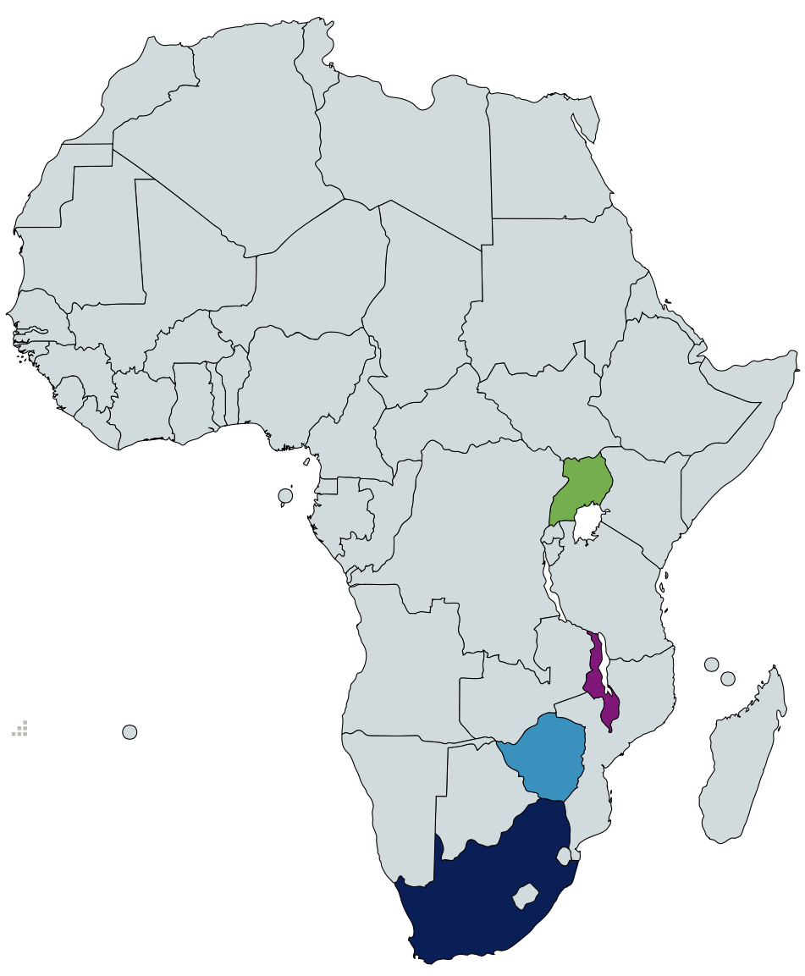
ESTABLISH PARTNERSHIPS - Consortium Building
UGANDA CANCER INSTITUTE
Dr. Nixon Niyonzima, cancer treatment, diagnostics
Dr. Noleb Mugisha, cancer treatment, care continuum
South Africa
UNC PROJECT – MALAWI; KAMUZU CENTRAL HOSP.
Dr. Maganizo Chagomerana, cancer epidemiology
Dr. Agatha Bula, qualitative research
WITS HEALTH CONSORTIUM; CHARLOTTE MAXEKE JO’BURG ACADEMIC HOSPITAL
Dr. Maureen Joffe, breast cancer and HIV
UNIVERSITY OF ZIMBABWE; PARIRENYATWA HOSPITAL
Dr. Margaret Borok, KS and other HIVAM
Dr. Ntokozo Ndlovu, cancer treatment, care continuum

Slide 7
Understand HIV Documentation in oncology records
Measure the burden of HIV among patients at cancer treatment centers

Slide 8
HIV-related information in Cancer records
Year(s) | Malawi N=1,648 2018-19 | South Africa N=1,044 2018-19 | Uganda N=1,137 2015 | Zimbabwe N=1,135 2018-19
HIV Status Availability, n (%) Available Not Available | 362 (22.0) 1286 (78.0) | 957 (91.7) 87 (8.3) | 805 (70.8) 332 (29.2) | 980 (86.3) 155 (13.7)
HIV Status, n (%) HIV Positive HIV Negative | 171 (47.2) 191 (52.8) | 232 (24.2) 725 (75.8) | 257 (31.9) 548 (68.1) | 366 (37.3) 614 (62.7)

Slide 9
HIV-related information in Cancer records
Year(s) | Malawi N=1,648 2018-19 | South Africa N=1,044 2018-19 | Uganda N=1,137 2015 | Zimbabwe N=1,135 2018-19
HIV Status Availability, n (%) Available Not Available | 362 (22.0) 1286 (78.0) | 957 (91.7) 87 (8.3) | 805 (70.8) 332 (29.2) | 980 (86.3) 155 (13.7)
HIV Status, n (%) HIV Positive HIV Negative | 171 (47.2) 191 (52.8) | 232 (24.2) 725 (75.8) | 257 (31.9) 548 (68.1) | 366 (37.3) 614 (62.7)
ART Status, n (%) On ART Not on ART Not Documented | -- -- -- | 219 (96.9) 6 (2.7) 1 (0.4) | 214 (83.3) 36 (14.0) 7 (2.7) | 350 (95.6) 7 (1.9) 9 (2.5)

Slide 10
Characteristics associated with documented HIV status
Older age, less likely to have HIV status documented
  aPR for age 60+ vs. age 40 ranged from 0.7 (Malawi) to 0.8 (Zim); p<0.01
Infection-related cancer, more likely to have HIV status documented
  aPR ranged from 1.2 (Zim) to 1.9 (Malawi); p<0.001

Slide 11
HIV-related information in Cancer records
Year(s) | Malawi N=1,648 2018-19 | South Africa N=1,044 2018-19 | Uganda N=1,137 2015 | Zimbabwe N=1,135 2018-19
HIV Status Availability, n (%) Available Not Available | 362 (22.0) 1286 (78.0) | 957 (91.7) 87 (8.3) | 805 (70.8) 332 (29.2) | 980 (86.3) 155 (13.7)
HIV Status, n (%) HIV Positive HIV Negative | 171 (47.2) 191 (52.8) | 232 (24.2) 725 (75.8) | 257 (31.9) 548 (68.1) | 366 (37.3) 614 (62.7)
Imputed HIV Prevalence, range | 42.2 - 47.5% | 23.7 - 24.6% | 27.3 – 32.7% | 33.8 - 35.2%
General HIV Prevalence, 15-49 | 8% | 19% | 6% | 12%

Slide 12
HIV-related information in Cancer records
Year(s) | Malawi N=1,648 2018-19 | South Africa N=1,044 2018-19 | Uganda N=1,137 2015 | Zimbabwe N=1,135 2018-19
HIV Status Availability, n (%) Available Not Available | 362 (22.0) 1286 (78.0) | 957 (91.7) 87 (8.3) | 805 (70.8) 332 (29.2) | 980 (86.3) 155 (13.7)
HIV Status, n (%) HIV Positive HIV Negative | 171 (47.2) 191 (52.8) | 232 (24.2) 725 (75.8) | 257 (31.9) 548 (68.1) | 366 (37.3) 614 (62.7)
Imputed HIV Prevalence, range | 42.2 - 47.5% | 23.7 - 24.6% | 27.3 – 32.7% | 33.8 - 35.2%
General HIV Prevalence, 15-49 | 8% | 19% | 6% | 12%
General HIV Prevalence, 50+ | 13% | 13% | 9% | 18%

Slide 13
Understand process of cancer and HIV care delivery identify intersections between cancer and HIV processes

Slide 14
Process mapping locations
Uganda Cancer Institute
The AIDS Support Organisation (TASO), Mulago
South Africa
Kamuzu Central Hospital – Malawi National Cancer Centre
Lighthouse Trust HIV Clinic
Soweto Comprehensive Cancer Centre
Chris Hani Baragwanath Academic Hospital HIV Clinics
Parirenyatwa Hospital Radiotherapy Centre
Parirenyatwa Hospital HIV Family Care Centre

Slide 17
Inclusion of HIV-related information in Cancer records
HIV status
  Documented from patient-held records or self-report
  HIV testing ordered if clinically relevant
CD4 and HIV VL
  Noted from patient-held records if available
  Ordered for cancer treatment planning

Slide 18
HIV and Cancer services more integrated in RSA
HIV viral load monitoring done by oncologists
Electronic medical record system enables access to test results by both HIV and cancer providers

Slide 19
HIV services with limited availability at cancer treatment centres
HIV-specific counseling
Services for ongoing management of ART, e.g. for refills or adjusting ART regimens

Slide 20
Understand cancer care provider perspectives about integrated HIV and Cancer service delivery

Slide 21
Characteristics of Respondents to Provider Questionnaire, (N=195)
Site, n (%) Malawi South Africa Uganda Zimbabwe | 57 (29) 42 (22) 39 (20) 57 (29)
Role at Cancer Center, n (%) Counsellor Data Clerk Medical Officer Nurse Pharmacist Physician Research Staff Otherª | 8 (4) 6 (3) 27 (14) 96 (49) 10 (5) 20 (10) 8 (4) 20 (10)
Directly provide cancer treatment or clinical care, n (%) | 165 (85)
ªIncludes administrators, laboratory personnel, medical records officers, patient navigators, and radiographers

Slide 26
Barriers to HIV service delivery in cancer care settings
Workspace limitations
Disruptions to existing workflow
Availability of staff to provide HIV-related services
Lack of resources for patients
Cost to cancer center; cost to patients

Slide 27
Qualitative Phase: In-Depth Interviews
61 in-depth interviews conducted across 4 sites
Broad support for integrating HIV and cancer management
HCPs felt underprepared and undertrained to manage dual complexities of HIV and cancer

Slide 28
Key differences in treatment of clients with HIV & cancer
Concerns about drug-drug interactions necessitate cautious approach to cancer treatment
Reliance on CD4 counts in cancer treatment decision-making, with modified chemotherapy regimens for those with lower CD4

Slide 29
Possible misalignment between cancer decision-making and guidelines for HIV management
HIV guidelines since 2018 recommend integrase-based regimens as first-line ART, vs. prior recommended efavirenz- and protease-inhibitor-based regimens
CD4 monitoring deprioritized in favor of viral load monitoring, esp. after established in care and stably on ART

Slide 30
Summary
PWH are 25-40% of patients at cancer treatment centres
Existing processes for documenting HIV-related clinical information, and links between siloed services
Most cancer providers support more integrated service delivery
Concerns about providing cancer care to PWH, feeling underprepared for clinical management of these clients

Slide 31
More research questions => Current and (Hopefully) Future projects

Slide 32
What about perspectives of people with HIV and Cancer?
Longitudinal study to measure barriers to accessing and adhering to concurrent HIV and cancer treatment, how these barriers change over duration of cancer treatment, impact on cancer treatment completion and outcomes
Pre-post quasi experiment to develop and test locally-developed strategies for supporting HIV care engagement

Slide 33
Future Study: Guidelines for HIV and cancer management
How can we improve guideline concordance?
Are there disparities in prescribed cancer therapy across CD4 count; and do they impact treatment initiation/length/response, survival?
How clinically important is CD4 count for oncology decision-making?

Slide 34
Future Study: Integrating HIV and cancer service delivery
No one-size-fits-all approach
Implementation strategy to enable tailoring micro-interventions to health system context
Measure impact of integrating care delivery on HIV and cancer clinical outcomes

Slide 35





Acknowledgements
Rachel Bender Ignacio, MD, MPH
Margaret Borok, MBChB, FRCP
Ntokozo Ndlovu, MBChB, MMed
Maganizo Chagomerana, PhD, MS
Agatha Bula, PhD, MPH, RN
Maureen Joffe, PhD
Nixon Niyonzima, MBChB
Noleb Mugisha, MBChB
Cyrus Mugo, MBChB, PhD, MPH
Liz Chiao, MD, MPH
Gabrielle O’Malley, PhD, MA
Anjuli Wagner, PhD, MPH
Katrina Ortblad, ScD, MPH
Renee Heffron, PhD, MPH
Collaborators and study teams in Uganda, Zimbabwe, South Africa, Malawi, Kenya, USA
Funding from NCI, NIAID, NIMH

