Slide 1
Reducing AIDS deaths by preventing opportunistic infections
April 3, 2025
Radha Rajasingham, MD
Associate Professor
Division of Infectious Diseases

Slide 2
Outline
Current state of HIV pandemic
Advanced HIV disease
Clinical trial evaluating new diagnostics
Validation
Clinical impact
Markers for poor clinical outcomes

Slide 3
BACKGROUND

Slide 4
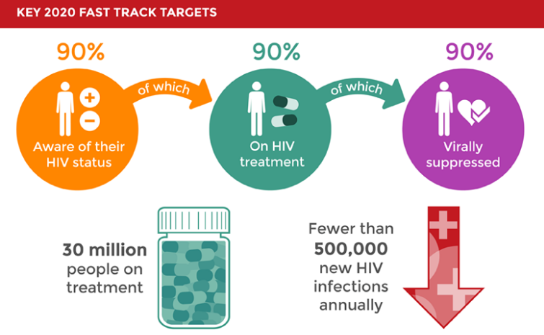
End AIDS by 2030
Notes:
International goal to end AIDS
AIDS-related deaths
AIDS-related deaths have been reduced by more than 55% since the peak in 2004.
In 2018, around 770 000 [570 000–1.1 million] people died from AIDS-related illnesses worldwide, compared to 1.7 million [1.3 million–2.4 million] in 2004 and 1.2 million [860 000–1.6 million] in 2010.
AIDS-related mortality has declined by 33% since 2010

Slide 5
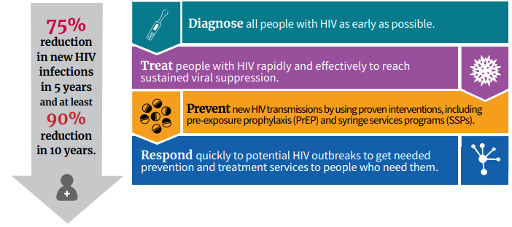

Slide 6
New HIV infections globally
Source: UNAIDS 2024 epidemiological estimates

Slide 7
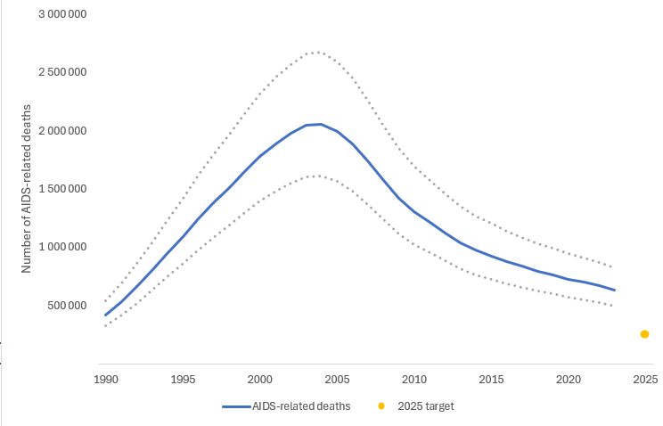
Global AIDS Deaths: 630,000 deaths in 2023
Source: UNAIDS 2024 epidemiological estimates
Notes:
AIDS deaths
2004: 1.7 million
2019: 690,000 -64% in Sub Saharan Africa
2020 goal: <500,000
2025 goal is <250,000

Slide 8
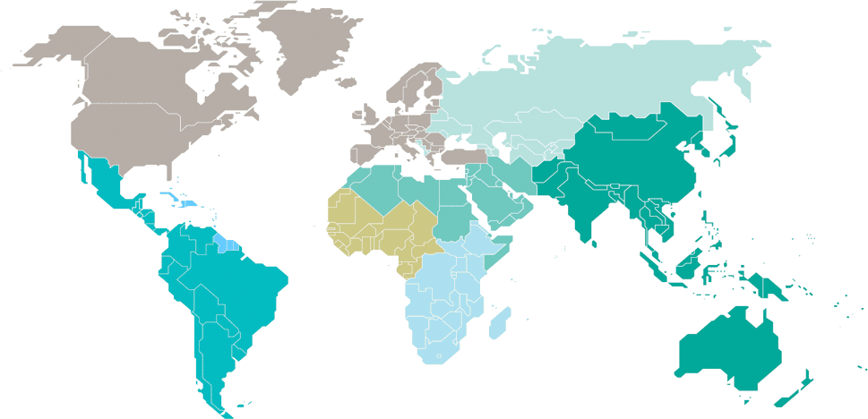
Estimated adult and child deaths from AIDS  2023
Eastern Europe and central Asia
44 000
[35 000–54 000]
North America and western and central Europe
13 000
[9400–17 000]
Caribbean
5100
[3500–7400]
Middle East and North Africa
6200
[4100–9400]
Western and central Africa
130 000
[100 000–170 000]
Asia and the Pacific
150 000
[110 000–200 000]
Latin America
30 000
[27 000–42 000]
Eastern and southern Africa
260 000
[210 000–330 000]
Total: 630 000 [500 000–820 000]
Source: UNAIDS 2024 epidemiological estimates

Slide 9
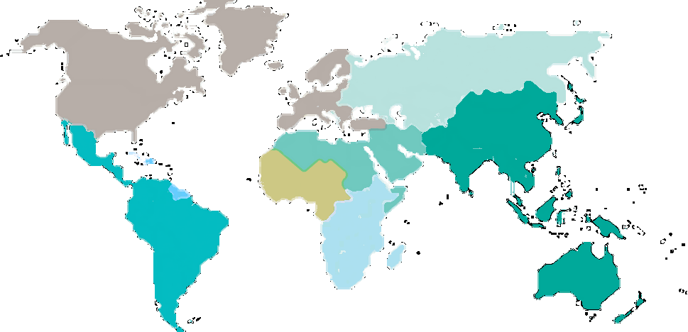
Advanced HIV Disease: CD4<200 cells/mcL
30-40% of people starting ART in LMICs

Slide 10
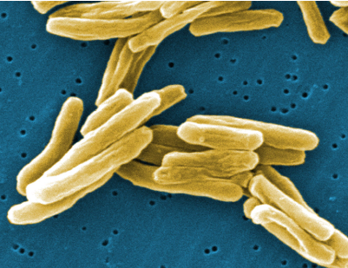
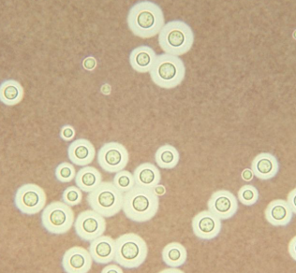
Advanced HIV disease
High risk for infections & death
1. TB
2. Cryptococcal infection
3. Bacterial infections

Slide 11
AN ENHANCED PACKAGE OF CARE TO REDUCE MORTALITY IN ADVANCED HIV DISEASE (ENCORE)
PI: Radha Rajasingham
Co-investigators: Elizabeth Nalintya, David Meya, David Boulware
R01AI162181

Slide 12
Background
WHO recommends baseline CD4 testing to identify people with advanced HIV disease
However, CD4 testing has been de-emphasized, in favor of HIV viral load monitoring
Lack of pre-ART CD4 is associated with higher mortality
Deaths typically occur within 90 days of ART initiation suggesting unmasking of OIs
Notes:
Data from 23 clinics in and around Kampala from 2019 showed 27% of people presenting to clinic have a CD4<200.
Lack of pre-ART CD4 testing is associated with higher mortality among persons with advanced HIV disease. In a cohort of > 39,000 HIV Zambian patients starting ART, absence of pre-therapy CD4 testing conferred a 45% increased hazard of death during the first year.²⁰ Most such deaths occurred within 90 days of ART initiation, which supports unmasking of OIs as a potential cause of death.
Despite test and treat, 30 to 40% of PLWH present to care with advanced HIV disease (CD4<200)
High risk for OIs, IRIS, morbidity, mortality
The WHO recommends baseline CD4 testing to identify people with advanced HIV disease for screening and prophylaxis
However CD4 testing has been de-emphasized, in favor of viral load testing
Lack of pre-ART CD4 testing is associated with higher mortality among people with advanced HIV disease
Deaths typically occur within 90 days of ART initiation –suggesting unmasking OIs as cause of death

Slide 13
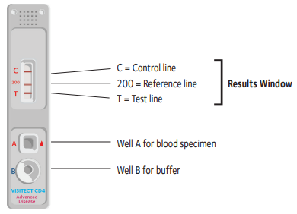
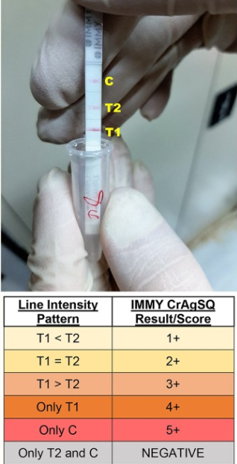
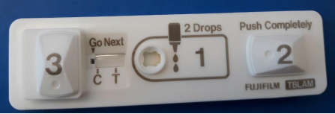
New point-of-care tests for advanced HIV
Visitect CD4
Fujifilm SILVAMP TB LAM
CrAg SQ
Notes:
Instrument free
Result semi-quantitative (above or below 200 cells/µL) in 40 minutes
Requires 30µL of blood (i.e., a finger prick)
Read visually
Requires no electricity
Can be stored at room temperature
Costs ~$6 per test
WHO prequalified
Fujifilm TB TB LAM
Sensitivity 70% PLWH
Specificity 91%
Need for prospective trials to understand affordability, user acceptability, and impact
CrAg SQ LFA
98% sensitivity and 98% specificity
Titer in real time
Requires 40µL of sample
Read in 10 minutes
Estimated cost $3.50
Implementation and impact have not been studied prospectively

Slide 14
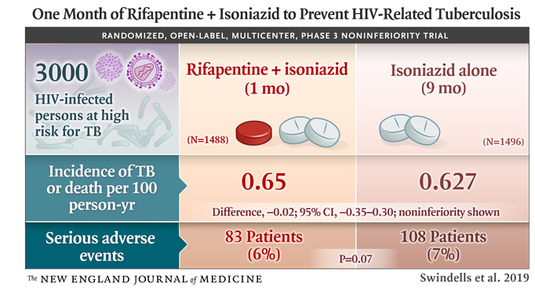
New options for Latent TB treatment
Isoniazid + rifapentine x 28 days (1HP)
Increased rate of completion
Recommended as an option by WHO and Ugandan 2021 national guidelines
Not widely implemented due to cost of (access to) rifapentine
Notes:
No dose adjustment with dolutegravir

Slide 15
Objective
Rapidly identify people with advanced HIV disease and implement OI screening in order to maximize survival

Slide 16
Aim 1
Evaluate the survival benefit of point-of-care CD4 testing vs standard CD4 via flow cytometry in persons with advanced HIV disease
12 clinics randomized to Visitect point-of-care CD4 test
12 clinics randomized to standard flow cytometry
Outcome: 6-month survival with retention-in-care

Slide 17
Aim 2
Determine the survival benefit of an enhanced OI screening and prophylaxis strategy in persons with advanced HIV disease
 | Standard OI screening and prophylaxis
TB Screening | Urine TB LAM
Cryptococcal screening | CrAg LFA
TB Prophylaxis | INH (6 months)
CrAg+ preemptive treatment | Fluconazole

Slide 18
Aim 2
Determine the survival benefit of an enhanced OI screening and prophylaxis strategy in persons with advanced HIV disease
Outcome: 6-month survival with retention-in-care
 | Standard OI screening and prophylaxis | Enhanced OI screening and prophylaxis
TB Screening | Urine TB LAM | FujiFilm TB LAM + Urine TB LAM
Cryptococcal screening | CrAg LFA | CrAg SQ LFA (titers)
TB Prophylaxis | INH (6 months) | INH + rifapentine (1 month)
CrAg+ preemptive treatment | Fluconazole | Fluconazole plus treatment for disseminated Cryptococcus if titers high

Slide 19
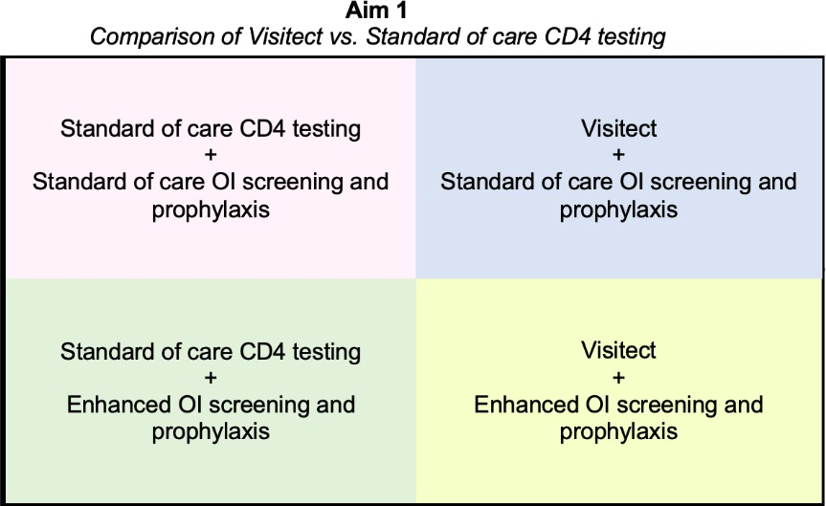
Factorial Cluster Randomized Design
Participants: 2400 participants with CD4<200 in 24 clinics (100 participants per clinic)
Screen: up to 20,000 PWH entering or re-entering care
Notes:
This will be a 2x2 factorial cluster randomized trial to evaluate:
(i) point-of-care CD4 testing to rapidly identify persons with advanced HIV disease, and
(ii) an enhanced strategy for diagnosis and prophylaxis of OIs in participants with advanced HIV disease.
We will identify participants with advanced HIV disease by randomizing clinics to either the Visitect point-of-care CD4 assay, or standard flow cytometry CD4 testing. Through a second randomization, we will subsequently evaluate an enhanced care package for participants with advanced disease

Slide 20
Population of interest
Inclusion criteria
Exclusion criteria
Age >18 years
CD4 < 200 cells/μL
Informed consent
Known virologic suppression (viral load <1000 copies/mL) within prior 3 months
Safety issues:
Pregnant and breastfeeding women included
Persons with contraindications to prophylaxis will still be followed for 6-month outcomes

Slide 21
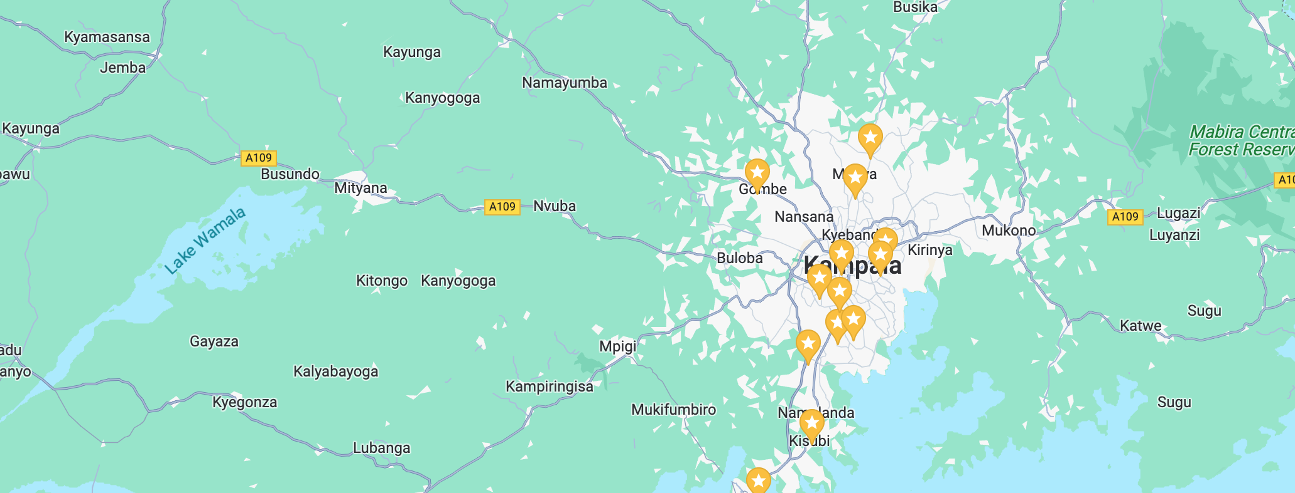
ENCORE clinic sites

Slide 22
Study evaluations
Routine care (not research)
Research-related procedures
Baseline labs
CrAg screen,
if CrAg+ preemptive fluconazole
TB care
Symptom screen
Urine TB LAM (Alere)
Xpert Ultra, CXR prn
Referral for active TB treatment,
INH preventive therapy (if no active TB)
ART care, HIV viral load at 6 months
CrAg SQ (titer in real time)
Low titer, standard fluconazole
High titer, referred for evaluation of meningitis / disseminated infection
Fujifilm SILVAMP TB
1HP preventive therapy (if no active TB)

Slide 23
Enrollment
Started May 2022
1900 participants to date

Slide 24
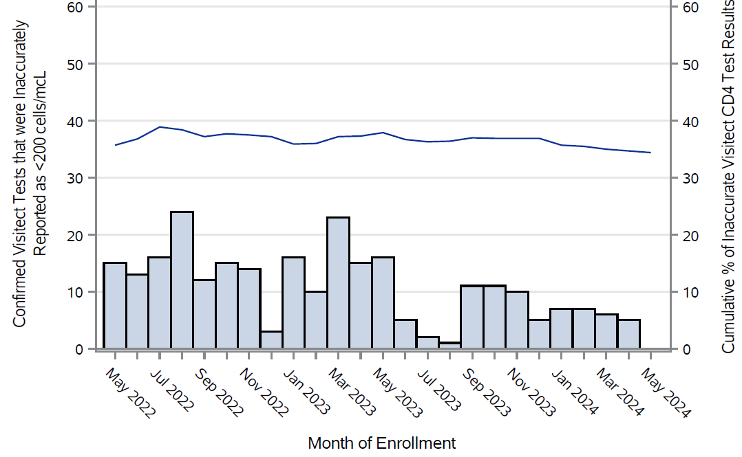
Innacurate Visitect results by month
Notes:
Over the course of the study 34% of Visitect results have been inaccurate

Slide 25
VISTECT VALIDATION SUBSTUDY

Slide 26
Background
Visitect is being rolled out as the primary method of CD4 testing
Anecdotally, many facilities and laboratory staff had concerns about Visitect accuracy
A prior lab validation has shown reduced specificity. How does this relate to real world performance in our clinic settings?

Slide 27
Objectives
Evaluate real world diagnostic performance
Qualitative assessment to understand challenges and barriers to implementation
Compare costs of Visitect vs. standard CD4 testing

Slide 28
Methods
Pragmatic laboratory validation at 4 clinics around Kampala from May 2022 to October 2023
4 clinics randomized to Visitect
Confirmatory testing performed via PIMA, BD Presto, or flow cytometry
Laboratory personnel were employed by the MoH (not research staff)
Notes:
90% confirmed on same blood sample, 10% on different blood sample median of 3 days after initial CD4 testing

Slide 29
Results
1495 venous samples process both by Visitect and another confirmatory CD4 method
30% (442/1495) had confirmatory CD4<200 cells/mcL

Slide 30
Visitect validation results
 | Confirmatory CD4<200 | Confirmatory CD4>200 | Total
Visitect CD4<200 | 442 | 198 | 640
Visitect CD4>200 | 0 | 855 | 855
Total | 442 | 1053 | 1495
Median CD4 397 (IQR 281 to 590)
Sensitivity 100%, Specificity 81%
PPV 69%, NPV 100%
Notes:
Of those with inaccurate results, 39% had CD4 between 200 and 350. 61% >350.

Slide 31
Percentage correctly classified stratified by CD4 category
CD4 category | <100 | 100-200 | 201-350 | 351-500 | >500
Correctly classified | 100% | 100% | 77% | 84% | 83%
Reference standard: PIMA (Abbott) or FACSPresto (B-D)
Notes:
Presented to WHO, funders, CHAI, Ministries of health, Global fund. Ugandan MOH has used our cost-benefit analysis to influence their national guidelines.

Slide 32
Visitect qualitative study
Understanding laboratory characteristics and healthcare workers’ perception of the test

Slide 33
Laboratory characteristics
Clinic # | PPV | Specificity | Number of patients seen per day | Dedicated lab staff for Visitect | Other
1 | 79% | 89% | 15-20 | Yes | -1 laboratory tech -well stocked -CD4 PIMA run concurrently
2 | 98% | 99% | 40-50 | Yes | -2 laboratory techs -well stocked -CD4 PIMA of BD Presto run concurrently
3 | 40% | -- | 100 | No | -2-3 laboratory techs -responsible for many other lab tests (peripheral smears, malaria rapid tests, CBC, HIV dx, blood draws) -many stockouts -no alternative forms of CD4 testing
4 | 54% | 63% | 150 | No | -5-6 laboratory techs -responsible for many other lab tests -many stockouts -CD4 PIMA run concurrently

Slide 34
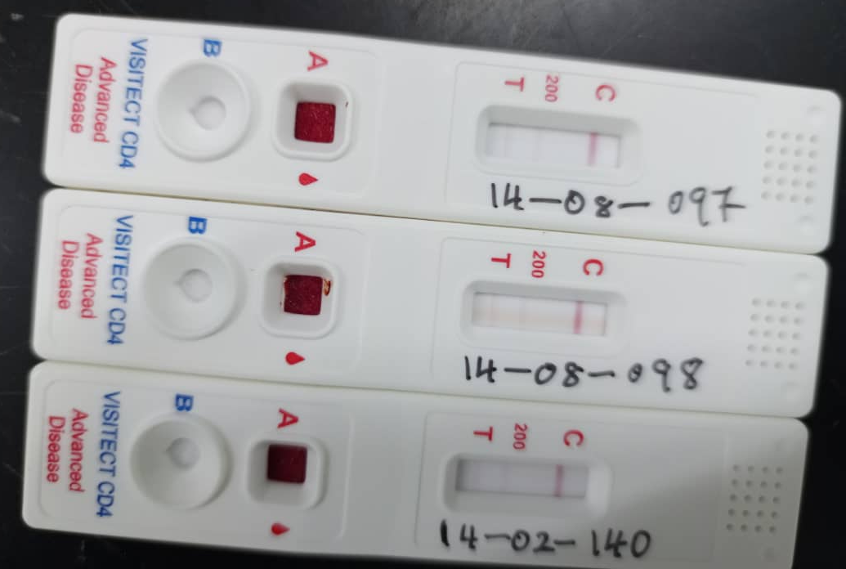
Sample controversial results
Notes:
Three Visitect CD4 results initially read as <200 cells/μL. When re-tested and read by an independent reader, read as >200 cells/μL. Confirmatory CD4 values for all three are >200 cells/μL. If the T line is stronger or darker than the 200 line, the CD4 count is >200 cells/μL. If the T line is equal or weaker (lighter) than the 200 line, the CD4 count is <200 cells/μL.

Slide 35
Themes of laboratories with good Visitect performance
Lab serves lower volume (<50 patients/day)
Adequately stocked with lab supplies
Dedicated laboratory staff for Visitect CD4 testing
PIMA of BD Presto run concurrently
Notes:
Laboratories that perform poorly have >100 patients/day, no dedicated lab staff, frequent lab stockouts. Staff run a wide array of lab tests. Tell them how it is run

Slide 36
Laboratory tech quotation
“We first look at these OPD [outpatient department] patients- they come in convulsing, the pregnant mothers are there you know. You have to first give them priority. Priority, priority, priority.
When I look at someone doing a CD4, it's not an emergency, you can leave the patient for 24 hours. But there are some of those with malaria, they have pneumonia, basically, that's when you need to do that urgent test immediately. So you give priority”

Slide 37
Impact
Presented to WHO, Global fund, PEPFAR, Ministries of Health
Ugandan MOH plans to adjust Visitect roll out based on this study (our findings supported by others)
Advocacy for different CD4 methodologies
Still debate about whether this is a useful technology
Notes:
Qualitative study
Cost-effectiveness analysis

Slide 38
VISITECT VS. STANDARD CD4 COMPARISON
Evaluating clinical outcomes of different CD4 methodologies
Does using Visitect improve survival?

Slide 39
Primary Objective
Evaluate 24-week survival with retention in care
Visitect CD4 strategy
Standard CD4 strategy
PIMA
BD Presto
Flow cytometry

Slide 40
Secondary outcomes
Time to CD4 results
Time to OI screening
Time to ART initiation
Incidence of SAEs, hospitalizations, opportunistic infections
% with virologic failure

Slide 41
Stopped randomizing by CD4 strategy
Visitect being rolled out in Uganda
This is the only modality of CD4 testing in some clinics
Unethical to randomize to a less efficient CD4 strategy
DSMB reviewed data and ultimately decided that this comparison wasn’t relevant

Slide 42
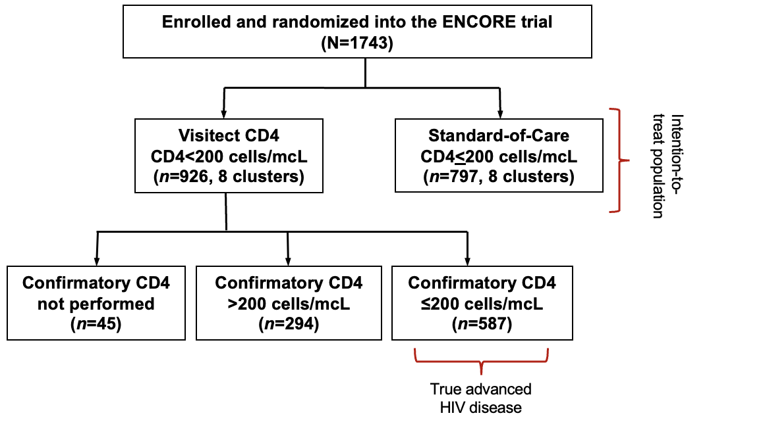
Results: Consort diagram
Notes:
Sixteen clusters were randomized to Visitect CD4 testing versus standard of care CD4 testing. All clusters received the allocated intervention and were included in the analysis. Average size of each cluster was 100 participants. However, given poor specificity of the Visitect CD4 test, 294 participants initially thought to have CD4<200 cells/mcL by Visitect CD4 test were determined to have a confirmatory CD4 result >200 cells/mcL. Thus, we present an intention-to-treat analysis, and a per protocol analysis, where only participants in the Visitect CD4 assignment and confirmatory CD4 testing results <200 cells/mcL were included.

Slide 43
Baseline Characteristics
 | Visitect CD4 | Standard CD4
Enrolled | 926 | 797
Age, years | 32 (27, 39) | 34 (29, 40)
Female | 509 (55%) | 377 (47%)
Weight, kg | 56 | 55
ART-naive | 496 (54%) | 470 (59%)
CD4, cells/mcL | 133 (60, 270) | 95 (43, 145)
Serum CrAg+ | 49 (5.3%) | 66 (8.3%)
Urine TB LAM+ | 200 (22%) | 225 (28%)
Receiving active TB treatment | 323 (35%) | 275 (35%)

Slide 44
Primary events by CD4 group
 | Visitect CD4 | Standard CD4
Randomized | 926 | 797
Completed follow up | 837 | 752
Death or Lost to follow up | 59 (7.0%) | 56 (7.4%)
Death | 28 | 30
Lost to follow up | 31 | 26
Hazard ratio (95% CI) | 0.95 (0.66, 1.37)
Notes:
P=0.774. After including only those with confirmatory CD4 testing <200 cells/mcL, no significant differences were found in death or loss to follow up between arms (Hazard ratio, 1.00 (95%CI: 0.66 to 1.50),

Slide 45
Survival with retention-in-care by CD4 strategy
Hazard ratio (95% CI) 0.95 (0.66, 1.37)

Slide 46
Secondary outcomes
Median time to receipt of CD4 results was 0 days in both arms
Median time to receipt of OI screening was 0 days in both arms
# of hospitalizations not different
Notes:
# of hospitalization not different by arm even among CD4<200 only

Slide 47
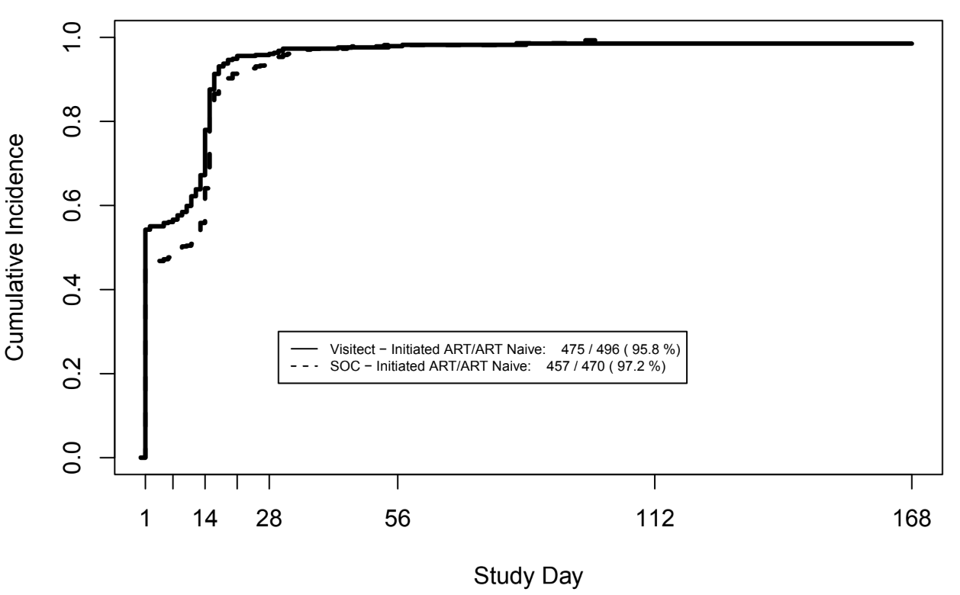
Time to ART initiation
Notes:
Visitect: 57% initiated ART on day 1
SOC: 48% initated ART on day 1

Slide 48
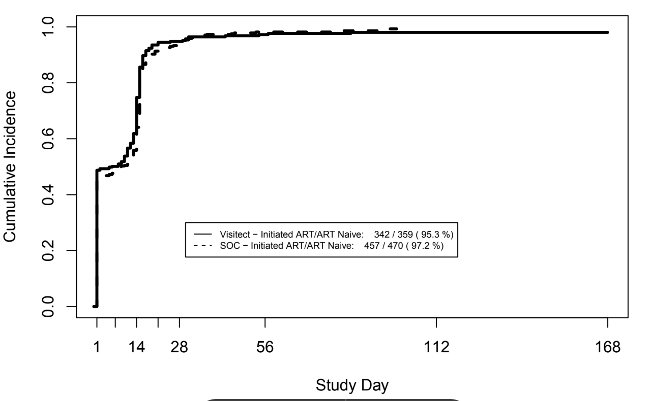
Time to ART initiation (CD4<200)

Slide 49
Summary of CD4 findings
No significant difference in 24-week survival and retention by CD4 strategy
Though Visitect has value in resource-poor settings where no other CD4 strategy is available

Slide 50
CHANGES/UNEXPECTED ISSUES DURING THE STUDY
Trials and tribulations of running a clinical trial

Slide 51
FujiLAM delay
FujiLAM was taken off the market in early 2022 due to lot to lot variability
The test has been revised and sent to us in May 2024
We performed a diagnostic accuracy study first to ensure that this is appropriate for implementation
If accuracy is good, we will incorporate into the final 8 clinics of the study

Slide 52
FUJILAM II DIAGNOSTIC ACCURACY STUDY
A substudy of the ENCORE trial

Slide 53
Background
TB is the leading cause of mortality in people with AHD
Diagnosis is challenging especially in people with extrapulmonary TB
Alere Determine TB LAM (current standard) has 42% sensitivity
Notes:
Novel urine-based TB tests are needed

Slide 54
Fujifilm SILVAMP TB LAM
Point-of-care assay
Detects mycobacterial LAM antigen in urine
Detects urine LAM concentrations 30x lower than current standard Alere LAM
Results <1 hour

Slide 55
Methods
We stored (froze) urine of ENCORE participants at 16 clinic sites in Kampala from 2022-2023
Documented symptoms
Received Alere LAM testing (standard)
FujiLAM performed on thawed (previously frozen) urine

Slide 56
How do you measure diagnostic accuracy when the current standard is imperfect?

Slide 57
TB classifications
Confirmed TB: Xpert or culture positive
Probable TB: Signs/symptoms of TB + receipt of TB treatment, or Alere LAM+
No TB: none of the above
No TB treatment
No Xpert or culture positive
No Alere LAM+
Notes:
Within 30 days of enrollment

Slide 58
Compared FujiLAM results to:
Confirmed TB
Confirmed TB or Alere LAM 2+
Confirmed TB + Probable TB

Slide 59
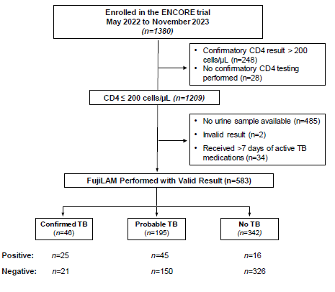
Results: Flow Diagram
Notes:
Who had FujiLAM performed, and what was their TB status

Slide 60
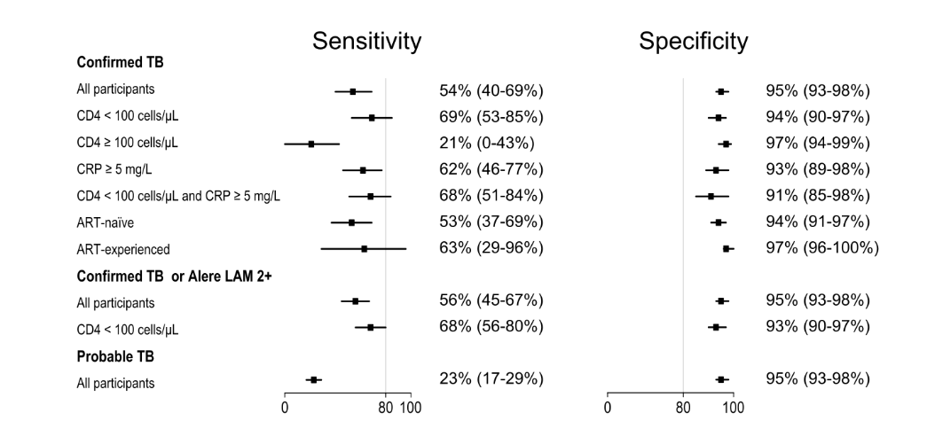
FujiLAM performance

Slide 61
Venn Diagram among participants who had all 3 tests
7
Xpert
5
FujiLAM II
13
20
7
11
40
Alere LAM
Notes:
Venn diagram of FujiLAM II, Xpert and Alere LAM test positivity among the 103 participants with all three tests performed and at least one test positive

Slide 62
How good is good enough?
Additional context: Alere LAM (endorsed by WHO) sensitivity is 42% among outpatients with advanced HIV disease (CD4<200)

Slide 63
Implications
FujiLAM may be a good addition for outpatients with AHD
Particularly if CD4<100 or CRP>5
Shortage of Alere LAM tests
Does this have the same sensitivity in fresh urine?

Slide 64
CRP AS A PREDICTOR OF POOR OUTCOMES IN AHD
ENCORE trial sub study

Slide 65
Background
C-reactive protein: marker for inflammation and infection
Elevated in active TB
Declines with TB treatment
Marker of OIs and death before ART
Before universal ART

Slide 66
Objective
Evaluate the predictive value of baseline serum CRP for OIs, hospitalization, or death in outpatients with AHD
receiving WHO-recommended OI screening and prophylaxis

Slide 67
Methods
Measured CRP prospectively in all participants
Collected baseline demographics, symptoms, clinical outcomes (OIs, hospitalization, death)

Slide 68
Outcomes
Primary: 30-day hospitalization or death
Secondary:
Incidence of OIs
Incidence of hospitalization
Incidence of death

Slide 69
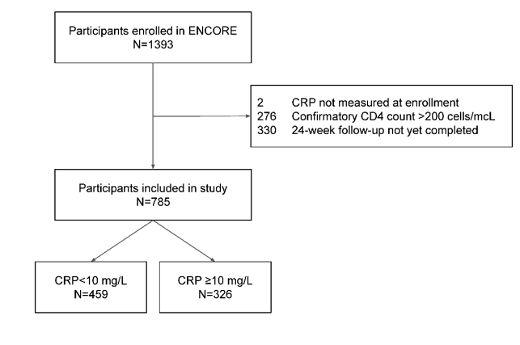
Results: Flow diagram
Notes:
785 had CRP measured and completed 6 month follow up

Slide 70
Baseline characteristics by CRP group
 | CRP <10mg/L | CRP >10mg/L | P-value
Number | 459 (59%) | 326 (41%)
Female | 257 (56%) | 138 (42%) | <0.001
Weight, kg | 56 (50-63) | 53 (47-59) | <0.001
CD4 count, cells/mL | 103 (56-154) | 61 (28-119) | <0.001
ART-naive | 442 (56%) | 225 (49%) | <0.001
Plasma CrAg+ | 28 (6%) | 36 (11%) | 0.017
Urine LAM+ | 93 (20%) | 133 (41%) | <0.001
Xpert MTB/Rif+ | 8 (10%) | 54 (39%) | <0.001

Slide 71
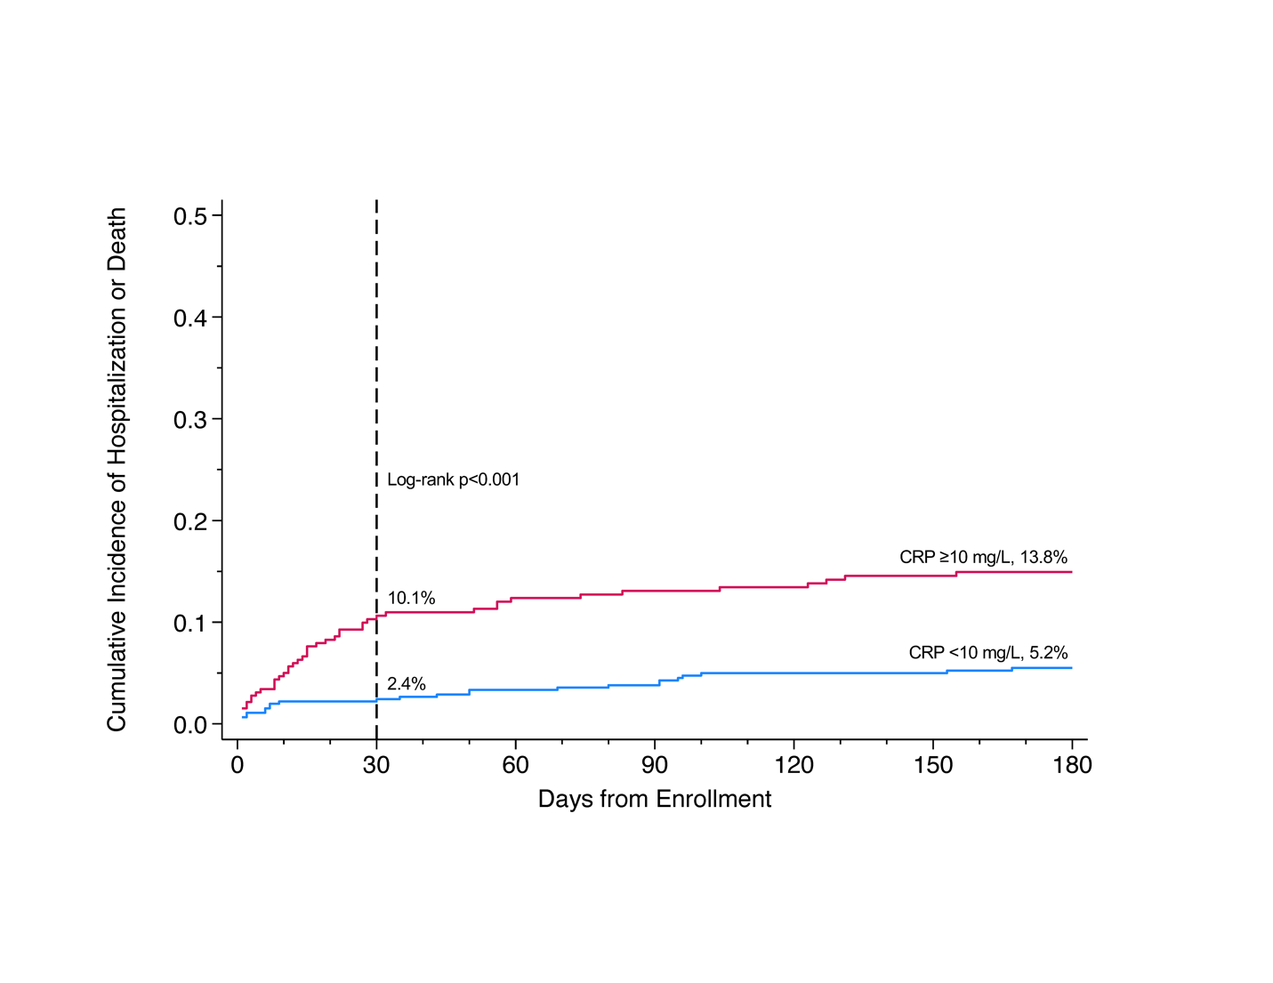
Cumulative incidence of hospitalization or death
Notes:
. 30-day and 180-day cumulative incidence of hospitalization or mortality among persons with advanced HIV disease by baseline serum C-reactive protein, N=785. The 30-day incidence of hospitalization or death among people with baseline CRP ≥10 mg/L was higher than those with CRP <10 mg/L (10.1% vs. 2.4%, log-rank p<.001). The 180-day incidence of hospitalization or death followed a similar trend (13.8% vs. 5.2%).

Slide 72
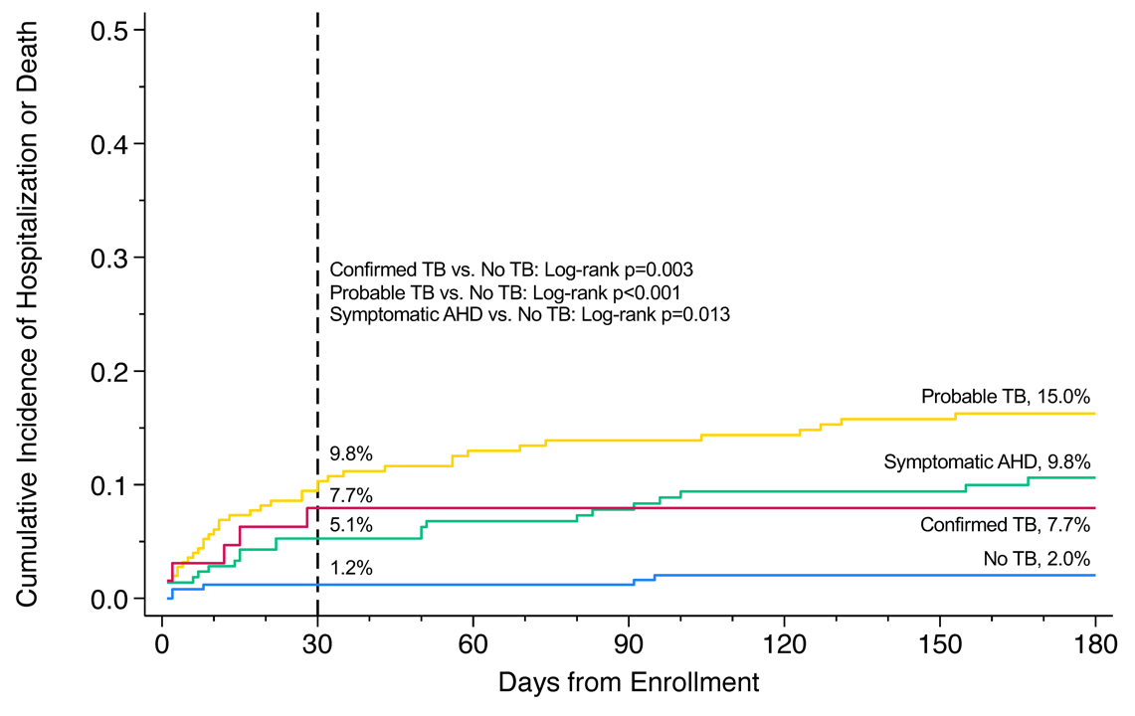
Cumulative incidence of hospitalization/death by TB status
Notes:
The 30-day incidence of hospitalization or death was highest among participants with probable TB (9.8%) or confirmed TB (7.7%). The 180-day incidence of hospitalization or death was highest among participants with probable TB (15.0%) or symptomatic AHD (9.8%).

Slide 73
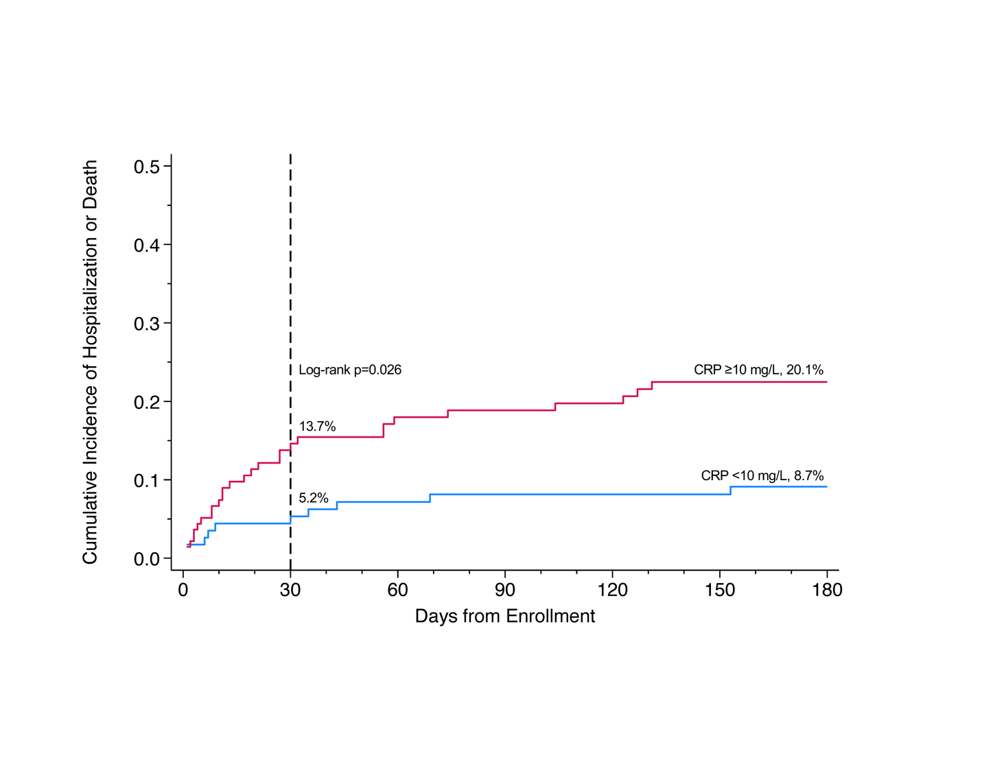
Cumulative incidence of hospitalization/death among people with probable TB
Notes:
Among people with probable TB, having a high CRP conferred increased risk of hospitalization or death. This is true among people with symptomatic AHD. But not different among people with confirmed TB and in people without TB.

Slide 74
Each doubling of CRP increased the hazard of 30-day hospitalization or death by 30%
In a Multivariate Cox proportional hazards regression
After adjusting for confounders (CD4, weight, ART status)
Notes:
(HR=1.3, 95%CI: 1.2–1.5, p<.001).

Slide 75
Participants with high CRP were:
2x as likely to develop an OI
3x more likely to be hospitalized
8x more likely to die
Compared with participants with low CRP
Within 30 days

Slide 76
What does this mean?
CRP predicts OIs, hospitalization, death in people with advanced HIV
People with probable TB have higher risk of death than those with confirmed TB
Likely unidentified other infections exist
Better TB diagnostics are needed
Point-of-care CRP testing may be a valuable triage tool

Slide 77
Next steps
Complete enrollment for ENCORE trial
Study new diagnostics in stored samples
Emphasis on people with probable TB
Next studies may use point-of-care CRP to identify people at high risk for death

Slide 78
Conclusions
Just because a test is being used, do not assume it is accurate
Point-of-care CD4 testing allows for early ART initiation and optimal OI screening
Fujifilm TB LAM II is another possible TB screening test of value
CRP is a marker for OIs, hospitalization, death
People with ‘probable TB’ and symptoms of TB without a confirmatory dx are an area of future exploration

Slide 79
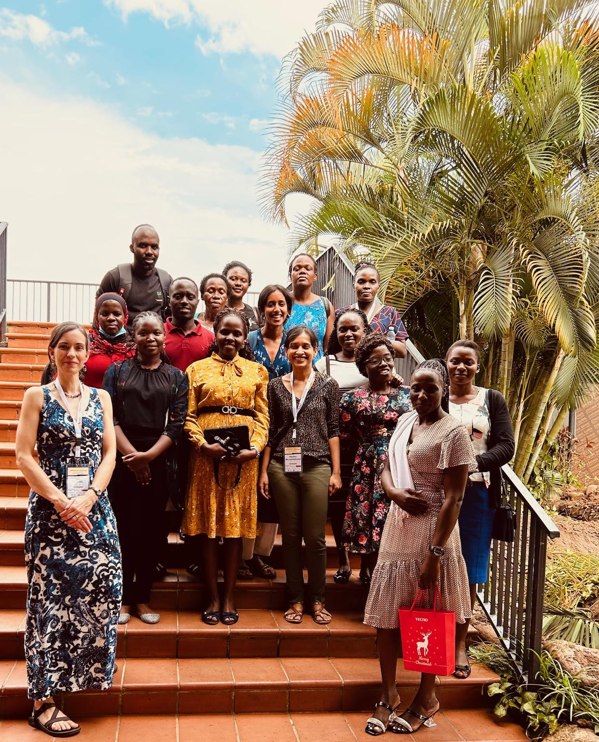

Slide 80
Acknowledgements
University of Minnesota
David Boulware
Biyue Dai
Kathy Hullsiek
Ann Fieberg
Abdul Wele
Caleb Skipper
Elli Schwartz
Infectious Diseases Institute
David Meya
Elizabeth Nalintya
ACACIA & ENCORE research teams
Fogarty Fellows
Preethiya Sekar
Tessa Adzemovic
Funding: NIH R01 AI162181, U01 AI174978

Slide 82
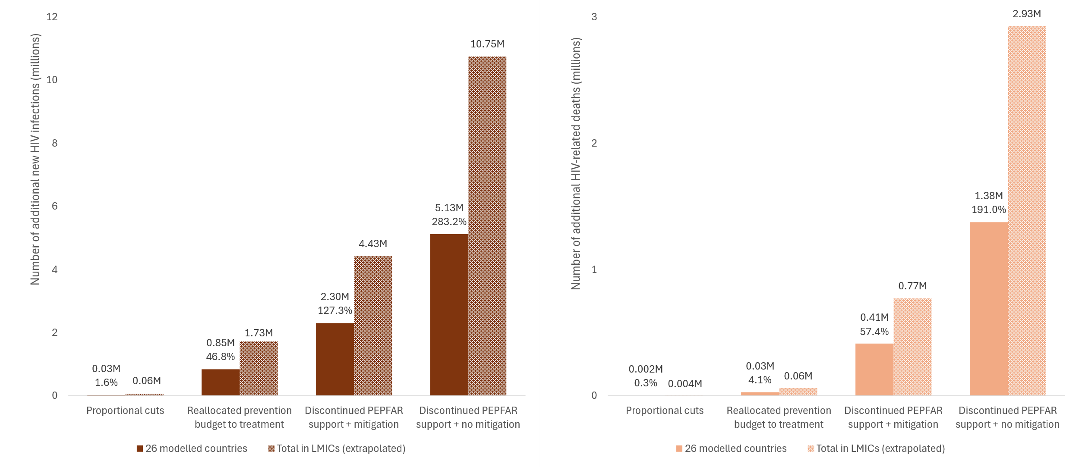
Projected outcomes 2025-2030 if PEPFAR is immediately discontinued
4.43 to 10.75 million additional new HIV infections
0.77 to 2.93 million additional HIV-related deaths
Notes: M = million. Percentage increase relative to Scenario 1 (status quo) in 26 modelled countries. Extrapolation from 26 modelled countries to all LMICs through multiplier methods. LMICs, low- and middle-income countries.
Results generated 3/9/25. Preprint available at https://www.medrxiv.org/content/10/1101/2025.02.28.25.323033v2
Slides borrowed from Jeff Imai-Eaton, Debra ten Brink, and Rowan Martin-Hughes

Slide 83
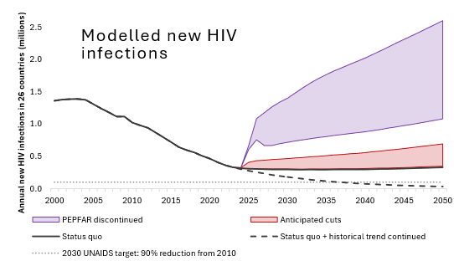
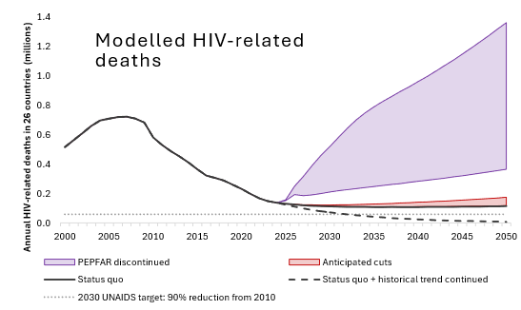
Impact of discontinuing PEPFAR
Slides borrowed from Jeff Imai-Eaton, Debra ten Brink, and Rowan Martin-Hughes

