Slide 1
Evaluation of the Reach, Adoption, Implementation and Maintenance of Assisted Partner Services among People who Inject Drugs in Kenya
Sarah Masyuko, MBCHB, MPH, PhD
Assistant Professor, Global Health,
University of Washington

Slide 2
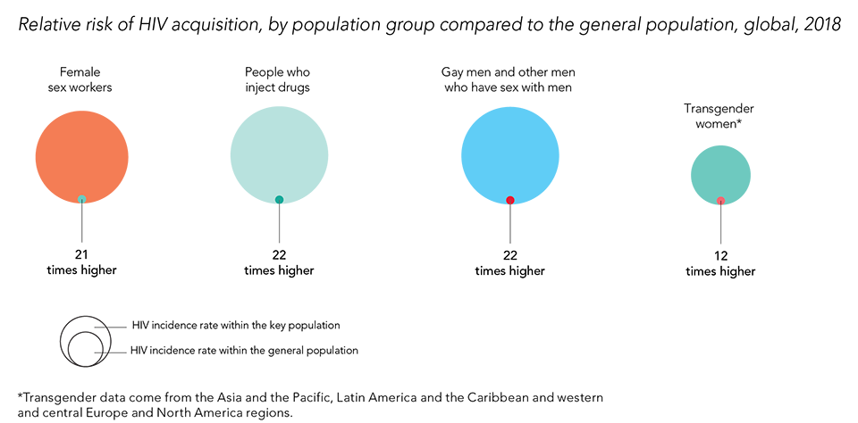
Key populations as higher risk of infection
People who inject drugs
22
times higher
UNAIDS, 2019
Notes:
So, we know that HIV risk among people who inject drugs is 22 times higher than in the general population and about the same as among MSM. And the increased risk of hepatitis C among PWID compared to the general population is even higher.
Source: UNAIDS. (2019). UNAIDS 2019 estimates. https://www.unaids.org/sites/default/files/media/images/20190401-Keypopulations_graphs.png

Slide 3
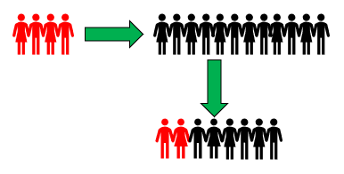
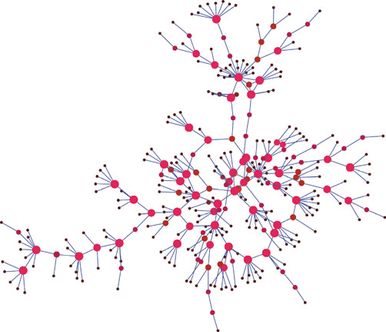
Background
Assisted partner services (APS) has been successfully used to increase testing and linkage to care in Kenya
Notes:
We also know that people who inject drugs face significant barriers to testing and engagement in care, and that assisted partner services, or APS, is effective at HIV case finding and linkage to care in Kenya and in other parts of the world. APS is a practice whereby healthcare workers help notify partners of people living with HIV that they have been exposed, in order to test them and link them to care.

Slide 4
SHARP Aims
Aim 1: To determine whether APS can identify and link to care the sexual and injecting partners of HIV-positive PWID
Aim 2: To determine modes and risk factors for ongoing HIV transmission among PWID using phylogenetic analyses
Aim 3: To determine modes and risk factors for ongoing HCV transmission among PWID using phylogenetic analysis
Notes:
So we conducted a study with 3 aims. Aims 2 and 3 concern phylogenetic analysis, which we will not discuss today. Aim 1 was to determine whether APS could identify and link to care the sexual and injecting partners of HIV-positive PWID.

Slide 5
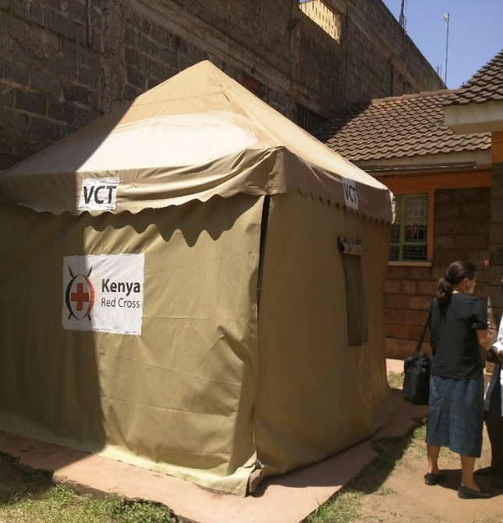
Research Team Collaborators
University of Washington
NASCOP
Kenyatta National Hospital
University of KwaZulu-Natal
Support for Addiction Prevention in Africa (SAPTA)
Ngara Health Centre & MAT Centre
Omari Project (Malindi)
Malindi Sub-county Hospital
MEWA Kilifi & Mtwapa
ReachOut Centre (Mombasa)
Notes:
This study was a collaboration of many different partners, and I want to call attention to the community-based harm reduction programs in Nairobi and on the coast, which were vital to supporting and accessing the community.

Slide 6
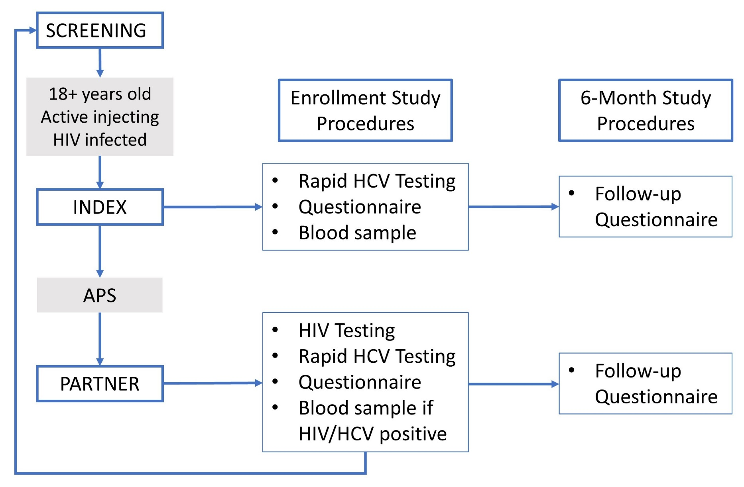
SHARP
IPV screening
Biometrics used for identification of unique individuals
Phylogenetic analysis of both HIV and HCV
Linkage to care for both HIV and HCV
Notes:
A few more notes on procedures. All participants were screened for intimate partner violence on enrollment, and indexes with high risk of IPV were excluded. We used iris scanning biometrics to identify unique individuals in the study. We performed a phylogenetic analysis of both HIV and HCV sequences from this study. And finally, we provided linkage to care for both HIV and hepatitis C for any individual testing positive in the study.

Slide 7
Community embedded Peer educators
Notes:
Community-embedded peer educators were absolutely vital to our success collecting data in this community. The peer educators were people who formerly injected drugs trained to offer outreach and harm-reduction services to PWID. Shown here with arrows is each step of this process that peer educators were involved with– finding individuals for screening, finding partners in the community, and bringing both indexes and partners in for follow up visits.

Slide 8
Parent study outcomes
989 index participants
4705 sexual and injecting partners mentioned
3,323 were traced and enrolled.
597(18%) and 393(11.8%) were HIV and HCV antibody positive, respectively.
504 (84.4%)%) were on ART at 6 months.
Index
N = 989
Partners named
N = 4705
Partners enrolled
N = 3323, HIV 18%(597)

Slide 9
Aim
Evaluate the reach, adoption, implementation and maintenance of APS among PWID using both qualitative and quantitative data guided by the RE-AIM and Consolidated Framework for Implementation Research (CFIR).

Slide 10
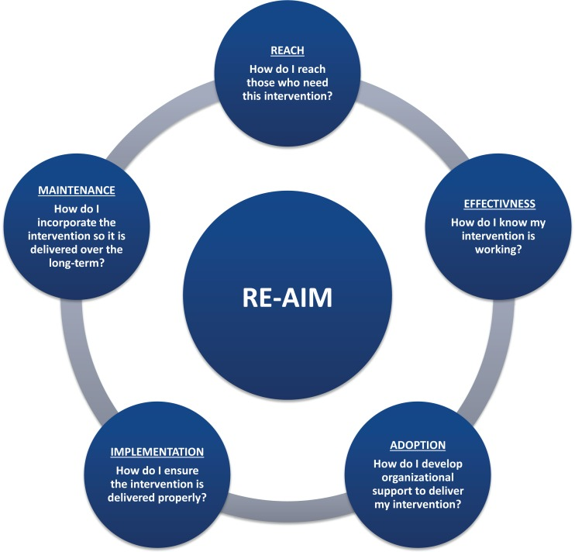
Methods
We used a mixed-methods design guided by the Reach, Effectiveness, Adoption, Implementation and Maintenance framework (RE-AIM) and the Consolidated Framework for Implementation Research (CFIR)
to understand patient, provider and organizational factors that influenced APS implementation among PWID in Nairobi, Mombasa and Kilifi Counties

Slide 11
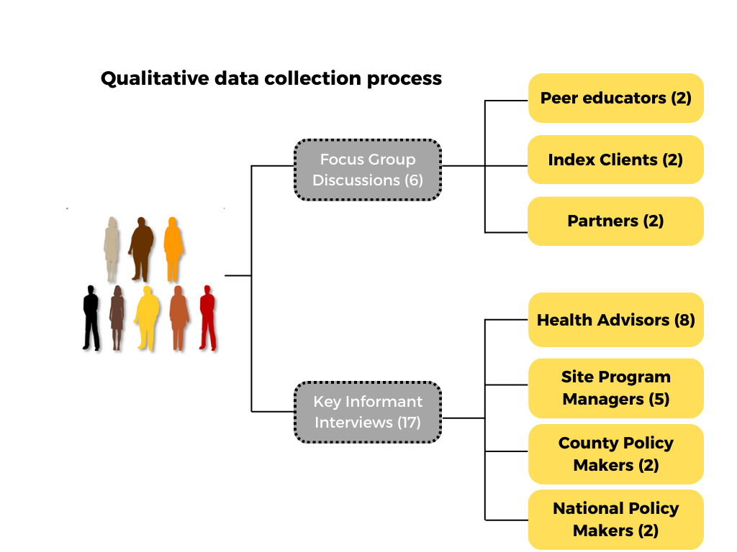
Methods
Quantitative data was collected through structured case report forms

Slide 12
RE-AIM domains
Component | Focus | Quantitative data (RE-AIM) | Qualitative data (CFIR)
Reach: Proportion willing to participate in the intervention | Index / partners | Proportion of index/partners who were offered and accepted APS Representativeness | Factors influencing participation in APS among PWID and their partners.
Adoption: Proportion who actually use the intervention | NSP sites/HAs Peers | Proportion of NSP sites/peers offering APS Characteristics of adopter and non-adopters | Barriers and facilitators of adopting APS (both adopters and non-adopters) How and why was the program adopted/modified over time?
Implementation: Fidelity and consistency of use | NSP sites/ CBOs | Proportion/ extent that the protocol was delivered as intended Adaptations made and consistently applied across sites | How was APS implemented and by whom and when? Barriers and facilitators that influenced implementation success or failure
Maintenance: Consistency over time and settings | NSP sites/ CBOs | Proportion of those that continued/ discontinued APS 6 months and 1 year after study ended | What has been sustained, what has been discontinued, what was modified and why?

Slide 13
Data Analysis

Slide 14
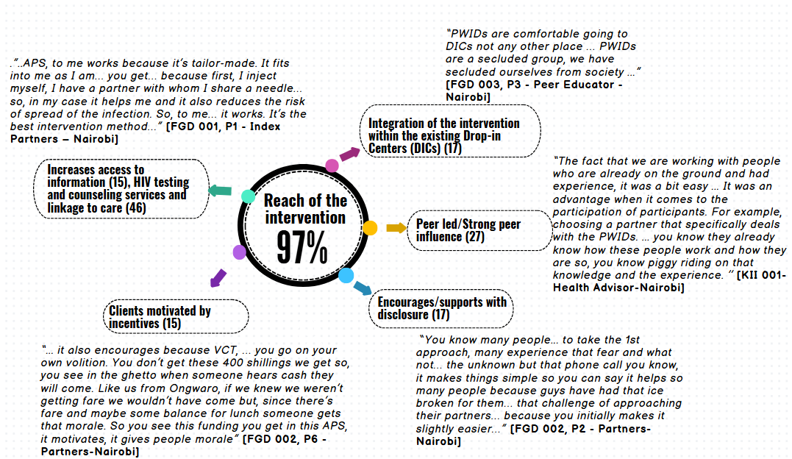
Results
Reach
Facilitators of high reach
The study enrolled 989 index participants who named 4,705 partners, of whom 4,597 were traced and tested representing a 97% Reach of APS
Notes:
The first dimension is Reach which refers to the absolute number, proportion, and representativeness of individuals who are willing to participate in a given initiative, program, or intervention. For reach, the key pragmatic priority to consider is WHO is or was intended to benefit and actually participate or be exposed to the intervention?
The study enrolled 989 index participants who named 4,705 partners, of whom 4,597 were traced and tested representing a 97% Reach of APS
From the interviews (KIIs and FGDs) with the different participant groups, it was clear the level of participation was high across the different study sites One of the factors seen to influence participation in the intervention as that came out most often was the intervention’s ability to increases access to HIV counselling and testing services (47); Peer led/Strong peer influence(27); Increases access to Information(17); Availability/integration with Drop In Centers - DICs (17); Encourages/supports with disclosure (16); Increases linkage to health care services for PWIDs (16) and availability of incentives (15).
I will talk more on the top 2 facilitators
Increasing access to HIV care: The fear of going for HIV testing is real. Majority of the participants reported they wouldn’t opted to go for a HIV test voluntarily and APS provided an easier option since they didn’t have to deal with having to make that decision.
Peer led mediated APS had a very strong influence on participation since this is a closed group and having someone familiar to the group reach out to them as the first point of contact gave them the trust and confidence they needed to participate.

Slide 15
Adoption
Notes:
The third dimension of RE-AIM is adoption which is defined as the absolute number, proportion, and representativeness of settings and intervention agents who are willing to initiate a program. Pragmatically, the question for adoption is Where is the program applied and who applied it?

Slide 16
Example of Adoption per peer educator in one Nairobi site from 2018-2022
While all peer educators adopted APS, it varied over time and level of adoption
Notes:
Some of the factors that influenced adoption: Relapse of some peer educators, saturation at sites, stages of study early vs late.

Slide 17
Implementation: Annualized total and cost per beneficiary
 | Total cost | Cost per person traced and enrolled
Start-up
Microplanning | 554
Initial Training | 3,252
Sensitization | 2,845
Sub-total start-up | 6,651 | 2.0
Recurrent
Personnel | 37,448 | 11.3
Supplies | 30,893 | 9.3
Transportation | 8,633 | 2.6
Communication | 16,950 | 5.1
Refresher training | 2,521 | 0.8
Overhead (electricity, utilities, etc.) | 898 | 0.3
Sub-total recurrent | 97.343 | 29.29
Total | 103,994 | 31.3
N=3,323 PWID traced

Slide 18
Implementation
Almost all the Health Advisors (98%) indicated they have high confidence in their ability to implement the APS intervention
Resource-intensive but perceived as acceptable and effective by providers and participants
Notes:
The fourth dimension of RE-AIM is implementation. At the setting level, implementation refers to the intervention agents’ fidelity to the various elements of an intervention’s protocol. This includes consistency of delivery as intended, adaptations made, and the time and cost of the intervention. The key pragmatic considerations are How consistently is or was the program or policy delivered? How will or was it be adapted? How much will it cost? And why did will or did the results come about?

Slide 19
Implementation - Unintended Consequences
Positive
Increased service utilization
Partner disclosure support
Identification and re-engagement of clients who had defaulted from treatment, thereby improving retention in HIV care programs
Expansion of services in DIC e.g. Reach out started offering ART,
Increased uptake of cervical cancer screening due to increased women in clinics
APS facilitated the availability of viral load testing through study-supported resources, ensuring continuity of care and adherence monitoring
Notes:
More

Slide 20
Implementation - Unintended Consequences
Negative
APS protocol focused primarily on injecting substance users, inadvertently excluding non-injecting substance users who may also be at substantial risk of HIV infection
Stigma especially for non injecting sexual partners
Confidentiality concerns
Resource limitations to cater for increased demand for services
Financial incentives: perceived as the primary motivation for attending clinics
A program manager in Nairobi alluded that “… for them it’s about money to go and buy more drugs to use because, you know, they are still using drugs there’s no intervention in terms of harm reduction that has been done yet”.
Notes:
Confidentiality: some peer educators reportedly compromising client privacy during partner tracing
Limited time: The restriction of partner elicitation to a three-year retrospective period limited the ability to capture and reach a broader range of sexual partners.
Stigma: .Stigma associated with attending DICs by Sexual partners, particularly those from key populations, were sometimes reluctant to access services due to fears of discrimination or being publicly identified as high-risk individuals.
Resources: Furthermore, the influx of clients generated by APS occasionally conflicted with the targets and capacities of other donor-funded programs, such as those supported by the Kenya Red Cross.

Slide 21
Maintenance
Six months post-implementation, all sites continued APS delivery but at a decreased scale
Simplicity of APS integration into existing health services makes maintenance easy
Some modifying delivery to include pre-exposure prophylaxis for HIV-negative participants
From the qualitative interviews, integrated services could be a win-win to get these key populations the services they need
. “… and integrate the services. I think that will be the win-win situation that we will appreciate. It’s good to have the MAT sites. They inform the programing for these special or key populations” [Health Advisor]
Notes:
The last dimension of RE-AIM is maintenance which is defined as the extent to which a program or policy becomes institutionalized or part of the routine organizational practices and policies. Maintenance in the RE-AIM framework also has referents at the individual level based on sustained changes and long-term outcomes. The key pragmatic consideration for maintenance is When will (or did) the initiative become operational and how long are the results sustained at the setting level and individual level?

Slide 22
Maintenance
Resources for tracing was a potential barrier to sustainment
Lack of training of service providers and shortage of rapid test kits
Normalization of HIV and availability of HIV self test may make APS less attractive
Notes:
The last dimension of RE-AIM is maintenance which is defined as the extent to which a program or policy becomes institutionalized or part of the routine organizational practices and policies. Maintenance in the RE-AIM framework also has referents at the individual level based on sustained changes and long-term outcomes. The key pragmatic consideration for maintenance is When will (or did) the initiative become operational and how long are the results sustained at the setting level and individual level?

Slide 23
Key strategies or suggested modifications
Integrated services in Drop In centers
Consider alternate pathways for non-injecting substance users
Consider alternate points of referrals for sexual partners
Incorporating PrEP provision
Integrating Hepatitis C treatment in Drop in centers
Notes:
We are recoding the transcripts with an eye to identify the strategies used to overcome some of the barriers and proposed modifications they would like the program to make.

Slide 24
Conclusion
Peer-mediated APS among PWID achieved high reach and adoption, with strong acceptability and maintenance across the settings
This demonstrates the importance of contextually tailored strategies to enhance the reach, adoption, implementation and maintenance of APS among PWID in Kenya
RE-AIM and CFIR facilitated a nuanced understanding of multilevel factors affecting implementation success of APS

Slide 25
Amanda Debuo Der
MPH student

Slide 26
Acknowledgements
Study Staffs, site clinicians and peer educators
NSP and Methadone clinics
SAPTA
Kenyatta National hospital
NASCOP
University of Washington
CFAR UW (P30AI027757)
NIH (R01 DA043409)
Amanda Debuo Der
MPH student

Slide 27
Research Team & Collaborators
University of Washington
NASCOP
Kenyatta National Hospital
Support for Addiction Prevention and Treatment in Africa (SAPTA)
Ngara Health Centre & MAT Centre
Mathari MAT Centre
Omari Project
Malindi Sub-county Hospital
MEWA Kilifi & Mtwapa
ReachOut Mombasa
Kisauni MAT Centre

