Slide 1
Immunopathogenesis of Mycobacterium tuberculosis Infectiousness in HIV Co-infection
Dr Lilian Njagi, MBChB, MSc, PhD
KEMRI, Centre for Respiratory Disease Research
^{Investigator Team}
Prof. Thomas R. Hawn, MD, PhD, University of Washington
Prof David J. Horne, MD, MPH, University of Washington
Prof Videlis Nduba, MBChB, MPH, PhD, KEMRI
Collaborator: Dr. Kevin Fennelly (National Heart, Lung, and Blood Institute, NIH)

Slide 2
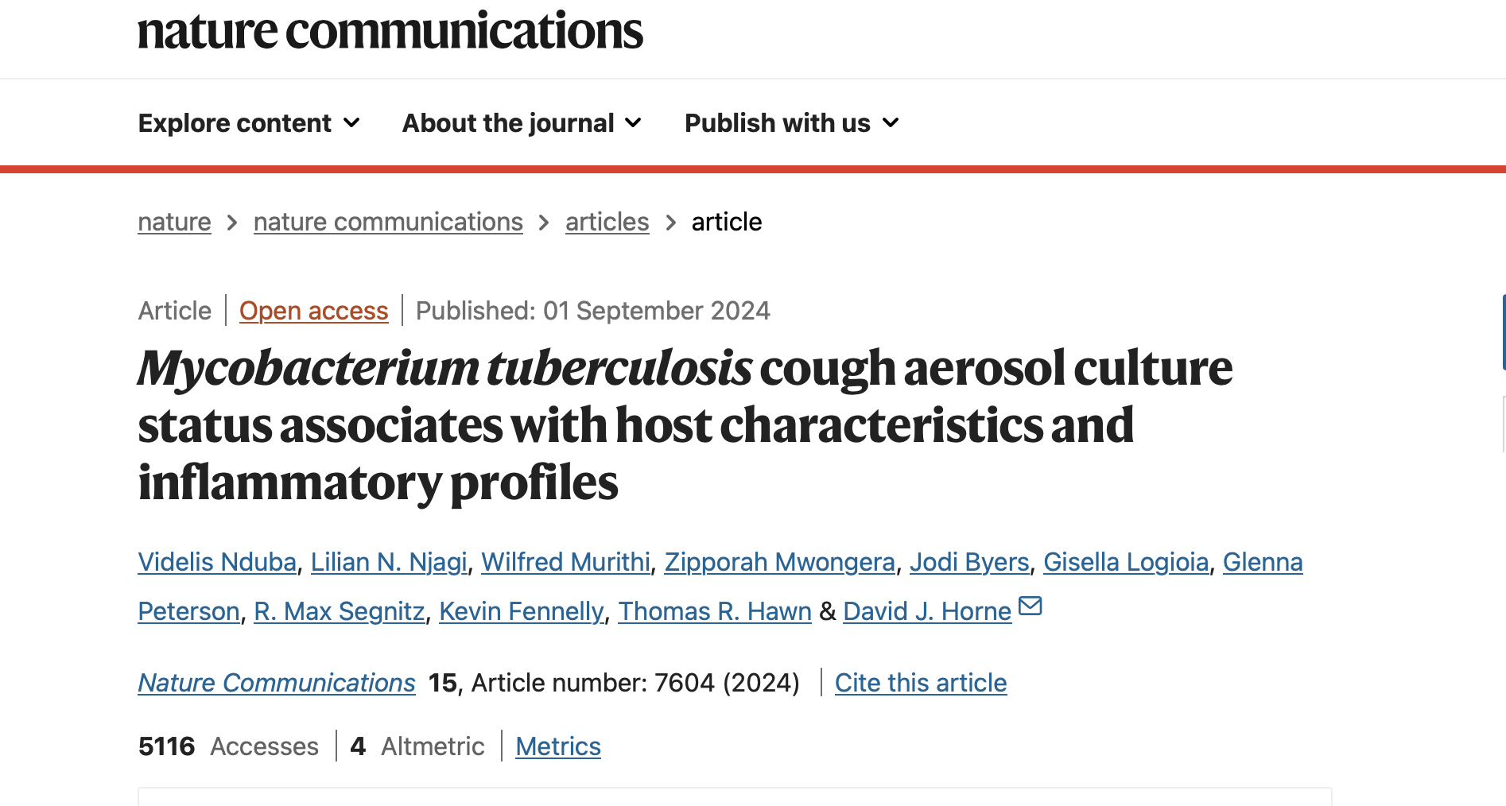
Nested in Ongoing TBAIT Study
TB Aerobiology, Immunology and Transmission (TBAIT)
A prospective, longitudinal study
Enrolling participants with pulmonary TB and Household contacts
Using Cough Aerosol Sampling System (CASS)
  Mtb is spread through aerosolized bacilli (a measure of infectiousness)
Interferon-gamma release assay (IGRA) responses in HHCs to assess Mtb transmission risk
Nduba. Nat Comm 2024
Cough aerosol culture status strongest predictor of contact IGRA result
Notes:
Mtb is spread through aerosolized bacilli (Superspreaders)

Slide 3
Background
Mycobacterium tuberculosis (Mtb) transmission is central to maintaining the TB/HIV epidemic
  Mtb is spread through aerosolized bacilli (Mtb aerosolization a measure of infectiousness)
Knowledge gaps
  Understanding Mtb infectiousness in the context of HIV co-infection
  Limitations of current diagnostic tools in ascertaining Mtb transmission
Important to support development of targeted interventions to reduce Mtb transmission and prevention TB infection

Slide 4
Mtb infectiousness in HIV co-infection
TB-HIV co-infection is associated with reduced Mtb transmissibility
Mechanisms underlying the variable infectiousness are unclear
  A subset of people living with HIV (PLWH) transmit Mtb
  Understanding immune pathways modulating infectivity in PLWH may support intervention development
  ^{Ref}
  Espinal, M. A. et al., The Lancet, 2000;
  Martinez, L. et al., Am. J. Respir Crit. Care Med. 2016
  Mtb Martinez, L. et al., Clin. Infect. Dis. 2021
  Cruciani, M. et al., Clin. Infect. Dis. 2001
Notes:
, including genome-wide transcriptional profiling

Slide 5
Mtb transmission Ascertainment
Conventional tests for Mtb infection diagnosis - IFN-γ-dependent (IGRA) & TST
  Fail to identify some infected people despite known exposure
  Fail to discriminate between recent and remote infections
Proposed diagnostic markers
  IFN-γ-independent markers (IFN-γ⁻)
  HLA-DR T-cell activation biomarker of recent infection

Slide 6
Impact of Index HIV status & Mtb aerosolization on IFN-γ⁻ /HLA-DR responses in contacts
HIV coinfection in the index
Influence the quantity and quality of aerosolized Mtb
Remain unknown
Activating distinct T-helper pathways in exposed contacts
Notes:
Impact of Mtb Aerosolization and Index HIV Status on IFN-γ⁻ and HLA-DR Responses in Exposed Contacts

Slide 7
CFAR Funded Work: Infrastructure and Preliminary Findings
TBAIT - Prospective, longitudinal study, to 12 months
Bio banked samples - QFT Supernatants, PBMCs, whole blood in paxgene tubes
Add PLWH Participants with pulmonary TB and Household contacts
  Collect cough aerosols in index cases using CASS
  PBMCs, whole blood in paxgene
HHC
  Interferon-gamma release assay (IGRA) responses in HHCs to assess Mtb transmission risk
  QFT Supernatants, PBMCs, whole blood in paxgene

Slide 8
Index CAC status/HIV co-infection and contact IFN-γ response
 | Bivariate |  |  | Multivariate
Characteristic | OR | 95% CI | P | aOR* | 95% CI | P
Age – HHC | 1.04 | 1.00-1.07 | 0.05 | 1.03 | 0.99-1.1 | 0.10
CAC+ | 8.51 | 1.6-44.8 | 0.01 | 8.8 | 1.5-53.2 | 0.02
PWH (index) (N=16) | 0.05 | 0.01-0.46 | 0.008 | 0.12 | 0.02-0.88 | 0.04
Xpert Ct | 0.89 | 0.8-1.0 | 0.06
TTD | 0.88 | 0.7-1.06 | 0.18
CRP level | 1.01 | 1.00-1.04 | 0.10
Cavitary Chest X-ray | 2.85 | 0.9-8.7 | 0.07
CAC strongest predictor of contact QFT result
HIV co-infection in the index associated with lower odds of Mtb transmission
CAC status did not differ by HIV status >> Other factors may influence Mtb transmission in PLWH
Nduba. Nat Comm 2024
Notes:
CAC status did not differ by HIV status >> Other factors may influence Mtb transmission in PLWH - need to understand underlying mechanisms

Slide 9
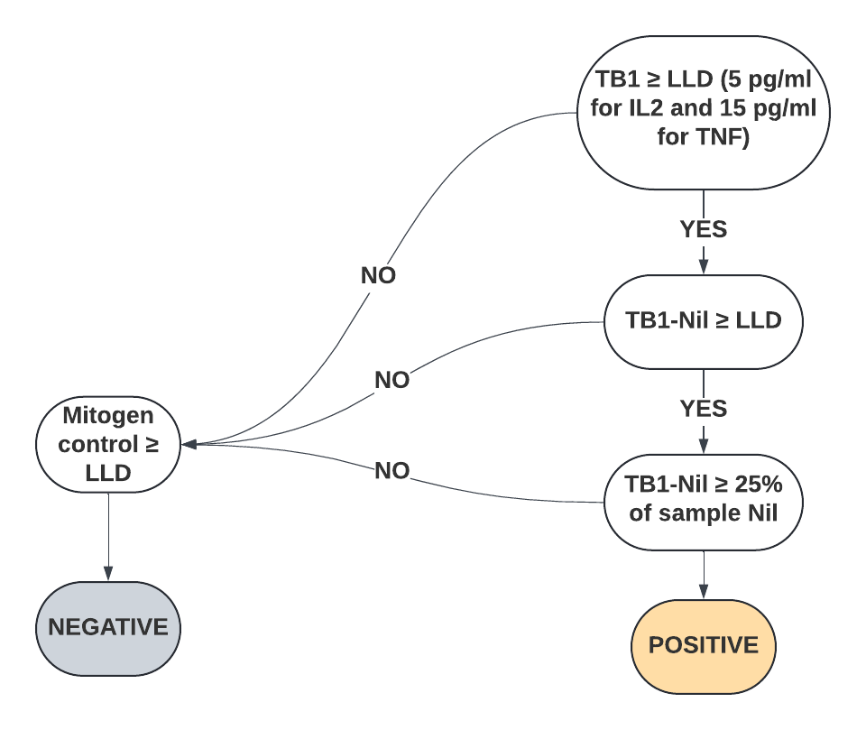
Mtb infection based on ESAT6/CFP10 Mtb-specific TNF and IL-2 responses
We modeled the QFT Plus criteria in defining Mtb infection based on TNF and IL-2 responses
Mtb infection endpoints (Cytokine positivity)
IFN-γ status - standard IGRA criteria
IL2 status
TNF status
Composite measure - any ESAT6/CFP10 response among IFN-γ, IL2, and TNF.
Primary Predictors
- Index HIV status
-Cough Aerosol Culture Status (CAC positive (CAC +) defined by culture growth on any CASS plates)
Other predictors – other measures of infectiousness (chest X-ray cavitation, AFB-smear grade, time to detection (TTD) of Mtb growth in liquid culture, GeneXpert semi-quantitative grade, and GeneXpert Ct values

Slide 10
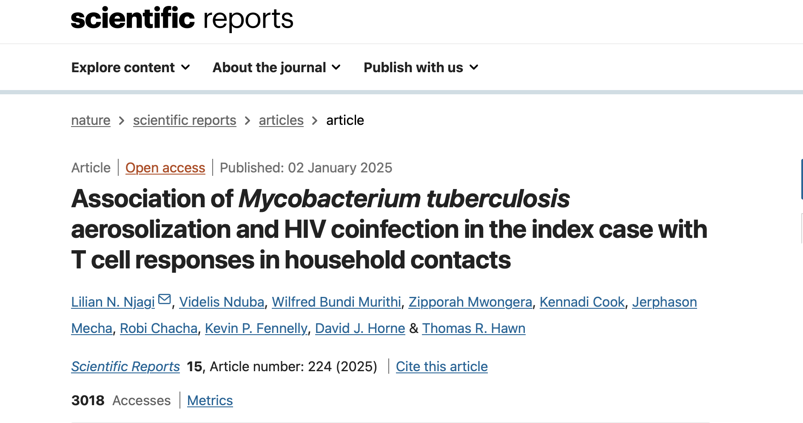
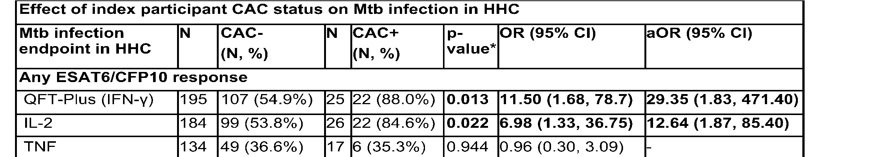
Index CAC status and contact IFN-γ⁻ responses
ESAT6/CFP10 IL-2 and TNF identified an additional 9.2% HHC with possible Mtb infection
  CAC+ associated with higher odds of Mtb transmission by IFN-γ and IL-2
  Differences in cytokine concentrations comparing HHCs of CAC+ and CAC- index participants:
    IFN-γ: 3.42 IU/mL (IQR 0.81-4.68) vs. 0.49 IU/mL (IQR 0-3.50); p=0.001)
    IL-2: 142.1 pg/mL vs 21.2; p=0.01)
    NOT TNF (p=0.99).
Njagi, Scientific Reports 2025
Notes:
We hypothesized that ESAT6/CFP10 TNF and IL-2 responses improve Mtb infection detection among exposed household contacts (HHCs) and are associated with index case Mtb aerosolization (i.e., cough aerosol culture positive for Mtb growth, CAC+) and HIV co-infection.

Slide 11
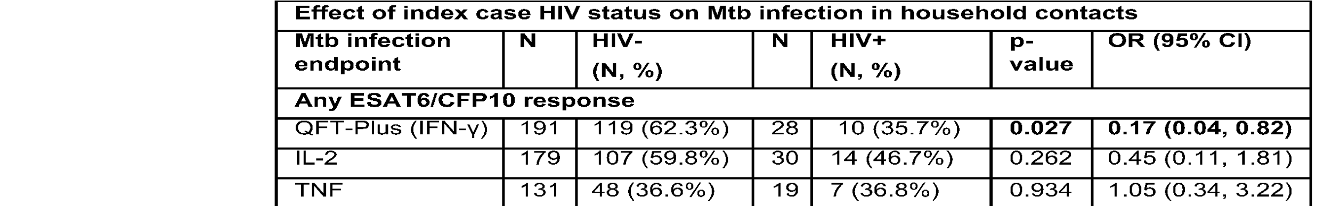
Index HIV status and IFN-γ⁻ responses
    HIV coinfection in the index negatively associated with ESAT6/CFP10 Mtb-specific IFN-γ responses in HHCs (OR 0.17; p=0.001)
    HIV coinfection in the index NOT associated with TNF and IL-2 (p=0.99), or Composite measure
Njagi, Scientific Reports 2025

Slide 12
Summary of Preliminary Findings
Mtb infectiousness in HIV co-infection
  CAC strongest predictor of contact QFT result
  CAC status did not differ by HIV status
  Other factors may influence Mtb transmission in PLWH. ?? underlying mechanisms
Mtb transmission Ascertainment - potential diagnostic markers
  TNF and IL-2 identified an additional 9.2% HHC with possible Mtb infection beyond 58.6% testing QFT+
  TNF+ likely children
Cytokine-specific associations with Aerosolized Mtb exposure and HIV co-infection in the index
  Differences in IFN-γ and IL2 concentrations & positivity comparing HHCs of CAC+ vs - index, not TNF
  HIV co-infection in the index associated with lower odds of Mtb transmission (by IFN-γ, not TNF and IL-2)
Notes:
In HHC, Assess Mtb-specific polyfunctional T-cell responses, identify IFN-γ independent markers of Mtb exposure, assess HLA-DR expression as a marker of recent infection, undertake bulk RNA sequencing-based investigations into novel signatures of recent infections

Slide 13

Next Steps to address knowledge
Further investigations into Mtb transmission mechanisms in PLWH
Further evaluation of potential diagnostic markers of Mtb transmission
Notes:
In HHC, Assess Mtb-specific polyfunctional T-cell responses, identify IFN-γ independent markers of Mtb exposure, assess HLA-DR expression as a marker of recent infection, undertake bulk RNA sequencing-based investigations into novel signatures of recent infections

Slide 14
Aim 1: Determine epidemiologic, microbiologic, and immunologic features of TB transmission in PLWH
Hypothesis:
Lower Mtb transmission in PLWH will be due to less cavitary disease, independent of bacillary load or aerosolization.
Distinct transcriptional signatures associated with lower Mtb transmission will also be associated with less cavitary disease but not aerosolization in PLWH
Additional PLWH with PTB with their HHC
  In the index;
    Collect cough and exhaled aerosols, microbiologic and epidemiologic data
    Genome-wide transcriptional profiling
    Mtb-specific polyfunctional T-cell responses
  In HHC
    IGRA responses at baseline
    IFN-γ-independent responses and HLA-DR expression
Importance - targeted interventions to reduce transmission
Notes:
In HHC, Assess Mtb-specific polyfunctional T-cell responses, identify IFN-γ independent markers of Mtb exposure, assess HLA-DR expression as a marker of recent infection, undertake bulk RNA sequencing-based investigations into novel signatures of recent infections

Slide 15
Aim 2: Evaluate immunologic markers of Mtb exposure in HHC and associations with HIV Co-infection and Mtb aerosolization in the index
Hypothesis –
    Negative HIV status and aerosolized Mtb in the index case will be associated with increased polyfunctionality of Mtb-specific CD4 and CD8 T cell responses and IFN-γ independent markers of Mtb exposure in the HHC.
    HLA-DR expression will be amplified by Mtb aerosolization in the index, independent of HIV coinfection status.
In HHC, use multi-parameter flow cytometry
    Evaluate Mtb-specific polyfunctional T-cell responses
    Identify IFN-γ independent markers of Mtb exposure
    Assess HLA-DR expression as a marker of recent infection
Other plans: Investigate transcriptomic signatures in HHCs associated with exposure to aerosolized Mtb
Importance- support development of improved diagnostics and targeted TB preventive Therapy
Notes:
In HHC, Assess Mtb-specific polyfunctional T-cell responses, identify IFN-γ independent markers of Mtb exposure, assess HLA-DR expression as a marker of recent infection, undertake bulk RNA sequencing-based investigations into novel signatures of recent infections

Slide 16




Acknowledgments
^{Investigators}
Prof. Thomas R. Hawn, MD, PhD, University of Washington
Prof Videlis Nduba, MBChB, MPH, PhD, KEMRI CRDR
Dr David J. Horne, University of Washington
Dr. Kevin Fennelly (National Heart, Lung, and Blood Institute, NIH)
Study participants, Staff & Management
Facilities: KEMRI CRDR, Hawn Lab
UW/Fred Hutch CFAR New Investigator Award, grant number P30 AI027757

