Slide 1



Implementation Science to Improve the Quality of TB Care
Achilles Katamba, MD, PhD
2025 – 2026 UW/Fred Hutch Center for AIDS Research Seminar Series
February 5th 2026

Slide 2
Learning Objectives
Participants will be able to:
Describe need for implementation science
Understand key principles of implementation science relevant to the improvement of global health service delivery and care
Cite examples of their application to TB services and care
Case Study: Implementation of Xpert MTB/RIF testing in Uganda
Identify opportunities where implementation science can be harnessed to improve TB knowledge and care in their own settings

Slide 3
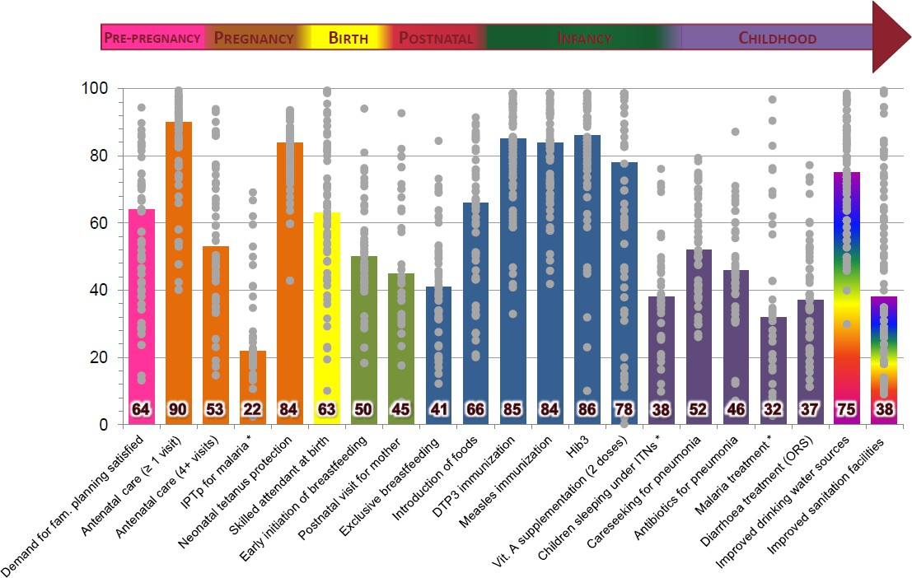
We often known what to do…..
.….but not how to get it done

Slide 4






Traditional approach to implementation
It Seemed Like A Good Idea At The Time
ISLAGIATT
Principle
Martin Eccles
KEY PROBLEM – Does not identify or address factors critical for successful implementation

Slide 5
What are the consequences?
New research takes too long to get adopted
Many interventions are not aligned with needs/priorities of patients and communities
Providers lack tools to implement relevant and effective interventions
Variation in effectiveness and/or practice in different settings not understood or planned for

Slide 6
Implementation Science
Study of methods or strategies to promote the systematic uptake of proven
interventions into routine clinical practice. In this context, it includes the study of
influences on the behavior of patients, providers, and organizations in either healthcare or population settings.
-- Implementation Science Journal
Study of methods to promote the integration of research findings and evidence into healthcare policy and practice. It seeks to understand the behavior of healthcare professionals and other stakeholders as a key variable in the sustainable uptake, adoption, and implementation of evidence-based interventions
-- NIH Fogarty International Center
Study of processes used in the implementation of initiatives and contextual factors that affect these initiatives. The basic intent is to understand not only what is and is not working, but how and why implementation is going right or wrong, and testing approaches to improve it.
-- World Health Organization

Slide 7
Common themes across definitions
Implementation science involves
Understanding behavior
Developing strategies to change behavior
Engaging stakeholders
Increase speed, quantity and quality of evidence uptake

Slide 8
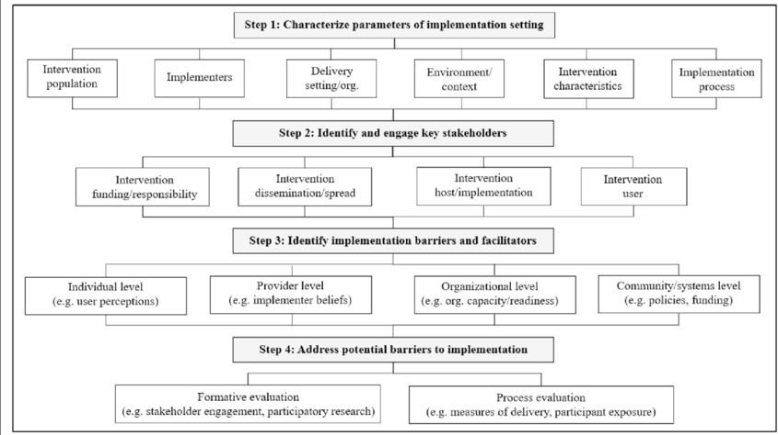
Koorts 2018

Slide 9
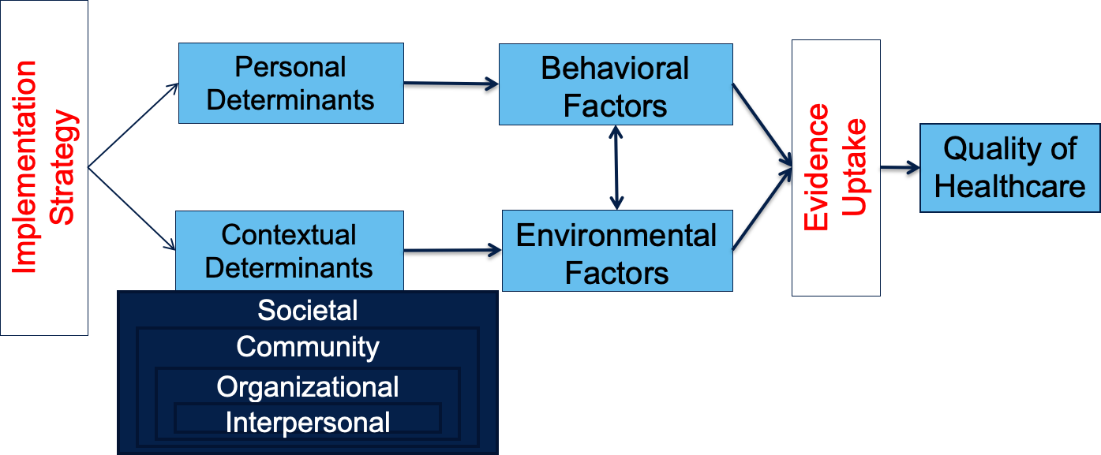
Logic Model

Slide 10
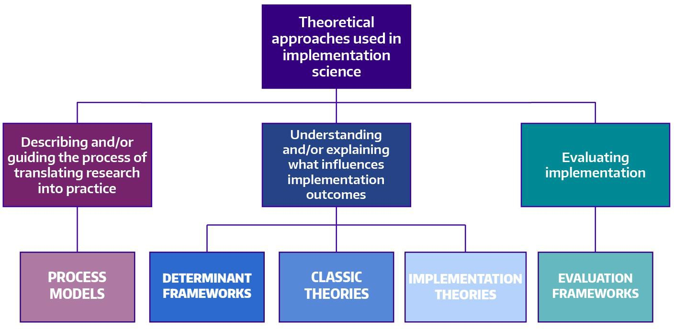
Nilsen, 2015

Slide 11
Use of theory/frameworks in implementation science
“Theory without empirical research is empty; empirical research without theory is blind” -- Immanuel Kant
Identify determinants of behavioral/environmental risk factors
Create a causal model of the problem
Specify determinants being targeted for change
Select intervention methods to match targets
Inform evaluation of implementation strategy

Slide 12
Efficacy/effectiveness vs. implementation research
Efficacy/effectiveness question | Implementation question
Does 3HP treatment reduce incident TB in high-burden countries? | Can digital adherence tools facilitate completion of self- administered 3HP treatment?
What is the yield of household contact tracing for identifying active TB cases? | Is clinic-based or home-based TB screening and testing more cost-effective for scaling-up household contact tracing?

Slide 13
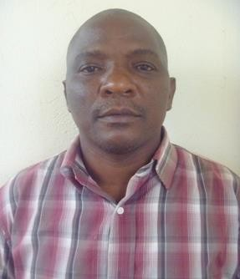
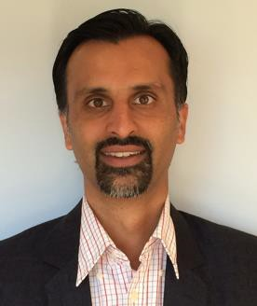
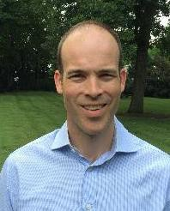



Case Study:
Implementation of Xpert MTB/RIF testing for tuberculosis in Uganda
Uganda Tuberculosis Implementation Research Consortium (U-TIRC)
https://utbspwebsite.wixsite.com/u-tirc
Achilles Katamba
Makerere University
Adithya Cattamanchi
University of California San Francisco
J. Lucian Davis
Yale University
David Dowdy
Johns Hopkins University
Stavia Turyahabwe (Uganda NTLP)
Moses Joloba (Uganda NTRL )
Prof. David Moore
London School of Hygiene & Tropical Medicine

Slide 14
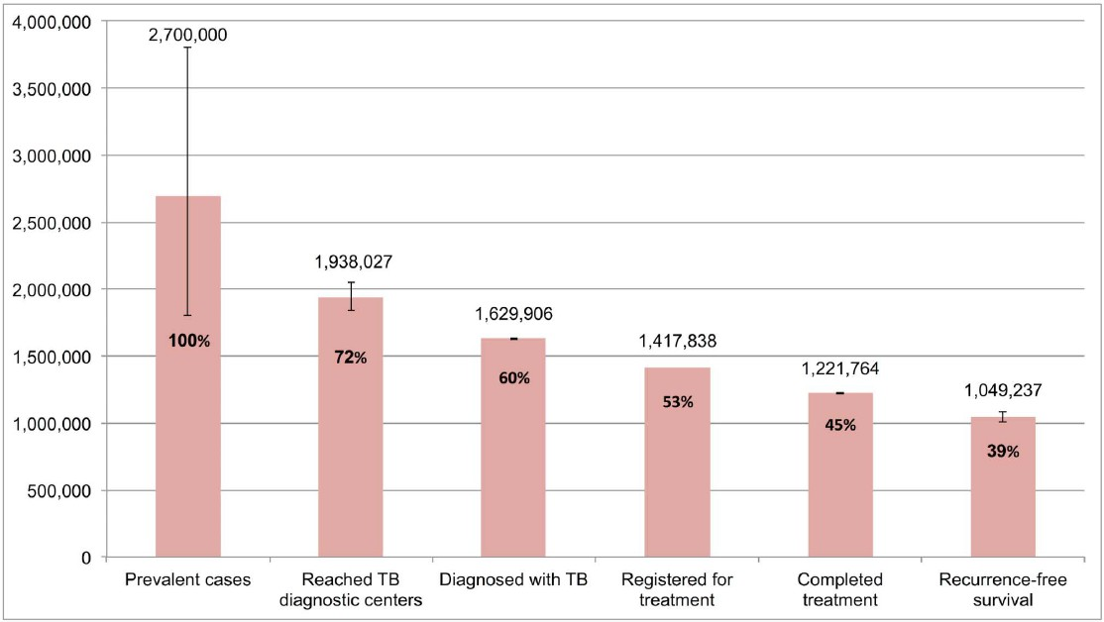
Diagnosis remains a critical challenge
Subaramman R et al, PLoS Med 2016

Slide 15
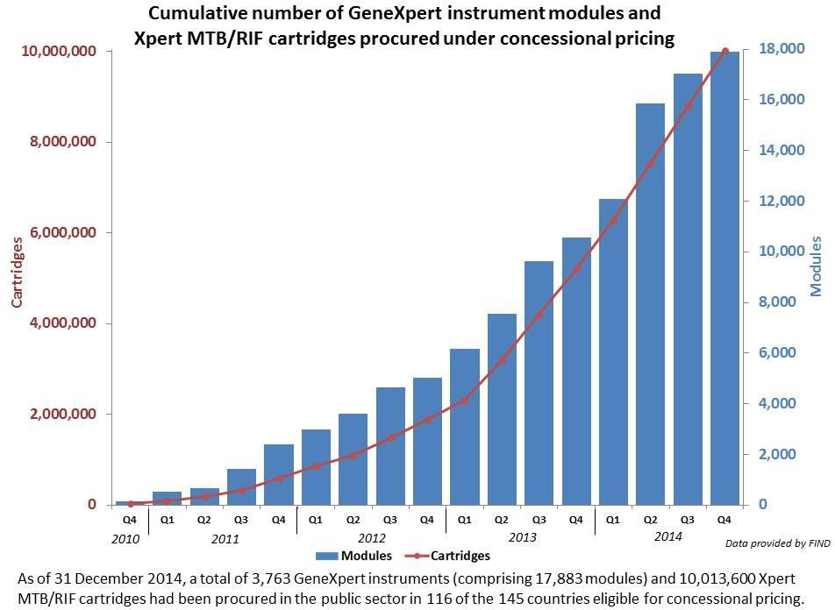
Xpert MTB/RIF - a game changer?
First molecular TB test to be endorsed by WHO (2010)
Semi-automated
Detects TB and RIF resistance in 2 hours
Sensitivity 85%, Specificity 98%
Significant donor and country investment ➔ rapid scale-up in high burden countries

Slide 16
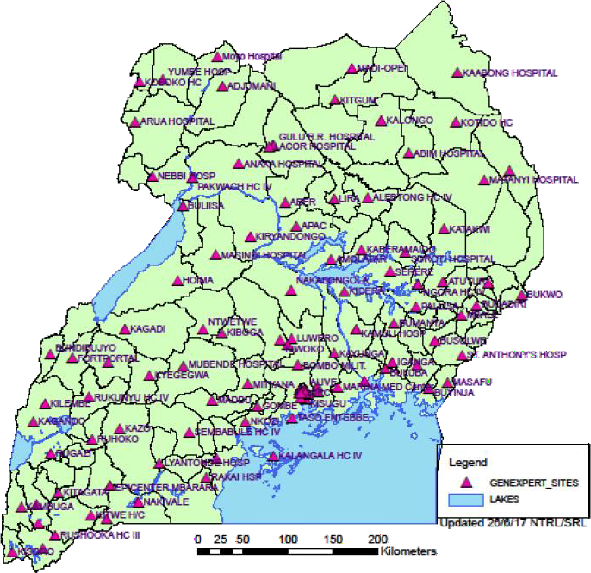
Uganda Context – Key successes
Among global leaders in Xpert scale-up
>200 GeneXpert devices (hub-and-spoke model)
>400,000 Xpert MTB/RIF cartridges
Nearly 4-fold increase in confirmed MDR TB patients (2009 ➔ 2015)
? increase in total TB cases notified annually
40-42000 ➔ 44-45000 cases (pre-2010 ➔ 2015)
? increase in proportion of bacteriologically- confirmed TB cases
60-65% ➔ >70% (pre-2010 ➔ 2015)

Slide 17
Unresolved questions
How well are Xpert referral networks functioning?
What is the quality of TB diagnostic care within Xpert referral networks?
What policy changes and co-interventions can further enhance Xpert implementation?

Slide 18
Xpert Performance Evaluation to facilitate Linkage to TB care (XPEL TB)
AIMS
To quantify gaps in TB diagnosis at health centers linked to Xpert testing sites
To identify modifiable barriers to high-quality TB diagnostic services
Provider-level
Patient-level
Health system-level
To develop and test a theory-driven intervention to improve the quality of TB diagnostic services

Slide 19
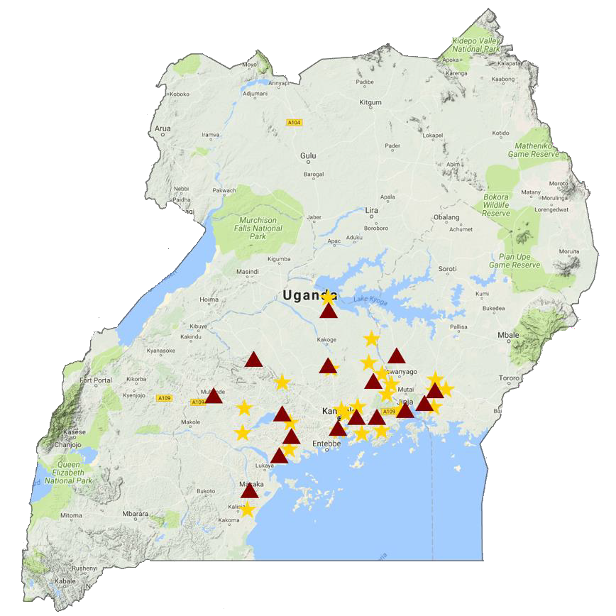
Aim 1: “Define quality gap”
Study setting
24 health centers (spokes) linked to 16 Xpert testing
sites (hubs)
Selected based on 2015 NTLP case notification data
Study design: Prospective cohort study
Participants: All adults undergoing TB evaluation

Slide 20

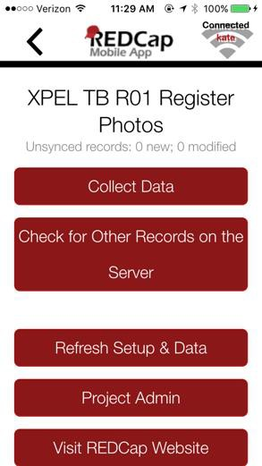
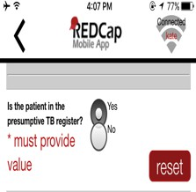


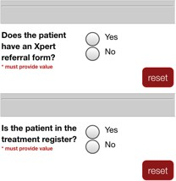
Methods
Data collection from routine data sources
Data sources: Presumptive TB register, TB laboratory register, Xpert
requisition forms, TB treatment register
1. Take & upload photos
2. Extract patient-level data
3. Resolve queries
Health Center Staff (every 2 weeks)
Study Staff
Study Staff/Health Center Staff
GxAlert server data used to ensure complete capture of Xpert results

Slide 21
Quality of TB diagnostic evaluation
6744 adults undergoing pulmonary TB evaluation (Jan – Dec 2017) | % | Range
Indicator 1: Proportion referred for sputum-based TB testing | 79% | 59 – 92%
Indicator 2: Proportion completing recommended TB testing (if referred) | 56% | 21 – 81%
Indicator 3: Proportion treated within 14 days (if smear- or Xpert-positive) | 75% | 14 – 100%
Indicator 4: Proportion receiving ISTC-recommended care | 42% | 16 – 64%
Davis JL, Katamba A et al. AJRCCM. 2011 Farr K, Nalugwa T et al. JC TUBE 2019

Slide 22
Utilization of Xpert testing
17% (365/2091) of patients referred for Xpert testing
34% (267/779) of HIV-positive adults
7% (98/1312) of HIV-negative adults
<5% (14/365) of patients referred for Xpert as first-line test
<50% (20/48) of Xpert-positive patients initiated treatment within 14 days
Median time-to-treatment: 7 days (IQR 1 – 17)
High coverage of Xpert testing services ≠ High quality care
Farr K, Nalugwa T et al. JC TUBE 2019

Slide 23
Aim 2: “Understand quality gap”
Conceptual Model: Theory of Planned Behavior
Patient Factors
Time/distance to access care
Cost to access care
Knowledge/skills
Attitudes
Social Norms
Self-efficacy
Intention to Follow ISTC
ISTC
Adherence
Case Detection and Treatment
ISTC, International Standards for TB Care
Health System Factors
Physical Resources
Material Resources

Slide 24
Methods
Data collection
Key informant interviews (N=22 staff at 6 health centers)
Field observation
Surveys (N=64 presumed TB patients at 6 health centers)
Analysis
Qualitative data
Transcribe interviews and field notes
Apply standard coding scheme to identify recurring themes/sub-themes
Quantitative data: descriptive statistics

Slide 25
Aim 2 Summary: Barriers to high-quality TB evaluation
PRECEDE framework | Recurring themes
Predisposing factors (Knowledge, attitudes, beliefs, intention) | Time and resource constraints (i.e., high workload) ➔ low self-efficacy Belief that TB evaluation is not urgent
Enabling Factors (Factors that if addressed make it easier to initiate the desired behavior) | Failure of patients to return after initial visit (due to time and costs) Inconsistent/delayed specimen transport to Xpert testing sites Inability to track and follow-up patients “When they have a cough for more than 2 weeks they are sent to the lab. But the problem is they get the first sample and sometimes, actually most times they don’t bring the second sample.”
Reinforcing Factors (Factors that if addressed make it easier to continue the desired behavior) | Lack of communication and coordination among staff Insufficient oversight from NTP “…Actually at times we have met but we don’t meet [regularly], only when we realize there is a problem that’s when we communicate and say why is this happening, then we try to rectify.”
1. Shete P, Haguma P et al. IJTLD 2015; 2. Nalugwa T, Shete PB et al. BMC Health Serv Res 2020; 3. Cattamanchi A et al. BMC Health Serv Res. 2015

Slide 26
Aim 3: “Improve quality gap”
Intervention design process:
Evidence review
Stakeholder consultation
Feasibility
Prioritize barriers
Select interventions
Specify how interventions delivered

Slide 27

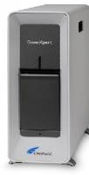

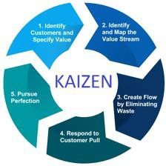
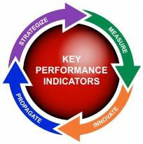
XPEL TB STRATEGY
Onsite Xpert testing using GeneXpert Edge at health clinic
Reduce workload, increase speed and accuracy of testing
Clinic process redesign to facilitate same day testing and treatment of TB
Address lack of urgency and failure of patients to return
Regular feedback of quality metrics to health facility staff
Improve communication, coordination and oversight

Slide 28
Intervention pilot – Single-arm interventional trial
1212 adults undergoing TB evaluation at 4 health centers | % | Range
Indicator 1: Proportion referred for sputum-based TB testing | 99% | 95 – 100%
Indicator 2: Proportion completing TB testing (if referred) | 99.6% | 99 – 100%
Indicator 3: Proportion treated within 14 days (if smear- or Xpert-positive) | 85% | 81 – 92%
Indicator 4: Cumulative probability of being diagnosed and treated | 84% | 76 – 92%
Xpert Utilization
91% (995/1091) of smear-negative patients received Xpert testing
76% (28/37) of Xpert-positive patients initiated treatment
Shete PB, Nalugwa T et al. IJTLD. 2017

Slide 29
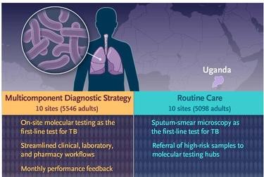
XPEL TB trial design and population
Objective: To evaluate the effectiveness, implementation and costs/cost-effectiveness of the XPEL TB strategy at community health centers.
Design: Cluster-randomized, hybrid effectiveness implementation (Type 2) trial at 20 community health centers in Uganda
Population: All adults evaluated for pulmonary TB from Oct 2018 to Mar 2020
Patients with RIF resistance excluded from analysis
Reza T, Nalugwa T et al. Implement Sci 2020 Cattamanchi A et al. NEJM 2021

Slide 30

XPEL TB trial procedures
Public randomization ceremony
restricted + stratified randomization using 2017 TB data
“Ultra-pragmatic features”
Waiver of informed consent
No trial-specific changes to usual care (e.g., no CXR, culture, additional patient contact)
Outcomes assessed using routine data sources (i.e., TB registers)
Minimal contact with health centers
initial training visit + quarterly site visits to resolve data queries and
conduct nested sub-studies
Reza T, Nalugwa T et al. Implement Sci 2020

Slide 31
XPEL TB trial effectiveness outcomes
Secondary outcomes:
Care Cascade | Outcome
Testing | Number completing TB testing per national guidelines
Diagnosis | Number diagnosed with confirmed TB*
Treatment | Number treated for confirmed TB*
Treatment | Number treated for TB*
Primary outcome:
Number of patients treated for microbiologically- confirmed TB within 14 days
*Assessed within 1-day (same-day) and 14 days
32

Slide 32
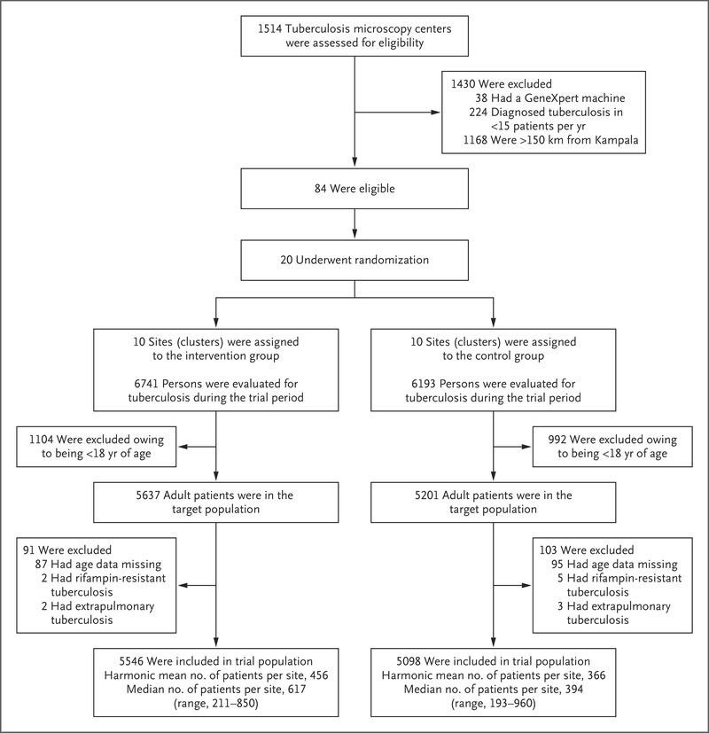
Trial flow chart
20 of 84 eligible health centers
selected and randomized
>10,000 in target population (adults
evaluated for pulmonary TB)
<2% excluded
Harmonic mean number of patients
higher in intervention arm (456 vs. 366)
Cattamanchi A et al. NEJM 2021 ₃₃

Slide 33
Patient-level characteristics
Characteristic | Intervention (n=5,546) | Control (n=5,093)
Female – no. (%) | 3289 (59.3) | 3112 (61.0)
Age in years – median (IQR) | 40 (30-52) | 38 (27-50)-
HIV status* – no. (%)
Positive | 2,285/5273 (43.3) | 1,905/4290 (44.4)
Negative | 2,988/5273 (56.7) | 2,385/4290 (55.6)
Cattamanchi A et al. NEJM 2021 ₃₄

Slide 34
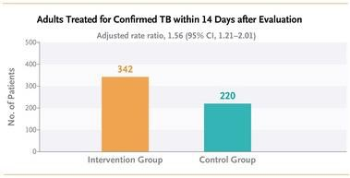
Primary outcome
Cluster-level analysis using negative binomial regression models
Adjusted rate ratio: 1.56 (1.21– 2.01)*
* Adjusted for: Randomization strata, number of patients treated for confirmed TB within 14 days in 12-month pre-trial period
Cattamanchi A et al. NEJM 2021 ₃₅

Slide 35
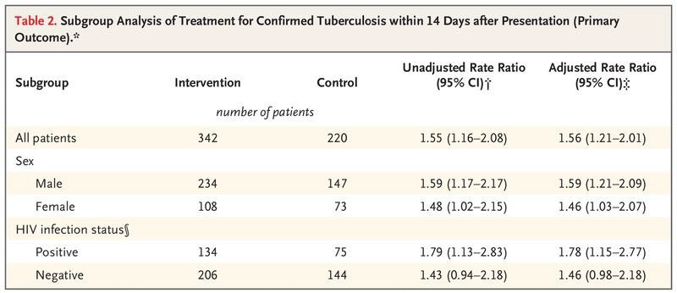
Subgroup analyses of primary outcome
* Adjusted for: Randomization strata, number of patients treated for confirmed TB within 14 days in 12- month pre-trial period
Cattamanchi A et al. NEJM 2021 ₃₆

Slide 36
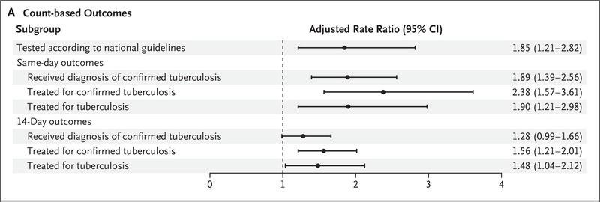
Secondary outcomes
High implementation fidelity and improved quality across the cascade of care
Cattamanchi A et al. NEJM 2021 ₃₇

Slide 37
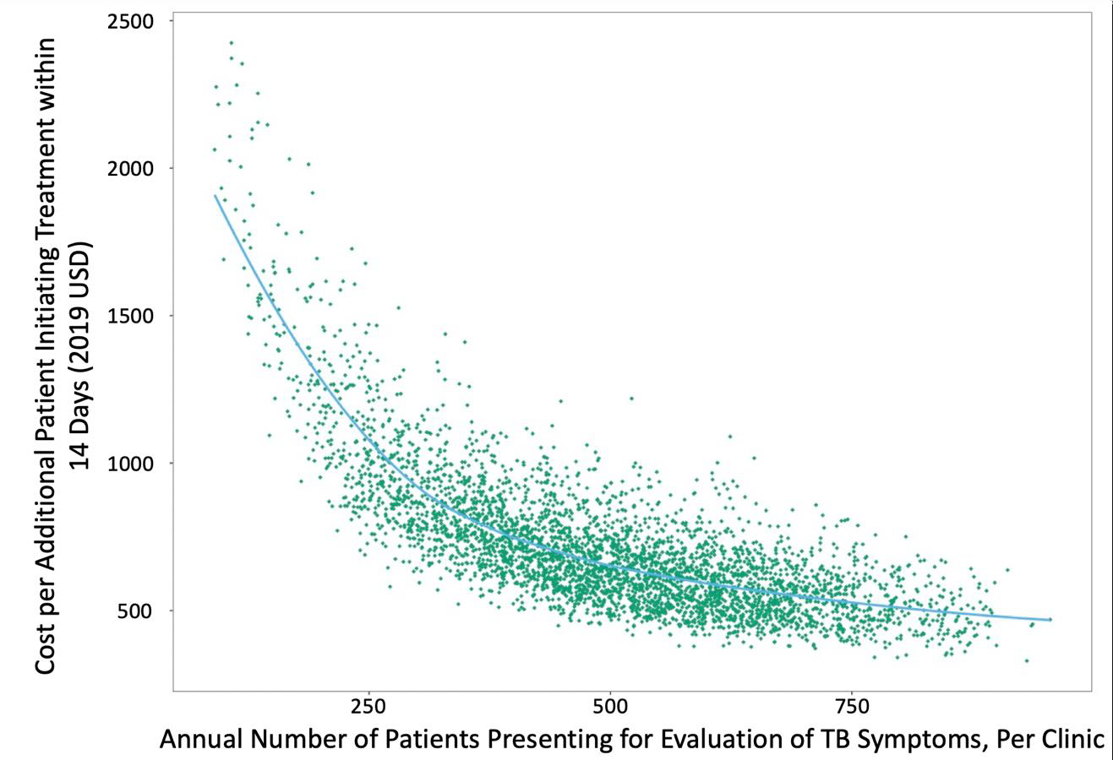
Costs and incremental cost-effectiveness ratio (ICER)
Outcome | Centralized testing | Decentralized testing
Cost per test | $20.61 (18.63 27.20) | $20.46 (17.85, 25.72)
Cost per patient | $9.59 (7.62, 14.34) | $20.28 (17.68, 25.48)
ICER* |  | $687 (501, 1,207)
* Cost per additional treatment within 14 days
38

Slide 38
Key limitations
Potential imbalance in the underlying prevalence of TB and other factors by trial arm given relatively small number of clusters
Multi-faceted intervention – effect of decentralized molecular testing alone unknown
Generalizability – uptake and impact of intervention strategy in other high burden countries uncertain
39

Slide 39
Conclusions
Scale-up of novel diagnostics alone is unlikely to significantly increase case detection or improve patient outcomes
The XPEL TB strategy (onsite Xpert testing + implementation supports)
increased 14-day TB diagnosis and treatment by 56%
improved quality metrics at each step along the TB diagnostic evaluation cascade of care
National TB programs should consider decentralized molecular testing to close
the case detection gap and improve quality of care
Implementation science-based methods are useful for designing and evaluating
health system interventions to improve quality of care
40

Slide 40

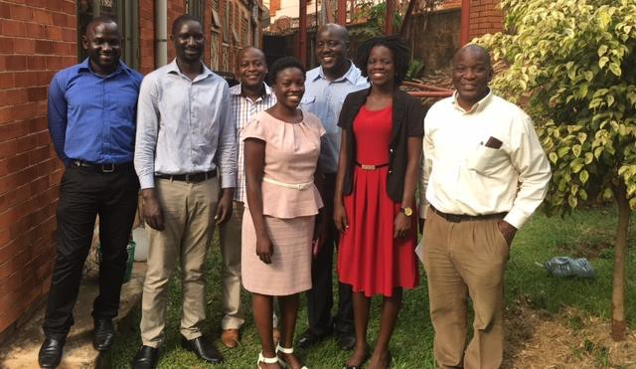



Acknowledgments
Tania Reza Katherine Farr Priya Shete Margaret Handley Sara Ackerman
Stavia Turyahabwe Frank Mugabe Moses Joloba Abdunoor Nyombi Diana Nadunga Faith Alikoba
Jane Babirye Godfrey Ekuka Nelson Mody Marvin Mugisa
Uganda TB Implementation Research Consortium: XPEL TB study Alex Kityamuweesi, Denis Oyuku, Joseph Ggita, Talemwa Nalugwa, Chris Ojok, Mariam Nantale, Achilles Katamba. Not shown: Irene Ayakaka, Sara Nabwire, Priscilla Haguma, Emma Ochom, Diana Babirye, Annette Sany
J. Lucian Davis
David Dowdy Hojoon Sohn
Funding
NIH/NIAID R21AI096158 (Cattamanchi) MRC/Wellcome Trust/DFID Pilot Grant (Moore) NIH/NHLBI R01HL130192 (Cattamanchi)
UCSF CFAR Pilot Award (Shete)
David Moore Katherine Fielding

