Slide 2
Mass Timber Case Studies: Understanding the Natural Climate Solutions role of mass timber constructions through the lens of Life Cycle Assessment

Slide 3
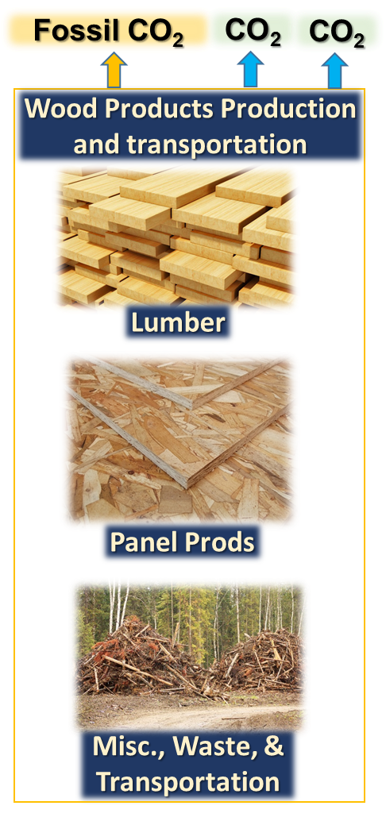
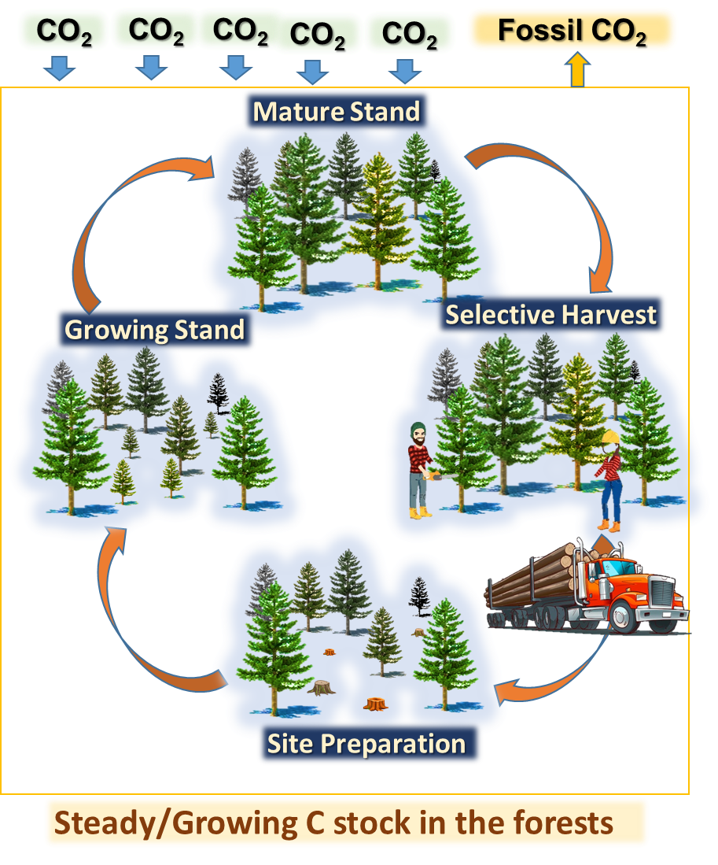
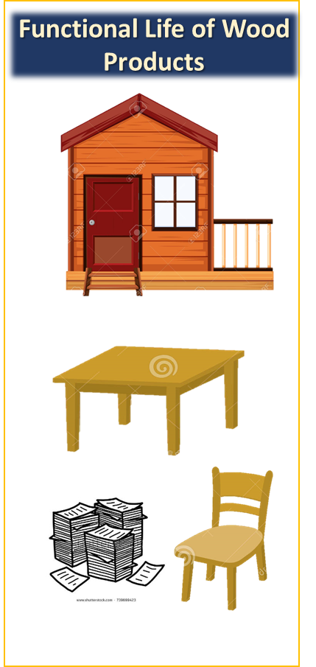
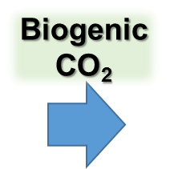
Aspects of environmental assessment of wood products
C stock in the wood products

Slide 4
How is radiative forcing used to measure impact of carbon stored in wood products?
Methodology for factoring-in impacts of wood products
Sequestered Carbon in Products: To quantify the benefits of carbon storage in a forest product, we apply the Bern Carbon cycle model over the lifetime of the product and then calculated a negative GWP.
Production Emissions: The LCA based Global Warming Potential (GWP) associated with production emissions were subtracted from GWP benefits of storing carbon in the product.
Environmental Impact
Carbon-footprint
or
embodied carbon
CO₂ drawdown from the atmosphere
The longevity of the product: To analyze the data of products in use over the life-span of the product, we applied the CO₂ decay curve at each time interval, taking into account the proportion of product still in use.
Carbon storage

Slide 5
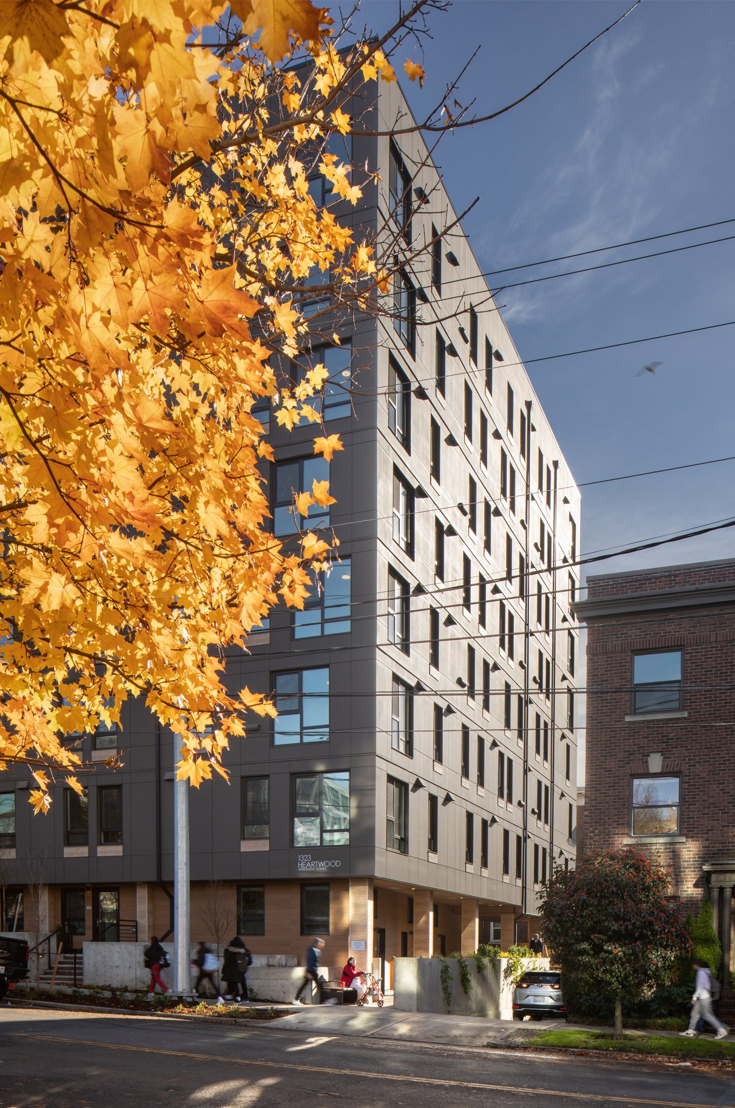
Case Study 1: The Heartwood project, Seattle Life Cycle Assessment of middle-income multifamily mass timber building

Slide 6
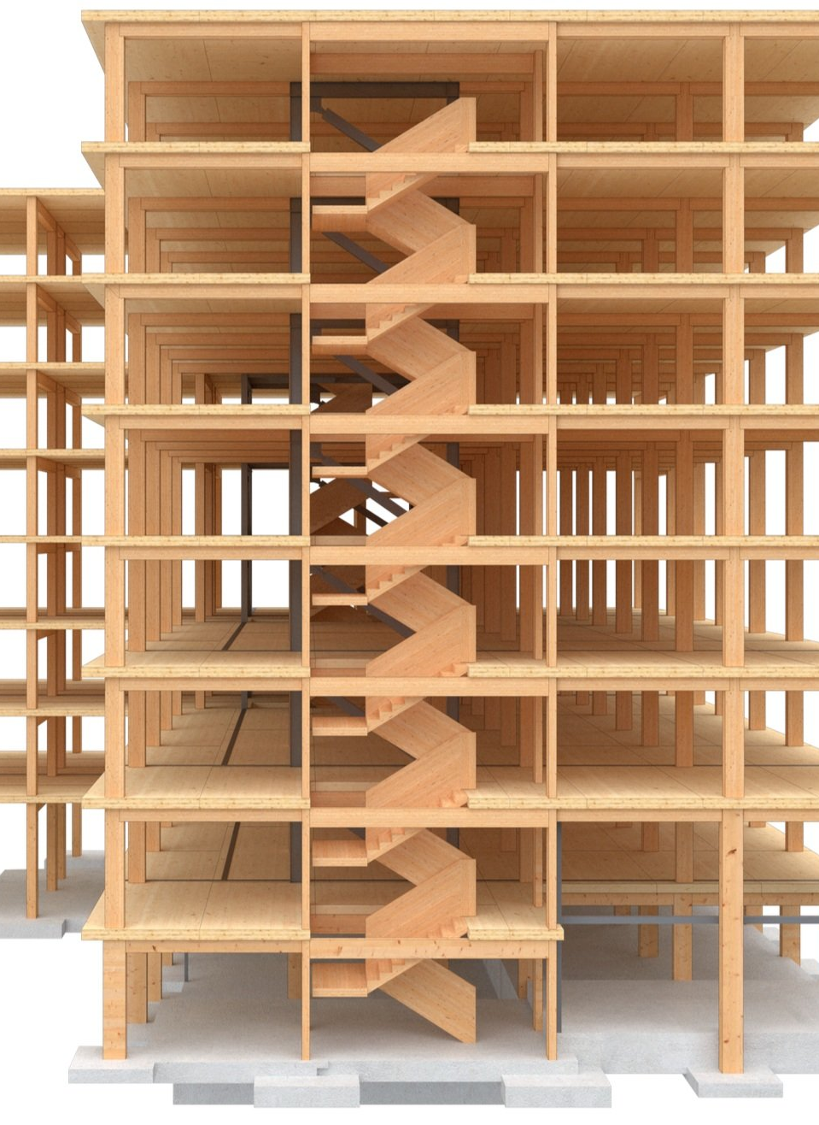
The Heartwood project
67 thousand square feet mass timber building
8-story residential building
Located in Seattle’s Capitol Hill neighborhood
Heartwood is an that utilizes
CLT floor panels & glulam post-and-beam system.
The building staircase is made with mass plywood panels.

Slide 7
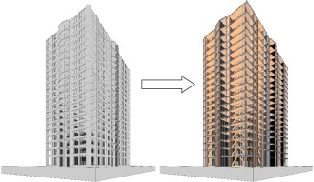
Comparative Life Cycle Assessment (LCA)
Understanding the environmental impact of mass timber buildings is critical to determine the environmental implications of transitioning construction from steel and concrete to CLT.
In this study, the environmental impact of the Heartwood building is evaluated and compared against the environmental impact of a reinforced concrete building with comparable functional characteristics.

Slide 8
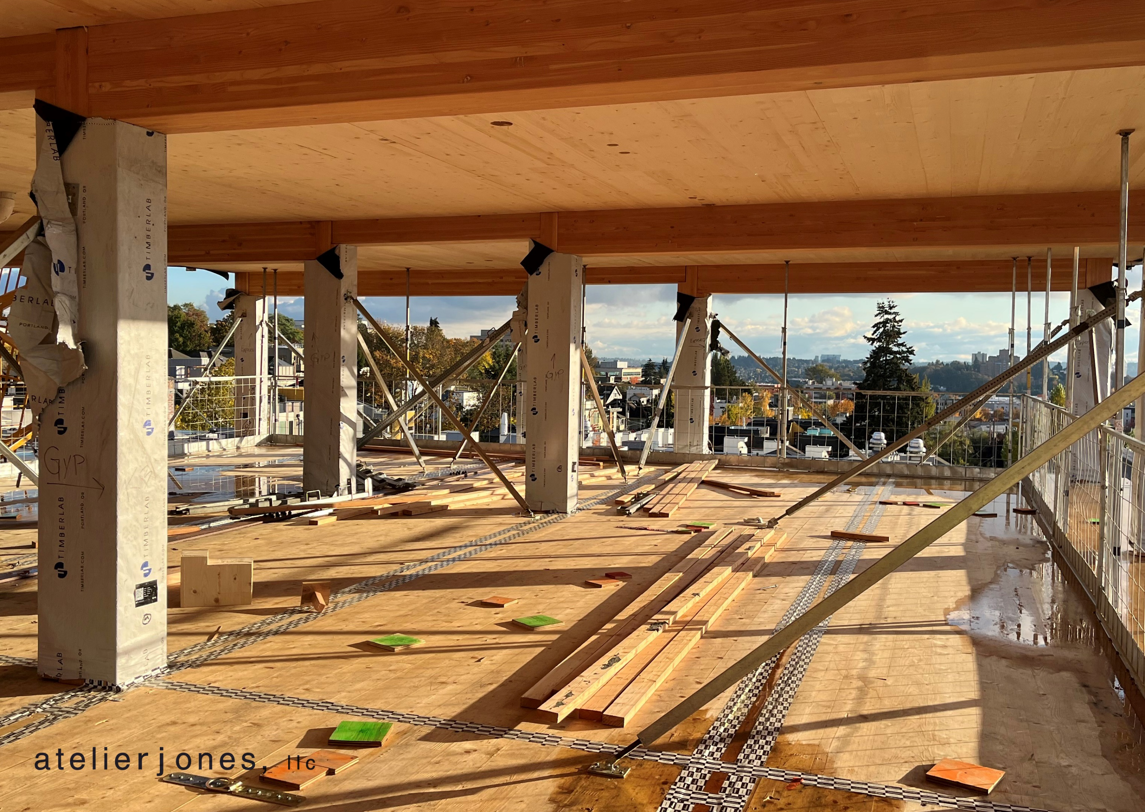
Materials and Methods
LIFE CYCLE ASSESSMENT
Life Cycle Assessment (LCA) is an internationally recognized method to evaluate the environmental impact of products and processes throughout their life cycle. An LCA was performed to compare the environmental impacts of the Heartwood building and a building with similar functionalities but constructed with reinforced concrete. The material take-offs for the Heartwood building are reported on next page. The total floor area of the building is 6,616.53 m².

Slide 9
Material Take-Offs for the Heartwood Building

Slide 10
COMPARATIVE RESULTS - HEARTWOOD BUILDING VS CONCRETE BUILDING
BY MATERIAL
reduction in fossil GHG emissions

Slide 11
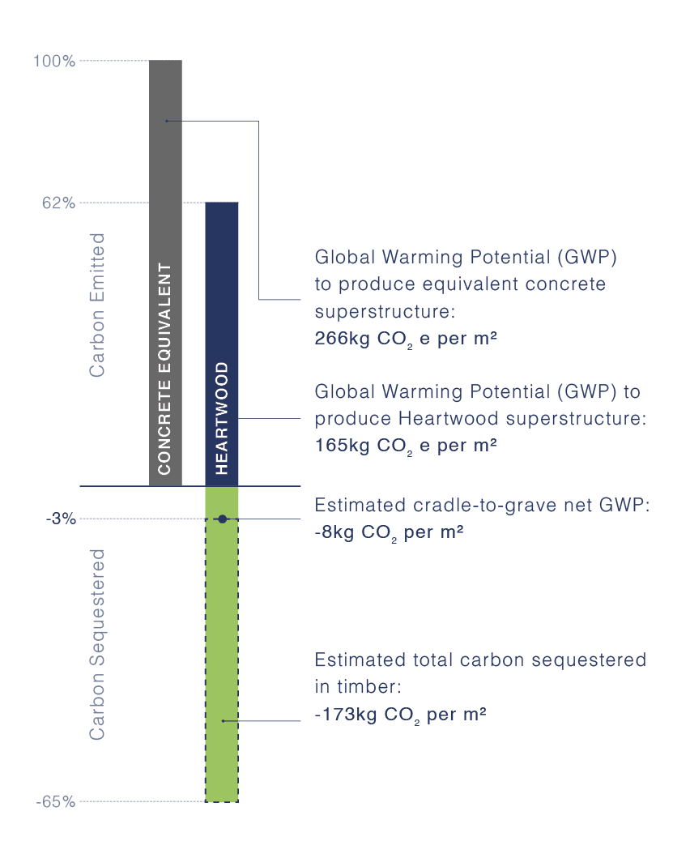
Net Carbon Footprint Analyses after factoring in radiative forcing reduction due to stored biogenic carbon

Slide 12
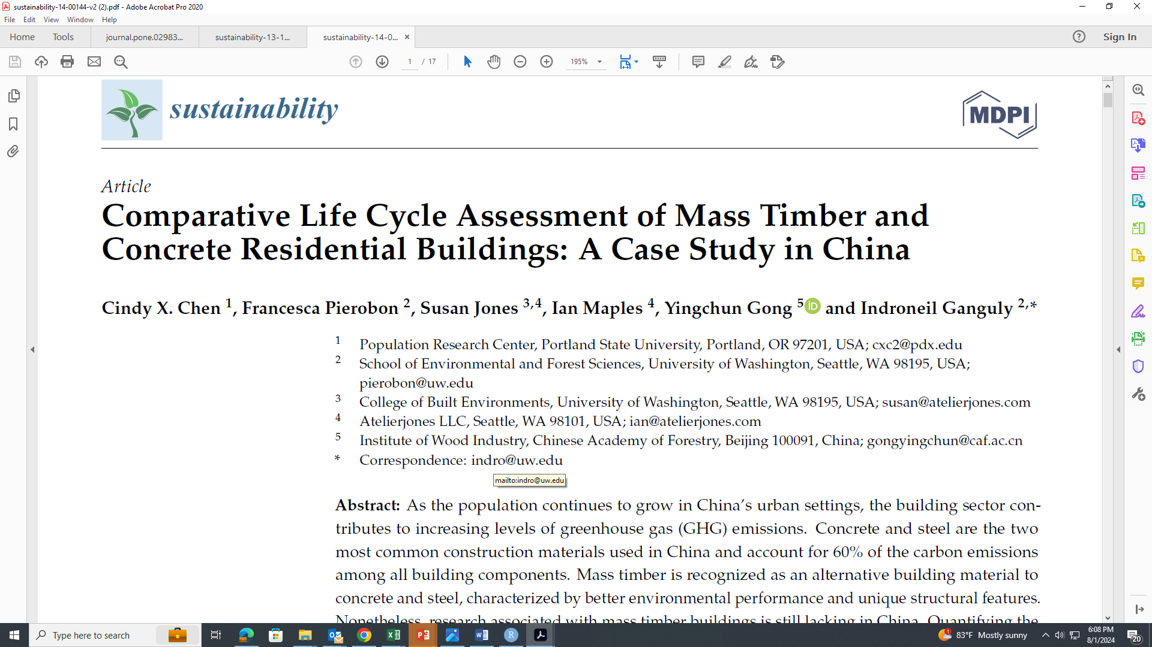
Case Study 2: Hypothetical Analyses in China
A research conducted in collaboration with researchers from the Chinese Academy of Forestry

Slide 13
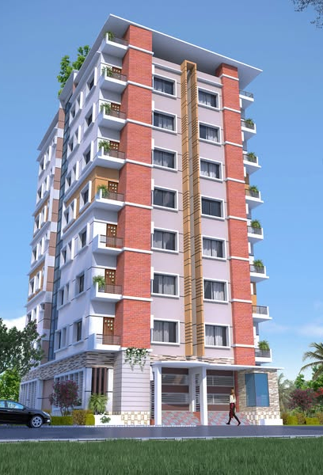
Scope of this study
The primary goal of this study was, using a cradle-to-gate LCA model, to evaluate the environmental impacts of a timber building and a functionally equivalent conventional concrete building in China.
Both buildings are 8-story residential buildings with an 80-year service life. Each building has a total area of 3524 m2.
The timber building design was based on design data provided by a Chinese architecture firm for a functionally equivalent concrete building.

Slide 14
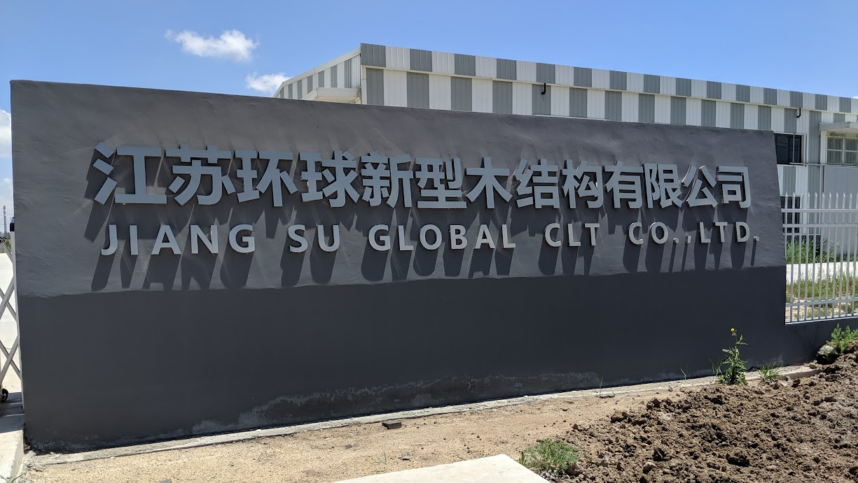
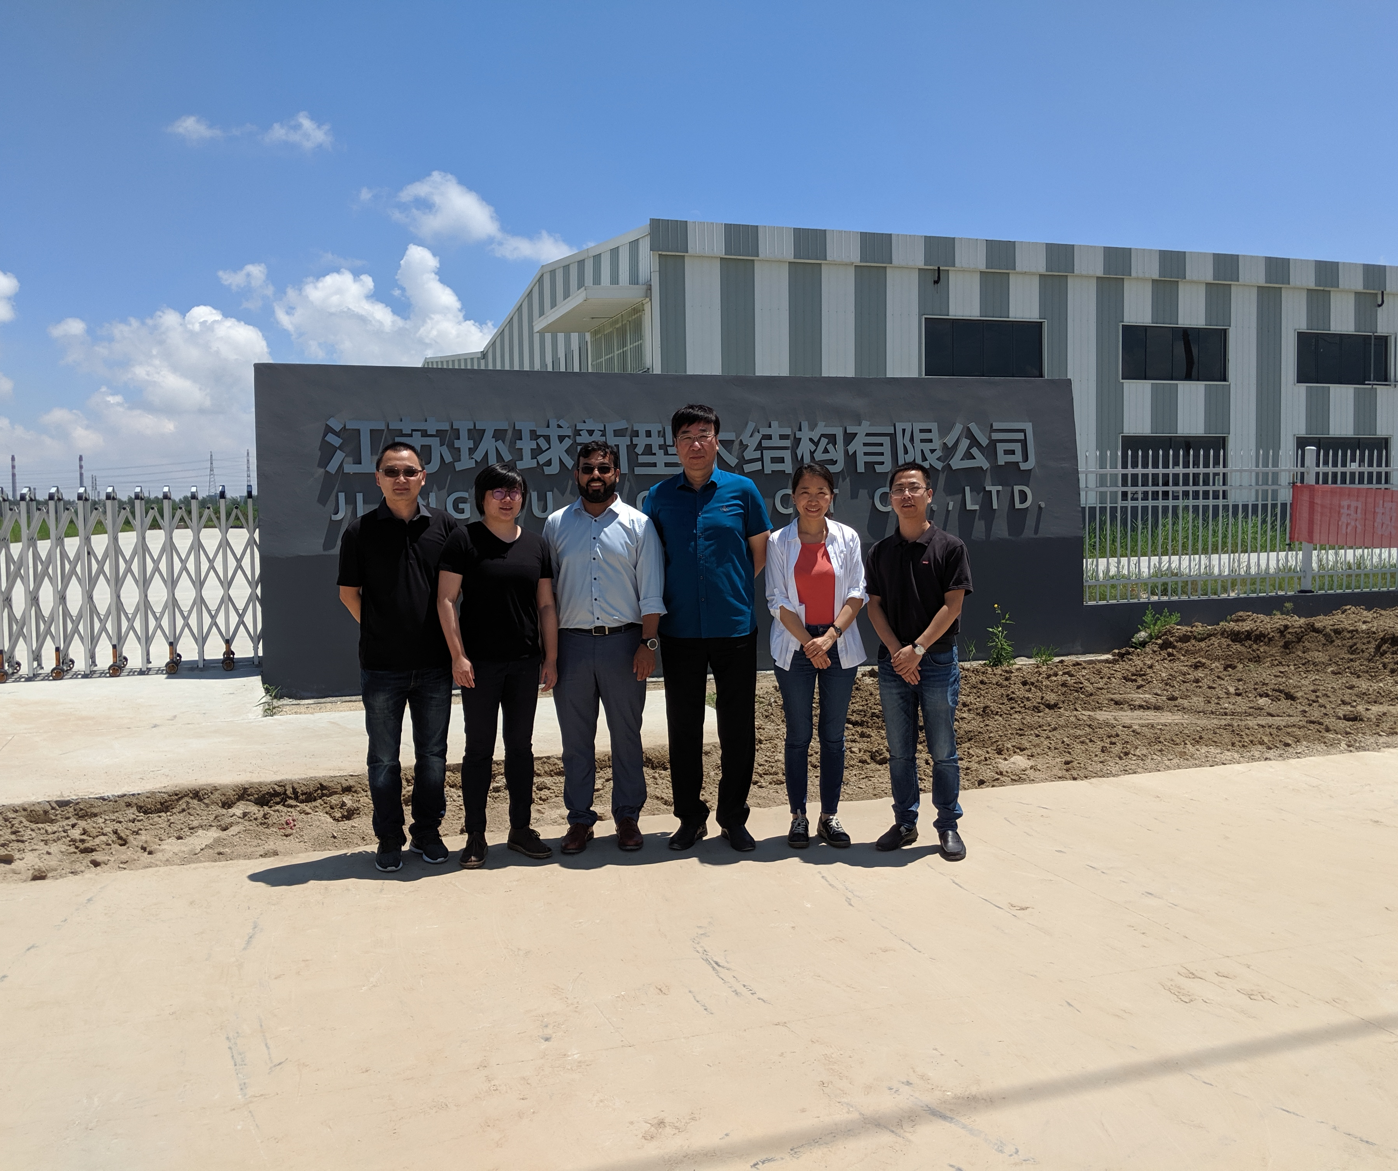
Data collection and analyses
A joint team of University of Washington (UW) and Chinese Academy of Forestry (CAF) researchers visited all the sites and collected the necessary data.
The Nature Conservancy (TNC) and Atelierjones also supported the study
The masstimber producers in China agreed to share their production emissions data
The UW researchers did the necessary analytical

Slide 15
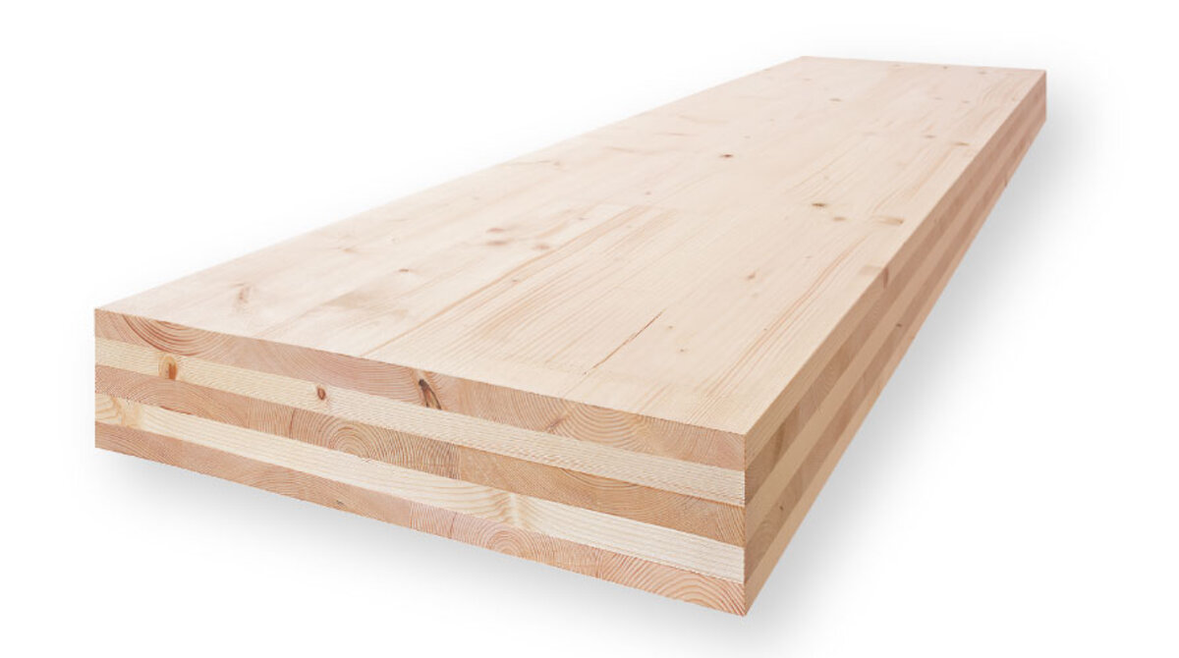
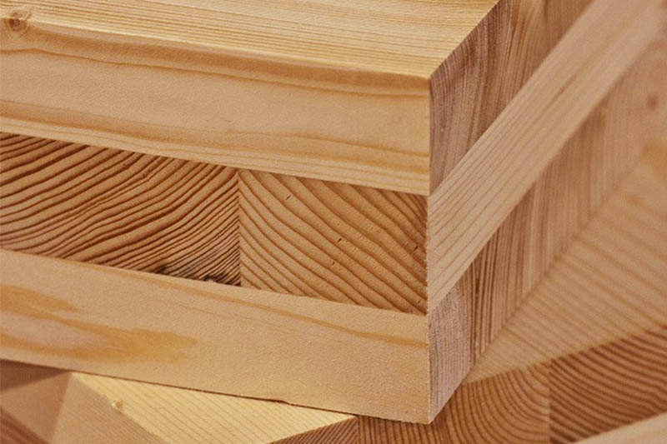
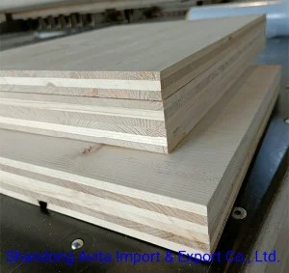
Masstimber related data and assumptions
European Spruce CLT
Douglas Fir CLT
Radiata Pine CLT
Data associated with the production of CLT, including lumber sourcing, wood species mix, waste treatment, resin types, transportation mode, and production capacity, were gathered through surveys collected during an onsite visit to a CLT manufacturing facility in Southeast China
It was assumed that the mass timber was made with spruce lumber imported from Finland and manufactured in China – based on the existing practice of the production facility.

Slide 16
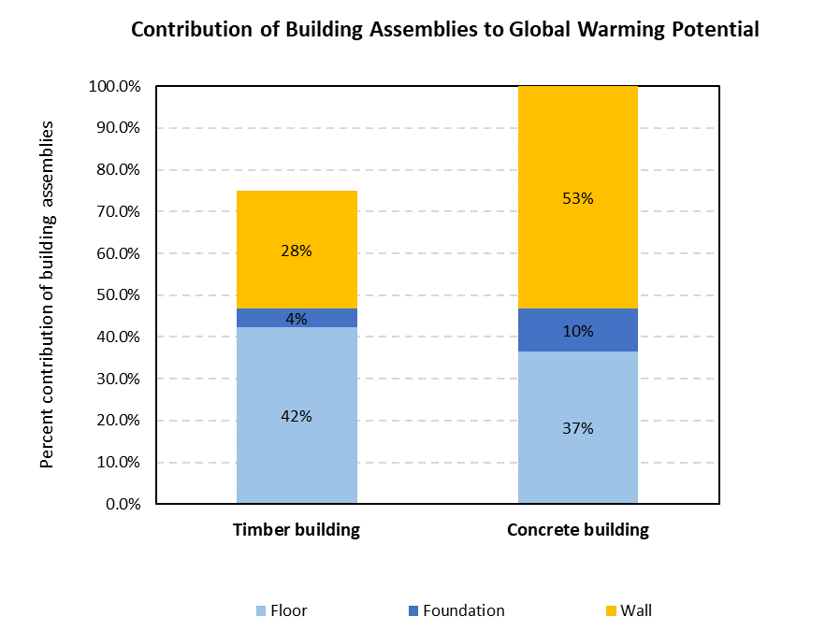
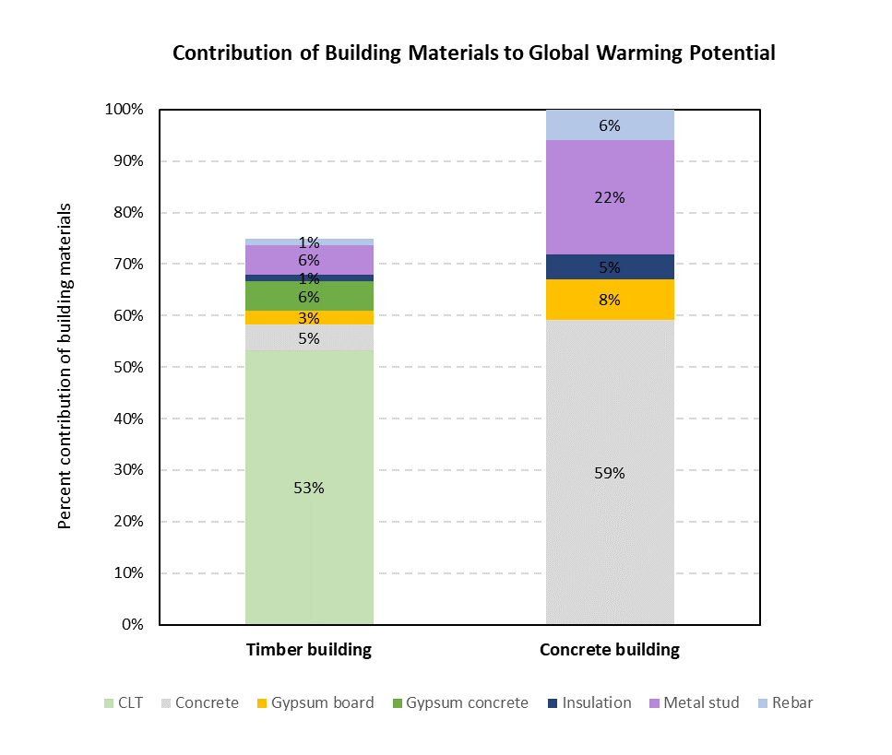
The results of comparative LCA
Contribution of building assemblies to total GWP.
Contribution of building materials to total GWP.

Slide 17
Result Interpretation
While there was a 25% reduction in the overall carbon footprint of the construction in China, the results were not as favorable as we have seen in the US or Europe.
Reasons:
Wood transportation: ocean transportation of the lumber from Europe played a significant role, however, the domestic road transportation within China first the lumber (250 km), then the CLT panels to construction site by truck played an even bigger role.
Mass Timber manufacturing: Given the early production process, there were some inefficiencies, especially drying the lumber from 19% MC to 12% MC using natural gas, played an important role
Code related design choices: Given lack of established code at the time of this research, we used a conservative hybrid design, with some overengineering.
General Material Sourcing: Most of the traditional construction material availability is established leading to scale advantages.

Slide 18
Thank you for your patience Questions?
My Contact Details …..
Indroneil Ganguly
Associate Professor and Associate Director
Center for International Trade in Forest Products
University of Washington
Box 352100
Seattle, WA 98195
Office: (206) 685-8311
E-mail: indro@uw.edu

Slide 19
Another Case: I will not discuss… Hybrid masstimber building: Comparative Whole Building LCA …. In Seattle

Slide 20
Project’s goal
Develop a comparative cradle-to-gate Life Cycle Assessments (LCA) of:
Hypothetical hybrid CLT building built in Washington State using wood from CLT facilities in the U.S. Pacific Northwest (Hybrid CLT building), and
Traditional reinforced concrete building (Reinforced concrete building)

Slide 21
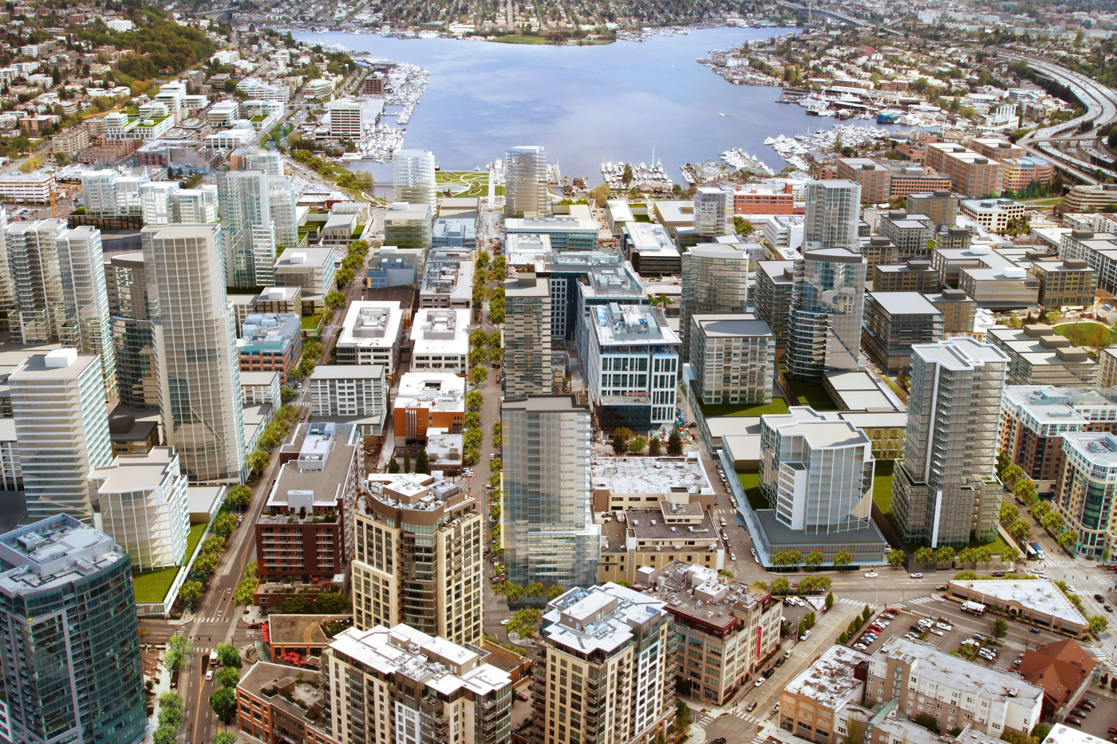
Reinforced concrete building
Seattle, South Lake Union area
Reinforced concrete building: developed starting from an existing building recently built in Seattle, whose geometry and construction were assessed to be representative of the region
Characteristics:
Mid-rise (8 stories above grade)
Commercial building
Made of reinforced concrete

Slide 22
Building geometry
Geometric properties:
Footprint: 90’x160’
Building height: 114’
Floor‐to‐floor heights: 16’ on the first floor and 14’ on typical floors
X-grid space: 30’
Y-grid space: 20’
Total floor area: 115,200 sf

Slide 23
Hybrid CLT building - Fire design scenarios
Scenario (a): Fire proofing
Scenario (b): Charring design
Char zone
Gypsum wall board
Heated zone
Solid wood with full strength
CLT panel

Slide 24
Material quantities – Building structure
Component | Material | Unit of Measure | Reinforced concrete building | Hybrid CLT building with fire proofing | Hybrid CLT building with charring design
Slabs + beams | Concrete, 5000 psi, PNW | cy | 3,927 | - | -
Slabs + beams | Steel rebar | tons | 301 | - | -
Concrete slabs | Concrete, 5000 psi, PNW | cy | - | 889 | 889
Concrete slabs | Steel rebar | tons | - | 51 | 51
CLT slabs | Cross laminated timber | ft³ | - | 39,600 | 66,000
Beams | Glue laminated timber | ft³ | - | 18,228 | 29,123
Columns | Concrete, 5000 psi, PNW | cy | 747 | - | -
Columns | Steel rebar | tons | 205 | - | -
Columns | Glue laminated timber | ft³ | - | 4,733 | 8,099
Steel connections | Steel | tons | - | 11 | 12
Floor underlayment | Gypsum wallboard | sf | - | 115,200 | 115,200
Fireproofing | Gypsum wallboard | sf | - | 460,800 | 0

Slide 25
System boundary
PRODUCT STAGE
CONSTRUCTION STAGE
A1
RAW MATERIAL SUPPLY
A2
TRANSPORT TO MANUFACTURER
A3
MANUFACTURING
A4
TRANSPORT TO CONSTRUCTION SITE
A5
CONSTRUCTION-INSTALLATION
Energy
Ancillary materials
Energy
SYSTEM BOUNDARY (CRADLE-TO-GATE)
Ancillary materials
Manufacturing of building components
(Glulam panels,
Cross Laminated Timber panels,
Steel reinforcement bars
Steel connections,
Nails, screws nuts and bolts,
Concrete,
Gypsum wall board,
Moisture resistant gypsum wallboard,
Coarse aggregate natural,
Fiber glass reinforced board,
Polyethylene,
PVC ,
EPDM membrane,
Polyiso foam board,
Drainage mat)
Energy (diesel, gasoline)
Energy (diesel, gasoline)
Extraction of raw materials from the environment
(Sawn wood,
Gypsum,
Iron,
Silica,
Crude oil,
Water)
Construction of the building
(Building Structure,
Subgrade,
Lateral,
Exterior wall,
Roof)
Waste management processes
FUNCTIONAL UNIT:
1 m² of total floor area
Transportation of raw materials to the manufacturing facilities
Transportation of building components to the construction site and on site transport

Slide 26
Results of the comparative analysis
Replacing fireproofing with charring is beneficial
GWP
-26.5%
Smog increases in the hybrid CLT building with fire proofing

