Slide 1
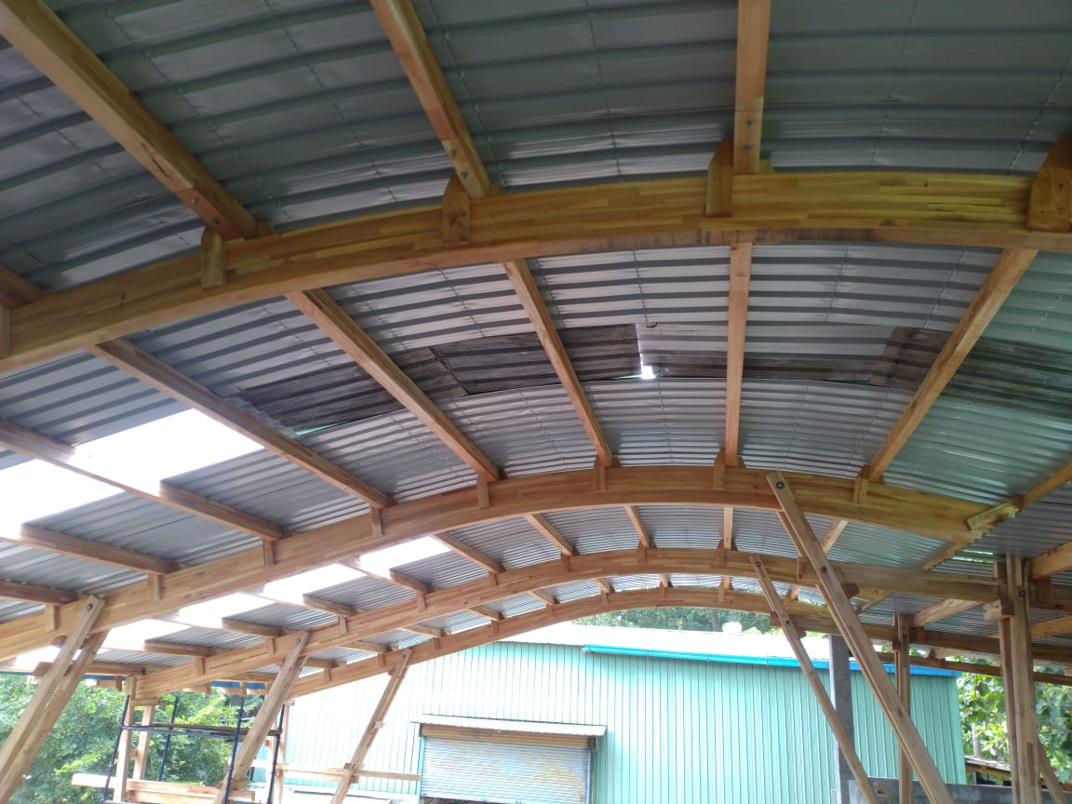
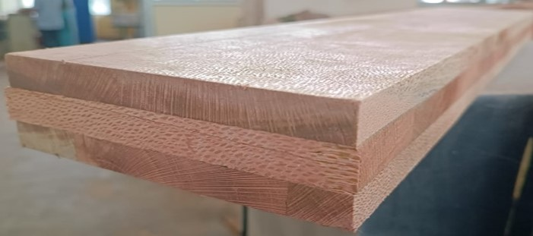
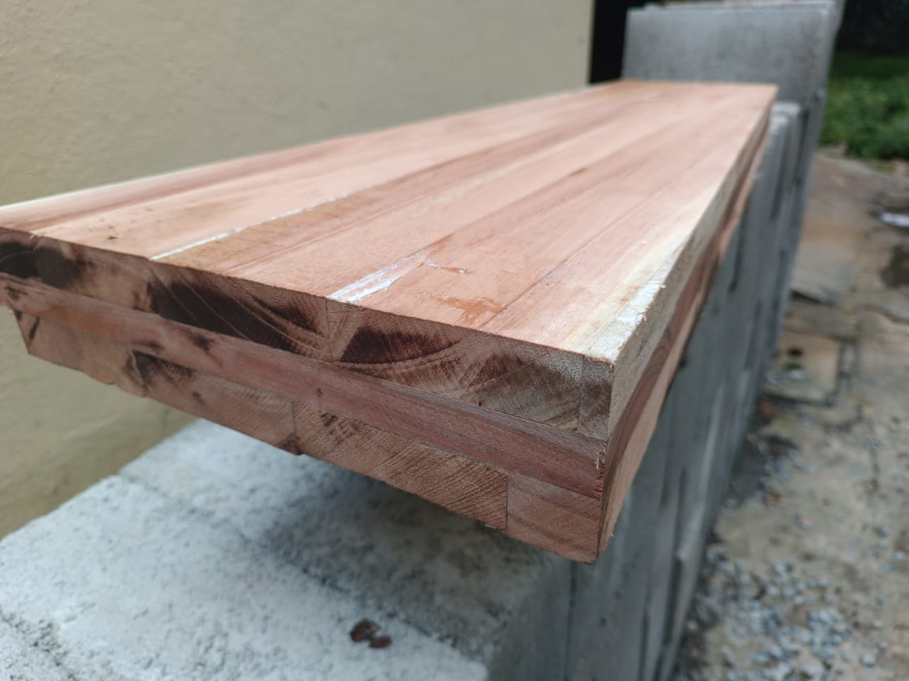


Mass Timber based construction: Indian Perspective
Anil Kumar Sethy
ICFRE-Institute of Wood Science and Technology Bengaluru

Slide 2
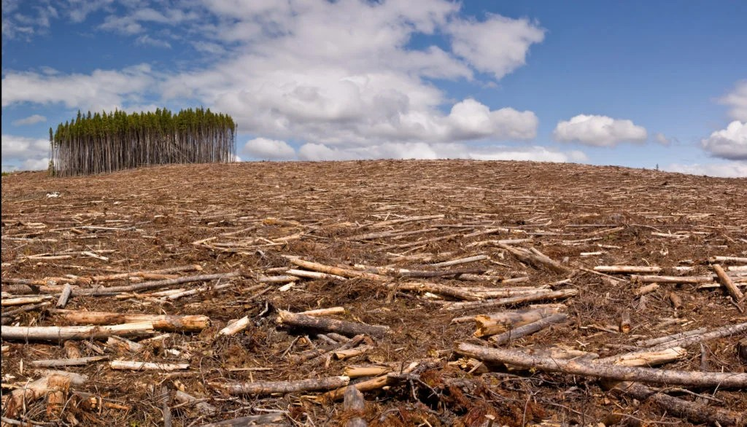

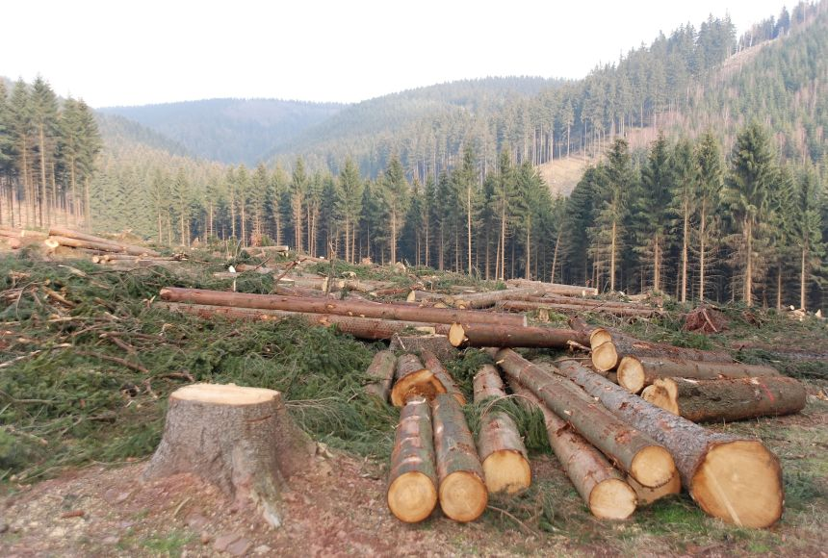
Wood Use
Two Schools of thoughts:
Deforestation

Slide 3


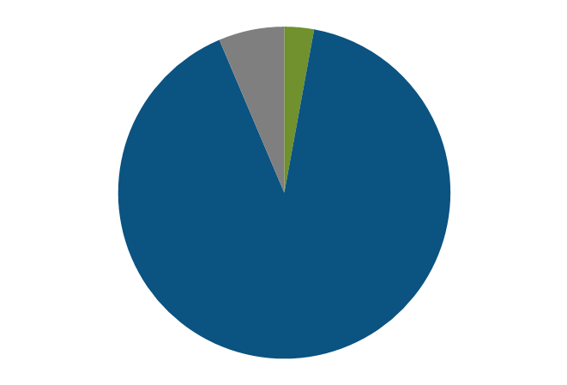
Different sources of wood
(in million CBM)
2.7
6
85.16
Forest
TOF
Import

Slide 4
Wood: A Preferred Material
Technical Properties
High Specific strength
High insulating capacity
Highly predictable behaviour in cases of fire
Good seismic performance
Material | Tensile strength (MPa) | Density (g/cm³) | Specific strength (kN.m/kg)
Concrete | 2–5 | 2.30 | 5.22
Polypropylene | 25–40 | 0.90 | 28–44
Low carbon steel | 365 | 7.87 | 46.4
Aluminium alloy | 310 | 2.70 | 115
Oak wood | 90 | 0.78–0.69 | 115–130
Pine wood | 78 | 0.35 | 223

Slide 5
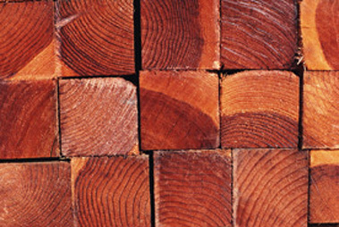
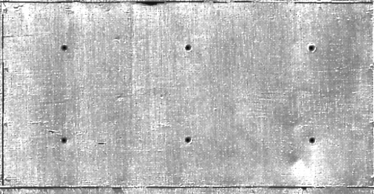
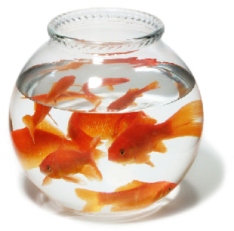
EMBODIED ENERGY IN CONSTRUCTION MATERIALS
1 tonne
1 tonne
Timber = 640 Killowatt Hours
Steel = 24 times the embodied energy of timber
Bricks = 4 times the embodied energy of timber
Concrete = 5 times the embodied energy of timber
Aluminium = 126 times the embodied energy of timber
Glass = 6 times the embodied energy of timber

Slide 6
Energy intensity classification of materials used in building construction
(Source: CPWD Guidelines for sustainable habitat, 2014)
Sl No. | Category of Material | Energy intensity (GJ/t) | Examples
i) | Very high energy | >50 | Aluminium, stainless steel, plastic, copper, zinc.
ii) | High energy | 5-50 | Cement, steel, glass, bitumen, solvents, cardboard, paper and lead.
iii) | Medium energy | 1-5 | Lime, gypsum plaster board, burnt clay brick, burnt clay brick from improved vertical shaft kiln, soil cement block, aerated block, hollow concrete block, gypsum plaster, concrete block, timber, wood products, particle board, medium density fibreboard, cellulose insulation, in-situ concrete.
iv) | Low energy | <1 | Sand aggregate, fly ash, cement stabilized earth block, straw bale, bamboo, stone.

Slide 7
Mass Timber based Constructions: Challenges
Lack of awareness and expertise
Lack of information on material suitable for production of CLT and GLT
Lack of ecosystem for production, transportation and use of mass timber
Cost and availability of materials
Lack of building codes and regulations for the use of mass timber
Long term durability of mass timber structure (against termite, fungus and humidity)
Reluctance in financing and investment including Insurance

Slide 8
Potential Solution strategy
Developing strong R&D capabilities within the country
Capacity building of architects, engineers, and builders
Creation of skilled manpower for manufacturing of mass timber
Creating entrepreneurship opportunities to promote local production
Policy Support : Developing timber-based building designs and codes
Demonstration structure

Slide 9
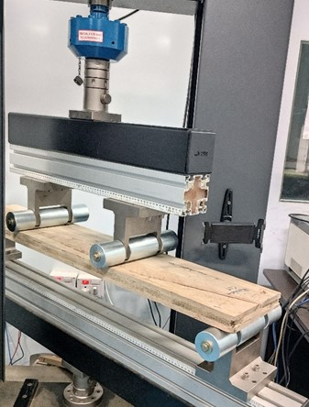
R&D initiatives by ICFRE-IWST
CLT from hardwoods
Species | MOE (MPa) | MOR (MPa) | Comp. parallel to grain (MPa) | Block shear strength (MPa)
Rubberwood | 8600 | 48.70 | 25.01 | 6.74
Melia wood | 6758 | 44.84 | 23.05 | 6.29
Silver oak | 8835 | 64.15 | 26.34 | 6.71
Eucalyptus | 13811 | 81.59 | 35.40 | 6.65
Radiata Pine | 4542 | 49.62 | 16.35 | 3.1
Chir pine | 4516 | 48.69 | 16.28 | 2.93

Slide 10
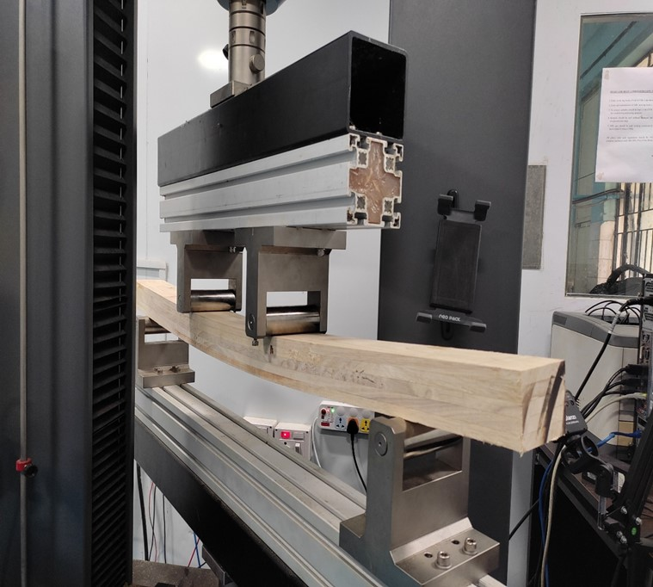
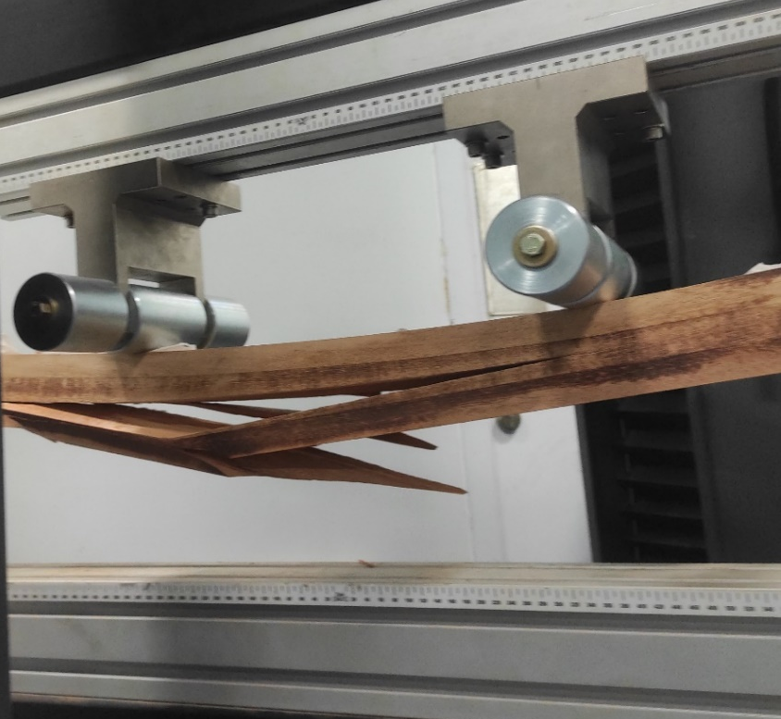
Properties of Glulam from plantation timbers
Species | MoE (Gpa) | MoR (MPa) | Shear Strength (MPa)
Melia dubia | 9.9 | 56.7 | -
Grevillea robusta | 8.0 | 46 | 7.2
Rubber wood | 10.5 | 65 | 8.4
Acacia auriculiformis | 14.5 | 44 | 8.8

Slide 11
Mass timber construction has significant potential in India, especially in terms of sustainability and reducing the carbon footprint of the construction industry.
However, overcoming the challenges will require a concerted effort from the government, industry professionals, research and educational institutions.

Slide 12
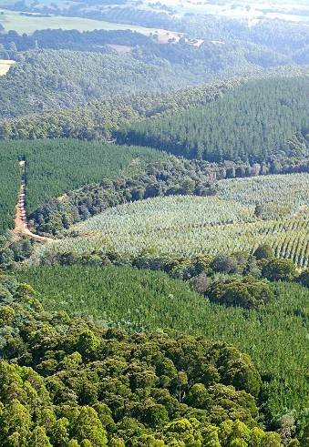
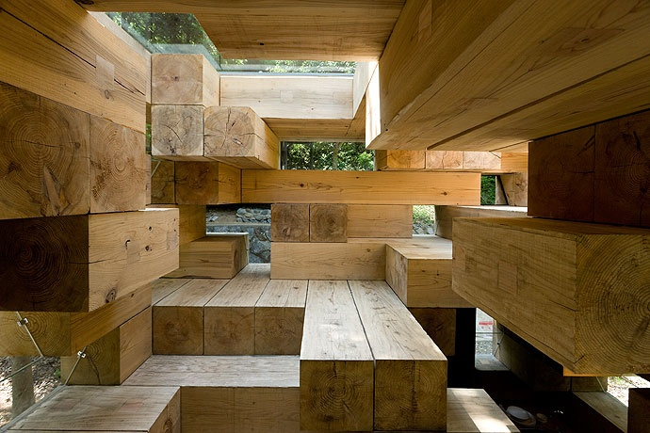
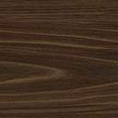
GROW MORE WOOD
USE MORE WOOD
Thank You

