Slide 1
NATIONAL BUILDING CODE OF INDIA
&
THE ROLE OF MASS TIMBER
Arunkumar S
Head (NBC Cell)
Bureau of Indian Standards, New Delhi

Slide 4
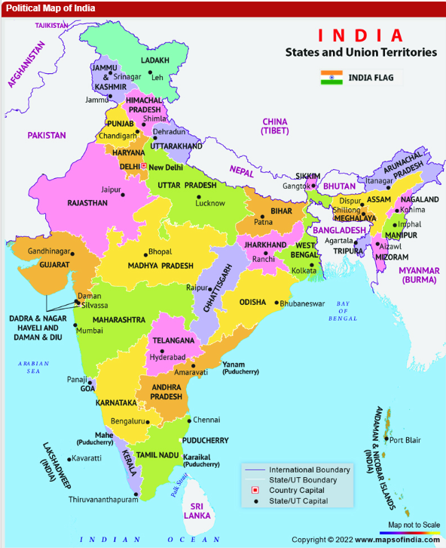

Slide 5
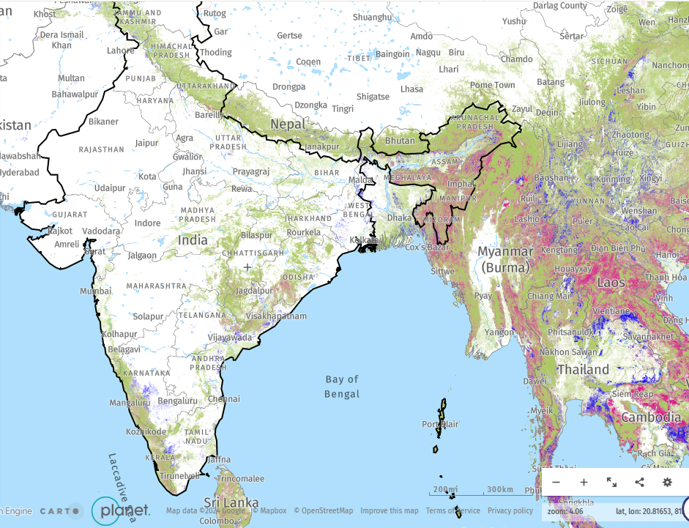
15% forest cover
https://www.globalforestwatch.org/

Slide 6
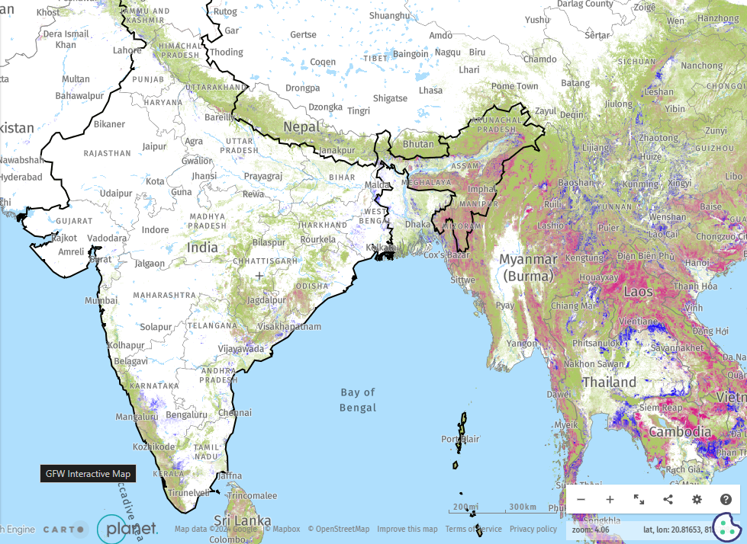
25% forest cover
https://www.globalforestwatch.org/

Slide 7
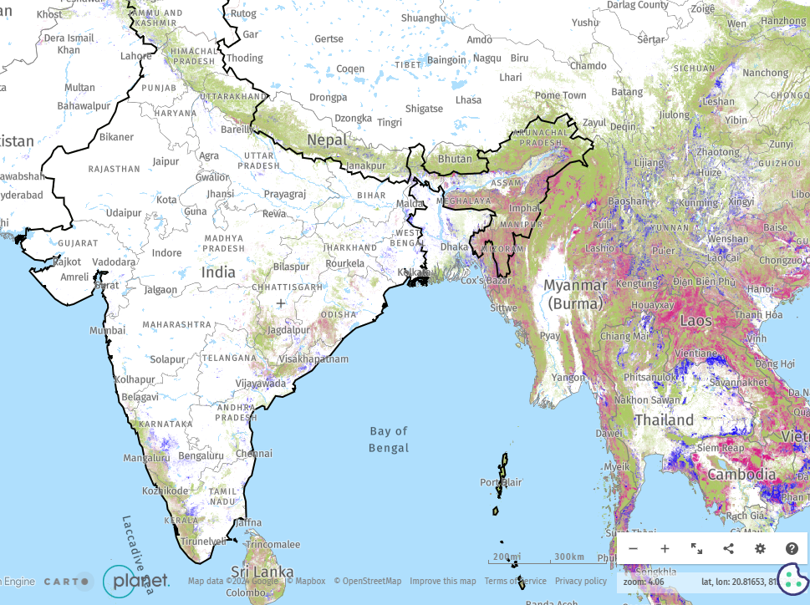
50% forest cover
https://www.globalforestwatch.org/

Slide 8
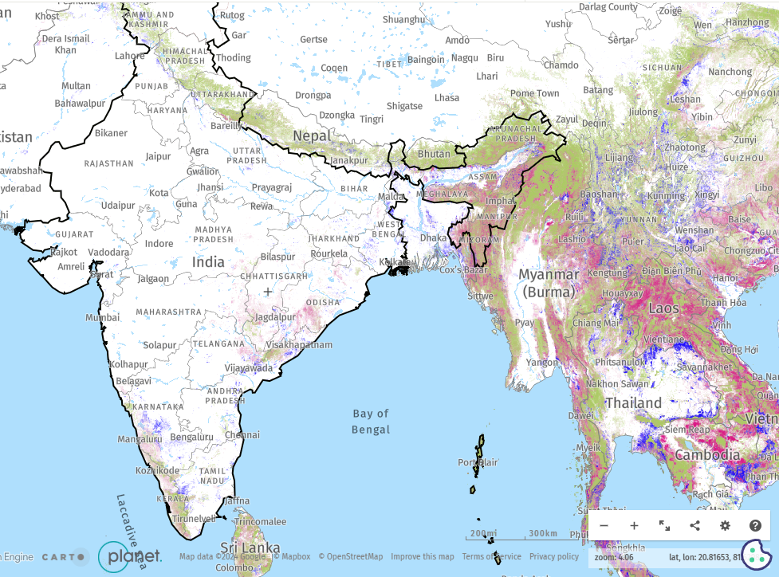
75% forest cover
https://www.globalforestwatch.org/

Slide 9
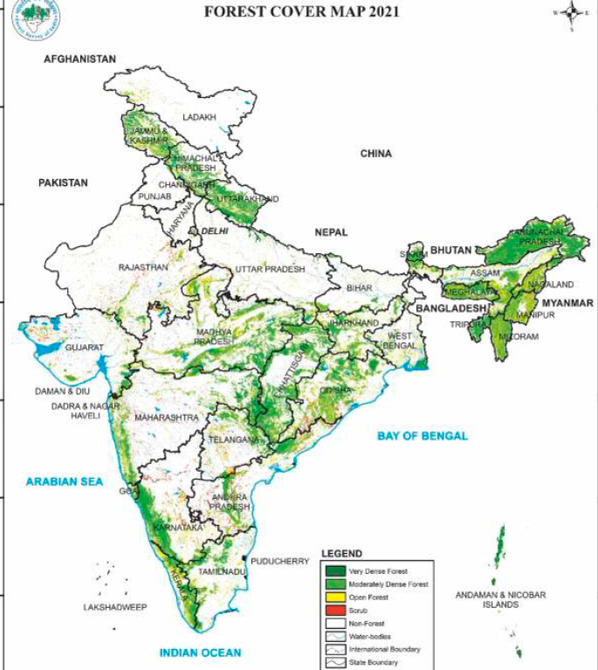

Slide 10
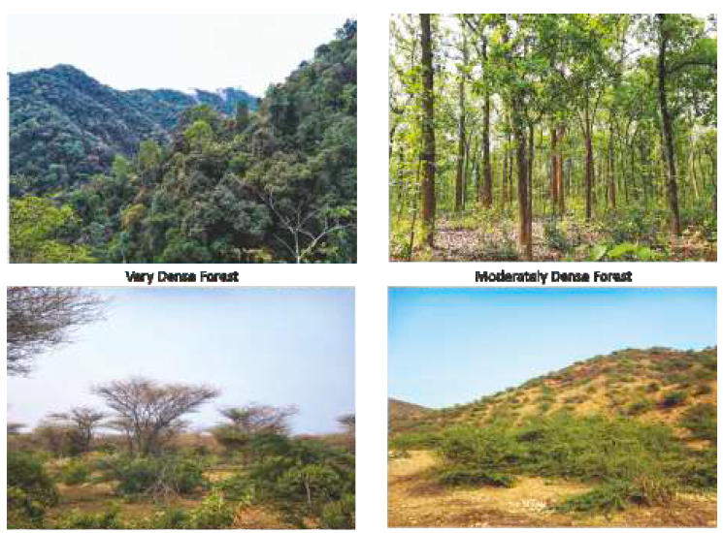
Very Dense Forest
Moderately Dense Forest
Open Forest
Scrub

Slide 11
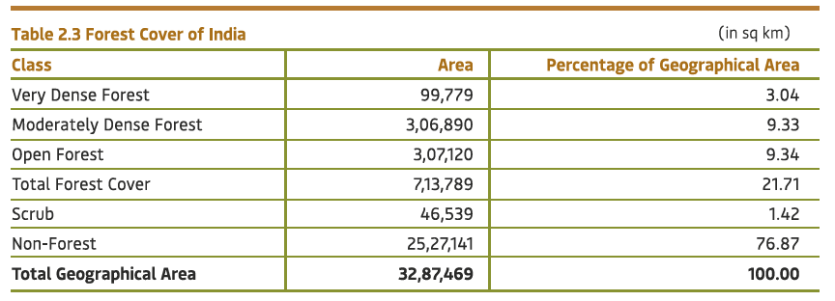
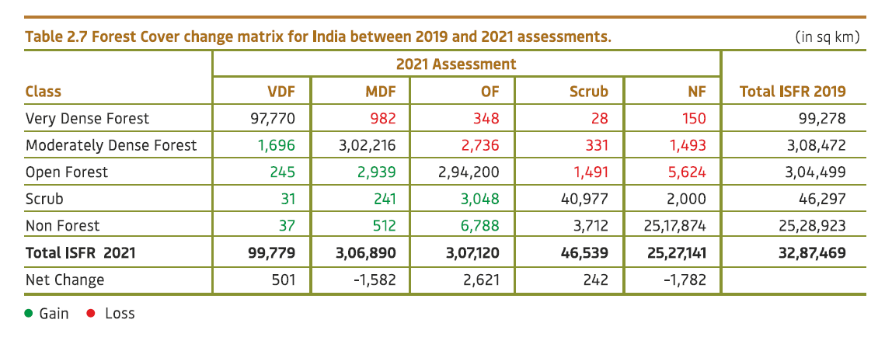

Slide 12
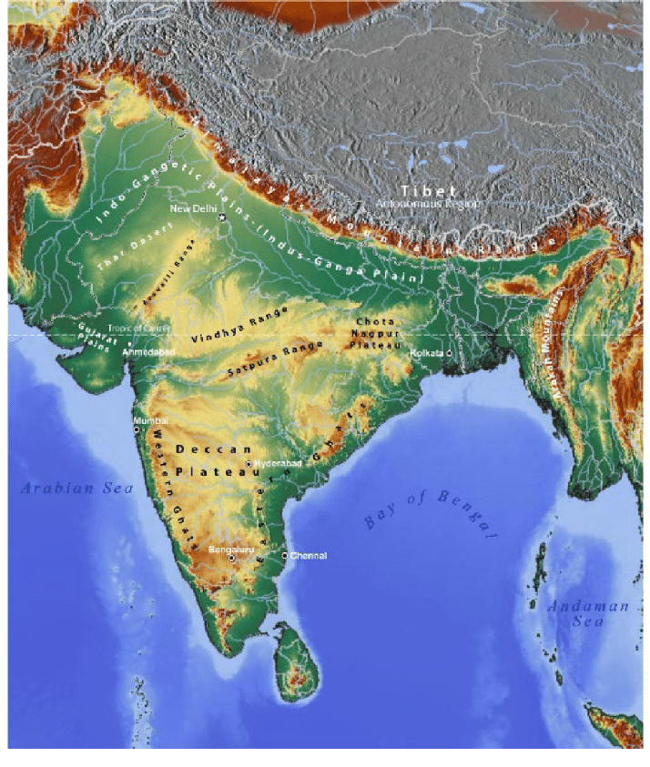

Slide 13
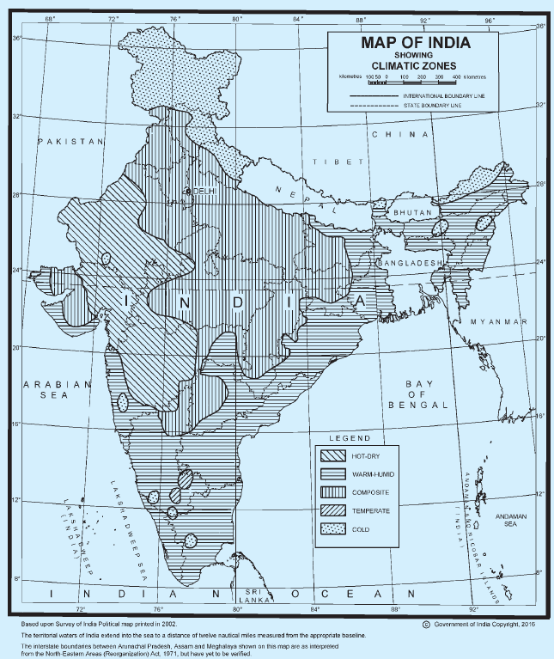
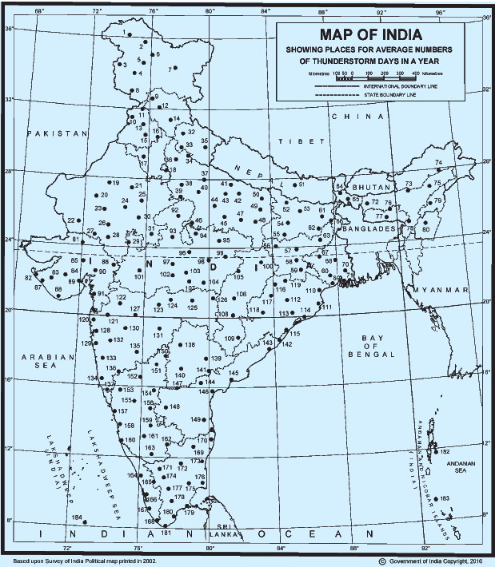

Slide 14
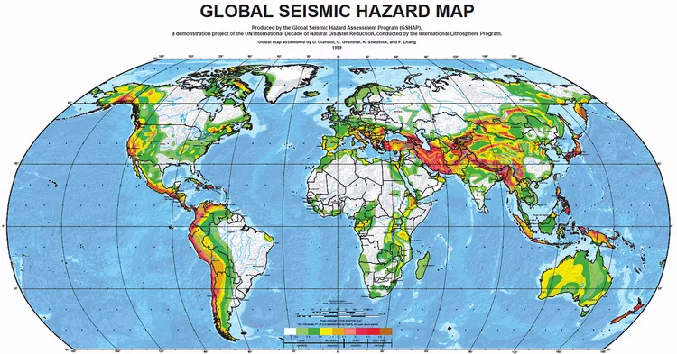

Slide 15
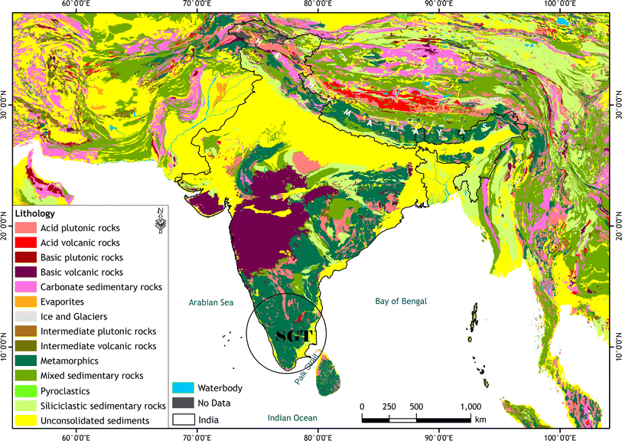

Slide 16
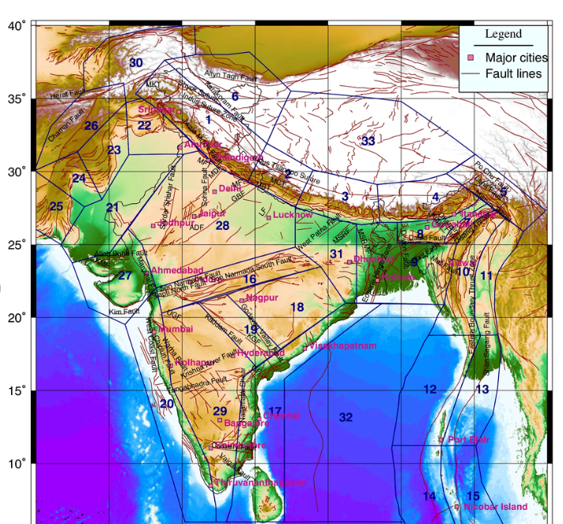

Slide 17
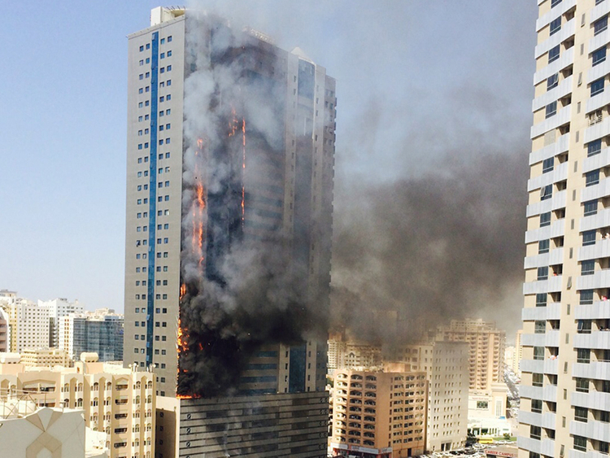

Slide 18
Standard
Specification
Method of Test
Code of Practice
Recommendations
Guidelines
Glossary
Safety

Slide 19
Some facts about BUILDING Code
Sets a level playing field to inter-related stakeholders
Easy to adopt / customize by local jurisdictions
Addresses both the present, and guides the future
Applicable when included in a contract
Becomes statutory when adopted by a one-liner reference by the town / city / state that adopts it
Thus, CODE is a document that drives the “go-to” OR makes it a “sought after” one

Slide 20
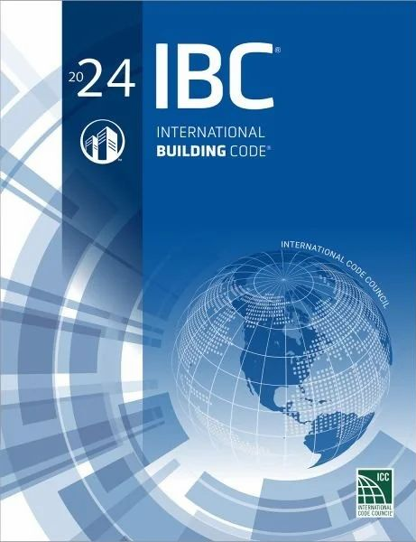
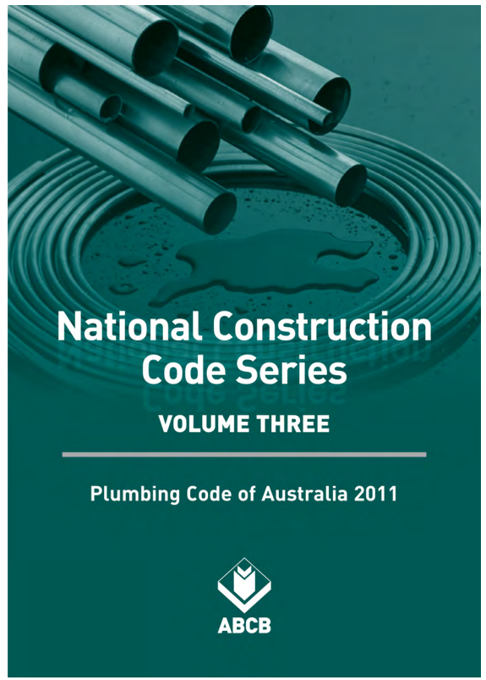
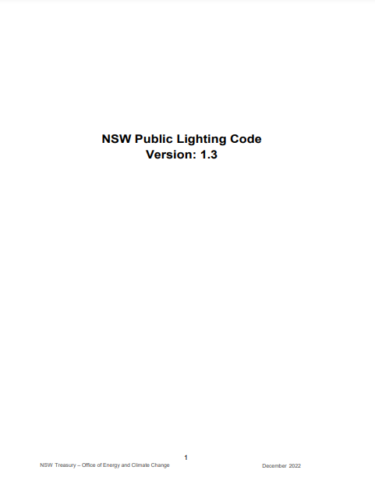
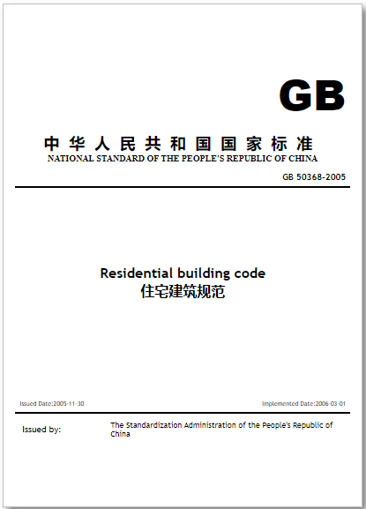

Slide 21
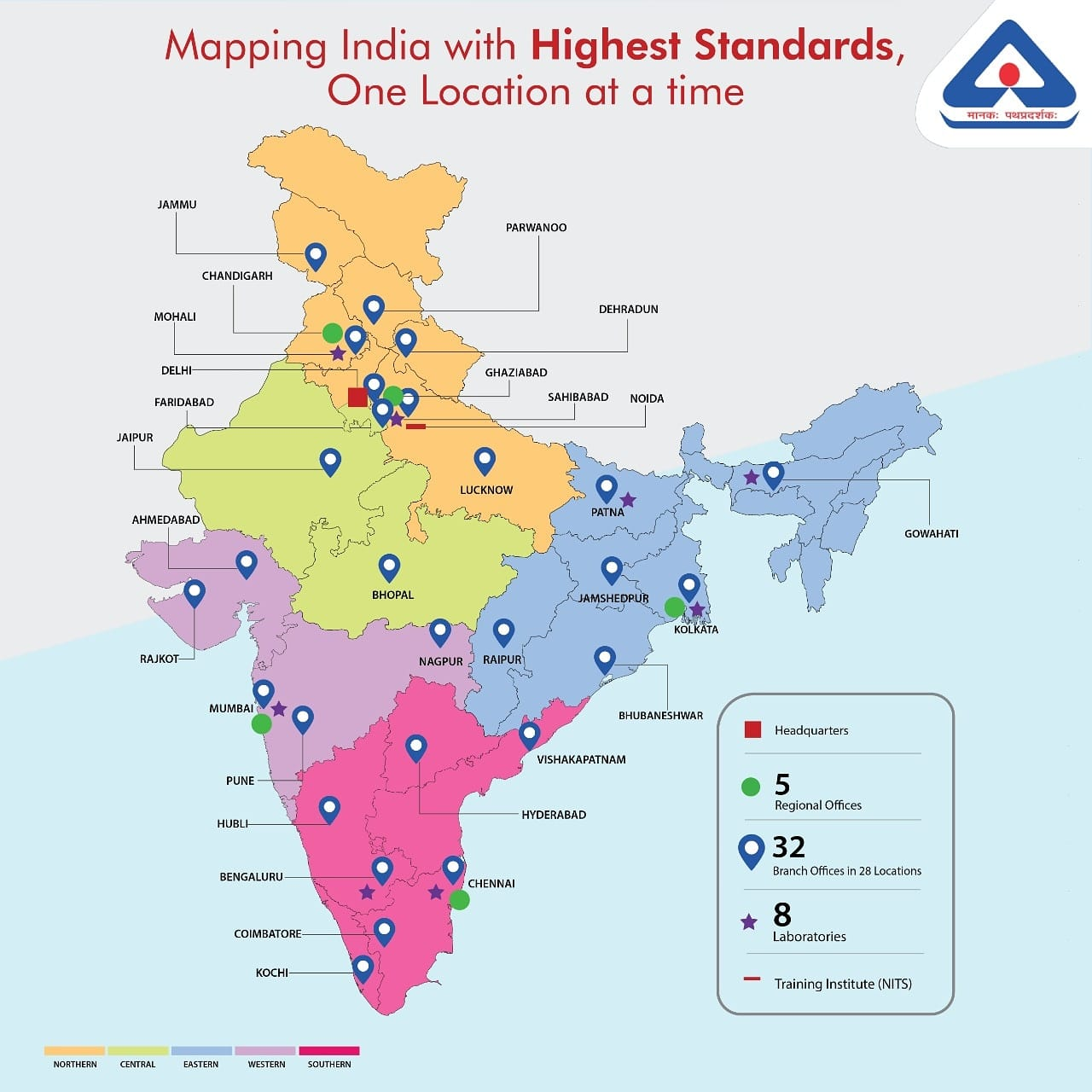
BUREAU OF INDIAN STANDARDS

Slide 22
DIVISION COUNCILS – Broad areas of work
CIVIL ENGINEERING
CHEMICAL
ELECTROTECHNICAL
FOOD & AGRICULTURE
ELECTRONICS & IT
MECHANICAL ENGINEERING
MANAGEMENT SYSTEMS
METALLURGICAL ENGINEERGING
MEDICAL EQUIPMENT & HOSPITAL PLANNING
PETROLEUM, COAL & RELATED PRODUCTS
PRODUCTION & GENERAL ENGINEERING
SERVICE SECTOR
TRANSPORT ENGINEERING
TEXTILES
WATER RESOURCES
17
AYUSH
ENVIRONMENT & ECOLOGY

Slide 23
SCOPE OF CIVIL ENGINEERING DIVISION COUNCIL, CEDC
Standardization in the field of
Civil Engineering including structural engineering;
building materials and components;
planning, design, construction and maintenance of civil engineering structures and built environment;
construction practices, and safety in building;
but excluding those subjects which specifically relate to Water Resources Development and Management

Slide 24
Committee No. | Title of the Committee
CED 02 | Cement and concrete sectional committee
CED 03 | Sanitary appliances and water fittings sectional committee
CED 04 | Building lime and gypsum products sectional committee
CED 05 | Flooring, wall finishing and roofing sectional committee
CED 06 | Stones sectional committee
CED 07 | Structural engineering and structural sections sectional committee
CED 09 | Timber and timber stores sectional committee
CED 11 | Doors, windows and shutters sectional committee
CED 12 | Functional requirements in buildings sectional committee
CED 13 | Building construction practices sectional committee
CED 15 | Builder’s hardware sectional committee
CED 20 | Wood and other lignocellulosic products sectional committee
CED 22 | Fire fighting sectional committee
CED 24 | Public health engineering sectional committee

Slide 25
Committee No. | Title of the Committee
CED 29 | Construction management sectional committee
CED 30 | Clay and stabilized soil products for construction sectional committee
CED 32 | Prefabricated construction sectional committee
CED 35 | Furniture sectional committee
CED 36 | Fire safety sectional committee
CED 37 | Structural safety sectional committee
CED 38 | Special structures sectional committee
CED 39 | Earthquake engineering sectional committee
CED 41 | Water proofing and damp-proofing sectional committee
CED 43 | Soil and foundation engineering sectional committee
CED 44 | Methods of measurement of works of civil engineering (excluding water resources development) sectional committee
CED 45 | Safety in construction sectional committee
CED 46 | National building code sectional committee
CED 47 | Ports, harbours and offshore installations sectional committee

Slide 26
Committee No. | Title of the Committee
CED 48 | Rock mechanics sectional committee
CED 50 | Plastic piping systems sectional committee
CED 51 | Planning and housing sectional committee
CED 53 | Cement matrix products sectional committee
CED 54 | Concrete reinforcement sectional committee
CED 55 | Sieves, sieving and other sizing methods sectional committee
CED 56 | Hill area development engineering sectional committee
CED 57 | Cyclone resistant structures sectional committee
CED 59 | Smart cities sectional committee
Summary of IS & SP in Civil Engineering
Committee No. | Product Specification (S) | Code of Practice (C) | Methods of Tests (M) | Terminology (T) | Dimensions (D) | System Standard | Safety Standard (SS) | Others (O) | Total
Total ISs & SPs | 752 | 470 | 354 | 45 | 11 | 0 | 41 | 148 | 1821

Slide 27
Safe ?
Every Building should be planned, designed, constructed, and operated & maintained to ensure,
Structural Safety
Fire and Life Safety
Health Safety
Public Safety
4 PILLARS
OF SAFETY

Slide 28
Sustainable ?
Buildings should be planned, designed, constructed and operated & maintained to ensure that,
The Environment is protected
Optimal use of resources

Slide 29
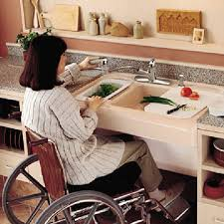
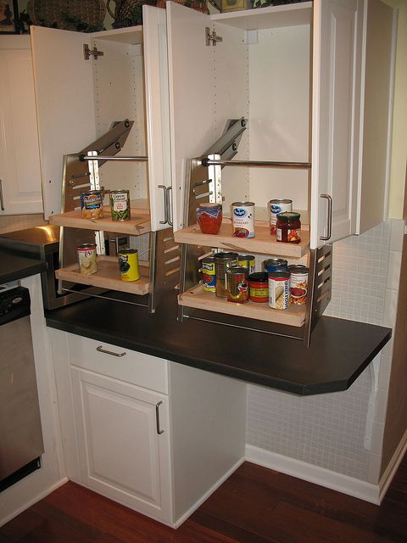
Accessible ?
Buildings should be planned, designed, constructed, and operated & maintained to ensure that,
The Building, its approach, entrance, exit and the facilities inside can be used by any person with disabilities and the elderly including the aged/senior citizens, kids, any pregnant lady without any hindrance or barrier or assistance

Slide 30
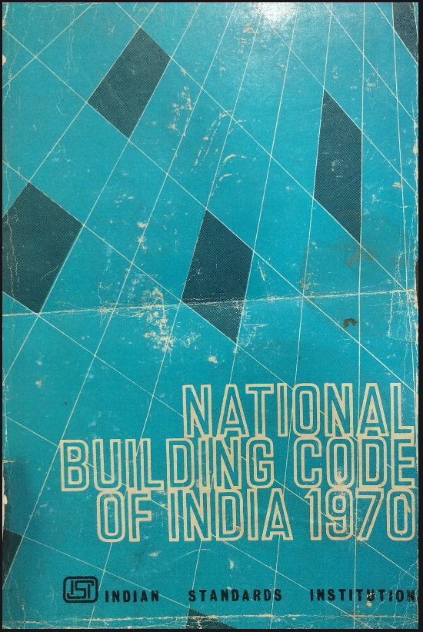
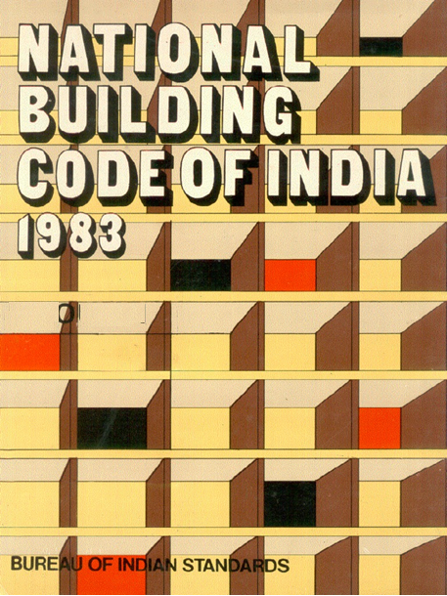
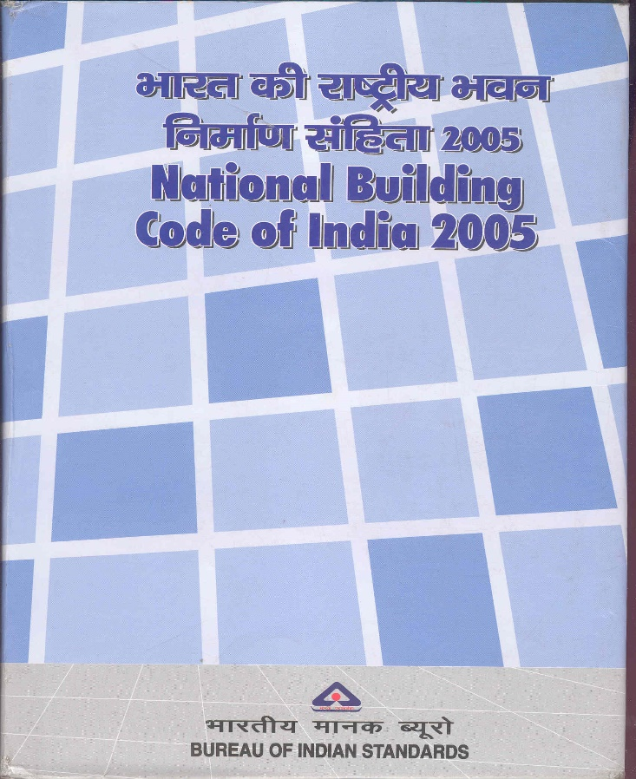
National Building Code of India
https://www.bis.gov.in/standards/technical-department/national-building-code/

Slide 31
NBC ….
Covers the entire gamut of operations regarding construction by addressing
Administration
Organization
Technical
Achieves economy in construction
Reflects the latest trend in building construction activity
Provides the list of multi-hazard prone areas to enable Authorities to plan for:
Disaster Preparedness
Disaster Mitigation
Disaster Prevention
Aims to regulate building construction across the country
Rationalizes state and local-level building bye-laws

Slide 33
WHAT IS NBC 2016
NBC 2016 is the Special Publication of the Bureau of Indian Standards (BIS), the National Standards Body of the country.
It covers all aspects of development and building construction:
Planning
Structural Design
Services
Construction
Operation and Maintenance
It is a voluntary Code used by various Authorities to frame Building Byelaws/ Regulations to regulate land development and building construction activities

Slide 34
CONTENTS OF NBC 2016
Part No. | Title
Part 0 | Integrated Approach – Prerequisite for Applying Provisions of the code
Part 1 | Definitions
Part 2 | Administration
Part 3 | Development Control Rules and General Building Requirements
Part 4 | Fire and Life Safety
Part 5 | Building Materials
Part 6 | Structural Design
Part 7 | Constructional Management, Practices and Safety
Part 8 | Building Services
Part 9 | Plumbing Services (including Solid Waste Management)
Part 10 | Landscape Development, Signs and Outdoor Display Structures
Part 11 | Approach to Sustainability
Part 12 | Asset and Facility Management

Slide 35
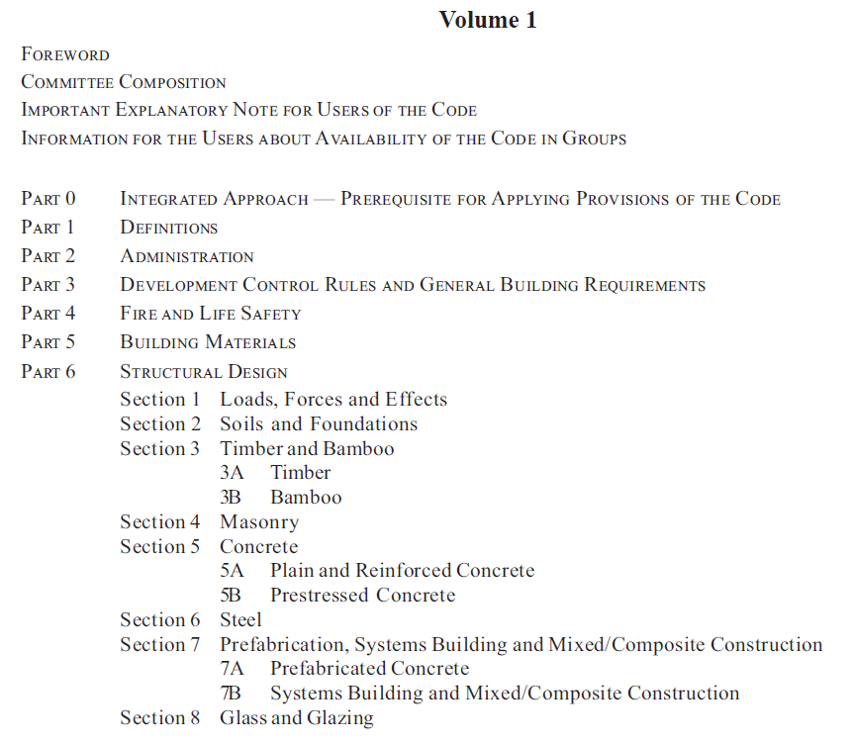

Slide 36
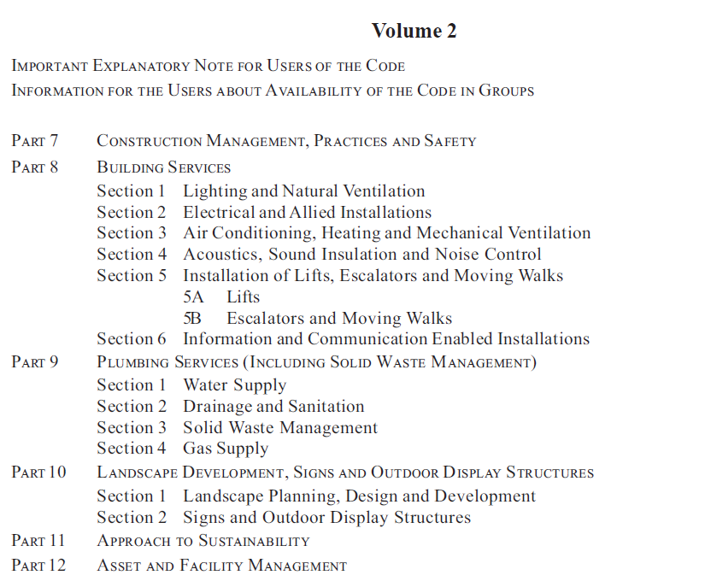

Slide 37
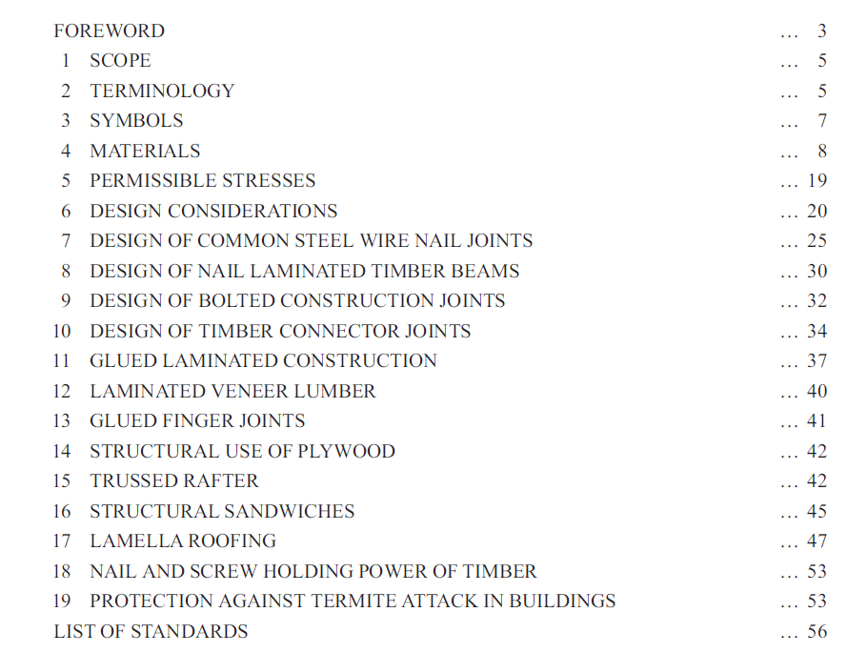

Slide 38
Major Modifications in NBC 2016 Part 6/Sec 3A Timber
Updated design provisions for timber connector joints, lamella roofing, trussed rafters, etc.
The permissible lateral strength (in double shear) of mild steel common wire for different new species of timber have been added and also strength values for some of the existing species have been modified based on latest research.
Data on block shear test results of glued timber joints and on strength properties of glued finger joints based on the indigenous work, has been included for guidance in design.
Illustrations added for possible orientation of planks in glue laminated beams (Glulam).
Design outline for horizontally laminated beams has been added.

Slide 39
Major Modifications in NBC 2016 Part 6/Sec 3A Timber
Lateral strength (in double shear) of mild steel wire for timber species
Increase in lateral strength of MS nails clenched across grains
Block shear of glued timber joints
Strength properties of glued finger joints
Glulam beams indicating orientation of planks
Horizontally laminated beams
Composite nail and screw holding power of certain timbers

Slide 40
Major Modifications in NBC 2016 Part 6/Sec 3A Timber
Timber connector joints
Design provisions of trussed rafters
Bearing strength of common wire nails in plywood-to-wood joints
Lamella roofing
Strength values of certain Indian species of timber

Slide 41
Important Standards utilized in Part 6/Sec 3A
IS No. | Title
IS 399:1963 | Classification of commercial timbers and their zonal distribution (revised)
IS 883:2016 | Code of practice for design of structural timber in building (fifth revision)
IS 1150:2000 | Trade names and abbreviated symbols for timber species (third revision)
IS 2366:1983 | Code of practice for nail-jointed timber construction (first revision)
IS 4891:1988 | Specification for preferred cut sizes of structural timber (first revision)
IS 4983:1968 | Code of practice for design and construction of nailed laminated timber beams
IS 11096:1984 | Code of practice for design and construction of bolt-jointed timber construction
IS 14616:1999 | Specification for laminated veneer lumber

Slide 42
NBC 2025 proposes…
SCOPE
TERMINOLOGY
SYMBOLS
MATERIALS
PERMISSIBLE STRESSES
DESIGN CONSIDERATIONS
DESIGN OF COMMON STEEL WIRE NAIL JOINTS
DESIGN OF NAIL-LAMINATED TIMBER BEAMS
DESIGN OF BOLTED CONSTRUCTION JOINTS
DESIGN OF TIMBER CONNECTOR JOINTS
GLUED LAMINATED CONSTRUCTION
LAMINATED VENEER LUMBER
GLUED FINGER JOINTS
STRUCTURAL USE OF PLYWOOD
TRUSSED RAFTER
STRUCTURAL SANDWICHES
LAMELLA ROOFING
NAIL AND SCREW HOLDING POWER OF TIMBER
PROTECTION AGAINST TERMITE ATTACK IN BUILDINGS
MASS TIMBER
CROSS-LAMINATED TIMBER (CLT)
LIFE CYCLE ASSESSMENT (LCA) OF TIMBER FOR USE IN BUILDINGS

Slide 43
Mass Timber
Cross Laminated Timber
Glued Laminated Timber
Nail Laminated Timber
Laminated Veneered Lumber
Used as a structural member in:
Structural Framing
Columns
Beams
Walls
Floors
Roofs
Safety Aspects Addressed
Design and Structural Integrity
Fire Resistance and Safety – 03 Construction Types, Sprinklers, Protection of connections, Fire seals in penetrations
Minimum Sizes/Dimensions
Construction Practice

Slide 44
Cross Laminated Timber
Material Specifications – CLT made using: Rubber wood, Melia Wood, Silver Oak, Eucalyptus, Radiata Pine
Physical Properties
Delamination Resistance
Water Absorption/Swelling
Density
Mechanical Properties
Bending / Compression / Shear
Adhesive’s Characteristics
Fire Safety Requirements
Durability / Resistance to Termites
Handling, Storage and Installation

Slide 45
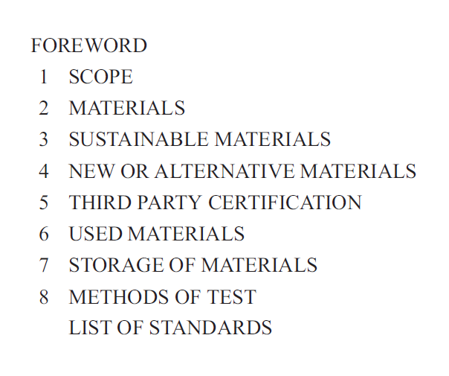
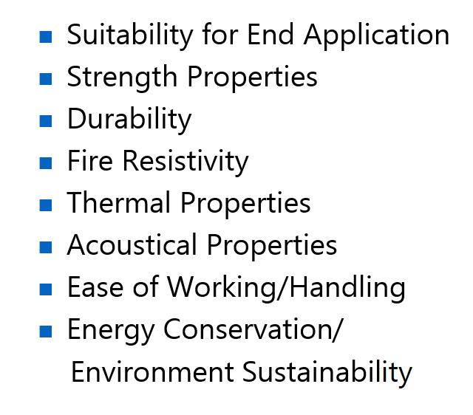

Slide 46
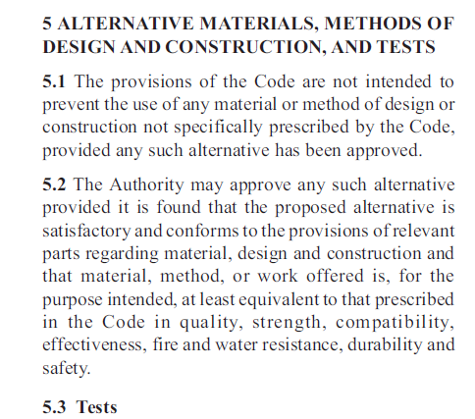
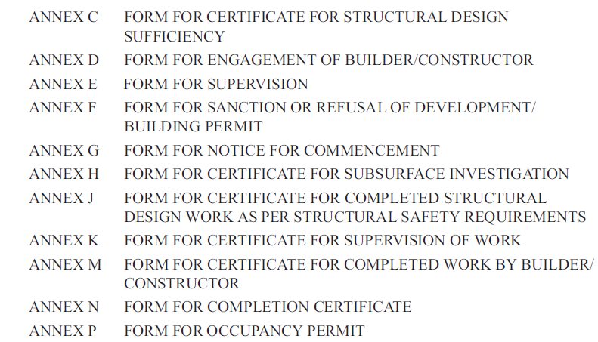

Slide 49
How NBC is useful in OBTAINING permits
Part 2 ‘Administration’ of NBC 2016 covers responsibility of the owner and all professionals, including Building Contractor involved in the planning, design and construction of the building.
It stresses on involving right professionals for planning, designing, construction, supervision and operation & maintenance of buildings.
Qualification and Competence of professionals like architects, engineers, structural engineers, supervisors, etc is laid down in this Part of NBC 2016
Mechanism of ensuring certification of structural safety of buildings by Civil / Structural Engineer is also covered in this Part.
IT IS NECESSARY TO INVOLVE ABOVE PROFESSIONALS AS WE CANNOT BE THE EXPERT OF ALL THESE ACTIVITIES. THEIR INVOLVEMENT WOULD ENSURE SAFETY OF OUR BUILDING.
Part 0 ‘Integrated Approach – Prerequisite for Applying Provisions of the Code’ of NBC 2016 stresses that team to be involved in the building construction activity should be multi-disciplinary team of need based professionals, particularly in big and complex projects

Slide 50
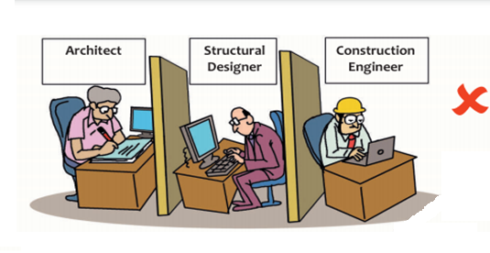
MULTI DISCIPLINARY TEAM OF BUILDING PROFESSIONALS
Architect
Civil Engineer
Structural Engineer
Geotechnical Engineer
Electrical Engineer
Plumbing Engineer
Fire Protection Engineer
HVAC Engineer
Lift, Escalator & Moving Walk Specialist
Acoustics Specialist
Information/Communication Technology Engineer
Health, Safety & Environment Specialist
Environment/Sustainability Specialist
Town Planner
Urban Designer
Landscape Architect
Security System Specialist
Interior Designer
Quantity Surveyor
Project/Construction Manager
Accessibility & Universal Design specialist
Asset/Facility Manager
Other subject specialists

Slide 51
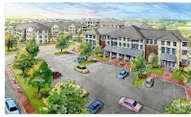
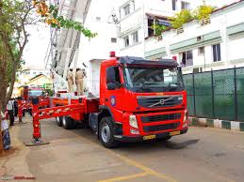
How NBC is useful in OBTAINING permits
Part 3 ‘Development Control Rules and General Building Requirements’ covers the following:
Land Use Classification
Open Spaces at City/Town Level
Amenities such as, Educational facilities, Health care facilities, Socio-cultural facilities, Distribution services at City/Town level
Open Spaces within a Plot for Lighting and Ventilation and Fire Tender Movement in case of certain buildings
Means of Access to Plots/Buildings
Height of Buildings
General Building Requirements: Habitable room, kitchen, bathroom, staircase, balcony, basement, meter room, etc.

Slide 52
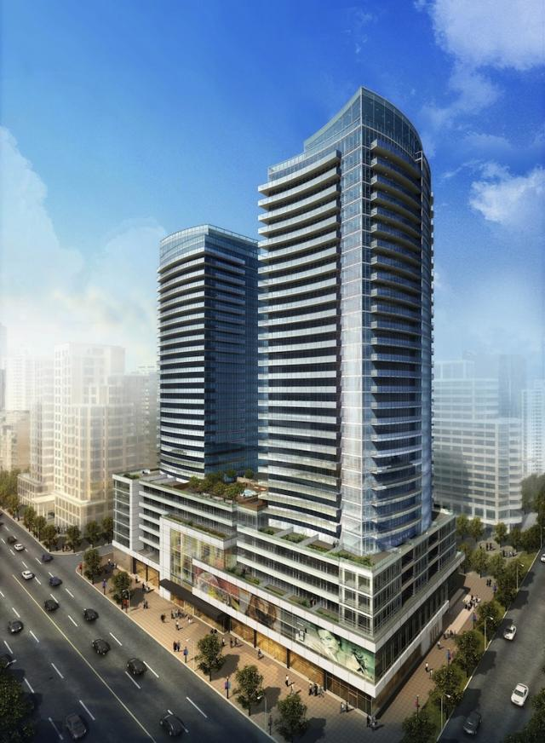
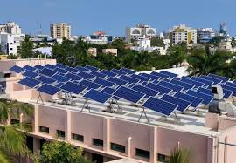
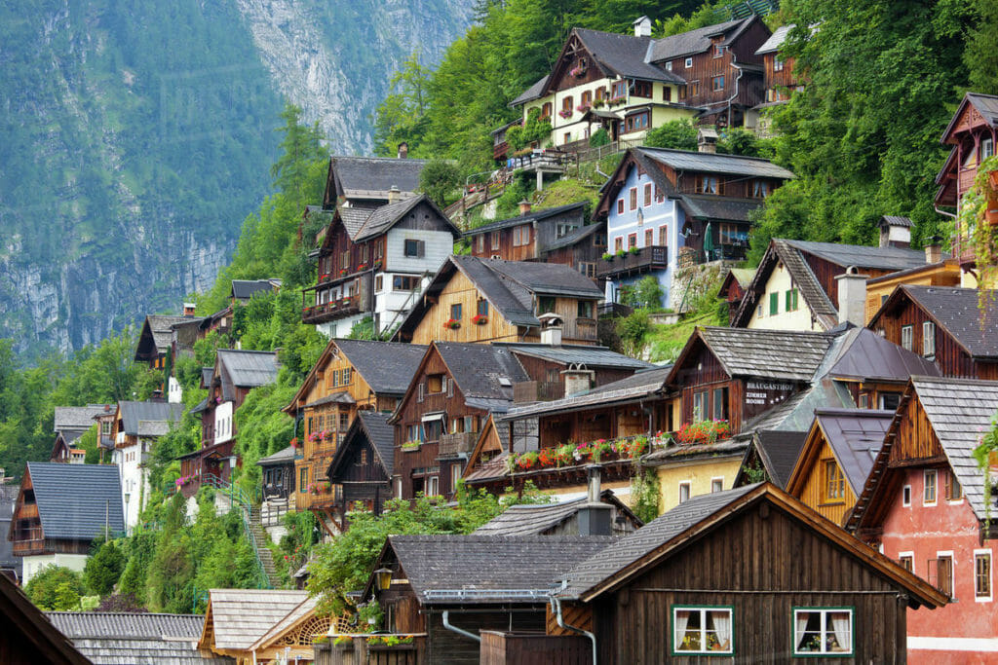
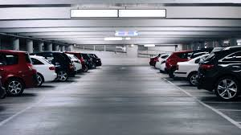
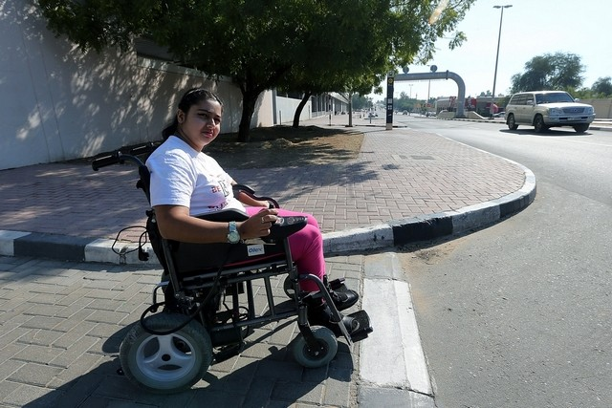
How NBC is useful in OBTAINING permits
Part 3 ‘Development Control Rules and General Building Requirements’ covers the following:
Group Housing
Parking facilities
Buildings on podium
Solar Energy Utilization
Low income housing in urban areas
Rural habitat planning
Development planning in hilly areas
Accessibility in Buildings & Built Environment for persons with disabilities and the elderly

Slide 53
How NBC is useful in OBTAINING permits
In this Part of NBC 2016, you can find,
Reference of Indian Standards for Solar PV installations
Reference of Indian Standards for Solar Water Heating Installations
Additional Safety Provisions for Buildings in Hilly Areas
Detailed Provisions on Accessibility in Public Buildings/Built Environment, Common Areas of Group Housing as also on Accessible homes

Slide 54
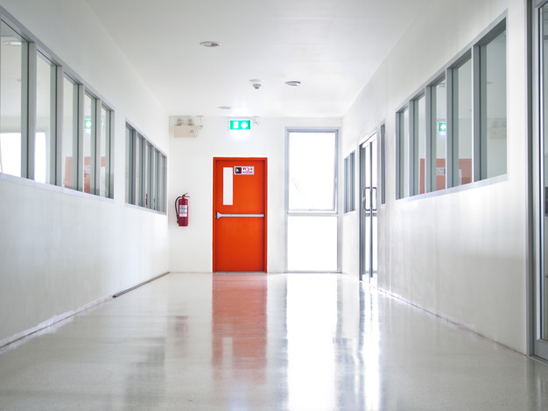
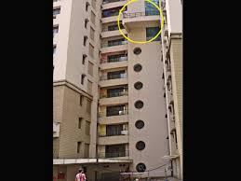
How NBC is useful in OBTAINING permits
Do you know high rise buildings (≥ 15 m height) and special buildings (Having floor area > 500 sq m) require clearance from Fire Authorities
Part 4 ‘Fire and Life Safety’ of NBC 2016 has been generally adopted by all Fire Authorities & compliance to the same will ensure NOC from those Authorities
What is important for you in this Chapter of NBC,
Different Building Occupancy types and their requirements
Various types of Building Construction and the level of protection (in terms of fire resistance rating) as offered by them in case of fire
Planning and Design of Means of Egress (Fire Doors, Corridors, Staircases including their Ventilation/Pressurization, Refuge Areas ) including Fire fighting Shaft & Compartmentation
DO YOU KNOW BALCONY IN YOUR MULTI-STOERYED APARTMENT FLAT SERVES AS A REFUGE AREA (A RELATIVELY SAFER PLACE TO REST IN CASE OF AN EMERGENCY)

Slide 55
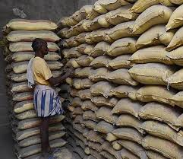
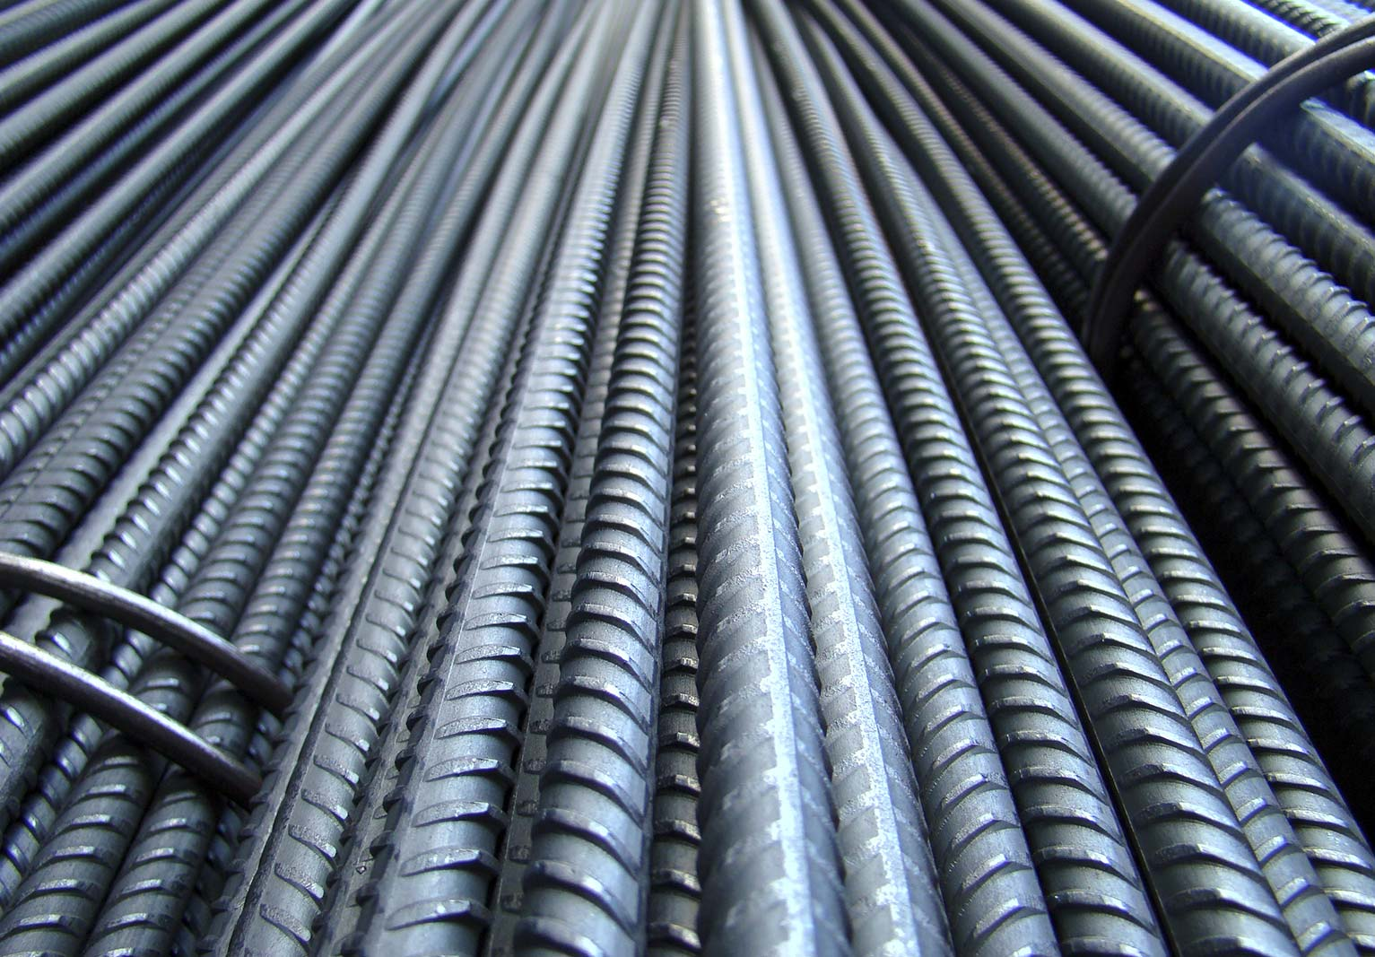
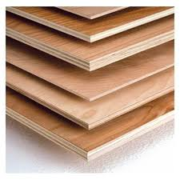
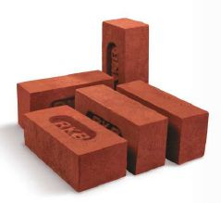
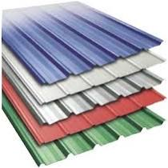
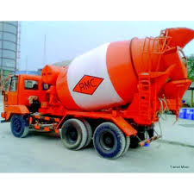
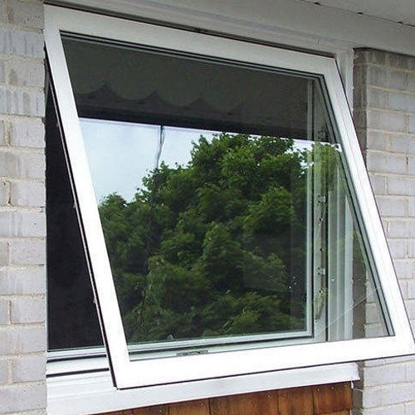
How NBC is useful in ensuring safety
Do you know it is necessary to use good quality building materials for the construction of your house so as to ensure its structural safety and durability
BUT HOW CAN THIS BE ENSURED
BIS has formulated series of Indian Standards for various Building Materials and their Methods of Tests. BIS also operates BIS Certification (ISI Mark) for third party quality certification of these products against the Indian Standards formulated for them
Part 5 ‘Building Materials’ lists all such Indian Standards
Major constituents of reinforced cement concrete construction, cement and steel reinforcing bars comes with ISI mark being mandatory products.
For other products, like aggregates, tiles, bricks, sanitary appliances, sinks, plumbing pipes, plywood, blockboard, door shutter and frame, either buy ISI Marked Product or get your product tested at nearest laboratory/Engg College

Slide 56
How NBC is useful in ensuring safety
Do you know STRUCTURAL DESIGN of your building is important to ensure its safety during its service life
Building (both superstructure and substructure) is subjected to various loads: loads of its components/materials (Dead Load), load of its occupants and fixtures/facilities inside the building (Imposed/Live load), Wind Load, Seismic (Earthquake) Forces, Horizontal thrust of Soil, Snow load, temperature effects
In order to ensure that your building is safe from Disasters including Earthquake, get the structural design of your building carried out by Engineer/Structural Engineer as per Part 6 ‘Structural Design’ of NBC 2016

Slide 57
Section | Title
Section 1 | Loads, Forces and Effects
Section 2 | Soils and Foundations
Section 3 | Timber and Bamboo
Sub section 3A | Timber
Sub section 3B | Bamboo
Section 4 | Masonry
Section 5 | Concrete
Sub section 5A | Plain and Reinforced Concrete
Sub section 5B | Prestressed Concrete
Section 6 | Steel
Section 7 | Prefabrication, Systems Building and Mixed/ Composite Construction
Sub section 7A | Prefabricated Concrete
Sub section 7B | Systems Building and Mixed/Composite Construction
Section 8 | Glass and Glazing (New)
While calculation of loads, forces and effects are covered in Section 1 of NBC 2016, Section 2 covers design of various types of foundations depending upon type of soil required.
Section 2 also covers ground improvement techniques
Sections 3 to 8 covers design and construction of buildings using different materials
Building Byelaws/Regulations generally refer to this Part for Structural Design

Slide 58
2016 Wind Map

Slide 59
2016 Seismic Zoning Map

Slide 60
Aspects to be considered for earthquake resistant design of buildings
Ensure that the structural design and detailing is carried out by a structural engineer as per IS 1893 (Part 1) and IS 13920
Keep the building plan simple and regular, for example, rectangular buildings
Limit the amount of cut-outs, such as openings in roof slabs
Avoid open ground storey construction (only columns and no walls in ground floor is dangerous)
Continuous Concrete walls in both the directions in selected bays to be provided from foundation to roof slab
In masonry buildings, all-round bands at plinth, sill and lintel level to be provided

Slide 61
How nbc ensures sustainability in built environment
Part 11 ‘Approach to Sustainability’ ensures sustainable buildings and built environment
Covers Siting, Form and Design, Envelope Optimization
Design strategies as per Climatic zones
Covers External Development and Landscape to ensure less dependence on private transport and to preserve natural flora and fauna
Water and waste management promoting water recycling and reuse
Building services optimization ensuring use of efficient and renewable energy sources
Sustainable construction practices
Commissioning, Operation, Maintenance and Building Performance Tracking
Building Byelaws/Regulations desires for green building rating of buildings and give incentives to builders for adopting the same

Slide 62
How NBC ensures that your dream home remains safe & serviceable
Part 12 ‘Asset and Facility Management’ of NBC 2016 covers management of building assets and associated services
This Part covers Maintenance of all types of facilities and fixed assets such as buildings and building services (includes both hard and soft services such as building fabric maintenance, roads and pathways, security, MEP services including fire safety installations, housekeeping, etc)
Security Services including Access Control, CCTV Installation in Buildings
Responsibilities of occupants for maintenance of facilities, such as, structures, equipment and exterior property.

Slide 63
How is NBC related to THESE REGULATIONS AND BYELAWS & WHY IS NBC SPECIAL
NBC is used to frame the Byelaws/Regulations so as to ensure planned development of towns/cities
NBC has also been referred in the Byelaws/Regulations for various provisions necessary for ensuring various safety aspects in building construction discussed earlier
NBC is also used by Govt Construction Departments, builders, developers, contractors, professionals/consultants like architects, civil and structural engineers, services engineers, etc
NBC has been prepared with the involvement of more than 1000 experts after holding around 50 meetings of the concerned technical committees

Slide 64
WHO IS THE AUTHORITY AND WHAT ARE THESE REGULATIONS AND BYELAWS
AUTHORITY = Municipal Corporation (Nagar Nigam)/Municipality/ Development Authority of your area
(Example: South Delhi Municipal Corporation, Delhi Development Authority)
They are responsible for regulating land development (town planning) and building construction
REGULATIONS/BYELAWS = Rules to be complied with/Processes to be followed for obtaining permissions from the AUTHORITY for development/building a house/occupying the house
(Example: Unified Building Byelaws for Delhi 2016)

Slide 66
Video explaining downloading OF Indian Standards: https://youtu.be/f9e0IrJlnck

Slide 67
https://www.bis.gov.in/wp-content/uploads/2022/08/Booklet-Guide-for-Using-NBC-2016.pdf

Slide 68
https://www.bis.gov.in/guide-for-homeowners-and-homebuyers/

Slide 69
https://www.bis.gov.in/standardized-development-and-building-regulations-2023/

Slide 70
https://www.services.bis.gov.in/tmp/news_2024-10-01_114.pdf

Slide 71
https://www.bis.gov.in/booklets/

Slide 73
https://ndma.gov.in/governance/guidelines

Slide 74
https://ndma.gov.in/governance/guidelines

Slide 76
BIS CARE Android App iStore App

Slide 77
Whatsapp Channel on NBC https://whatsapp.com/channel/0029VaKdgv3GzzKM6SCoDS0c

Slide 78
THANKS
FOR YOUR KIND ATTENTION
www.bis.gov.in ced@bis.gov.in
NBC - ced46@bis.gov.in
+91 11 23608406

