Slide 1
Supply Chain Barriers and Solution
Dr. Sanja Bala
Faculty, Ecosystem & Environmemnt Management
Indian Institute of Forest Management
sanjayb@iifmbhopal.edu.in

Slide 2
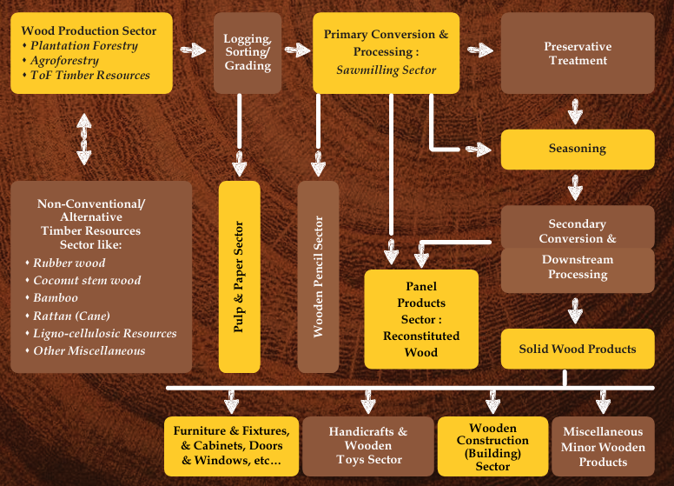
Supply Chain of Timber
IWST

Slide 3
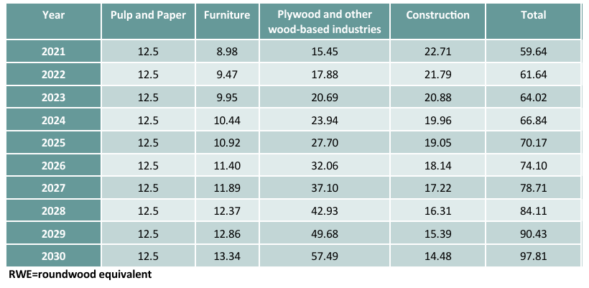
India, roundwood demand forecasts by wood-based sector, 2021-2030 (million m3 RWE)
ITTO

Slide 4
Supply Chain Barriers and solutions
Awareness regarding Mass Timber technology
Infrastructure for production of Mass Timber (Glulam, CLT, LVL……)
Skilled workforce
Indian Fiber Sourcing
Mass timber Lumber Sourcing
Venturing into new market and market adoption
Financial Implecation

Slide 5
Thank You

