Slide 1
Developing and Extending the MASS Library (Java) Places.exchangeBoundary( )
Richard Romanus 08/23/2013
CSS 497 - Cooperative Education Faculty Research Internship Spring / Summer 2013

Slide 2
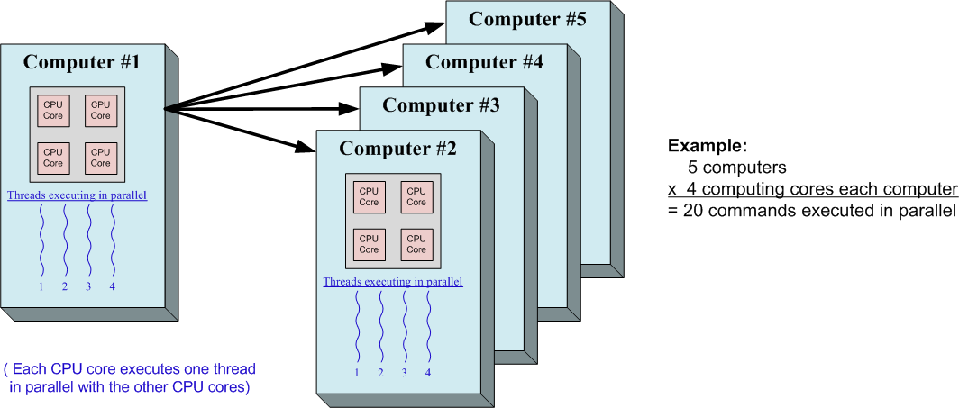
MASS Basic Description
MASS (Multi-Agent Spatial Simulation ) is
a parallel computing software library
Simplifies the task of creating and running parallel applications across multiple computers and CPU cores.

Slide 3
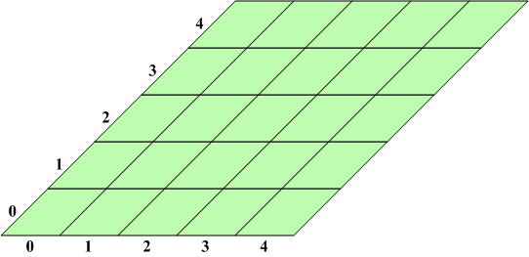
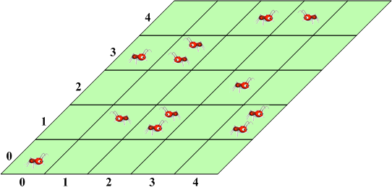
MASS Basic Description
Two primary types of simulations:
A Stand-alone Grid of Stationary Locations Example: A map and it’s grid of sub-locations
A Grid of Stationary Locations with Mobile Units Example: A map, it’s grid of sub-locations and mobile units

Slide 4
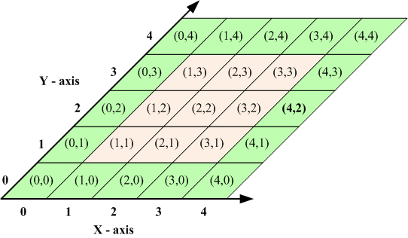
MASS Library Stand-alone Grid of Stationary Locations
Composed of:
The Grid of Locations
referred to as Places in MASS
contains the grid of stationary locations
Single Stationary Location
referred to as a Place object in MASS
contains basic information about the local place
Example: local Temperature

Slide 5
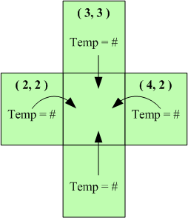
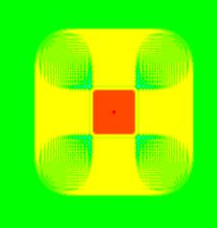
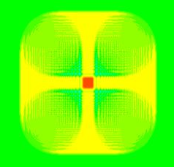
Wave2D - 2D Wave Simulation
A 2-dimensional simulation using Schrödinger wave diffusion equation.
Each Place location gathers wave height information from it’s neighbors
Use gathered data to re-calculate new wave height

Slide 6
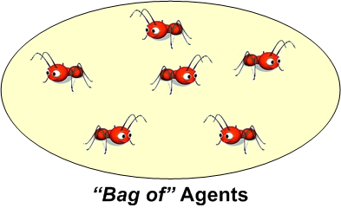
Grid of Stationary Locations with Mobile Units
Composed of:
Collection of Mobile Units
referred to as “Bag of” Agents in MASS
each Place location has a “Bag of” Agents
contains the mobile units for the Place location
Mobile Unit
referred to as Agent in MASS
contains basic information about the mobile unit
Example: Amount of sugar an ant (agent) has consumed

Slide 7
The Overall MASS Framework
Places
Maintain & Manages the Place locations
Manages exchange between the Place locations
Place
Maintains Place location data (inc. “Bag of” Agents)
Provides a user software interface
Agents
Maintains & Manages the Agent units
Manages the exchange and migration of Agent units
Agent
Maintains the Agent data
Provides a user software interface
callAll( )
exchangeAll( )
exchangeBoundary( )
callMethod( )
{User created functions}
callAll( )
exchangeAll( )
manageAll( )
callMethod( )
{User created functions}

Slide 8
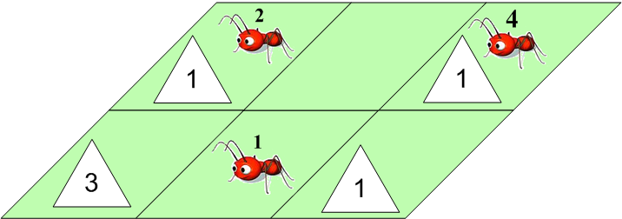
SugarScape - Simulation
An Agent-based social simulation
Uses both:
stationary Land locations (place)
mobile Ant units (agent)
Each Land location (place) maintains:
a number of agents
a level of sugar

Slide 9
SugarScape - Simulation
The Ant units (agent) also maintain a certain level of sugar
During each iteration of time, each ant will do one of the following:
Consume sugar
Move to new location
or Die (if out of sugar)
Moving costs the ant a certain amount sugar

Slide 10
My SugarScape Simulation using MASS
My Simulation:
Each ant has a random visual distance (between 1 – 3), in all directions
Each location starts with a random amount of sugar (0-5)
Each location can have zero or more ants at any time
Ants calculate best location by subtracting number of agents from the amount of sugar a location has.
Example: 4 sugar - 2 agents = +2 move index

Slide 11
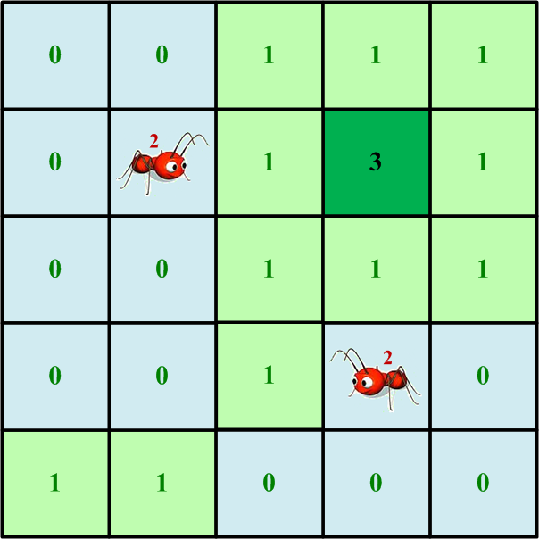
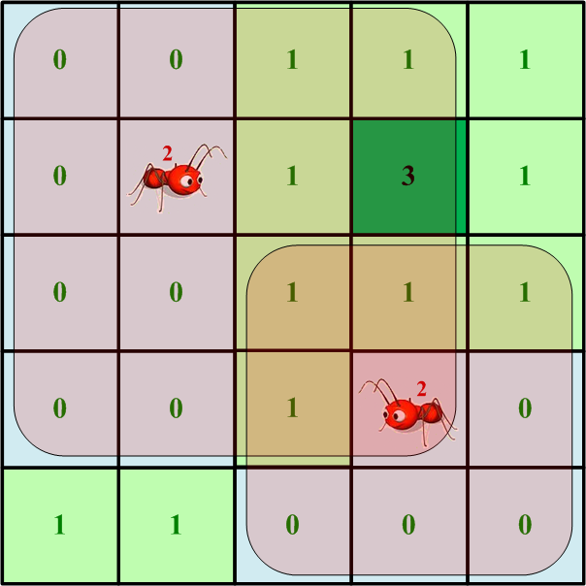
My SugarScape Simulation using MASS
Different ants can have different visual ranges
An ant with a larger visual range has an advantage

Slide 12
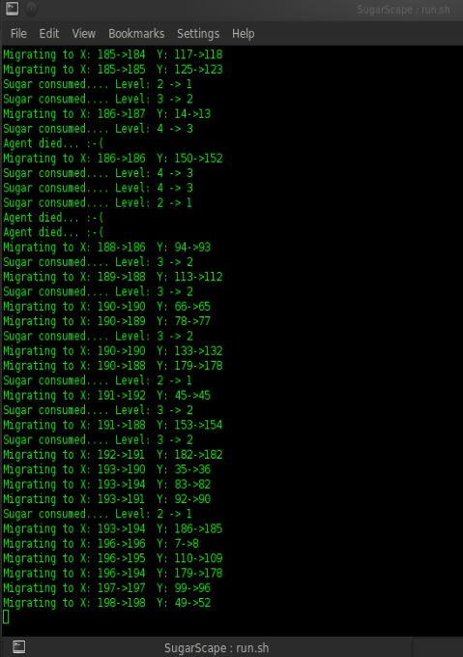
My SugarScape Simulation using MASS
My Simulation:

Slide 13
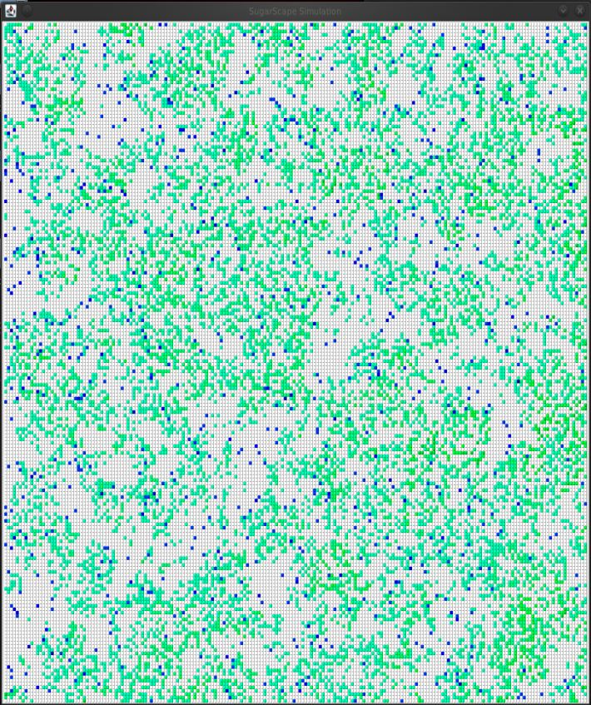
My SugarScape Simulation using MASS
My Simulation:

Slide 14
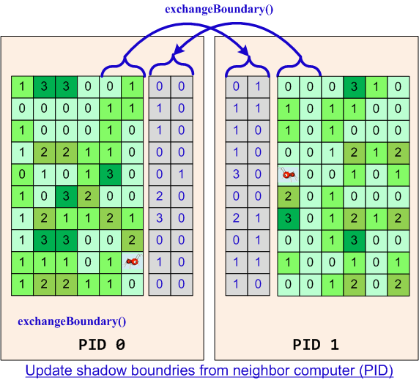
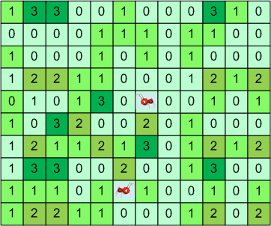
Places.exchangeBoundary( )
Ants on the grid of places
The sugar levels for each place are shown
The grid is divided up across different computers
The Boundaries between computers is shadowed on the other machine

Slide 15
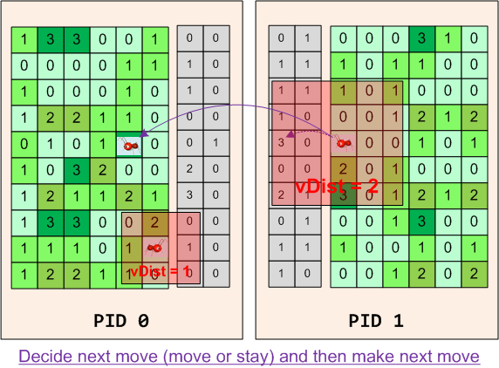
Places.exchangeBoundary( )
The Shadowed boundaries provide, all units on a computer with quick access to information on the other computer

Slide 16
Places.exchangeBoundary()
API functions
Places.Places( int handle, String className, Object argument, int boundaryWidth, boolean wrapEdge, int... size )
Creates a matrix of place locations that represent the matrix space.
Creates a shadow boundary space on one or both of it’s first dimensional boundaries with the neighboring computers.
The width of the boundaries is determined by the user provided boundaryWidth variable.
Furthermore, the user may select (wrapEdge = true) whether or not to allow the first dimensional edges to wrap around
Places.exchangeBounday( )
First runs notifies all of the other nodes and other threads to run exchangeBoundary()
Then runs the eb_exchangeBoundary() function which creates request messages sends them to the other nodes. It then processes the messages it receives from the other nodes and sends back a reply with the requested data.
Finally, the function updates all of the inMessages array on all of the local places

Slide 17
Test Results
size =500 (500x500 = 250000 places)
numAgents =5000
maxTime =300
collectInterval =5
numProc =2
numThrd =2
exchangeBoundary()
1) *** Total Time (ms) : 193459
*** Execution Time (ms): 192713
2) *** Total Time (ms) : 191724
*** Execution Time (ms): 191088
3) *** Total Time (ms) : 189940
*** Execution Time (ms): 189301
exchangeAll()
1) *** Total Time (ms) : 225817
*** Execution Time (ms): 225109
2) *** Total Time (ms) : 231572
*** Execution Time (ms): 230938
3) *** Total Time (ms) : 232650
*** Execution Time (ms): 231996
size =500 (500x500 = 250000 places)
numAgents =5000
maxTime =300
collectInterval =5
numProc =4
numThrd =2
exchangeBoundary()
1) *** Total Time (ms) : 120222
*** Execution Time (ms): 119857
2) *** Total Time (ms) : 118846
*** Execution Time (ms): 118492
3) *** Total Time (ms) : 124268
*** Execution Time (ms): 123896

