Slide 1
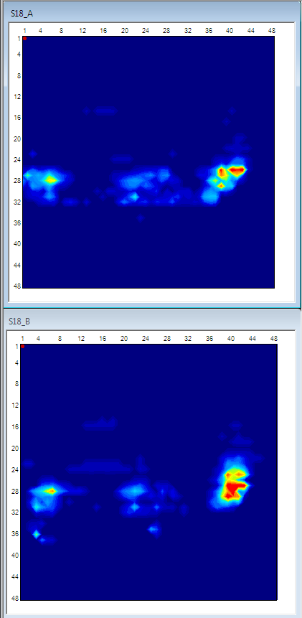
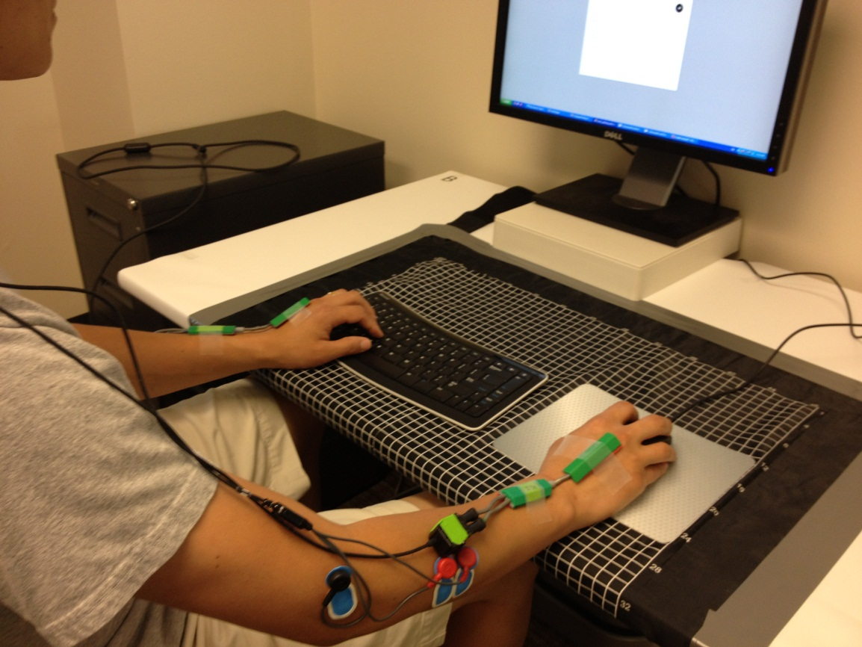


Soft
Mouse pad
Work surface Edge
Hard
Mouse pad
Study aims: Compare occupational biomechanical risks including musculoskeletal loads and contract pressure during computer work on between soft and hard worksurface.
Funding source: Steelcase Inc.
Result: UW Ergonomics group found that contact pressure was significantly lower with wider contact areas on the soft work surface as compared to the hard worksurface.
*Picture description:
Left: contract pressure distribution on soft (top) and hard (bottom) worksurfaces. Red color indicates higher contact pressure.
Right: instrumentation including pressure mat (black pad with white grids) to measure contact pressure, electrogoniometers (green sensors on the wrist) to measure wrist postures, electromyography (blue electrodes on the forearm) to measure muscle activity.
Work surface Edge

