Slide 1
The Six Building Blocks
A Team-Based Approach to Improving Opioid Management in Primary Care
The development team includes:
Michael Parchman, MD, MPH
Kaiser Permanente Washington Health Research Institute (KPWHRI)
Laura-Mae Baldwin, MD, MPH
University of Washington
Kelly Ehrlich, MPH
KPWHRI
Nicole Ide, MPH
University of Washington
Brooke Ike, MPH
University of Washington
Doug Kane, MS
KPWHRI
Rob Penfold, PhD
KPWHRI
Kari Stephens, PhD
University of Washington
Mark Stephens, MA
Change Management Consulting
David Tauben, MD
University of Washington
Nicole Van Borkulo, Med
KPWHRI
Michael Von Korff, ScD
KPWHRI
  This work was funded by the Agency for Healthcare Research & Quality (R18HS023750), and the National Center For Advancing Translational Sciences of the National Institutes of Health (UL1TR000423). Additional funding comes from DOH subcontract (HED23124) of Cooperative U17CE002734, funded by the CDC. Its contents are solely the responsibility of the authors and do not necessarily represent the official views of CDC or the WA State Department of Health.

Slide 2
Agenda
Background: How did we get here?
Six Building Blocks to best practices for opioid
management
Small group discussions of your clinic’s current approach
to chronic opioid management and your priorities for
change
Notes:
Introduce the site visit survey, please fill out before you leave today. How will it be used

Slide 3
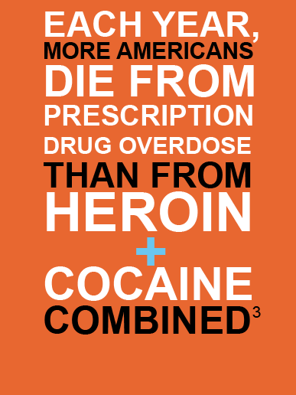

Slide 4
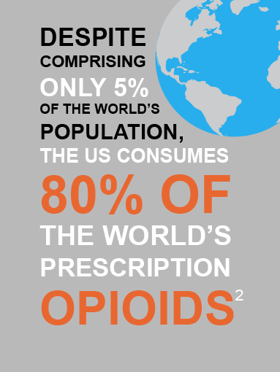

Slide 5
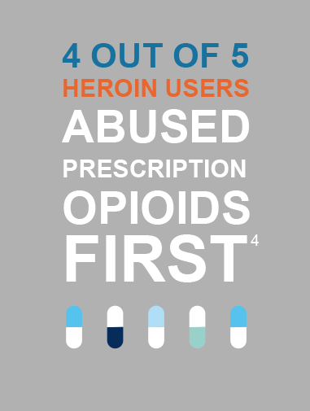
Notes:
https://www.drugabuse.gov/drugs-abuse/opioids/opioid-overdose-crisis#seven

Slide 6
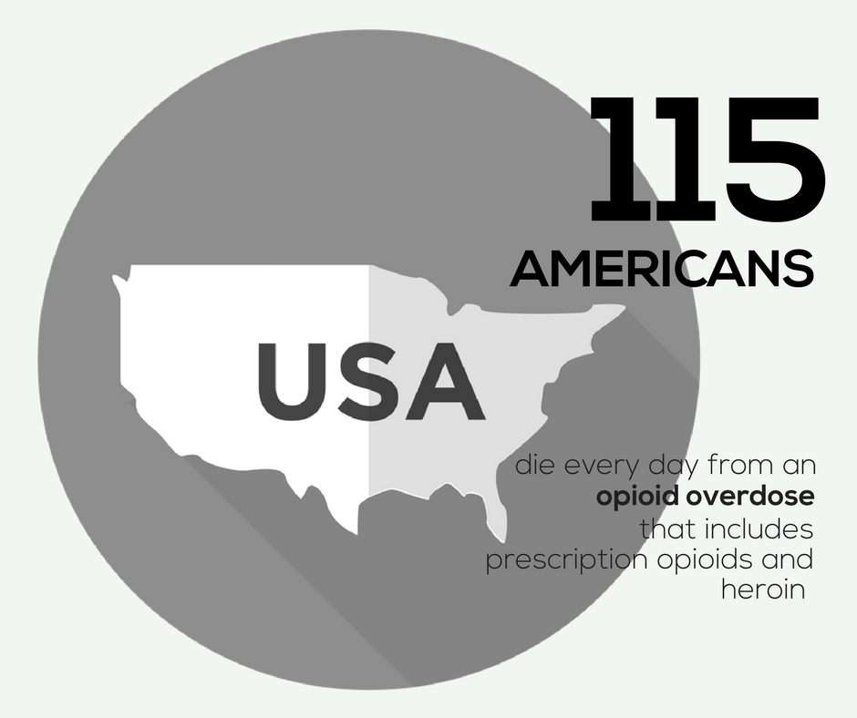
Notes:
https://www.cdc.gov/drugoverdose/epidemic/index.html

Slide 7
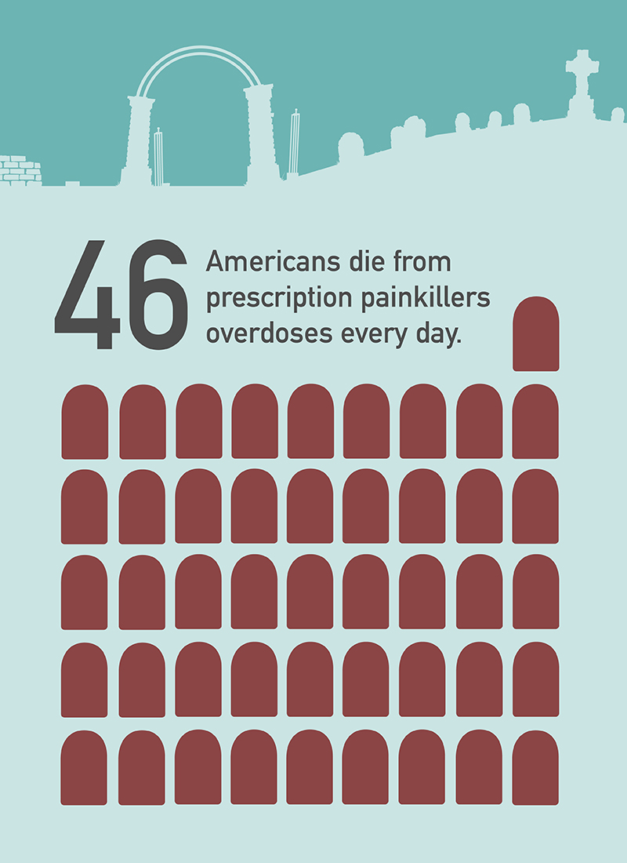
Notes:
More than 46 people died every day from overdoses involving prescription opioids www.cdc.gov/drugoverdose/data/overdose.html
91 people die from opioid overdose each day (including prescription opioids and heroin)

Slide 8

In Washington state, there are
65 opioids
For prescription pain written for every 100 people.
Notes:
https://www.cdc.gov/drugoverdose/maps/rxstate2016.html

Slide 9
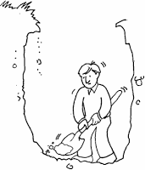
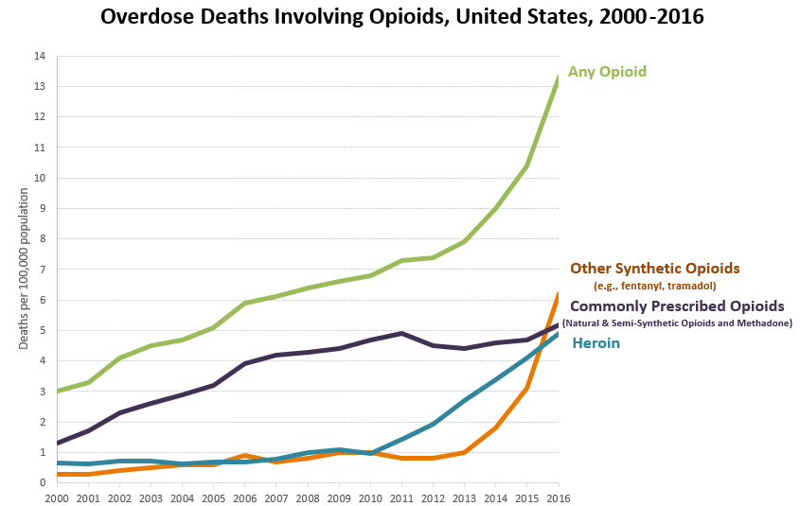
We have Dug a Deep Hole
40% of all U.S. opioid overdose deaths involve a prescription opioid
Notes:
www.cdc.gov/drugoverdose/data/analysis.html

Slide 10
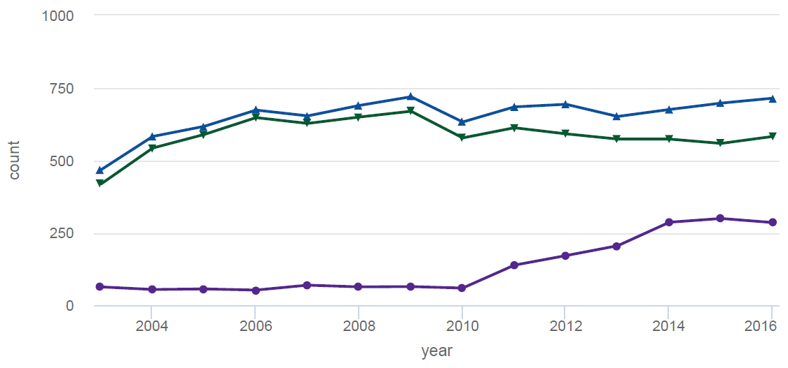

Opioid Deaths in Washington State
Notes:
Counts of deaths by opiate, Washington State
https://adai.washington.edu/WAdata/opiate_home.htm

Slide 11
Top five medicines prescribed in the U.S. in 2016 were:
Levothyroxine (123 million Rx)
Lisinopril (110 million)
Atorvastatin (106 million)
Hydrocodone/acetaminophen (90 Million)
Metoprolol (88 million)
Notes:
https://www.iqvia.com/institute/reports/medicines-use-and-spending-in-the-us-a-review-of-2016

Slide 12
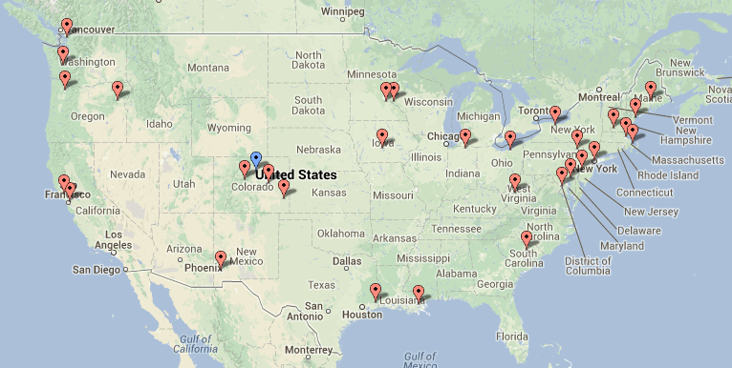
Learning from Effective Ambulatory Practices (LEAP) study learning:
Innovative Primary Care Practices Nationally were Addressing the Opioid Crisis through Team-Based Care

Slide 13
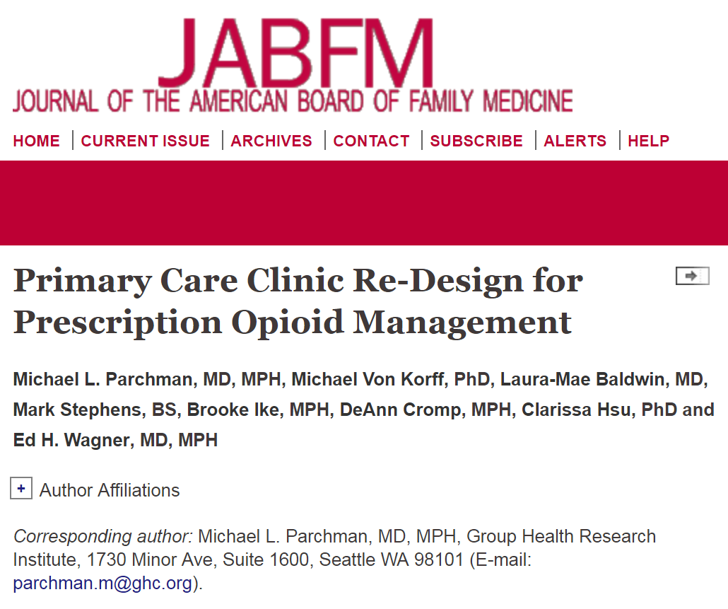
Learnings from these practices organized into the Six Building Blocks and published in the Journal of American Board Family Medicine in February 2017
Notes:
http://www.jabfm.org/content/30/1/44.full#abstract-1

Slide 14
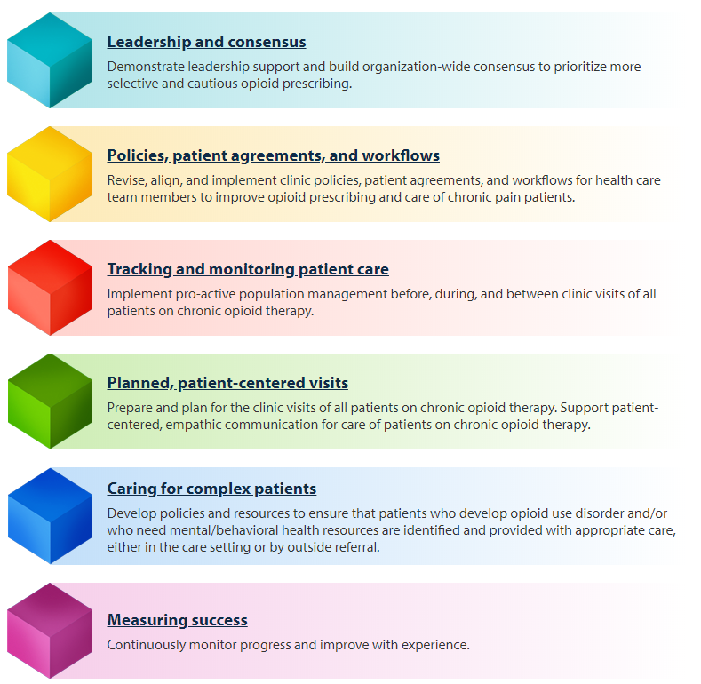
The Six Building Blocks

Slide 15
The Six Building Blocks

Slide 16
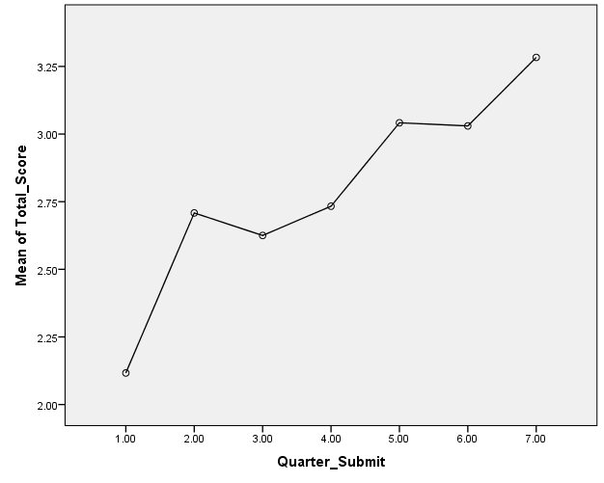
Applying the Six Building Blocks in Primary Care Practices
We studied the implementation of the Six Building Blocks in 20 rural and rural-serving clinics in Eastern Washington and Central Idaho
Participation led to improvement in clinics’ BB scores
Clinicians in clinics with higher BB scores are:
  More confident in use of opioids
  for chronic pain
  More comfortable prescribing
  opioids for chronic pain

Slide 17
What one clinician said about how he felt after implementing the 6 BBs project:
  "Having a defined care pathway for an emotionally charged and complex area of care - to walk in with a plan. It's like walking into the ER and someone having a cardiac arrest. Not the most stressful thing I do because we have a clear plan. Now I have the same kind of pathway for opioids. Having what we are going to do defined.”

Slide 18
Implementing the Six Building Blocks

Slide 19
What the Six Building Blocks team offers
An in-person kickoff event with your clinic
Ongoing guidance from a practice facilitator to develop and implement action plans
Monthly Shared Learning Calls
Connection to clinical education resources
Provision of Six Building Block resources, such as:
      Model policy
      Model patient agreement
      Patient education materials
      Strategies for tracking and monitoring
      A guide for having difficult conversations

Slide 20
What we need from your clinic
Vocal, engaged leadership
Opioid Improvement Team commitment, including monthly meetings
Participation in a clinic-wide kickoff event
Opioid Improvement Team participation in practice facilitation calls and
Shared Learning Calls
Clinician and staff participation in clinical education
Time dedicated to the work, e.g. policy and patient agreement
revision, developing and staffing a tracking and monitoring program,
designing new workflows

Slide 21

Why this project is important to (NAME OF CLINIC)
(insert clinic slides)

Slide 22
Where are we now?
A time for reflection & discussion

Slide 23

Diverse Perspectives
First step: gather an accurate baseline picture
Different roles and clinics = different perspectives
It is essential to get a sense of these different understandings to help build consensus & inform the quality improvement initiatives
Notes:
The first step in beginning quality improvement change is to really get an accurate understanding of where you are now with chronic opioid patient management. We know that depending on your role and clinic, you might have a different perspective than another person in the room. It is essential to get a sense of these different understandings to help build consensus and inform the first steps of the quality improvement initiatives. (See Self-Assessment Guide on www.improvingopioidcare.org for more detailed instructions.)

Slide 24
Self-assessment activity directions
  Divide into groups
  Each group will start with a different section. Complete as many sections as you can.
  As a group, circle the description that best matches your group’s perspective on the status of the organization. If your group cannot agree, mark both scores and make a note.
  Add up and indicate totals for each section on page 9.
  If you finish the whole assessment, proceed with the challenges & successes discussion guide on page 10.
  Prepare to share your scores and discussion points with the other groups.
  Time: 25 minutes *No right or wrong answers!
Notes:
4-5 people per group
Each group will start with a different BB and finish as many as they can in 25 minutes. We’re looking for personal perspectives on how things are going – not answers based on the Champion’s presentation.

Slide 25
Small-group baseline self-assessment results

Slide 26
Leadership & Consensus
Leadership prioritizes the work | 1 2 3 | 4 5 6 | 7 8 9 | 10 11 12
The commitment of leadership in this clinic to improving management of patients on chronic opioid therapy… | …is not visible or communicated. | …is rarely visible, and communication about use of opioids for chronic pain patients is ad hoc and informal. | …is sometimes visible and communication about patients on chronic opioid therapy is occasionally discussed in meetings. | …is communicated consistently as an important element of meetings, case conferences, emails, internal communications, and celebrations of success.
Shared vision | 1 2 3 | 4 5 6 | 7 8 9 | 10 11 12
A shared vision for safer and more cautious opioid prescribing… | …has not been formally considered or discussed by clinicians and staff. | …has been discussed, and preliminary conversations regarding a clinic-wide opioid prescribing standard have begun. | …has been partially achieved, but consensus regarding a clinic-wide opioid prescribing standard has not yet been reached. | …has been fully achieved. Clinicians and staff consistently follow prescribing standards and practices.
Responsibilities assigned | 1 2 3 | 4 5 6 | 7 8 9 | 10 11 12
Responsibilities for practice change related to patients on chronic opioid therapy… | …have not been assigned to designated leaders. | …have been assigned to leaders, but no resources have been committed. | …have been assigned to leaders with dedicated resources, but more support is needed. | …have been assigned. Dedicated resources support protected time to meet and engage in practice change.
Notes:
Each group presents on their findings. 20 minutes. Keep in mind about 3 minutes per slide.
Each group will report on the section they started with, how they scored themselves and why. Next ask audience if that resonated with them or if they have a different experience they want to share.

Slide 27
Policies, patient agreements, and workflows
Policy development/ revision | 1 2 3 | 4 5 6 | 7 8 9 | 10 11 12
Comprehensive policies regarding chronic opioid therapy that reflect evidence-based guidelines, such as the CDC Guideline for Prescribing Opioids for Chronic Pain or state-based opioid prescribing guidelines… | …do not exist. | …exist, but have not been recently revised and updated. | …exist, have been recently updated, but are still lacking essential components. | …exist, and have been recently updated to reflect recent evidence-based guidelines, and are comprehensive.
Policy Implementation | 1 2 3 | 4 5 6 | 7 8 9 | 10 11 12
Policies regarding chronic opioid therapy… | …have not been distributed to clinicians and staff. | …have been distributed to clinicians and staff, but have not been discussed. | …have been distributed, have been discussed with all clinic staff and clinicians, but are not consistently followed. | …have been distributed, have been discussed with all clinic staff and clinicians, and are consistently followed.
Patient agreements | 1 2 3 | 4 5 6 | 7 8 9 | 10 11 12
Formal signed patient agreements regarding chronic opioid therapy… | …do not exist. | …exist, but do not align with current clinic policies and/or are not consistently used | …exist, align with current clinic policies, but are not consistently used. | …exist, align with current policies, and are consistently used with all patients on chronic opioid therapy.
Workflows | 1 2 3 | 4 5 6 | 7 8 9 | 10 11 12
Clinic workflows for managing patients on chronic opioid therapy… | …do not exist. | …exist, but do not support current clinic policies. | …exist, support current clinic policies, but are not fully implemented. | …exist, support current clinic policies, and are fully implemented

Slide 28
Tracking and monitoring patient care
Tracking & monitoring of patients prescribed chronic opioids | 1 2 3 | 4 5 6 | 7 8 9 | 10 11 12
Use of a system to pro-actively track & monitor patients prescribed chronic opioids to ensure their safety… | …has not been explored or is not possible with existing data systems. | …is technically possible, but systems to get useful reports are not yet in place. | …is possible and systems are in place to produce basic reports on a regular basis. | …is possible, systems are in place, and reports are produced that allow for tracking of patient care and monitoring of clinician practices.
Tracking & monitoring data collection workflows established | 1 2 3 | 4 5 6 | 7 8 9 | 10 11 12
Workflows to enter data into the tracking & monitoring system… | …have not been developed. | …are in development, but not established. | …are established, but aren’t consistently implemented. | …are established and consistently implemented. Responsibilities are assigned and protected time is available to complete assigned responsibilities.
Tracking & monitoring data use workflows established | 1 2 3 | 4 5 6 | 7 8 9 | 10 11 12
Workflows to use data to track patient care and monitor clinician practices… | …have not been developed. | …are in development, but not established. | …are established, but aren’t consistently implemented. | …are established and consistently implemented. Responsibilities are assigned and protected time is available to complete assigned responsibilities.

Slide 29
Planned, patient-centered visits
Planned opioid patient visits | 1 2 3 | 4 5 6 | 7 8 9 | 10 11 12
Before routine clinic visits, patients on chronic opioid therapy… | …are not identified. There is no advance preparation for patient visits for chronic opioid therapy. | …are sometimes identified, but there is no discussion or advance preparation for visits with patients prescribed chronic opioids. | …are identified, and a discussion or chart review to prepare for the visit sometimes occurs. | …are consistently identified and discussed before the visit. The chart is reviewed and preparations made to address safe opioid use.
Empathic communication | 1 2 3 | 4 5 6 | 7 8 9 | 10 11 12
Training on patient-centered, empathic communication emphasizing patient safety, e.g., opioid risks, dose escalation, and to tapering… | …has not been offered to clinicians and staff. | …has been offered to clinicians, but there was limited participation. | …has been offered and the majority of clinicians participated. | …is consistently offered with widespread, regular participation.
Patient involvement | 1 2 3 | 4 5 6 | 7 8 9 | 10 11 12
Training on how to involve patients on chronic opioid therapy in decision-making, setting goals for improvement and providing support for self-management… | …has not been offered to clinicians. | …has been offered to clinicians, but there was limited participation. | …has been offered and the majority of clinicians participated. | …is consistently offered with widespread, regular participation.
Care plans | 1 2 3 | 4 5 6 | 7 8 9 | 10 11 12
Care plan templates for chronic pain management… | …do not exist. | …exist, but do not align with current clinic policies and/or are not consistently used | …exist, align with current clinic policies, but are not consistently used. | …exist, align with current policies, and are consistently used.
Patient Education | 1 2 3 | 4 5 6 | 7 8 9 | 10 11 12
Patient education materials that include explanation of the risks, and limited benefits of long-term opioid use… | …do not exist. | …exist, but strategies to disseminate to patients do not exist. | …exist and dissemination strategies exist, but the strategies have not been fully implemented. | …exist, dissemination strategies exist, and the strategies have been fully implemented.

Slide 30
Caring for complex patients
Identifying complex patients | 1 2 3 | 4 5 6 | 7 8 9 | 10 11 12
Policies, clinic-selected screening tools, and workflows to identify opioid misuse, diversion, addiction, and to recognize mental/behavioral health needs… | …do not exist. | …partially exist. | …exist, but are only partially implemented. | …exist and are consistently implemented.
Behavioral health resources | 1 2 3 | 4 5 6 | 7 8 9 | 10 11 12
Mental/behavioral health services… | …are difficult to obtain reliably. | …are available from behavioral health specialists but aren’t timely or convenient. | …are available from behavioral health specialists and are usually timely and convenient. | …are readily available from behavioral health specialists who are onsite or who work in an organization that has a referral protocol or agreement with our practice setting.

Slide 31
Measuring Success
Monitoring progress | 1 2 3 | 4 5 6 | 7 8 9 | 10 11 12
A system to measure and monitor progress in opioid therapy practice change… | …does not exist. | …exists, including overall tracking goals, but regular tracking reports on specific objectives have not been produced. | …is used to produce regular tracking reports on specific objectives. Leadership reviews are done occasionally, but not on a formal schedule. | …has been fully implemented to measure and track progress on specific objectives. Leadership reviews progress reports regularly and adjustments and improvements are implemented.
Assessing and modifying | 1 2 3 | 4 5 6 | 7 8 9 | 10 11 12
Adjustments to achieve safer opioid prescribing based on monitoring data… | …are not being made. | …are occasionally made, but are limited in scope and consistency. | …are often made and are usually timely. | …are consistently made and are integrated in overall quality improvement strategies.

Slide 32
Now the work begins!
This is an all clinic, team process
Opioid Improvement Team will create a plan to move forward, be
prepared to engage in these processes.
You will have a chance to participate in Clinical Education
opportunities
Now is a good time to sign up for the Prescription Monitoring
Program (PMP) if you have not already
Notes:
Your clinic will be updating some policies and patient agreements…you might be engaged in providing feedback for the development and implementation of these…

Slide 33
UW TelePain
Audio and videoconference-based knowledge network of inter-professional specialists with expertise in the management of challenging chronic pain problems.
Every Wednesday from 12.00pm to 1.30pm
Weekly UW TelePain sessions include:
Didactic presentations from the UW Pain Medicine curriculum for community healthcare providers
Case presentations from community clinicians
Interactive consultations for providers with an inter-professional panel of specialists
The use of measurement based clinical instruments to assess treatment effectiveness and outcomes
TO REGISTER: www.depts.washington.edu/anesth/care/pain/telepain
Notes:
The University of Washington Division of Pain Medicine offers weekly UW TelePain sessions, an audio and videoconference-based knowledge network of interprofessional specialists with expertise in the management of challenging chronic pain problems. The goal is to increase the knowledge and skills of community practice providers who treat patients with chronic pain.

Slide 34
Resources for you
CDC patient education handout
VA tapering Guidelines
Scripts for difficult conversations
Prescription Monitoring Program registration info
And more… check out the Six Building Blocks website,
www.improvingopioidcare.org
Notes:
COLLECT SURVEY AT END

Slide 35
Contacts
Nicole Ide, MPH
Practice Facilitator, University of Washington Department of Family Medicine
Phone: 206-616-6760 E-mail: iden8@uw.edu
Laura-Mae Baldwin, MD, MPH
Professor, University of Washington Department of Family Medicine
Director, WWAMI region Practice and Research Network
Phone: 206-685-4799 E-mail: lmb@uw.edu
Brooke Ike
Practice Facilitator Specialist, University of Washington Department of Family Medicine
Phone: 206-685-1052 E-mail: bike2@uw.edu
Michael L. Parchman, MD, MPH
Director, MacColl Center for Health Care Innovation, Kaiser Permanente
Washington Health Research Institute
Phone: 206-287-2704 E-mail: parchman.m@ghc.org
Notes:
Next meeting on same day, Opioid Improvement Team Action Plan Meeting

