Slide 1
The Six Building Blocks
A Team-Based Approach to Improving Opioid Management in Primary Care
The development team included:
Michael Parchman, MD, MPH
Kaiser Permanente Washington Health Research Institute (KPWHRI)
Laura-Mae Baldwin, MD, MPH
University of Washington
Kelly Ehrlich, MPH
KPWHRI
Nicole Ide, MPH
University of Washington
Brooke Ike, MPH
University of Washington
Doug Kane, MS
KPWHRI
Rob Penfold, PhD
KPWHRI
Kari Stephens, PhD
University of Washington
Mark Stephens, MA
Change Management Consulting
David Tauben, MD
University of Washington
Nicole Van Borkulo, Med
KPWHRI
Michael Von Korff, ScD
KPWHRI
  This work was funded by the Agency for Healthcare Research & Quality (R18HS023750), and the National Center For Advancing Translational Sciences of the National Institutes of Health (UL1TR000423). Additional funding comes from a WA OCH subcontract and a WA DOH subcontract (HED23124) of Cooperative U17CE002734, funded by the CDC. Its contents are solely the responsibility of the authors and do not necessarily represent the official views of CDC or the WA State Department of Health.

Slide 2
Agenda
Why is this work important?
What are the Six Building Blocks?
What do we need to be successful?
Are we ready to commit?
Next steps

Slide 3
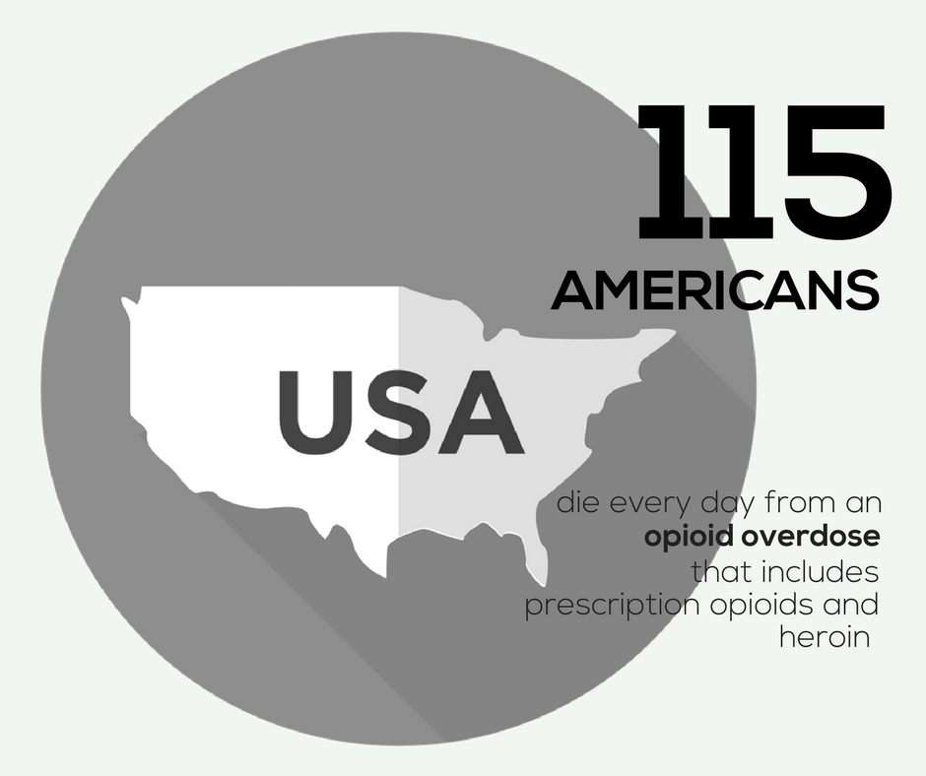
Notes:
https://www.cdc.gov/drugoverdose/epidemic/index.html

Slide 4
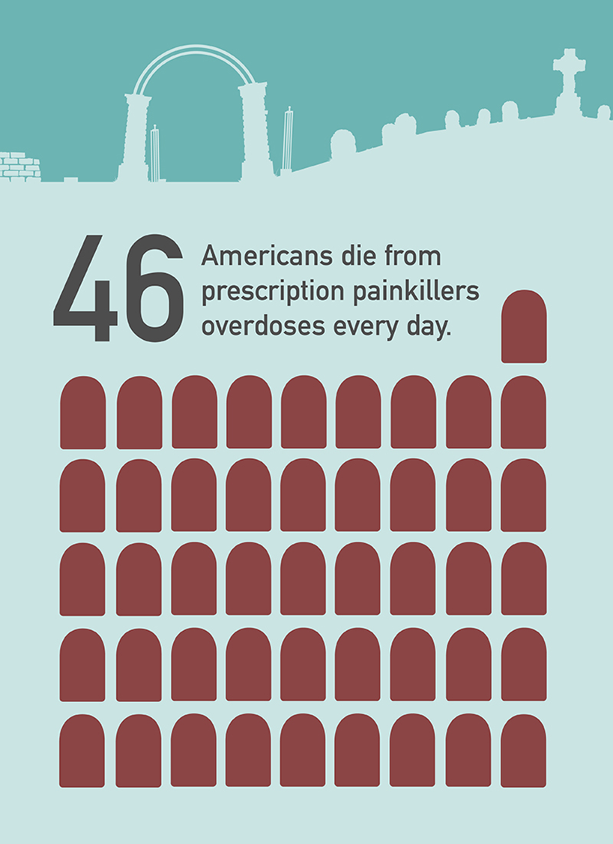

Slide 5
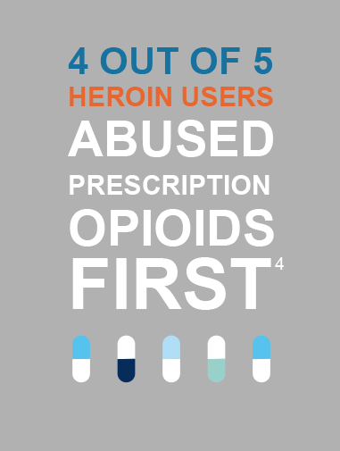

Slide 6
Opioid Overdose Risk
Dunn et al Ann Intern Med 2010

Slide 7
Top five medicines prescribed in the U.S. in 2016 were:
Levothyroxine (123 million Rx)
Lisinopril (110 million)
Atorvastatin (106 million)
Hydrocodone/acetaminophen (90 Million)
Metoprolol (88 million)
Notes:
https://www.iqvia.com/institute/reports/medicines-use-and-spending-in-the-us-a-review-of-2016

Slide 8
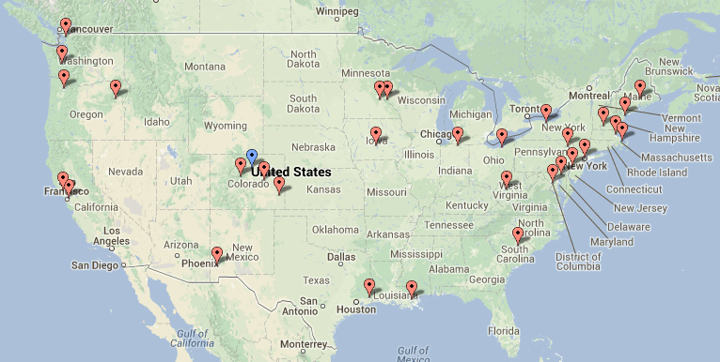
The Six Building Blocks derive from observations of approaches taken among 20 primary care practices across the U.S. that were identified as having exemplar, team-based workforce innovations
Learning from Effective Ambulatory Practices (LEAP) study

Slide 9
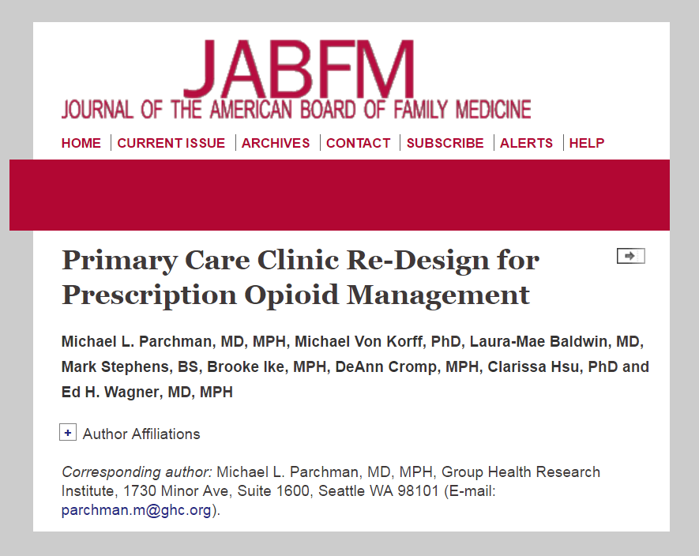
Learnings from these practices organized into the Six Building Blocks of Safer Opioid Management and published in the Journal of American Board Family Medicine in February 2017
Notes:
http://www.jabfm.org/content/30/1/44.full#abstract-1

Slide 10
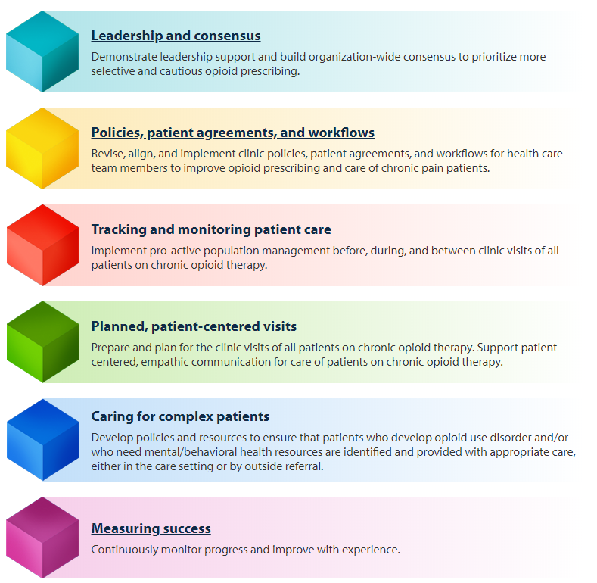
The Six Building Blocks

Slide 11
The Six Building Blocks

Slide 12
Team-Based Opioid Management in Primary Care
  Kaiser Permanente Washington Research Institute (KPWRI) and the University of Washington developed a facilitated program to guide primary care organizations in implementing the Six Building Blocks and tested implementation of the Six Building Blocks Program in 20 rural and rural-serving clinics.
Notes:
Best practices include:
-- implementation of policies and procedures that match with the CDC guidelines for opioid management
-- use of the PMP
-- UDT
-- referral of patients with OUD to treatment
-- avoidance of opioid and sedative co-prescribing
-- initiating difficult conversations with patients on high doses of opioids about tapering
Practice coach meets with practices quarterly and as needed to support the development and implementation of a practice “action plan.”
Practices learn from each other through monthly virtual learning collaborative calls
Coach connects patients with telepain conferences, which include short didactic presentations and case presentations of difficult cases with a multidisciplinary team of pain “experts”
Provides simple tools to assist with tracking opioid use and management.

Slide 13
Team-Based Opioid Management in Primary Care
The number of patients using chronic opioid therapy and the proportion on high dose opioids decreased

Slide 14
What one clinician said about how he felt after implementing improvements to opioid management using the Six Building Blocks:
  "Having a defined care pathway for an emotionally charged and complex area of care - to walk in with a plan. It's like walking into the ER and someone having a cardiac arrest. Not the most stressful thing I do because we have a clear plan. Now I have the same kind of pathway for opioids. Having what we are going to do defined.”

Slide 15
What others said about clinic life after implementing improvements to opioid management using the Six Building Blocks:
“Everybody that works in this clinic says to me, ‘do you remember how much turmoil there was around it? Wow, we don’t have any of that anymore.”
Medical Director
“Hopefully there’s no going back. It works. I don’t think any one of us wants to go back.”
Medical Assistant
“I saw one of the high MED patients that I inherited… we got him down to 80... just for him to say, ‘You know, I’m more functional — my pain is not different, might be better.”
Physician
“The teamwork, there’s been a lot of teamwork regarding it. I wouldn’t say that was a surprise, but it’s been nice.”
Nurse

Slide 16
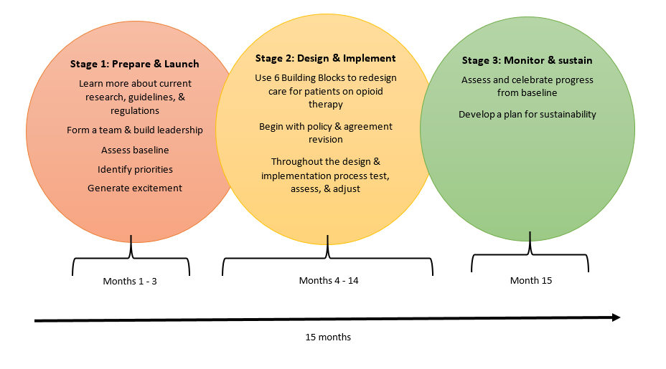
Stages of Six Building Blocks Implementation

Slide 17
Questions to consider
Is our organization ready for change?
Do we have engaged leadership across roles with time for the work?
Do we have the capacity to track and measure data?
Do we empanel patients?
Do we have quality improvement experience/skills?
Do we use team-based care?
Notes:
Refer to page 5 of the Introduction for sub-questions.

Slide 18
Are we ready to commit?

Slide 19
If yes…
Next steps are for a QI lead to:
☐ Identify the Opioid Improvement Team
☐ Schedule the Prepare & Launch meetings
☐ Collect existing policy, agreement, and tracking and monitoring resources and prepare information to present to the team.
More information is available in the Stage 2: Prepare & Launch Guide.

Slide 20
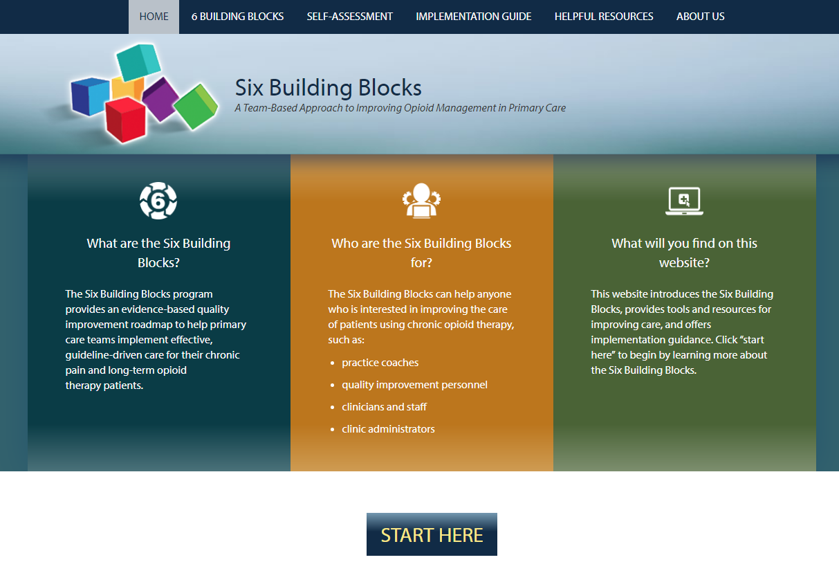
Resources
www.improvingopioidcare.org
Notes:
Pull up the website and show resource page and the implementation guide sections

