Slide 1
The Six Building Blocks
A Team-Based Approach to Improving Opioid Management in Primary Care
  The Six Building Blocks program has received funding from the Agency for Healthcare Research & Quality (R18HS023750), the Washington State Department of Health (Subcontract HED23124 of Cooperative U17CE002734, funded by the CDC), and the Washington State’s Olympic Communities of Health. Its contents are solely the responsibility of the authors and do not necessarily represent the official views of CDC, NIH, the WA State Department of Health, or the Olympic Communities of Health.

Slide 2
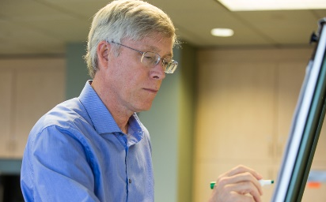


Six Building Blocks Program Team
Laura-Mae Baldwin, MD, MPH
Professor, Department of Family Medicine
University of Washington
lmb@uw.edu
Michael Parchman, MD, MPH
Senior Investigator
Kaiser Permanente Washington Health Research Institute
parchman.m@ghc.org
Brooke Ike, MPH
Practice Facilitator
University of Washington
bike2@uw.edu
Katie Osterhage, MMS
Practice Facilitator
University of Washington
katieost@uw.edu

Slide 3
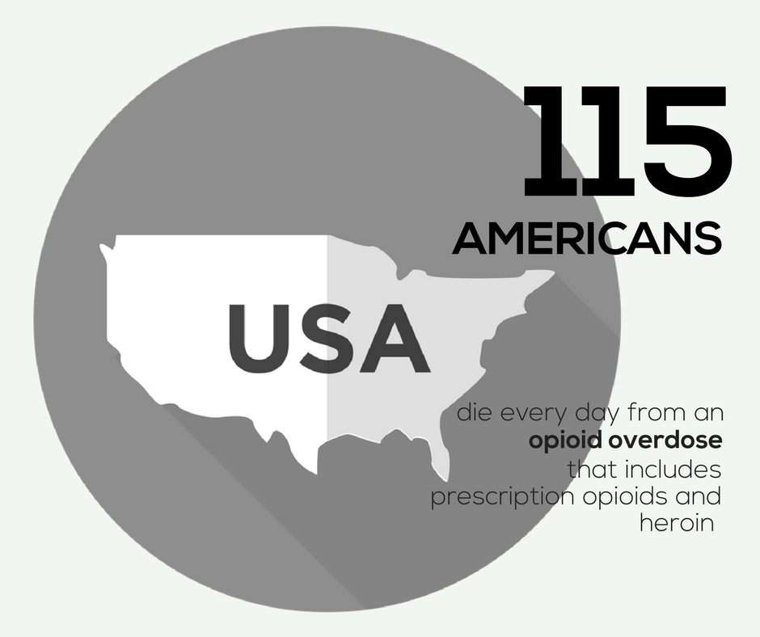
Notes:
https://www.cdc.gov/drugoverdose/epidemic/index.html

Slide 4
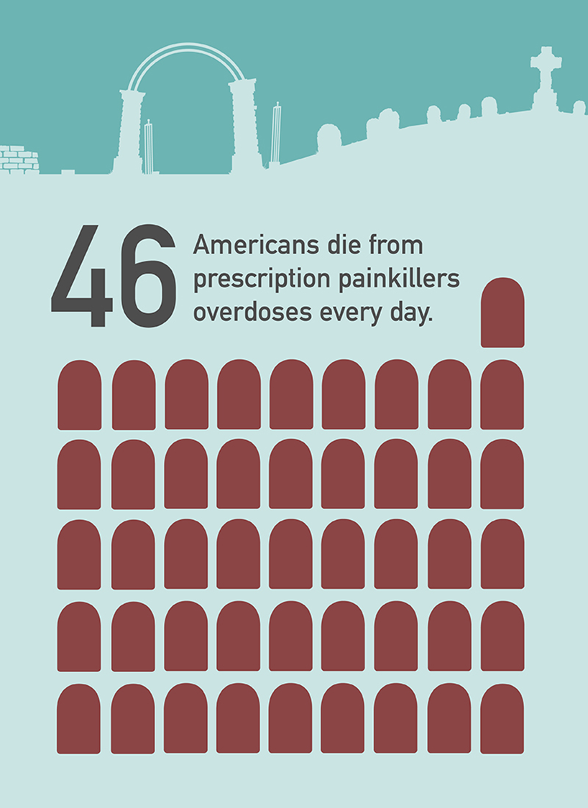

Slide 5
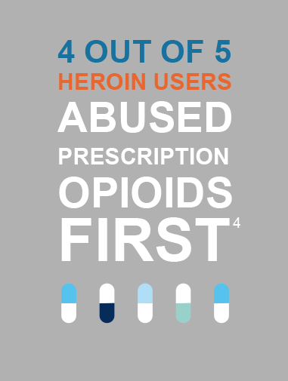

Slide 6

In THE U.S.,
there WEre
59 opioid
prescriptions written for every 100 people IN 2017.
Notes:
And with the majority of opioid prescriptions written by primary care providers, it’s important that our organization does its part to manage opioids as responsibly as possible. That’s why I am excited about the opportunity that the Six Building Blocks program offers to help us do so.
https://www.cdc.gov/drugoverdose/maps/rxstate2017.html

Slide 7

In Washington, there WEre
57 opioid
prescriptions written for every 100 people IN 2017.
Notes:
Washington state: 57.2
https://www.cdc.gov/drugoverdose/maps/rxstate2017.html

Slide 8
Opioid Overdose Risk
Dunn et al Ann Intern Med 2010

Slide 9
What do the guidelines say?
CDC Recommendations:
Opioids are not first-line therapy
Establish goals for pain and function
Discuss risks & benefits
Use immediate-release opioids when
starting
Use the lowest effective dose
Prescribe short durations for acute pain
Evaluate benefits & harms frequently
Use strategies to mitigate risk
(e.g., naloxone)
Review PDMP data
Use urine drug testing
Avoid concurrent opioid & benzodiazepine prescribing
Offer treatment for Opioid Use Disorder
Notes:
Update as guidelines change, and/or add other guidelines, as applicable.

Slide 10
What regulations do we need to know?
Notes:
Add relevant information about your state and local regulations, as applicable.

Slide 11
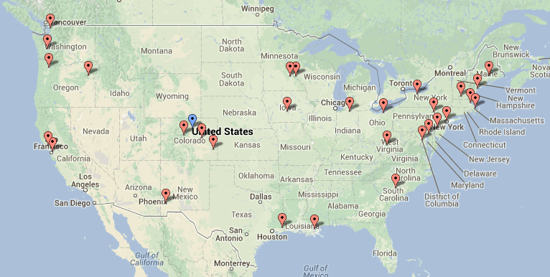
Learning from Effective Ambulatory Practices (LEAP) study learning:
Innovative Primary Care Practices Nationally were Addressing the Opioid Crisis through Team-Based Care

Slide 12
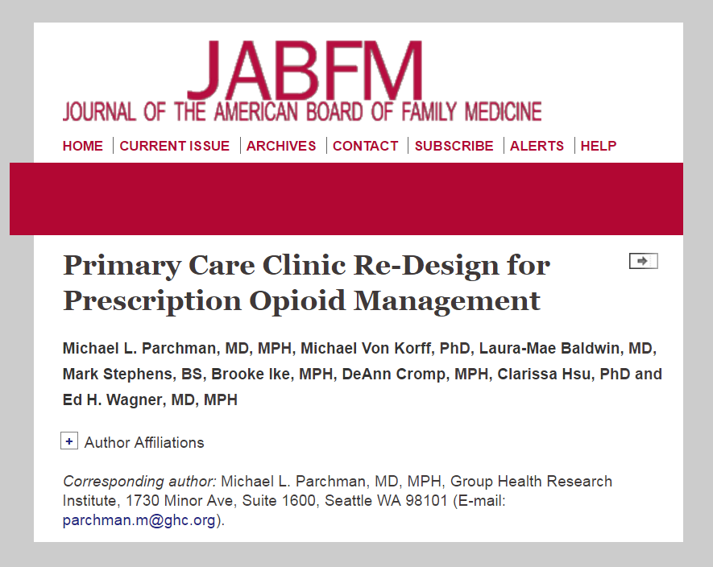
Learnings from these practices organized into the Six Building Blocks of Safer Opioid Management and published in the Journal of American Board Family Medicine in February 2017
Notes:
http://www.jabfm.org/content/30/1/44.full#abstract-1

Slide 13
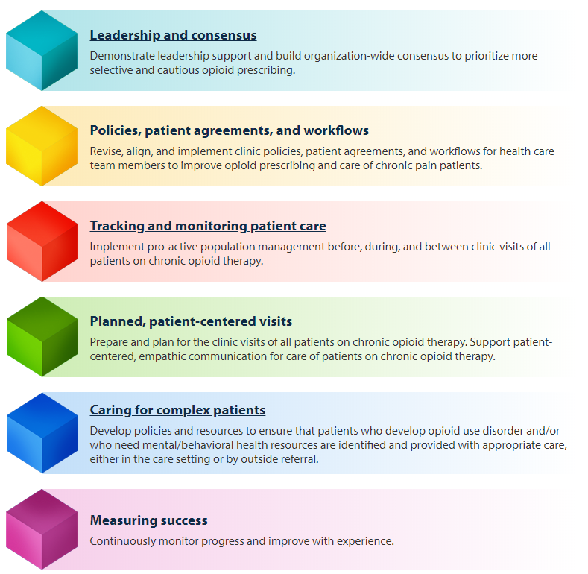
The Six Building Blocks

Slide 14
The Six Building Blocks

Slide 15
Team-Based Opioid Management in Primary Care
A research project in 20 rural and rural-serving clinics in Eastern Washington and Central Idaho
External Support for 15 months to implement the 6-BBs:
  Creation of an opioid quality improvement team at each site
  Team-building Kickoff Event with clinic-wide self-assessment of 6-BBs
  Facilitation by an external practice coach
  Monthly Shared Learning Calls
  Monthly UW TelePain participation
Notes:
Best practices include:
-- implementation of policies and procedures that match with the CDC guidelines for opioid management
-- use of the PMP
-- UDT
-- referral of patients with OUD to treatment
-- avoidance of opioid and sedative co-prescribing
-- initiating difficult conversations with patients on high doses of opioids about tapering
Practice coach meets with practices quarterly and as needed to support the development and implementation of a practice “action plan.”
Practices learn from each other through monthly virtual learning collaborative calls
Coach connects patients with telepain conferences, which include short didactic presentations and case presentations of difficult cases with a multidisciplinary team of pain “experts”
Provides simple tools to assist with tracking opioid use and management.

Slide 16
Team-Based Opioid Management in Primary Care
The number of patients using chronic opioid therapy and the proportion on high dose opioids decreased

Slide 17
What one clinician said about how he felt after implementing the Six Building Blocks project:
  "Having a defined care pathway for an emotionally charged and complex area of care - to walk in with a plan. It's like walking into the ER and someone having a cardiac arrest. Not the most stressful thing I do because we have a clear plan. Now I have the same kind of pathway for opioids. Having what we are going to do defined.”

Slide 18
What others said about clinic life after implementing the Six Building Blocks:
“Everybody that works in this clinic says to me, ‘do you remember how much turmoil there was around it? Wow, we don’t have any of that anymore.”
Medical Director
“Hopefully there’s no going back. It works. I don’t think any one of us wants to go back.”
Medical Assistant
“I saw one of the high MED patients that I inherited… we got him down to 80... just for him to say, ‘You know, I’m more functional — my pain is not different, might be better.”
Physician
“The teamwork, there’s been a lot of teamwork regarding it. I wouldn’t say that was a surprise, but it’s been nice.”
Nurse

Slide 19
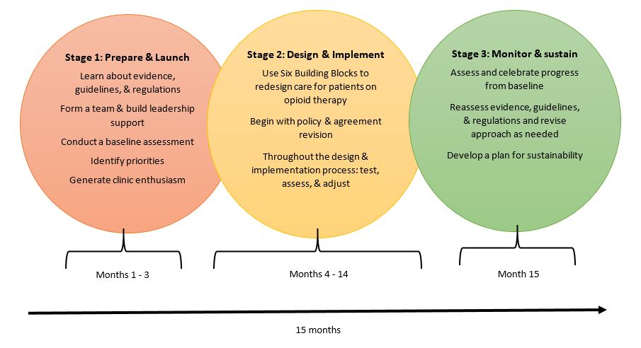
Stages of Six Building Blocks Implementation
Notes:
There are three stages to implementing the Six Building Blocks program:
Prepare and Launch stage – when the clinic forms its opioid improvement team, assessing where it is starting from, and holds a Kickoff Event with the entire clinic – providers and staff
Design and Implement stage – when the improvement team uses the Six Building Blocks materials and framework to redesign care for patients using opioid therapy. Usually this begins with review and revision of the policies and patient agreement related to opioid management
Monitor and sustain stage – when the clinic assesses and celebrates its progress in implementing the Six Building Blocks and plans for sustainability

Slide 20
How the Six Building Blocks Team works with Clinics
Development of an Opioid Improvement Team
Clinic-wide Kickoff Event
Ongoing guidance from a Practice Coach
Shared learning with others who are doing this project
Clinical education for providers and staff through UW TelePain (see handout)
Action plan development to implement relevant Six Building Block elements, such as:
    Revised policies, patient agreement, workflows
    System for tracking and monitoring opioid patients
    Patient education materials and behavioral health resources
    Complex patient resources
Notes:
Talk about how we can connect with resources to ensure compliance with 1427 and to get started on OBOT.

Slide 21
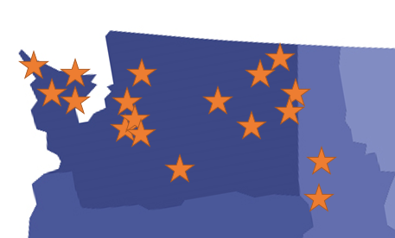
Six Building Blocks Reach
We have implemented or begun implementing the Six Building Blocks at 18 organizations throughout the Pacific Northwest.
Notes:
Brooke and Katie, how many clinics have we reached via DOH thus far?
20 clinics, 6 orgs in Team Opioid
4 clinics, 4 orgs in OCH
X clinics, X orgs in DOH

Slide 22
Six Building Blocks Scale Up and Spread
Coaching program available through the Washington State Department of Health and the Olympic Communities of Health
Self-service model and toolkit for the Six BBs being developed with Abt Associates (funding from AHRQ)
Planned development of a Six BBs Train the Practice Facilitator model with funding from NIDA through the National Drug Abuse Treatment Clinical Trials Network (CTN)

Slide 23
Adoption of the Six Building Blocks Nationally
Adapted for the Oregon Prescription Drug Overdose Project funded by the Centers for Disease Control and Prevention
Included in the Implementation Package for the CDC Chronic Pain guidelines
Included in the 2018 Collaborative Care for Chronic Pain Report and Recommendations from the Bree Collaborative

Slide 24
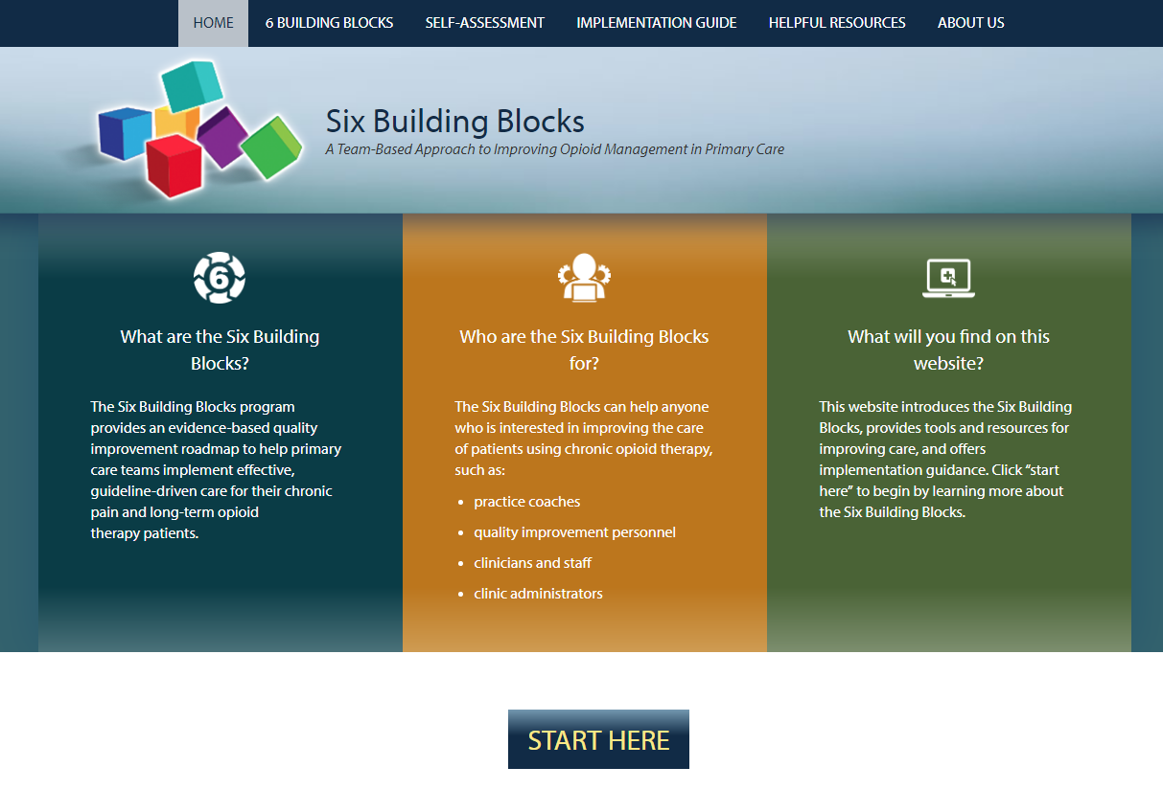
Resources
www.improvingopioidcare.org
Notes:
Pull up the website and show resource page and the implementation guide sections

Slide 25
UW TelePain
Audio and videoconference-based knowledge network of inter-professional specialists with expertise in the management of challenging chronic pain problems.
Every Wednesday from 12.00pm to 1.30pm
Weekly UW TelePain sessions include:
Didactic presentations from the UW Pain Medicine curriculum for community healthcare providers
Case presentations from community clinicians
Interactive consultations for providers with an inter-professional panel of specialists
The use of measurement based clinical instruments to assess treatment effectiveness and outcomes
TO REGISTER: www.depts.washington.edu/anesth/care/pain/telepain
Notes:
The University of Washington Division of Pain Medicine offers weekly UW TelePain sessions, an audio and videoconference-based network of specialists with expertise in the management of challenging chronic pain problems. The goal is to increase the knowledge and skills of community practice providers who treat patients with chronic pain.

Slide 26
UW Pain & Opioid Hotline
Clinical advice for healthcare providers caring for patients with complex pain medication regimens, particularly high dose opioids
Monday through Friday 8:30 AM – 4:30 PM
1-844-520-PAIN (7246)
Consultations:
Interpretation of WA Prescription Monitoring Program record to provide guidance to primary care providers on dosing
Individualized opioid taper plans
Systematic management of withdrawal syndrome
Evaluation and recommendation for non-opioid/adjuvant analgesic treatment
Consultation regarding triage and risk screening
Individualize case consultation for client care and medication management

Slide 27
Questions?
Brooke Ike
Phone: 206-685-1052, E-mail: bike2@uw.edu
Laura-Mae Baldwin
Phone: 206-685-4799, E-mail: lmb@uw.edu

